Slide 1
CS 2200 Input / Output

Slide 2
Communication between the CPU and the I/O devices
Computer
Device Controller
Input/Output Device

Slide 3
Device Controller
Assume that I/O is a keyboard.
Need a temporary space to hold the character that was typed.
Need to grab the attention of the processor to give it this character (device controller comes in here)
Device controller has two registers:
Data register
Status register
Status register includes:
Ready bit- is the character in the data register new
Interrupt enable- is processor allowing the device to interrupt
Interrupt flag- is controller ready to interrupt the processor

Slide 4
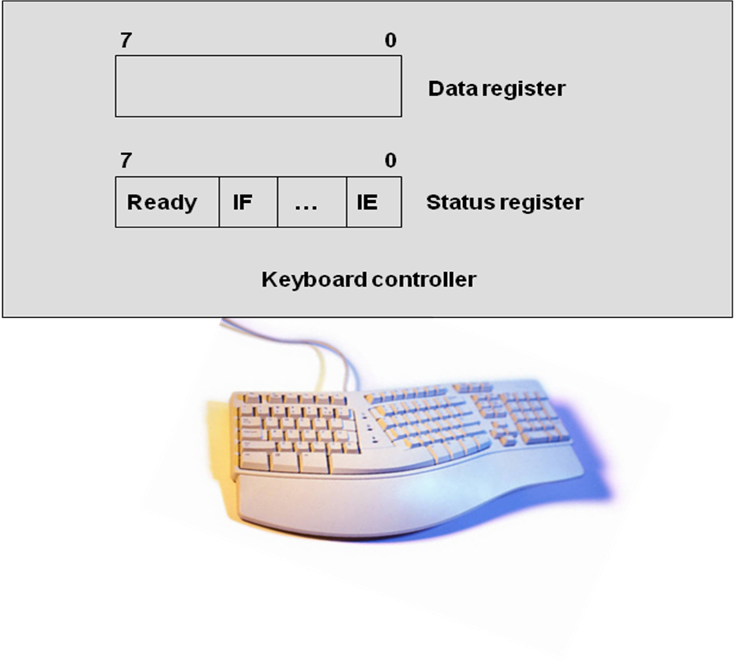
Device Controller

Slide 5
How to hook up controller?
Port Mapped IO
Requires ISA support (in out on i7)
Requires separate address space
Memory Mapped IO
No special instructions (uses load/store)
Uses block of main memory

Slide 6
Memory Mapped I/O
Use memory-processor bus
Make the registers in the controller appear as memory locations to the CPU - referred to as memory mapped I/O
How to achieve this trick?
Give the device registers unique memory addresses

Slide 7
Memory mapped I/O
CPU
Address
Data
7
0
Main memory
Data register
(address = 5000)
7
0
Ready
IF
…
IE
Status register
(address = 5002)
Keyboard controller

Slide 8
Memory Mapped I/O
LW r1, Mem [5000]
The usual convention is to reserve high addresses for I/O device registers.
I/O addresses are marked as “uncacheable” in the cache, so that new value has to be read from the “memory”
Advantage: no special I/O instructions needed
Disadvantage: some parts of the memory are not usable by the kernel or user
Is this approach slow or fast?

Slide 9
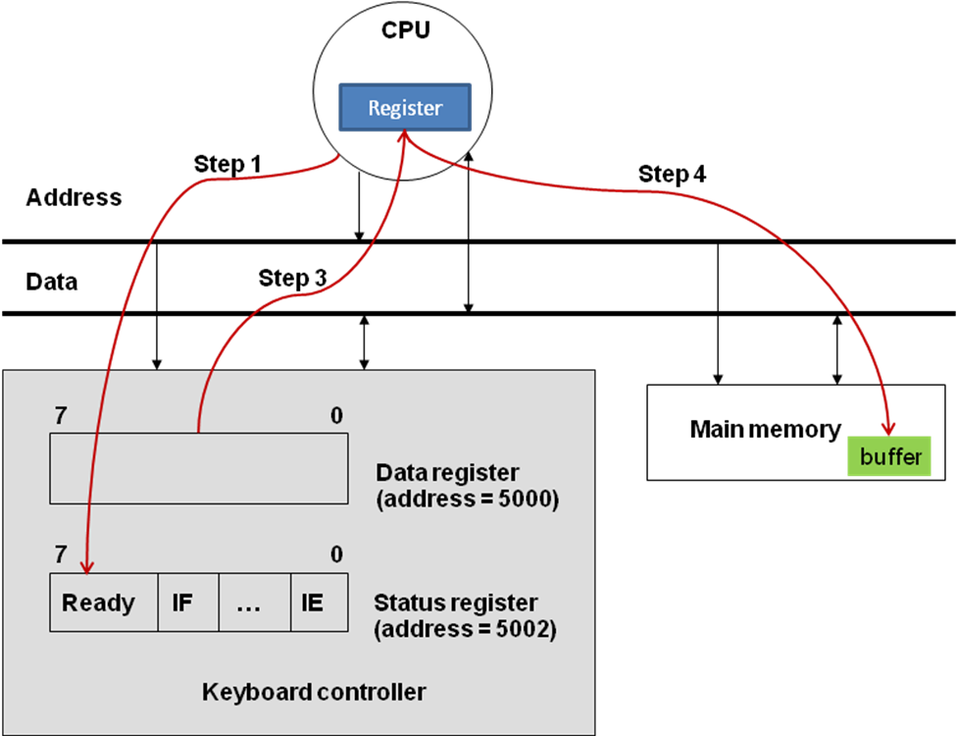
Programmed I/O
How to program CPU-I/O communication?

Slide 10
Programmed I/O
How to check if ready bit is set?
Processor constantly polling the ready bit
Processor enable the interrupt bit, and OS handles scheduling of interrupt
Programmed data transfer works for slow-speed devices that produce data asynchronously.
However, it does not work for high-speed devices that produce data synchronously. (i.e., disks), also not very efficient in general.

Slide 11
Direct Memory Access (DMA)
Processor
Memory
C
Controller
Disk

Slide 12
DMA
CPU
Memory bus
DMA controller
Status
Command
Go
Memory
Device address
Memory buffer address
Count
256 bytes
Buffer
Processor to Controller:
Move N bytes from memory location M to disk location D

Slide 13
Direct Memory Access
Processor sets the following registers:
Step 1: store N into the Count Register
Step2: store M into the Memory buffer address register
Step3: Store D into the Device address register
Step4: Store write to the device command into the command register
Step5: set the go bit in the status register
The device controller is like a CPU (has data path)

Slide 14
DMA Transfer example
Note that controller is competing with CPU for memory bus
Memory bus
DMA controller
Buffer
Memory
Mem Buf
Destination
on Device

Slide 15
Buses
System Bus (or Memory Bus) is key resource in entire design.
Functionally, bus has following components:
Address lines (usually 32 bits)
Data lines (larger, need to transfer cache block size)
Interrupt lines (how many lines?)
Interrupt acknowledge lines
Bus arbitration lines
Command lines (carry binary encoding for read, write, block read, block write, etc)

Slide 16
INT8
INTA 8
Device 1
Device 2
.
.
.
.
.
.
.
.
Priority
Encoder
Processor
INT
INT1
INTA
INTA 1
Device 1
Device 2

Slide 17
PCI bus with System Bus
CPU
System bus
Bridge
PCI bus
Memory
Controller
Controller
Controller
Peripheral component interchange (PCI) – an open standard for I/Os
Synchronous and asynchronous buses

Slide 18
I/O Processor
CPU
I/O processor
System bus
Bridge
I/O bus
Shared
Memory
Controller
Controller
Controller
For very high-performance systems such as web servers, database servers, etc.

Slide 19
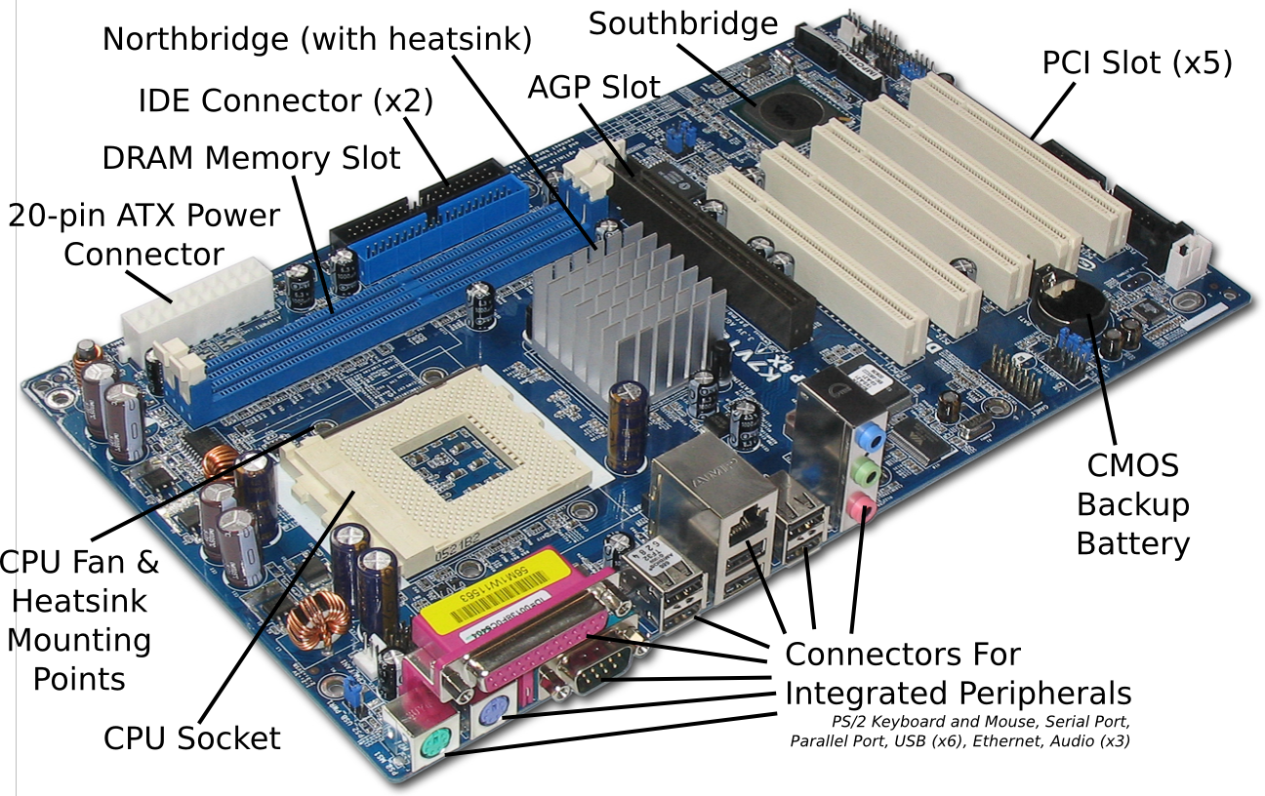
ASRock k7VT4A Pro

Slide 20
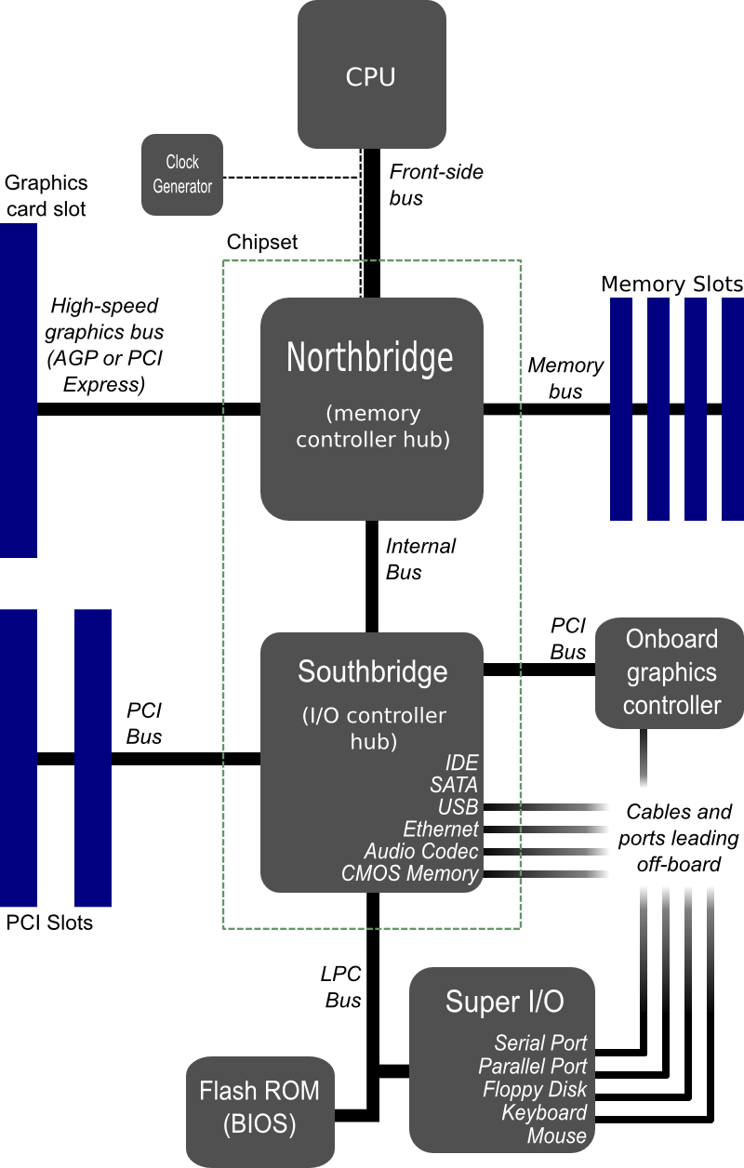

Slide 21
Device Drivers and OS
There is a device driver controlling each device in the computer system.
Device driver is part of OS

Slide 22
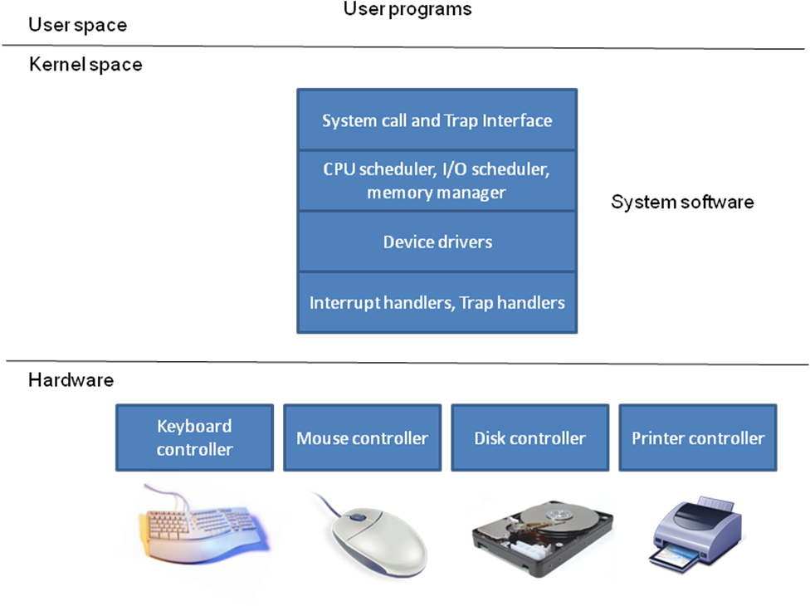
Device Drivers and OS
Full abstraction

Slide 23
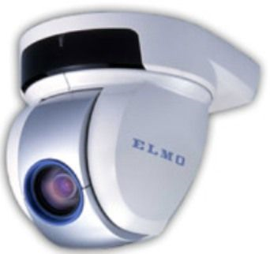
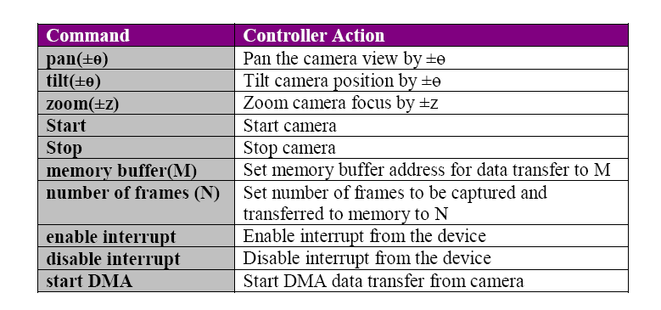
Device driver: An example
Pan-tilt-zoom (PTZ) Camera Controller

Slide 24
Device driver: An Example
// device driver: camera
// The device driver performs several functions:
// control_camera_position;
// convey_DMA_parameters;
// start/stop data transfer;
// interrupt_handler;
// error handling and reporting;

Slide 25
An Example
// Control camera position
camera_position_control (angle pan_angle; angle tilt_angle; int z) {
pan(pan_angle);
tilt(tilt_angle);
zoom(z);
}
// Set up DMA parameters for data transfer
camera_DMA_parameters(address mem_buffer;int num_frames) {
memory_buffer(mem_buffer);
capture_frames(num_frames);
}

Slide 26
An Example
// Start transfer
camera_start_data_transfer() {
start_camera();
start_DMA();
}
// Stop transfer
camera_stop_data_transfer() {
// automatically aborts data transfer
// if camera is stopped;
stop_camera();
}
// Enable interrupts from the device
camera_enable_interrupt() {
enable_interrupt();
}
// Disable interrupts from the device
camera_disable_interrupt() {
disable_interrupt();
}

Slide 27
An Example
// Device interrupt handler
camera_interrupt_handler() {
// This will be coded similar to any
// interrupt handler we have seen in
// chapter 4.
//
// The upshot of interrupt handling may
// to deliver “events” to the upper layers
// of the system software (see Slide 21)
// which may be one of the following:
// - normal I/O request completion
// - device errors for the I/O request
//
}
The message of the example: writing a device driver is straightforward, but needs taking care of corner cases

Slide 28
Peripheral Devices
Device | Input/output | Human in the loop | Data rate (circa 2008) | PIO | DMA
Keyboard | Input | Yes | 5-10 bytes/sec | X
Mouse | Input | Yes | 80-200 bytes/sec | X
Graphics display | Output | No | 200-350 MB/sec |  | X
Disk (hard drive) | Input/Output | No | 100-200 MB/sec |  | X
Network (LAN) | Input/Output | No | 1 Gbit/sec |  | X
Modem | Input/Output | No | 1-8 Mbit/sec |  | X
Inkjet printer | Output | No | 20-40 KB/sec | X | X
Laser printer | Output | No | 200-400 KB/sec |  | X
Voice (microphone/speaker) | Input/Output | Yes | 10 bytes/sec | X
Audio (music) | Output | No | 4-500 KB/sec |  | X
Flash memory | Input/Output | No | 10-50 MB/sec |  | X
CD-RW | Input/Output | No | 10-20 MB/sec |  | X
DVD-R | Input | No | 10-20 MB/sec |  | X

Slide 29
Q1. (30 sec) A thread
Is the same as a process
Is usually part of a process
Has nothing to do with a process
Usually refers to a set of processes
Is part of the memory hierarchy
No clue…

Slide 30
Q2. (30 sec) A thread starts its execution
In main
At some top-level procedure that is part of the same program
At some top-level procedure that is part of a different program
All of the above
None of the above

Slide 31
Q3. (30 sec) A thread
Lives forever
Terminates when the top-level procedure it started in terminates
Terminates when main terminates
Terminates when the top-level procedure or main terminates
None of the above
No clue…

Slide 32
Q4. (30 sec) A mutex lock
Allows exactly one thread to acquire it at a time
Allows any number of threads to acquire it at a time
Allows some user-defined number of threads to acquire it at a time
None of the above
All of the above

Slide 33
Q5. (30 sec) A condition variable
Is just another name for mutex lock
Enables a thread to wait for a condition without consuming processor cycles
Enables a thread to enter a critical section
None of the above
All of the above

Slide 34
Q6. (30 secs) Deadlock
Is a condition where threads are not using mutex locks
Is a condition where all the locks variables are in use
A lock variable that is dead
Is a condition where one or more threads are waiting for an event that will never happen
None of the above
All of the above

Slide 35
while (state == BUSY)
thread_cond_wait (c, m);
state = BUSY;
Q7. (30 sec) Replacing the “while” by “if” in the above construct for exclusive access to a resource
Will always result in violating the intended synchronization
Will never result in violating the intended synchronization
May sometimes result in violating the intended synchronization
What is “cond_wait”?
What is synchronization?

Slide 36
Q8. (30 sec) The contents of a TCB
Same as PCB
Subset of PCB
Superset of PCB
Contains the thread specific information not in the PCB
None of the above
What is TCB?

Slide 37
Q9. (30 sec) User level threads with process level scheduling
Serves no purpose since the operating system does not schedule at the thread level
Is useful for overlapping computation with I/O
Is useful as a structuring mechanism at the user level
None of the above

Slide 38
Q10. (30 sec) User level threads with process level scheduling
Can take advantage of the hardware concurrency available in multiprocessor
Is impossible to implement on a true multiprocessor
Will have no performance advantage on a multiprocessor compared to a uniprocessor
None of the above

Slide 39
Q11. (30 sec) Ensuring that all the threads of a given process share an address space in an SMP is
Impossible
Trivially achieved since the page table is in shared memory
Achieved by careful replication of the page table by the operating system for each thread
Achieved by the hardware providing cache consistency
No clue…

Slide 40
Q12. (30 sec) Keeping the TLBs consistent in an SMP
Is the responsibility of the user program
Is the responsibility of the hardware
Is the responsibility of the operating system
Is impossible
What is TLB?

