Slide 1
CS 2200 Stable Storage

Slide 2
Disk Storage
Head
Track
Spindle
Shaft
Sector
Arm
Head Assembly
All heads move
together
Platter
Top and bottom
Surfaces

Slide 3
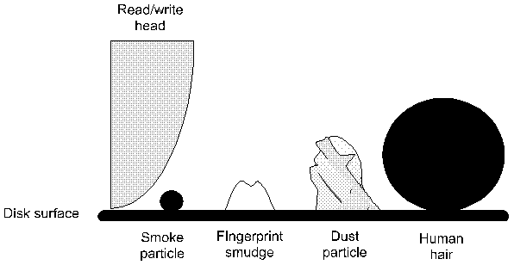

Slide 4
Magnetic Disk
P
l
a
t
t
e
r
s
T
r
a
c
k
s
P
l
a
t
t
e
r
S
e
c
t
o
r
S
(the basic unit of recording-fixed size
In terms of recorded information)
T
r
a
c
k

Slide 5
Let,
p – number of platters,
n – number of surfaces per platter (1 or 2),
t – number of tracks per surface,
s – number of sectors per track,
b – number of bytes per sector,
The total capacity of the disk:
Capacity = (p * n * t * s* b) bytes

Slide 6
Example
Suppose a disk drive has 256 bytes per sector, 12 sectors per track, 100 tracks per surface and 6 platters. What is the total capacity of such a drive in bytes?
bytes/sector=256
sector/track=12
tracks/surface=100
surface/platter=2
No of platter=6
Capacity=bytes/sector*sector/track*track/surface*surface/platter*No_platter=256*12*100*2*6=3600 KB

Slide 7
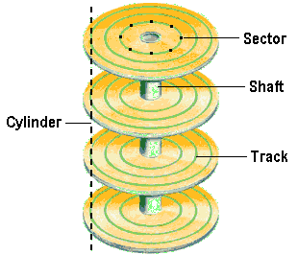
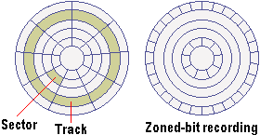
Zoned Bit Recording (ZBR)
Outer tracks have more
sectors

Slide 8
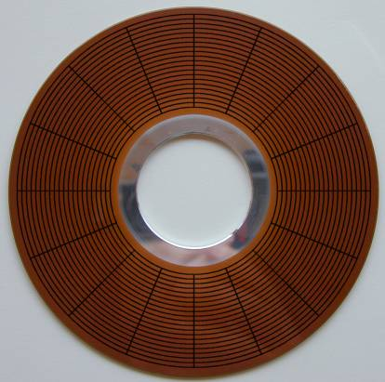
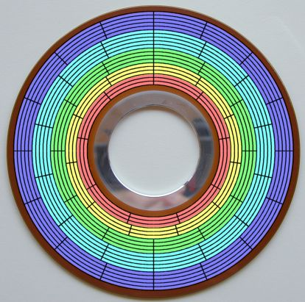
Zoned recording
(a) Normal (Non zoned) recording
(b) Zoned bit recording

Slide 9
Zoned recording
p – number of platters,
n – number of surfaces per platter (1 or 2),
t – number of tracks per surface,
s – number of sectors per track,
b – number of bytes per sector,
The total capacity of the disk:
Capacity = (p * n * t * s* b) bytes
With zoned recording,
z – number of zones,
t_{zi} – number of tracks at zone z_{i},
s_{zi} – number of sectors per track at zone z_{i},
The total capacity of the disk with zoned recording:
Capacity = (p * n * (∑ (t_{zi} * s_{zi}), for 1 ≤ i ≤ z) * b) bytes

Slide 10
Example
Given the following specifications for a disk drive:
256 bytes per sector
12 sectors per track
20 tracks per surface
3 platters
Assume a zoned bit recording with 3 zones
Zone 3 (outermost): 8 tracks, 18 sectors per track
Zone 2: 7 tracks, 14 sectors per track
Zone 1: 5 tracks, 12 sectors per track
What is the total capacity of this drive with the zoned-bit recording?

Slide 11
Example
Capacity = (p * n * (∑ (t_{zi} * s_{zi}), for 1 ≤ i ≤ z) * b) bytes
Capacity=256*2*3*(8*18+7*14+5*12)=453 KB

Slide 12
Total time for reading/writing
Disk head has to find the specific cylinder (i.e., track) – seek time (typical value 8ms)
Disk has to spin to bring required sector under the head – rotational latency (typical value 4ms)
Data are read and transferred to the controller – data transfer time
How to compute data transfer time?

Slide 13
Data transfer rate
Let,
r – rotational speed of the disk in revolutions per min,
s – number of sectors per track,
b – number of bytes per sector,
Time for one revolution = 60/r seconds
Amount of data read in one revolution = s *b bytes
The data transfer rate of the disk:
(Amount of data in track) / (time for one revolution)
= (s * b)/(60/r)
Data transfer rate
= (s * b * r) / 60 bytes/second

Slide 14
Example
Given the following specifications for a disk drive:
512 bytes per sector
400 sectors per track
6000 tracks per surface
3 platters
Rotational speed 15000 RPM
What is the transfer rate of the disk?

Slide 15
Example
Time for one revolution=60/r=60/15000=4ms
Data read in one revolution=512*400=204,800 bytes
Data transfer rate= 204,800/(0.004)=51,200,000 bytes/s

Slide 16
Average seek time and rotational latency
Assuming uniform distribution of requests over all the tracks, the average seek time is the mean of the observed times to seek to the first track and to the last track of the disk.
The average rotational latency is the mean of the access times to each sector in the disk, i.e., it is the half of the rotational latency of the disk.

Slide 17
Let,
a – average seek time in seconds
r – rotational speed of the disk in RPM
s – number of sectors per track
Rotational latency = 60/r seconds
Average rotational latency = (60 / (r * 2)) seconds
Sector read time = rotational latency / number of sectors per track
Sector read time = ( 60 / (r * s) ) seconds

Slide 18
Time to get to the desired track
= Average seek time = a seconds
Time to get the head over the desired sector
= Average rotational latency
= ( 60 / (r * 2) ) seconds
Time to read a sector
= Sector read time
= ( 60 / (r * s) ) seconds
Time to read a random sector on the disk
= Time to get to the desired track +
Time to get the head over the
desired track + Time to read a sector
= a + ( 60 / (r * 2) ) + ( 60 / (r * s) )
seconds

Slide 19
Example
Given the following specifications for a disk drive:
256 bytes per sector
12 sectors per track
20 tracks per surface
3 platters
Average seek time of 20 ms
Rotational speed 3600 RPM
Normal recording
What would be the time to read 6 contiguous sectors from the same track?
What would be the time to read 6 sectors at random?

Slide 20
Example
Average seek time= 20 ms
Rotational latency=60/r=60/3600=16.16 ms
Average rotational latency=16.66/2=8.33
Time to read 1 sector = 60/(12*3600)=16.66/12
Time to read 6 sectors = 6*(16.66/12)=16.66/2
Time to read 6 contiguous sectors:
20ms + 8.33 + 16.66/2 = 36.66ms
Time to read 6 random sectors:
6*(20ms + 8.33 + 16.66/12)=178.31ms

Slide 21
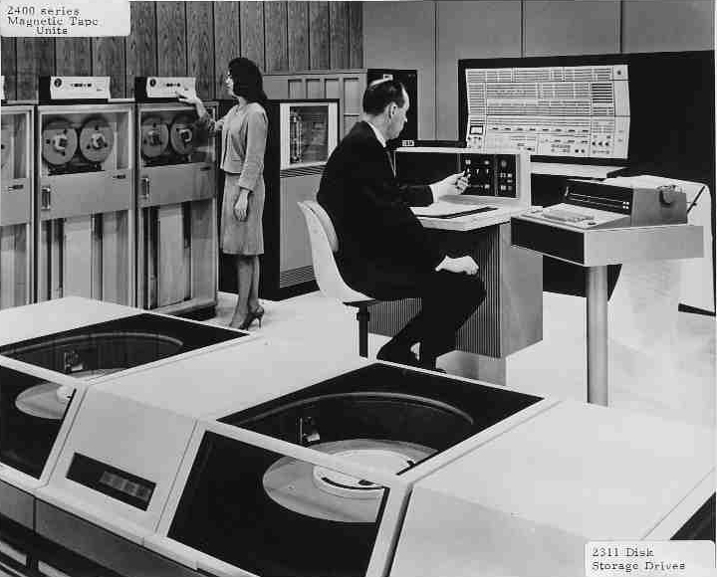

Slide 22
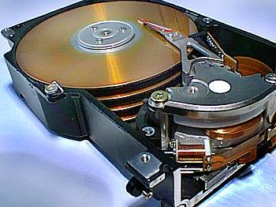

Slide 23

4 GB drive

Slide 24
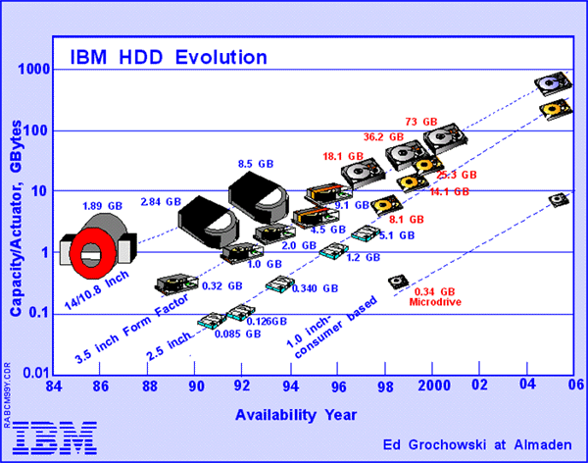

Slide 25
Disk scheduling algorithms
request_q
Track = t1
Track = t2
Track = t3
Track = t4
…..

Slide 26
Name | Notation | Units | Description
Throughput | n/T | Jobs/sec | System-centric metric quantifying the number of I/O requests n executed in time interval T
Avg. Turnaround time (t_{avg}) | (t₁+t₂+…+t_{n})/n | Seconds | System-centric metric quantifying the average time it takes for a job to complete
Avg. Waiting time (w_{avg}) | ((t₁-e₁) + (t₂-e₂)+ … + (t_{n}-e_{n}))/n or (w₁+w₂+ … +w_{n})/n | Seconds | System-centric metric quantifying the average waiting time that an I/O request experiences
Response time/ turnaround time | t_{i} | Seconds | User-centric metric quantifying the turnaround time for a specific I/O request i
Variance in Response time | E[(t_{i} – t_{avg})²] | Seconds² | User-centric metric that quantifies the statistical variance of the actual response time (t_{i}) experienced by an I/O request i from the expected value (t_{avg})
Variance in Wait time | E[(w_{i} – w_{avg})²] | Seconds² | User-centric metric that quantifies the statistical variance of the actual wait time (w_{i}) experienced by an I/O request i from the expected value (w_{avg})
Starvation | - | - | User-centric qualitative metric that signifies denial of service to a particular I/O request or a set of I/O request due to some intrinsic property of the I/O scheduler

Slide 27
request_q
Track = t1
Track = t2
Track = t3
Track = t4
…..
FCFS
t3
t1
t4
t2
head

Slide 28
FCFS
This method has the smallest variance in waiting time
It has poor throughput
Disk head has to swing back and forth

Slide 29
Shortest Seek Time First (SSTF)
Similar to shortest job first
Service the tracks that lead to minimizing the head movement
SSTF minimizes the average wait time, i.e., results in good throughput
Has potential for starvation
Has higher variance than FCFS

Slide 30
request_q
Track = t1
Track = t2
Track = t3
Track = t4
…..
SSTF
t3
t1
t4
t2
head

Slide 31
request_q
Outermost track
SCAN
Track = t1
Track = t2
Track = t3
Track = t4
…..
Very similar performance as SSTF, but avoids starvation
Innermost track
head
t3
t1
t4
t2
t6
t5

Slide 32
Outermost track
request_q
C-SCAN
Track = t1
Track = t2
Track = t3
Track = t4
…..
Removes bias for requests clustered around the middle tracks of the disk.
Lower variance in waiting time
Innermost track
head
t3
t1
t4
t2
Retract
t6
t5

Slide 33
Outermost track
request_q
LOOK
Track = t1
Track = t2
Track = t3
Track = t4
…..
Innermost track
t3
t1
t4
t2
head
t5
t6
head

Slide 34
Outermost track
request_q
Track = t1
Track = t2
Track = t3
Track = t4
C-LOOK
…..
Innermost track
t3
t1
t4
t2
head
t5
t6
head

Slide 35
Example :
Given the following:
Total number of cylinders in the disk=200 (numbered 0 to 199)
Current head position =cylinder 23
Current requests in order of arrival=20, 17, 55, 35, 25, 78, 99
R1…………………...R7
Show the schedule for the various
disk scheduling algorithms for the above set of requests.

Slide 36
Total number of cylinders in the disk=200 (numbered 0 to 199)
Current head position =cylinder 23
Current requests in order of arrival=20, 17, 55, 35, 25, 78, 99
R1…………………...R7
C-LOOK:
25, 35, 55,78, 99, 17, 20
SSTF:
25, 20, 17,35,55,78,99
LOOK:
25,35,55,78,99,20,17
FCFS:
20,17,55,35,25,78,99

Slide 37
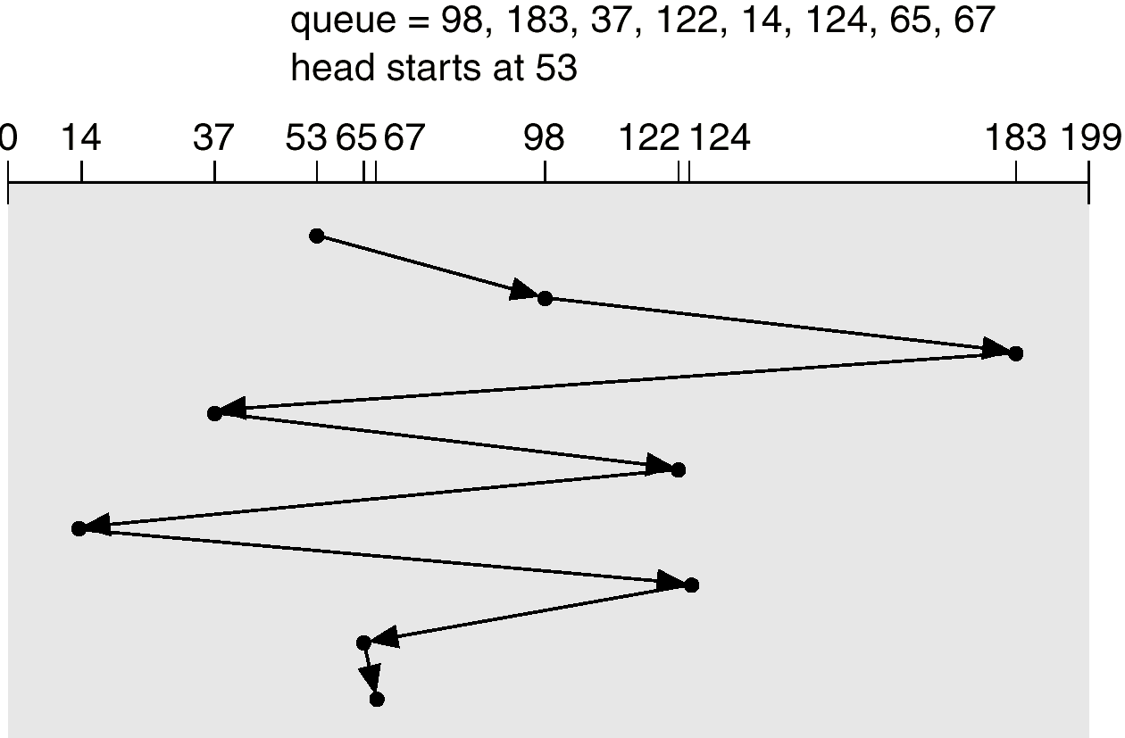
FCFS

Slide 38
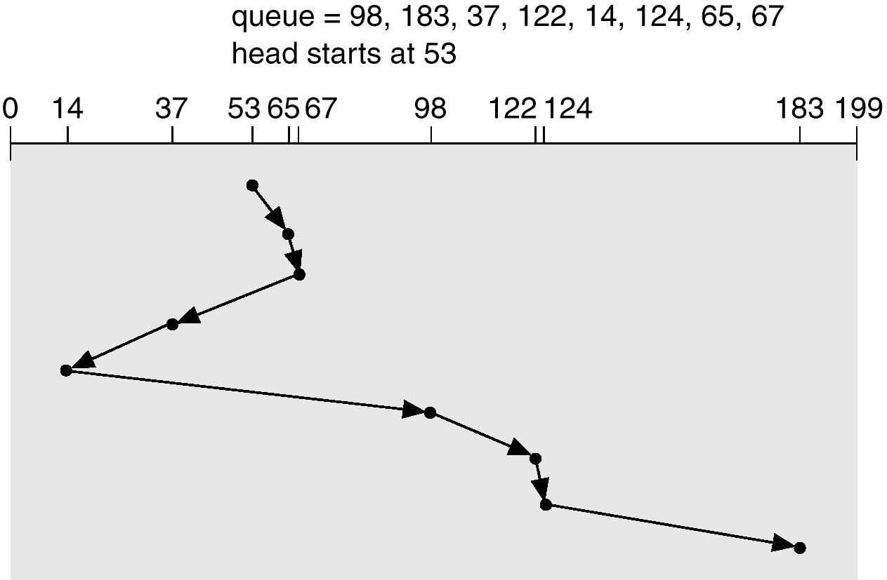
SSTF

Slide 39
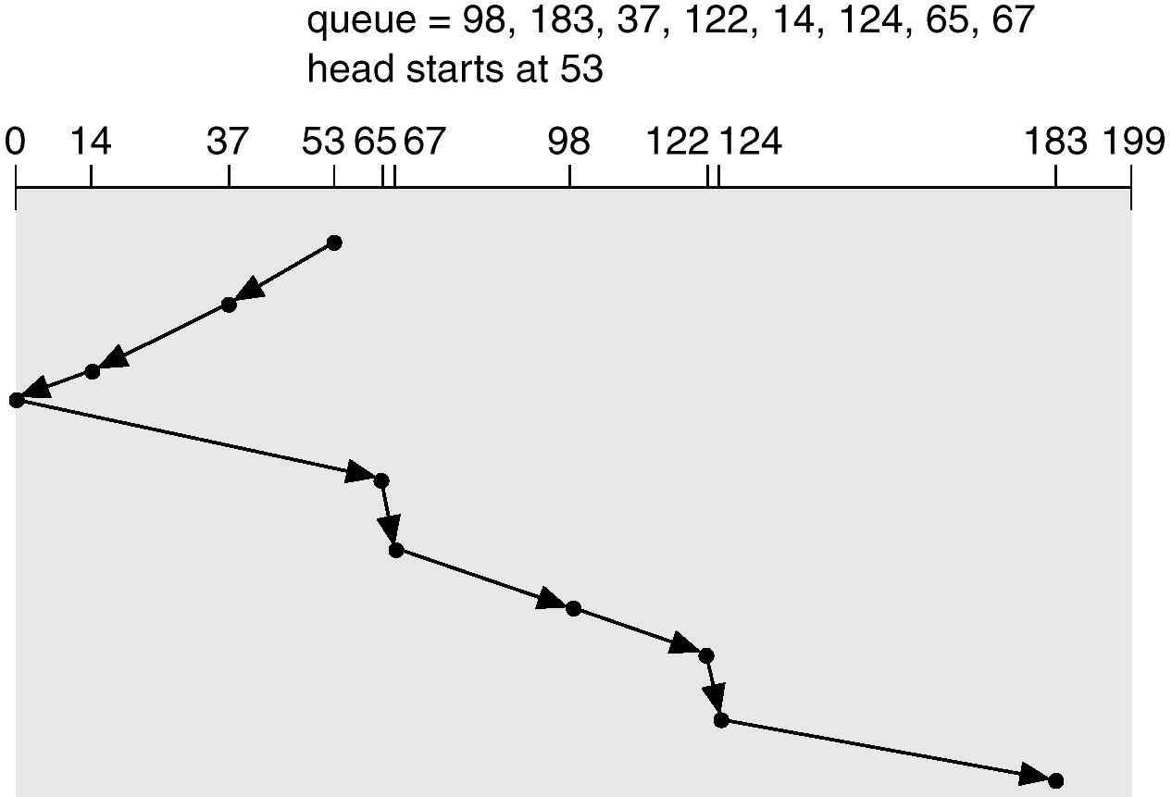
SCAN

Slide 40
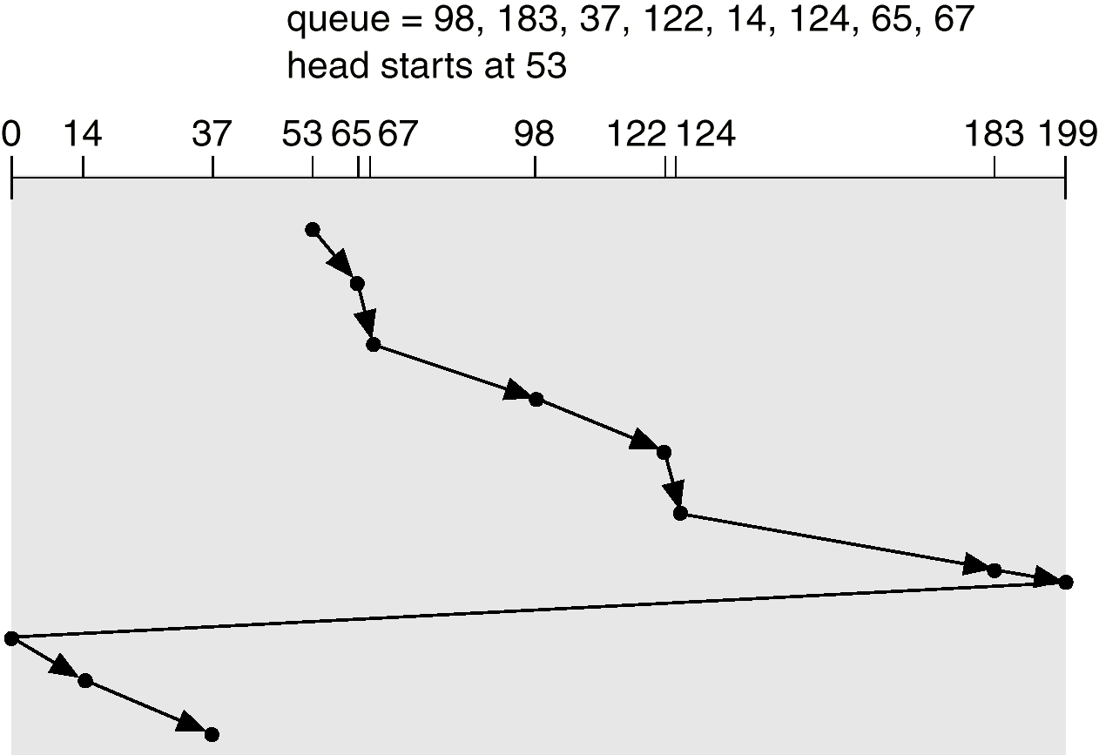
C-Scan

Slide 41
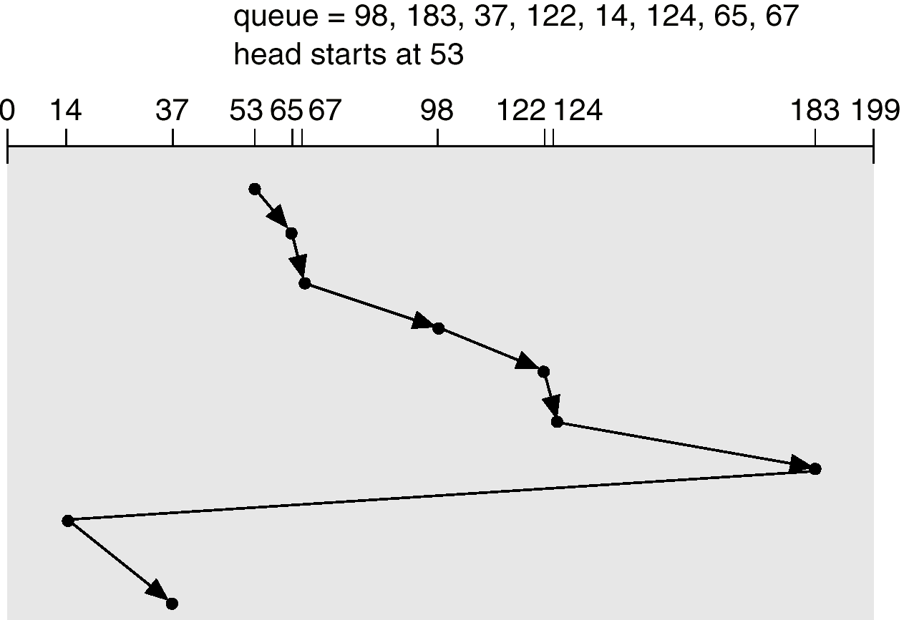
C-Look

Slide 42
Requests | FCFS | Response time SSFT | LOOK
R1 (cyl 20) | 3 | 7 | 155
R2 (cyl 17) | 6 | 10 | 158
R3 (cyl 55) | 44 | 48 | 32
R4 (cyl 35) | 64 | 28 | 12
R5 (cyl 25) | 74 | 2 | 2
R6 (cyl 78) | 127 | 71 | 55
R7 (cyl 99) | 148 | 92 | 76
Average | 66.4 | 36 | 70

Slide 43
Q1. (30 sec) Ethernet
Is a logical bus
Is a token ring
Is a point to point network
Uses a circulating token for arbitration
Always uses CSMA/CD for arbitration

Slide 44
Q2. (30 sec) Hub
Is Ethernet in a box
Is token ring in a box
Same as a bridge
Same as a switch
Something to do with automobiles?

Slide 45
MAC address
IP address of the destination
Message
Q3. (30 sec) The above packet format
Could be meant for any node on the Internet
Is meaningful only in Ethernet
Is meaningful only in a Token ring
Is meant for a special node on the LAN that is connected to the Internet
None of the above

Slide 46
Q4. (30 sec) All the nodes connected to a switch
Form a single collision domain
Forms exactly two collision domains
Forms as many collision domains as the number of ports on the switch
What is a collision domain?

Slide 47
Q5. (30 sec) Token ring
Is as collision prone as Ethernet
Uses IP addresses
Results in better throughput under high load compared to Ethernet
Results in less average latency per transmission compared to Ethernet
None of the above

Slide 48
Packet size = 1500 bytes
Header size = 100 bytes
Q6. (30 sec) size of payload in each packet
1600 bytes
1400 bytes
1500 bytes
Cannot be determined with the data given

Slide 49
Message size = 100,000 bytes
Header size per packet = 100 bytes
Packet size = 1100 bytes
Q7. (30 sec) Number of packets needed to transmit the message (assume no loss)
100
91
1000
Cannot be determined with the data given

