Slide 1
Process Management
(Processor Scheduling)
CS2200

Slide 2
Where are we???
Application Programs
Shell
Operating System Kernel
ISA
Hardware (Pipeline Datapath and Memory)

Slide 3
Revenge of the Vocabulary!!!
Program
Process
Thread
Task
Scheduler
Job
Multiprogramming
Time-Share / Interactive
Batch

Slide 4
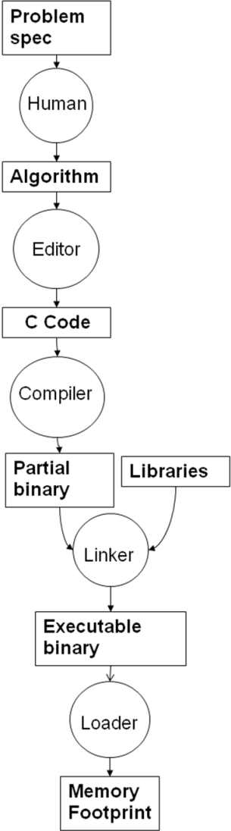
Program to Process

Slide 5
Idealized Layout
Low memory
Use by the OS
Program code
Memory footprint
of
User program
Program global data
Program heap
Program stack
Use by the OS
High memory

Slide 6
Actual Layout
Process 1
Process 2
.
.
.
Process n
OS Data
Structures
OS routines

Slide 7
How do these processes get run?
Available System Memory
Arrival Time
Instantaneous Memory Reqmnts
Priority
Expected Runtime
Expected Memory Use
Expected IO Reqmnts
Dynamic system properties
Process 1
Static properties
Process 2
scheduler
Processor
.
.
.
winner
Process n

Slide 8
Name | Usual Connotation | Use in this chapter
Process | Program in execution; unit of scheduling | Synonymous with job
Thread | Unit of scheduling and/or execution; contained within a process | Not used in the scheduling algorithms described in this chapter
Task | Unit of work; unit of scheduling | Not used in the scheduling algorithms described in this chapter, except in describing the scheduling algorithm of Linux
Process = Program in execution + all threads that are executing in that program

Slide 9
Program vs Process
On Disk
Static
No PC
No State/Registers
Fixed Size
In memory (and disk)
Dynamic
PC and Registers
Grows and Shrinks
Basic Unit of Scheduling

Slide 10
Process Life Cycle
New
Terminated
Admitted
Exit
Interrupt
Ready
Running
Scheduler Dispatch
Waiting
I/O or Event Wait

Slide 11
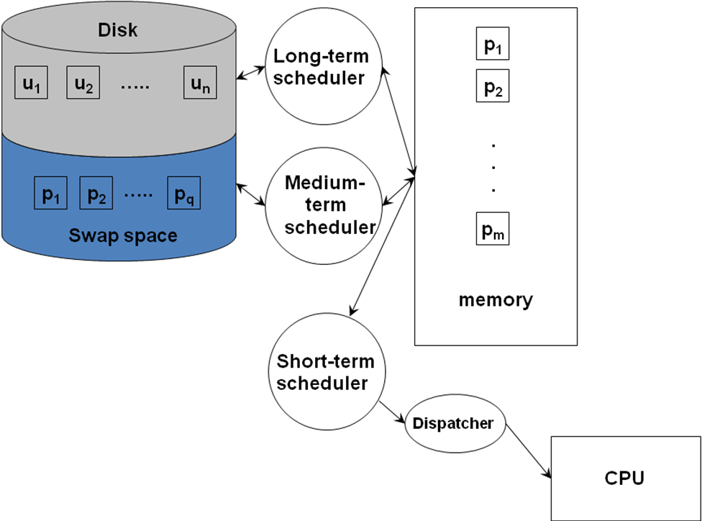
Types of Schedulers

Slide 12
Name | Environment | Role
Long term scheduler | Batch oriented OS | Control the job mix in memory to balance use of system resources (CPU, memory, I/O)
Medium term scheduler | Every modern OS (time-shared, interactive) | Balance the mix of processes in memory to avoid thrashing
Short term scheduler | Every modern OS (time-shared, interactive) | Schedule the memory resident processes on the CPU
Dispatcher | In every OS | Populate the CPU registers with the state of the process selected for running by the short-term scheduler

Slide 13
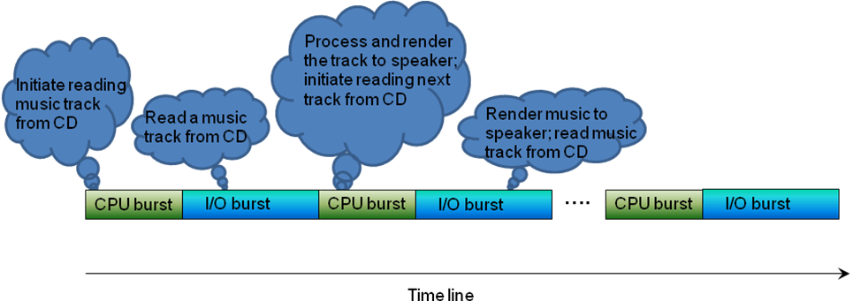
Process Characteristics

Slide 14
I/O or Compute Bound
Compute
Wait for I/O
Compute
Bound
I/O
Bound

Slide 15
Scheduler Basics
Basic scheduler steps
  Grab the attention of the processor.
  Save the state of the currently running process.
  Select a new process to run.
  Dispatch the newly selected process to run on the processor.
Schedulers come in two basic flavors
  Preemptive
  Non-preemptive

Slide 16
Non-Preemptive Scheduling
Long Term Scheduler sending jobs in
Process has control of CPU
until it gives it up voluntarily
Ready Queue
CPU
I/O
I/O Queue
I/O Request
Child Executes
Fork a Child
Interrupt Occurs
Wait for an
Interrupt

Slide 17
Process Control Block (PCB)
Pointer
Process
State
Process Number
Program Counter
Registers
Scheduling Info
Memory Limits
I/O Status Info
Accounting Info

Slide 18
PCB Code
enum state_type {new, ready, running, waiting,
halted};
typedef struct _control_block
{
struct control_block *next_pcb;
enum state_type state;
int pid;
address PC;
int reg_file[NumRegs];
int priority;
address page_table;
...
} control_block;

Slide 19
Conceptual Queues
Ready queue
PCB1
PCB2
…
PCBn
I/O queue
PCB1
PCB2
…
PCBn

Slide 20
Forking
Technique used to start up a process
System call: fork()
Essentially duplicates process creating a child
Parent
x = fork()
Parent
Child
x = child pid
x = 0

Slide 21
Preemptive Scheduling
Long Term Scheduler sending jobs in
Processes may be forced
to give up CPU.
Partially Executed
Swapped Out Processes
Ready Queue
CPU
I/O
I/O Queue
I/O Request
Time Slice Expired
Child Executes
Fork a Child
Interrupt Occurs
Wait for an
Interrupt

Slide 22
Scheduling Term Summary
Name | Description
CPU burst | Continuous CPU activity by a process before requiring an I/O operation
I/O burst | Activity initiated by the CPU on an I/O device
PCB | Process context block that holds the state of a process (i.e., program in execution)
Ready queue | Queue of PCBs that represent the set of memory resident processes that are ready to run on the CPU
I/O queue | Queue of PCBs that represent the set of memory resident processes that are waiting for some I/O operation either to be initiated or completed
Non-Preemptive algorithm | Algorithm that allows the currently scheduled process on the CPU to voluntarily relinquish the processor (either by terminating or making an I/O system call)
Preemptive algorithm | Algorithm that forcibly takes the processor away from the currently scheduled process in response to an external event (e.g. I/O completion interrupt, timer interrupt)
Thrashing | A phenomenon wherein the dynamic memory usage of the processes currently in the ready queue exceed the total memory capacity of the system

Slide 23
Scheduling Algorithms
Non-Preemptive
  First Come First Served (FCFS)
  Shortest Job First (SJF)
  Priority Based
Preemptive
  Round Robin

Slide 24
Performance Metrics
CPU Utilization: Percentage of time the processor is busy.
System Centric.
  Throughput: Number of jobs executed per unit time.
  Average turnaround time: Average elapsed time for jobs entering and leaving the system.
  Average waiting time: Average of amount of time each job waits while in system
User Centric
  Response time: Time until system responds to user.

Slide 25
Performance Metrics
P1
P2
P3
w1
e1
e2
e3
t1
w2
t2
w3
t3
wi, ei, and ti, are respectively the wait time, execution time, and the elapsed time for a job Pi

Slide 26
Performance Metrics
P1
P2
P3
2
3
4
3
2
5
5
Assume times are in ms
9
12
14
19
CPU Utilization
Throughput =3/t3=3/19
Average turnaround time=(t1+t2+t3)/3=(5+12+19)/3
Average waiting time=(w1+w2+w3)/3=(2+9+14)/3
Response time Rp1=t1=5, Rp2=t2=12, Rp3=t3=19

Slide 27
Concerns to Watch for
Two other qualitative issues
  Starvation: The scheduling algorithm prevents a process from ever completing
  Convoy Effect: The scheduling algorithm allows long-running jobs to dominate the CPU. CPU Hog backs up faster IO bound jobs.

Slide 28
Assumptions for discussion
Process switch time is negligible
Single I/O queue
Simple model (first-come-first-served) for scheduling I/O requests

Slide 29
Non-Preemptive Scheduling Algorithms
Scheduler has no control over the currently executing process once it has been scheduled on the CPU.

Slide 30
First Come First Served (FCFS)
Intrinsic property: Arrival time
No starvation
May exhibit convoy effect
High variability of average waiting time

Slide 31
FCFS
BURST TIME:
CPU
10
1
2
I/O
10
2
3
P1
P2
P3
CPU
P1
P2
P3
P1
P2
P3
10
1
2
7
10
1
2
7
I/O
P1
P2
P3
P1
10
10
2
3
5
10

Slide 32
FCFS Example
Consider a non-preemptive First Come First Served (FCFS) process scheduler.
There are three processes in the scheduling queue and the arrival order is
P1, P2, and P3. The arrival order is always respected when picking the next process
to run on the processor. Scheduling starts at time t = 0, with the following
CPU and I/O burst times:
CPU burst time I/O burst time
P1 8 2
P2 5 5
P3 1 5
Each process terminates after completing the following sequence of three actions:
CPU burst
I/O burst
CPU burst
Show the CPU and I/O timelines that result with FCFS scheduling from t = 0 until
all three processes complete.
b) What is the response time for each process?
c) What is the waiting time for each process?

Slide 33
FCFS Solution
Time
CPU
P1
P2
P1
P2
P3
P3
8 5 8 5 1 5 1
I/O
P1
P2
P3
8 2 3 5 3 5 1 5
Response time (P1) = 8+5+8=21 (2 CPU bursts + 1 I/O burst)
Response time (P2)=8+5+8+5=26
Response time (P3)=8+5+8+5+1+5+1=33

Slide 34
Solution pt 2
Time
CPU
P1
P2
P1
P2
P3
P3
8 5 8 5 1 5 1
I/O
P1
P2
P3
8 2 3 5 3 5 1 5
Waiting time(P1) =Total time-Ex. Time= 21-(8+2+8)=3
Waiting time (P2)= 26-(5+5+5)=11
Waiting time (P3)=33-(1+5+1)=26

Slide 35
Shortest Job First (SJF)
Uses anticipated burst time- CPU picks the process with the shortest burst time first
No convoy effect
Probably optimal for best average waiting time
May suffer from starvation
May be addressed with aging rules (gives a priority to the longest waiting process over the shortest one)

Slide 36
SJF
CPU
10
1
2
I/O
10
2
3
P1
P2
P3
CPU
P2
P3
P2
P1
P3
P1
1
2
1
10
2
8
10
I/O
P2
P3
P1
1
2
3
8
10

Slide 37
Example
Consider a non-preemptive Shortest Job First (SJF) process
scheduler. There are three processes in the scheduling queue
and assume that all three of them are ready to run.
As the scheduling discipline suggests, always the shortest job
that is ready to run is given priority. Scheduling starts at
time t = 0. The CPU and I/O burst patterns of the three
processes are as shown below:
CPU I/O CPU I/O CPU
P1 4 2 4 2 4 P1 is done
P2 5 2 5 P2 is done
P3 2 2 2 2 2 P3 is done
Each process exits the system once its CPU and I/O bursts
as shown above are complete.
Show the CPU and I/O timelines that result with SJF
scheduling from t = 0 until all three processes exit the system.
b) What is the waiting time for each process?
c) What is the average throughput of the system?

Slide 38
Solution
CPU Schedule (SJF)
2 4 2 4 2 4 5 2 5
P3 P1
P3 P1
P3 P1
P2
P2
0 25 29
Timeline
I/O Schedule
2 24
P3
P1
P3
P1
P2
2 2 2 2 2 2 4 5 2
CPU I/O CPU I/O CPU
P1 4 2 4 2 4 P1 is done
P2 5 2 5 P2 is done
P3 2 2 2 2 2 P3 is done

Slide 39
Solution - Wait Time
CPU Schedule (SJF)
2 4 2 4 2 4 5 2 5
P3 P1
P3 P1
P3 P1
P2
P2
0 25 29
Timeline
I/O Schedule
2 24
P3
P1
P3
P1
P2
2 2 2 2 2 2 4 5 2
Waiting time (P1)=Total time-Ex. Time=(2+4+2+4+2+4)-(4+2+4+2+4+2)=18-16=2
Waiting time (P2)=(30-12)=18
Waiting time (P3)=(2+4+2+4+2+4+2)-(2+2+2+2+2)=14-10=4

Slide 40
Priority Scheduling
Each process is assigned a priority
May have additional policy such as FCFS for all jobs with same priority
Attractive for environments where different users will pay more for preferential treatment
SJF is a special case with Priority=1/burst time
FCFS is a special case with Priority = arrival time
One queue for each priority level
Starvation can be a problem (can increase priority with age)
Convoy effect could happen if high priorities are CPU hogs.

Slide 41
Preemptive Scheduling
Two simultaneous implications.
Scheduler is able to assume control of the processor anytime unbeknownst to the currently running process.
Scheduler is able to save the state of the currently running process for proper resumption from the point of preemption.
Any of the Non-preemptive algorithms can be made Preemptive:
FCFS with preemption
SJF with preemption variation: SRTF (Shortest Remaining Time First)
Priority with preemption
Round Robin

Slide 42
Consider the following four processes waiting for the CPU. The scheduler uses SRTF.
The table shows the arrival time of each process.
Process | Arrival Time | Execution Time
P1 | T0 | 4ms
P2 | T0+1ms | 2ms
P3 | T0+2ms | 2ms
P4 | T0+3ms | 3ms
Show the schedule starting from T0 for SRTF.
What is the waiting time for each process?
What is the average wait time with SRTF?
What is the schedule for with FCFS?
What is the average wait time with FCFS?

Slide 43
Solution
Process | Arrival Time | Execution Time
P1 | T0 | 4ms
P2 | T0+1ms | 2ms
P3 | T0+2ms | 2ms
P4 | T0+3ms | 3ms
Time | 0 | 1 | 2 | 3 | 4 | 5 | 6 | 7 | 8 | 9 | 10 | 11
Process | P1 | P2 | P2 | P3 | P3 | P1 | P1 | P1 | P4 | P4 | P4

Slide 44
Time | 0 | 1 | 2 | 3 | 4 | 5 | 6 | 7 | 8 | 9 | 10
Process | P1 | P2 | P2 | P3 | P3 | P1 | P1 | P1 | P4 | P4 | P4
What is the waiting time for each process?
What is the average wait time with SRTF?
a) Rp1=completion time-arrival time=8-0=8ms
Rp2=3-1=2ms
Rp3=5-2=3ms
Rp4=11-3=8ms
Wp1=response time-execution time=8-4=4ms
Wp2=2-2=0ms
Wp3=3-2=1ms
Wp4=8-3=5ms
b) Wp=(Wp1+Wp2+Wp3+Wp4)/4=2.5ms

Slide 45
Example - FCFS
What is the schedule for with FCFS?
Process | Arrival Time | Execution Time
P1 | T0 | 4ms
P2 | T0+1ms | 2ms
P3 | T0+2ms | 2ms
P4 | T0+3ms | 3ms
Time | 0 | 1 | 2 | 3 | 4 | 5 | 6 | 7 | 8 | 9 | 10
Process | P1 | P1 | P1 | P1 | P2 | P2 | P3 | P3 | P4 | P4 | P4

Slide 46
Time | 0 | 1 | 2 | 3 | 4 | 5 | 6 | 7 | 8 | 9 | 10
Process | P1 | P1 | P1 | P1 | P2 | P2 | P3 | P3 | P4 | P4 | P4
What is the average wait time with FCFS?
Rp1=completion time-arrival time=4-0=4ms
Rp2=6-1=5ms
Rp3=8-2=6ms
Rp4=11-3=8ms
Wp1=response time-execution time = 4-4=0ms
Wp2=5-2=3ms
Wp3=6-2=4ms
Wp4=8-3=5ms
Wp=(Wp1+Wp2+Wp3+Wp4)/4=3ms

Slide 47
Round Robin Scheduling
Appropriate for time-sharing environments
Need to determine time quantum q: Amount of time a process gets before being context switched out (also called time-slice)
Context switching time becomes important
FCFS is a special case with q = ∞
If n processes are running under round robin they will have the illusion they have exclusive use of a processor running at 1/n times the actual processor speed

Slide 48
Example
What is the wait time for each of the three processes
with round robin schedule?
Assume time-slice is q=2
CPU I/O CPU I/O
P1 4 2 2 P1 is done
P2 3 2 2 P2 is done
P3 2 2 4 2 P3 is done

Slide 49
Timeline
CPU Schedule (Round Robin, timeslice = 2)
2 2 2 2 1 2 2 2 2
P1
P2
P3
P1
P2
P3
P1
P3
P2
I/O Schedule
6 8 10 11 12 14 15 16
P3
P1
P2
P3
2 2 2 3 2
CPU I/O CPU I/O
P1 4 2 2 P1 is done
P2 3 2 2 P2 is done
P3 2 2 4 2 P3 is done

Slide 50
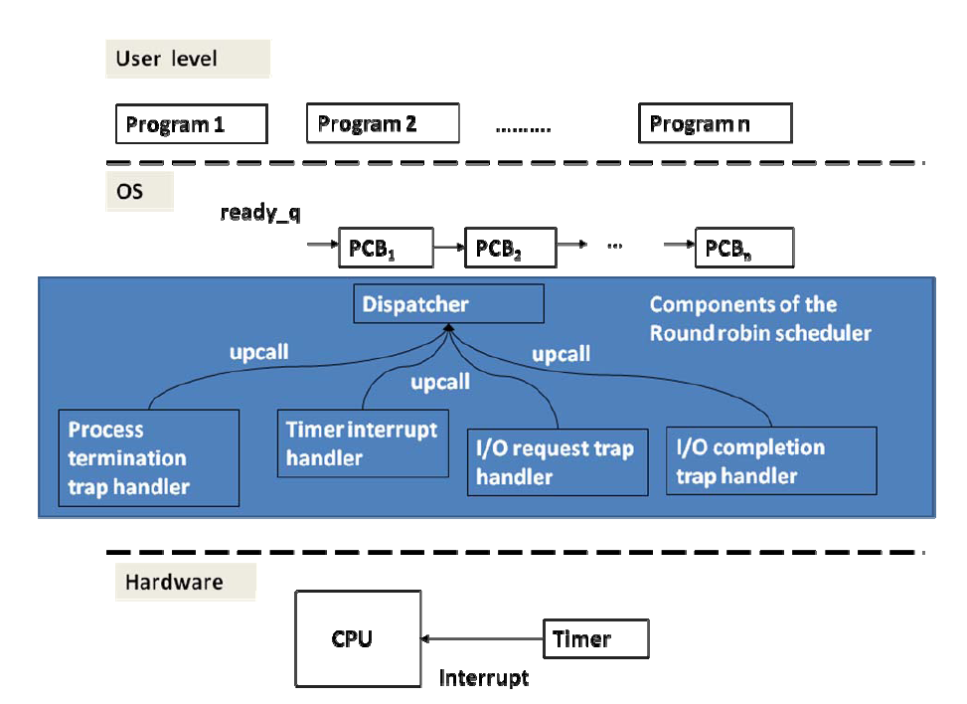

Slide 51
Timer interrupt handler:
save context in PCB;
move PCB to the end of the ready queue;
upcall to dispatcher;
Dispatcher:
get head of ready queue;
set timer;
dispatch;
I/O request trap:
save context in PCB;
move PCB to I/O queue;
upcall to dispatcher;
I/O completion interrupt handler:
save context in PCB;
move PCB of I/O completed process to ready queue;
upcall to dispatcher;
Process termination trap handler:
Free PCB;
upcall to dispatcher;

Slide 52
Name | Property | Scheduling criterion | Pros | Cons
FCFS | Intrinsically non-preemptive; could accommodate preemption at time of I/O completion events | Arrival time (intrinsic property) | Fair; no starvation; | high variance in response time; convoy effect
SJF | Intrinsically non-preemptive; could accommodate preemption at time of new job arrival and/or I/O completion events | Expected execution time of jobs (intrinsic property) | Preference for short jobs; provably optimal for response time; low variance in response times | Potential for starvation; bias against long running computations
Priority | Could be either non-preemptive or preemptive | Priority assigned to jobs (extrinsic property) | Highly flexible since priority is not an intrinsic property, its assignment to jobs could be chosen commensurate with the needs of the scheduling environment | Potential for starvation
SRTF | Similar to SJF but uses preemption | Expected remaining execution time of jobs | Similar to SJF | Similar to SJF
Round robin | Preemptive allowing equal share of the processor for all jobs | Time quantum | Equal opportunity for all jobs; | Overhead for context switching among jobs

Slide 53
Linux Scheduler
Scheduler designed to match personal computing and server domains
Goals
  High efficiency
    Spending as little time as possible in scheduler, important goal for server environment
  Support for interactivity
    Important for the interactive workload of the desktop environment
  Avoid starvation
    Ensure that computational workload do not suffer as a result of interactive workloads
  Support for soft real-time scheduling
    Meet the demands of interactive applications with real-time constraints

Slide 54
Linux Scheduler
Linux scheduler recognizes three classes of tasks:
  Real-time FCFS
  Real-time round robin
  Timeshared
Scheduler has 140 priority levels.
  Levels 0-99 for real-time tasks
  Remaining levels for timeshared tasks.

Slide 55
runqueue
Other stuff
Active
P
P
0
P
.
.
Priority
Arrays
P
P
P
139
Expired
0
P
P
P
139

Slide 56
Operation
Pick first task with highest priority from active array and run it.
If task blocks (due to I/O) put it aside and pick next highest one to run.
If time quantum runs out (does not apply to FCFS tasks) for currently scheduled task then place it in expired array.
If a task completes its I/O then place it in active array at right priority level adjusting its remaining time quantum.
If there are no more tasks to schedule in active array, simply flip active and expired array pointers and continue with scheduling algorithm (i.e., expired array becomes the active array and vice versa).

