Slide 1
The T-Rex Serialization Library « TSL »
Elaborated by : Supervised by :
ZKARA CHAIMAE | CHAABI AYOUB Mr.BOULMAKOUL
FARAJI HAMZA | HILALI ABDERRAHMANE

Slide 2
PLAN
Introduction

Slide 3
PLAN
Introduction
A
Problematics
B

Slide 4
PLAN
Introduction
A
Problematics
B
Part 1
C

Slide 5
PLAN
Introduction
Problematics
A
B
Part 1
Part 2
C
D

Slide 6
PLAN
Introduction
Problematics
A
B
Part 2
Part 2
C
D
Part 3
E

Slide 7
PLAN
Introduction
Problematics
A
B
Part 1
Part 2
C
D
Part 3
Improvements & Perspectives
E
F

Slide 8



Serialization / deserialization
Network
Memory
Object
Object
Stream
Stream
Notes:
Serialization is the process of converting an object into a stream of bytes in order to store the object or transmit it to memory, a database, or a file. Its main purpose is to save the state of an object in order to be able to recreate it when needed. The reverse process is called deserialization.
This illustration shows the overall process of serialization.
The object is serialized to a stream, which carries not just the data, but information about the object's type, such as its version, culture, and assembly name. From that stream, it can be stored in a database, a file, or memory.
Serialization allows the developer to save the state of an object and recreate it as needed, providing storage of objects as well as data exchange. Through serialization, a developer can perform actions like sending the object to a remote application by means of a Web Service, passing an object from one domain to another, passing an object through a firewall as an XML string, or maintaining security or user-specific information across applications.

Slide 9
Problematic
Aclass
Attributes and their values ??
Attribute1 : Integer
Attribute2 : String
Attribute3 : Aclass2
Container : vector
Serialization process
doSomeThing():void

Slide 10
Reflection mechanism
Uknown object
reflection is the ability of a program to examine, introspect, and modify its own structure and behavior at runtime.
Reflection API
informations about class at runtime
Notes:
Reflection can be used for observing and modifying program execution at runtime. A reflection-oriented program component can monitor the execution of an enclosure of code and can modify itself according to a desired goal related to that enclosure. This is typically accomplished by dynamically assigning program code at runtime.
What is Reflection?
A database of types and their inheritance relationship with each other.
A means of creating objects of a specific type by name.
A list of data member descriptions for each type, with name/type/offset tuples.
A database of enumeration types and their associated key/value pairs.
A database of functions/methods with their return types and parameter lists.
A means of calling functions/methods by name at runtime with an arbtrarily constructed parameter list.
A database of properties represented as Get/Set method pairs that externally look like a named value.
A database of attributes that can be attached to any of the above, describing how they should be used.
Each language has varying levels of support for reflection, while C++ has RTTI. You can do various things with RTTI but it’s an incredibly limited system that only gives you:
The ability to discover an object’s type at runtime through the typeid operator.
A typeid operator that can also be applied to types themselves.
A type’s name, its hash code and some comparison functions.
Runtime downcasting and similar operations through dynamic_cast.

Slide 11
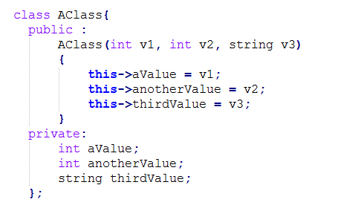
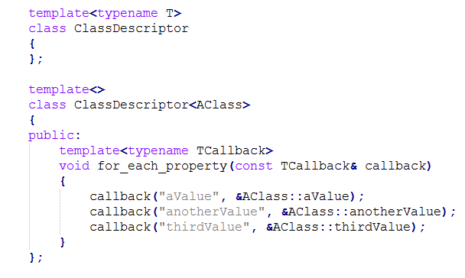
solution (Part 1)
Notes:
here's my idea of what a reflection class could look like. Imagine you have a class 'AClass' and you want to reflect it.

Slide 12
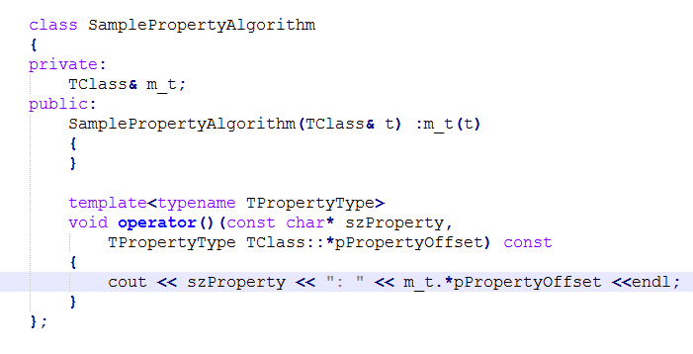
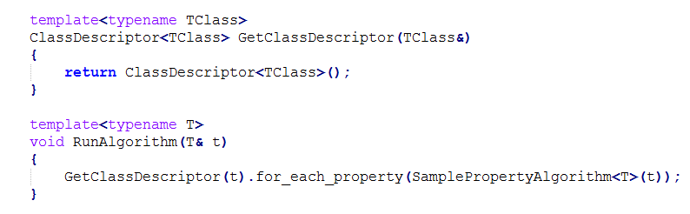
solution (Part 1)
Notes:
A template specialisation allows you to represent any class type that you're interested in and you can capture the offset for each of the properties of that represented class. Then, all you need to do is represent the algorithm:
you only have to write it once, for each property, and you've captured not only the name but the type and value of each property.

Slide 13
Generating Json
PART2

Slide 14
Solution (part 2)
1
What is JSON ?
2
JSON Syntax
3
Writing Json

Slide 15

Solution (part 2)
What is json ?

Slide 16
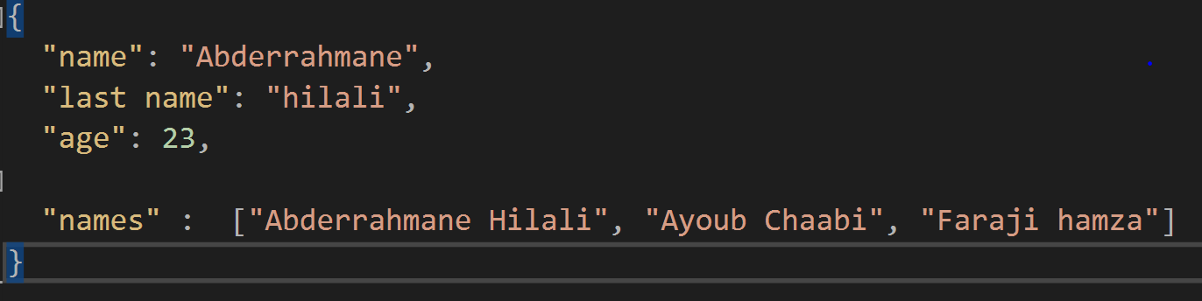
Solution (part 2)

Slide 17
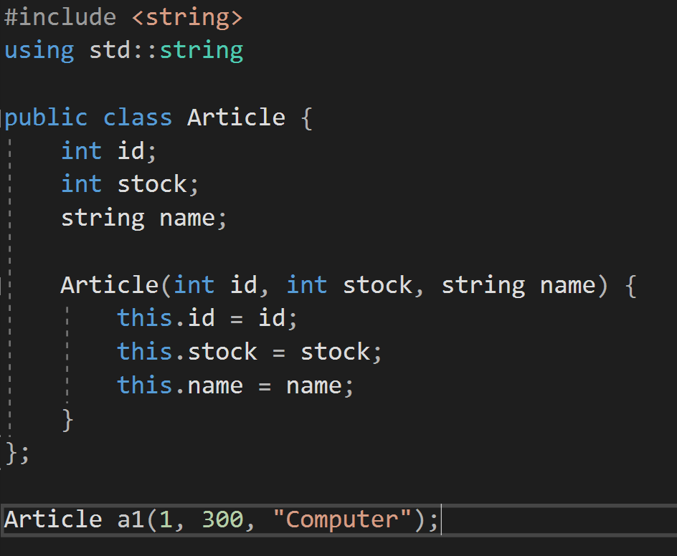
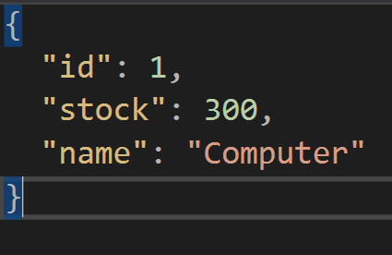

Slide 18
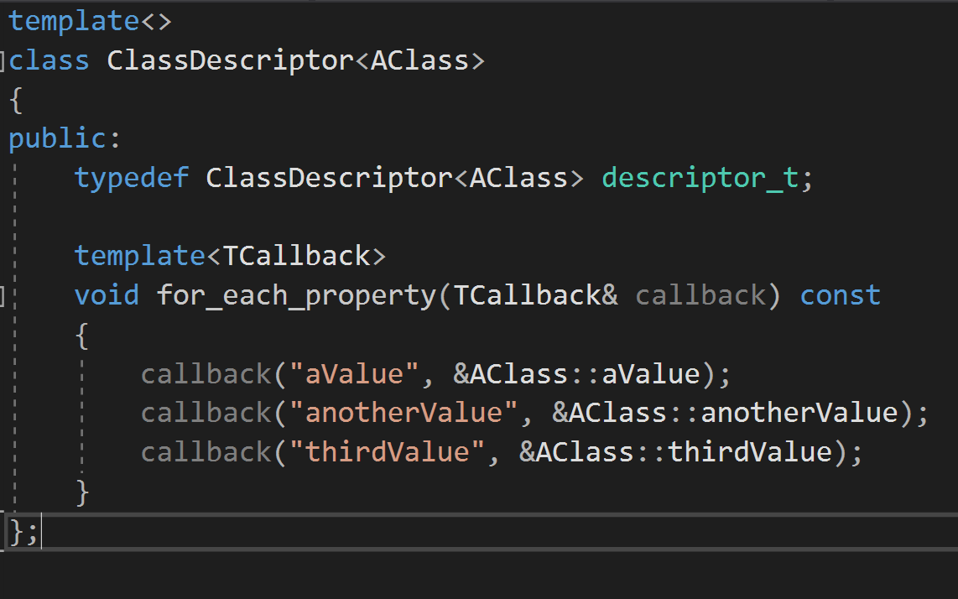
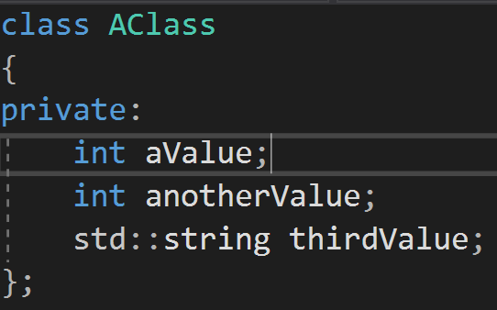
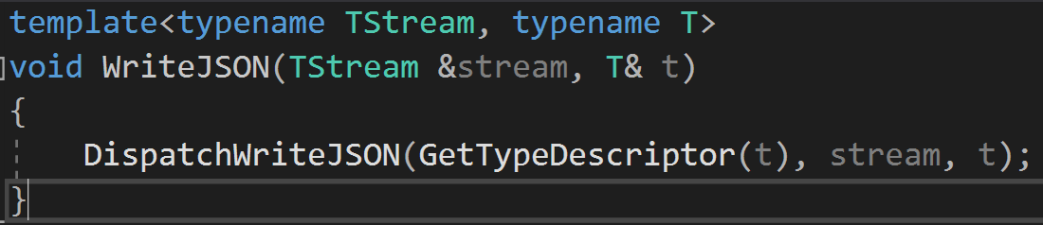
solution

Slide 19
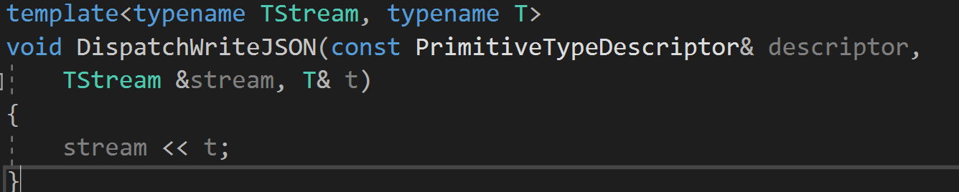
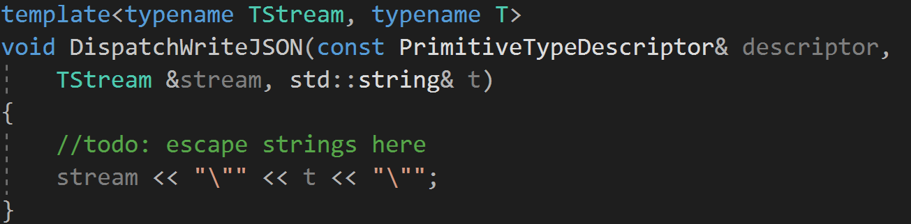
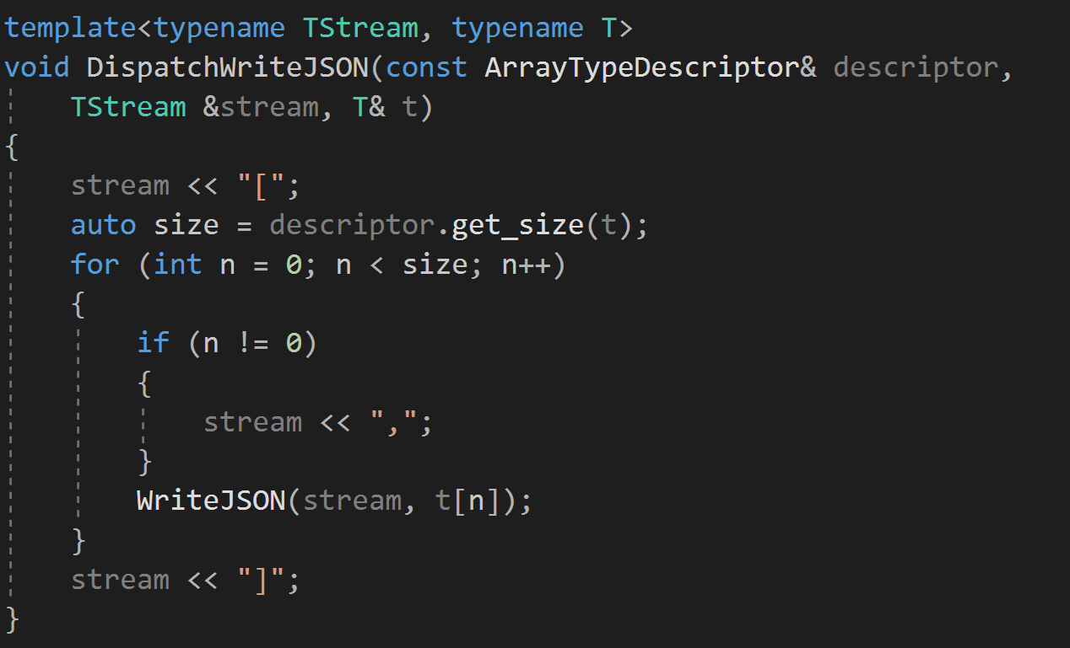
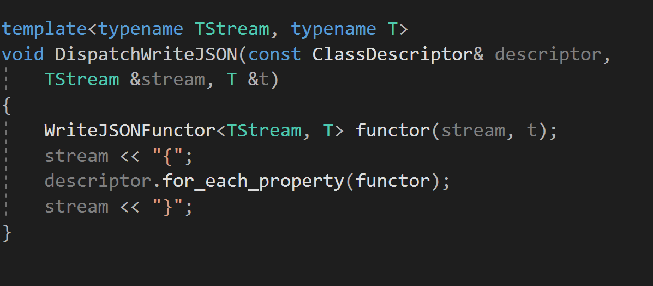

Slide 20
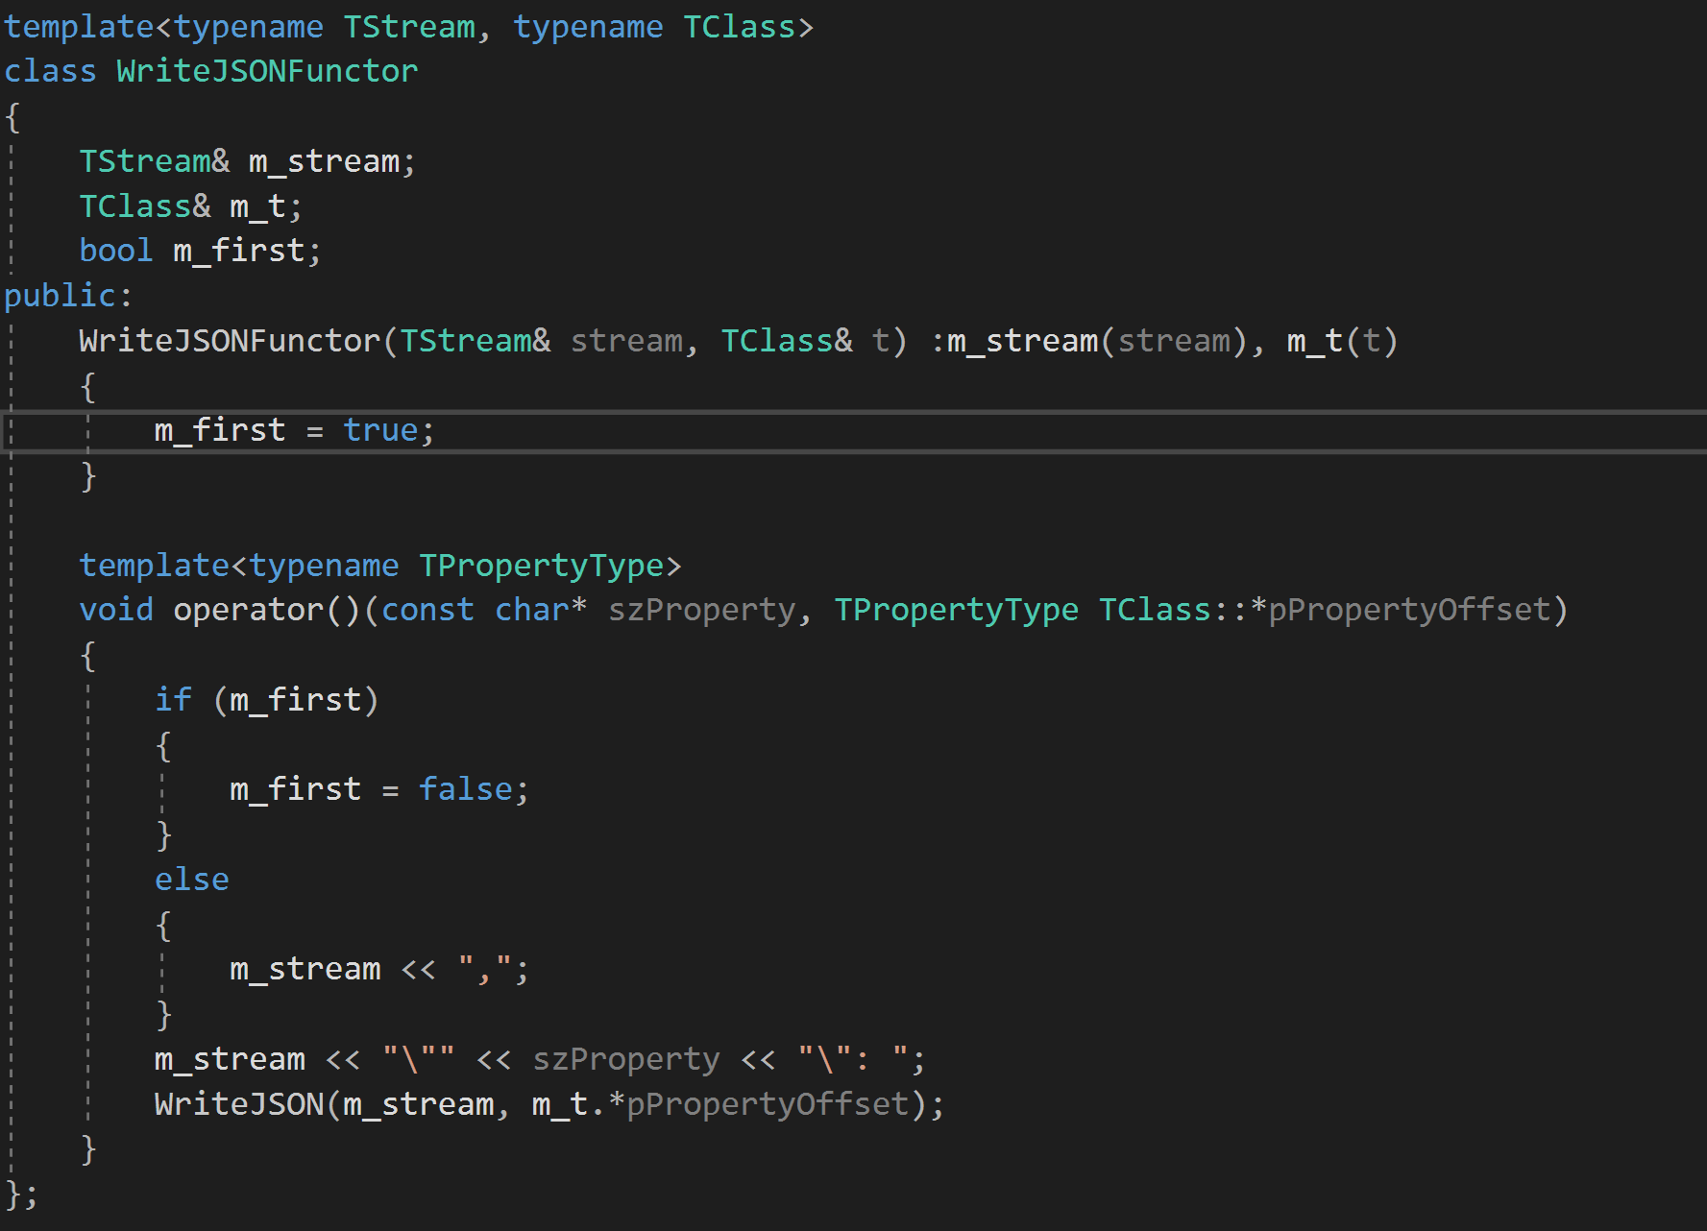

Slide 21
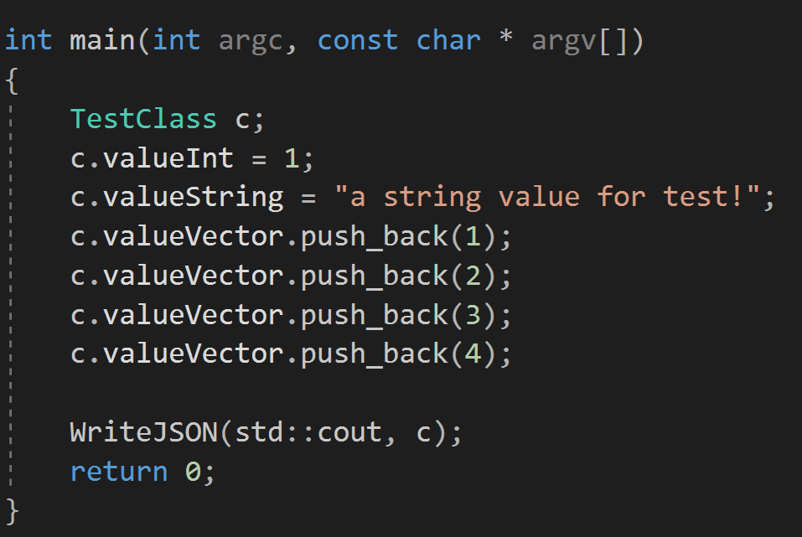
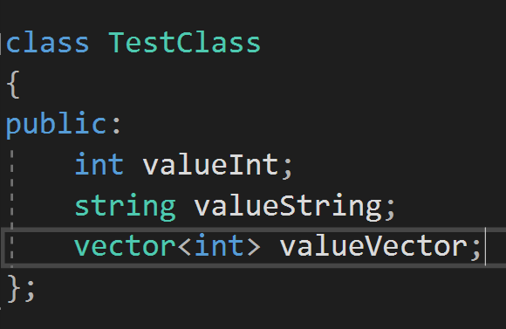
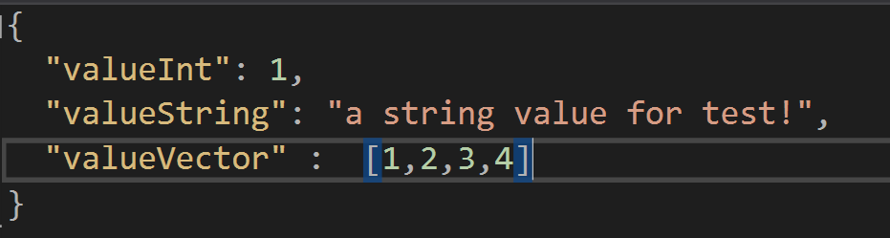
Execution Example

Slide 22
THE TSL
PART 3
T-REX Serialization Library

Slide 23
PART 3 : TSL
Improving the writing process

Slide 24
PART 3 : TSL
Improving the writing process
More collections

Slide 25
PART 3 : TSL
Improving the writing process
Reading objects
More collections

Slide 26
PART 3 : TSL
Improving the writing process
Reading objects
More collections
The client interface

Slide 27
PART 3 : TSL
Improving the writing process
Reading objects
The static library
More collections
The client interface

Slide 28
What's missing ?
This only writes C++ classes to JSON
The JSON format is still tightly coupled with the iteration (better to separate that),
This doesn’t support polymorphic types where we have a pointer or maybe a shared_ptr.

Slide 29
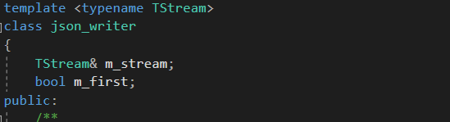
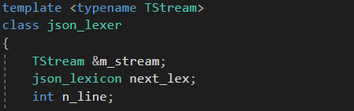
Improving the writing process
The stream is no longer exposed in the reading and writing functors :
Notes:
The stream is no longer exposed in the reading and writing objects, they are sort of encapsulted inside the template classes json writer and json lexer
This comes with not only advantages, but with disadvantages infortunatly :
The advantage is that the implentation of the json format is separated from the library logic

Slide 30
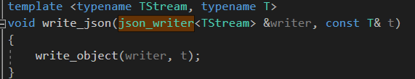
Improving the writing process
Notes:
But , it's not sepertated fully, this code right here is not extensible
what if the client wants to use another format, like xml maybe ?

Slide 31
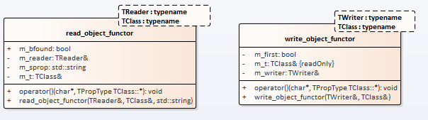
Notes:
The stream is no longer exposed in the reading and writing objects, they are sort of encapsulted inside the template classes json writer and json lexer
This comes with not only advantages, but with disadvantages infortunatly :
The advantage is that the implentation of the json format is separated from the library logic

Slide 32
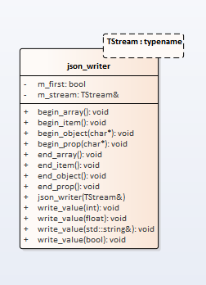
Notes:
The stream is no longer exposed in the reading and writing objects, they are sort of encapsulted inside the template classes json writer and json lexer
This comes with not only advantages, but with disadvantages infortunatly :
The advantage is that the implentation of the json format is separated from the library logic

Slide 33
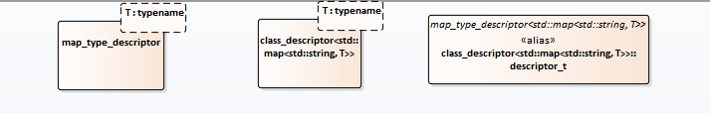
More collections
A new class has been added that implements the std::map logic.
Notes:
Because the map is different than the vector and the array, it contains a key, then its value.
So in json, the syntax to write a map object is as shown here :

Slide 34
Reading Objects
The inverse of writing process, the process consists of constructing objects of a given type from a any kind of stream that is conform to JSON’s syntax

Slide 35
Reading Objects
The operation can be divided into 2 phases :
A lexical analysis phase : Using a tokenizer(lexer) object that reads and tokenizes the stream;
An object construction phase : using the reader object that performs matches and retrieves tokens on demand from the tokenizer(lexer), the properties are then checked and assigned to the (empty) object

Slide 36
Reading Objects
The sequence of characters in the stream is read character by character while the token are being constructed at the same time.
Using the provided stream, the reader object performs matches against the symbols of JSON's syntax and retrieves property names and values via a set of functions
The match/advance operations are similar to context free grammar matching process

Slide 37
Reading Objects
For example :
Match opening bracket
Read property name
Check
if property name is different from array class member then it's an error
else then content of array is read recursively using the same reading process (inner objects...)

Slide 38
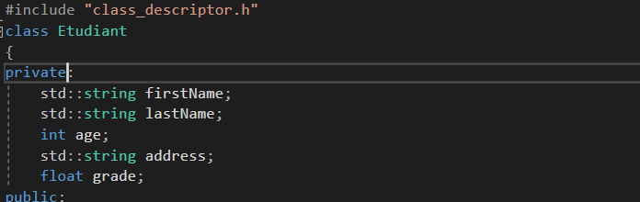
The client code

Slide 39
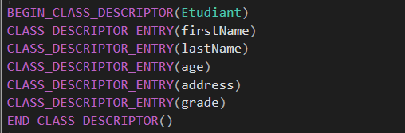
The client code

Slide 40
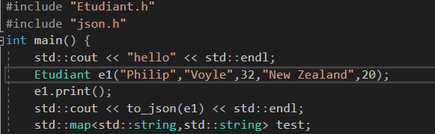
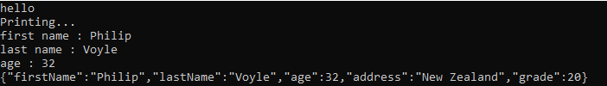
The client code
Notes:
And the output is

Slide 41
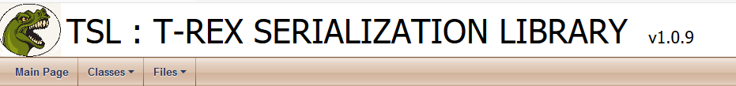
Static library
To complete this framework, we tought about making it a static library for the use of programmers.
we named it the TSL, which refers to : T-REX Serialization Library
Notes:
We generated a documentation for this project using the doxywizzard, and we plan on pushing it to a github account for the world to use it.

Slide 42
Improvements and Perspectives
We tried to improve the library in many ways, according to the following categories :
Structure improvements
Features improvements
Code standards improvements
Notes:
And the output is

Slide 43
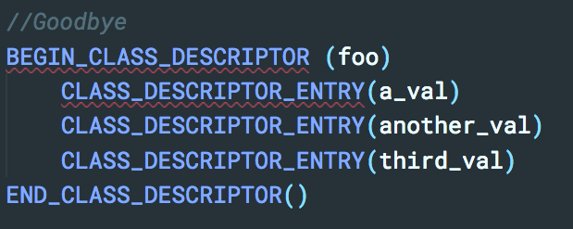
Feature Improvements
Strict OOP rules : more encapsulation (removing all public fields)
One-line serialization
syntax :
Becomes
Notes:
And the output is

Slide 44
Code standards improvements
The library’s code was reviewed and corrected as to :
Include some of C++14 and C++17 features (using type aliasing instead of typedef type definitions)
More robust type checking using the ‘auto’ and ‘decltype’ keywords (instead of plain type)
Avoidance of all compiler-related extensions (such as predefined macros)
Notes:
And the output is

Slide 45
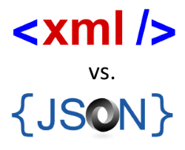
Structure Improvements
Major improvement :
Syntax-free serialization !
The structure of the library is not flexible enough to allow for more
extensions (JSON only).
Let’s make it more flexible !
Notes:
And the output is

Slide 46
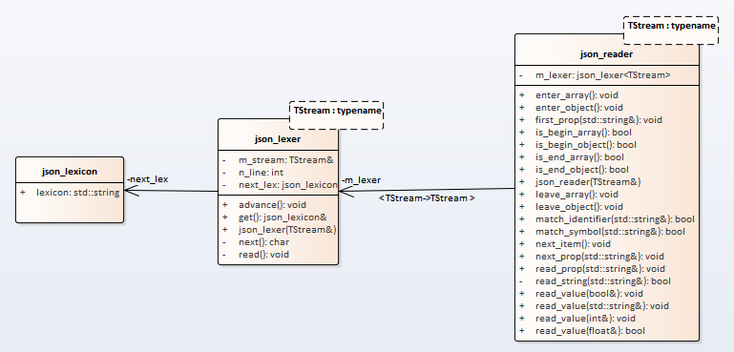
Structure Improvements
JSON reading classes
JSON writing class

Slide 47
Perspectives & Conclusion
We could improve the library in many other ways :
Deserializer for arbitrary JSON strings (the project does only known schemas)
Include metadata for functions to use the serialization and perform remote procedure calls

