Slide 1

VERIDICT
SECURE PROGRAM SYNTHESIS
HACKATHON · MAY 2026
PITCH DECK
ai writes the code.
math approves the merge.
ZK-attested · spec-driven code review for the AI-synthesis era.
AUTHOR
TRACKS
LIVE
Sumit Vekariya · Solo entry
2 · Specification / 3 · Spec-driven dev
veridict.zkred.tech

Slide 2
VERIDICT
02 / 12
table of content
01
Hello, here is Veridict
INTRODUCTION
02
Open source is leaking trust
Most code review today rests on a single named maintainer. AI synthesis makes that worse. Review volume now exceeds what any one human can verify by reading. Veridict is a merge gate that decouples qualified-reviewer-ness from identity. Three formal proofs verify the PR. One ZK signature authorises it. Zero identities revealed.
03
The thesis
04
Two primitives
05
How it works
06
What was built
07
Live deployment
08
Results & numbers
09
Trust model
10
Limits & what's next
Live at →
veridict.zkred.tech

Slide 3
VERIDICT
03 / 12
01 / INTRODUCTION
hello, here is
veridict.
A merge gate for synthesized code. Three formal proofs verify the PR (mypy, pytest, Z3). One Longfellow ZK signature authorizes it. Zero identities revealed.
Built in 72 hours · solo · no caffeine spared.
github.com/Zkred/veridict

Slide 4
VERIDICT
04 / 12
02 / THE PROBLEM
open source is
leaking trust.
Four incidents. One pattern. Different projects, same architectural hole.
INCIDENT 01
Dec 2024
INCIDENT 02
Mar 2024
bincode
xz-utils
Maintainer rewrote git history while migrating off GitHub. The questions became doxxing. The project shut down permanently.
“Jia Tan” earned maintainer status over two years, then shipped a backdoor that nearly compromised sshd on every major Linux distro.
INCIDENT 03
Jan 2024
INCIDENT 04
Feb 2025
curl
vibe-coding
“My job is increasingly fact-checking the AI,” wrote Daniel Stenberg. Maintainers drown in plausible AI PRs that fail invariants.
Karpathy coined it. The practice went mainstream anyway: ship when it looks right. Verification skipped at scale.
Same shape: identity-coupled trust at the centre · no formal gate before approval · reviewers paying the cost.

Slide 5
VERIDICT
05 / 12
03 / THE THESIS
the thesis.
DECOUPLE
REPLACE WITH
qualified-reviewer-ness from identity.
two separable primitives.
The architectural hole in open-source review is not the absence of clever tooling. It is the lack of separation between being a qualified reviewer and being a known identity.
01
02
Formal gate
ZK credentials
mypy + pytest + Z3
Longfellow MDOC

Slide 6
VERIDICT
06 / 12
04 / HOW IT WORKS
six stages.
one signature.
End-to-end on Cloud Run. The reviewer clicks once.
01
02
03
04
05
06
Spec
Synthesis
Verify
Credential
ZK proof
Merge
Natural-language
requirement
Claude emits impl,
tests, Z3 invariants
mypy + pytest + Z3
run server-side
Longfellow MDOC
bound to commit SHA
Reviewer proves
role anonymously
Branch protection
flips to green
~10s
<3s
~10s
~7s
End-to-end ~30 seconds from PR comment to merge-eligible commit status.

Slide 7
VERIDICT
07 / 12
05 / CONTRIBUTION
what was built.
Six concrete pieces shipped in the timebox. Every one of them is a real file in the repo.
01
Spec-check gate
02
Structured synthesis
mypy + pytest + Z3 results gate ES256-signed MDOC minting.
Claude emits impl, pytest suite, and Z3 invariants in one call.
issuer/server.py
issuer/synthesizer.py
03
Longfellow patch
04
Anti-replay MDOC
Reviewer namespace org.example.reviewer registered.
Transcript = sha256(owner/repo/pr/sha) bound inside ZK session.
patches/add-reviewer-namespace.patch
issuer/mdoc_builder.py
05
GitHub branch gate
06
Pseudonyms + chips
Bot pushes zk-review-gate commit status; merge gated at API level.
HMAC-derived per-PR tags; identicons; role/age/repo-count buckets.
.github/workflows/
backend/main.py

Slide 8
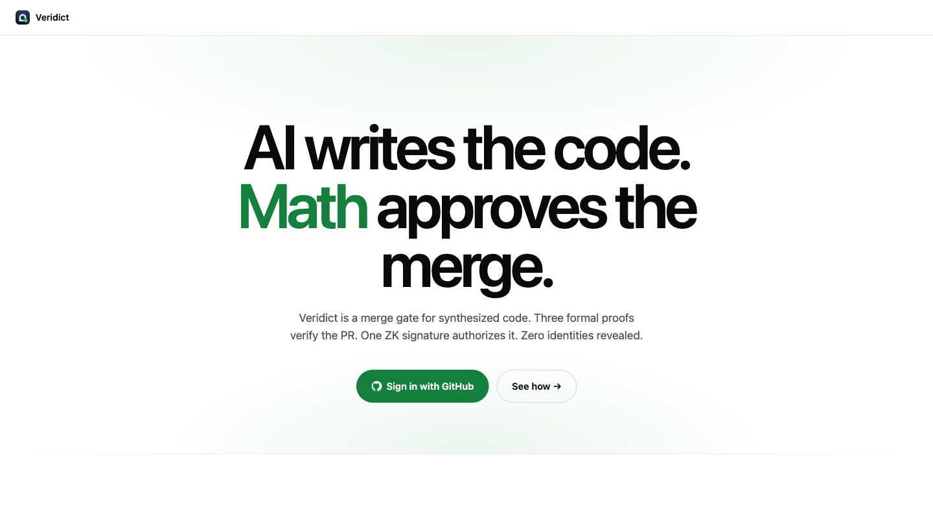
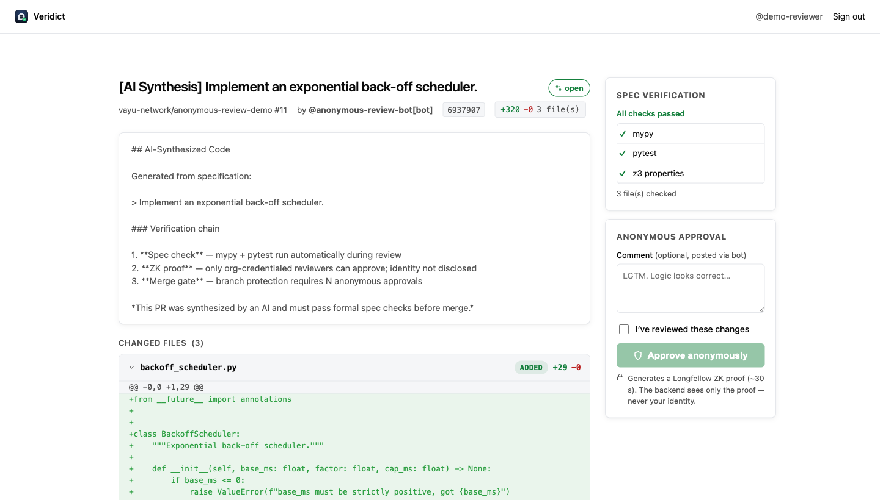
VERIDICT
08 / 12
06 / LIVE DEMO
it is real. it is deployed.
Two views from the live deployment: the landing page and the reviewer's PR view.
veridict.zkred.tech
veridict.zkred.tech/review/load
LANDING
REVIEWER VIEW
Sign in with GitHub · synth or review.
Spec diff, spec-check, approve anonymously.
LIVE NOW
Zkred/veridict · branch protection on · 2 / 2 anonymous approvals required

Slide 9
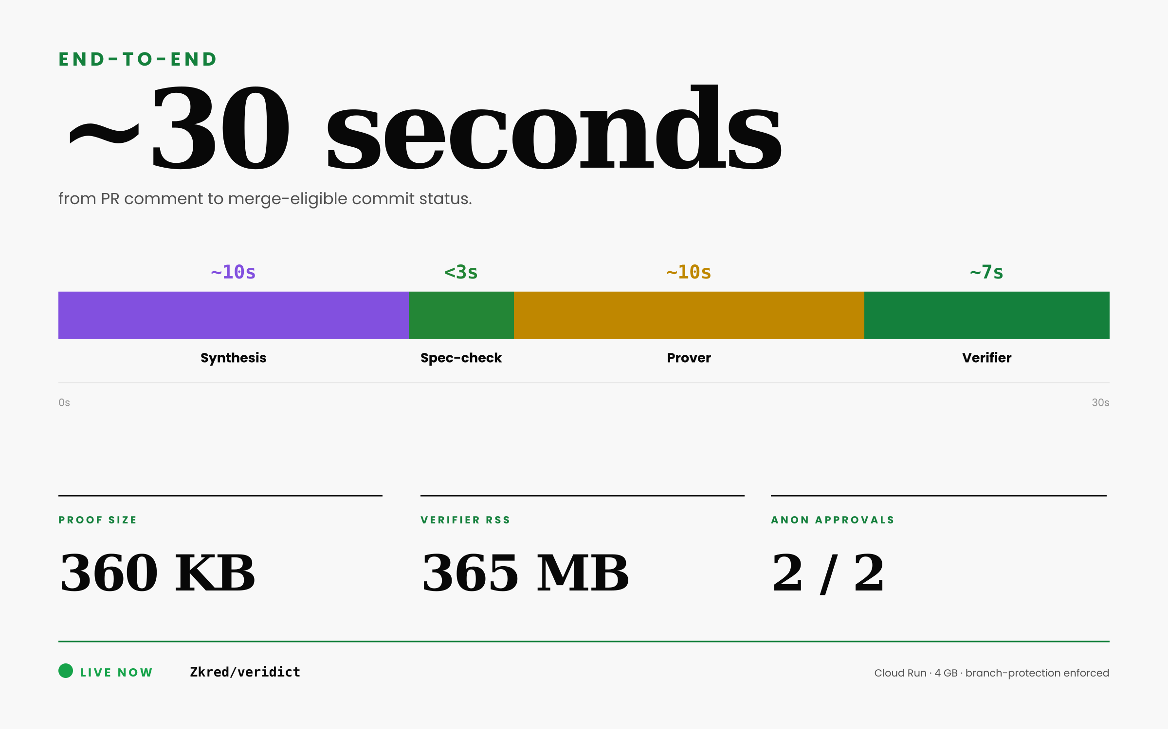
VERIDICT
09 / 12
07 / RESULTS
measured on cloud run.
PIPELINE TIMINGS
Synthesis
Claude → PR opened
~10s
Spec-check
mypy + pytest + Z3
<3s
Prover
Longfellow ZK
~10s
Verifier
Longfellow ZK
~7s
ARTIFACTS
Proof size
per approval
360 KB
Verifier RSS
peak memory
365 MB
Credential
MDOC, 10-min validity
ES256
DEPLOYMENT
Approvals
anonymous + verified
2 / 2
Branch gate
zk-review-gate context
enforced
Repo
Zkred/veridict

Slide 10
VERIDICT
10 / 12
08 / TRUST MODEL
who sees what.
Anonymity is structural. Below: who can see which fact, from least private to most public.
REVIEWER
ISSUER
BACKEND / CI
PR AUTHOR + GH
Reviewer's true identity
● self
✓
·
·
OAuth identity
● own
✓
·
·
Spec-check result
● own PR
✓
✓
✓
ZK proof
● own
·
✓
·
Pseudonym + reputation
● own
✓
✓
✓
Approval count (N / req'd)
·
✓
✓
✓
Other reviewers' identities
·
·
·
·
✓ sees this · ● own only (own credential, own PR scope) · · hidden
Note: anonymity is toward the verifier: PR author, CI, audit trail. Not toward the issuer. Said out loud.

Slide 11
VERIDICT
11 / 12
09 / WHAT THIS ISN'T
limits, said out loud.
A weekend prototype is allowed limits as long as it names them. Here are ours.
ANONYMITY
KEY CUSTODY
No nullifier yet
Issuer mints the device key
Two browser sessions = two pseudonyms for one reviewer. Fix: derive a blinded ID inside the ZK circuit.
For demo speed. A real deployment generates the device key in the browser so the issuer never sees it.
SPEC COVERAGE
COMMENTS
Python only, for now
Single bot account
mypy + pytest + Z3 only run on .py files. Non-Python PRs pass through unverified. Dafny, Rust, Lean are obvious next stops.
Every anonymous approval posts as @anonymous-review-bot. Pseudonyms + identicons inside the comment do the distinguishing.

Slide 12
VERIDICT
12 / 12
thank you.
anonymity should be cheaper than identity.
TRY IT
CODE
veridict.zkred.tech
github.com/Zkred/veridict
Sumit Vekariya · Solo · Built in 72 hours
Secure Program Synthesis Hackathon · May 2026

