Slide 1
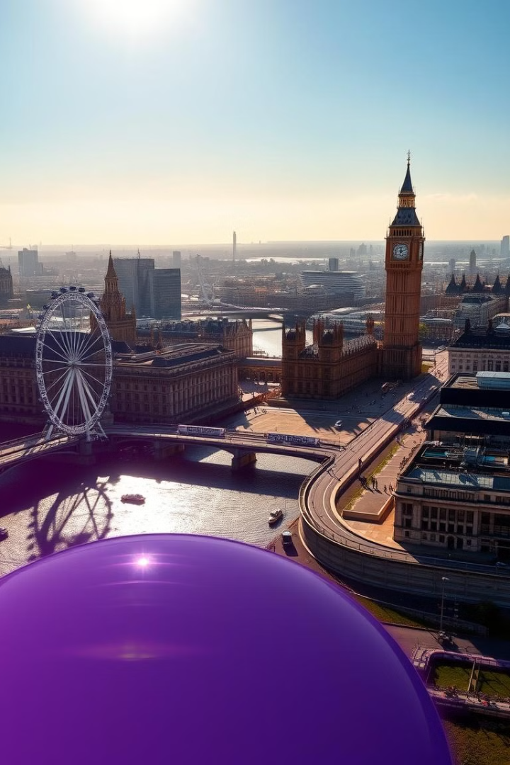
A brief look at London
London is a lively city rich in history and culture.

Slide 2
Geography and Landmarks
River Thames
Iconic Sites
Parks & Gardens
A defining feature, bisecting the city, dotted with bridges.
Buckingham Palace, Tower Bridge, and the Houses of Parliament are must-sees.
Green spaces like Hyde Park, Regent's Park, and Richmond Park provide respite.
Notes:
Around 8.9 million people
607 square miles

Slide 3
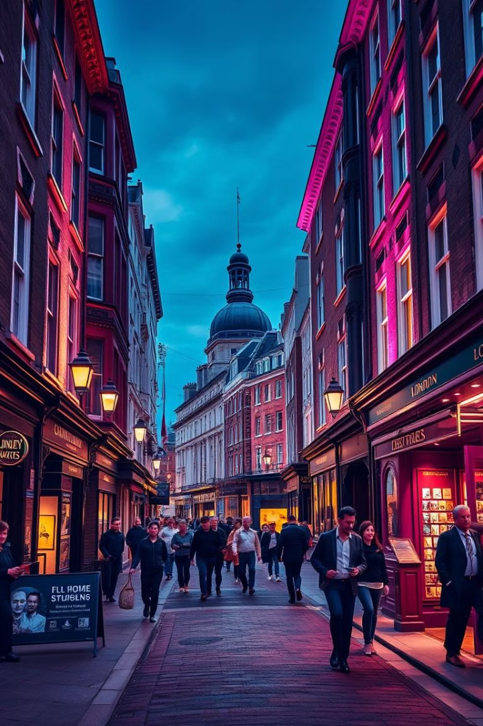
History and Culture
1
Ancient Roots
2
Royal Legacy
From Roman settlements to medieval times, London has witnessed centuries of change.
A history intertwined with monarchy, from the Tower of London to Windsor Castle.
3
Artistic Hub
4
Global Influence
London has been a center for artistic expression, with people like Shakespeare
London's influence extends beyond its borders, shaping fashion, music, and cuisine.

Slide 4
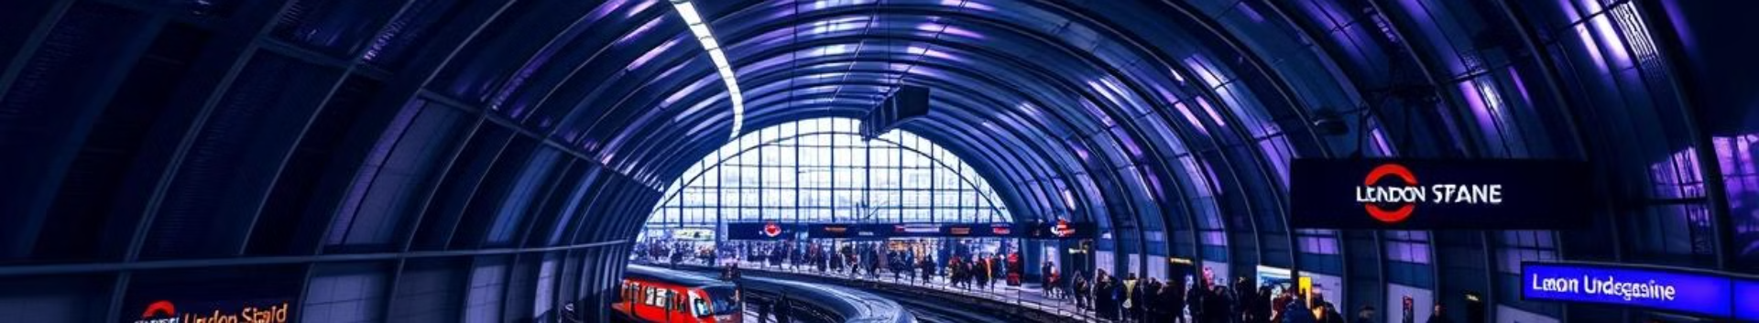



Transportation and Infrastructure
London's vast network enables easy exploration.
London Underground
Bus Network
Overground
A historic and efficient subway system, with 11 lines and 272 stations.
Red double-decker buses are an iconic sight, covering extensive routes across the city.
Connecting outer boroughs and major airports with the central city.

Slide 5
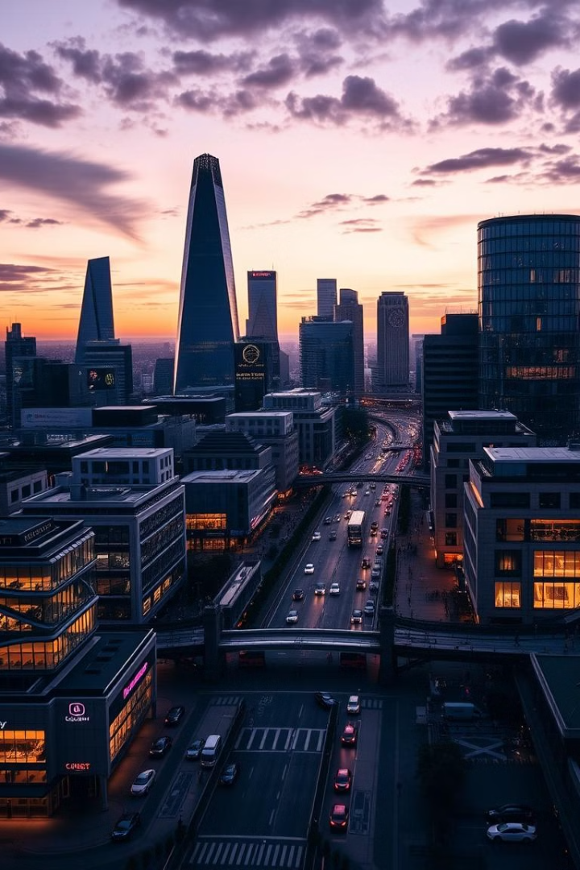
Economy and Business
London is a global financial hub, attracting businesses and investment.
Finance
The City of London is a world-renowned financial center.
Technology
London's tech sector is booming, attracting startups and innovation.
Tourism
A major contributor to the economy, drawing millions of visitors annually.
Notes:
the world's second-largest centre for hedge fund management, after New York. The UK had around £350bn -- hadge fund = akcie
Blockchain.com
London welcomed 20.3 million international visitors in 2023

Slide 6
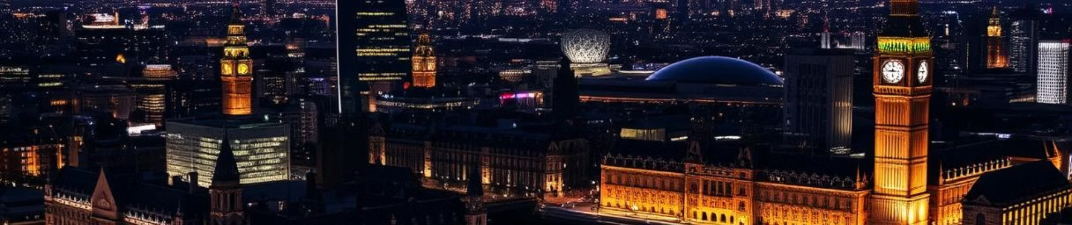


Conclusion and Key Takeaways
Tourism
Symbols
Weather
London Is a big center
of tourism of all kind
London’s symbol’s like the double
decker bus are worlsd wide
recognized as the symbols of this city
The weather is unforgivable as
It’s allways raining

