Slide 1
PACKAGE DELIVERY ROBOT in APARTMENT
A1_17 Liam Chen

Slide 2
Agenda
Review of Sprint 2
01
Some Background of Robot Arm
02
Demo of Pick & Place
03
Sprint 4 Goal
04

Slide 3
Review of Sprint 2
Method to pick up packages, or alternative way to achieve the demand.
Tune some parameters to optimize the delivery efficiency (Still in Progress).

Slide 4
Some Background of Robot Arm - Kinematics
Collision Checking
MoveIt 2 uses a package called FCL(Flexible Collision Library) to do the collision check.
Allowed Collision Matrix (ACM) : A binary value corresponding to the need to check for collision between pairs of bodies. If the value corresponding to two bodies is set to True in the ACM, it specifies that a collision check between the two bodies is either not required or wanted. In this way, we can reduce the computational expense

Slide 5
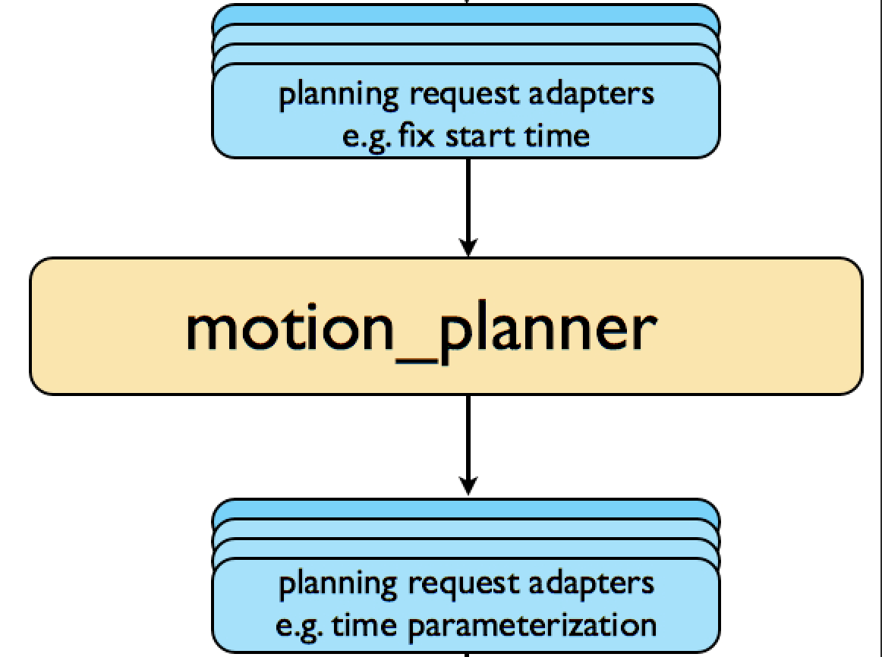
Some Background of Robot Arm - Motion Planning
Motion Plan Request (C++)
Motion Request
Position constraints
Orientation constraints
Joint constraints
Move_group node( motion_planner) will
generate a trajectories with desired constraints.
MoveIt 2 uses OMPL (Open Motion Planning Library) here.
Motion Plan Response (C++)

Slide 6
Demo of Pick & Place

Slide 7
Demo of Pick & Place - Motion planning
We can have several ways to achieve one purpose with different costs.

Slide 8
Sprint 4 Goal
Build an environment that makes the robot arm & delivery robot together, and simulate how they look like while working.

