Slide 1
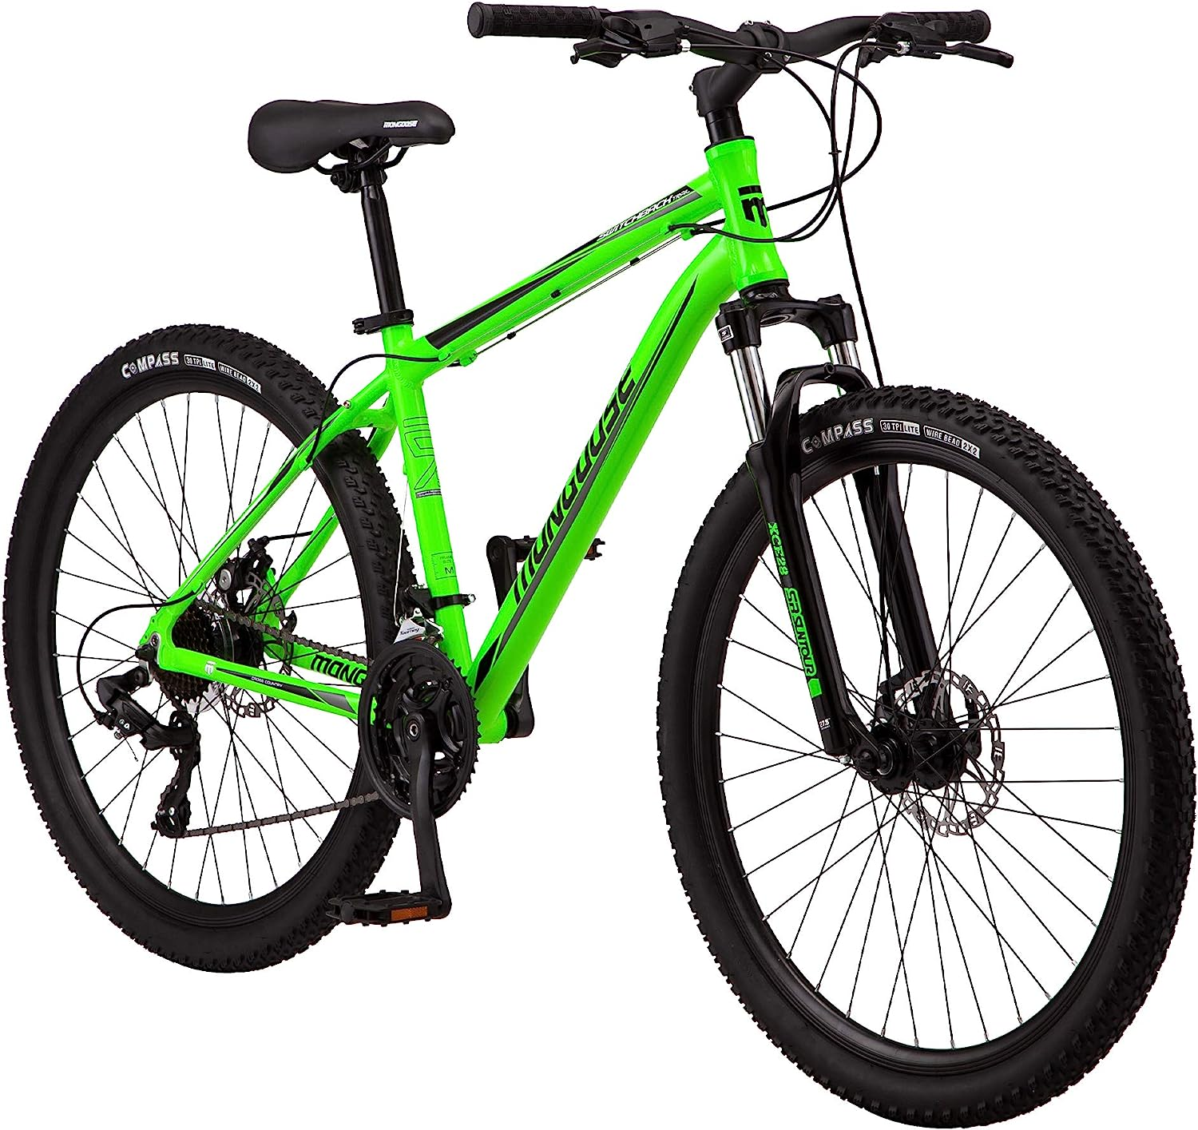
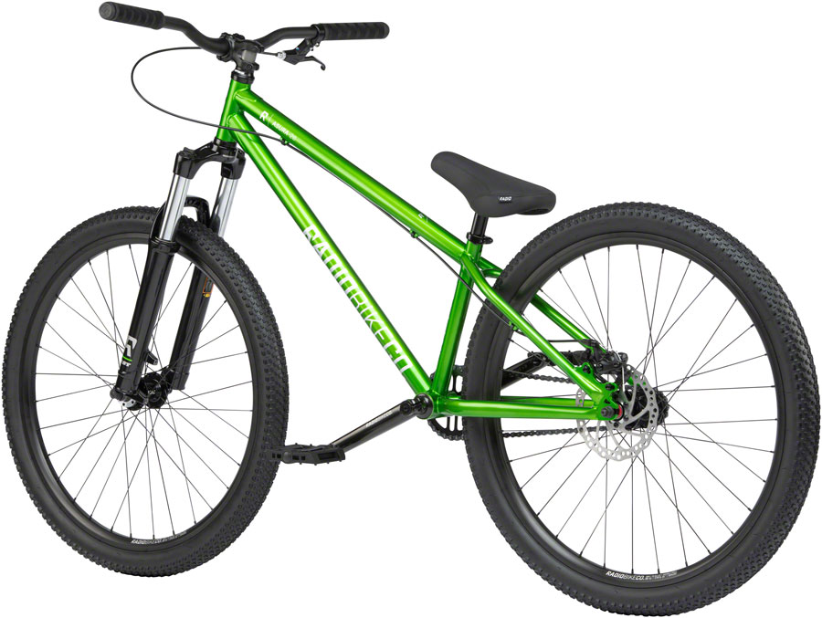
Cyclistic Bikes
A closer look at rider types
Purpose: Data exploration of 2022 rider data comparing annual vs. casual riders. The goal is to produce recommendations to the marketing team that drive conversion of casual members to annual subscriptions

Slide 2
Sources
Project: Case Study
Data: https://divvy-tripdata.s3.amazonaws.com/index.html - 2022
R Core Team (2021). R: A language and environment for statistical computing. R Foundation for Statistical Computing, Vienna, Austria. URL https://www.R-project.org/
Packages – tidyverse, ggplot2, lubridate, dplyr, readr, skimr,

Slide 3


Key Question and Audience
Audience: Dir. Marketing, Marketing Analytics Team, Cyclistic Executive Team
Key Question - How do annual members and casual riders use Cyclistic bikes differently and how can we design marketing strategies aimed at converting casual riders into annual members?

Slide 4
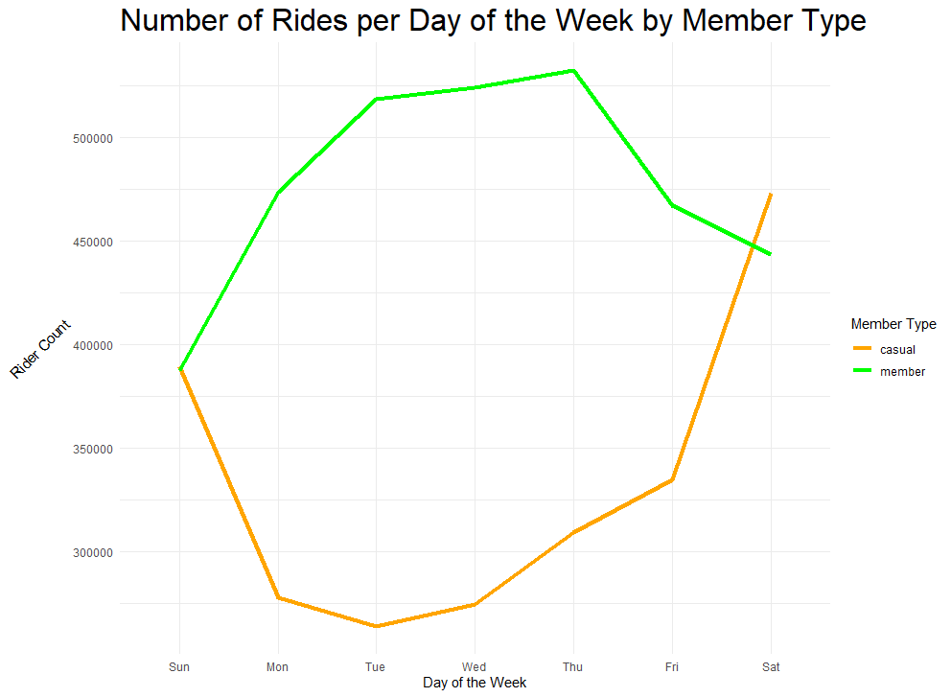
Key Findings
Members tend to use the bikes more on the weekdays vs. casual counterparts
Opposite usage peaks during the week by member type

Slide 5
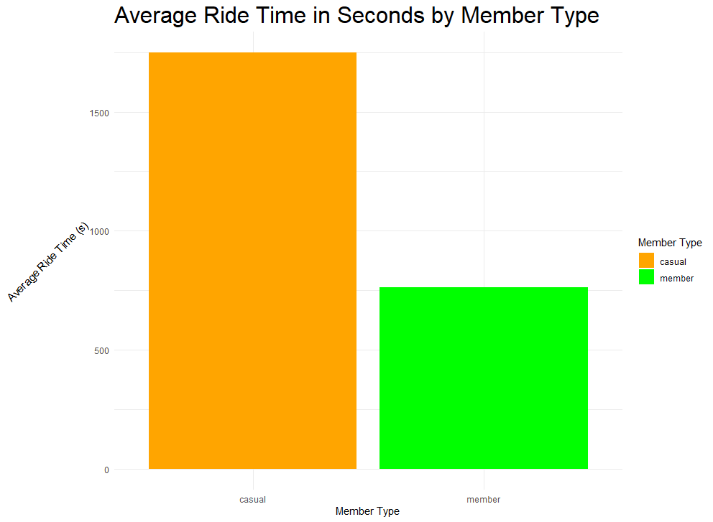
Key Findings (cont.)
Member average ride time is much shorter on average

Slide 6
Conclusions
Member users are more likely to be biking during the workweek and less likely on weekend vs. casual riders
Member users ride for shorter durations on average vs. casual riders
Marketing that highlights the benefits of Cyclistic bikes in a commuting style may be more likely to drive conversions
Casual riders are more likely to be one-off riders enjoying a weekend out and ride for longer periods of time on the weekends

Slide 7
Recommendations
Context: : How do annual members and casual riders use Cyclistic bikes differently and how can we design marketing strategies aimed at converting casual riders into annual members?.
Marketing strategies should be aimed at commuter riders
Convenience
Availability
Ease-of-use
Time/Money Savings
Market to urban and high-traffic communities
Bus Stops
Public Transit
High Traffic Highways
Avoid marketing focused on ‘hardcore’ riders

Slide 8
Appendix

Slide 9
Data Cleaning Steps – performed in R
Merge 12 months file
Add ride_length and day_of_the_week columns
Filter ride_length > 0 (100 rows removed, unclear reason for data)
Trim unneeded columns

