Slide 1
Text Summarizer
Zachary Austin

Slide 2
Description
1. Text Summarizer
• Use nltk or gensim to extract the top sentences summarizing a paragraph or article.
• Try both frequency-based summarization and, if you want a small challenge, transformer summarizers (with transformers library)

Slide 3
Frequency vs Transformer
Frequency Summarizer:
Summarizes based on the frequency of certain words
Produces a concatenation of sentences from the original text
Transformer Summarizer:
Summarizes via neural network
Synthesizes a brand new sentence based on the essence of the original text

Slide 4
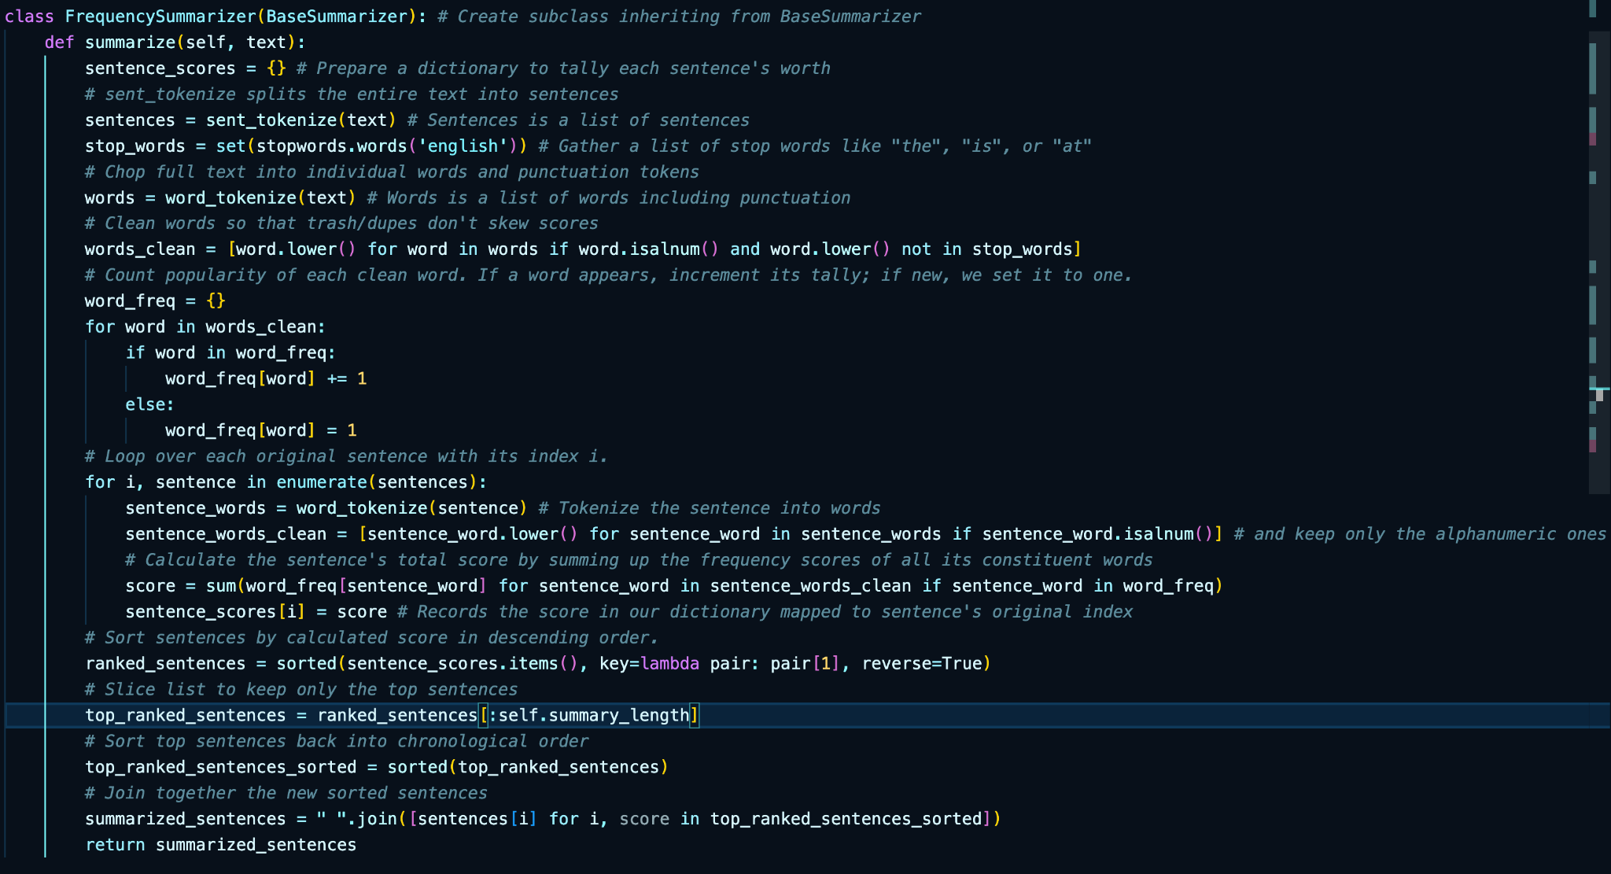
Frequency Summarizer

Slide 5
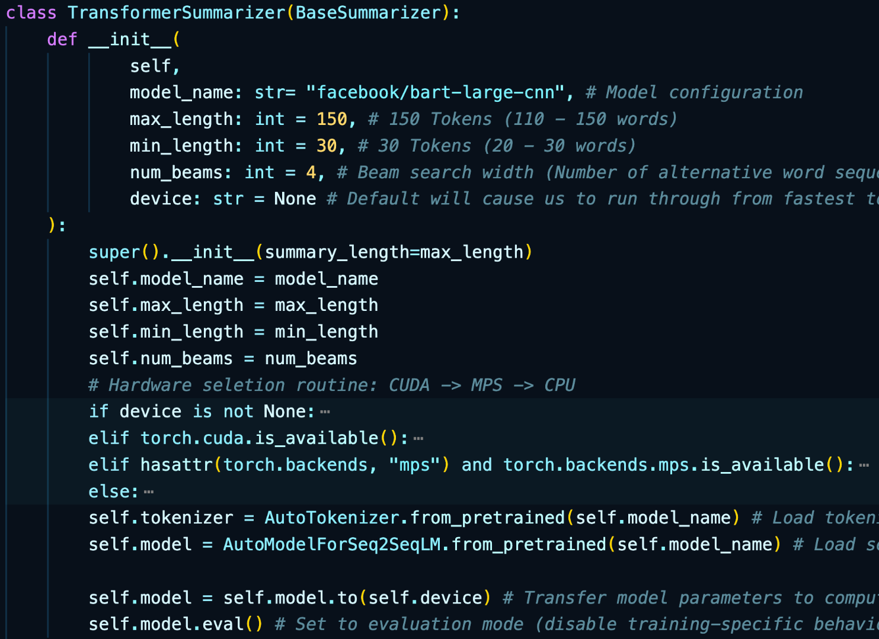
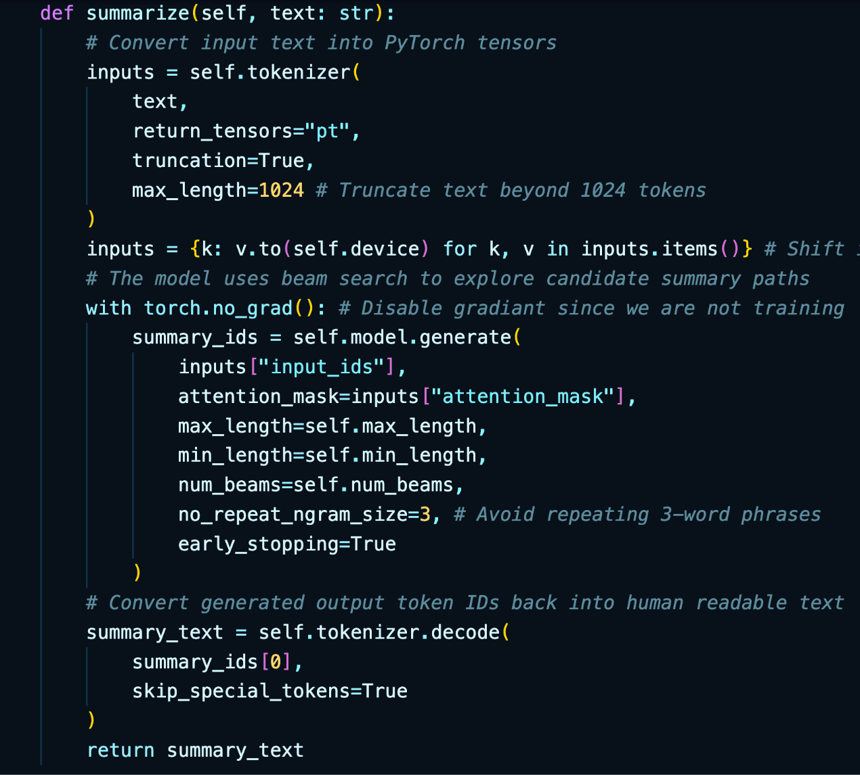
Transformer Summarizer

Slide 6
GitHub Repo:
https://github.com/Zman04/cs3080_Austin_Semester-Project

