Slide 1
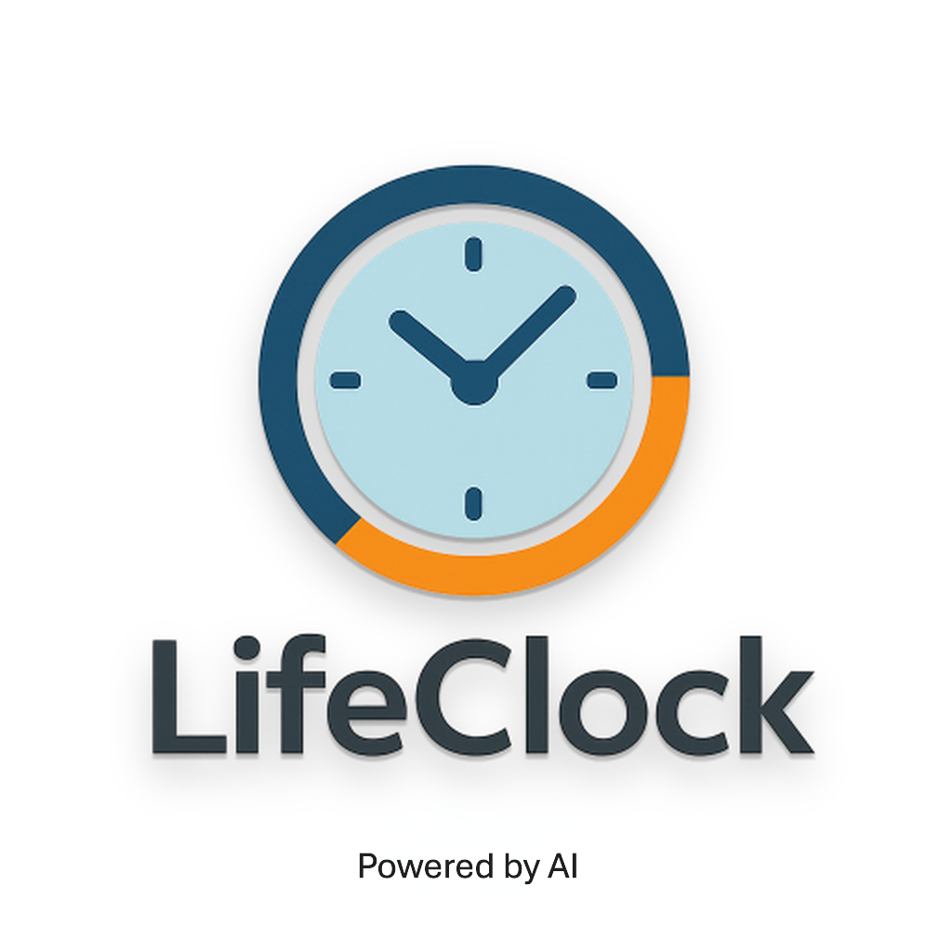
“Eat smarter. Live longer with LifeClock.”
© 2025 SVG Holdings LLC — Confidential Pitch Deck | George Gonzalez · lifeclock@proton.me · www.my-lifeclock.com · linkedin.com/in/george-gonzalez-ee-mba-pmp-850abb7b

Slide 2
LifeClock – AI Nutrition & Longevity Tracker
Every Meal Adds or Subtracts Minutes of Healthy Life
Founder: George Luis Gonzalez Jr, Electrical Engineer, MBA, PMP
SVG Holdings LLC, Started in 2022
Trademark #99486737
Functional Prototype Live
Copyright: 1-15035234651
Patent Pending: 63/943767
© 2025 SVG Holdings LLC — Confidential Pitch Deck | George Gonzalez · lifeclock@proton.me · www.my-lifeclock.com · linkedin.com/in/george-gonzalez-ee-mba-pmp-850abb7b

Slide 3
The Problem
People track calories—but have no idea what those calories mean for longevity.
Chronic disease and diet-related aging cost >$4 trillion annually.
Wellness apps lack scientific transparency and actionable insight.
© 2025 SVG Holdings LLC — Confidential Pitch Deck | George Gonzalez · lifeclock@proton.me · www.my-lifeclock.com · linkedin.com/in/george-gonzalez-ee-mba-pmp-850abb7b

Slide 4
Our Solution
LifeClock translates every meal into an easy-to-grasp metric: Minutes added to or subtracted from healthy lifespan.
AI models analyze photo, voice, or text input → nutrients → longevity score → personal insight.
© 2025 SVG Holdings LLC — Confidential Pitch Deck | George Gonzalez · lifeclock@proton.me · www.my-lifeclock.com · linkedin.com/in/george-gonzalez-ee-mba-pmp-850abb7b

Slide 5
How It Works
1. Log meal (via text / photo / voice)
2. AI recognizes foods and portions (USDA + OpenAI integration)
3. Scoring Engine computes minutes of life impact
4. App visualizes insights + weekly AI narratives
[Diagram: Input Meal → AI → Scoring → Insights → Share]
© 2025 SVG Holdings LLC — Confidential Pitch Deck | George Gonzalez · lifeclock@proton.me · www.my-lifeclock.com · linkedin.com/in/george-gonzalez-ee-mba-pmp-850abb7b

Slide 6
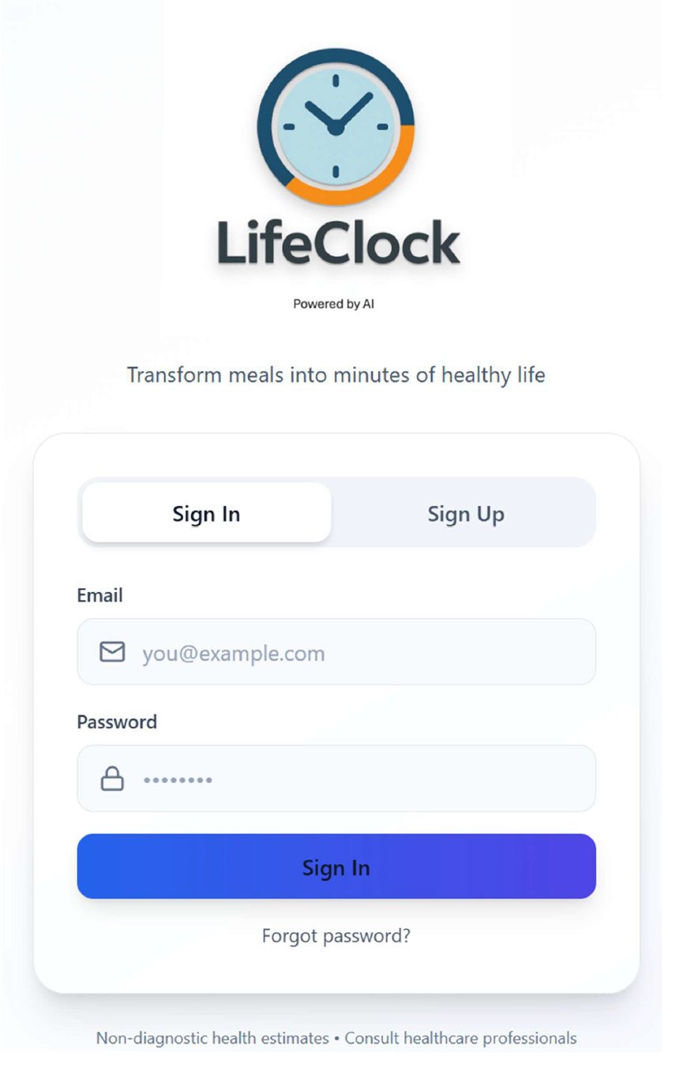
Login Screen
© 2025 SVG Holdings LLC — Confidential Pitch Deck | George Gonzalez · lifeclock@proton.me · www.my-lifeclock.com · linkedin.com/in/george-gonzalez-ee-mba-pmp-850abb7b

Slide 7
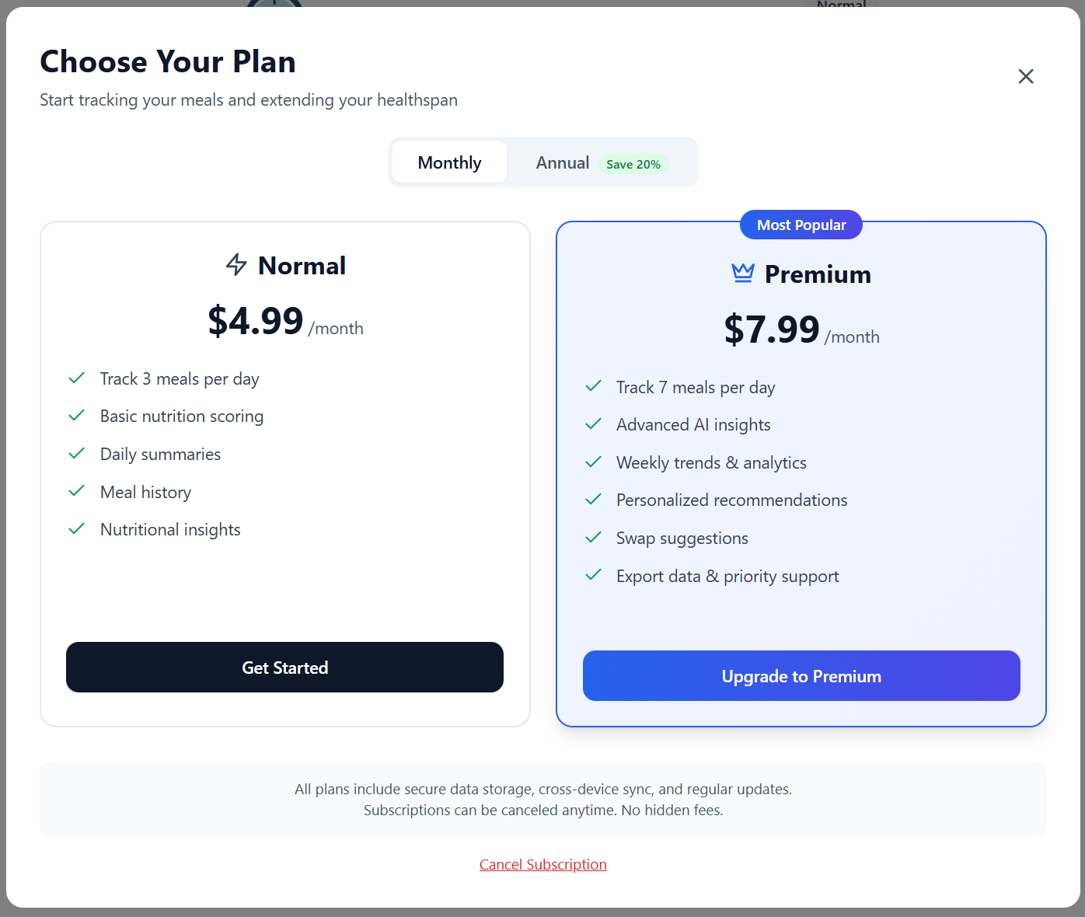
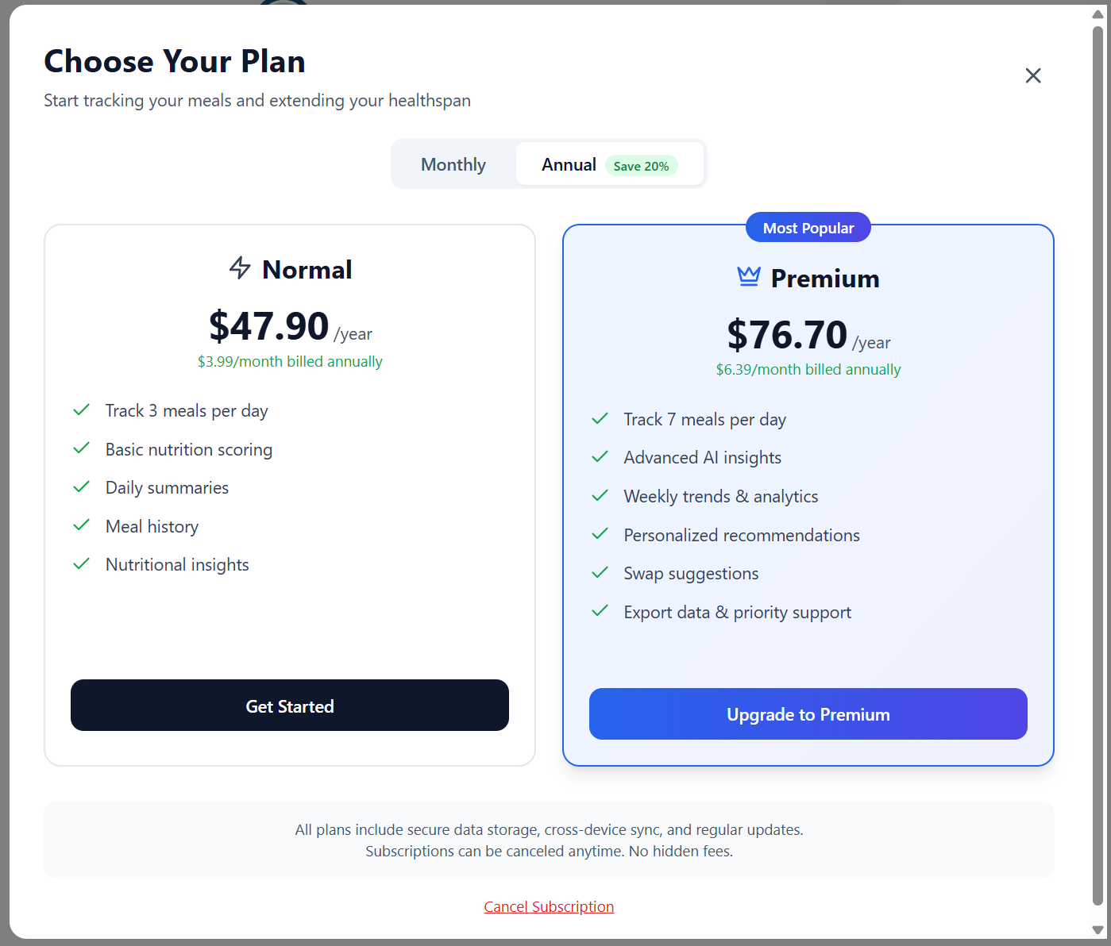
Subscription Modal
© 2025 SVG Holdings LLC — Confidential Pitch Deck | George Gonzalez · lifeclock@proton.me · www.my-lifeclock.com · linkedin.com/in/george-gonzalez-ee-mba-pmp-850abb7b

Slide 8
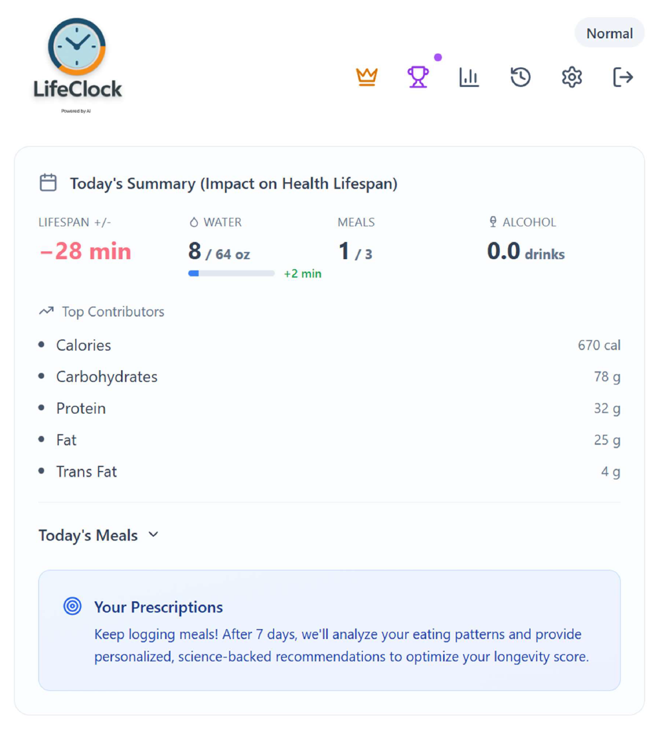
Main Dashboard
© 2025 SVG Holdings LLC — Confidential Pitch Deck | George Gonzalez · lifeclock@proton.me · www.my-lifeclock.com · linkedin.com/in/george-gonzalez-ee-mba-pmp-850abb7b

Slide 9
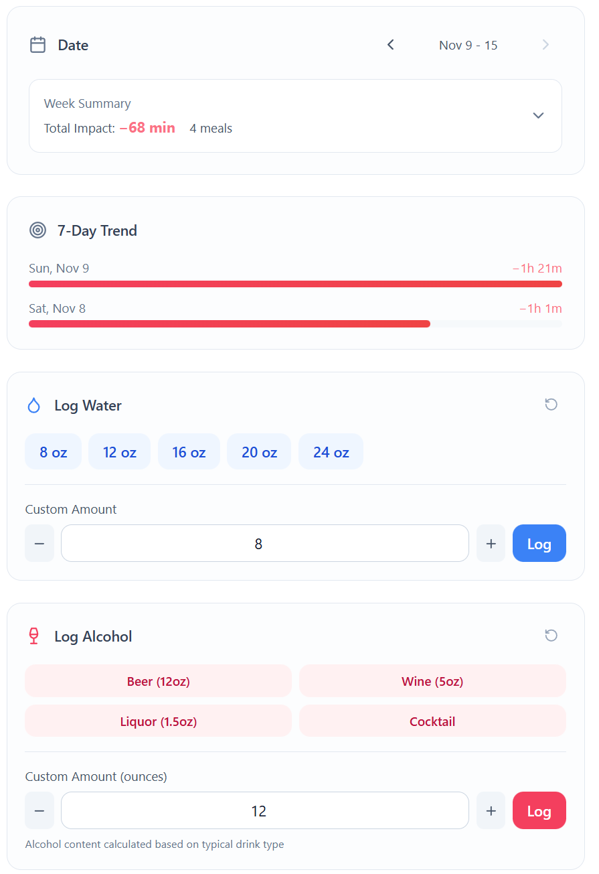
Main Dashboard cont’d
Features:
Weekly Summary expands for easy access to meal history.
7 Day Trend
Log Water
Log Alcohol
© 2025 SVG Holdings LLC — Confidential Pitch Deck | George Gonzalez · lifeclock@proton.me · www.my-lifeclock.com · linkedin.com/in/george-gonzalez-ee-mba-pmp-850abb7b

Slide 10
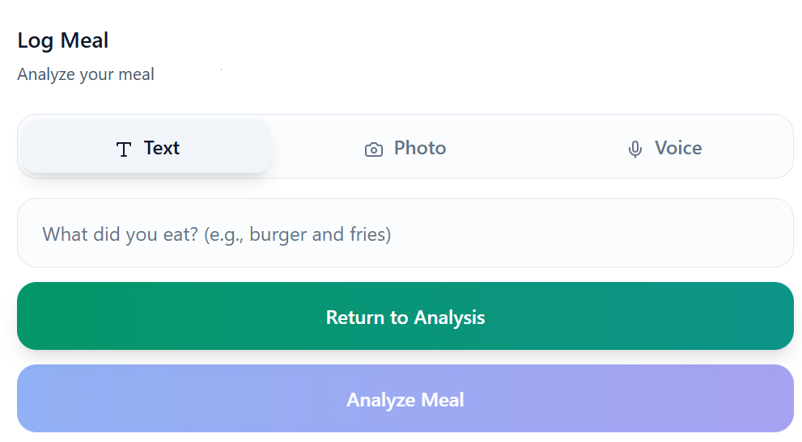
Main Dashboard cont’d
© 2025 SVG Holdings LLC — Confidential Pitch Deck | George Gonzalez · lifeclock@proton.me · www.my-lifeclock.com · linkedin.com/in/george-gonzalez-ee-mba-pmp-850abb7b

Slide 11
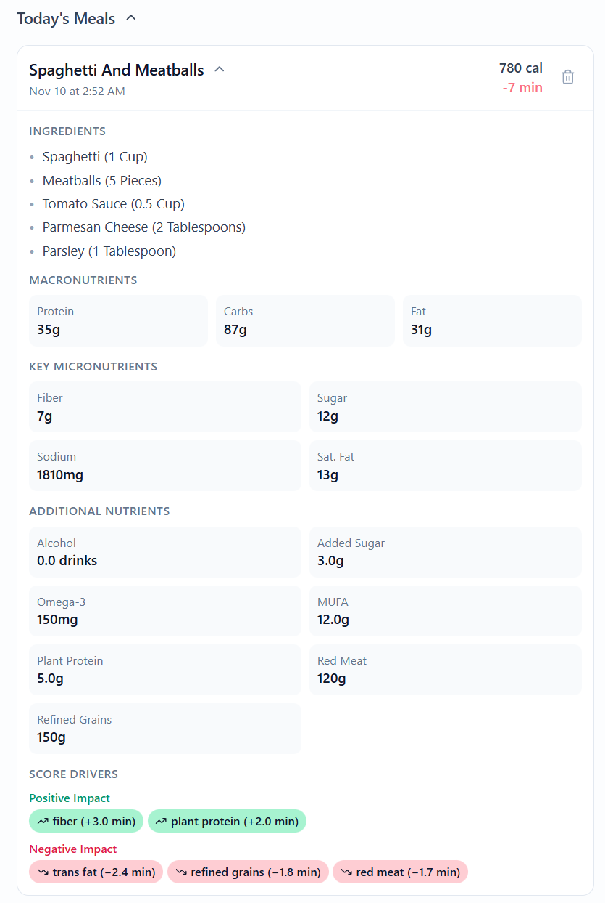
Meal Analysis in Dashboard
Today’s Meals Features:
Expandible 7 day meal history
Longevity score
Breakdown of meal ingredients
Macronutrients
Key micronutrients
Additional nutrients
Positive and negative score drivers
© 2025 SVG Holdings LLC — Confidential Pitch Deck | George Gonzalez · lifeclock@proton.me · www.my-lifeclock.com · linkedin.com/in/george-gonzalez-ee-mba-pmp-850abb7b

Slide 12
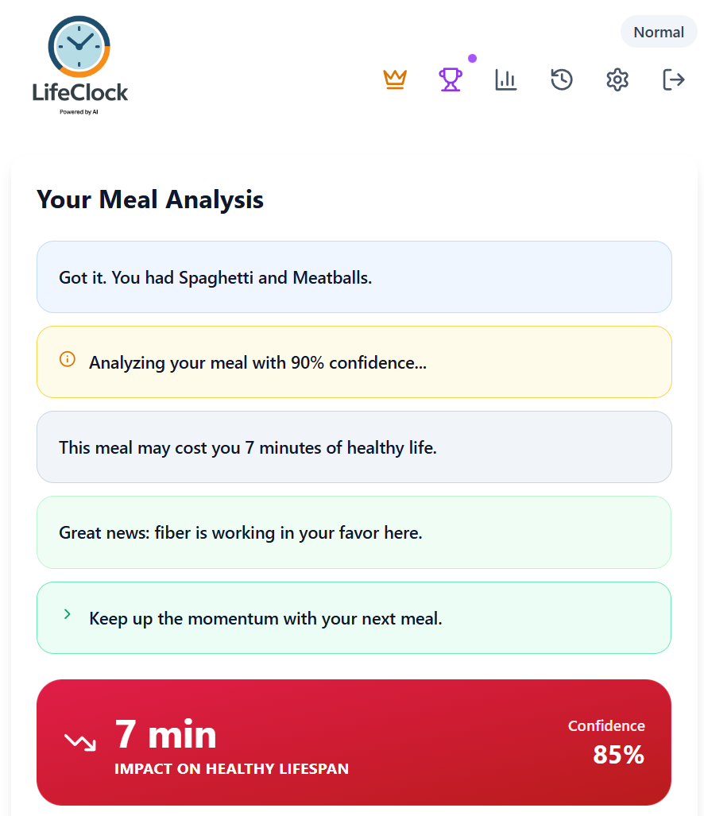
Meal Analysis
Provide users with:
Meal Description
Confidence in analysis
Healthy Life impact score
Contributing factors
© 2025 SVG Holdings LLC — Confidential Pitch Deck | George Gonzalez · lifeclock@proton.me · www.my-lifeclock.com · linkedin.com/in/george-gonzalez-ee-mba-pmp-850abb7b

Slide 13
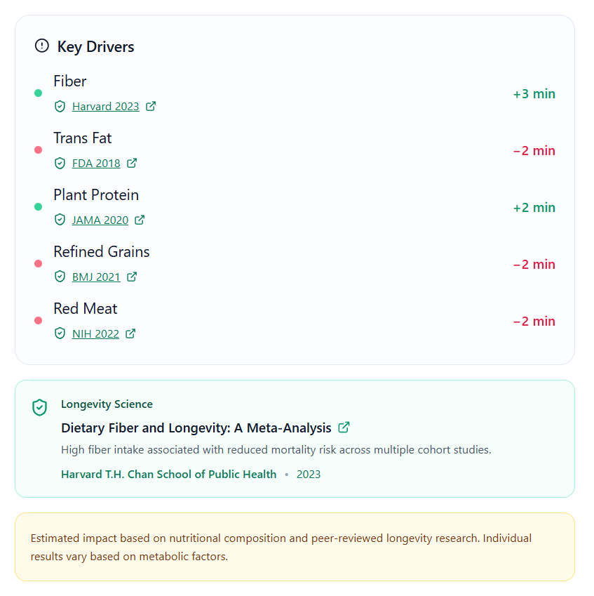
Meal Analysis Results - cont’s
Provide users with:
Key Driver Score
Estimated impact on healthy life
Relevant studies
Longevity science
© 2025 SVG Holdings LLC — Confidential Pitch Deck | George Gonzalez · lifeclock@proton.me · www.my-lifeclock.com · linkedin.com/in/george-gonzalez-ee-mba-pmp-850abb7b

Slide 14
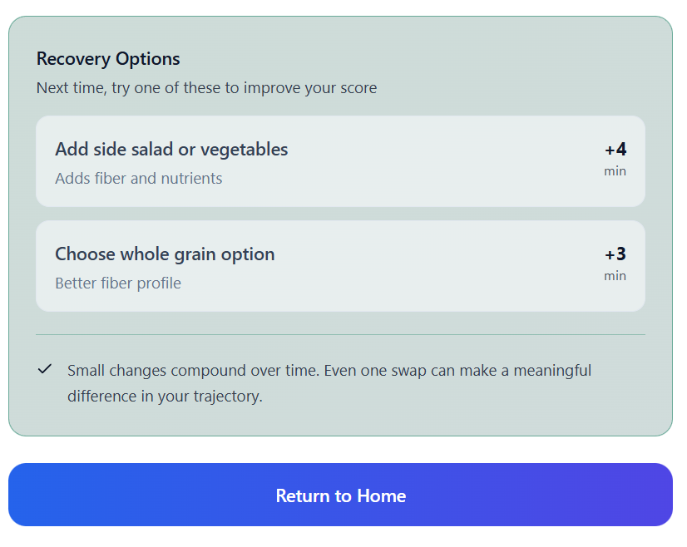
Meal Analysis Results - cont’s
Provide users with:
Recovery Options
Improve Diet Suggestions
Encouragement
© 2025 SVG Holdings LLC — Confidential Pitch Deck | George Gonzalez · lifeclock@proton.me · www.my-lifeclock.com · linkedin.com/in/george-gonzalez-ee-mba-pmp-850abb7b

Slide 15
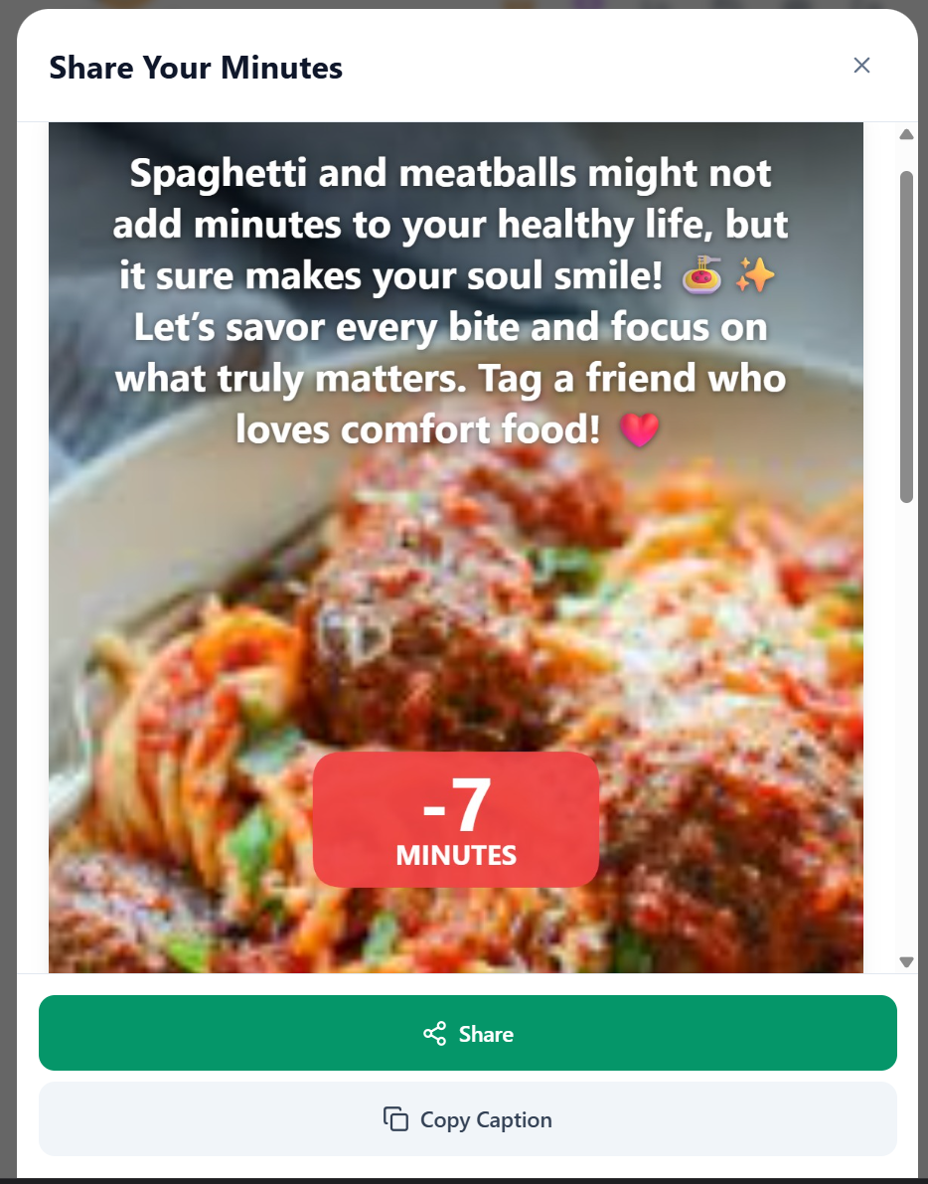
Share Card Screen
Provide users with:
Editable Text
Copyable Picture
Share via Email, Text,
Share with Social Media
TikTok, Instagram, Meta, ..ect.
© 2025 SVG Holdings LLC — Confidential Pitch Deck | George Gonzalez · lifeclock@proton.me · www.my-lifeclock.com · linkedin.com/in/george-gonzalez-ee-mba-pmp-850abb7b

Slide 16
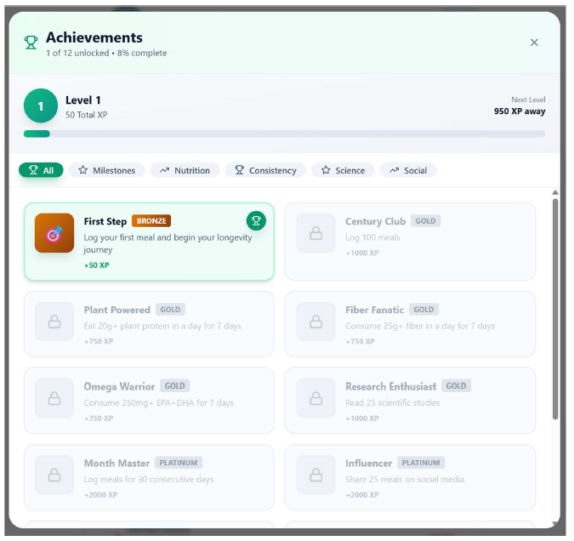
Achievements Screen
Provide users with:
Achievement
Gamification
Potential to unlock free meal analysis.
Encourages and rewards good eating habits.
Hydration and reduced alcohol consumption.
© 2025 SVG Holdings LLC — Confidential Pitch Deck | George Gonzalez · lifeclock@proton.me · www.my-lifeclock.com · linkedin.com/in/george-gonzalez-ee-mba-pmp-850abb7b

Slide 17
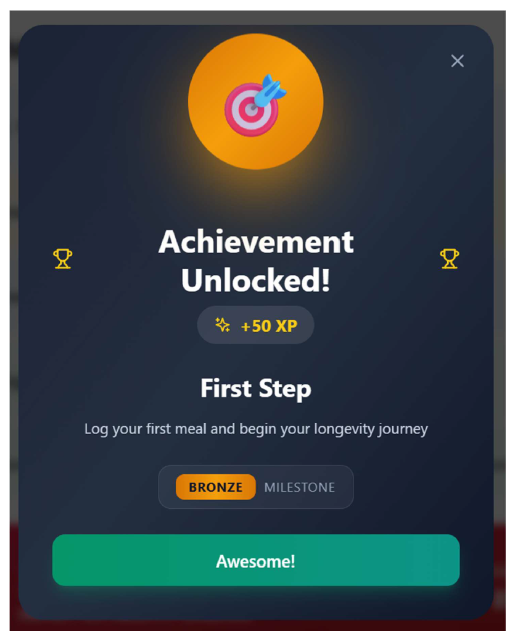
© 2025 SVG Holdings LLC — Confidential Pitch Deck | George Gonzalez · lifeclock@proton.me · www.my-lifeclock.com · linkedin.com/in/george-gonzalez-ee-mba-pmp-850abb7b

Slide 18
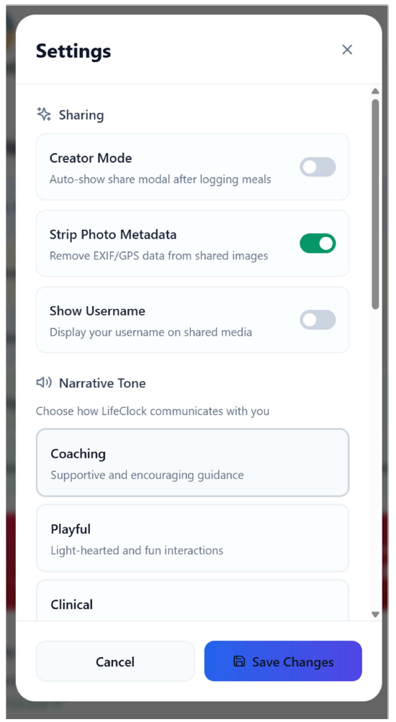
© 2025 SVG Holdings LLC — Confidential Pitch Deck | George Gonzalez · lifeclock@proton.me · www.my-lifeclock.com · linkedin.com/in/george-gonzalez-ee-mba-pmp-850abb7b

Slide 19
“Eat smarter. Live longer with LifeClock.”
© 2025 SVG Holdings LLC — Confidential Pitch Deck | George Gonzalez · lifeclock@proton.me · www.my-lifeclock.com · linkedin.com/in/george-gonzalez-ee-mba-pmp-850abb7b

