Slide 1

Local Expectation Testing for Terraform
Zach Gleason, Sreenidish Chinmayanilayam, Yaroslav Buzko

Slide 2
Abstract
With the rise of large, distributed systems, Infrastructure as code (IaC) has evolved from a best practice to a requirement in industry environments. HashiCorp’s Terraform has become the go to IaC solution for many companies. In this paper, we explore potential solutions for testing Terraform locally using AWS mocking tools LocalStack and Moto. Specifically, this paper proposes a framework for testing Terraform configurations that can (i) identify errors locally that were previously only detectable in the cloud, (ii) speed up test run time, and (iii) save money. Our findings show the benefits of testing Terraform configurations locally but highlight the need for further research.

Slide 3
State of the Field
HashiCorp testing Framework
Unit Tests, Contract Tests, Integration Tests, End-To-End Tests
Unit Tests and Contract Tests are local
Idempotency checks
Code smell and quality metrics
No comprehensive local testing

Slide 4
Tools
Moto
Mock AWS Services
Used as a Python module in place of boto
Or, in our use case, can be used as a standalone server
LocalStack
LocalStack is a fully functioning local AWS cloud environment
Supports many services including EC2, SNS, S3, and DynamoDB
Run within a Docker container
These tools are only on AWS

Slide 5
Experiments
Expected Behavior
If a test fails locally, it should not pass remotely
If a test passes locally, it most likely passes remotely (with limitations)
There are no cloud resources created
A total of 10 Test cases across 4 AWS services
EC2
SNS
S3
DynamoDB
Process
Create a Terraform error
Test the error locally and remotely
Fix the error
Test the fix locally and remotely
Record accuracy, time, and cost during runs
Repeat 10 times across multiple machines to account for outliers

Slide 6
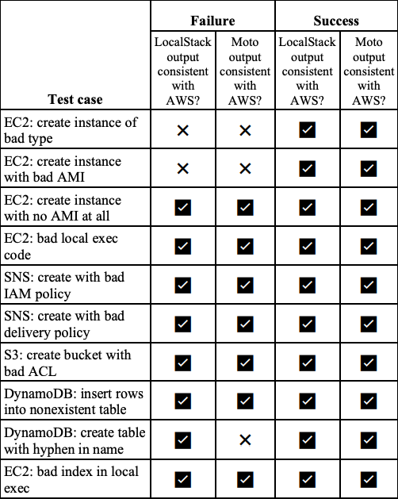
Accuracy Results
Notes:
On this slide we see the accuracy results from our experiments where we are testing if Moto and Localstack are consistent with AWS in failing and passing terraform runs
As shown in the Success Column, Moto and Localstack match AWS in passing every test.
In the Failure Column, we see Moto and Localstack match AWS in throwing an error on almost every test case.
These results match our expected behavior because every test case that threw an error locally also threw an error on AWS.
Further, most tests that passed locally also passed on AWS. The exceptions are EC2... on M and L and DynamoDB on M which passed locally and failed on AWS. Consistent with second bullet point

Slide 7
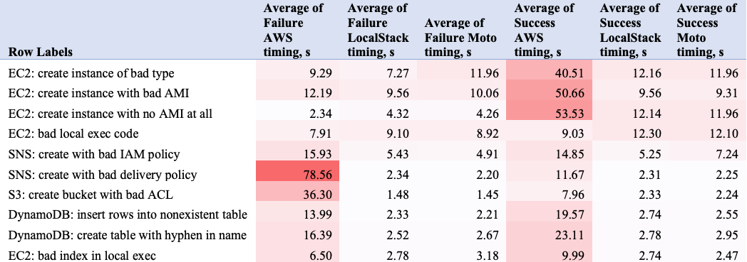
Time Results

Slide 8
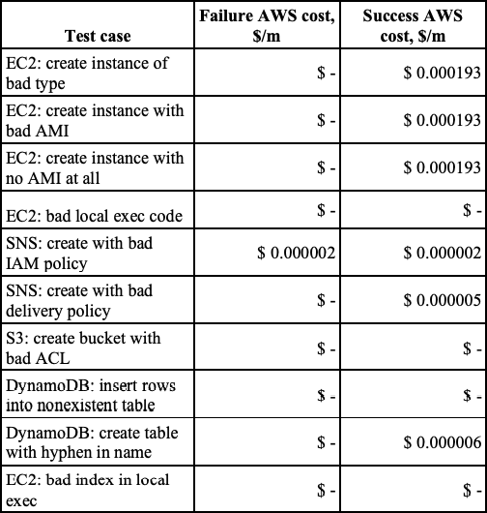
Cost Results

Slide 9
Conclusion and Future Work
Results
Accurate tests
Time savings
Not as many cost savings in our unit tests
Support more clouds
Azure and GCP
Add more tests
Verify in industry infrastructure stacks
Notes:
Overall, we believe our results were promising as they showed high accuracy and time savings across most tests. The cost savings were low in our unit tests, but applied to corporate tech stacks, our framework could provide meaningful savings
In the future, we would like to expand our work by supporting more clouds, adding more tests, and applying our framework to infrastructure stacks

Slide 10
References
M. Guerriero, M. Garriga, D. A. Tamburri, F. Palomba, Adoption, Support, and Challenges of Infrastructure-as-Code: Insights from Industry, 2019, ISBN 978-1-7281-3095-8
A. Rahman, R. Mahdavi-Hezaveh, L. Williams, A systematic mapping study of infrastructure as code research, Information and Software Technology, vol. 108, April 2019, p. 65-77
W. Hummer, F. Rosenberg, F. Oliveira, T. Eilam, Testing Idempotence for Infrastructure as Code
J. Schwarz, A. Steffens, H. Lichter, Code Smells in Infrastructure as Code
S. Naziris, Infrastructure as Code: Towards Dynamic and Programmable IT systems, http://purl.utwente.nl/essays/80190 , November, 2019
J. H. A. Al Kiswani, Smart-Cloud: A Framework for Cloud Native Applications Development, http://hdl.handle.net/11714/5691, May, 2019
R. Wang, Testing HashiCorp Terraform, https://www.hashicorp.com/ blog/testing-hashicorp-terraform
LocalStack - A fully functional local AWS cloud stack, https://github.com/localstack/localstack
N. Gibbon, LocalStack for Local AWS Dev, https://medium.com/pareture/localstack-for-local-aws-dev22775e483e3d
S.Dalla Palma, D.Di Nuccia, F.Palomba, D. A. Tamburri, Toward a catalog of software quality metrics for infrastructure code, https://www.sciencedirect.com/science/article/pii/S0164121220301618
A. Rahman, L. Williams, Source code properties of defective infrastructure as code scripts, arXiv:1810.09605
A.Weiss, A.Guha, Y.Brun, Tortoise: interactive system configuration repair, ASE 2017: Proceedings of the 32nd IEEE/ACM International Conference on Automated Software Engineering, October 2017
Y. Brikman, Terraform Up and Running: Writing Infrastructure as Code Second Edition, O'Reilly, ISBN 9781492046905
J.Hecht, Continuous cloud infrastructure with Ansible, Molecule & TravisCI on AWS, https://blog.codecentric.de/en/2019/01/ansiblemolecule-travisci-aws/
Ikeshita, K., Ishikawa, F., Honiden, S., Gabmeyer, S., Johnsen, E., Test Suite Reduction in Idempotence Testing of Infrastructure as Code, In Proceedings of the International Conference on Tests and Proofs (TAP’17), 2017
Oliver Hanappi, Waldemar Hummer, Schahram Dustdar, Asserting reliable convergence for configuration management scripts, SIGPLAN Not. 51, 10 (October 2016)
W. Hummer, F. Rosenberg, F. Oliveira, T. Eilam, Automated testing of chef automation scripts, In Proceedings Demo & Poster Track of ACM/IFIP/USENIX International Middleware Conference (MiddlewareDPT ’13). ACM, New York, NY
T. Sharma, M. Fragkoulis, D. Spinellis, Does your configuration code smell?, in: Proceedings of the 13th International Conference on Mining Software Repositories, MSR ’16, ACM, New York, NY, USA, 2016, pp.189–200. doi:10.1145/2901739.2901761.
M. Smith, A Jump Start on Terraform Testing, https://medium.com/swlh/a-jump-start-on-terraform-testing295522cdb407 [20] TerraTest by GruntWorks
What is LocalStack?, https://localstack.cloud/
K. Brandes, Testing AWS Python code with Moto, https://blog.codecentric.de/en/2020/01/testing-aws-python-code-withmoto/

Slide 11
Contact
https://github.com/Zman94/Local-Expectation-Testing-for-Terraform
zgleaso2@Illinois.edu
sc49@Illinois.edu
ybuzko2@Illinois.edu
Notes:
All resources can be found at this github link
If you have any follow up questions, you can contact us at the listed email addresses

