Slide 1


Slide 2
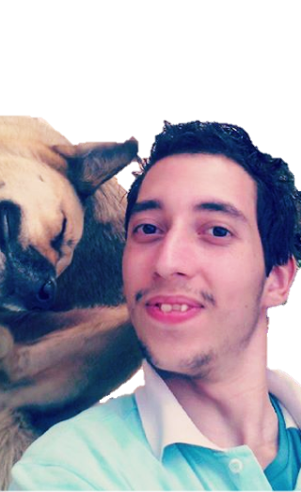





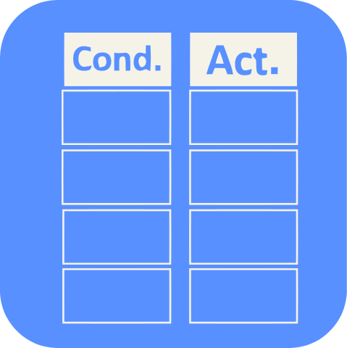









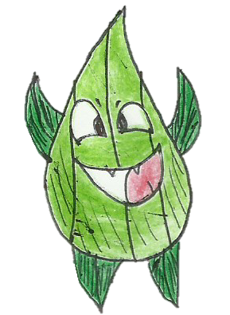



D
aniell Mesquita

Slide 3


oney

Slide 4



Slide 6


