Slide 1
Docker and Containers
Zumar Noor

Slide 2
Agenda
What is Docker?
Docker vs. Virtual Machine
Docker’s Use cases
Images and Containers
Developer Viewpoint
Around Docker

Slide 3
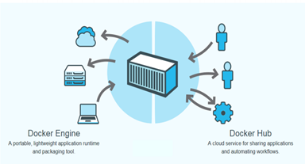
Docker
Docker is an open platform for developers and sysadmins to build, ship, and run distributed applications, whether on laptops, data center VMs, or the cloud.

Slide 4
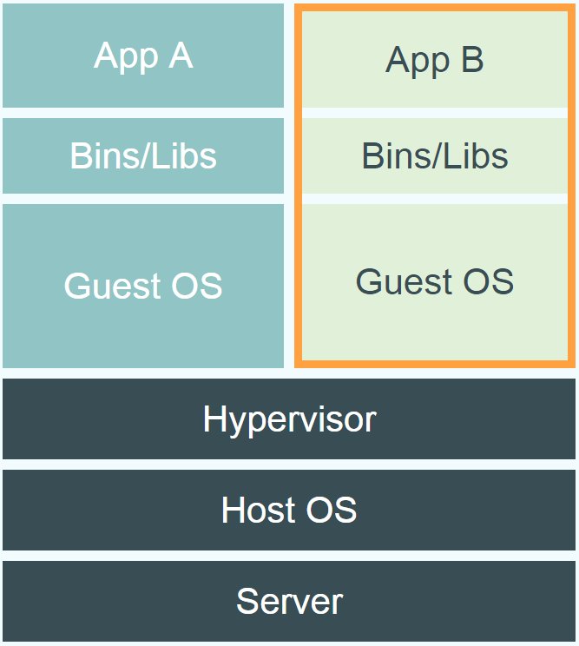
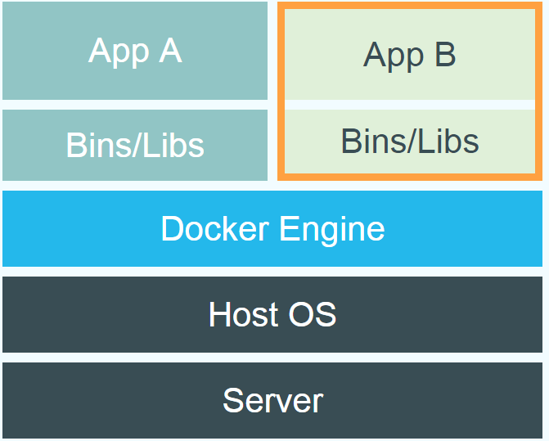
Virtual Machine Vs Docker

Slide 5
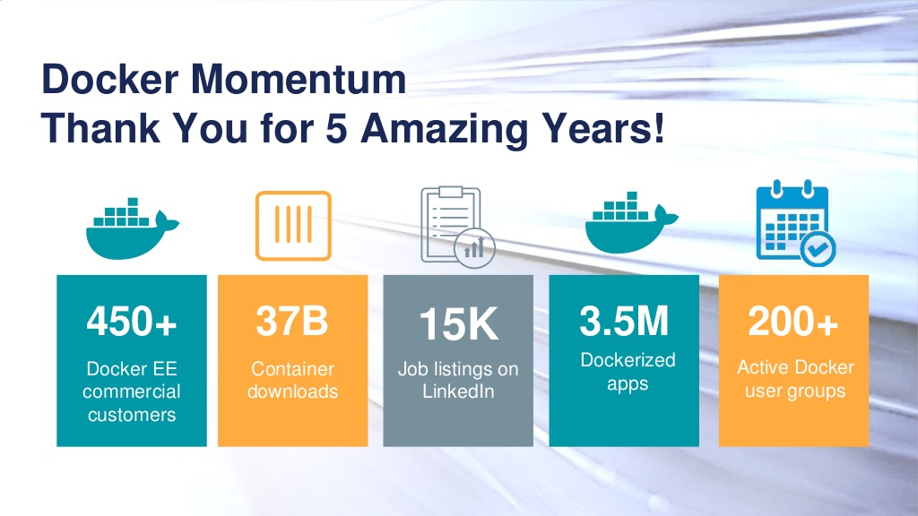
Motivation

Slide 6
Docker’s Key use cases
Simplifying Configuration
Code Pipeline Management
Developer Productivity

Slide 7
Container
Here is an analogy that Docker use’s to let you understand….

Slide 8
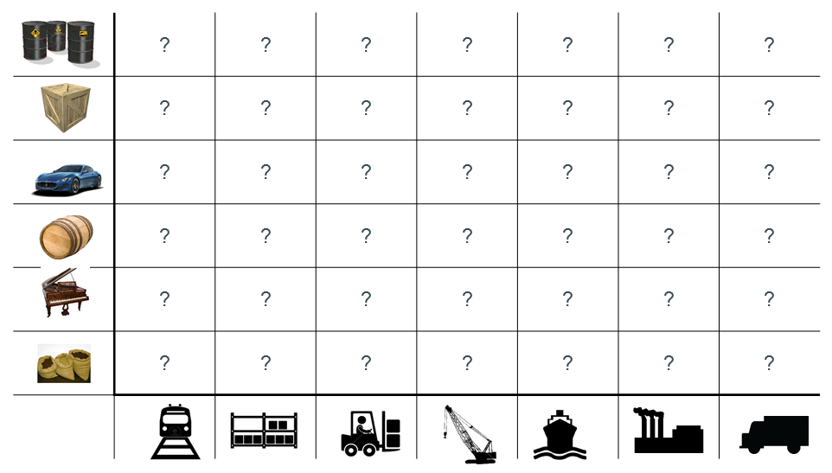
Looking for all kinds of solutions…
Too many to consider

Slide 9
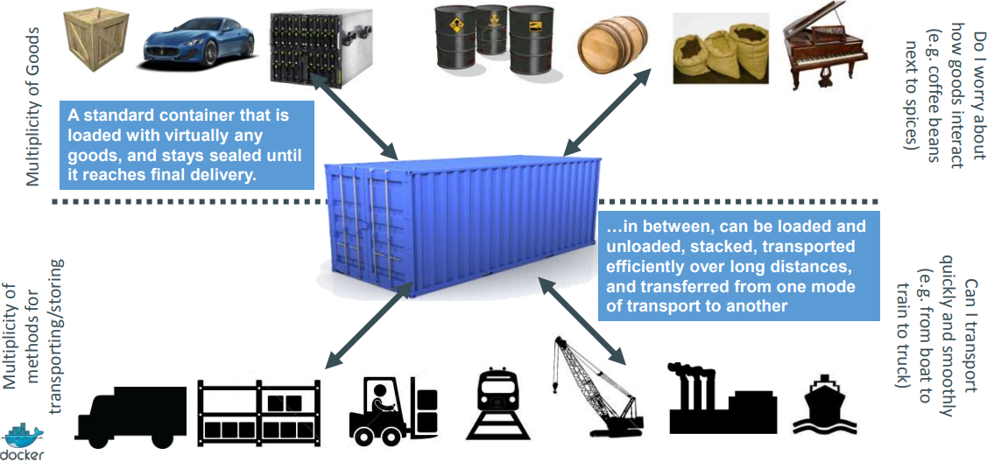
Solution: Intermodal Shipping Container

Slide 10
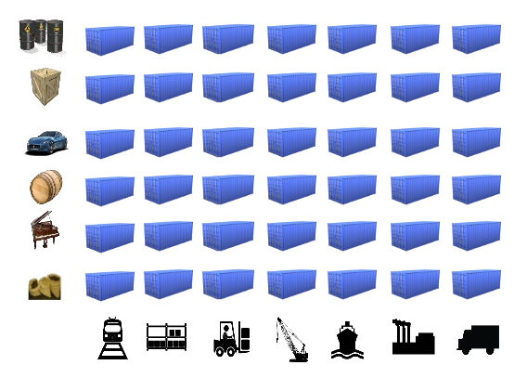
Standard Shipping Container

Slide 11
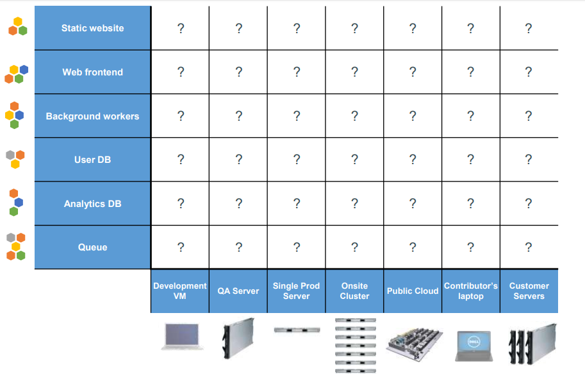
Multiplicity of hardware environments

Slide 12
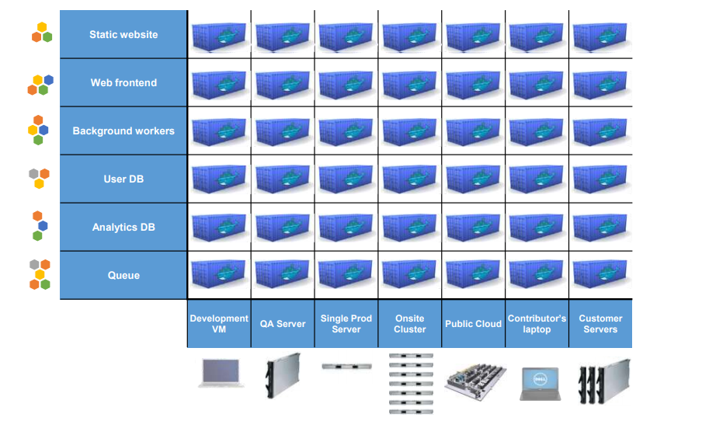
Docker Containers - Standard Shipping Container

Slide 13
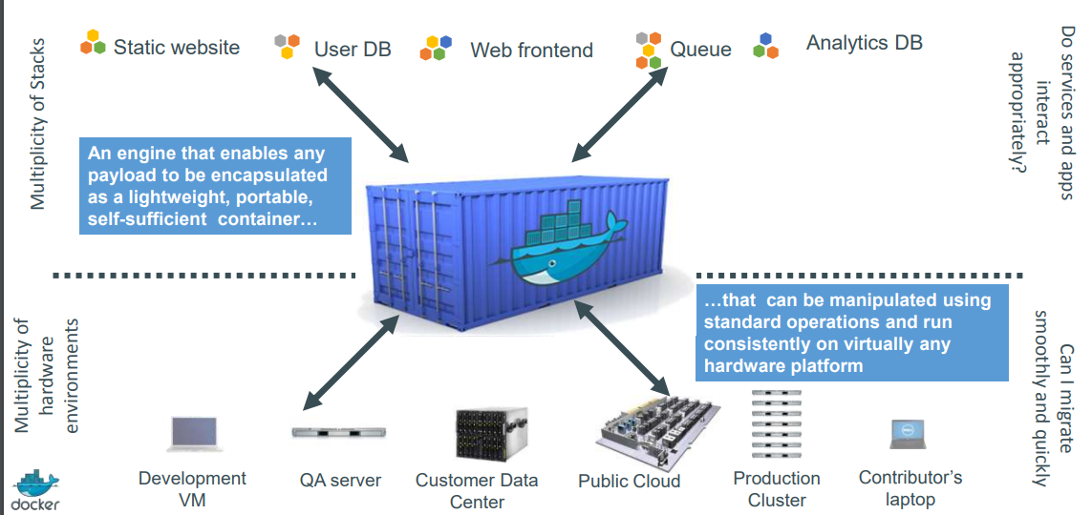
Docker is a shipping container system for Code

Slide 14
Docker Daemon
Builds Images
Runs and Manages Containers
RESTful API

Slide 15
Inside my container
My code
My libraries
My package manager
My app
My data

Slide 16
Image
An image is an inert, immutable, file that's essentially a snapshot of a container. Images are created with the build command, and they'll produce a container when started with run.

Slide 17
Docker has a repository like github
You can push and pull container images to/from the Docker registry, which is something like a “GitHub” for Docker container images.

Slide 18
Dockerfile
Create images automatically using a build script: <<Dockerfile>>
Can be versioned in a version control system like Git or SVN, along with all dependencies
Docker Hub can automatically build images based on dockerfiles on Github

Slide 19
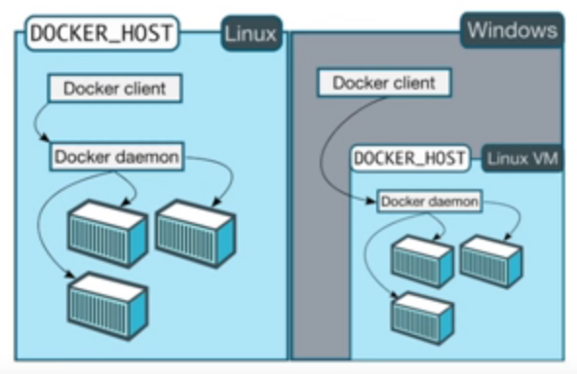
Docker on Linux Vs Windows

Slide 20
Docker container—developer viewpoint
Build once… run anywhere
A clean, safe, hygienic and portable runtime environment for your app.
No worries about missing dependencies, packages and other pain points during subsequent deployments.
Run each app in its own isolated container, so you can run various versions of libraries and other dependencies for each app without worrying.
Reduce concerns about compatibility on different platforms, either your own or your customers.

Slide 21
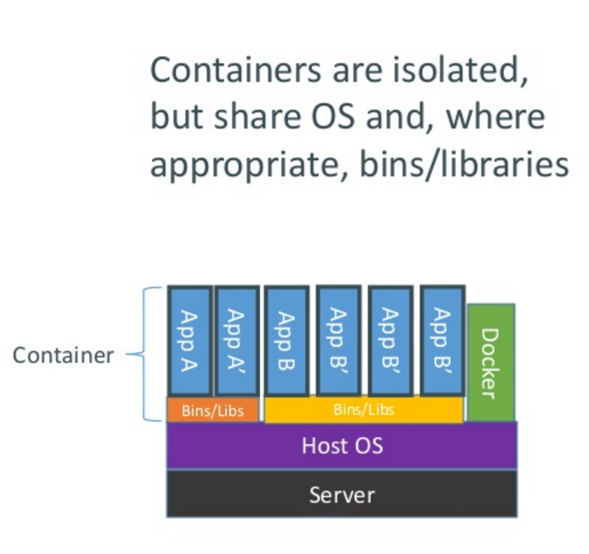
How does Docker containers work?

Slide 22
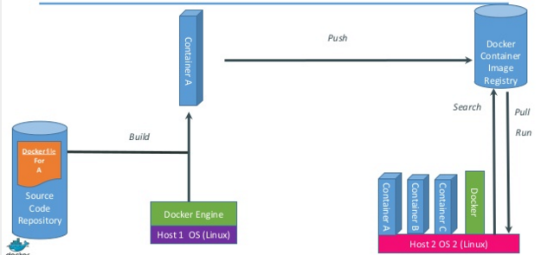
Just how does Docker work

Slide 23
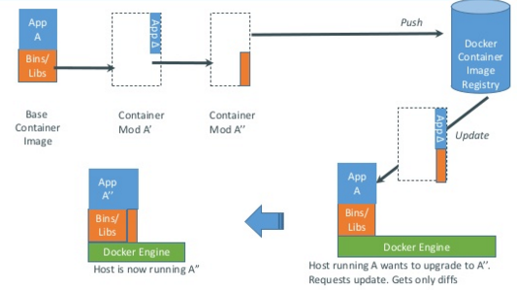
Docker updates/changes

Slide 24
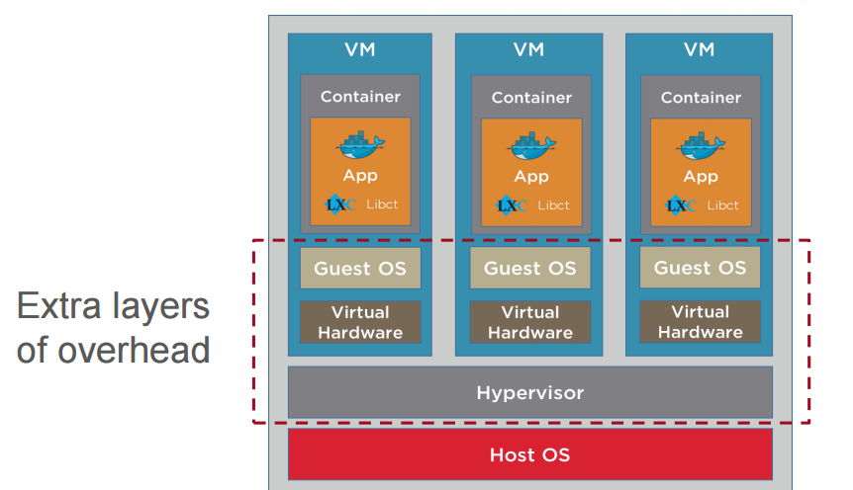
Open source Container inside VM Configuration

Slide 25
Getting Started
https://www.docker.com/community-edition#/download
https://docs.microsoft.com/en-us/windows/wsl/install-win10
https://nickjanetakis.com/blog/setting-up-docker-for-windows-and-wsl-to-work-flawlessly
https://hub.docker.com/

Slide 26
Terminology- Image
images: List all local images
run: Create a container from an image and execute a command in it
tag: Tag an image
pull: Download image from repository
rmi: Delete a local image
This will also remove intermediate images if no longer used

Slide 27
Terminology -Container
ps: List all running containers
ps –a: List all containers (incl. stopped)
top: Display processes of a container
start: Start a stopped container
stop: Stop a running container
pause: Pause all processes within a container
rm: Delete a container
commit: Create an image from a container

Slide 28
Thank you ☺

