Slide 1
Lec 05
ProImageshop / ProThreaded
Spring Boot introduction
RESTful web-services
$git fetch gerber updates
$git fetch gerber updates_ws
$git checkout -b lec05 gerber/updates
$git checkout -b lec05_ws gerber/updates_ws

Slide 2
Terminology
What is CRUD?
What is REST?
What is Spring?
What is HATEOAS?
What is Microservice?
So… hands on!

Slide 3
What is CRUD?
“In computer programming, create, read, update and delete (as an acronym CRUD) (Sometimes called SCRUD with an "S" for Search) are the four basic functions of persistent storage.”
http://en.wikipedia.org/wiki/Create,_read,_update_and_delete

Slide 4
What is REST?
“Representational state transfer (REST) is an abstraction of the architecture of the World Wide Web; more precisely, REST is an architectural style consisting of a coordinated set of architectural constraints applied to components, connectors, and data elements, within a distributed hypermedia system.”
http://en.wikipedia.org/wiki/REST

Slide 5
Basic CRUD with REST
Operation | HTTP / REST
Create | PUT / POST
Read (Retrieve) | GET
Update (Modify) | PUT / PATCH
Delete (Destroy) | DELETE

Slide 6
What is Spring?
“The Spring Framework is an open source application framework and inversion of control container for the Java platform.”
http://en.wikipedia.org/wiki/Spring_Framework
Inversion of control container is also called dependency injection
Supports many templating engines for web-service and also full-featured dynamic web-sites.
Support for popular Frameworks such as Bootstrap, Vaadin, Thymleaf, etc. etc. etc.

Slide 7
Inversion of control container / dependency injection:
Rather than instantiating an object using the new keyword, the container injects (and manages) a reference for you.
This may seem just a delegation swap, but it has important implications for the scope of those objects.
You have seem dependency injection in FXML already.
Inversion of control container is also called dependency injection

Slide 8
What is HATEOAS?
“HATEOAS, an abbreviation for Hypermedia as the Engine of Application State, is a constraint of the REST application architecture that distinguishes it from most other network application architectures.”
http://en.wikipedia.org/wiki/HATEOAS

Slide 9
HATEOAS representations/addresses
XML
<person xmlns:atom="http://www.w3.org/2005/Atom">
<firstname>Dave</firstname>
<lastname>Matthews</lastname>
<links>
<atom:link rel="self" href="http://myhost/people/1" />
</links>
</person>
JSON
{ firstname : "Dave",
lastname : "Matthews",
links : [ { rel : "self", href : "http://myhost/people/1" } ] }

Slide 10
What is Microservice?
“The term "Microservice Architecture" has sprung up over the last few years to describe a particular way of designing software applications as suites of independently deployable services.”
http://martinfowler.com/articles/microservices.html

Slide 11
What are “Web Services”?
A service is a software entity that can be discovered and invoked by other software systems.

Slide 12
More precisely: Web Service
A web service is just a web page meant for a computer to request and process
More precisely, a Web service is a Web page that’s meant to be consumed by an autonomous program as opposed to a Web browser which is for human consumption.

Slide 13
Microservices Reference
The “ID” on a HATEOAS system is mainly an URI
  Example: If you create a “teacher”, his “id” will be “http://localhost:8080/teacher/1” instead of just “1”.
Then, each Microservice can reference other services entities.

Slide 14
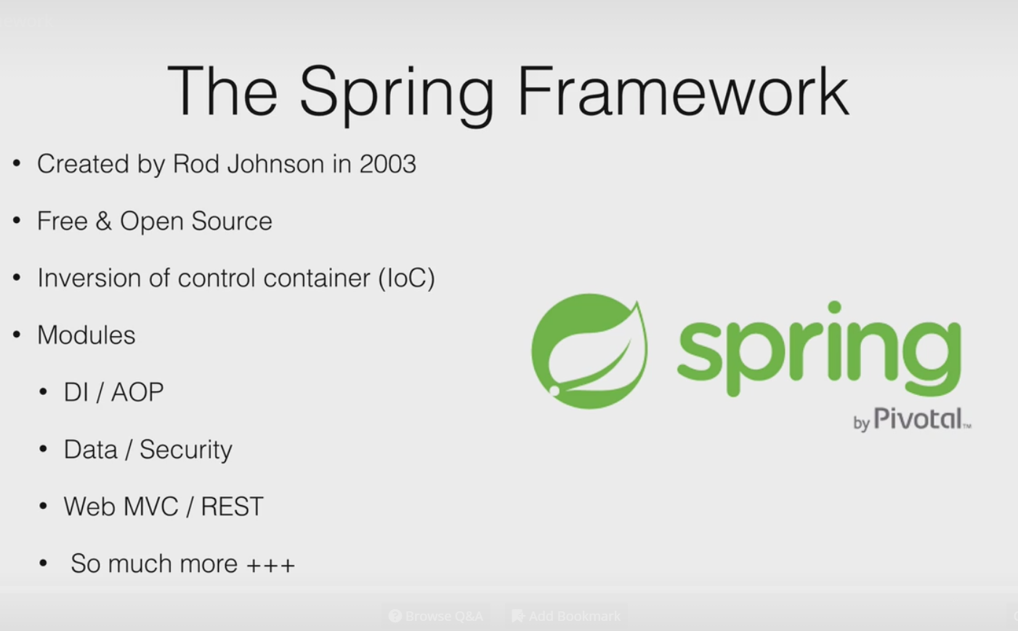

Slide 15
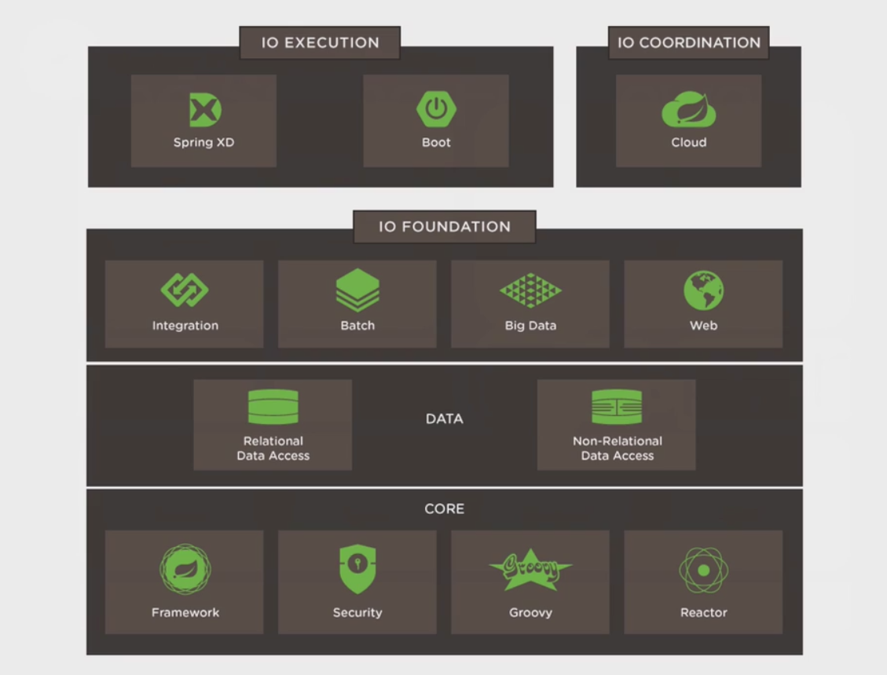
http://spring.io/projects

Slide 16
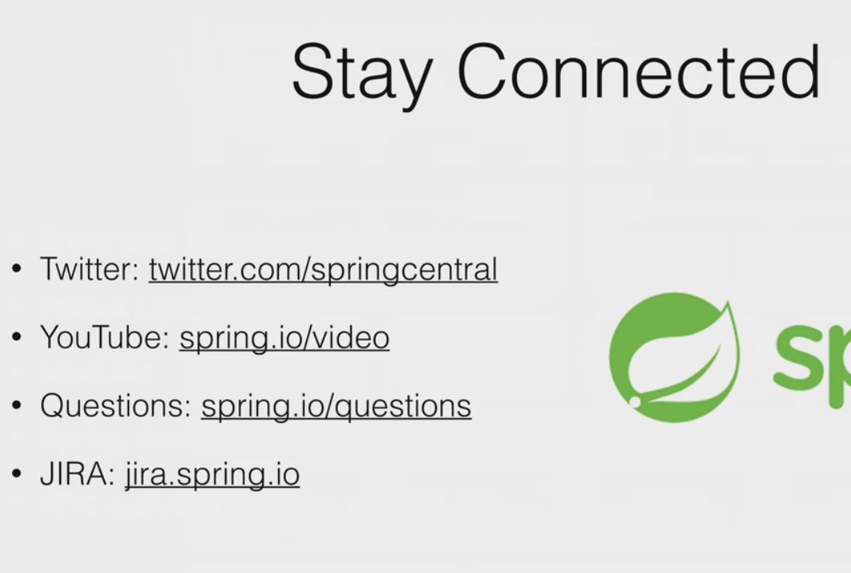

Slide 17
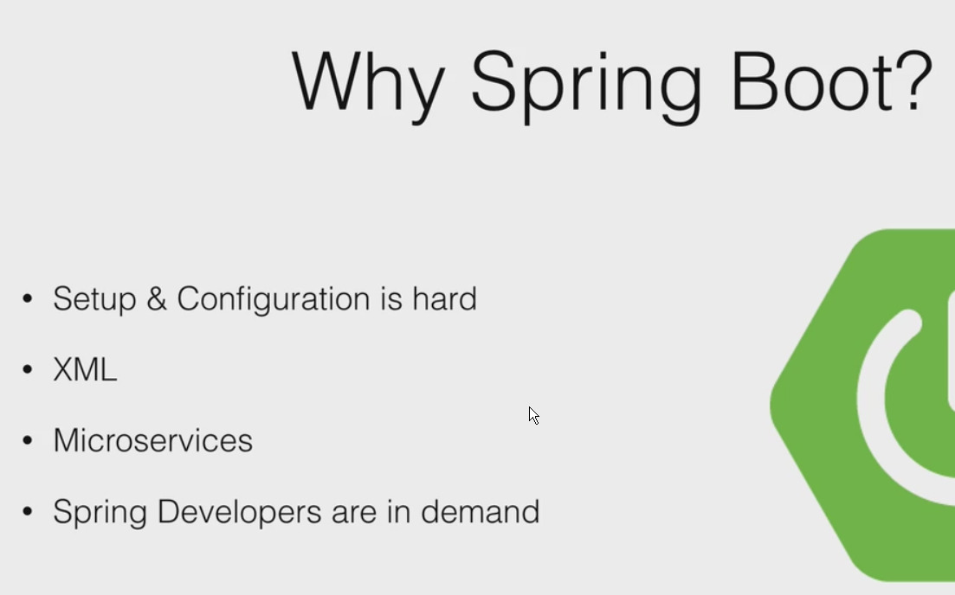
Spring Boot uses convention over configuration

Slide 18
Get sdkman and install springboot
$curl -s get.sdkman.io | bash
[restart term window]
$sdk help
$sdk list springboot
$sdk install springboot
spring help
spring init -list

Slide 19
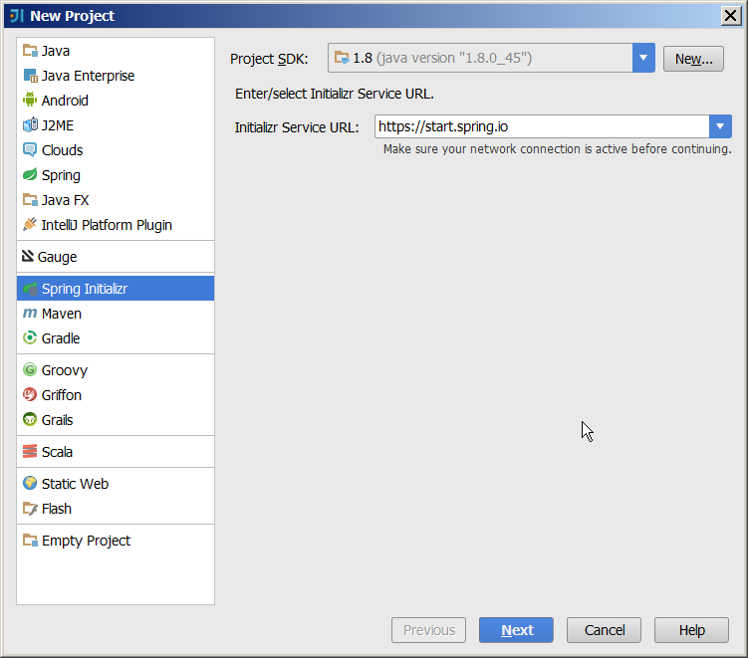
1/ Cmd:$spring init -list
2/ Url:start.spring.io
3/ IntelliJ ->

Slide 20
Create new project from intelliJ
Select web
Add controller: HomeController
@RestController
public class HomeController {
@RequestMapping
public String home(){
return "hello spring boot";
}
}

Slide 21
A very simple Web App (app.groovy)
Run simple file from command line
H:\dev\java\adv\2016\ws\app.java
From gitbash
$spring run app.java
Tomcat embedded on localhost:8080
Ctrl-c to quit

Slide 22
Executable JAR
Compile: app.java
$spring jar app.jar app.java
$java -jar app.jar
Compile the jar and run it as an executable

Slide 23
Application.java
Create a new application
SpringApplication.run(Application.class, args);
Create Attractions app web/h2/thymeleaf/hal/jpa from spring initializr

Slide 24
A very basic app
>my first spring app
@RestController is used in conjunction with @RequestMapping

Slide 25
What is a bean?
> add Service implementation details
There are four types of beans that spring will manage: component, service, controller, repository
Controller: often times a RestController which defines routes, produces and consumes defintions.
Service: This is where you put your business logic. Typically defined as an interface to CRUD + L.
Repository: defines low-level DB operations, mostly inherited.
Component: everything else.

Slide 26
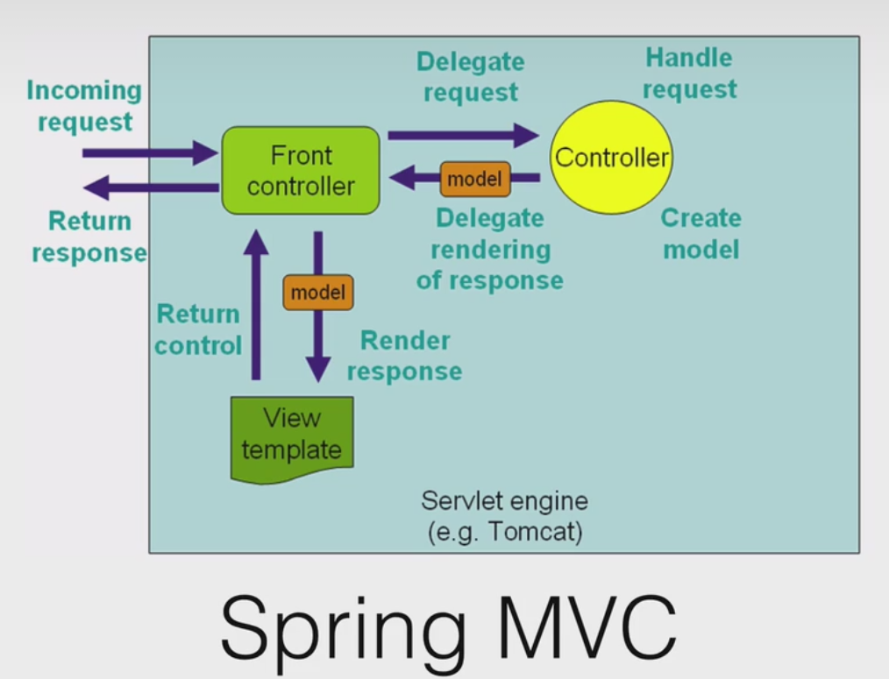
Spring MVC
H:\ss\01-TeachingLectures\javaAdvCourse\2016\rest\_spring-boot-intro-master\core-spring\auto-configure
Open project existing sources as maven
Spring Dispatcher Servlet
Service
Repo

Slide 27
What is a bean?
>beans example

Slide 28
App properties
>external configuration example
Be sure to change parent POM <version>1.3.6.RELEASE</version>
:application.properties
:yml (YAML) files.

Slide 29
Parent POM for maven
<parent>
<groupId>org.springframework.boot</groupId>
<artifactId>spring-boot-starter-parent</artifactId>
<version>1.3.6.RELEASE</version>
<relativePath/> <!-- lookup parent from repository -->
</parent>
Jump to this in external libraries to see the parent POM

Slide 30
Config env for prod/dev
>profiles project
:application.properties
:application-development.properties
:application-production.properties

Slide 31
Config others
>configuration-properties

Slide 32
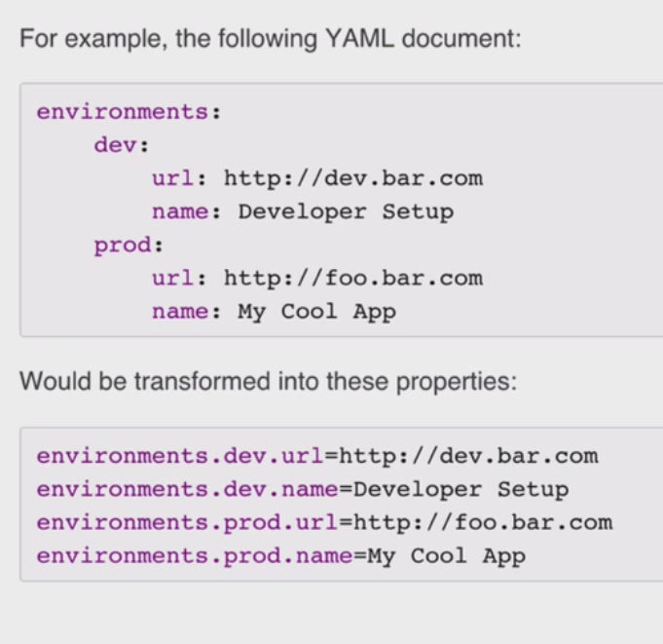
YAML
H:\ss\01-TeachingLectures\javaAdvCourse\2016\rest\_spring-boot-intro-master\core-spring\beans
Open project existing sources as maven

Slide 33
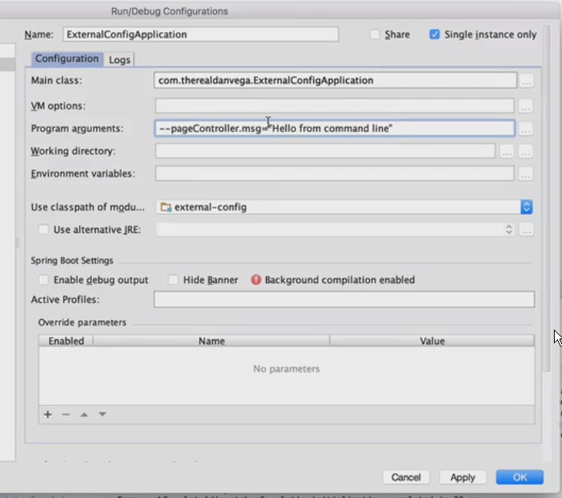
External config – using commandline

Slide 34
REST

Slide 35
What is REST ?
REST is a term coined by Roy Fielding to describe an architecture style of networked systems. REST is an acronym standing for REpresentational State Transfer.

Slide 36
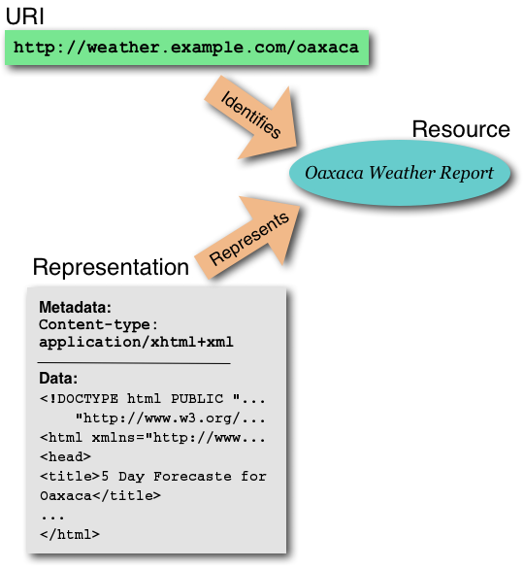
Resource (web server)
URI-Uniform Resource Identifier (or URL)
Web Page (HTML Page)

Slide 37
Two Fundamental Aspects of the REST Design Pattern
Resources
Every distinguishable entity is a resource. A resource may be a Web site, an HTML page, an XML document, a Web service, a physical device, etc.
URLs Identify Resources
Every resource is uniquely identified by a URL. This is Tim Berners-Lee Web Design, Axiom 0.

Slide 38
Why is it called Representational State Transfer ?
Client
http://weather.example.com/oaxaca
Resource
OaxacaWeather.html

Slide 39
"Representational State Transfer is intended to evoke an image of how a well-designed Web application behaves: a network of web pages (a virtual state-machine), where the user progresses through an application by selecting links (state transitions), resulting in the next page (representing the next state of the application) being transferred to the user and rendered for their use."
Roy Fielding.

Slide 40
REST and HTTP
HTTP 1.1 was designed to conform to REST
Its methods are defined well enough to get work done
Unsurprisingly, HTTP is the most RESTful protocol
But it's possible to apply REST concepts to other protocols and systems

Slide 41
REST - An Architectural Style of Networked System
Utilize the underlying architectural model of the world wide web – rather than inventing your own.
Guiding framework for Web protocol standards.
REST based web services
Online shopping
Search services
Dictionary services

Slide 42
Characteristics of a REST based network
Client-Server: a pull-based interaction style(Client request data from servers as and when needed).
Stateless: each request from client to server must contain all the information necessary to understand the request, and cannot take advantage of any stored context on the server.
Cache: to improve network efficiency, responses must be capable of being labeled as cacheable or non-cacheable.
Uniform interface: all resources are accessed with a generic interface (e.g., HTTP GET, POST, PUT, DELETE).
Named resources - the system is comprised of resources which are named using a URL.
Interconnected resource representations - the representations of the resources are interconnected using URLs, thereby enabling a client to progress from one state to another, and to communicate statelessly to whichever resource it needs on the web.

Slide 43
Web Design, Axiom 0
(Tim Berners-Lee, director of W3C)
Axiom 0: all resources on the Web must be uniquely identified with a URI.
URL1
resource1
URL2
resource2
URL3
resource3

Slide 44
Approach 2:
URLs are Cheap! Use Them!
The airline provides several URLs - one URL for premier members, a different URL for frequent flyers, and still another for regular customers.
Premier
Member
Reservation
Service
http://www.kings-air/reservations/premier
client
Premier Members
Frequent
Flyer
Reservation
Service
http://www.kings-air/reservations/frequent-flyer
client
Frequent Flyer Members
Regular
Member
Reservation
Service
http://www.kings-air/reservations/regular
client
Regular Members

Slide 45
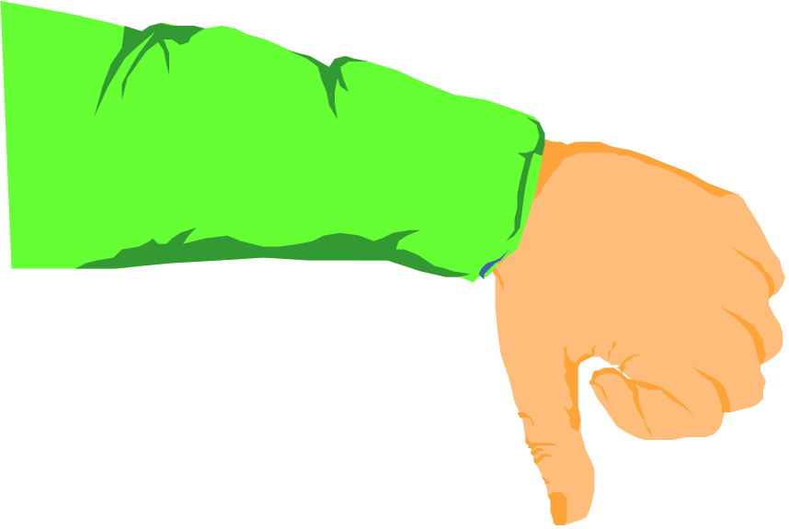
This Ain't the
REST Design Pattern
Premier
Customer
Representative
Premier Members
Answering
Machine
F.F.
Customer
Representative
Airline Reservation
Frequent Flyer Members
Regular
Customer
Representative
Regular Members
“press 7 to be connected to the Executive club”

Slide 46

This is the
REST Design Pattern
Premier
Customer
Representative
1-800-Premier
Premier Members
F.F.
Customer
Representative
1-800-Frequent
Frequent Flyer Members
Regular
Customer
Representative
1-800-Reservation
Regular Members
Numbers are cheap, use them.

Slide 47
This ain't the
REST Design Pattern
client
Premier Members
Premier
Customer
Reservation
Web
Service
Determine
Priority
F.F.
Customer
client
Frequent Flyer Members
Regular
Customer
client
Regular Members

Slide 48
This is the
REST Design Pattern
Premier
Member
Reservation
Service
http://www.kings-air/reservations/premier
client
Premier Members
Frequent
Flyer
Reservation
Service
http://www.kings-air/reservations/frequent-flyer
client
Frequent Flyer Members
Regular
Member
Reservation
Service
http://www.kings-air/reservations/regular
client
Regular Members
URLs are cheap, use them.

Slide 49
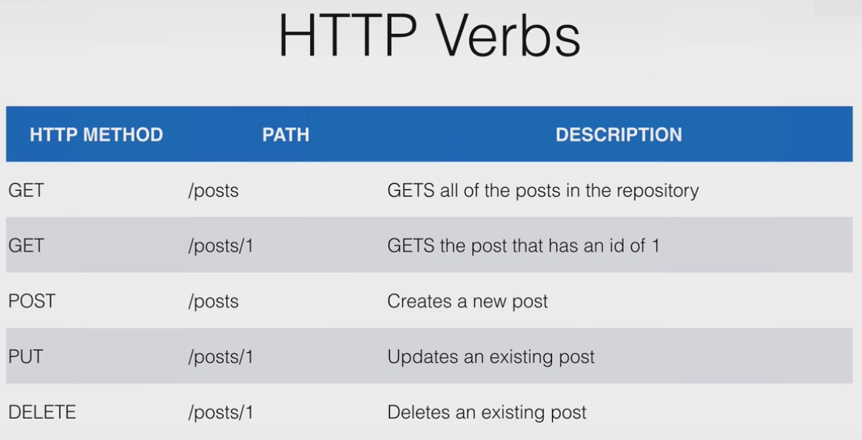

Slide 50
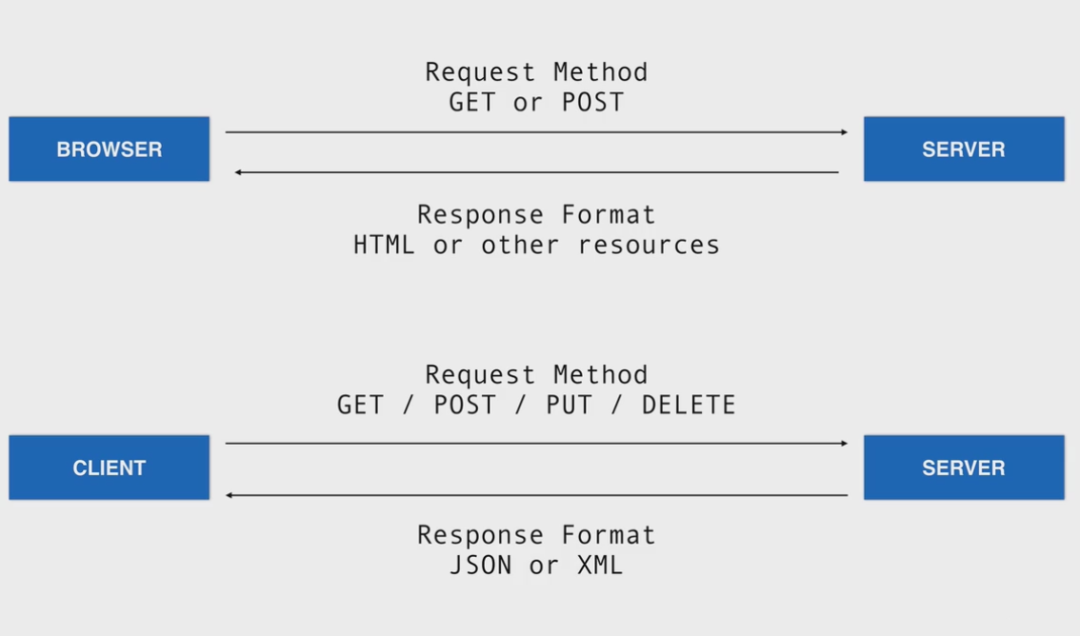

Slide 51
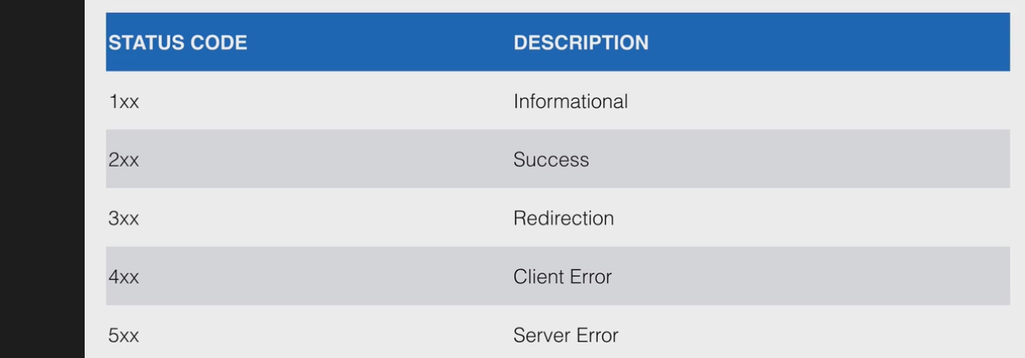
200 ok
404 not found
Etc.

Slide 52
inspect element/network
View amazon.com
Right click | inspect element in chrome
Click network
Examine the response codes

Slide 53
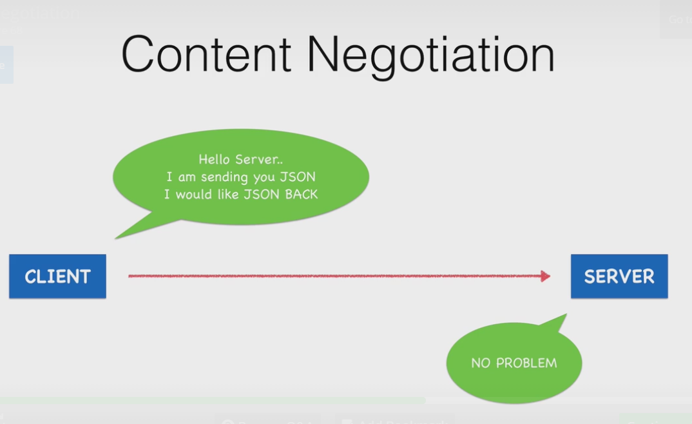
Content Negotiation
Right click | inspect elemernt
Click network

Slide 54
Basic CRUD with REST
Operation | HTTP / REST
Create | PUT / POST
Read (Retrieve) | GET
Update (Modify) | PUT / PATCH
Delete (Destroy) | DELETE

Slide 55

HyperText Transfer Protocol
Used for conversations between web clients and servers
Most of the internet uses HTTP
Supports verbs for GET, PUT, POST, DELETE
Query parameter framework

Slide 56

Client sends a request
  Method
  URL
  Headers
  (sometimes) parameters
  (sometimes) body
Server replies with a response
  Content
  Status
  Headers
Use postman and chrome inspect

Slide 57

Headers
  Generally meta-information about the request
  For instance: requesting an image in a specific format
Parameters
  Limit or describe how you want the resource (searches, filters)
  Defines the resource you’re requesting

Slide 58

Request (client)
  Accept: Give me this kind of response. Here’s a list in order of what I’m hoping you’ll send.
  Accept: text/html,application/xhtml+xml,application/xml
Response (server)
  Content-Type: This is the kind of response I’m sending you.
  Content-Type: text/html; charset=UTF-8

Slide 59

Part of the URL
Everything after the question mark, delimited by ampersands
http://www.example.com/search_people?this=that&foo=bar

Slide 60

Chrome browser sends a request to Google
  Method: GET
  URL: http://www.google.com
  Headers:
    Accept: text/html,application/xhtml+xml,application/xml;q=0.9,*/*;q=0.8
    Accept-Language: en-US,en;q=0.8
    Accept-Charset: ISO-8859-1,utf-8;q=0.7,*;q=0.3
    Connection: keep-alive
    User-Agent: Mozilla/5.0 (Macintosh; Intel Mac OS X 10_7_3) AppleWebKit/535.19 (KHTML, like Gecko) Chrome/18.0.1025.168 Safari/535.19
    Accept-Encoding: gzip,deflate,sdch
    Cookie: NID=59=EudJ2a15ql8832PCysQA0qchtuvGWMoA7rkp79VpIYAQ8-j42IO17LFudCYNMXm9l6SHcu3YgrGRCdrRCyM468xPZaOek4Pi-AXQ8eARqU1SGYx6y7_9LW-c3HHb-vs2; PREF=ID=994f8de0e8b39a5b:U=237805f1f710dc73:FF=0:TM=1336752507:LM=1336752509:S=W0Hha7x4czdXp51U
    Host: www.google.com

Slide 61

Google sends a response
  Headers:
    Content-Length: 24716
    Content-Encoding: gzip
    Set-Cookie: NID=59=F48kbwfwOi-qCHJyrnMSUlDBVxK-ZVKZpq5B5jttt_25IRN4lS-0rQcVttq-dnOIlQzafw1i4HPQAO0RpZ7NuC0WCKWta7SYoekx0--YGf2zIFZ9VXIKS-_UEaOH9iBe; expires=Sat, 10-Nov-2012 21:26:46 GMT; path=/; domain=.google.com; HttpOnly
    Expires: -1
    Server: gws
    X-XSS-Protection: 1; mode=block
    Cache-Control: private, max-age=0
    X-Frame-Options: SAMEORIGIN
    Content-Type: text/html; charset=UTF-8
    Date: Fri, 11 May 2012 21:26:46 GMT
  Content: A bunch of HTML
  Status: 200
Use postman and chrome inspect rest-starter

Slide 62

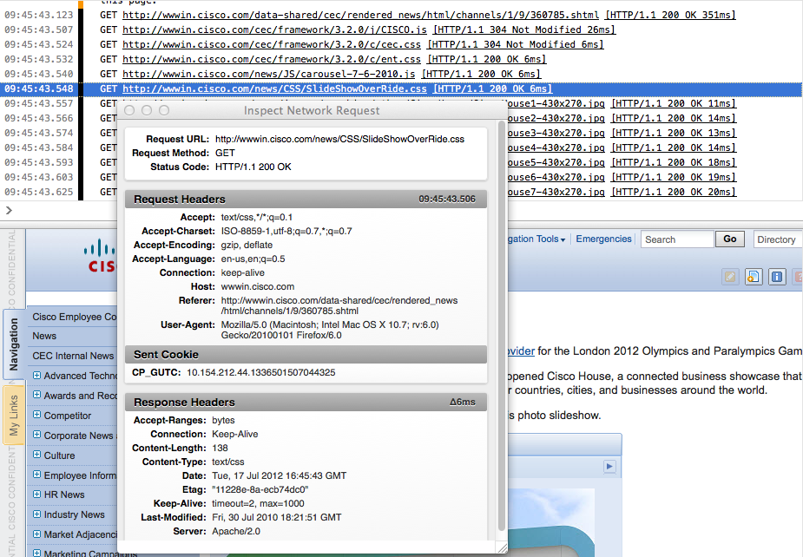
Some browsers provide tools to view HTTP traffic
Chrome is really good at this.

Slide 63
REST project
rest-starter
8080/posts/
8080/posts/1 or 2
use jsonviewer
chrome://apps/
postman
you can also do a curl:
curl -v http://localhost:8080/
curl -help
See >rest-starter

Slide 64

Uses URL paths to define resources
Create, Read, Update, Delete
  POST, GET, PUT, DELETE
Error Codes
  HTTP Status Codes
Request parameters
  Query parameters
Response types and configuration
  Headers

Slide 65

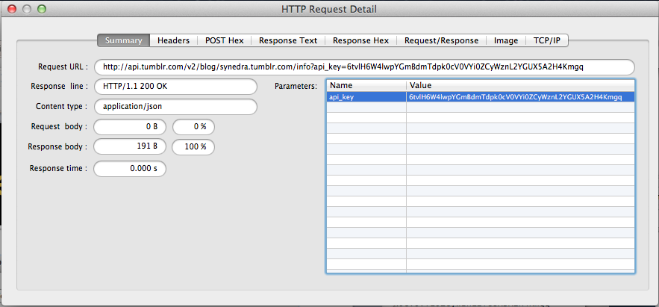
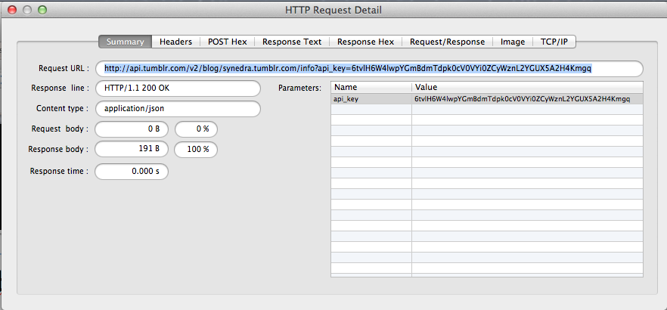

Slide 66
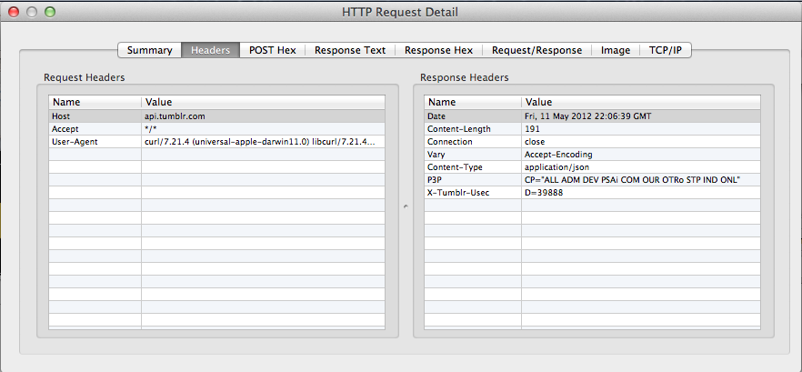
Headers

Slide 67
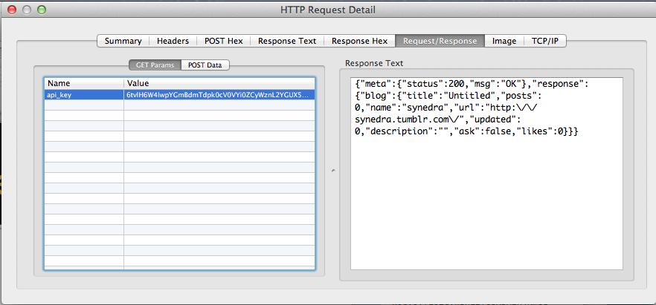
Request/Response

Slide 68
Four verbs for every noun (the named identifier)
GET to retrieve information
POST to add new information, showing its relation to old information
PUT to update information
DELETE to discard information

Slide 69
Why not just use plain HTML?
Web pages are designed to be understood by people, who care about layout and styling, not just raw data
Every URI could have a human-readable and a machine-processable representation:
  Web Services clients ask for the machine-readable one
  Browsers ask for the human-readable one

Slide 70
REST style
Client-server
Stateless
Cached
Uniform interface
Layered system (human layer, machine layer)

Slide 71
State
“State” means application/session state
Maintained as part of the content transferred from client to server back to client
Thus any server can potentially continue transaction from the point where it was left off
State is never left in limbo

Slide 72
Transfer of state
Connectors (client, server, cache, resolver, tunnel) are unrelated to sessions
State is maintained by being transferred from clients to servers and back to clients

Slide 73
B2B
B2B systems usually assume that POSTed documents disappear into each partner's internal business systems
Business processes would actually work better if treated like a Web resource
  An order is a resource
  Shipments and payments are sub-resources
Amazon gets this mostly right

Slide 74
Two kinds of state
Application state is the information necessary to understand the context of an interaction
  Authorization and authentication information are examples of application state
Resource state is the kind that the S in REST refers to
The "stateless" constraint means that all messages must include all application state.

Slide 75
Resource state
Changes in resource state are unavoidable
  Someone has to POST new resources before others can GET them
REST is about avoiding implicit or unnamed state; resource state is named by URIs
Application state is required by the server to understand how to process a request

Slide 76
Session state
Session state is also application state
If you want a session, you often need smarter clients than a browser
Specialized clients can manage both application and resource state

Slide 77
Sessions
A purchasing client could send a single HTTP request mentioning everything it wanted to purchase in one message
Shopping carts are for people, who have trouble keeping state in their heads

Slide 78
The purpose of statelessness
Prevents partial failures
Allows for substrate independence
  Load-balancing
  Service interruptions

Slide 79
Another kind of state
Don’t confuse REST state with state-machine state
REST state is the representation of the values of the properties of a resource
State machines fit into REST when the states are expressed as resources with links indicating transitions

Slide 80
The “OOP on the Web” theory
HTTP is just a transport layer between objects
Messages and objects are both opaque
Objects jealously guard their private state

Slide 81
Smash the (private) state
Eliminating private state lets us develop architectures that can scale to larger designs.
REST systems transfer the entire state of the transaction at every state transition
You can pick up where you left off by merely accessing the URI at a later time, regardless of client or server changes.

Slide 82

Spring MVC

Slide 83
Spring MVC
<parent>
<groupId>org.springframework.boot</groupId>
<artifactId>spring-boot-starter-parent</artifactId>
<version>1.3.6.RELEASE</version>
<relativePath/> <!-- lookup parent from repository -->
</parent>

Slide 84
Cars with Thymeleaf
>thymeleaf example
(see router at ~/posts/)
Examine POM for starters added -web and thyme
Web, thyme, jpa, hal, h2
Other possible apps: make/model : movie/actor : restaurant/dish : country/attraction

Slide 85
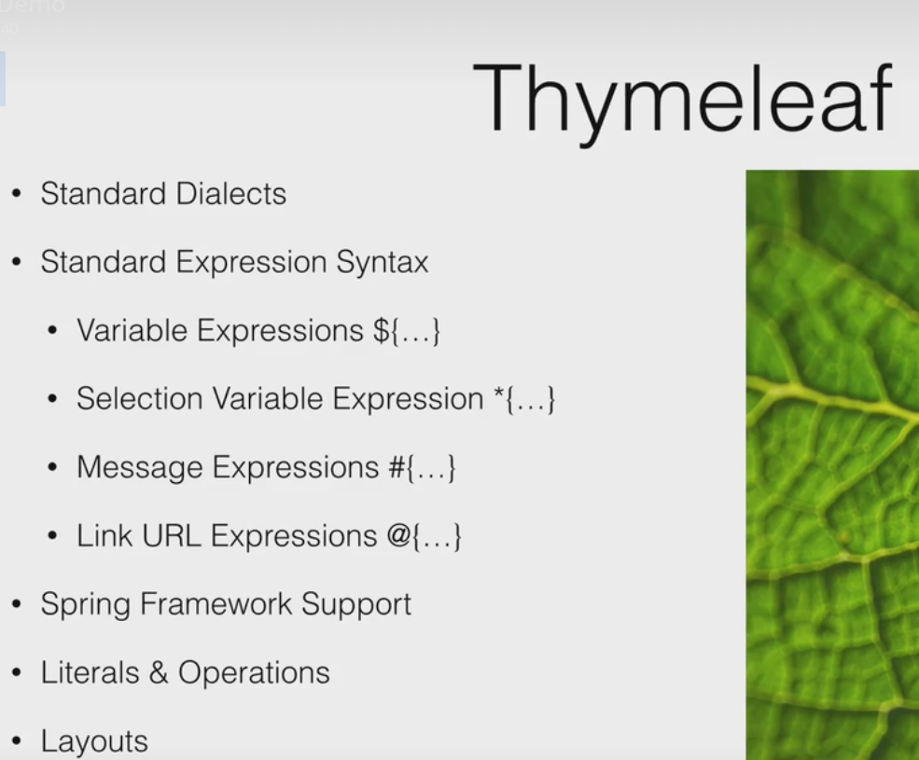
Cars with Thymeleaf
thymeleaf.org/
>thymeleaf example
(see router at ~/posts/)
Examine POM for starters added -web and thyme
Web, thyme, jpa, hal, h2
Other possible apps: make/model : movie/actor : restaurant/dish : country/attraction

