Slide 1
冒險故事

Slide 2
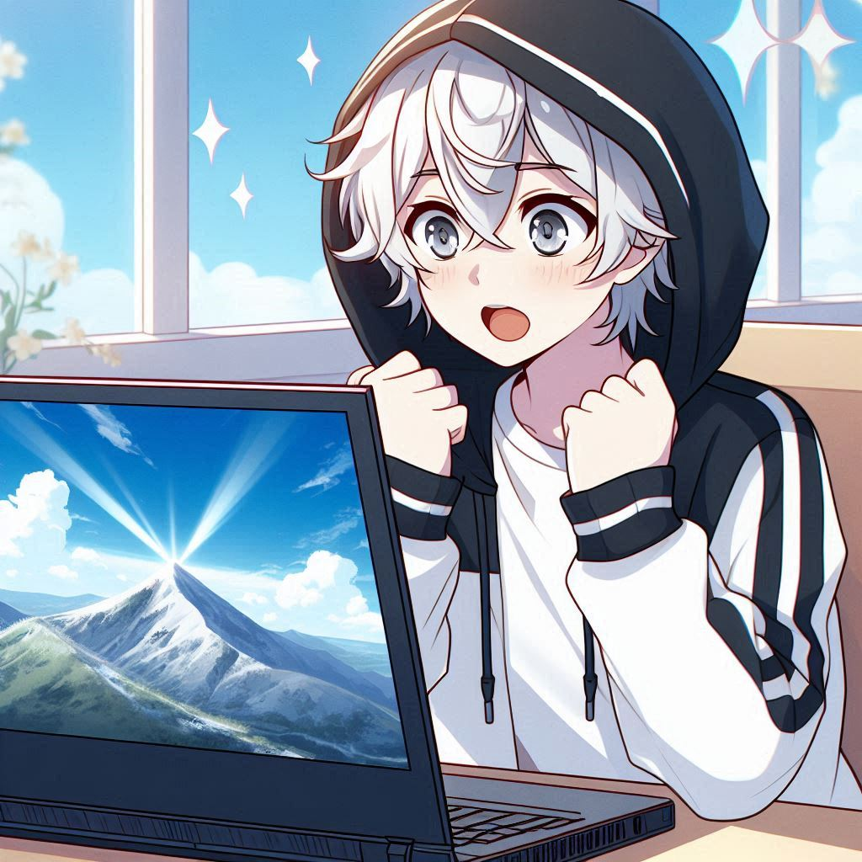
目標
Notes:
Create an anime style boy teenager with white hair and grey eyes, wearing a black and white hoodie. He saw a mountain spot from the laptop screen and he's thinking of going there while looking excited

Slide 3
目標
Notes:
Create an anime style boy teenager with white hair and grey eyes, wearing a black and white hoodie. He saw a mountain spot from the laptop screen and he's thinking of going there while looking excited

Slide 4
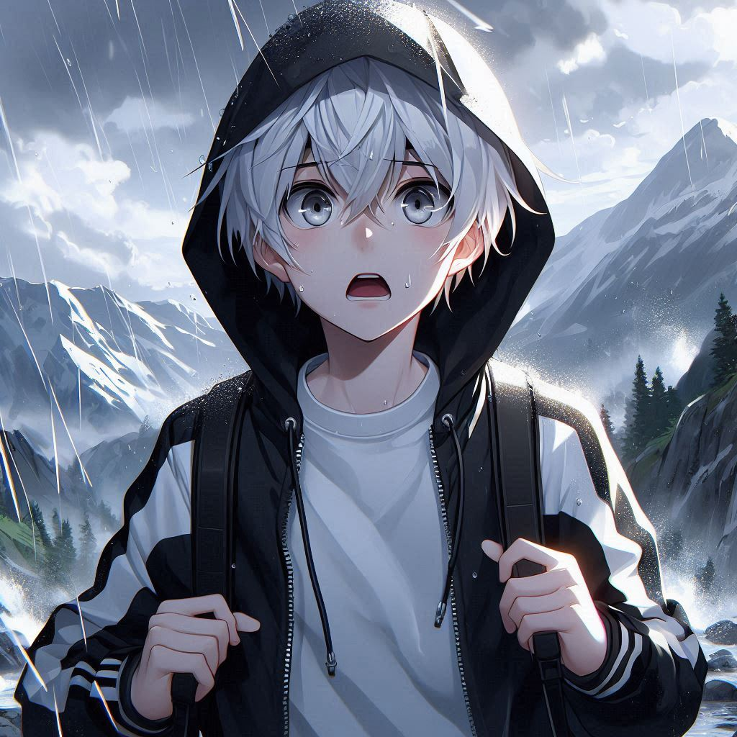
阻礙
Notes:
Create an anime style boy teenager with white hair and grey eyes, wearing a black and white hoodie. He's walking on the mountains but suddenly heavy rain falls. He looks panicked

Slide 5
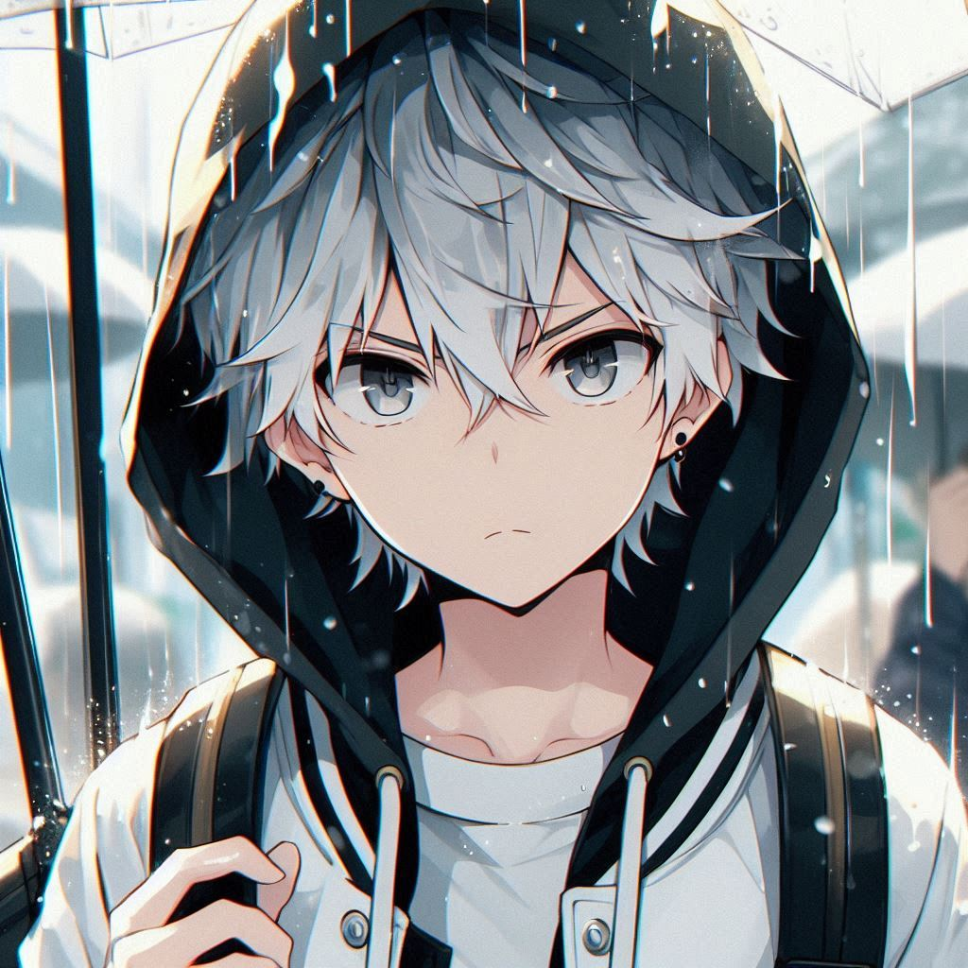
努力
Notes:
Create an anime style boy teenager with white hair and grey eyes, wearing a black and white hoodie. Even though it's raining but he's determined to go to his destination

Slide 6
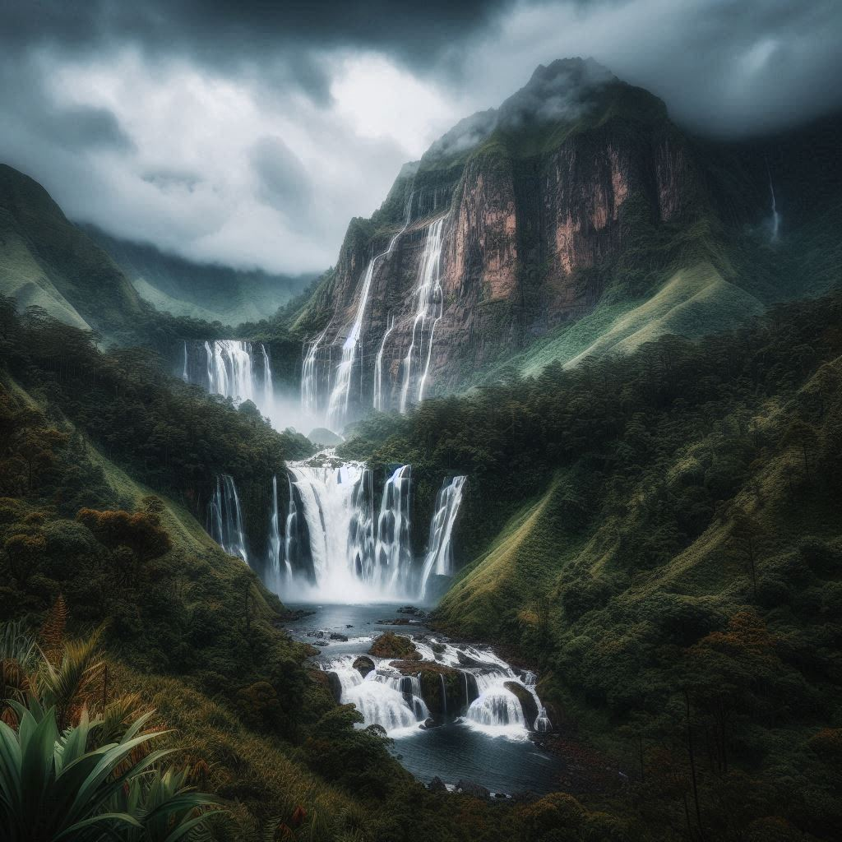
努力
Notes:
Create an anime style boy teenager with white hair and grey eyes, wearing a black and white hoodie. Even though it's raining but he's determined to go to his destination

Slide 7
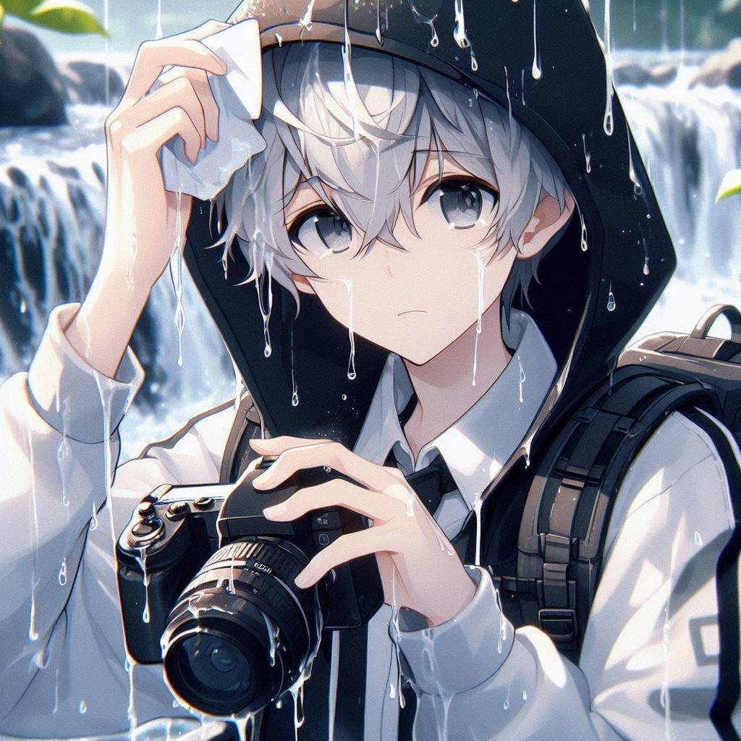
結果
Notes:
Create an anime style boy teenager with white hair and grey eyes, wearing a black and white hoodie. He finally reached his destination to go to the waterfall. He's holding a wet camera and try to wipe the camera looking sad

Slide 8
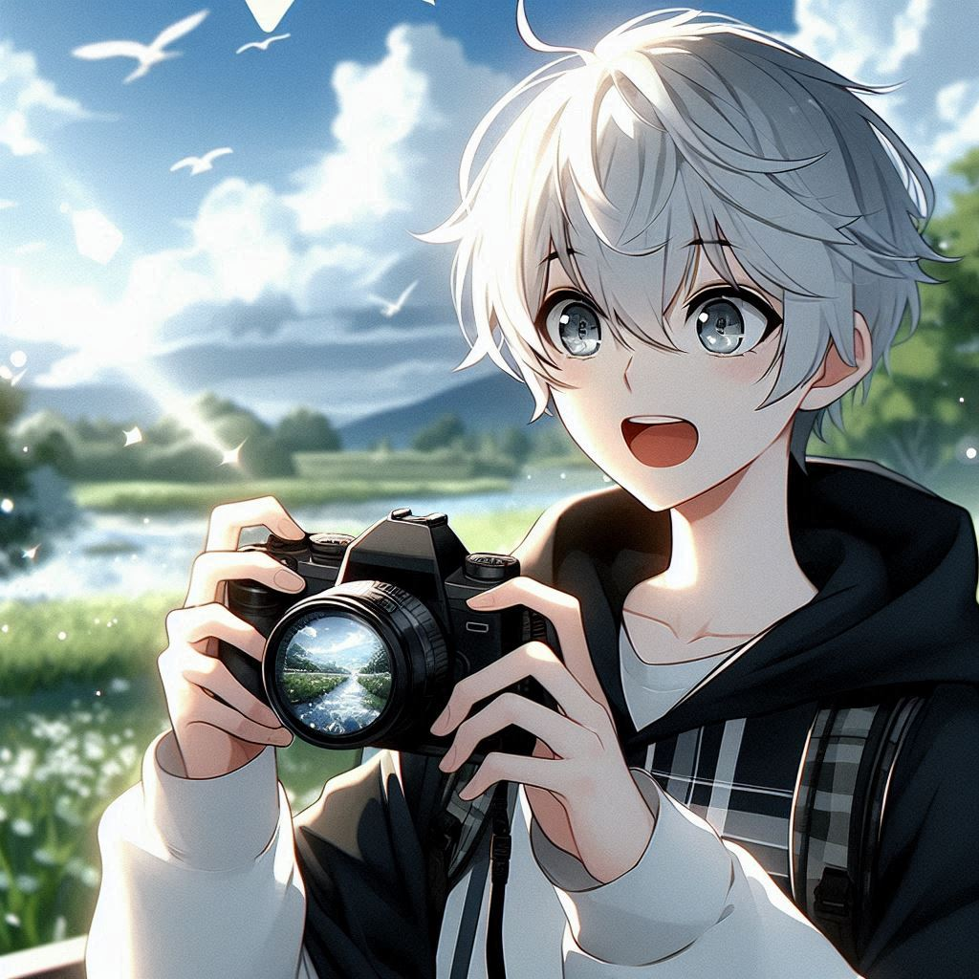
意外
Notes:
Create an anime style boy teenager with white hair and grey eyes, wearing a black and white hoodie. Holding his camera with an excited look

Slide 9
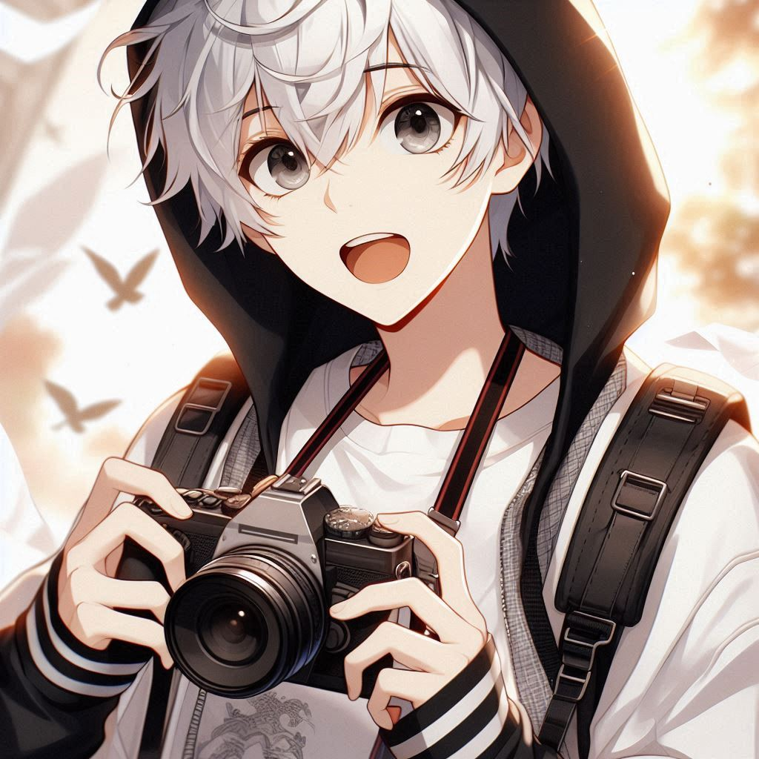
轉彎
Notes:
Create an anime style boy teenager with white hair and grey eyes, wearing a black and white hoodie, doing programming while looking excited

Slide 10
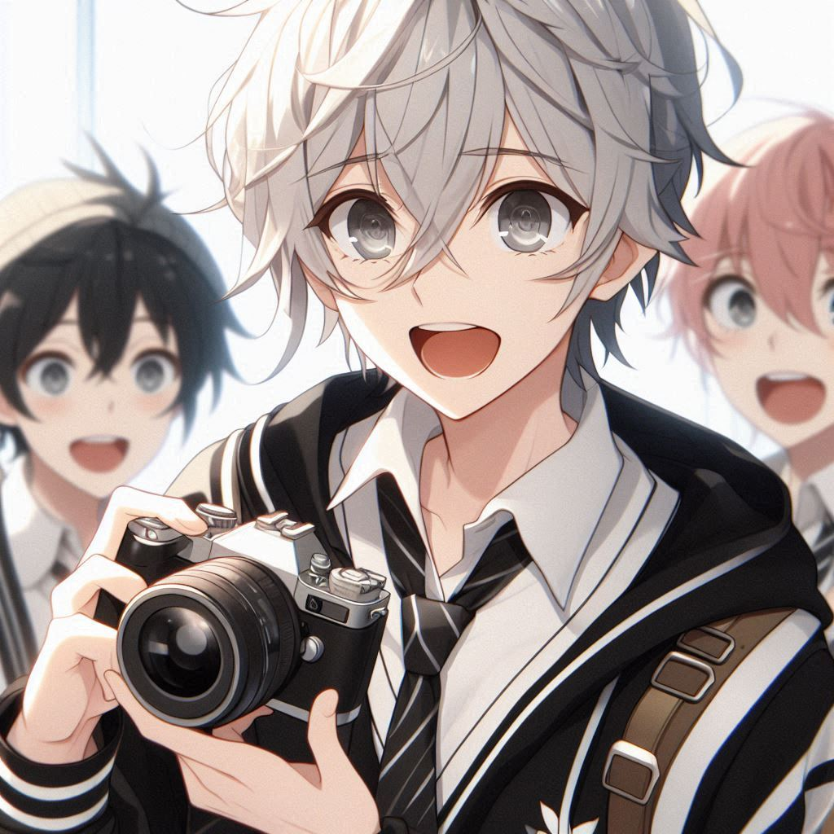
結局
Notes:
Create an anime style boy teenager with white hair and grey eyes, wearing a black and white hoodie. Showing his camera to his friends excitedly

Slide 11
謝謝

