Slide 1
自我介紹

Slide 2
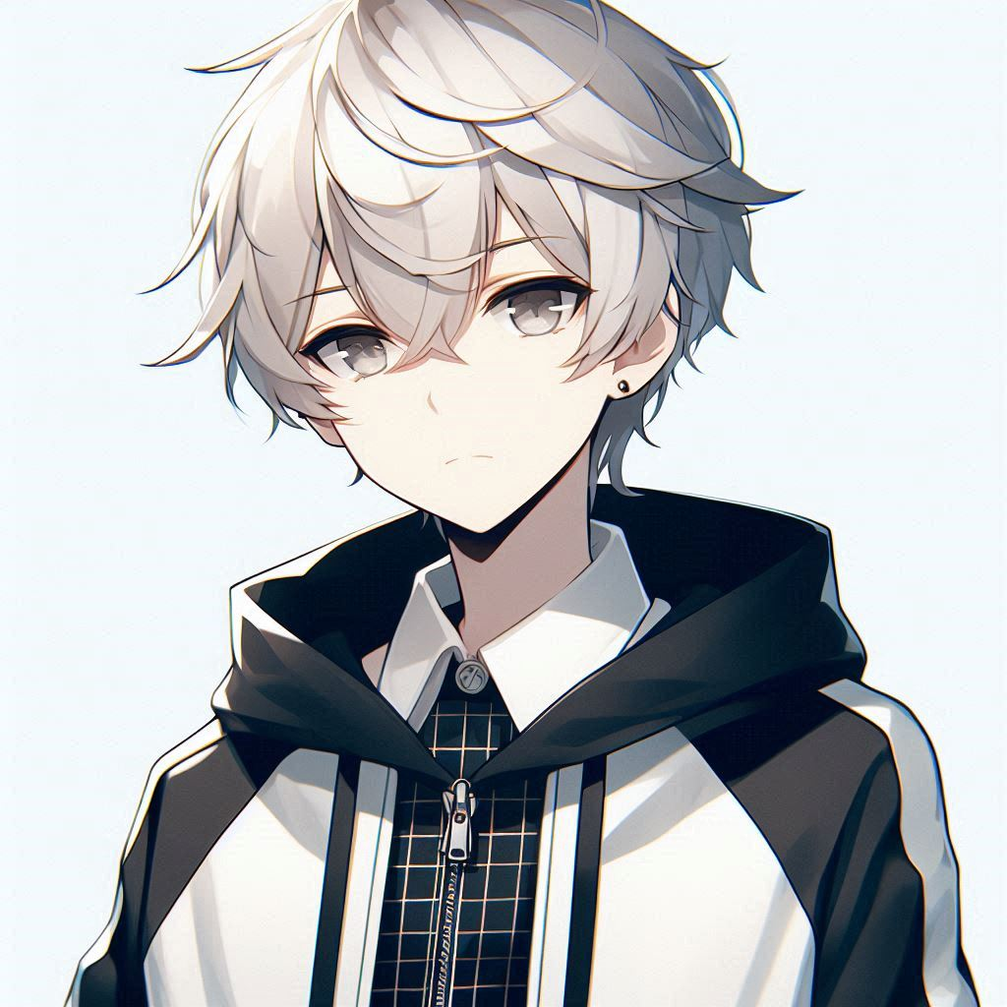
目標
Notes:
An anime style boy teenager with white hair and grey eyes, wearing a black and white hoodie

Slide 3
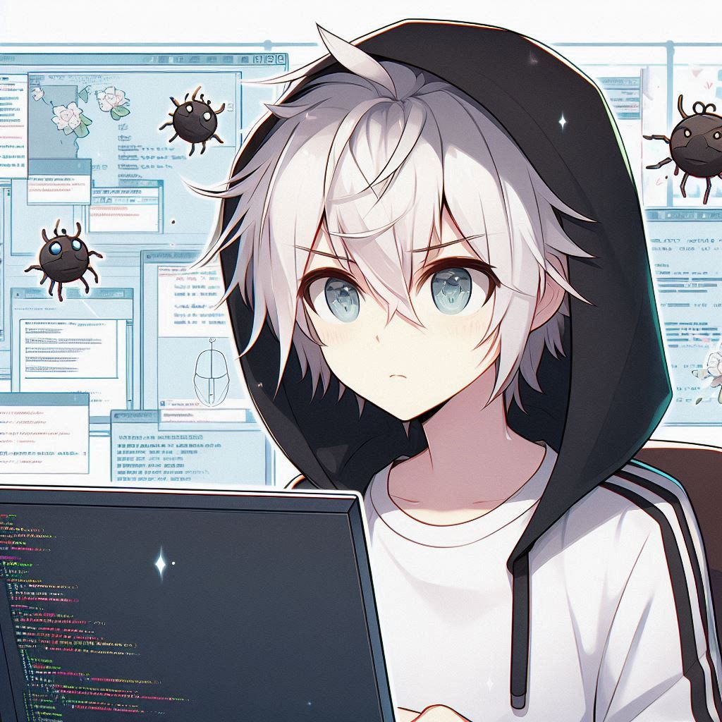
阻礙
Notes:
Create an anime style boy teenager with white hair and grey eyes, wearing a black and white hoodie, doing a programming but suddenly he encounters a bug

Slide 4
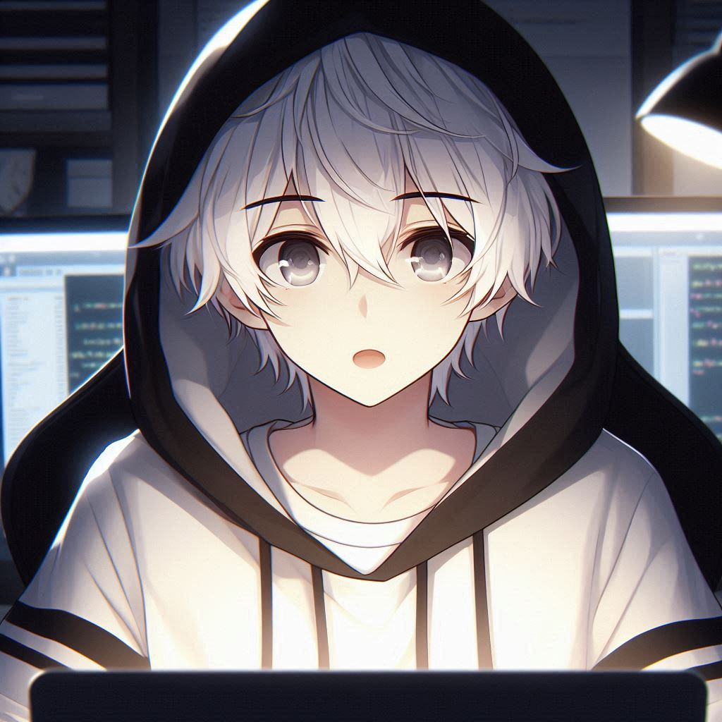
努力
Notes:
Create an anime style boy teenager with white hair and grey eyes, wearing a black and white hoodie, staying up late while programming

Slide 5
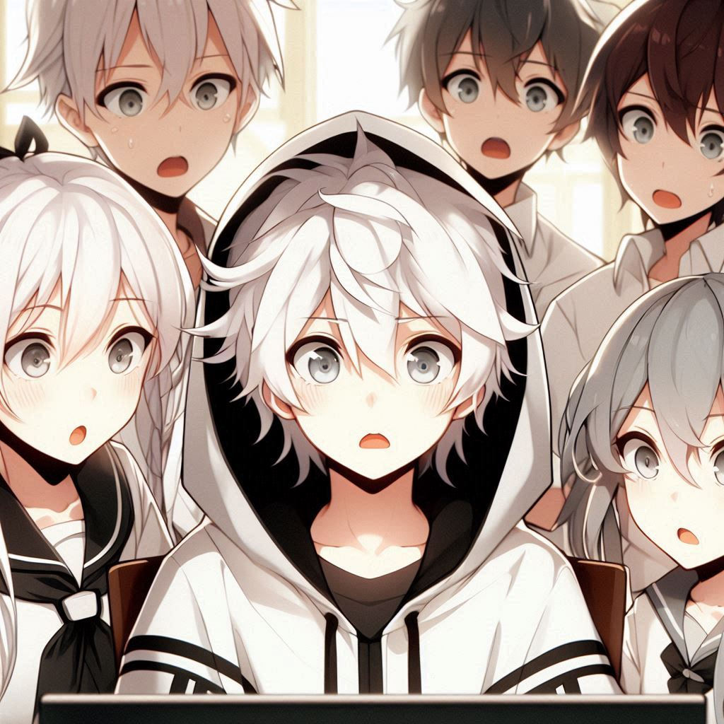
結果
Notes:
Create an anime style boy teenager with white hair and grey eyes, wearing a black and white hoodie, he and his friends are looking at a game screen and everyone has a shocked expression

Slide 6
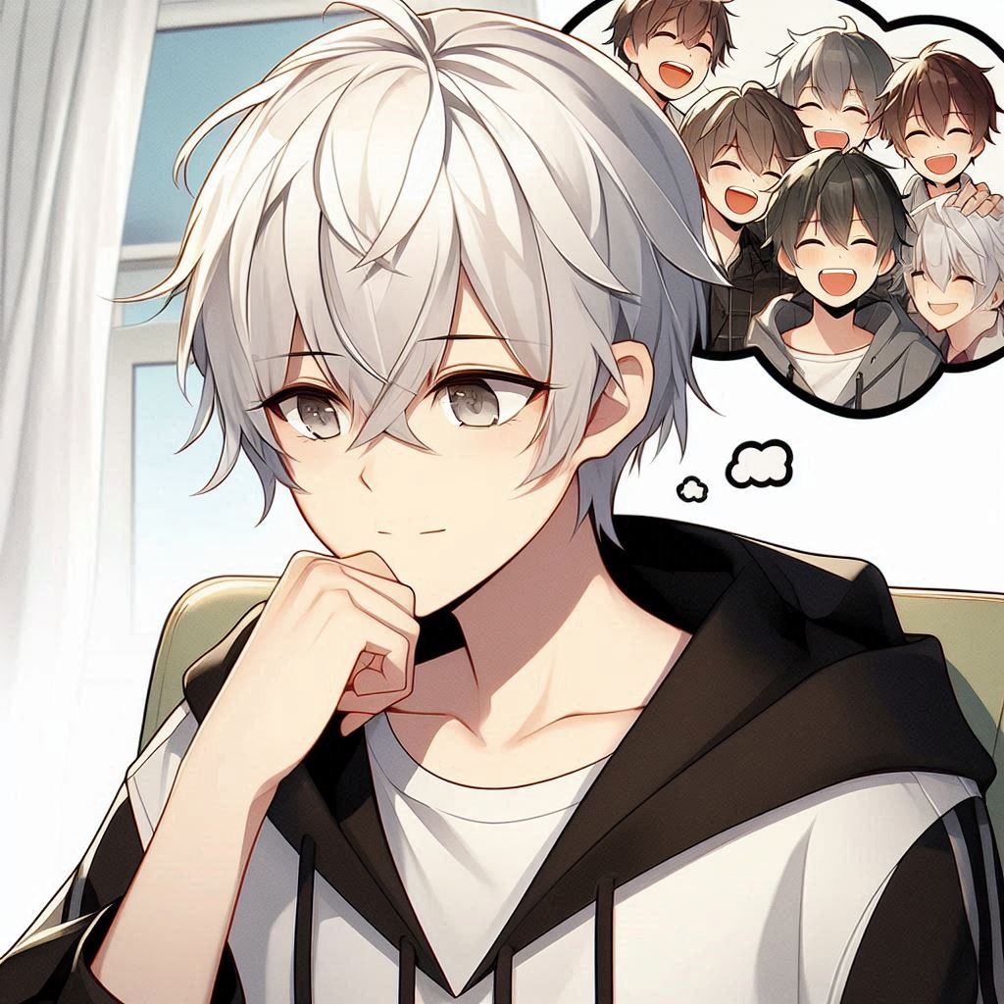
意外
Notes:
Create an anime style boy teenager with white hair and grey eyes, wearing a black and white hoodie. He's thinking of how his friends are laughing when they see a screen

Slide 7
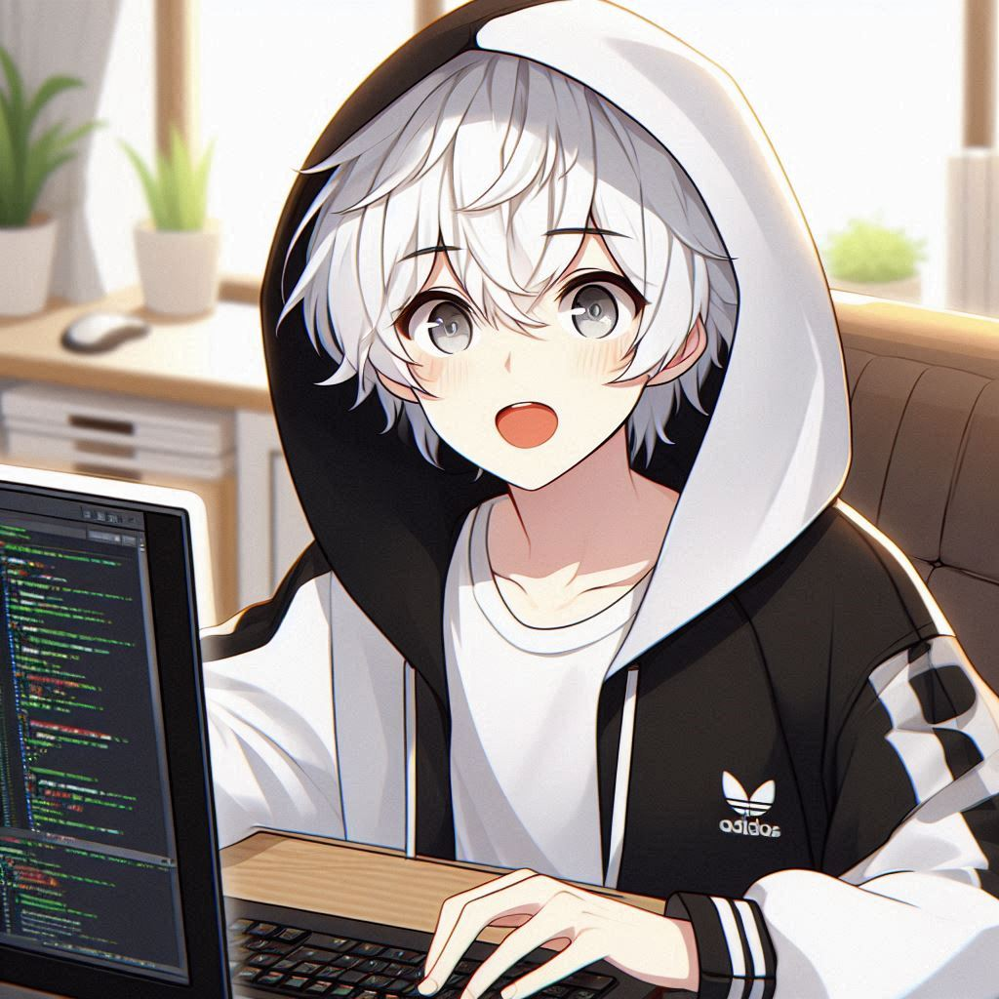
轉彎
Notes:
Create an anime style boy teenager with white hair and grey eyes, wearing a black and white hoodie, doing programming while looking excited

Slide 8
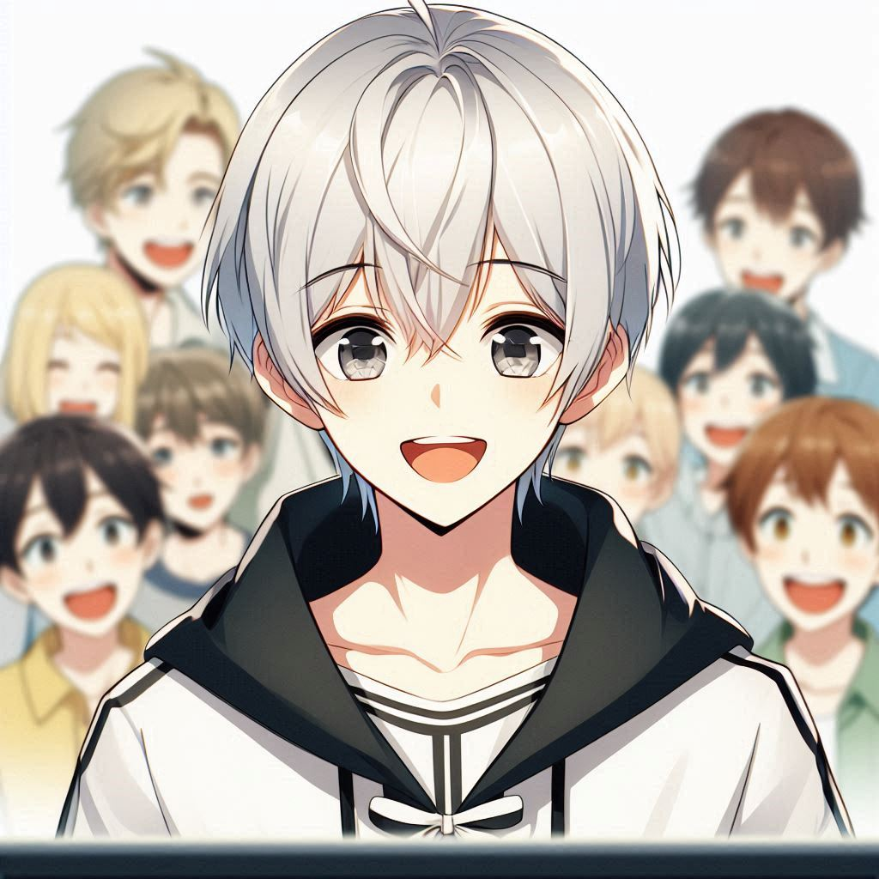
結局
Notes:
Create an anime style boy teenager with white hair and grey eyes, wearing a black and white hoodie, is happy and all people is also happy looking at a screen

Slide 9
謝謝

