Slide 1
Ice task – weather app
Members:
Panashe
Zoe
Kgomotso

Slide 2
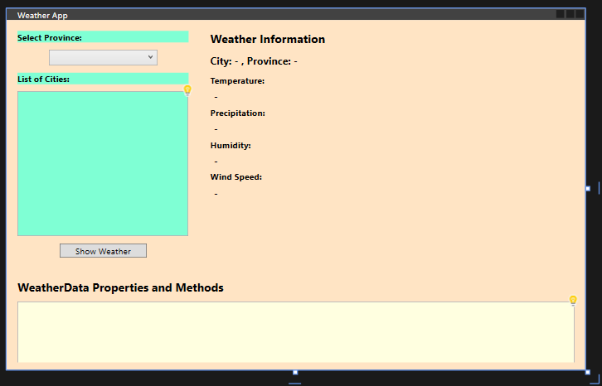
wpf

Slide 3
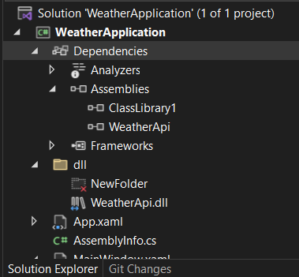

dll

Slide 4
Reflection

Slide 5
results

