Slide 1
Translating Logic to Natural Language
Run Zhang
Huaijin Ning
Haoyang Tao
CS 4TB3 - Apr.17, 2022

Slide 2
Logic formula
Propositional logic
OR (∨)
AND (∧)
Negation/ NOT (¬)
Implication / if-then (⇒)
If and only if (≡).
Predicate Logic
Universal Quantifier
∀x
Existential Quantifier
∃x
¬ p
p ∨ q
p ∧ q ⇒ r
p ⇒ q ≡ ¬ p ∨ q
…
…
…
((false ⇒ r) ∨ ((¬ z) ∨ h)) ∧ (p ∨ true) ≡ (true ∧ p) ∨ (false ∨ true)
(∀ x ❙ Q ∧ R • P) ≡ (∃ x ❙ (true ∧ (true ∧ false)) • R ∧ (p ∨ r))
???

Slide 3
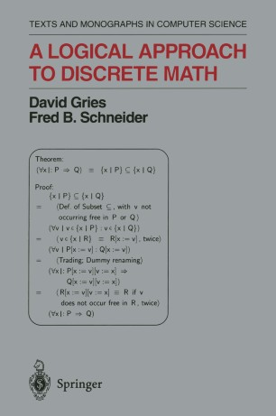
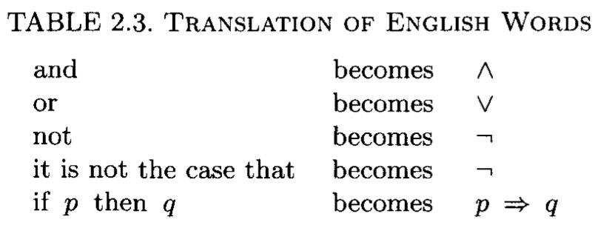
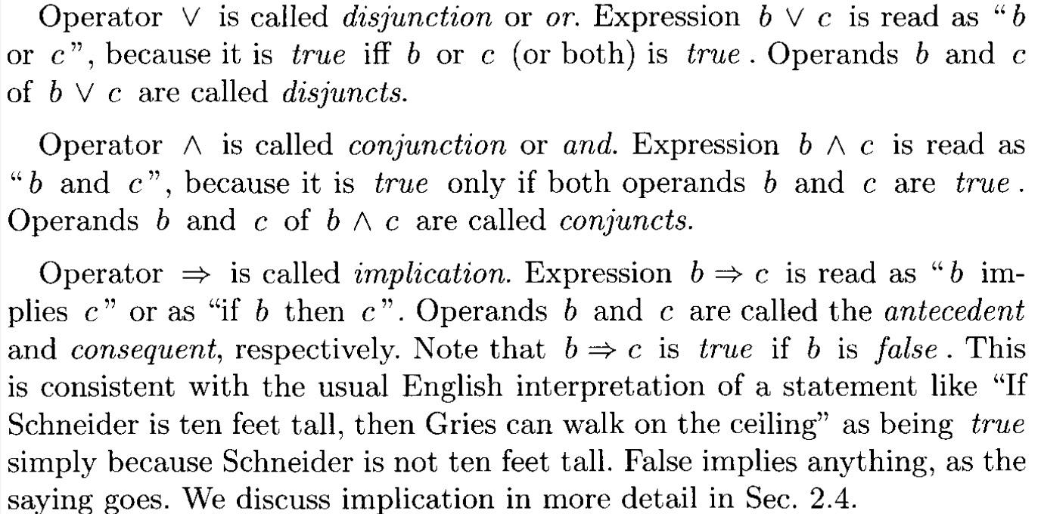
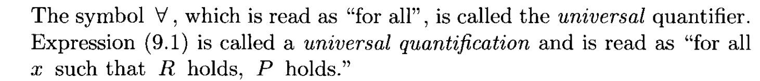
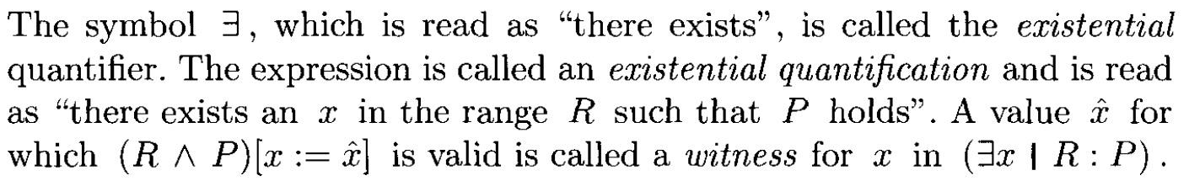
Research challenge
CALCCHECK
A Proof-Checker
List of symbol
Official meaning/translate for each symbol
Combination of multiple symbols
How to understand the meaning correctly?

Slide 4
Output format
Single line output:
p ∨ q ∧ true ≡ false
p or q and true equivalence false
Pointer:
p ∨ q ∧ true ≡ false
p
^ or
^ q and true
^ equivalence
^ false
Arrow:
p ∨ q ∧ true ≡ false
p or ↓
q and true↓
equivalence↓
false
It’s better to
make it in multiple line!
Natural language:
p ∨ q ∧ true ≡ false
The left hand side in natural language is
calculate p or q
calculate the result of above and True
The right hand side in natural language is False
Finally, the result of LHS is equivalent to the result of RHS.
Order number:
p ∨ q ∧ true ≡ false
p or q (1)
(1) and true (2)
(2) equivalence false

Slide 5
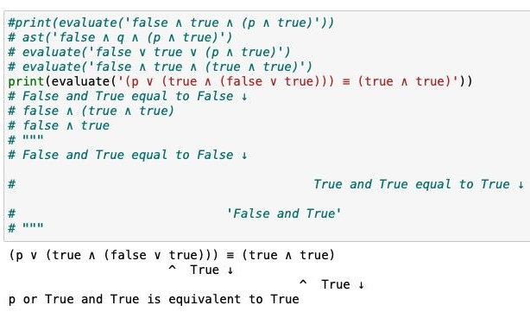
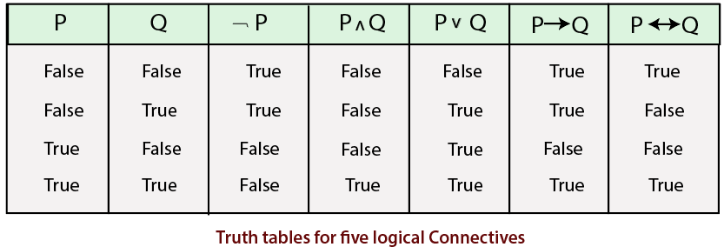
Need a true/false evaluator?
⇒
≡
We focus more on the translation in natural language! :D

Slide 6
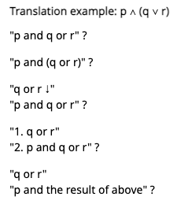
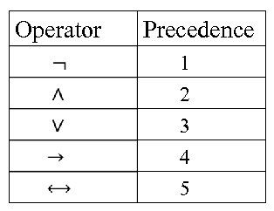
Priority (logic sequence)
Priority of input string is implicit, so parentheses!
And (∧) / Or (∨)
Nested identical symbols
Equivalence
Imply
How to use natural language to demonstrate priority?
⇒
≡

Slide 7
Propositional logic
Translation Scheme
¬ q | the negation of q
p ∧ q | calculate p and q
p ∨ q | calculate p or q
p ⇒ q | calculate p implies q
p ≡ q | The left hand side in natural language is p The right hand side in natural language is q Finally, the result of LHS is equivalent to the result of RHS.
Predicate logic
∀ x ❙ Q • P | for all x, if step: R returns true, then T.
∃ x ❙ Q • T | exist an x that matches the following statements Statement: R, Statement: T.

Slide 8
Deviation
Division of work.
Spent more time working together instead of dividing tasks and working separately.
Evaluator.
Had two plans for the evaluator and successfully implemented one, but finally decided not to use it.

Slide 9
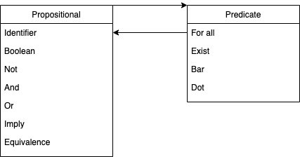
Project Structure
Statistics:
Scanner: 64 lines
Propositional: 164 lines
Predicate: 37 lines
Procedure: 61 lines
Testcase: 21 lines
Testcase: 50 cases
Five notebooks
Scanner
Propositional logic
Predicate logic
Grammar procedures
Test cases
Logic classes

Slide 10
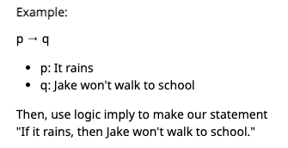
Conclusion
So Far
Translator functions
Insightful to work with
Understand more about the interpreter of recursive definitions
Future Step
Add more logic in predicate part
Improve the translation and fix errors for the evaluator
Add a set of logically related vocabulary to substitute expression
⇒

Slide 11
Demo
Jupyter Notebook is used for interactive demo.

Slide 12
References
Textbook by David Gries and Fred B. Schneider: A Logical Approach to Discrete Math
Propositional Logic in Discrete Math: https://ggc-discrete-math.github.io/logic.html
Propositional Logic Syntax: https://www.logicthrupython.org/chapter01.pdf
Getting Started with the CalcCheck Language: http://calccheck.mcmaster.ca/CalcCheckDoc/GettingStartedWithCalcCheck.html
Getting Started with CalcCheckWeb: http://calccheck.mcmaster.ca/CalcCheckDoc/GettingStartedWithCalcCheckWeb.html
CalcCheck Syntax: http://calccheck.mcmaster.ca/CalcCheckDoc/2019-12-20_CalcCheck-Syntax-Hints.pdf
CalcCheck Theorem List: https://www.cas.mcmaster.ca/~kahl/CS2DM3/2018/2DM3-2018-Mid-November-ThmReference.html

