Slide 1

Decode Chinese stock market with HSMM
Yuning Xie
Dept. of ECE
Boston University
Yanling Li
Dept. of SE
Boston University

Slide 2
2.MODEL SELECTION
1.FEATURE
ANALYSIS
CONTENTS
3.IMPLEMENT

Slide 3
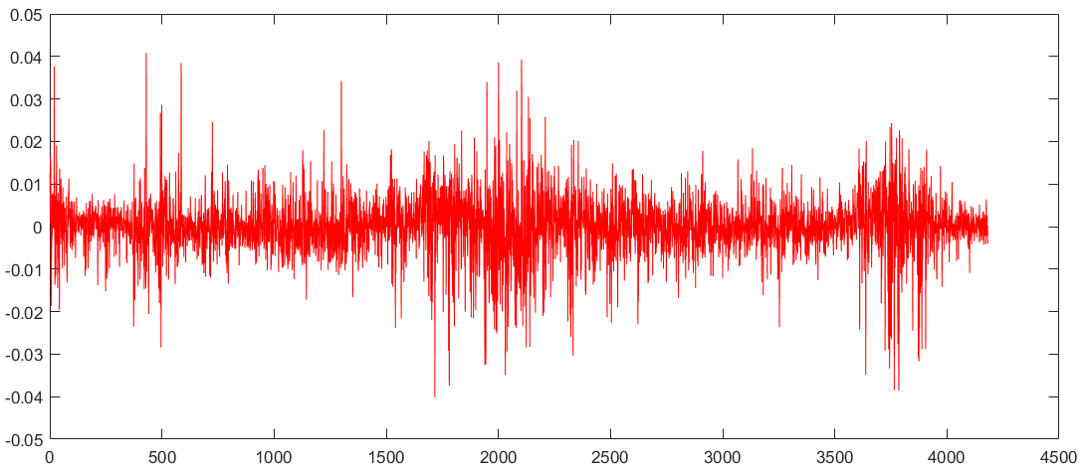
FEATURE ANALYSIS
Collecting data
Daily Returns of Shanghai stock market index
From Jan 1st 2000 to April 17th 2017
Notes:
The raw data is the stock market index of Shanghai Stock Exchange( including the price and )returns. The sample period is from Jan 1st 2000 to April 17th 2017. The number of observations accounts for 4183 in total.
Return=log( today price)-log(yesterday price)

Slide 4
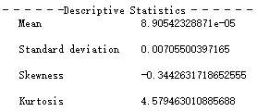
FEATURE ANALYSIS
Analyzing the characteristics of financial time series
Skewness
Measure of the asymmetry of the probability distribution
Kurtosis
Measure of the “tailedness” of the probability distribution
The kurtosis of any normal distribution is 3
Distributions with kurtosis greater than 3 are said to be leptokurtic
Notes:
Skewness(偏度)：负偏度是往右偏is a measure of the asymmetry of the probability distribution of a real-valued random variable about its mean.
Kurtosis(峰度 大于3就比正态分布尖): a measure of the “tailedness” of the probability distribution of a real-valued random variable. The kurtosis of any univariate normal distribution is 3. Distributions with kurtosis greater than 3 are said to be leptokurtic(尖峰值).

Slide 5
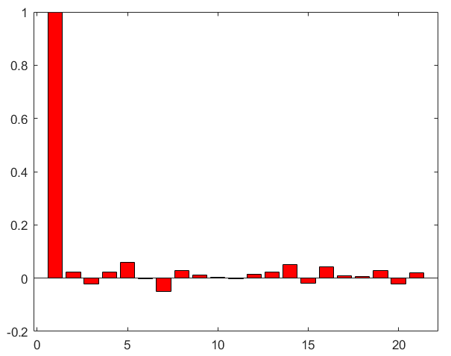
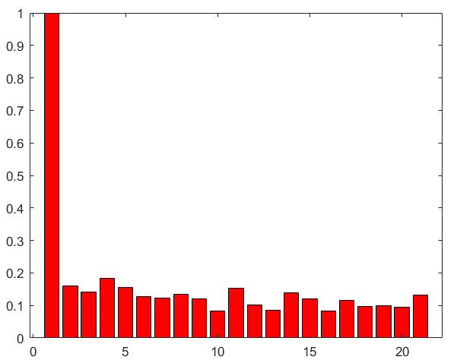
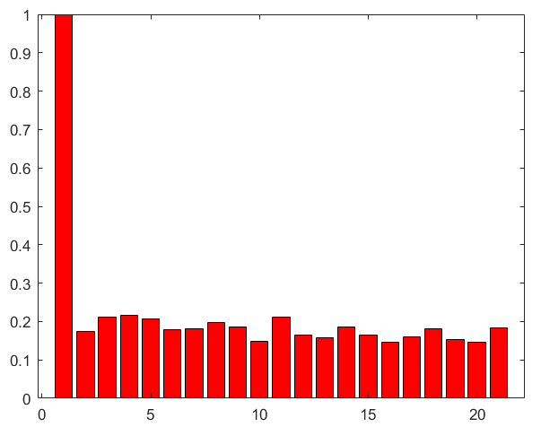
FEATURE ANALYSIS
Analyzing the characteristics of financial time series
Autocorrelation
function
of returns
Autocorrelation function of squared returns
Autocorrelation function of absolute returns
Notes:
while returns themselves are uncorrelated, absolute returns {\displaystyle |r_{t}|} or their squares display a positive, significant and slowly decaying autocorrelation function
the autocorrelation functions are insignificant2 for most lags with a small number of exceptions. Thus,
daily returns are uncorrelated.
股票日收益率的均值可以近似为0，因此日收益率的平方也就可以用来衡量股票收益率的波动。
Both squared returns and absolute returns are two types of volatility measure. The reason behind the “long-memory” could be
volatility clustering, which results from the fact that the volatility of the past returns will affect the volatility of future returns for a
considerably long period of time.

Slide 6
FEATURE ANALYSIS
Data properties
DISTRIBUTIONAL
PROPERTY
TEMPORAL
PROPERTY
LEPTOKURTOSIS
FAT TAILS
VOLATILITY CLUSTING
Notes:
volatility clustering refers to the observation, that "large changes tend to be followed by large changes, of either sign, and small changes tend to be followed by small changes.“
A quantitative manifestation of this fact is that, while returns themselves are uncorrelated, absolute returns {\displaystyle |r_{t}|} or their squares display a positive, significant and slowly decaying autocorrelation function: corr(|r_{t}|, |r_{t+τ} |) > 0 for τ ranging from a few minutes to several weeks.

Slide 7
MODEL SELECTION
01
Why hidden semi markov model
‘fat-tails’
‘leptokurtosis’
Unknown
Distribution
‘Lags and slowly decaying’
‘Choose Semi Markov Model’
Nonnegligible
Past Volatility
Sojourn Time Not Geometric Distribution
Notes:
Considering the following properties of market returns
1.Unknown Distribution Taller Middle than normal distribution and Taller two sides than t-student distribution
##Maybe we can use log likelihood to find which distribution is best way to start
Thus we need to use the hidden markov model. To find the distribution of the returns.
##The observable sequence is the daily returns we get.
##The hidden state is which market/which distribution are we staying.
2.Long-memory property
(Taylor effect) ##First, the intensity of volatility is directly related to it’s duration.
##Second, the returns from stock market will influenced by previous volatility.
A Markov chain or semi-Markov chain is also capable of modelling volatility clustering in a discrete way
3.We should apply semi markov model. Because the time the variables stay in each state is not geometric distributed.

Slide 8
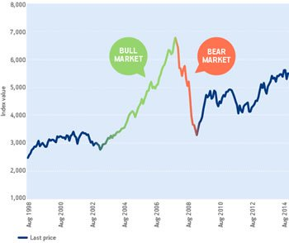

MODEL SELECTION
BULL MARKET: prices are rising or are expected to rise.
BEAR MARKET: prices are decreasing or are expected to decrease.
SIDEWALK: neither bull nor bear.
02
Why 3-states
Notes:
The raw data is the stock market index of Shanghai Stock Exchange( including the price and )returns. The sample period is from Jan 1st 2000 to April 17th 2017. The number of observations accounts for 4183 in total.

Slide 9
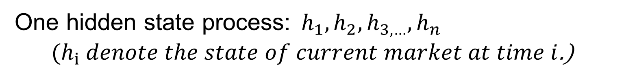

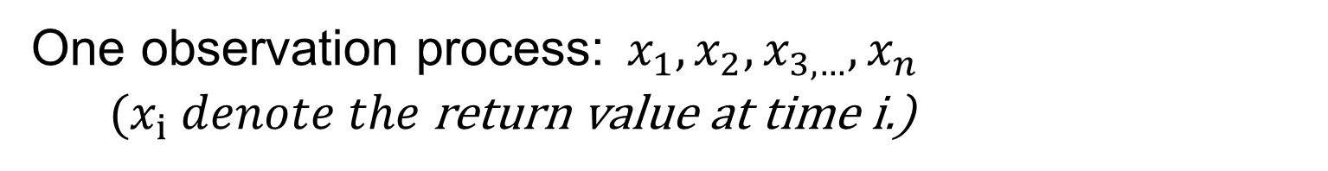







IMPLEMENT
3-States HSMM in Decoding Chinese Stock Market
One observation process:${ x}_{1},x_{2},x_{3,…},x_{n}$
${ (x}_{i} denote the$return value at time i.)
One hidden state process:${ h}_{1},h_{2},h_{3,…},h_{n}$
${ (h}_{i} denote the state of current market at time i$.)
$$γ_{1m}$$
$$γ_{12}$$
$$γ_{2m}$$
$$γ_{ij}=p\left(h_{t+1}=\left.j\right|h_{t}=ⅈ\right)$$
h1
h2
…
hm
$$ⅈ,j∈\left[1,2,…,m\right]$$
$$γ_{m2}$$
$$γ_{21}$$
$$γ_{m1}$$

Slide 10
THANKS

