Slide 1

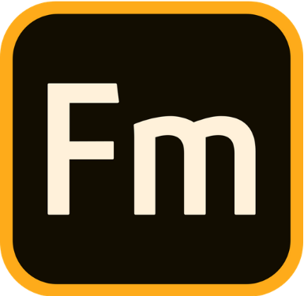


Adobe
FrameMaker
MadCap Flare
Mike Yakavonis
May 12, 2022

Slide 2
MadCap Flare: Favorite Features
Most intuitive (least learning curve)
Core concept of “topics” is black and white
Best option so you’re not tied to a particular layout/format
Multiple output publishing
Fully integrated with Windows apps and standard file types
UI is clean and sleek – much of the “scripting” is concealed in backend
The find/replace feature for locating elements and markup is practical and impressive
Ideal for designing a PDF newsletter, FAQ doc or hardware manual that will require significant diagrams and revisions

Slide 3
Flare’s limitation(s)
Compared to some of the other tools, there aren’t as many shortcuts
Since there are fewer shortcuts, finding the button you need can be annoying
Not the easiest for collaboration/reviews
Can be laggy since it’s hosted on a server (probably more noticeable the larger the document)

Slide 4
FrameMaker

Slide 5
FrameMaker’s shortcomings
It’s old and clunky, and it shows
It’s a…process just to Insert images or perform other basic tasks (i.e., not user friendly)
Once objects are in, they’re not easy to manipulate or move around
Several manual steps compared to newer tools (updating a footer, editing graphics)
Need to rely on storage and other must-haves outside of the application, rather than having everything readily available.

Slide 6
I meant what I said, but…
FrameMaker does have its place in the Tech Writing World
Useful for structuring a book’s layout
It’s been around a long time
Very template-friendly
Easy enough to link files together and move location
Still useful for translating a large document/book into multiple languages

Slide 7
Scenario 5: DITA
Won’t be an issue acquiring an Oxygen or similar license
Many collaborators means many rounds of review and the need to easily track versioning and pick up where someone left off – DITA allows for a paper trail of comments
Assuming the product you acquired is similar to your existing product line, you can use DITA to separate various features so you’re only re-publishing those sections with actual revised content
The ability to target multiple audiences in DITA would in theory allow you to host multiple Wikis, while also having crossover among standard topics
Large Team
Large Company, all the funds
Acquired another product to integrate with existing product
Revamp existing Wiki documentation
Translation

