Slide 1
Less Tech, More Talk
Martine Thomas-Fox,

Slide 2
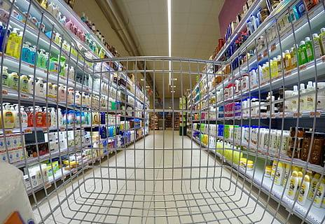
The Destruction of Language Development
Next time you go to the supermarket, look to see how many toddlers are using their parents’ phones as parents throw items in their carts.
This lack of interaction between parents and toddlers appears harmless, but, in reality, language development is in danger!

Slide 3
Why is language development important?
Language development is the foundation for reading and writing skills, allowing children and teenagers to understand and express ideas through written words.
It enables youth to comprehend complex concepts, interact effectively with others, and achieve academic success across all subjects.

Slide 4

So, let’s go back to the supermarket.
When parents engage in conversation with their toddlers about the colors and shapes of fruits and vegetables, they helps their toddlers increase their language to understand the world around them.

Slide 5
Toddlers who are swiping instead of talking, grow up to be children and teenagers who are too distracted to read books.
If youth are not reading, they are not developing reading comprehension skills such as making inference, understanding the main ideas and the supporting details, and summarizing text.
To make matters worse, too much technology limits youth’s critical thinking skills leading to the literacy gap in youth.

Slide 6
Research
Research shows that excessive screen time for young children, can negatively impact language development by reducing opportunities for crucial face-to-face interactions and verbal communication thus leading to delays in vocabulary acquisition and comprehension skills. -LENA | Building Brains Through Early Talk
Research suggests that environmental contexts are key in shaping language development. -Psychology Today

Slide 7

The Benefits of Technology for Children
Technology is not all bad. Children are reading e-books, there are online phonics games that spark children's interest to learn, and interactive word games online can make literacy more engaging and motivating for children of all ages.
The trick is to set an amount of time each day, ranging from fifteen to twenty minutes, for children to be online. When children are on their screens ALL DAY the excitement for learning decreases.

Slide 8

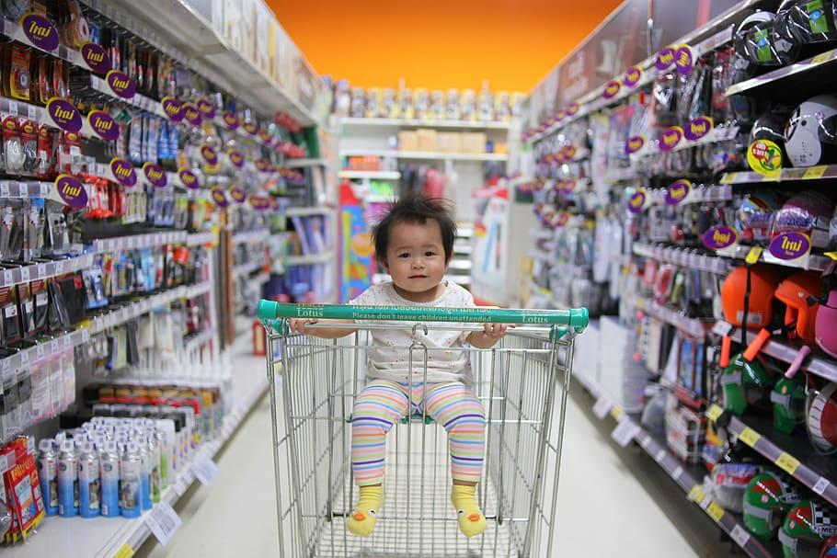
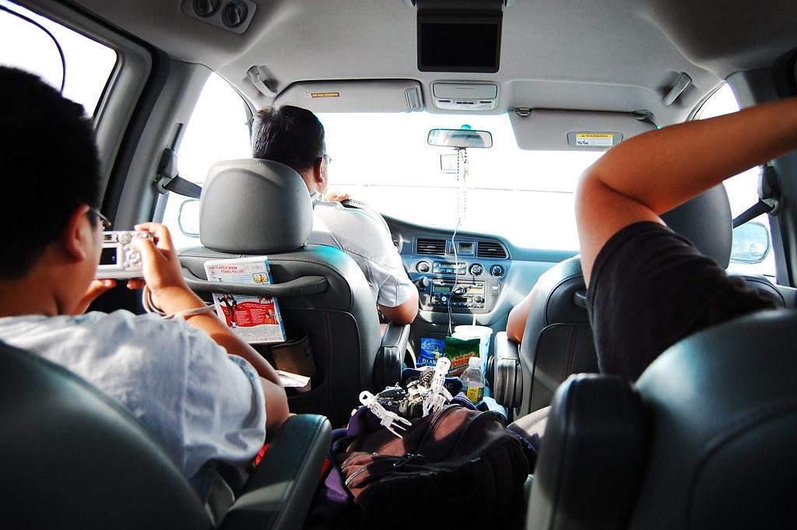
Language Development Activities
Supermarket Chats
Talking & Travel
Singing a Song
While you are pushing your toddler in the shopping, cart,talk to them, named the item you placing in the cart.
Long trip: talk, talk and chat away with your children. Instead of swiping, ask your child about the scenery or play ISpy.
Singing with your child, 0-5, will help them develop their vocabulary skills through rhyming.
Singing with your 0-5 year old is a fun way to share special time with your child while you boost their vocabularies and help them to get to know the rhythms of language.
Singing with your 0-5 year old is a fun way to share special time with your child while you boost their vocabularies and help them to get to know the rhythms of language.

