Slide 1

Welcome to Praat !
Key Acoustic Functions for Linguists and Speech Therapists
Anna Holt
Week 3 Homework

Slide 2
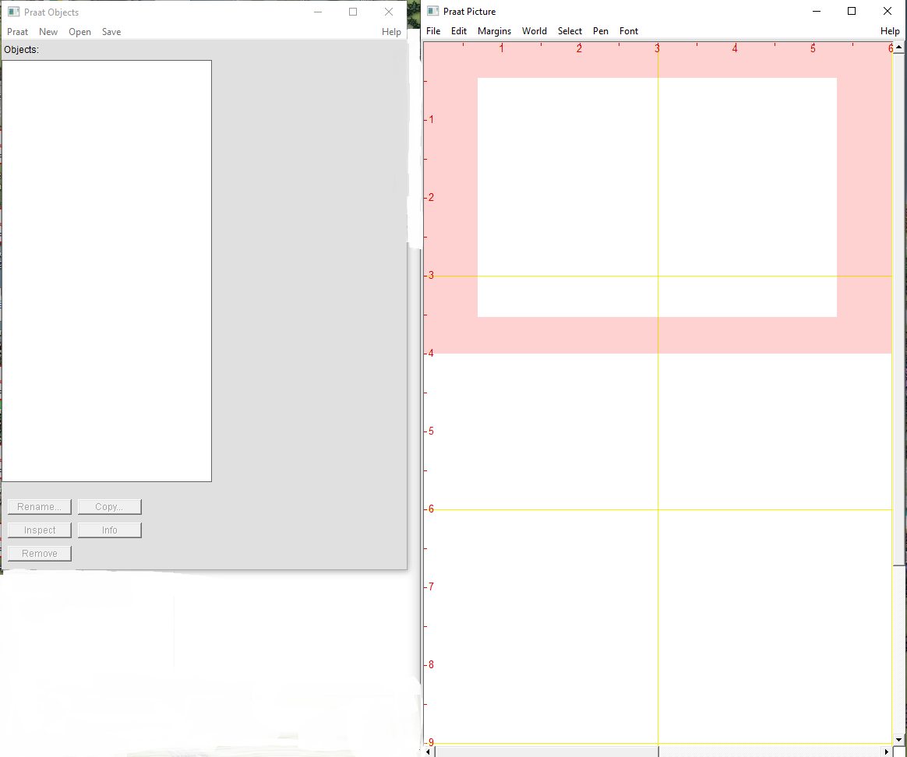
Launching Praat
Picture Window
The Praat Picture window opens automatically. It is used to create publication-quality final images of analyses done in the objects window. Many users choose to close this window immediately upon opening Praat. Minimize or close the picture window using common windows tabs.
Back Next End

Slide 3
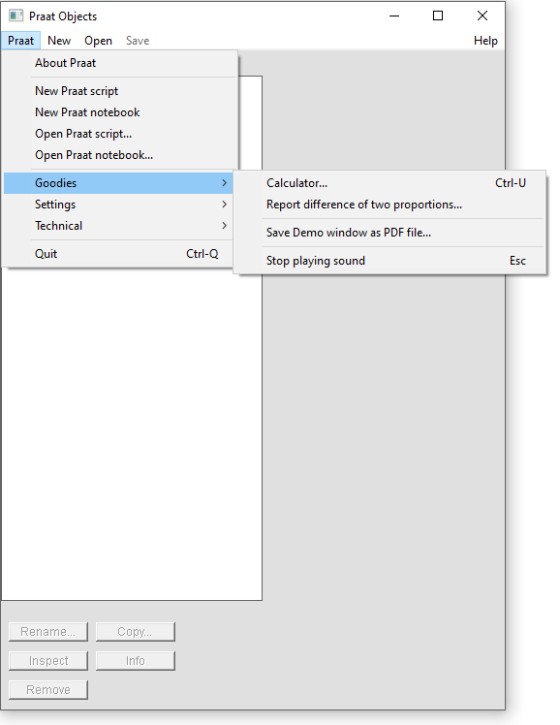
The Praat Object Window: Praat Menu
Goodies Tab
The Praat dropdown window is mostly focused on scripting and other automation tools. It also contains some useful easter eggs hidden under the Goodies tab. These include the ability to save a .pdf screenshot of the current open window as a pdf and even a calculator!
Back Next End

Slide 4
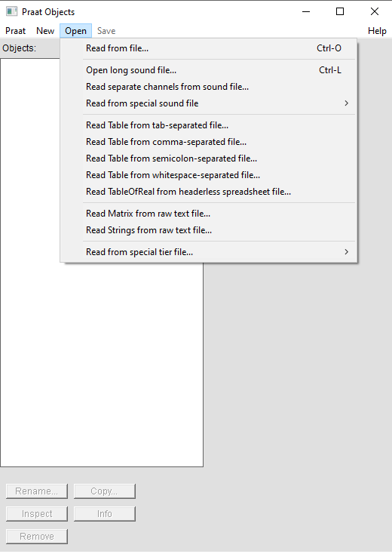
The Praat Object Window: Opening an Existing Sound File
Saving a File
The Save button is greyed out until there is a file in the Object window to save.
Back Next End
Opening a File
The Praat Open dropdown menu contains the most commonly used features for most academic Praat users. Clicking on Read from File enables the user to select an open a file, which will show up as a file name under the Objects whitespace window. Users can have many files open at once. Each will show in a list.
Back Next End

