Slide 1
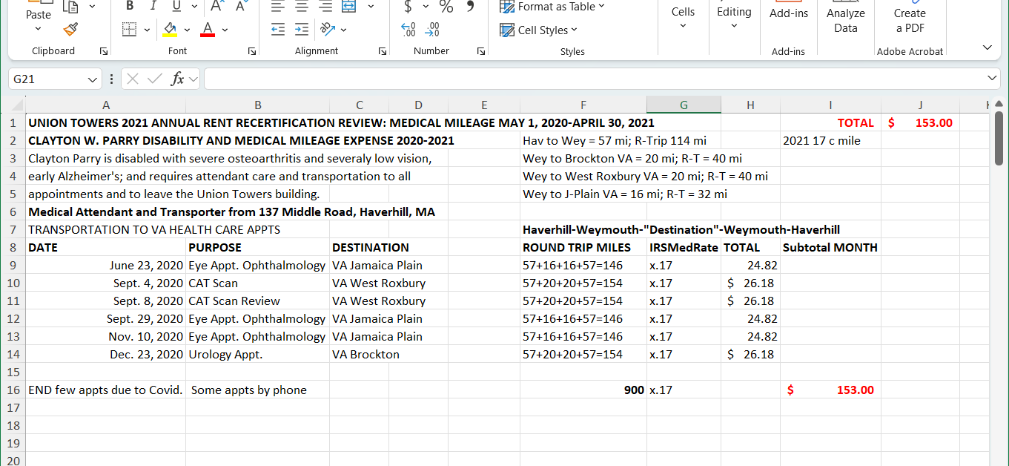
Excel Spreadsheet Tour p.1
Roberta Roffo
Example of using Excel for a Mileage Spreadsheet.
Use Columns A & B & C for information such as:
Appointment dates, Purpose, Destination
All columns can be stretched wider by dragging the line between them as shown here.

Slide 2
Excel Spreadsheet Tour p. 2
In column F, type the mileage for each leg of the trip, and the total Round Trip Miles for each appointment listed
in columns A & B.

Slide 3
Excel Spreadsheet Tour p. 3
In column G type the medical mileage rate
.
In column H type the monetary amount of the Round trip miles for that row x the medical rate. You can make a formula if desired. See slide 4.

Slide 4
Excel Spreadsheet Tour p. 4
Input the Sum formula for this cell: example ==SUM(H9:H15)
into the function box at top to obtain the correct total claim for all medical mileage.

