Slide 1
Garageband: Getting Started with Audio Regions
A Tour Mock-Up
by Anita Weiner

Slide 2
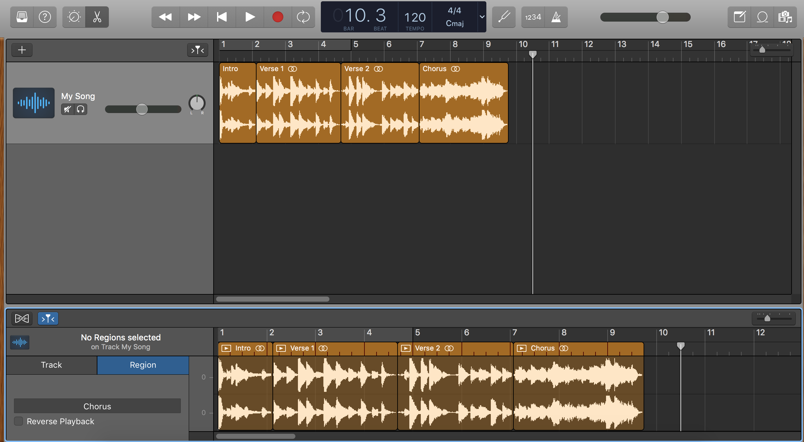
You can divide a track into sections and then edit each section. Each section is called an audio region.
Back Next End

Slide 3
This track currently has four audio regions: Intro, Verse 1, Verse 2, and Chorus. You can create new regions anytime.
Back Next End

Slide 4
This is the Audio Editor window. This is where you create new audio regions for your tracks.
Back Next End

Slide 5
To open or close the Audio Editor, click the scissor button.
Back Next End

Slide 6
To create an audio region, highlight the region you want to create in the Audio Editor and then click the highlighted region.
To highlight, place the cursor in the lower half of the waveform until it turns into a marquee pointer (+) and then drag left or right.
Back Next End

Slide 7
Name your region here
Back Next End

Slide 8
You can edit regions in the Workspace or Audio Editor: move, loop, trim, copy, fade, EQ, and much more. Have fun!
Back Next End

