Slide 1
Final Presentation
Tools and Technologies for tech writers, winter 2026
(Cathy Lavey)
Notes:
Just by way of preface -- I spoke to Zoe a couple of weeks ago, about things heating up at the company where I work. I wasn’t sure if I could get the rest of the homework done, never mind the final project. She basically told me not to worry about it, to just do whatever I could. I’m not planning to look for a tech writing job, so I don’t have a portfolio of samples -- I took this class to help with my current job. So I am presenting my real-life documentation scenario w/o too much else.
[Please feel free to interrupt with questions…]

Slide 2
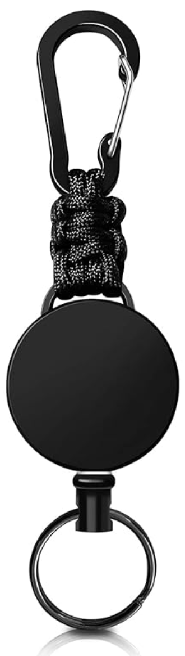
My Background
Senior software engineer (30+ years)
Large & small, commercial & Government work
Includes writing requirements specs, functional & design specs (less so with Agile methodologies), API docs, reference docs, release notes, etc.
Technical writer as needed at several jobs, incl my curr
User guides, operator manuals, reference guides
Last week I turned a quick reference guide (6 double-sided pages) into a 4”x6” laminated flip book on a carabiner and zip reel
Notes:
A little bit about me: I’m a software engineer. Been in the industry for a long time! I have helped develop commercial software and I’ve worked at several government contractors, including the company where I work now. Before Agile, writing was a good part of an engineer’s job, although usually the audience was other engineers. I have also sometimes written user documentation.
What hat(s) I wear is dependent on the size of company and what we’re producing. The two largest companies I’ve worked for both had over 100,000 employees worldwide. The smallest place I worked had two. Those smaller companies are where I’ve sometimes worn a hat as a tech writer, in addition to writing code.
I’m at a smaller company now, and I’ve been wearing both hats. That’s the reason I signed up for this class. The documents I’ve written over my career have all been in Microsoft Word (barf), and I was hoping to learn about what other options are out there, for our upcoming documentation needs.
There was too much text on this slide -- I wanted to put in a picture, so I’ll mention the set of user documentation I’ve been working on most recently; it includes a 50+pg operator manual, a 30pg user interface guide, a 10 page UI quick reference guide, and a week or so ago I turned the quick reference into a 4”x6” laminated flip book. We put that onto a key ring on a zip reel, with a carabiner to hook onto anything handy when users are out in the field (and I do mean – REALLY out in a field).

Slide 3
How (Some) Government Research Works
Small Business Innovation Research (small bus. <500 empls)
Small Business Technology Transfer (usually involves a small business partnering w/a college or university)
SBIR/STTR program officially started in 1982 by the Small Business Innovation Development Act
Periodically renewed by Congress
Find out about SBIR/STTR programs at https://www.sbir.gov
Notes:
I’m going to make a brief detour to talk a bit about research. One of my Government jobs was at Raytheon (which is now RTX), developing C++ software for a large Government contract. The other two govt jobs I’ve had have been for companies that do government research. The Small Business Innovation Research program was started in the early 80s, with a number of goals behind the legislation; lawmakers wanted to:
1) promote American technological innovation; 2) help businesses commercialize and sell their new technologies; and 3) encourage economic growth by creating jobs.
A lot of high tech, medical, and biotech research starts in academic institutions, then moves to startups with their inventors; hopefully those grow and further develop their tech to the point of receiving venture capital investment, and then move to commercialization. SBIR grants help businesses with money to get from their very early stages of development, to VC investment and/or productization.
The SBIR Act is still going strong after 44 years. According to my congressional representative, it’s considered one of the most successful pieces of legislation in US history.
Why is this important?

Slide 4
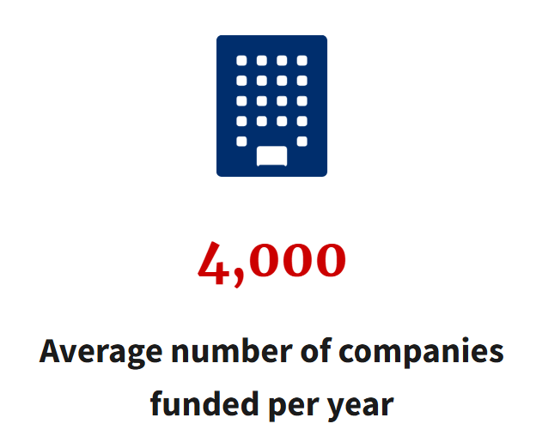
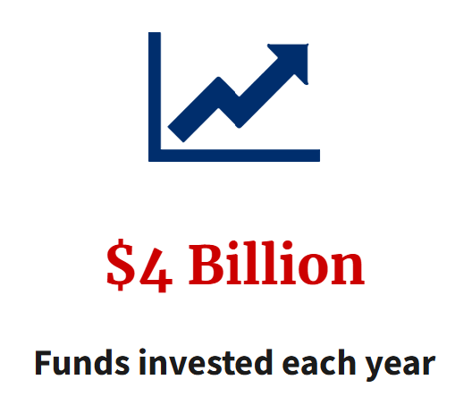
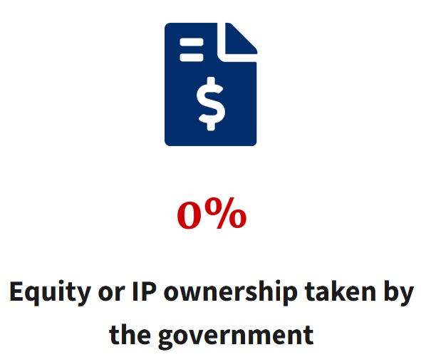
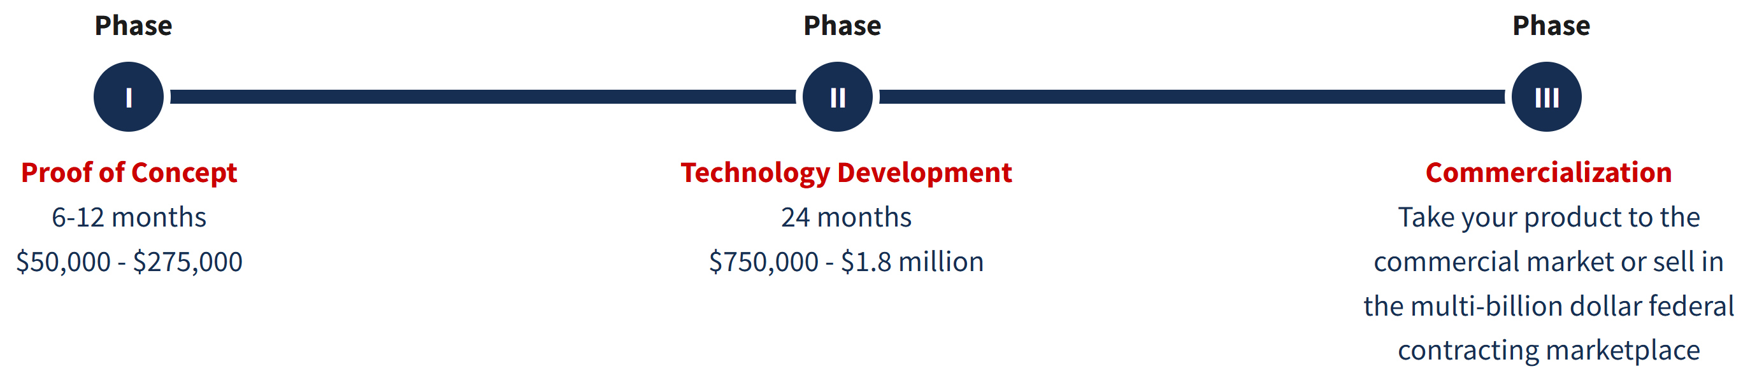
How (Some) Govt Research Works (cont.)
(All graphics from https://www.sbir.gov.)
Coordinated by the Small Business Administration and funded through participating federal agencies: USDA, DOC, DOD, DOE, ED, HHS [incl’s CDC, FDA, NIH], DHS, DOT, EPA, NASA, NSF
Notes:
I took these graphics directly from the SBIR website. The Department of Defense has the biggest research budget of all the fed agencies; there is a TREMENDOUS amount of our current everyday technology that originated from the DoD, including microwave ovens, GPS, and drones. One of the requirements when proposing DoD SBIR research is that there must be what’s called a “dual-use” capability – a commercial need and market for what is being researched and prototyped.
The second biggest budget comes from Health and Human Services, for medical and biotech research; they fund the CDC, FDA, and NIH.
There is a proposal and evaluation process, and there are a number of stages to go through in developing whatever your prototype or product is. It is not quite as simple as the lower graphic illustrates. At my current company, the software we’re developing started from a Phase I SBIR ($250K for six months, although it can vary w/organization), and has gone through multiple Phase II, Phase III, and BAA awards, over the course of more than 11 years and $20 million. Right now, we have a core group of four people working on it, with at least 15-20 more who’ve come and gone over my 9 years, and that does not count people loaned from other groups in our company or summer interns.

Slide 5
My (Real Life) Documentation Scenario
Small company, founded 1990ish
~100 employees; 40% Ph.D.s
Has doubled in size since I started there in 2017
Does mainly Government research (SBIRs & BAAs*):
Computer vision, w/estimation & optimization algorithms
Software modeling and simulation
Proof of concept projects with robots
Sometimes full prototypes with software
*Broad Agency Announcement; like SBIRs, but lots more $$$/time/staff when you’ve proven you can manage smaller programs, and you’ve developed a good commercial & Govt network in your specific research area.
Notes:
So here’s my real-life documentation scenario.
We are a small company, roughly 100 people. Up until the past 10-12 years, we’ve done mainly SBIRs, but management started to realize that that was not a sustainable way to grow the company. We’ve been pushing for awhile to turn some of our longest-running programs into actual saleable software products.
We do a lot with computer vision, with estimation and optimization algorithms; a lot of modeling and simulation.
We once partnered with a university to design and test a new shape for an airplane wing. (I didn’t see the wing, but the project lead asked me to review the manual and give some feedback.)
We’ve worked on developing aircraft collision avoidance systems and non-GPS navigation.

Slide 6
Documentation Scenario (cont.)
My group has developed autonomy software that allows a mobile robot to perform higher-level tasks that would otherwise need human supervision. (These are mainly robots being used by the Army.)
Software is close to being a minimum viable product (MVP)
Have received an order for 40+ units – hardware with software licenses – for evaluation
Need to produce (minimum): safety documentation, etc.
May need (???): training materials, user guides, reference guides
1 technical writer*
*Research engineers are usually good writers, but they’re mainly academics, which is a different kind of writing.
Notes:
My group is working on autonomy software that allows a mobile robot to perform higher-level tasks. Any soldier who’s piloting a robot is 1st) pinning down the squad, which is dangerous; 2nd) needs another squad member to protect them while they’re operating the drone; and 3rd) those two may need someone protecting them as well. Using a tablet to send the command “go search this area and tell me if you see any people with weapons” is a much safer and more efficient way for a squad of soldiers to do reconnaissance before they enter an area.
We’ve partnered with a robotics manufacturer. We’ve just sold 40 systems for evaluation, we’ll be loading their systems with our software. We’ll need to produce documentation, figure out how to do tech support, handle bug tracking and software releases for bug fixes. There’s a lot that has to happen in the next few months to make this all come together, in a company that has never dealt with selling products before.
One of my concerns is that we’ve been working with various groups of soldiers field-testing our systems, but we don’t have a good handle yet on WHAT KIND of user documentation they’ll need or want. So far, they basically want to take it out of the box, power it on, and go.

Slide 7
My Doc-related Recommendations (to my mgmt & coworkers)
Git: already using for our code (I curse at it just as much there as I did during this class!)
Our IT dept is working on an automation pipeline for our software
I’m hoping we can integrate doc generation into that
Talked to tech lead about DITA and single source for our docs
He had it Googled and was on board before I finished my second sentence
Also liked the fact there are Visual Studio Code extensions for DITA
Notes:
We are already using git (I hate it just as much at work as I did for this course, although had fewer nightmares with merges here.) Our IT department is working on standing up an automation pipeline for our software releases. (At some point we’ll have to figure out how to do over-the-air software updates.) I’m hoping they can set up some doc automation too, once we figure out what we’ll need.
I’ve already talked to our tech lead about DITA and OxygenXML Editor and Author. Chris had Googled DITA before I finished my second sentence, and was on board right away.

Slide 8
My Doc-related Recommendations (to my mgmt & coworkers)
Budget is uncertain
We should be able to foot the bill for a few OxygenXML licenses
I will also research other options for software to handle DITA
We have a UX subcontractor overhauling our tablet-based UI
I asked on last week’s call whether the text is isolated for translation – it is
They are also supposed to provide a video tutorial of the user interface, to be accessed from a Help menu. I may or may not get involved in that (after reviewing Weeks 10, 13, and 14)
Notes:
I am not certain what our budget is for doc tools, but we SHOULD be able to get a couple of software licenses, whether it’s for OxygenXML or something else similar to it. I’ll have to research what else is out there, just for the sake of doing our due diligence, and for targeting something that will support our doc needs – once we figure them out..
We have a subcontractor who’s redoing our user interface. The engineer who originally worked on it moved on, and while he had a good background in Java, he did not have UI design experience. I touched base with them on isolating the UI text for translation; they’ve got that covered. They are working on a video tutorial – I can’t remember whether that will be explanatory (“this does this thing, that does that function, etc.”) or demonstrative (“this shows the steps to perform function X”). Whether I can or should be involved with that may depend on the doc budget and maybe the politics of the relationship. I think they’re a new vendor for us, and I’m not sure how we connected up with them. I want to talk to my manager and tech lead about that.

Slide 9
Thank you, and good luck!
Questions?
Notes:
I’ve enjoyed learning alongside you all. I wish you all the best in your tech writing careers.
Zoe, thank you so much for introducing us to everything we’ve covered these past 15 weeks. I’m going to put some of this information to use in my job fairly quickly, so this course has absolutely been very useful, and I’m grateful for your willingness to share your expertise.
Any questions?

Slide 10
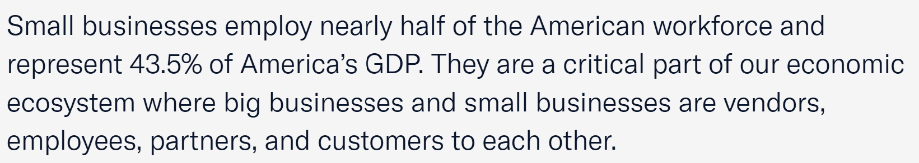
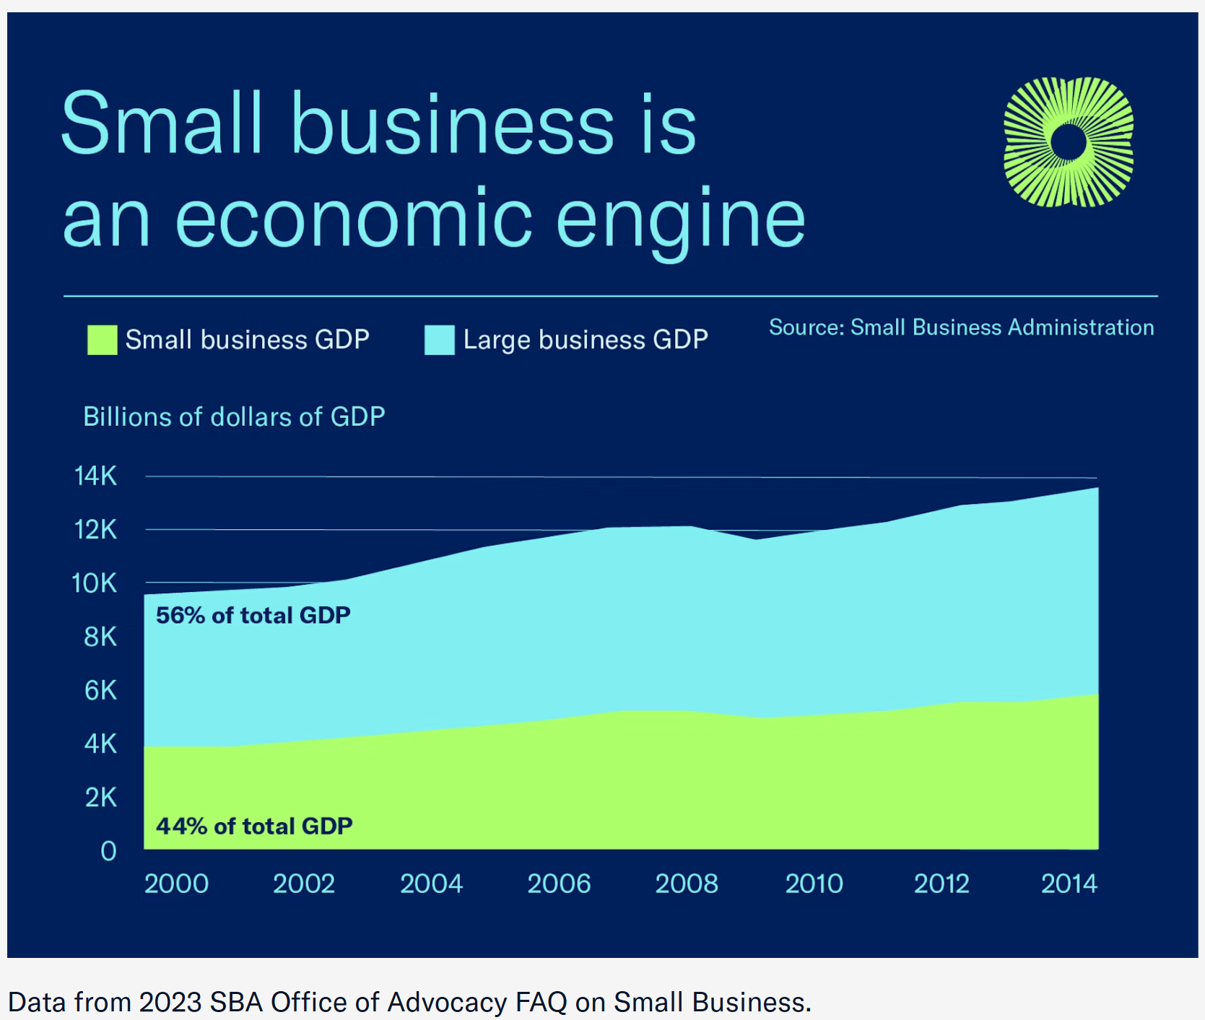
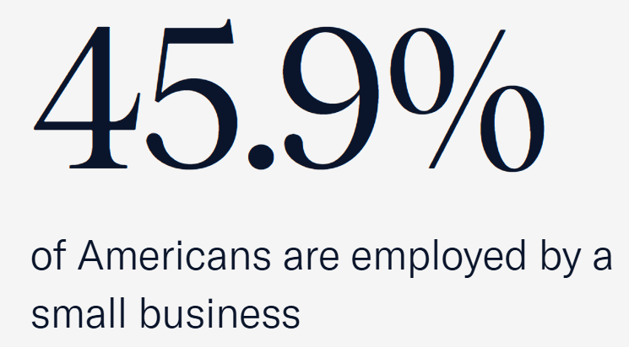
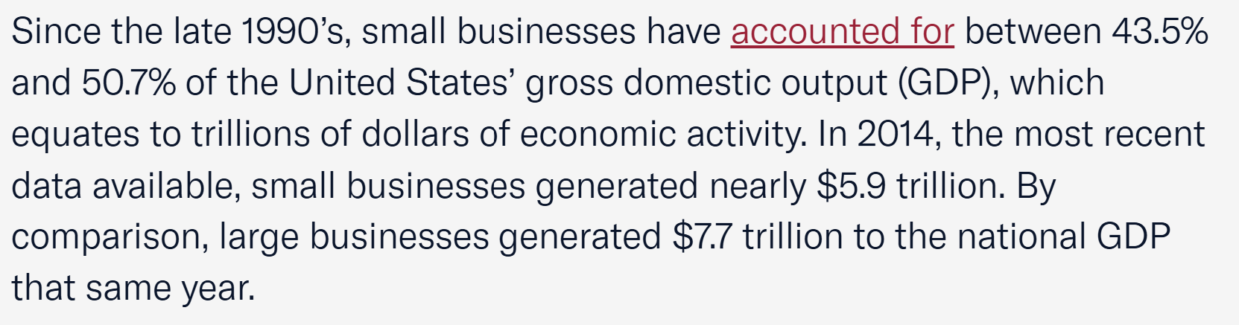
The US Runs on Small Businesses
*
*
*
*
*Source: https://www.uschamber.com/small-business/small-business-data-center
Notes:
Because the US runs on small businesses. All the information on this slide is taken from the US Chamber of Commerce’s website, on the Small Business Data Center page. The rest of what’s on that web page is eye-opening, as far as how small businesses drive our economy. Small businesses employ almost half the American workforce, and produce almost half of the nation’s gross domestic output. Take a look at the dollar figures I underlined in the lower left quote: in 2014, small businesses generated almost 5.9 TRILLION dollars of the national GDP. Large businesses generated 7.7 trillion.

