Slide 1

EA-MT
Entity-Aware Machine Translation in English to Chinese
Team4 Jou-Yi Lee 2024/12/2

Slide 2
Contents
6 – EA-MT
Evaluation Flowchart
1 – Introduction
2 – IWSLT En-Zh Dataset
7 – METEOR
3 – EA-MT Flowchart
8 – HIT-CIR (Tongyici Cilin 同義詞詞林)
WordSimilarity Dataset
4 – NER - SpaCy
9 – OpenHowNet
5 – mBART
10 – Evaluation Results

Slide 3
PART.01
Introduction
EA-MT : Entity-Aware Machine Translation English to Chinese

Slide 4
Introduction Section
Challenges in NER
Study Focus
Objective
Contextual Ambiguity :
Apple (Fruit? Or Company?)
Multi-word Entities:
literal translations often produce awkward outputs.
Department of Justice 司法部
Cross-lingual Consistency :
Entities can have multiple valid translations
IWSLT 2017 NER Translation Task
SpaCy for NER
mBART
Integrates these entities into a machine translation model
Enhance Translation Accuracy
Named Entity Translation Model
Maintain context and semantic accuracy when doing cross-lingual machine translation jobs.

Slide 5
PART.02
IWSLT En-Zh Dataset

Slide 6
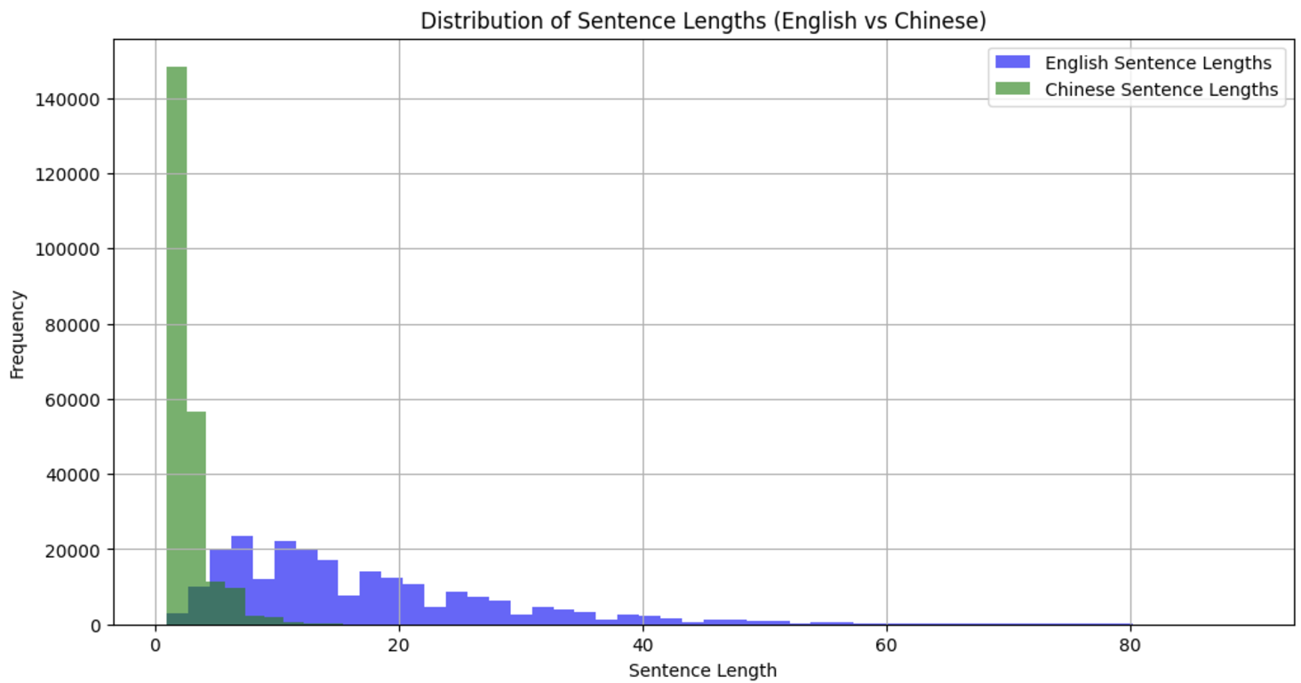
IWSLT
IWSLT 2017 En-Zh
IWSLT is Real-World conversation dataset.
English sentences are longer than Chinese sentences.
The Chinese language is character-based.

Slide 7
Linguistic Structural Differences
Character-Based vs. Word-Based
Word Order and Syntax
Chinese uses characters as the smallest semantic units.
English follows a strict Subject-Verb-Object (SVO)
Chinese allows flexible structures.
Example:
[The dog is on the mat.]
(6 English words)
[狗在墊子上]
(5 Chinese characters)
Example:
[I like this book]
Standard Chinese
[我喜歡這本書]
Emphasis:
[這本書，我喜歡]
These will cause inaccuracies in translation

Slide 8
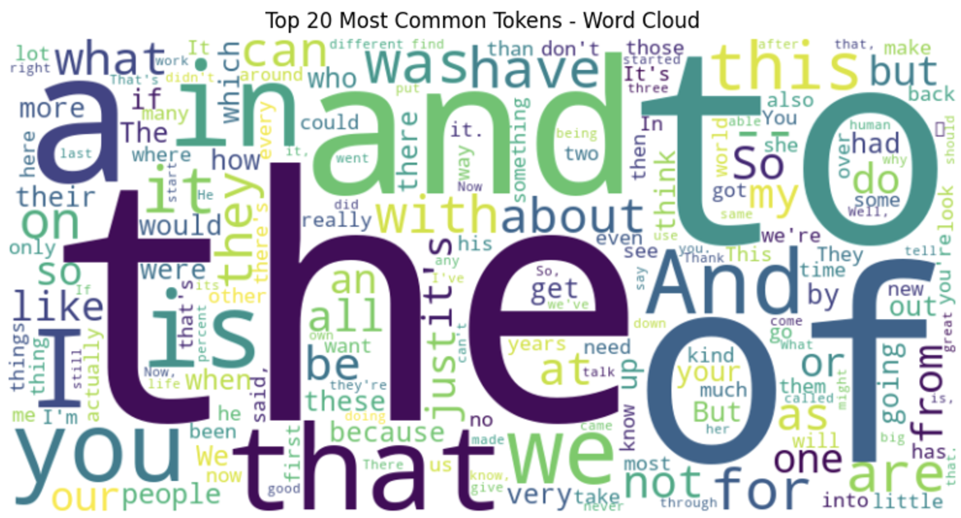
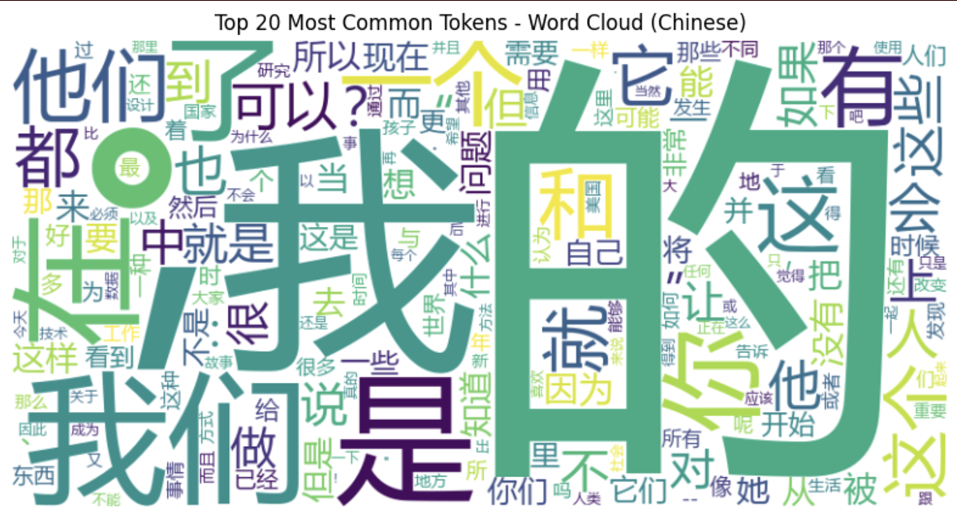
Word Cloud Analysis
Common function words
(e.g., "the," "and," "to ,"of")
High-frequency tokens
(“的,”“是,”“我,“)
Conform to Zipf's Law

Slide 9
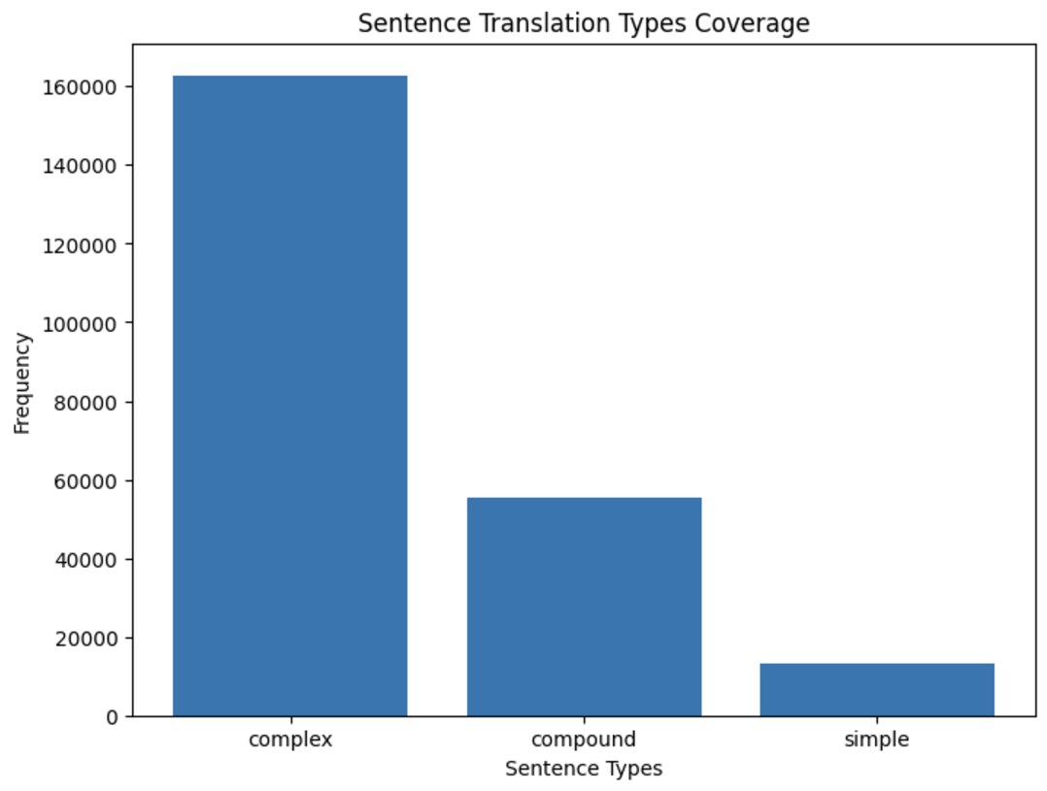
Sentence Type Analysis
Complex Sentences:
Have “because,” “although”
Compound Sentences:
Have "and" or "but
Implications for Machine Translation
Character-Based vs. Word-Based
Word Order and Syntax
Zipf's Law
Different Sentences Type

Slide 10
PART.03
EA-MT Flowchart
Entity-Aware Machine Translation Flowchart

Slide 11
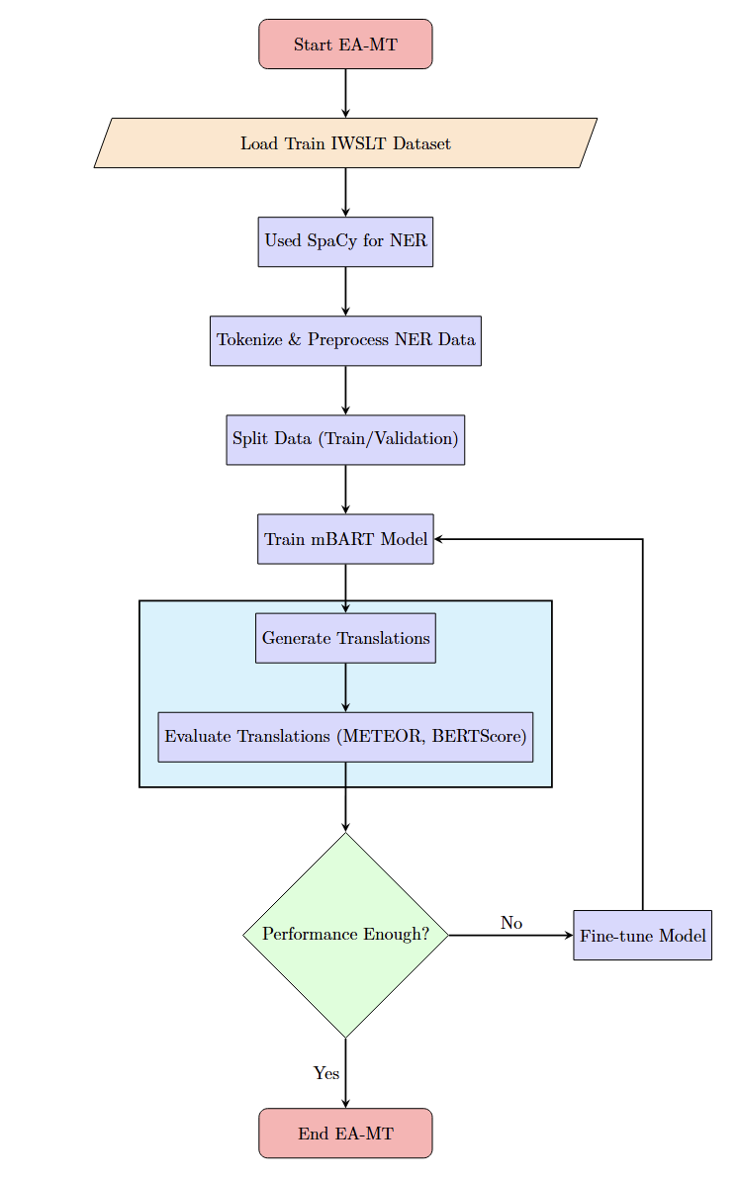
EA-MT Flowchart

Slide 12
PART.04
NER - SpaCy
Named Entity Recognition using

Slide 13
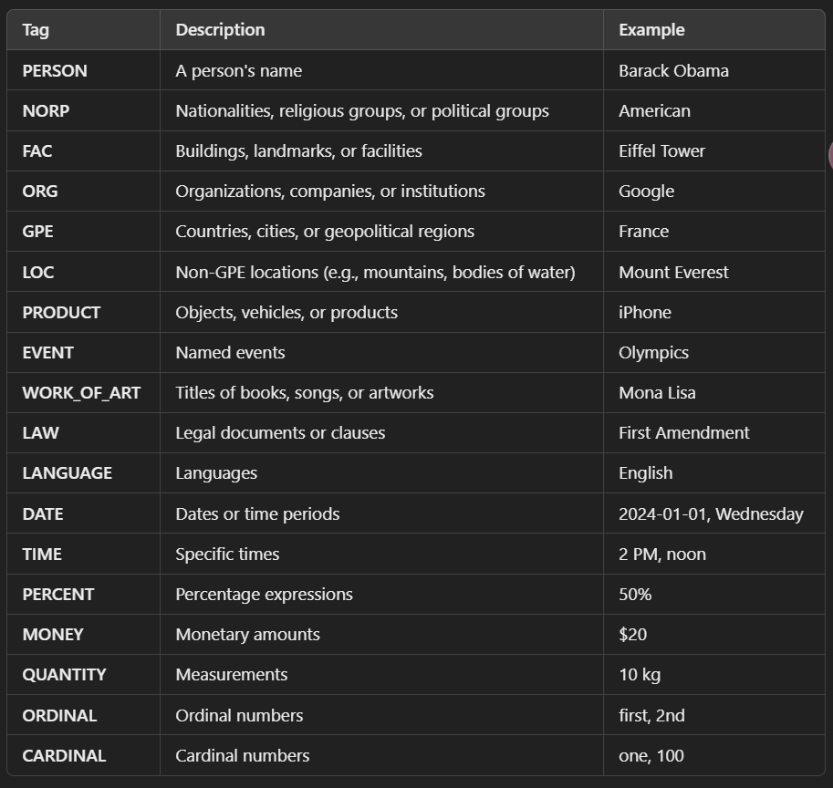
Named Entity Translation Process
SpaCy:
Transformer-based NER model
Used (en_core_web_trf) model
<<Entity Label : Entity Text>>
Improved the model's awareness of named entities
<<ORG：Apple>>
SpaCy: Have 18 different Tags

Slide 14
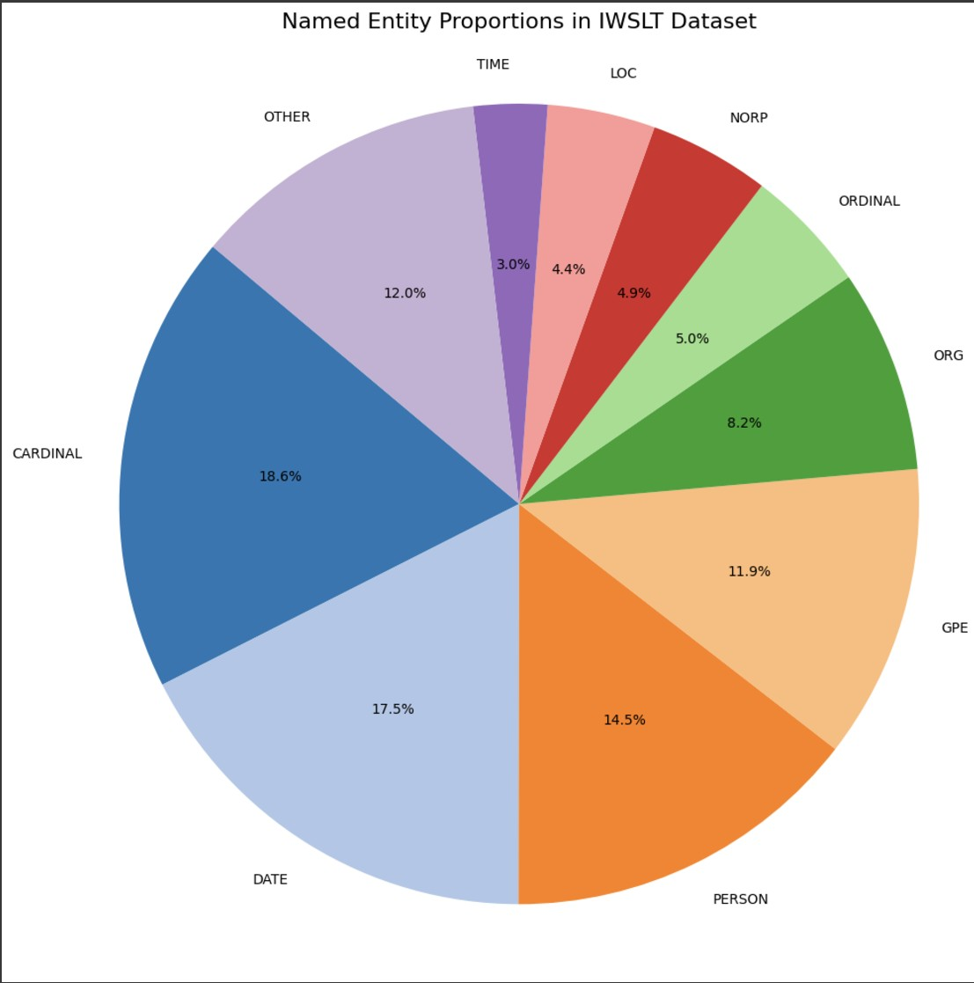
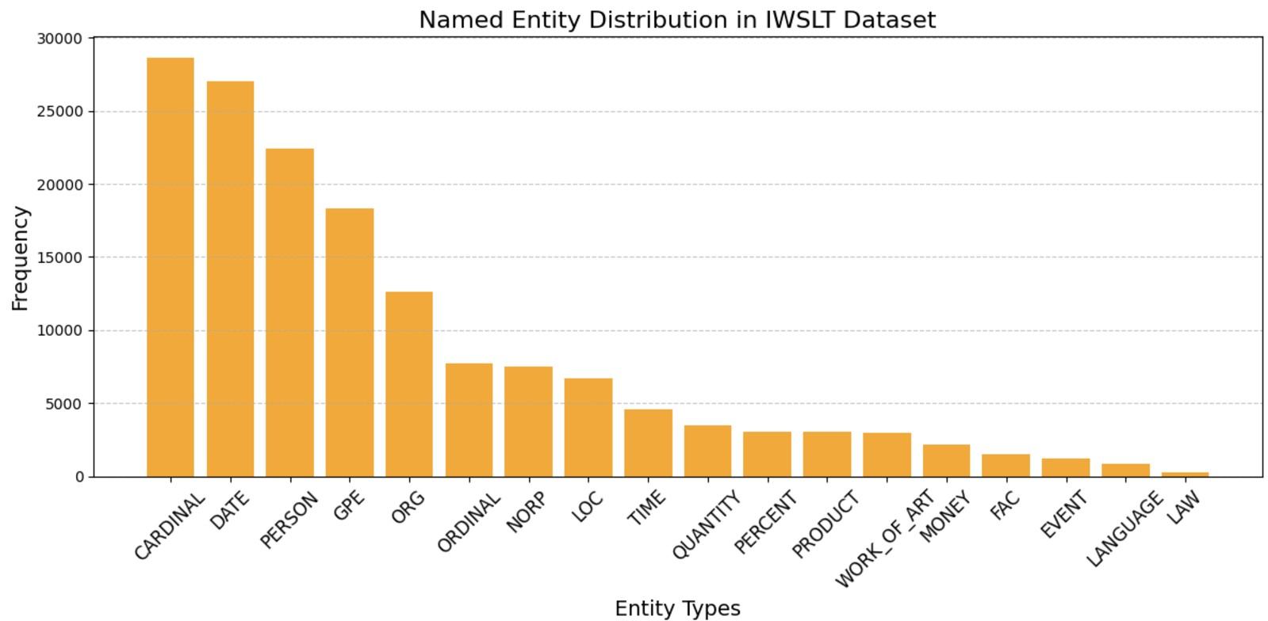
Visualization of NER Tag Distributions
CARDINAL and DATE tags account for 36.1% of all named entities.
Entities are mainly distributed in 10 categories.
Base on this We can adject the weight of the model.

Slide 15
PART.05
mBART
mbart-large-50-many-to-many-mmt from Meta AI

Slide 16
mBART
Architecture
Model
Encoder-Decoder Architecture
Developed by Facebook AI
mbart-large-50-many-to-many-mmt
12 layers for both encoder and decoder
Hidden dimension: 1024
Model Comparing
mBERT :
bidirectional Transformer model
Understanding tasks & question answering
mBART:
Good at multilingual sequence-to-sequence tasks
mBART25 => 25 Language
BLEU improvement 12 point
Configurations of mBART50
Many-to-One (N→1)
One-to-Many (1→N)
Many-to-Many (N↔N

Slide 17
PART.06
EA-MT
Entity-Aware Machine Translation

Slide 18
EA-MT
Process the entity From SpaCy to <<Entity Label : Entity Text>>
Set Source language (en_XX) and target language (zh_CN)
Used Tokenizer to padding and truncation let max length 256
IWSLT Train Data split: 90% for training 10% for validation
Used A100 from Google Colab
Hyperparameters
Learning rate: 1×10^−5
Stability during fine-tuning
Batch size: 4 : Prevent GPU memory overflow.
Regularization :Weight decay set to 0.01.
EarlyStoppingCallback :It will stop if there is no progress after 3 Epochs.

Slide 19
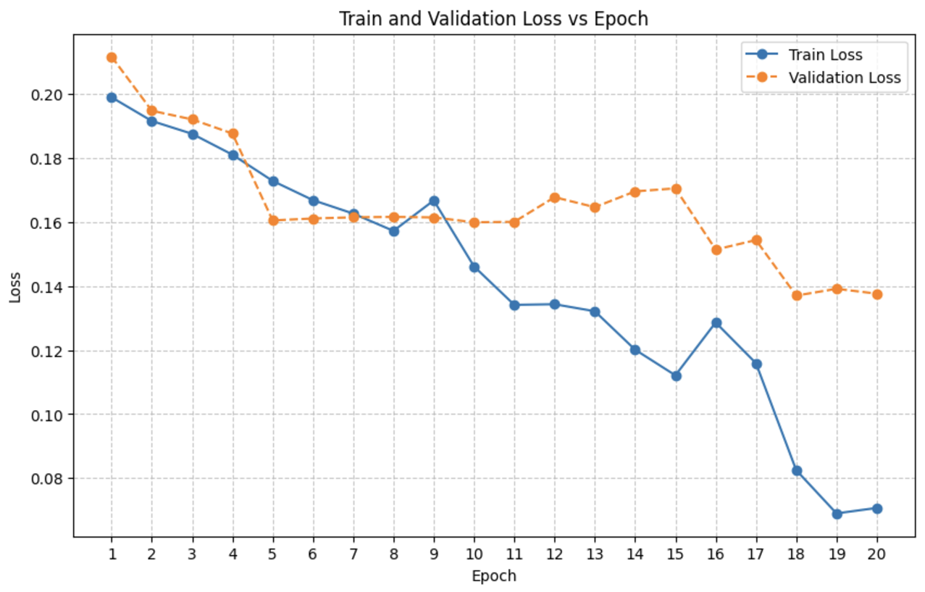
Training and Validation Loss
Training Loss :
From 0.1989 (Epoch 1) to 0.0707 (Epoch 20)
After 10 Epoch model Improved a lot
Validation Loss:
From 0.2116 (Epoch 1) to 0.1376 (Epoch 20)
Fluctuations starting from Epoch 10 stabilized near 0.14.

Slide 20
PART.07
EA-MT
Evaluation Flowchart

Slide 21
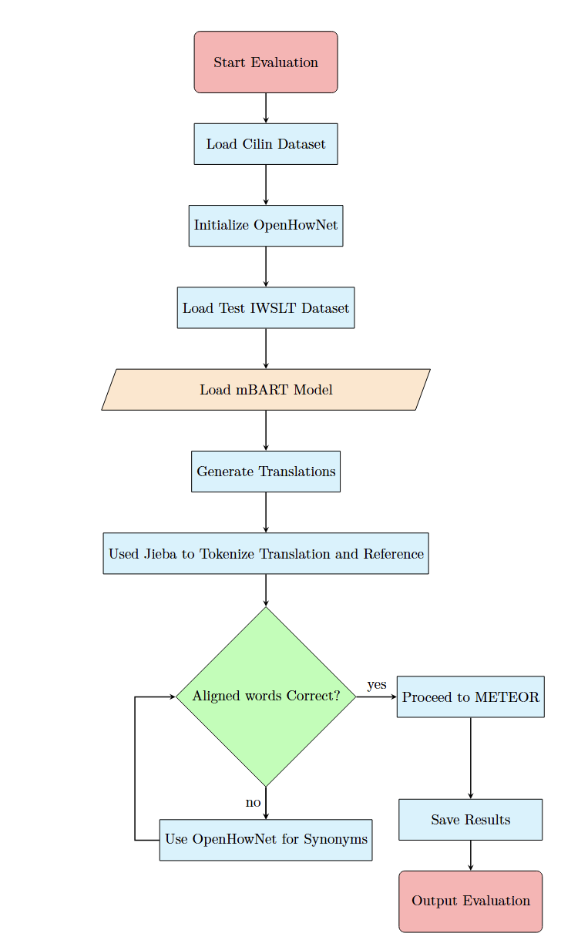
EA-MT
Evaluation Flowchart

Slide 22
PART.08
METEOR & Jieba
Evaluation Entity-Aware Machine Translation

Slide 23
METEOR
METEOR Score : 0 ~ 1 0 = Completely wrong translation
1 = Translated completely correctly
Overall METEOR Score: 0.04137237761331027
============================================================
"Original Text": "Day four.",
"Reference Text": "第四天。"
"Translated Text": "第四天。"
METEOR : 1
============================================================
Original Text: You know, we wake up in the morning and we feel we make decisions.
Reference Text: 我们早上起来，觉得可以主宰自己的决定，
Translated Text: 大家知道,我们早上起来后,我们感觉自己要做决定。
METEOR : 0
============================================================
Original Text: If they want sad music, they just play those two notes.
Reference Text: 他们就不停的用这两个音符。
Translated Text: 如果他们想要悲伤的音乐,他们就只演奏这两段音符。
METEOR : 0
============================================================

Slide 24
METEOR
Tokenization Issues:
METEOR's design for clear word boundaries.
English : "This is a book" => ["This", "is", "a", "book"]
Chinese : "这是一本书" => ["这是一本书"]
Solution : Jieba is Chinese segmentation tool
Jieba : "这是一本书“ => [“這”， “是”， “一本”， “書”]
Differences in the punctuation (comma) format.
Used regular expressions to delete comma.
Lack of Built-in Synonym Support for Chinese
METEOR used WordNet for Word-Similarity matching, not support Chinese.
Harbin Institute of Technology Word-Similarity Wordnet
Not Enough Attention in Word-Similarity Dataset
Harbin Institute of Technology Word-Similarity Wordnet not enough
OpenHowNet.calculate_word_similarity to match Word-Similarity
OpenHowNet.calculate_word_similarity => 0 ~1

Slide 25
PART.09
HIT-CIR & OpenHowNet
WordSimilarity Dataset& Calculate Word Similarity

Slide 26
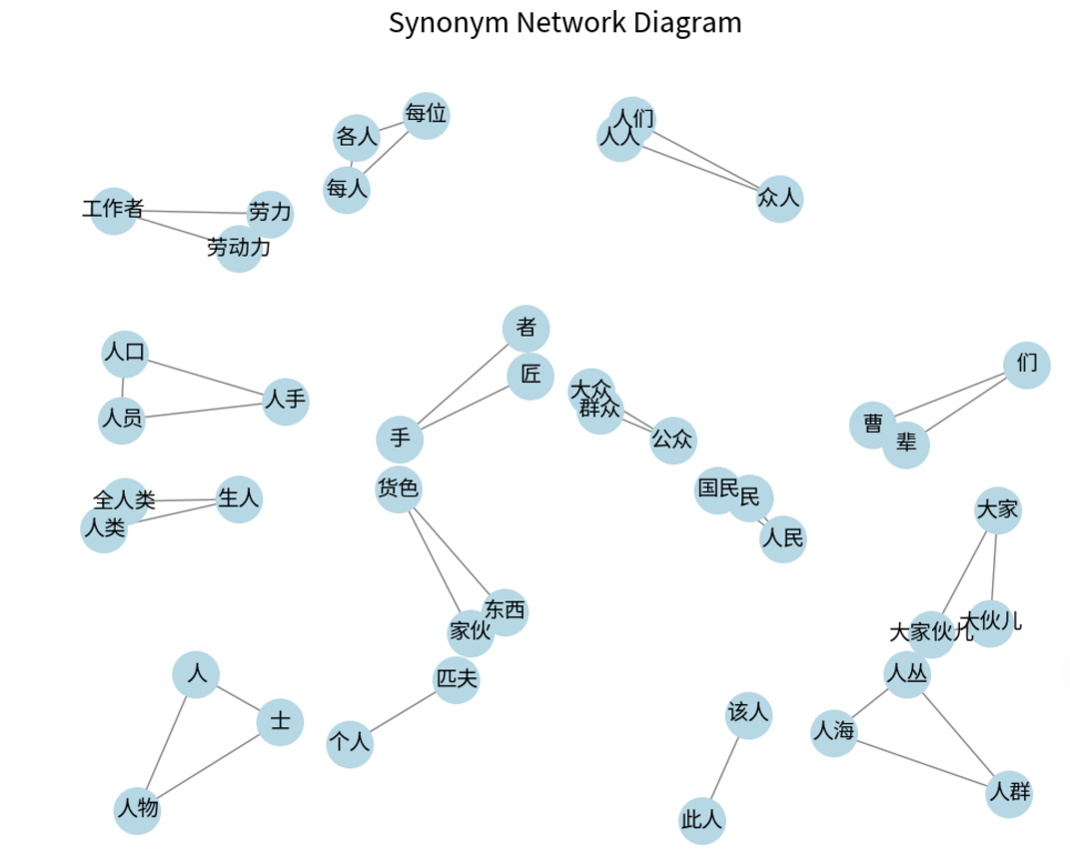
HIT-CIR Word-Similarity
HIT-CIR ≈WordNet
Organized into five levels:
Top-level categories (e.g., "Person", "Object").
Subcategories (e.g., "Human Behavior").
Specific subcategories.
Semantic units.
Individual words or phrases.
OpenHowNet.calculate_word_similarity
0 : Not match
1 : Completely match
0.7 :considered synonyms

Slide 27
PART.10
Evaluation Results
Entity-Aware Machine Translation Result

Slide 28
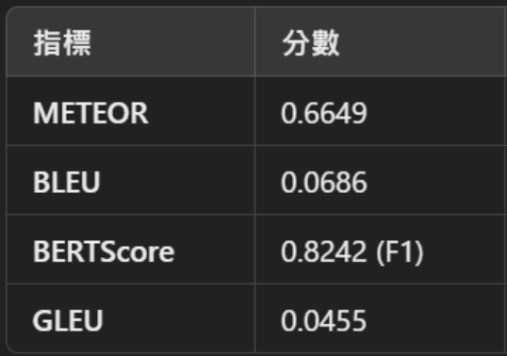

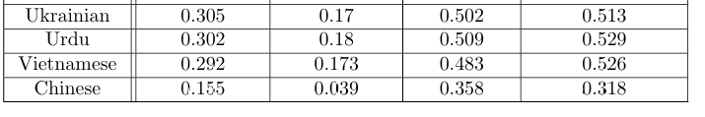
Evaluation Results
Overall METEOR: 0.6649
Reflecting strong semantic and structural alignment.
BERTScore:
Precision: 0.8008
Measures the proportion of content in the generated translation that correctly aligns with the reference.
80.08% of the content in the generated translations matches the reference translations.
Recall: 0.7933
Measures the proportion of the reference content covered by the generated translation.
79.33% of the reference translation’s content is successfully captured.
F1: 0.7965
Harmonic mean of Precision and Recall, providing a balanced evaluation metric.
Reflects a good balance between translation accuracy and semantic coverage.
BLUE: 0.0686
0 : Not match
1 : Completely match
Automated Multi-Language to English Machine Translation Using Generative Pre-Trained Transformers

Slide 29
Conclusion
EA-MT English-to-Chinese system :
SpaCy for NER
mBART for multilingual machine translation.
Enhancing evaluation metrics:
Jieba Chinese tokenization
HIT-CIR& OpenHowNet synonym matching
METEOR score of 0.6649
BERTScore (F1: 0.7965)
Demonstrating superior translation quality and semantic alignment.

Slide 30


