Slide 1

EA-MT
Entity-Aware Machine Translation in English to Chinese
Team4 Jou-Yi Lee 2024/12/2

Slide 2
Contents
6 – EA-MT
Evaluation Flowchart
1 – Introduction
2 – IWSLT En-Zh Dataset
7 – METEOR
3 – EA-MT Flowchart
8 – HIT-CIR (Tongyici Cilin 同義詞詞林)
WordSimilarity Dataset
4 – NER - SpaCy
9 – OpenHowNet
5 – mBART
10 – Evaluation Results

Slide 3
PART.01
Introduction
EA-MT : Entity-Aware Machine Translation English to Chinese

Slide 4
Introduction Section
Challenges in NER
Study Focus
Objective
Contextual Ambiguity :
Apple (Fruit? Or Company?)
Multi-word Entities:
literal translations often produce awkward outputs.
Department of Justice 司法部
Cross-lingual Consistency :
Entities can have multiple valid translations
IWSLT 2017 NER Translation Task
SpaCy for NER
mBART
Integrates these entities into a machine translation model
Enhance Translation Accuracy
Named Entity Translation Model
Maintain context and semantic accuracy when doing cross-lingual machine translation jobs.

Slide 5
PART.02
IWSLT En-Zh Dataset

Slide 6
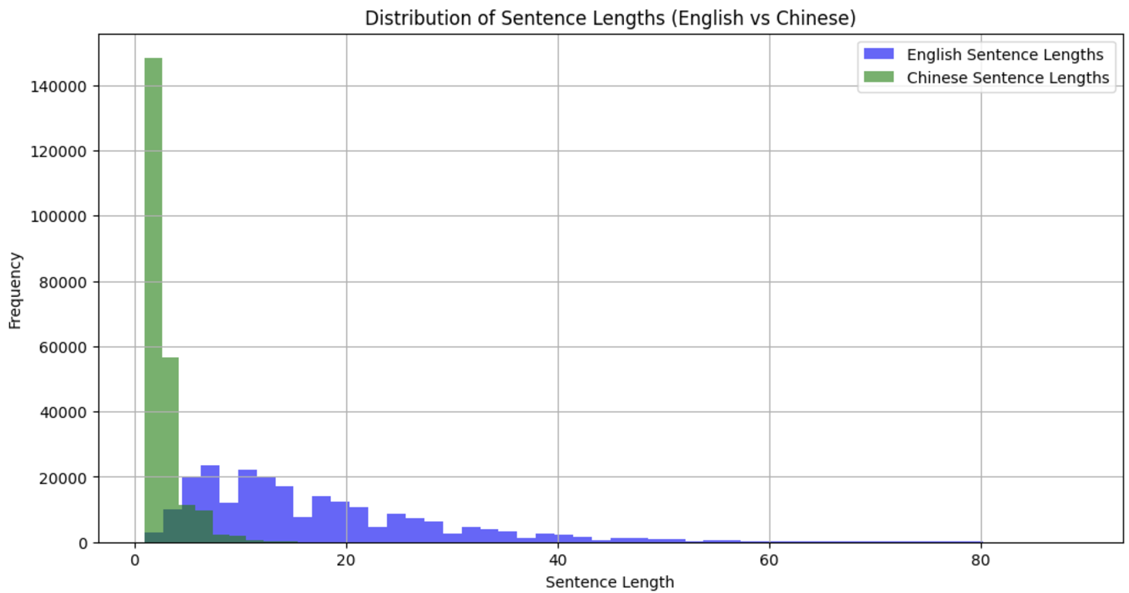
IWSLT
IWSLT 2017 En-Zh
IWSLT is Real-World conversation dataset.
English sentences are longer than Chinese sentences.
The Chinese language is character-based.

Slide 7
Linguistic Structural Differences
Character-Based vs. Word-Based
Word Order and Syntax
Chinese uses characters as the smallest semantic units.
English follows a strict Subject-Verb-Object (SVO)
Chinese allows flexible structures.
Example:
[The dog is on the mat.]
(6 English words)
[狗在墊子上]
(5 Chinese characters)
Example:
[I like this book]
Standard Chinese
[我喜歡這本書]
Emphasis:
[這本書，我喜歡]
These will cause inaccuracies in translaation

Slide 8
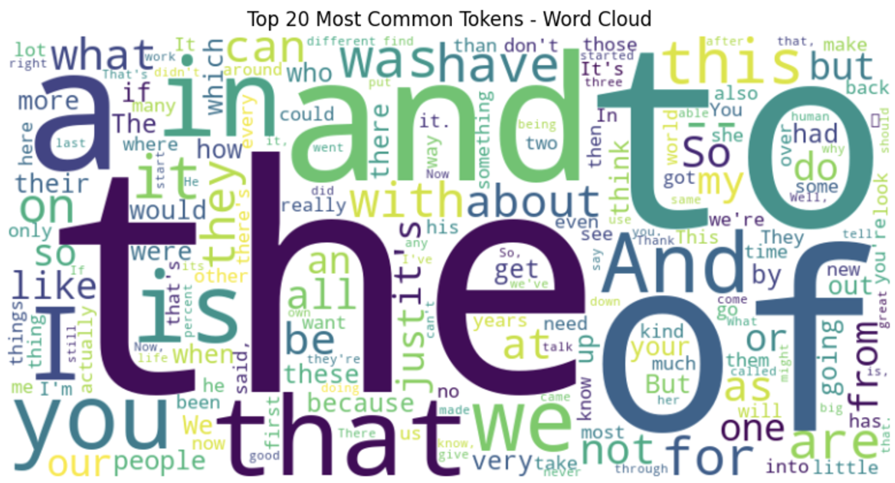
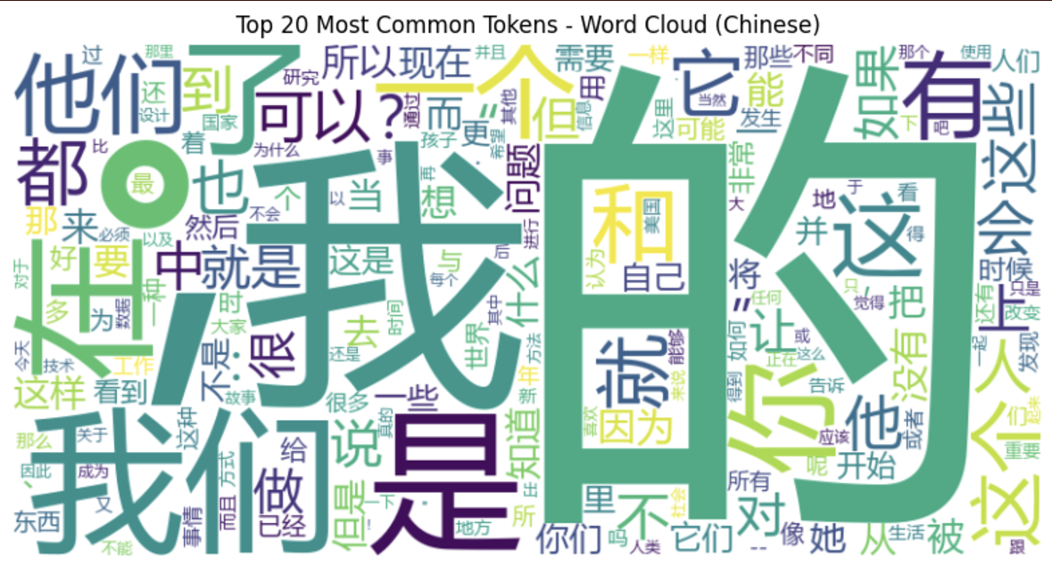
Word Cloud Analysis
Common function words
(e.g., "the," "and," "to ,"of")
High-frequency tokens
(“的,”“是,”“我,“)
Conform to Zipf's Law

Slide 9
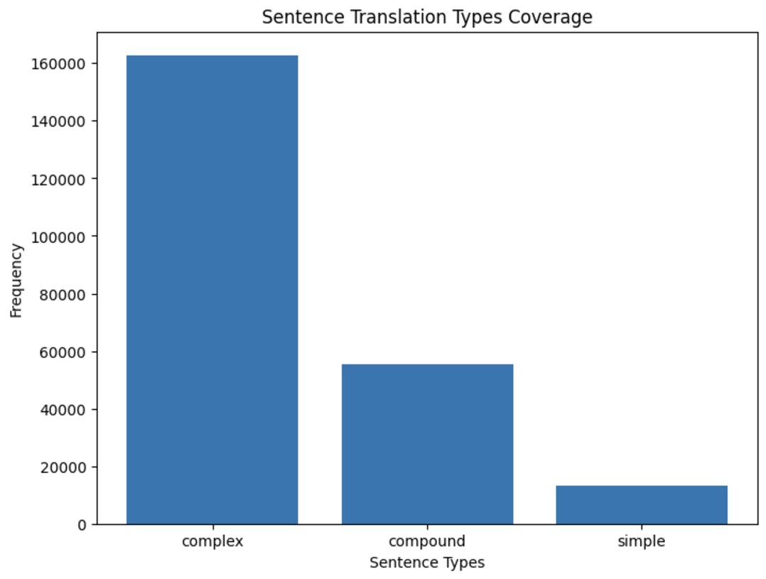
Sentence Type Analysis
Complex Sentences:
Have “because,” “although”
Compound Sentences:
Have "and" or "but
Implications for Machine Translation
Character-Based vs. Word-Based
Word Order and Syntax
Zipf's Law
Different Sentences Type

Slide 10
PART.03
EA-MT Flowchart
Entity-Aware Machine Translation Flowchart

Slide 11
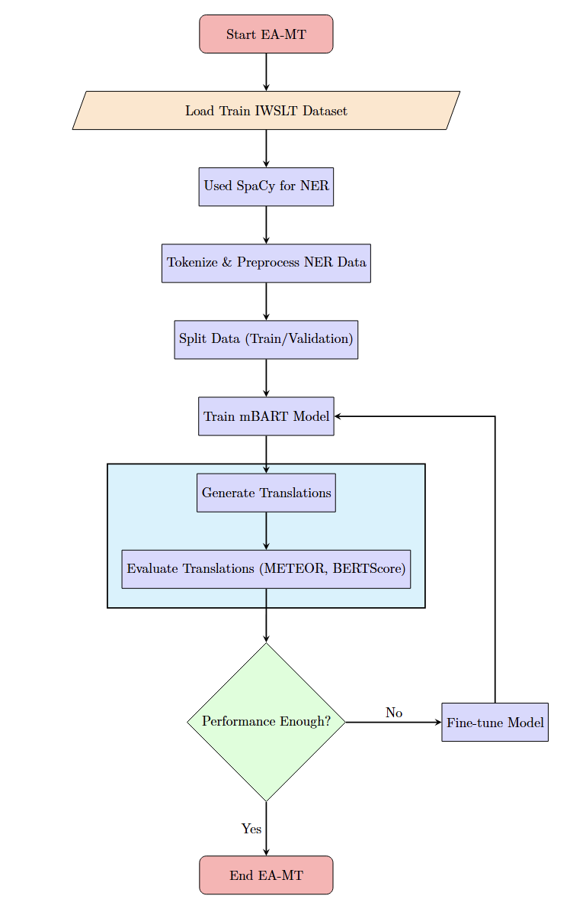
EA-MT Flowchart

Slide 12
PART.04
NER - SpaCy
Named Entity Recognition using

Slide 13
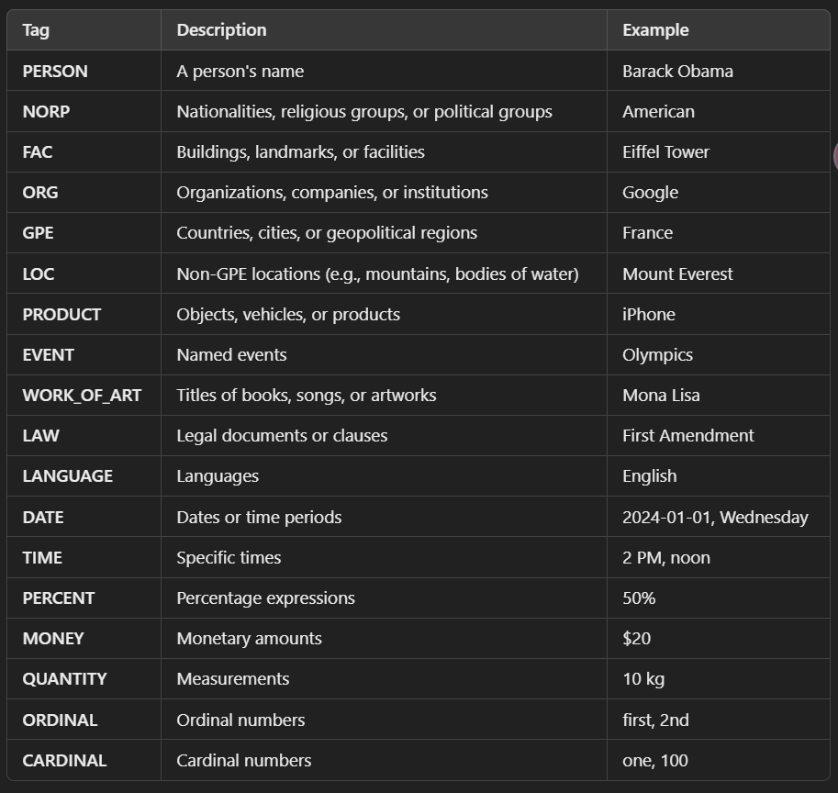
Named Entity Translation Process
SpaCy:
Transformer-based NER model
Used (en_core_web_trf) model
<<Entity Label : Entity Text>>
Improved the model's awareness of named entities
<<ORG：Apple>>
SpaCy: Have 18 different Tags

Slide 14
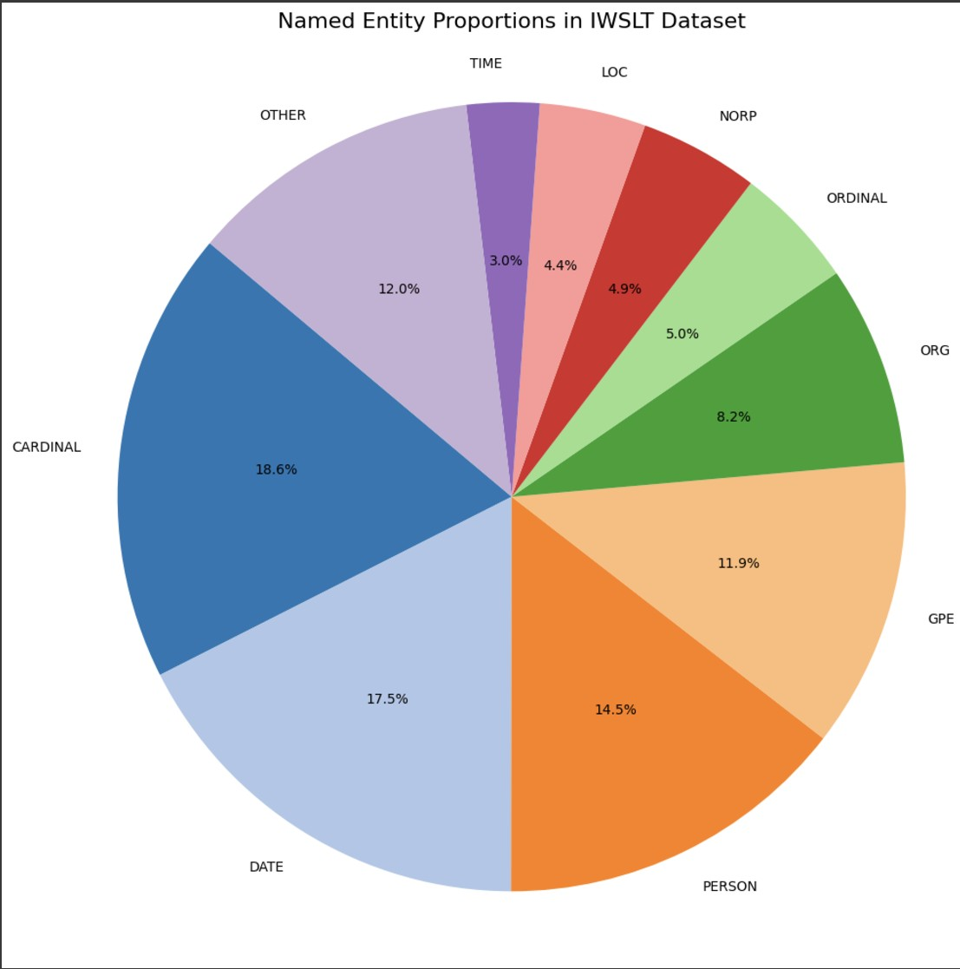
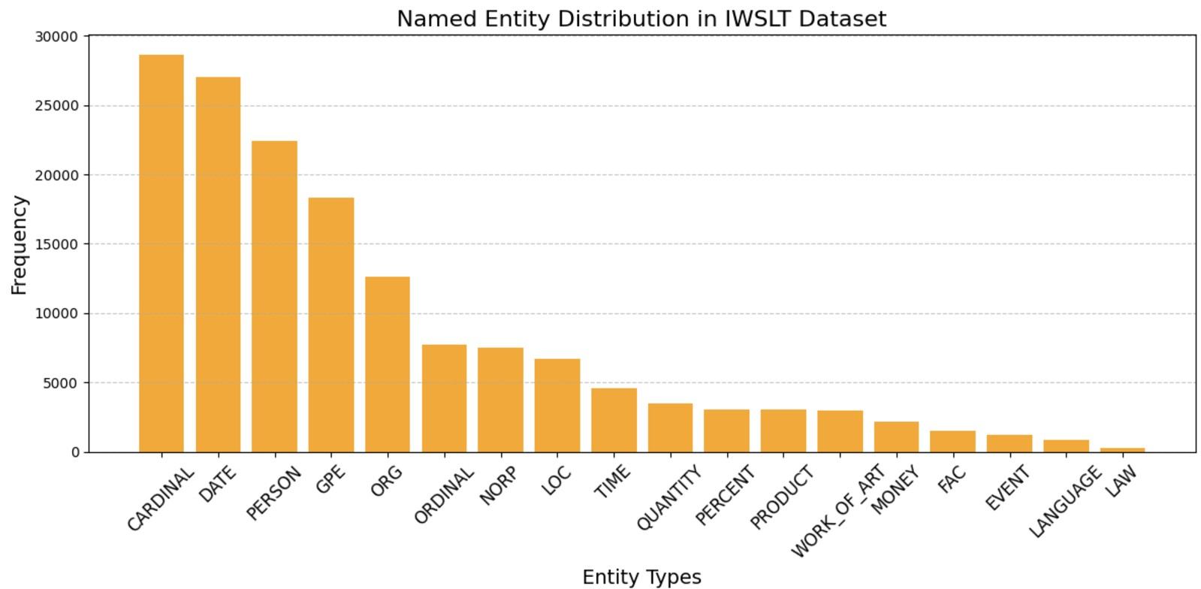
Visualization of NER Tag Distributions
CARDINAL and DATE tags account for 36.1% of all named entities.
Entities are mainly distributed in 10 categories.
Base on this We can adject the weight of the model.

Slide 15
PART.05
mBART
mbart-large-50-many-to-many-mmt from Meta AI

Slide 16
mBART
Architecture
Model
Encoder-Decoder Architecture
Developed by Facebook AI
mbart-large-50-many-to-many-mmt
12 layers for both encoder and decoder
Hidden dimension: 1024
Model Comparing
mBERT :
bidirectional Transformer model
Understanding tasks & question answering
mBART:
Good at multilingual sequence-to-sequence tasks
mBART25 => 25 Language
BLEU improvement 12 point
Configurations of mBART50
Many-to-One (N→1)
One-to-Many (1→N)
Many-to-Many (N↔N

Slide 17
PART.06
EA-MT
Entity-Aware Machine Translation

Slide 18
EA-MT
Process the entity From SpaCy to <<Entity Label : Entity Text>>
Set Source language (en_XX) and target language (zh_CN)
Used Tokenizer to padding and truncation let max length 256
IWSLT Train Data split: 90% for training 10% for validation
Used A100 from Google Colab
Hyperparameters
Learning rate: 1×10^−5
Stability during fine-tuning
Batch size: 4 : Prevent GPU memory overflow.
Regularization :Weight decay set to 0.01.
EarlyStoppingCallback :It will stop if there is no progress after 3 Epochs.

Slide 19
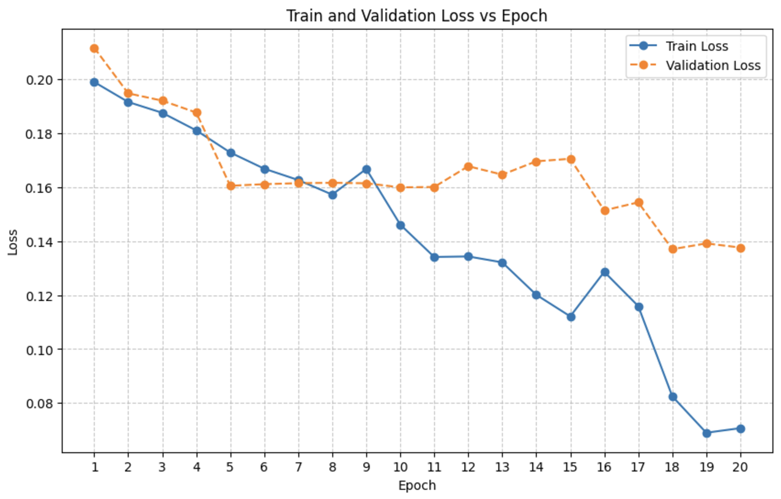
Training and Validation Loss
Training Loss :
From 0.1989 (Epoch 1) to 0.0707 (Epoch 20)
After 10 Epoch model Improved a lot
Validation Loss:
From 0.2116 (Epoch 1) to 0.1376 (Epoch 20)
Fluctuations starting from Epoch 10 stabilized near 0.14.

Slide 20
PART.07
EA-MT
Evaluation Flowchart

Slide 21
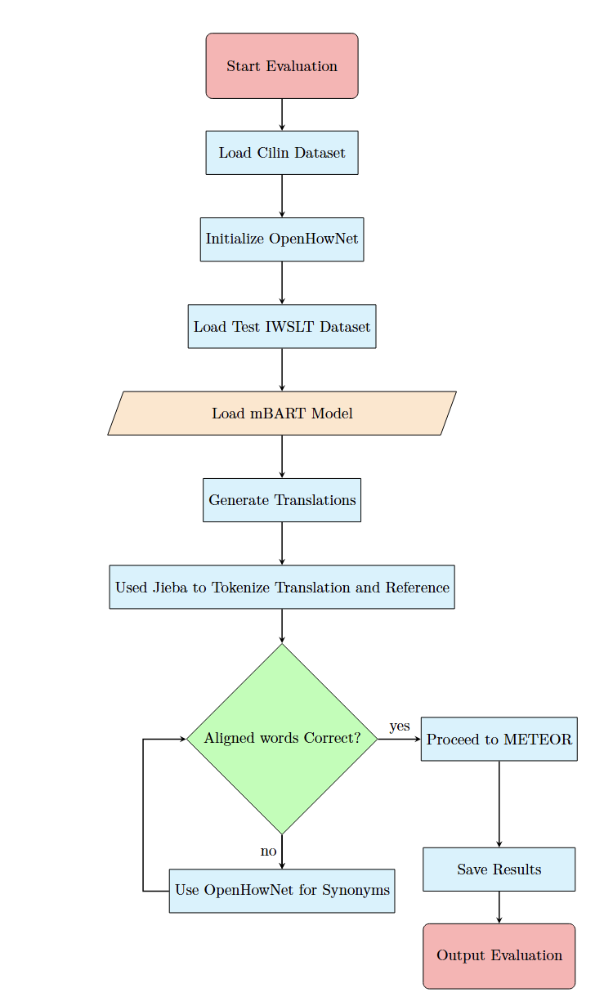
EA-MT
Evaluation Flowchart

Slide 22
PART.08
METEOR & Jieba
Evaluation Entity-Aware Machine Translation

Slide 23
点击输入您的标题

Slide 24
PART.09
HIT-CIR & OpenHowNet
WordSimilarity Dataset& Calculate Word Similarity

Slide 25
点击输入您的标题

Slide 26
PART.10
Evaluation Results
Entity-Aware Machine Translation Result

Slide 27
点击输入您的标题

Slide 28
点击输入您的标题

Slide 29


Slide 30
点击输入您的标题

