Slide 1
NLP 220 Data Science and Machine Learning Fundamentals Lecture 10
Jalal Mahmud
jumahmud@ucsc.edu

Slide 2
Corpus Analytics

Slide 3
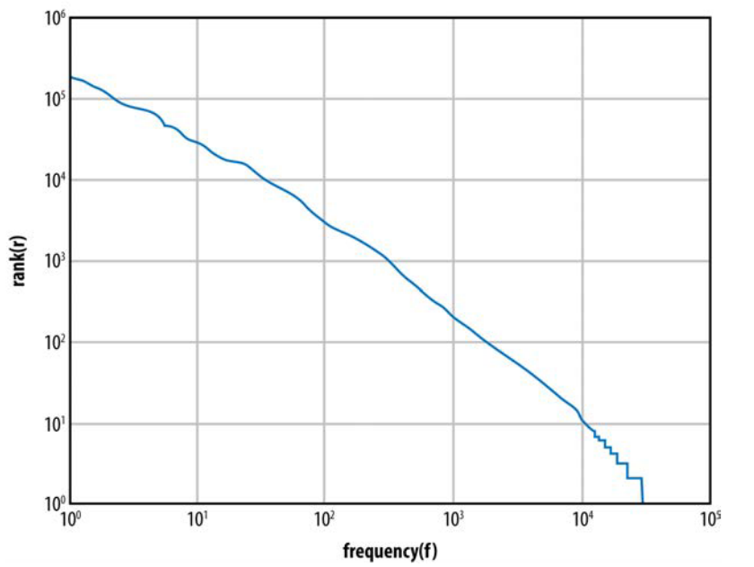
Corpus analytics
Frequency distribution in the NLTK Gutenburg corpus

Slide 4
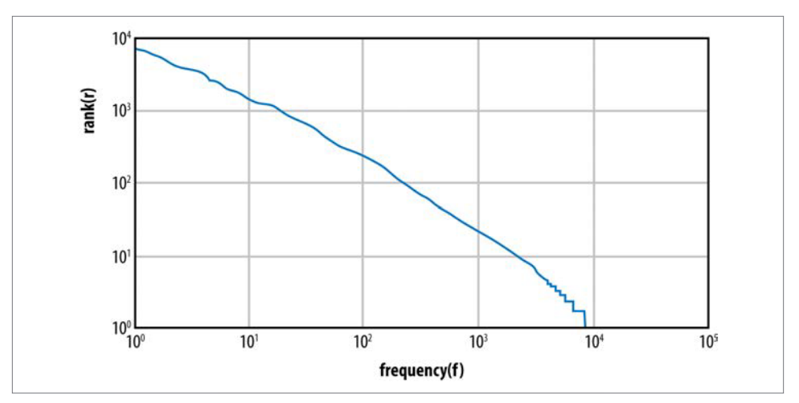
Corpus analytics
Frequency distribution in the IMDB corpus

Slide 5
Corpus analytics
>>> import nltk
>>> from nltk.corpus import PlaintextCorpusReader
>>> imdbcorpus = PlaintextCorpusReader('./training','.*’)
>>> from nltk import FreqDist
>>> fd1 = FreqDist(imdbcorpus.words())
>>> fd1.N()
#total number of sample outcomes. Same as len(imdbcorpus.words())
160035

Slide 6
Corpus analytics
>>> fd1.B()
#total number of sample values that have counts greater than zero
16715
>>> len(fd1.hapaxes())
#total number of all samples that occur once
7933
>>> frequentwords = fd1.keys()
#automatically sorts based on frequency
>>> frequentwords[:50]
[',', 'the', '.', 'and', 'to', 'a', 'of', 'is', 'in', "'", 'his', 's', 'he', 'that', 'with', '-', 'her', 'she', 'their', 'at', 'it', 'be', 'out', 'up', 'will', 'He', 'when', 'was', 'one', 'this', 'not', 'into', 'them', 'have']

Slide 7
Metrics to Remember
Two of the basic concepts you need for performing lexical statistics over a corpus
Corpus size (N) - The number of tokens in the corpus
Vocabulary size (V) - The number of types in the corpus

Slide 8
Metrics to Remember
For any tokenized corpus, you can map each token to a type; for example, how many times the appears (the number of tokens of the type the), and so on.
Once we have the word frequency distributions over a corpus, we can calculate two metrics:
- the rank/frequency profile and
- the frequency spectrum of the word frequencies.

Slide 9
Ranks and Frequency
Rank/Frequency Profile:
To get the rank/frequency profile, take the type from the frequency list and replace it with its rank, where the most frequent type is given rank 1, and so forth.
Frequency Specterm:
To build a frequency spectrum, you simply calculate the number of types that have a specific fre­quency.

Slide 10
Ranks and Frequency
In the Brown Corpus, about half of the vocabulary size is made up of words that occur only once.
The first thing one notices with these metrics is that the top few frequency ranks are taken up by function words (i.e., words such as the, a, and and; prepositions; etc.).
In the Brown Corpus, the 10 top-ranked words make up 23% of the total corpus size (Baroni 2009).

Slide 11
Ranks and Frequency
Another observation is that the bottom-ranked words display lots of ties in frequency.
For example, in the frequency table for the IMDb corpus, the number of hapax legomena (words appearing only once in the corpus) is over 8,000.
The mean or average frequency hides huge deviations.
In Brown, the average frequency of a type is 19 tokens, but the mean is increased because of a few very frequent types.

Slide 12
Frequency Distribution of IMDB Corpus
Frequency distribution in the IMDB corpus

Slide 13
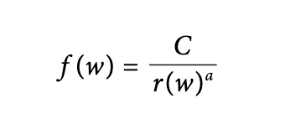
Zipf’s Law
The uneven distribution of word types shown in the preceding section was first pointed out over a variety of datasets by George Zipf in 1949.
He noticed that frequency of a word, f(w), appears as a nonlinearly decreasing function of the rank of the word, r(w), in a corpus, and formulated the following relationship between these two variables:

Slide 14
Zipf’s Law
C is a constant that is determined by the particulars of the corpus, but for now, let’s say that it’s the frequency of the most frequent word in the corpus.
Let’s assume that a is 1; then we can quickly see how frequency decreases with rank.
Notice that the law is a power law: frequency is a function of the negative power of rank, –a.
So the first word in the ranking occurs about twice as often as the second word in the ranking, and three times as often as the third word in the ranking, and so on.

Slide 15
N-gram analysis

Slide 16
N-gram analysis
Imagine that we have a string of tokens, W, consisting of the elements w1, w2, ... , wn.
Now consider a sliding window over W. If the sliding window consists of one cell (wi), then the collection of one-cell substrings is called the unigram profile of the string;
There will be as many unigram profiles as there are elements in the string.
Consider now all two-cell substrings, where we look at w1 w2, w2 w3, and so forth, to the end of the string, wn–1 wn.
These are called bigram profiles, and we have n–1 bigrams for a string of length n.

Slide 17
N-gram analysis
Using the definition of conditional probability mentioned earlier, we can define a prob­ability for a token, having seen the previous token, as a bigram probability.
Thus the conditional probability of an element, wi, given the previous element, wi–1:
P(wi | wi−1)
Extending this to bigger sliding windows, we an define an n-gram probability as simply the conditional probability of an element given the previous n–1 elements.
That is:
P(wi | wi−N−1 ... wi−1)

Slide 18
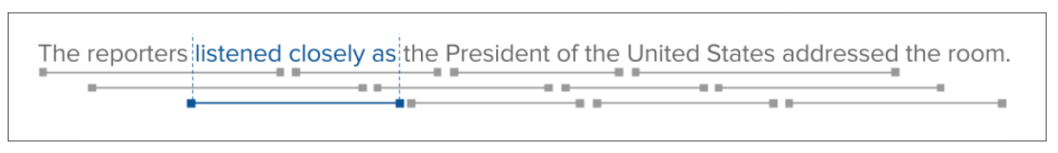
N-gram analysis
“The reporters listened closely as the President of the United States addressed the room.”
By scanning a window of a fixed length, n, across the text, we can collect all possible contiguous subsequences of tokens.
When n=1 (e.g., individual tokens).
When n=2 we have bigrams, a tuple of tokens such as ("The", "reporters") and ("reporters","listened").
When n=3, trigrams are a three-tuple: ("The", "reporters", "listened") and so on for any n.

Slide 19
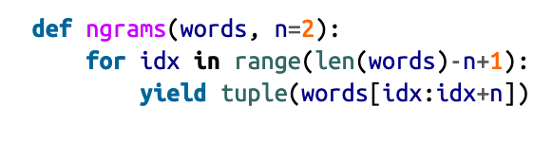
N-gram analysis
This function ranges a start index from 0 to the position that is exactly one n-gram a way from the end of the word list.
It then slices the word list from the start index to n-gram length, returning an immutable tuple.

Slide 20
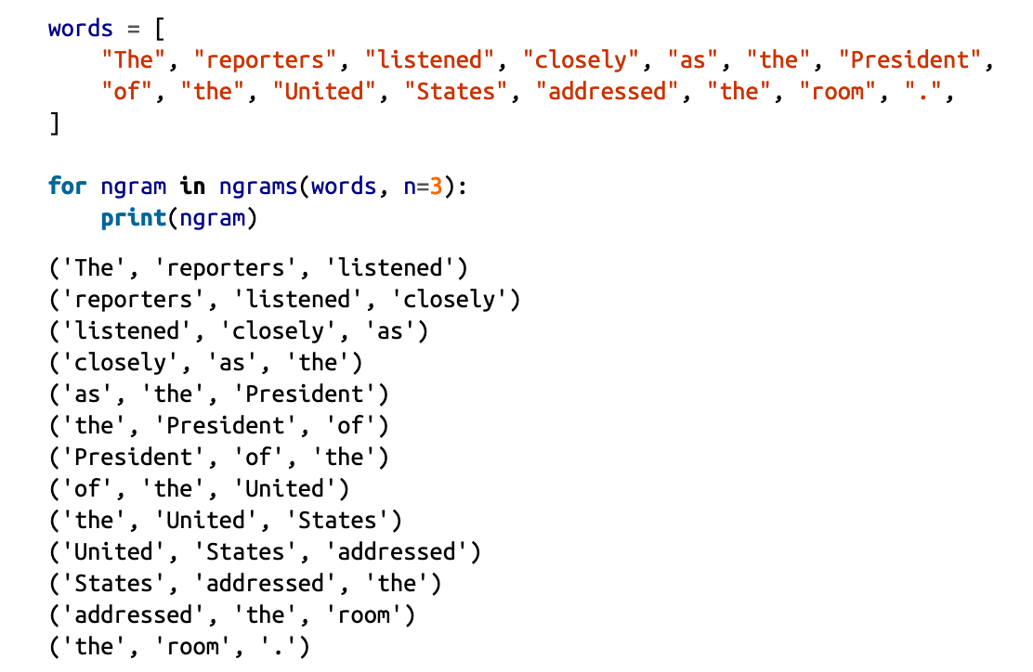
N-gram analysis

Slide 21
N-gram analysis
The most common bigrams in any corpus will most likely not be very interesting to you, however. They involve the most frequent words in word pairs.
This happens to usually be boring function word pairs, such as the following:
• of the
• in the
• on the
• in a
If you want to get a more meaningful set of bigrams (and trigrams), you can run the corpus through a part-of-speech (POS) tagger, such as one of those provided by the NLTK.
This would filter the bigrams to more content-related pairs involving, for ex­ample, adjectives and nouns.

Slide 22
New Concept N-gram analysis - Collocations

Slide 23
N-gram analysis - Collocation
A better solution, however, is to take advantage of the “natural affinity” that the words in an n-gram have for one another.
This includes what are called collocations.
A collocation is the string created when two or more words co-occur in a language more frequently than by chance.
A convenient way to do this over a corpus is through a concept known as pointwise mutual information (PMI).

Slide 24
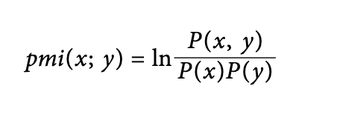
N-gram analysis - PMI
For two words, X and Y, we would like to know how much one word tells us about the other.
For example, given an occurrence of X, x, and an occurrence of Y, y, how much does their joint probability differ from the expected value of assuming that they are independent?
This can be expressed as follows:

Slide 25
Significant Collocations

Slide 26
Significant Collocations
Using raw n-grams will produce many, many candidates, most of which will not be relevant.
For example, the sentence “I got lost in the corn maze during the fall picnic” contains the trigram ('in', 'the','corn'), which is not a typical prepositional target, whereas the trigram ('I','got', 'lost') seems to make sense on its own.
In practice, this is too high a computational cost to be useful in most applications.
The solution is to compute conditional probability.

Slide 27
Significant Collocations
For example, what is the likelihood that the tokens ('the', 'fall') appear in the text given the token 'during’?
We can compute empirical likelihoods by calculating the frequency of the (n-1)-gram conditioned by the first token of the n-gram.
Using this technique we can value n-grams that are more often used together such as ('corn', 'maze') over rarer com‐positions that are less meaningful.
The idea of some n-grams having more value than others leads to another tool in the text analysis toolkit: significant collocations.

Slide 28
Significant Collocations
NLTK contains two tools to discover significant collocations: the CollocationFinder, which finds and ranks n-gram collocations, and
NgramAssocMeasures, which contains a collection of metrics to score the significance of a collocation.
Both utilities are dependent on the size of n and the module contains bigram, trigram, and quad‐gram ranking utilities.

Slide 29
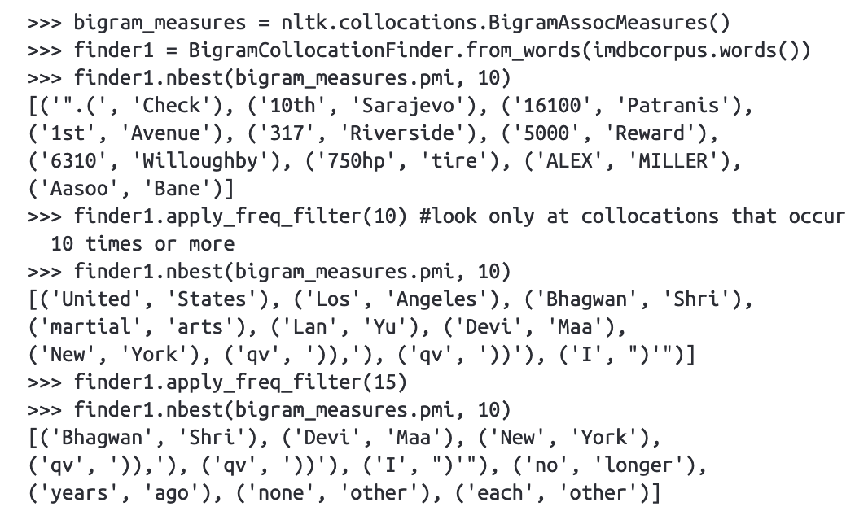
Significant Collocations – Bigram Collocations
Applying PMI to the bigrams from the IMDb corpus, we can see the following results:

Slide 30
Significant Collocations – Bigram Collocations
Applying PMI to the bigrams from the genesis corpus, we can see the following results:
from nltk.collocations import *
bigram_measures = nltk.collocations.BigramAssocMeasures()
finder = BigramCollocationFinder.from_words(
nltk.corpus.genesis.words('english-web.txt'))
print(finder.nbest(bigram_measures.pmi, 10))

Slide 31
Significant Collocations – Bigram Collocations
While these words are highly collocated, the expressions are also very infrequent. Therefore it is useful to apply filters, such as ignoring all bigrams which occur less than three times in the corpus:
finder.apply_freq_filter(3)
finder.nbest(bigram_measures.pmi, 10)

Slide 32
Significant Collocations – Trigram Collocations
Applying PMI to the trigrams from the genesis corpus, we can see the following results:
from nltk.collocations import *
trigram_measures = nltk.collocations.TrigramAssocMeasures()
finder1 = TrigramCollocationFinder.from_words(
nltk.corpus.genesis.words('english-web.txt'))
print(finder1.nbest(trigram_measures.pmi, 10))

Slide 33
Significant Collocations – Trigram Collocations
Applying PMI to the trigrams from the genesis corpus, we can see the following results:
finder1.apply_freq_filter(2)
finder1.nbest(trigram_measures.pmi, 10)

Slide 34
Significant Collocations – Applying Filters
>>> finder = BigramCollocationFinder.from_words( ... nltk.corpus.genesis.words('english-web.txt'), ... window_size = 20)
>>> finder.apply_freq_filter(2)
>>> ignored_words = nltk.corpus.stopwords.words('english’)
>>> finder.apply_word_filter(lambda w: len(w) < 3 or w.lower() in ignored_words)
>>> finder.nbest(bigram_measures.likelihood_ratio, 10)

Slide 35
More on Collocation Finder
The collocations package provides collocation finders which by default consider all ngrams in a text as candidate collocations:
>>> text = "I do not like green eggs and ham, I do not like them Sam I am!"
>>> tokens = nltk.wordpunct_tokenize(text)
>>> finder = BigramCollocationFinder.from_words(tokens)
>>> scored = finder.score_ngrams(bigram_measures.raw_freq)
>>> sorted(bigram for bigram, score in scored)
https://www.nltk.org/howto/collocations.html

Slide 36
More on Collocation Finder
We could otherwise construct the collocation finder from manually-derived FreqDists:
>>> word_fd = nltk.FreqDist(tokens)
>>> bigram_fd = nltk.FreqDist(nltk.bigrams(tokens))
>>> finder = BigramCollocationFinder(word_fd, bigram_fd)
>>> scored = finder.score_ngrams(bigram_measures.raw_freq)
https://www.nltk.org/howto/collocations.html

Slide 37
More on Filtering
>>> finder = TrigramCollocationFinder.from_words(tokens)
>>> len(finder.score_ngrams(trigram_measures.raw_freq))
14
>>> finder.apply_word_filter(lambda w: w in ('I', 'me’))
>>> len(finder.score_ngrams(trigram_measures.raw_freq))
8
>>> sorted(finder.above_score(trigram_measures.raw_freq, ... 1.0 / len(tuple(nltk.trigrams(tokens)))))
[('do', 'not', 'like')]

Slide 38
Significant Collocations – quadgram collocations
Let’s explore the discovery of significant quad-grams.
Because finding and ranking n-grams for a large corpus can take a lot of time, it is a good practice to write the results to a file on disk.

Slide 39
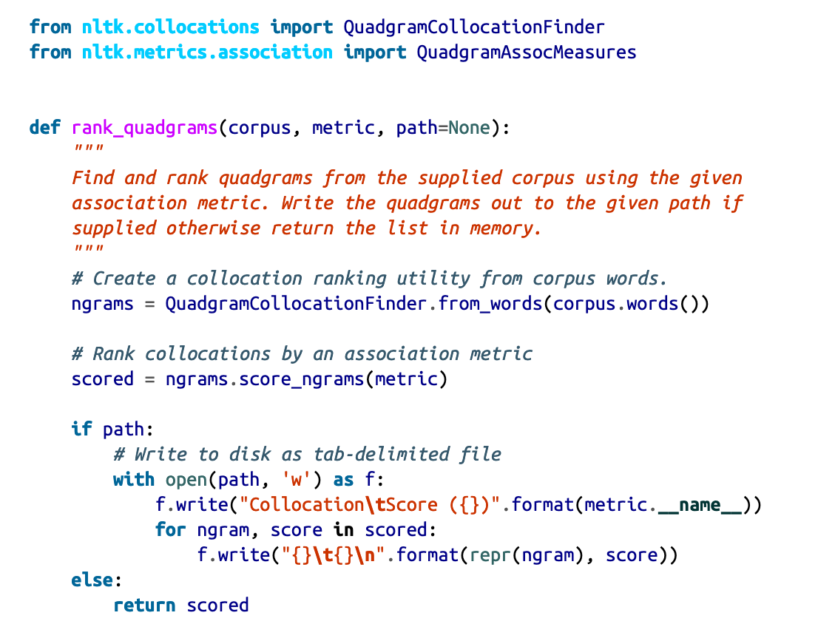
Significant Collocations

Slide 40
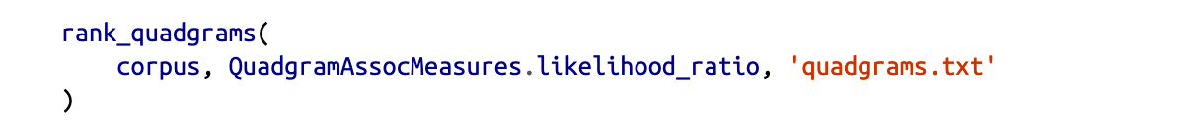
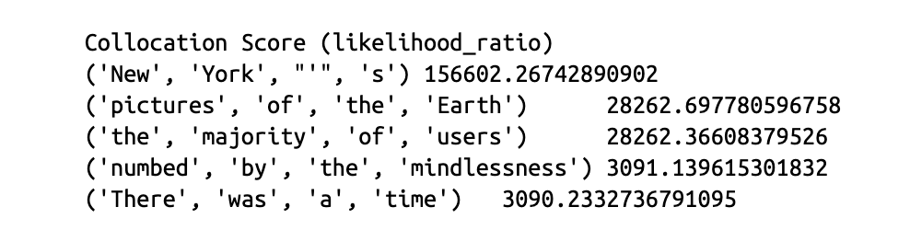
Significant Collocations

Slide 41

Significant Collocations
The QuadgramAssocMeasures class gives several methods with which to rank significance via hypothesis testing.
These methods assume that there is no association between the words (e.g., the null hypothesis), then compute the probability of the association occurring if the null hypothesis was true.
If we can reject the null hypothesis because its significance level is too low we can accept the alternative hypothesis

Slide 42
Corpus Analytics - Summary
Corpus analytics comprises statistical and probabilistic tools that provide data analysis over your corpus and information for performing inferential statistics.
This will be necessary information when you take your annotated corpus and train an ML algorithm on it.
It is necessary to distinguish between the occurrence of a word in a corpus (the token) and the word itself (the type).

Slide 43
Corpus Analytics - Summary
The total number of tokens in a corpus gives us the corpus size.
The total number of types in a corpus gives us the vocabulary size.
The rank/frequency profile of the words in a corpus assigns a ranking to the words, according to how many tokens there are of that word.
The frequency spectrum of the word gives the number of word types that have a given frequency.
Zipf ’s law is a power law stating that the frequency of any word is inversely pro­portional to its rank.

Slide 44
Corpus Analytics - Summary
Constructing n-grams over the tokens in a corpus is the first step in building lan­guage models for many NLP applications.
Pointwise mutual information is a measure of how dependent one word is on an­other in a text. This can be used to identify bigrams that are true collocations in a corpus.•

Slide 45
Regular Expressions

Slide 46
Regular Expressions
In computing, a regular expression, also referred to as "regex" or "regexp", provides a concise and flexible means for matching strings of text, such as particular characters, words, or patterns of characters.
A regular expression is written in a formal language that can be interpreted by a regular expression processor.
http://en.wikipedia.org/wiki/Regular_expression

Slide 47
Understanding Regular Expressions
Really clever "wild card" expressions for matching and parsing strings.
Very powerful and quite cryptic
Fun once you understand them
Regular expressions are a language unto themselves
A language of "marker characters" - programming with characters
It is kind of an "old school" language - compact

Slide 48
Regular Expressions
Use regular expressions to:
Search a string (search and match)
Replace parts of a string (sub)
Break strings into smaller pieces (split)

Slide 49
Regular Expression Quick Guide
^ Matches the beginning of a line
$ Matches the end of the line
. Matches any character
\s Matches whitespace
\S Matches any non-whitespace character
* Repeats a character zero or more times
*? Repeats a character zero or more times (non-greedy)

Slide 50
Regular Expression Quick Guide
+ Repeats a character one or more times
+? Repeats a character one or more times (non-greedy)
[aeiou] Matches a single character in the listed set
[^XYZ] Matches a single character not in the listed set
[a-z0-9] The set of characters can include a range
( Indicates where string extraction is to start
) Indicates where string extraction is to end

Slide 51
Regular Expression Syntax
Most characters match themselves
The regular expression “test” matches the string ‘test’, and only that string
[x] matches any one of a list of characters
“[abc]” matches ‘a’,‘b’,or ‘c’
[^x] matches any one character that is not included in x
“[^abc]” matches any single character except ‘a’,’b’,or ‘c’

Slide 52
Regular Expression Syntax
“.” matches any single character
Parentheses can be used for grouping
“(abc)+” matches ’abc’, ‘abcabc’, ‘abcabcabc’, etc.
x|y matches x or y
“this|that” matches ‘this’ and ‘that’, but not ‘thisthat’.

Slide 53
Regular Expression Syntax
x* matches zero or more x’s
“a*” matches ’’, ’a’, ’aa’, etc.
x+ matches one or more x’s
“a+” matches ’a’,’aa’,’aaa’, etc.
x? matches zero or one x’s
“a?” matches ’’ or ’a’
x{m, n} matches i x‘s, where m<i< n
“a{2,3}” matches ’aa’ or ’aaa’

Slide 54
Regular Expression Syntax
“\d” matches any digit; “\D” any non-digit
“\s” matches any whitespace character; “\S” any non-whitespace character
“\w” matches any alphanumeric character; “\W” any non-alphanumeric character
“^” matches the beginning of the string; “$” the end of the string
“\b” matches a word boundary; “\B” matches a character that is not a word boundary

Slide 55
The Regular Expression Module in Python
Before you can use regular expressions in your program, you must import the library using "import re”
You can use re.search() to see if a string matches a regular expression similar to using the find() method for strings
You can use re.findall() extract portions of a string that match your regular expression

Slide 56
Using re.search() like find()
import re
hand = open('mbox-short.txt')
for line in hand:
line = line.rstrip()
if re.search('From:', line) :
print line
hand = open('mbox-short.txt')
for line in hand:
line = line.rstrip()
if line.find('From:') >= 0:
print line
http://www.py4inf.com/

Slide 57
Using re.search() like startswith()
import re
hand = open('mbox-short.txt')
for line in hand:
line = line.rstrip()
if re.search('^From:', line) :
print line
hand = open('mbox-short.txt')
for line in hand:
line = line.rstrip()
if line.startswith('From:') :
print line
We fine-tune what is matched by adding special characters to the string
http://www.py4inf.com/

Slide 58
Wild-Card Characters
The dot character matches any character
If you add the asterisk character, the character is "any number of times"
Match the start of the line
Many times
^X.*:
Match any character

Slide 59
Exercise
Find all the numbers from -
My favorite numbers are 19 and 42 and 67
I want to drive 60 miles per hour

Slide 60
Matching and Extracting Data
The re.search() returns a True/False depending on whether the string matches the regular expression
If we actually want the matching strings to be extracted, we use re.findall()
>>> import re
>>> x = 'My 2 favorite numbers are 19 and 42'
>>> y = re.findall('[0-9]+',x)
>>> print(y)
['2', '19', '42']

Slide 61
Matching and Extracting Data
When we use re.findall() it returns a list of zero or more sub-strings that match the regular expression
>>> import re
>>> x = 'My 2 favorite numbers are 19 and 42’
>>> y = re.findall('[0-9]+’,x)
>>> print(y)
['2', '19', '42’]
>>> y = re.findall('[AEIOU]+',x)
>>> print(y)
[]

Slide 62
Warning: Greedy Matching
The repeat characters (* and +) push outward in both directions (greedy) to match the largest possible string
One or more characters
>>> import re
>>> x = 'From: Using the : character'
>>> y = re.findall('^F.+:', x)
>>> print(y)
['From: Using the :']
^F.+:
First character in the match is an F
Last character in the match is a :
Why not 'From:'?

Slide 63
Non-Greedy Matching
Not all regular expression repeat codes are greedy! If you add a ? character
One or more characters but not greedily
>>> import re
>>> x = 'From: Using the : character'
>>> y = re.findall('^F.+?:', x)
>>> print(y)
['From:']
^F.+?:
First character in the match is an F
Last character in the match is a :

Slide 64
Fine Tuning String Extraction
You can refine the match for re.findall() and separately determine which portion of the match that is to be extracted using parenthesis
From stephen.marquard@uct.ac.za Sat Jan 5 09:14:16 2008
\S+@\S+
>>> y = re.findall('\S+@\S+',x)
>>> print(y)
['stephen.marquard@uct.ac.za’]
At least one non-whitespace character

Slide 65
Fine Tuning String Extraction
Parenthesis are not part of the match - but they tell where to start and stop what string to extract
From stephen.marquard@uct.ac.za Sat Jan 5 09:14:16 2008
>>> y = re.findall('\S+@\S+',x)
>>> print(y)
['stephen.marquard@uct.ac.za']
>>> y = re.findall('^From (\S+@\S+)',x)
>>> print(y)
['stephen.marquard@uct.ac.za']
^From (\S+@\S+)

Slide 66
Fine Tuning String Extraction
21
31
From stephen.marquard@uct.ac.za Sat Jan 5 09:14:16 2008
>>> data = 'From stephen.marquard@uct.ac.za Sat Jan 5 09:14:16 2008'
>>> atpos = data.find('@')
>>> print atpos
21
>>> sppos = data.find(' ',atpos)
>>> print sppos
31
>>> host = data[atpos+1 : sppos]
>>> print host
uct.ac.za
Extracting a host name - using find and string slicing.

Slide 67
The Double Split Version
Sometimes we split a line one way and then grab one of the pieces of the line and split that piece again
From stephen.marquard@uct.ac.za Sat Jan 5 09:14:16 2008
words = line.split()
email = words[1]
pieces = email.split('@')
print pieces[1]
stephen.marquard@uct.ac.za
['stephen.marquard', 'uct.ac.za']
'uct.ac.za'

Slide 68
The Regex Version
From stephen.marquard@uct.ac.za Sat Jan 5 09:14:16 2008
import re
lin = 'From stephen.marquard@uct.ac.za Sat Jan 5 09:14:16 2008'
y = re.findall('@([^ ]*)',lin)
print(y)
['uct.ac.za']
'@([^ ]*)'
Look through the string until you find an at-sign

Slide 69
The Regex Version
From stephen.marquard@uct.ac.za Sat Jan 5 09:14:16 2008
import re
lin = 'From stephen.marquard@uct.ac.za Sat Jan 5 09:14:16 2008'
y = re.findall('@([^ ]*)',lin)
print y
['uct.ac.za']
'@([^ ]*)'
Match non-blank character
Match many of them

Slide 70
The Regex Version
From stephen.marquard@uct.ac.za Sat Jan 5 09:14:16 2008
import re
lin = 'From stephen.marquard@uct.ac.za Sat Jan 5 09:14:16 2008'
y = re.findall('@([^ ]*)',lin)
print y
['uct.ac.za']
'@([^ ]*)'
Extract the non-blank characters

Slide 71
Even Cooler Regex Version
From stephen.marquard@uct.ac.za Sat Jan 5 09:14:16 2008
import re
lin = 'From stephen.marquard@uct.ac.za Sat Jan 5 09:14:16 2008'
y = re.findall('^From .*@([^ ]*)',lin)
print y
['uct.ac.za']
'^From .*@([^ ]*)'
Starting at the beginning of the line, look for the string 'From '

Slide 72
Even Cooler Regex Version
From stephen.marquard@uct.ac.za Sat Jan 5 09:14:16 2008
import re
lin = 'From stephen.marquard@uct.ac.za Sat Jan 5 09:14:16 2008'
y = re.findall('^From .*@([^ ]*)',lin)
print y['uct.ac.za']
'^From .*@([^ ]*)'
Skip a bunch of characters, looking for an at-sign

Slide 73
Even Cooler Regex Version
From stephen.marquard@uct.ac.za Sat Jan 5 09:14:16 2008
import re
lin = 'From stephen.marquard@uct.ac.za Sat Jan 5 09:14:16 2008'
y = re.findall('^From .*@([^ ]*)',lin)
print y['uct.ac.za']
'^From .*@([^ ]*)'
Start 'extracting'

Slide 74
Even Cooler Regex Version
From stephen.marquard@uct.ac.za Sat Jan 5 09:14:16 2008
import re
lin = 'From stephen.marquard@uct.ac.za Sat Jan 5 09:14:16 2008'
y = re.findall('^From .*@([^ ]*)',lin)
print y['uct.ac.za']
'^From .*@([^ ]*)'
Match non-blank character
Match many of them

Slide 75
Even Cooler Regex Version
From stephen.marquard@uct.ac.za Sat Jan 5 09:14:16 2008
import re
lin = 'From stephen.marquard@uct.ac.za Sat Jan 5 09:14:16 2008'
y = re.findall('^From .*@([^ ]*)',lin)
print y['uct.ac.za']
'^From .*@([^ ]*)'
Stop 'extracting'

Slide 76
Exercise
Find all the email address from -
Hello from shubhamg199630@gmail.com to priya@yahoo.com about the meeting @2PM

Slide 77
Regular Expression Quick Guide
^ Matches the beginning of a line
$ Matches the end of the line
. Matches any character
\s Matches whitespace
\S Matches any non-whitespace character
* Repeats a character zero or more times
*? Repeats a character zero or more times (non-greedy)
+ Repeats a chracter one or more times
+? Repeats a character one or more times (non-greedy)
[aeiou] Matches a single character in the listed set
[^XYZ] Matches a single character not in the listed set
[a-z0-9] The set of characters can include a range
( Indicates where string extraction is to start
) Indicates where string extraction is to end

Slide 78
Escape Character
If you want a special regular expression character to just behave normally (most of the time) you prefix it with '\'
>>> import re
>>> x = 'We just received $10.00 for cookies.'
>>> y = re.findall('\$[0-9.]+',x)
>>> print y
['$10.00']
At least one or more
\$[0-9.]+
A real dollar sign
A digit or period

Slide 79
Search and Match
The two basic functions are re.search and re.match
Search looks for a pattern anywhere in a string
Match looks for a match staring at the beginning
Both return None (logical false) if the pattern isn’t found and a “match object” instance if it is
>>> import re
>>> pat = "a*b”
>>> re.search(pat,"fooaaabcde")
<_sre.SRE_Match object at 0x809c0>
>>> re.match(pat,"fooaaabcde")
>>>

Slide 80
Match Object
A: an instance of the match class with the details of the match result
>>> r1 = re.search("a*b","fooaaabcde")
>>> r1.group() # group returns string matched
'aaab'
>>> r1.start() # index of the match start
3
>>> r1.end() # index of the match end
7
>>> r1.span() # tuple of (start, end)
(3, 7)

Slide 81
What got Matched
Here’s a pattern to match simple email addresses
\w+@(\w+\.)+(com|org|net|edu)
>>> pat1 = "\w+@(\w+\.)+(com|org|net|edu)"
>>> r1 = re.match(pat,"finin@cs.umbc.edu")
>>> r1.group()
'finin@cs.umbc.edu’
We might want to extract the pattern parts, like the email name and host

Slide 82
What got Matched
We can put parentheses around groups we want to be able to reference
>>> pat2 = "(\w+)@((\w+\.)+(com|org|net|edu))"
>>> r2 = re.match(pat2,"finin@cs.umbc.edu")
>>> r2.group(1)
'finin'
>>> r2.group(2)
'cs.umbc.edu'
>>> r2.groups()
r2.groups()
('finin', 'cs.umbc.edu', 'umbc.', 'edu’)
Note that the ‘groups’ are numbered in a preorder traversal of the forest

Slide 83
What got Matched
We can ‘label’ the groups as well…
>>> pat3 ="(?P<name>\w+)@(?P<host>(\w+\.)+(com|org|net|edu))"
>>> r3 = re.match(pat3,"finin@cs.umbc.edu")
>>> r3.group('name')
'finin'
>>> r3.group('host')
'cs.umbc.edu’
And reference the matching parts by the labels

Slide 84
More re functions
re.split() is like split but can use patterns
>>> re.split("\W+", “This... is a test,
short and sweet, of split().”)
['This', 'is', 'a', 'test', 'short’,
'and', 'sweet', 'of', 'split’, ‘’]
re.sub substitutes one string for a pattern
>>> re.sub('(blue|white|red)', 'black', 'blue socks and red shoes')
'black socks and black shoes’
re.findall() finds all matches
>>> re.findall("\d+”,"12 dogs,11 cats, 1 egg")
['12', '11', ’1’]

Slide 85
Exercise
Find phone number from -
Call Mr. Jeff at 449-647-1200

