Slide 1
NLP 220 Data Science and Machine Learning Fundamentals Lecture 15
Jalal Mahmud
jumahmud@ucsc.edu

Slide 2
Scaling and Normalization
https://www.kaggle.com/alexisbcook/scaling-and-normalization

Slide 3
Scaling and Normalizing
Depending on your data and the type of research you are conducting, scaling and normalizing your dataset might mean calculating new values using the values you currently have.
or it might mean applying scaling or normalizations across a particular column or value

Slide 4
Scaling and Normalizing
Normalization, from a statistical view, often has to do with calculating new values from a dataset to standardize the data on a particular scale.
For example, you might need to normalize scores for a test to scale so you can accurately view the distribution.
You might also need to normalize data so you can accurately see percentiles, or percentiles across different groups

Slide 5
Why you should do this?
Why do we need to scale the variables in our dataset?
Some machine learning algorithms are sensitive to feature scaling while others are virtually invariant to it.
Machine learning algorithms like linear regression, logistic regression, neural network, etc. that use gradient descent as an optimization technique require data to be scaled.
Having features on a similar scale can help the gradient descent converge more quickly towards the minima.

Slide 6
Why you should do this?
Distance algorithms like KNN, K-means, and SVM are most affected by the range of features.
This is because behind the scenes they are using distances between data points to determine their similarity.
Therefore, we scale our data before employing a distance based algorithm so that all the features contribute equally to the result.

Slide 7
Why you should do this?
Tree-based algorithms, on the other hand, are fairly insensitive to the scale of the features.
Think about it, a decision tree is only splitting a node based on a single feature. The decision tree splits a node on a feature that increases the homogeneity of the node.
This split on a feature is not influenced by other features.

Slide 8
Scaling and Normalization
Scaling vs. Normalization: What's the difference?
One of the reasons that it's easy to get confused between scaling and normalization is because the terms are sometimes used interchangeably and, to make it even more confusing, they are very similar!
In both cases, you're transforming the values of numeric variables so that the transformed data points have specific helpful properties. The difference is that:
in scaling, you're changing the range of your data, while
in normalization, you're changing the shape of the distribution of your data.

Slide 9
Scaling
This means that you're transforming your data so that it fits within a specific scale, like 0-100 or 0-1.
You want to scale data when you're using methods based on measures of how far apart data points are, like support vector machines (SVM) or k-nearest neighbors (KNN).
With these algorithms, a change of "1" in any numeric feature is given the same importance.

Slide 10
Scaling
For example, you might be looking at the prices of some products in both Yen and US Dollars.
One US Dollar is worth about 100 Yen, but if you don't scale your prices, methods like SVM or KNN will consider a difference in price of 1 Yen as important as a difference of 1 US Dollar!
This clearly doesn't fit with our intuitions of the world. With currency, you can convert between currencies.
But what about if you're looking at something like height and weight? It's not entirely clear how many pounds should equal one inch (or how many kilograms should equal one meter).

Slide 11

Min-Max Scaling
Here’s the formula for Min-Max scaling:

Slide 12
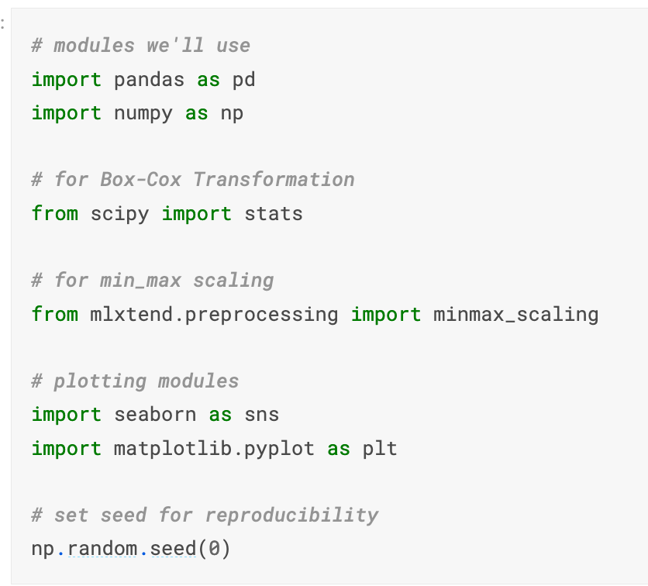
Scaling

Slide 13
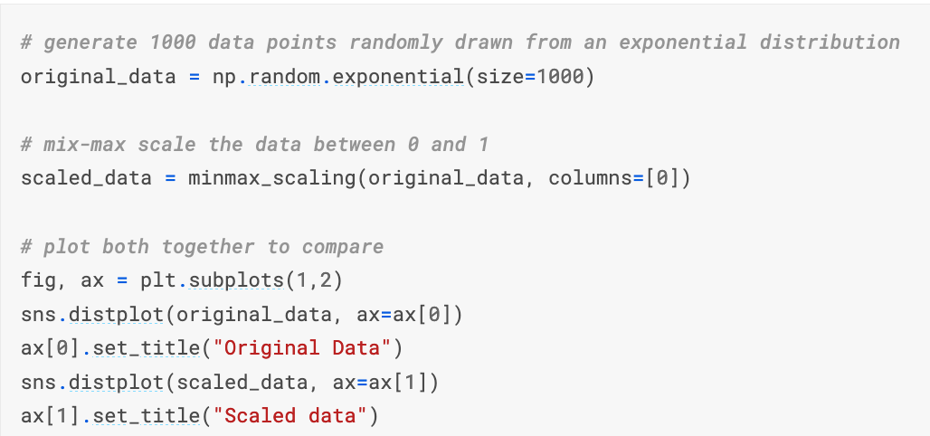
Scaling

Slide 14
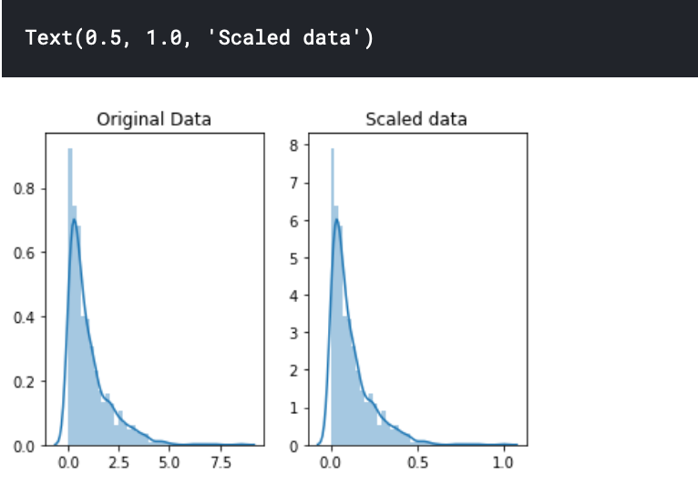
Scaling

Slide 15
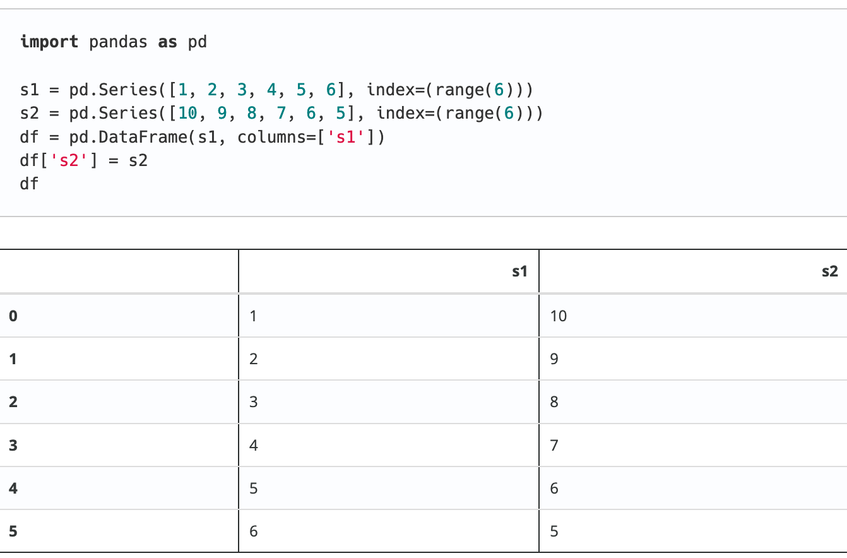
Scaling
http://rasbt.github.io/mlxtend/user_guide/preprocessing/minmax_scaling/

Slide 16
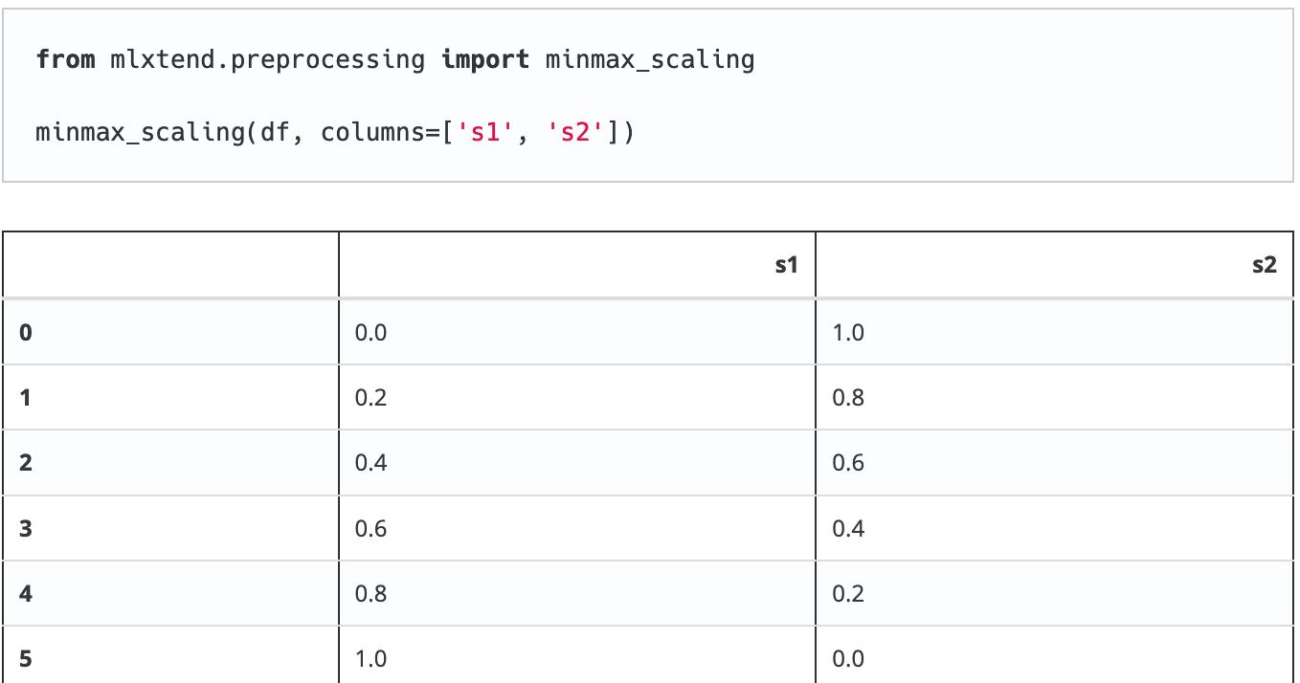
Scaling
http://rasbt.github.io/mlxtend/user_guide/preprocessing/minmax_scaling/

Slide 17
Scaling
You can also look at:
https://scikit-learn.org/stable/modules/generated/sklearn.preprocessing.MinMaxScaler.html
Transform features by scaling each feature to a given range.
This estimator scales and translates each feature individually such that it is in the given range on the training set, e.g. between zero and one.

Slide 18
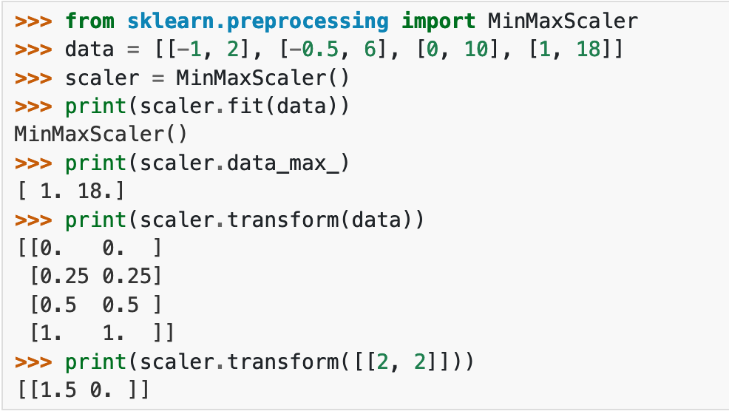
Scaling

Slide 19
Normalization
Scaling just changes the range of your data.
Normalization is a more radical transformation. The point of normalization is to change your observations so that they can be described as a normal distribution.
Normal distribution: Also known as the "bell curve", this is a specific statistical distribution where a roughly equal observations fall above and below the mean, the mean and the median are the same, and there are more observations closer to the mean. The normal distribution is also known as the Gaussian distribution.

Slide 20
Normalization
In general, you'll normalize your data if you're going to be using a machine learning or statistics technique that assumes your data is normally distributed.
Some examples of these include linear discriminant analysis (LDA) and Gaussian naive Bayes.

Slide 21

Normalizing
This means that the mean of the attribute becomes zero and the resultant
distribution has a unit standard deviation.
Here’s the formula for normalization:

Slide 22
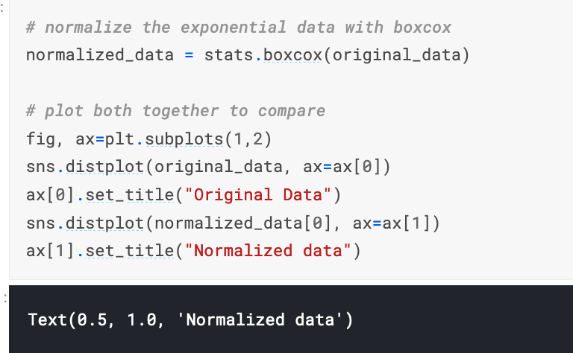
Normalization

Slide 23
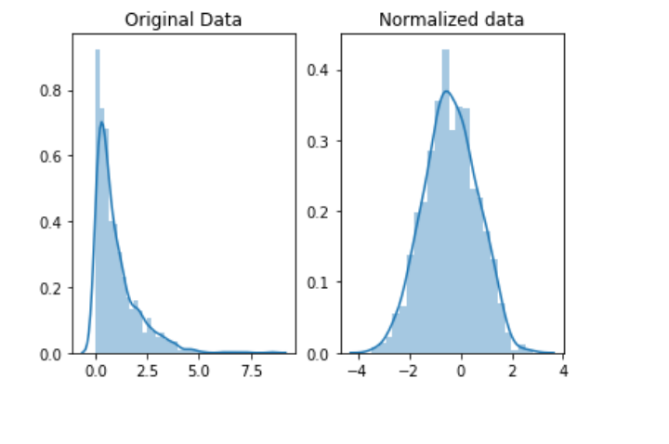
Normalization
Notice that the shape of our data has changed.
Before normalizing it was almost L-shaped. But after normalizing it looks more like the outline of a bell (hence "bell curve").

Slide 24
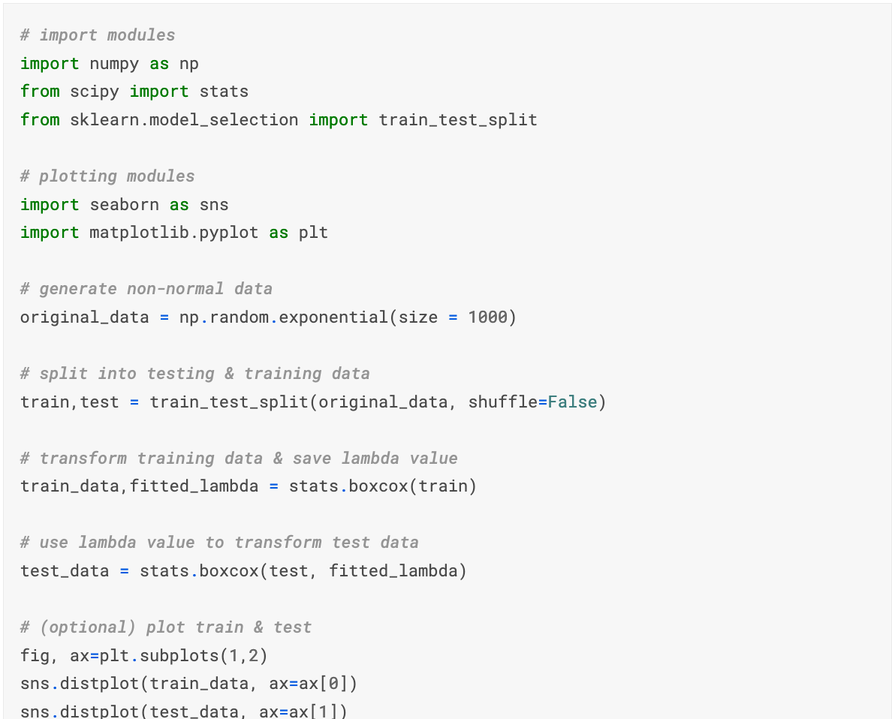
Box-cox transform of train and test data
https://www.kaggle.com/rtatman/boxcox-transform-on-train-test-data

Slide 25
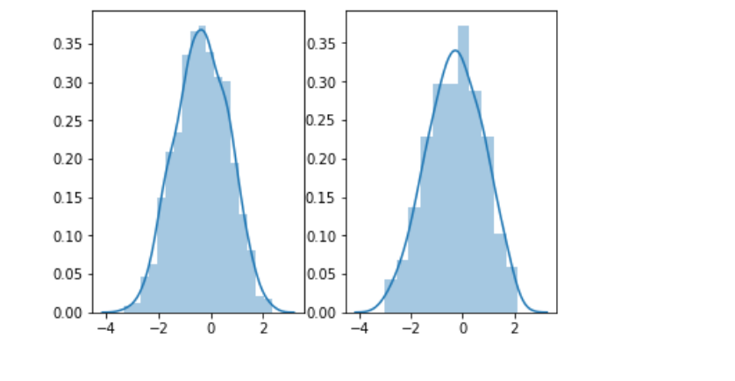
Box-cox transform of train and test data
https://www.kaggle.com/rtatman/boxcox-transform-on-train-test-data

Slide 26
Let’s Try the Code!

Slide 27
Scaling & Normalization: Another Example

Slide 28
Scaling & Normalization: Another Example
Kickstarter Project Dataset

Slide 29
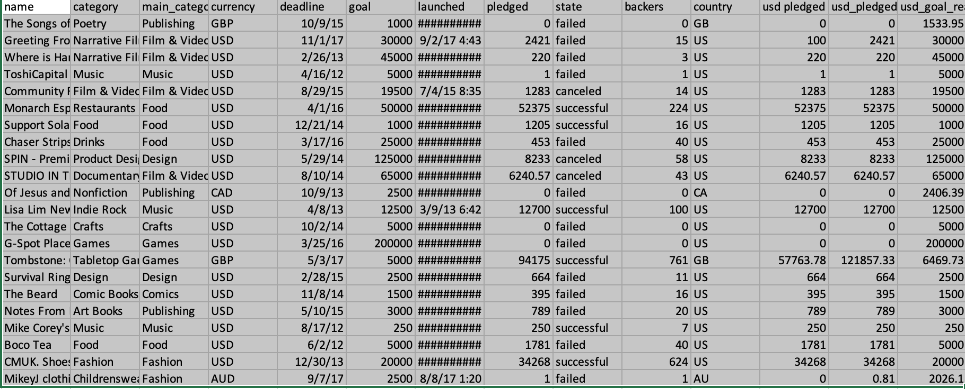
Scaling & Normalization: Another Example

Slide 30
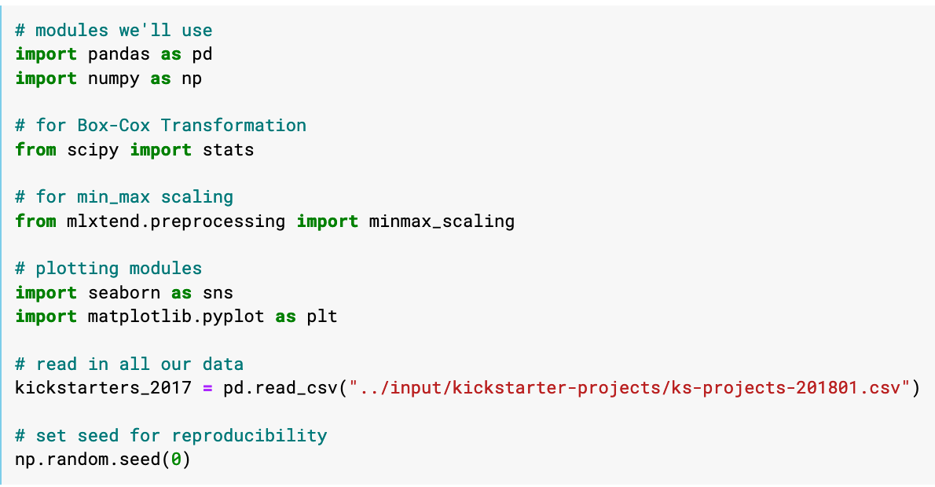
Scaling & Normalization: Another Example

Slide 31
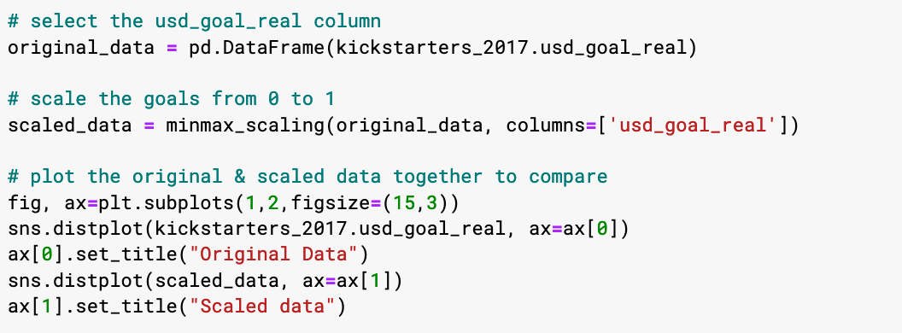
Scaling & Normalization: Another Example
Let's start by scaling the goals of each campaign, which is how much money they were asking for.

Slide 32
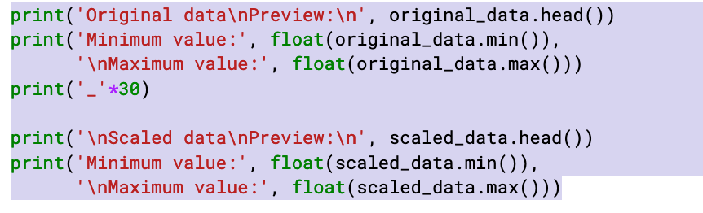
Scaling & Normalization: Another Example

Slide 33
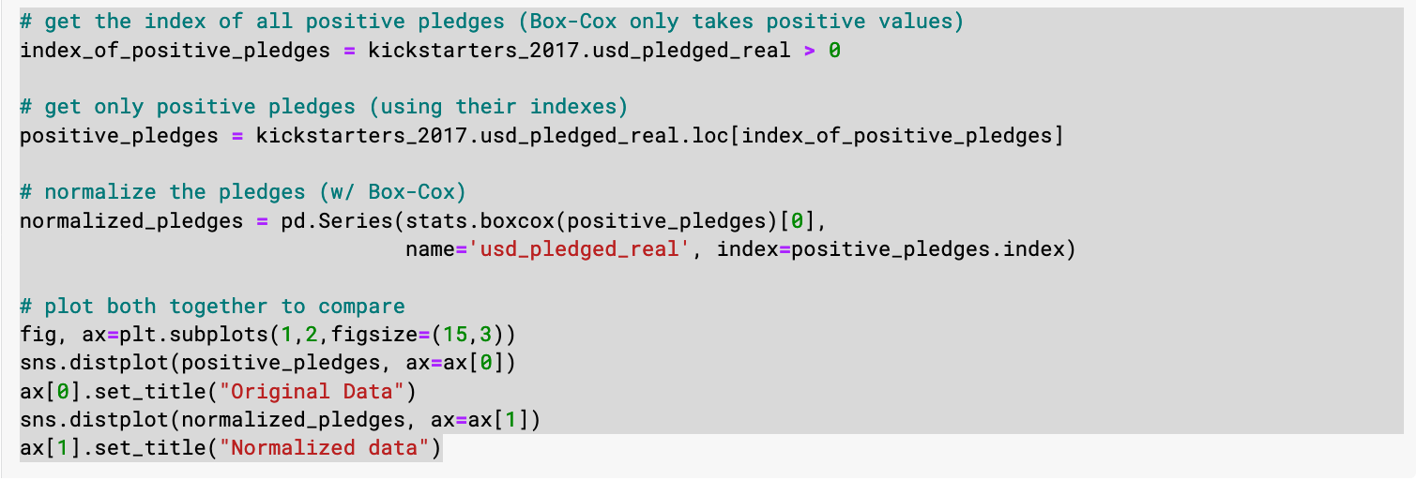
Scaling & Normalization: Another Example

Slide 34
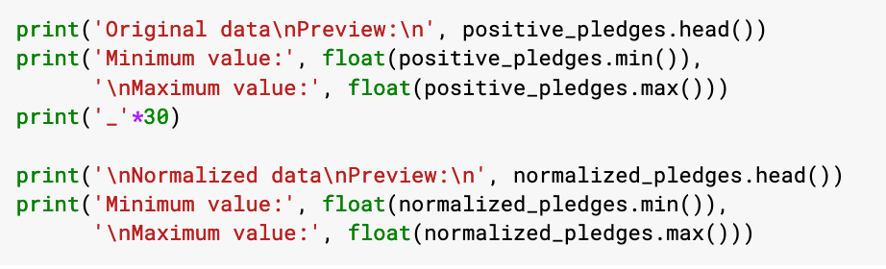
Scaling & Normalization: Another Example

Slide 35
Let’s Try The Code!

Slide 36
Parsing Dates
https://www.kaggle.com/alexisbcook/parsing-dates

Slide 37
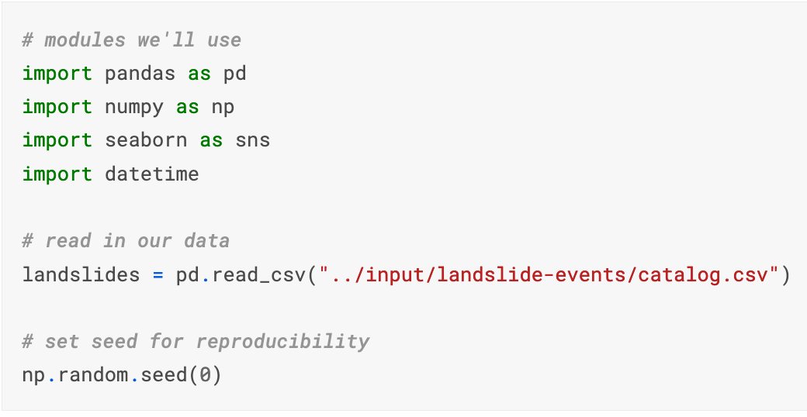
Parsing Dates

Slide 38
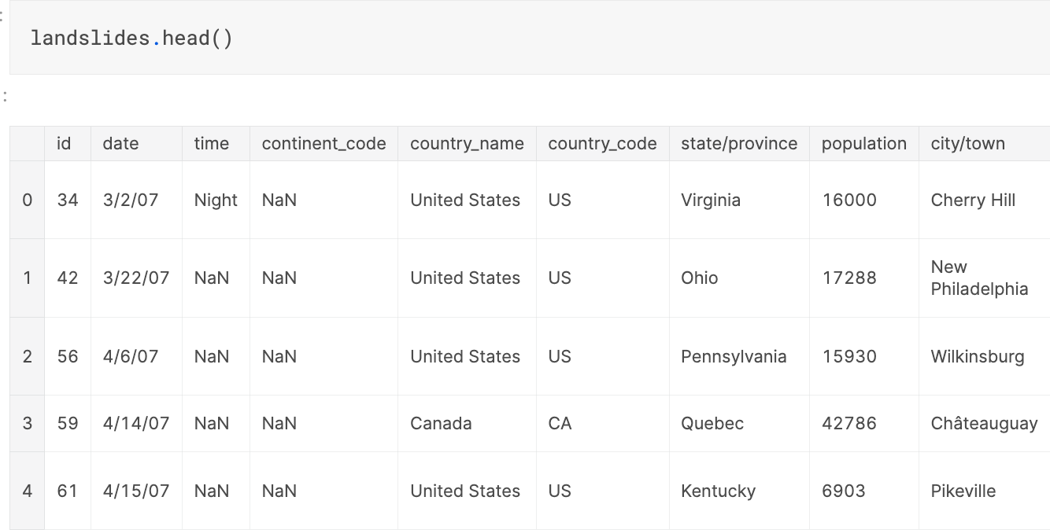
Parsing Dates

Slide 39
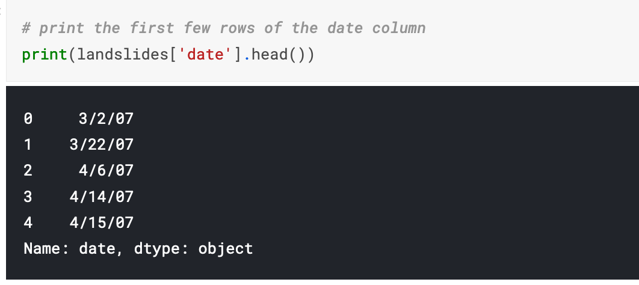
Parsing Dates

Slide 40
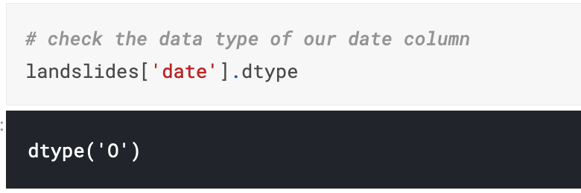
Parsing Dates

Slide 41
Convert Date Columns to Date Time
Now that we know that our date column isn't being recognized as a date, it's time to convert it so that it is recognized as a date.
This is called "parsing dates" because we're taking in a string and identifying its component parts.

Slide 42
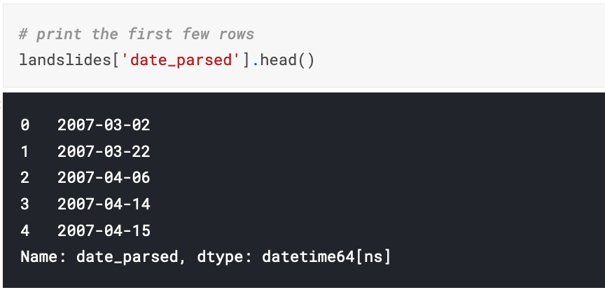
Convert Date Columns to Date Time
Now that our dates are parsed correctly, we can interact with them in useful ways.

Slide 43
Convert Date Columns to Date Time
What if I run into an error with multiple date formats? While we're specifying the date format here, sometimes you'll run into an error when there are multiple date formats in a single column.
If that happens, you have pandas try to infer what the right date format should be.
You can do that like so:
landslides['date_parsed'] = pd.to_datetime(landslides['Date'], infer_datetime_format=True)

Slide 44
Convert Date Columns to Date Time
Why don't you always use infer_datetime_format = True?
There are two big reasons not to always have pandas guess the time format.
The first is that pandas won't always been able to figure out the correct date format, especially if someone has gotten creative with data entry.
The second is that it's much slower than specifying the exact format of the dates.

Slide 45
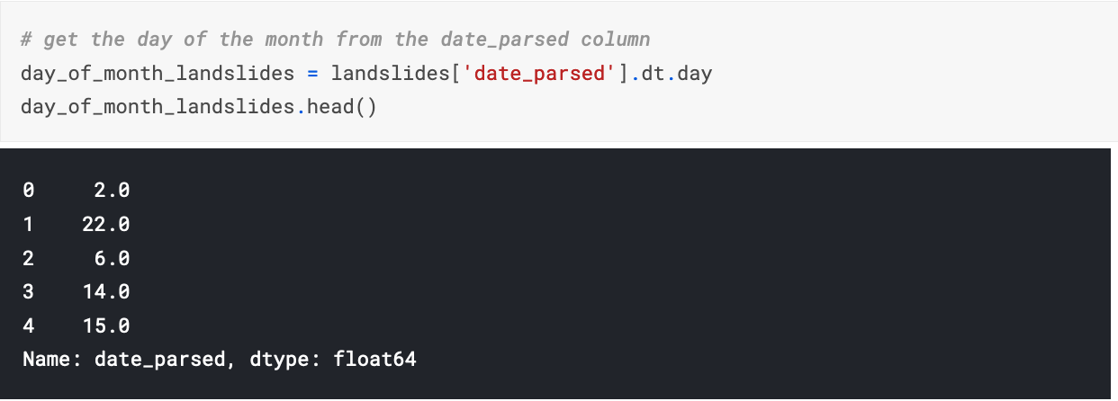
Select the day of the month
Now that we have a column of parsed dates, we can extract information like the day of the month that a landslide occurred.

Slide 46
Select the day of the month
If we tried to get the same information from the original "date" column, we would get an error: AttributeError: Can only use .dt accessor with date time like values.
This is because dt.day doesn't know how to deal with a column with the dtype "object".
Even though our dataframe has dates in it, we have to parse them before we can interact with them in a useful way.

Slide 47
Plot the day of the month to check the date parsing
One of the biggest dangers in parsing dates is mixing up the months and days.
The to_datetime() function does have very helpful error messages, but it doesn't hurt to double-check that the days of the month we've extracted make sense.
To do this, let's plot a histogram of the days of the month.
We expect it to have values between 1 and 31 and, since there's no reason to suppose the landslides are more common on some days of the month than others, a relatively even distribution.
(With a dip on 31 because not all months have 31 days.)
Let's see if that's the case:

Slide 48
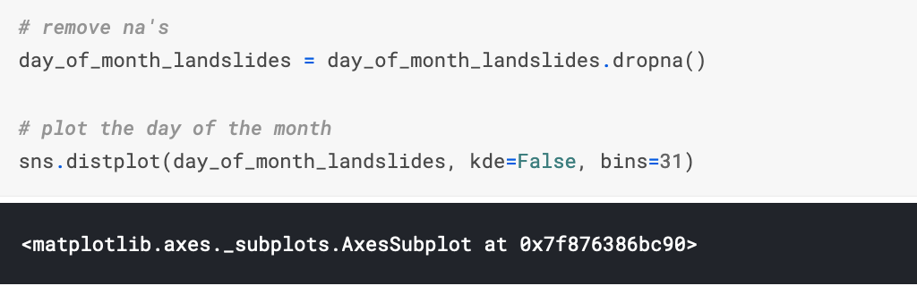
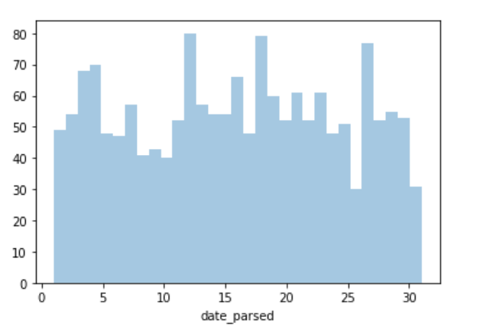
Plot the day of the month to check the date parsing

Slide 49
Another Example

Slide 50
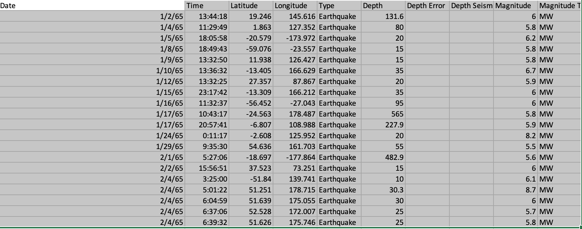
Another Example

Slide 51
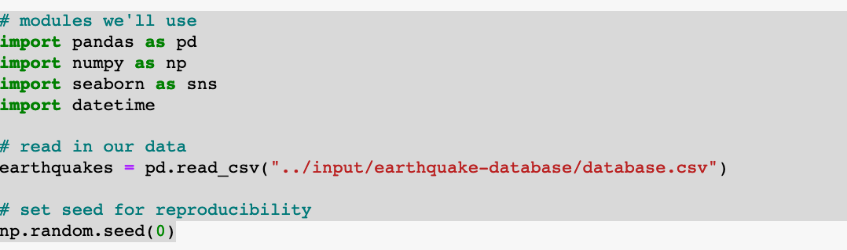
Another Example
print(earthquakes['Date'].head())

Slide 52
Another Example
Most of the entries in the "Date" column follow the same format: "month/day/four-digit year".
However, the entry at index 3378 follows a completely different pattern.
earthquakes[3378:3383]
Date ... Status
3378 1975-02-23T02:58:41.000Z ... Reviewed
3379 2/23/75 ... Reviewed
3380 2/23/75 ... Reviewed
3381 2/25/75 ... Reviewed
3382 2/26/75 ... Reviewed

Slide 53
Another Example
This does appear to be an issue with data entry: ideally, all entries in the column have the same format.
We can get an idea of how widespread this issue is by checking the length of each entry in the "Date" column.
date_lengths = earthquakes.Date.str.len()
date_lengths.value_counts()
[5 rows x 21 columns]
7 14158
6 5024
8 4227
24 3
Name: Date, dtype: int64

Slide 54
Another Example
indices = np.where([date_lengths == 24])[1]
print('Indices with corrupted data:', indices)
print(earthquakes.loc[indices])
Indices with corrupted data: [ 3378 7512 20650]
Date ... Status
3378 1975-02-23T02:58:41.000Z ... Reviewed
7512 1985-04-28T02:53:41.530Z ... Reviewed
20650 2011-03-13T02:23:34.520Z ... Reviewed

Slide 55
Character Encoding
https://www.kaggle.com/alexisbcook/character-encodings

Slide 56
Character Encoding
Character encodings are specific sets of rules for mapping from raw binary byte strings (that look like this: 0110100001101001) to characters that make up human-readable text (like "hi").
There are many different encodings, and if you tried to read in text with a different encoding than the one it was originally written in, you ended up with scrambled text called "mojibake" (said like mo-gee-bah-kay).
Here's an example of mojibake:
æ–‡å—åŒ–ã??

Slide 57

Character Encoding
You might also end up with "unknown" characters.
There are what gets printed when there's no mapping between a particular byte and a character in the encoding you're using to read your byte string in and they look like this:
Character encoding mismatches are less common today than they used to be, but it's definitely still a problem.
There are lots of different character encodings, but the main one you need to know is UTF-8.

Slide 58
Character Encoding
UTF-8 is the standard text encoding. All Python code is in UTF-8 and, ideally, all your data should be as well.
It's when things aren't in UTF-8 that you run into trouble.
It was pretty hard to deal with encodings in Python 2, but thankfully in Python 3 it's a lot simpler.
There are two main data types you'll encounter when working with text in Python 3.
One is is the string, which is what text is by default.

Slide 59
Character Encoding
# start with a string
before = "This is the euro symbol: €"
# check to see what datatype it is
type(before)

Slide 60
Character Encoding
The encode() method returns an encoded version of the string.
Default encoding is the current default string encoding. The errors may be given to set a different error handling scheme.
Syntax
Following is the syntax for encode() method −
str.encode(encoding = 'UTF-8',errors = 'strict')

Slide 61
Character Encoding
The other data is the bytes data type, which is a sequence of integers.
You can convert a string into bytes by specifying which encoding it's in:
# encode it to a different encoding, replacing characters that raise errors
after = before.encode("utf-8", errors="replace")
# check the type
type(after)
print(before)
print(after)
This is the euro symbol: €
b'This is the euro symbol: \xe2\x82\xac'

Slide 62
Character Encoding
If you look at a bytes object, you'll see that it has a b in front of it, and then maybe some text after.
That's because bytes are printed out as if they were characters encoded in ASCII.
Here you can see that our euro symbol has been replaced with some mojibake that looks like "\xe2\x82\xac" when it's printed as if it were an ASCII string.

Slide 63
Character Encoding
When we convert our bytes back to a string with the correct encoding, we can see that our text is all there correctly, which is great! :)
# convert it back to utf-8
print(after.decode("utf-8"))
This is the euro symbol: €

Slide 64
Character Encoding
However, when we try to use a different encoding to map our bytes into a string, we get an error.
This is because the encoding we're trying to use doesn't know what to do with the bytes we're trying to pass it.
You need to tell Python the encoding that the byte string is actually supposed to be in.
# try to decode our bytes with the ascii encoding print(after.decode("ascii"))

Slide 65
Character Encoding
Analogy:
You can think of different encodings as different ways of recording music.
You can record the same music on a CD, cassette tape or 8-track.
While the music may sound more-or-less the same, you need to use the right equipment to play the music from each recording format.
The correct decoder is like a cassette player or a CD player. If you try to play a cassette in a CD player, it just won't work.

Slide 66
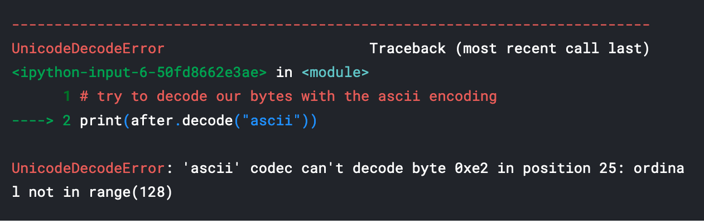
Character Encoding
# try to decode our bytes with the ascii encoding print(after.decode("ascii"))

Slide 67
Character Encoding
We can also run into trouble if we try to use the wrong encoding to map from a string to bytes.
Strings are UTF-8 by default in Python 3, so if we try to treat them like they were in another encoding we'll create problems.
For example, if we try to convert a string to bytes for ASCII using encode(), we can ask for the bytes to be what they would be if the text was in ASCII.
Since our text isn't in ASCII, though, there will be some characters it can't handle.

Slide 68
Character Encoding
We can automatically replace the characters that ASCII can't handle.
If we do that, however, any characters not in ASCII will just be replaced with the unknown character.
Then, when we convert the bytes back to a string, the character will be replaced with the unknown character.
The dangerous part about this is that there's not way to tell which character it should have been.
That means we may have just made our data unusable!

Slide 69
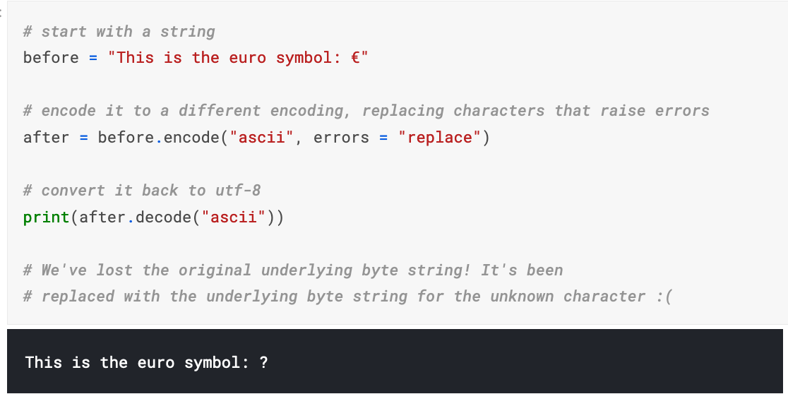
Character Encoding
This is bad and we want to avoid doing it! It's far better to convert all our text to UTF-8 as soon as we can and keep it in that encoding. The best time to convert non UTF-8 input into UTF-8 is when you read in files, which we'll talk about next.

Slide 70
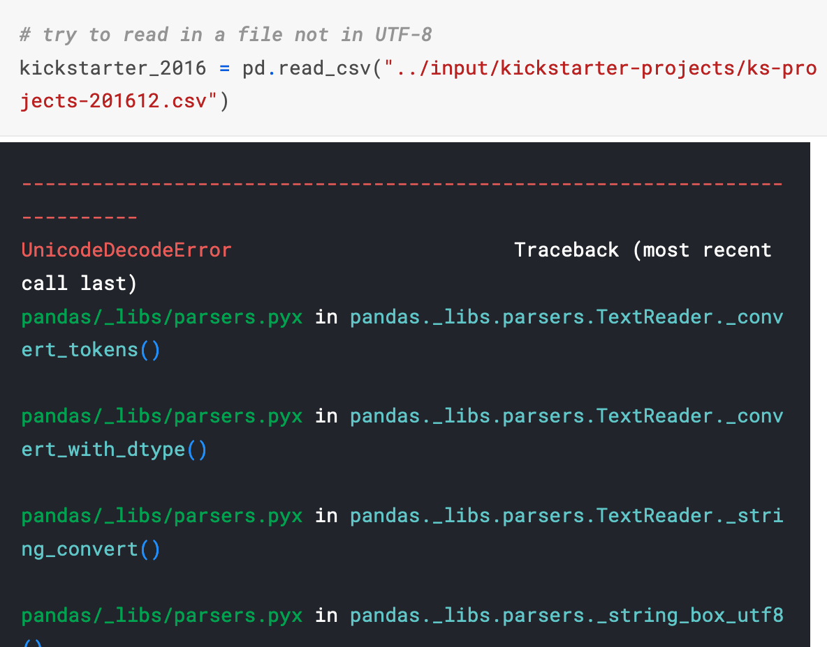
Reading in files with encoding problems
Most files you'll encounter will probably be encoded with UTF-8. This is what Python expects by default, so most of the time you won't run into problems. However, sometimes you'll get an error like this:

Slide 71
Reading in files with encoding problems
Notice that we get the same UnicodeDecodeError we got when we tried to decode UTF-8 bytes as if they were ASCII!
This tells us that this file isn't actually UTF-8. We don't know what encoding it actually is though.
One way to figure it out is to try and test a bunch of different character encodings and see if any of them work.
A better way, though, is to use the chardet module to try and automatically guess what the right encoding is. It's not 100% guaranteed to be right, but it's usually faster than just trying to guess.

Slide 72
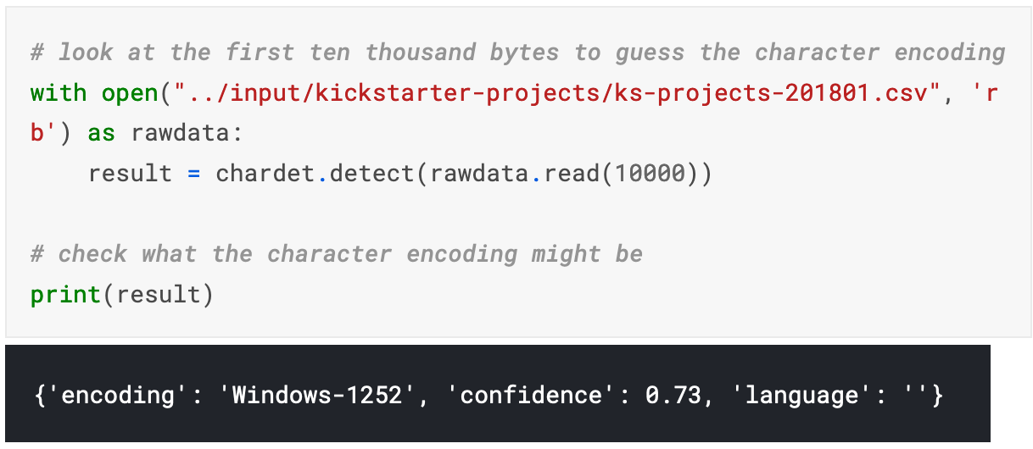
Reading in files with encoding problems

Slide 73
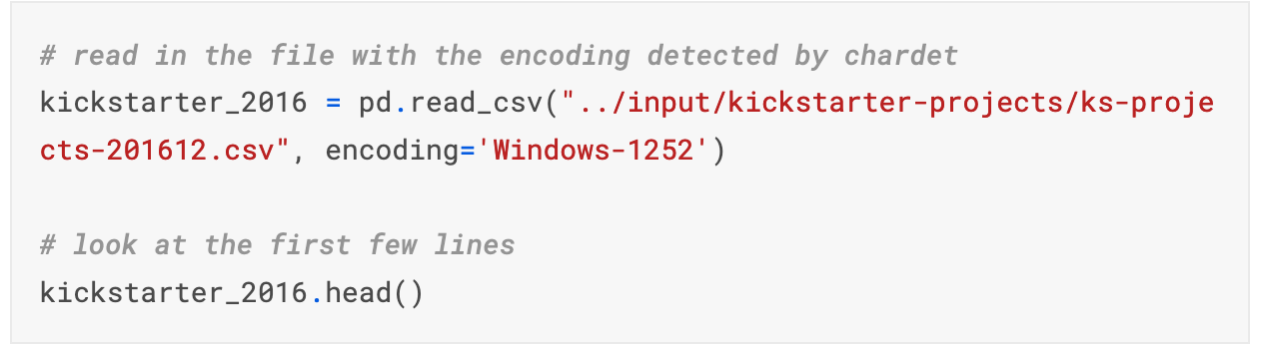
Reading in files with encoding problems

Slide 74
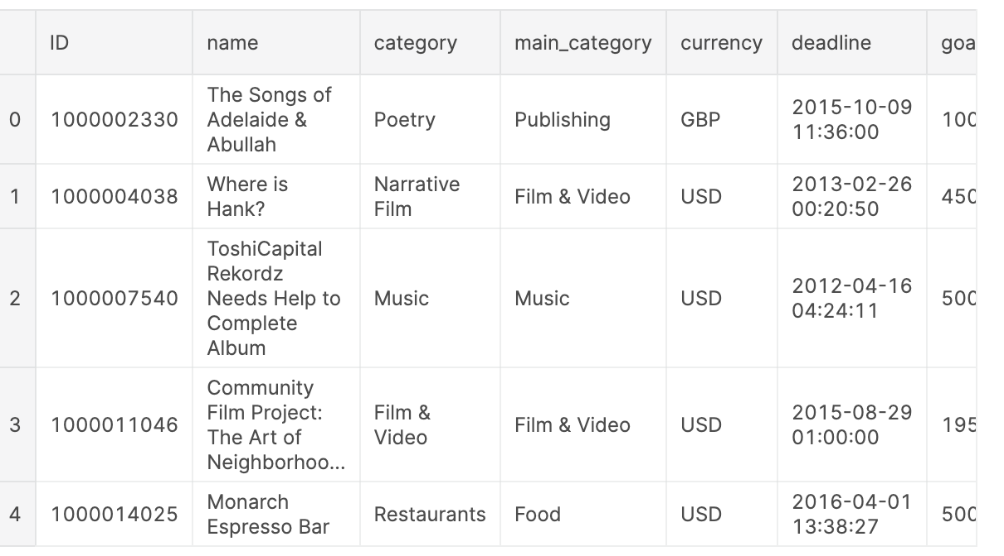
Reading in files with encoding problems

Slide 75
Reading in files with encoding problems
What if the encoding chardet guesses isn't right?
Since chardet is basically just a fancy guesser, sometimes it will guess the wrong encoding.
One thing you can try is looking at more or less of the file and seeing if you get a different result and then try that.

