Slide 1
NLP 220 Data Science and Machine Learning Fundamentals Lecture 6
Jalal Mahmud
jumahmud@ucsc.edu

Slide 2
Outline for Today
Review of SVM, and Linear Regression
Gradient Descent
Some Slides from Dilek Hakkani Tur, John Whitehead, Rachid Salmi, Jean-Claude Desenclos, Thomas Grein, Alain Moren, Pandu Nayak and Prabhakar Raghavan
Also:
https://towardsdatascience.com/https-medium-com-pupalerushikesh-svm-f4b42800e989
https://machinelearningmastery.com/linear-regression-for-machine-learning/

Slide 3
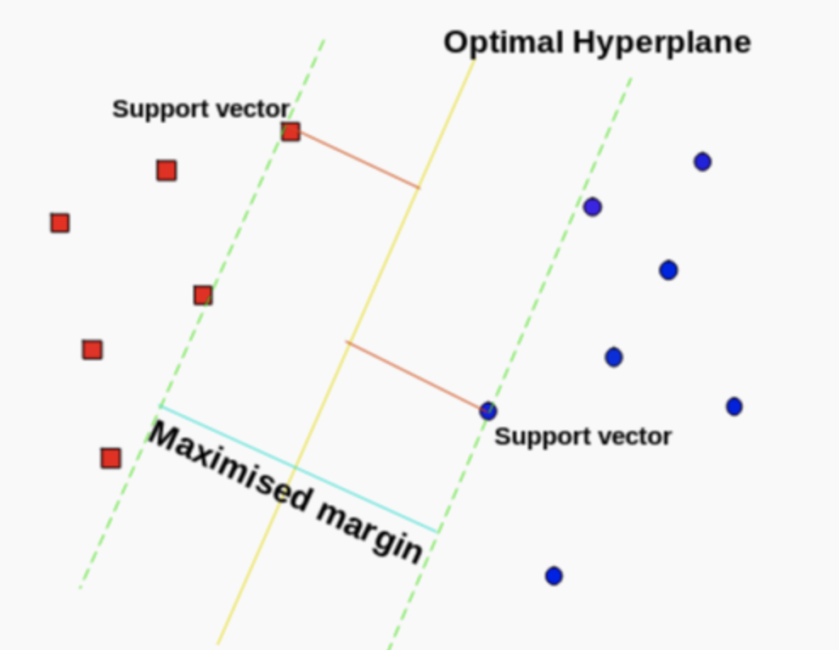
SVM Review
https://towardsdatascience.com/https-medium-com-pupalerushikesh-svm-f4b42800e989

Slide 4
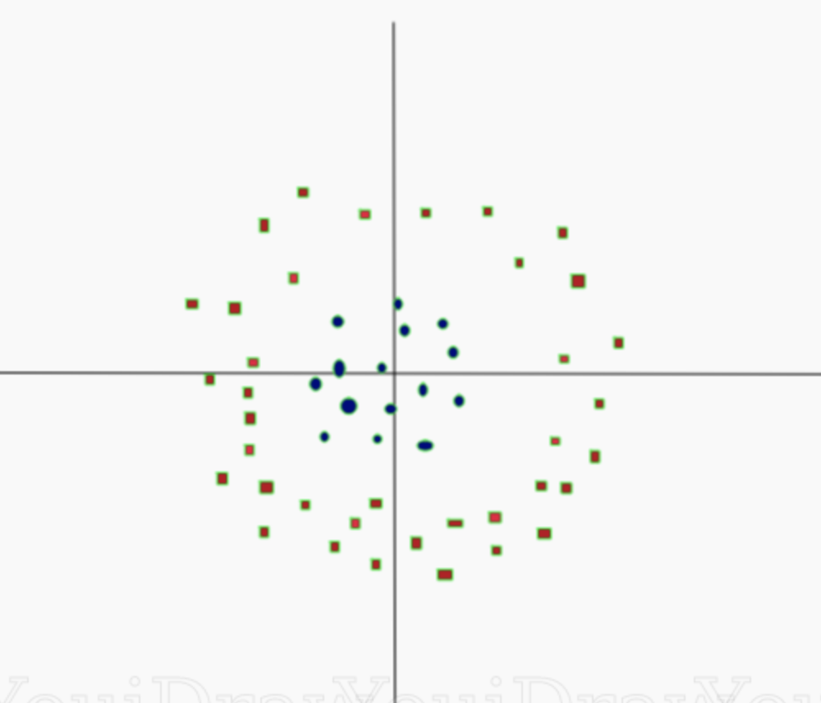
Non Linearly Separable Data

Slide 5
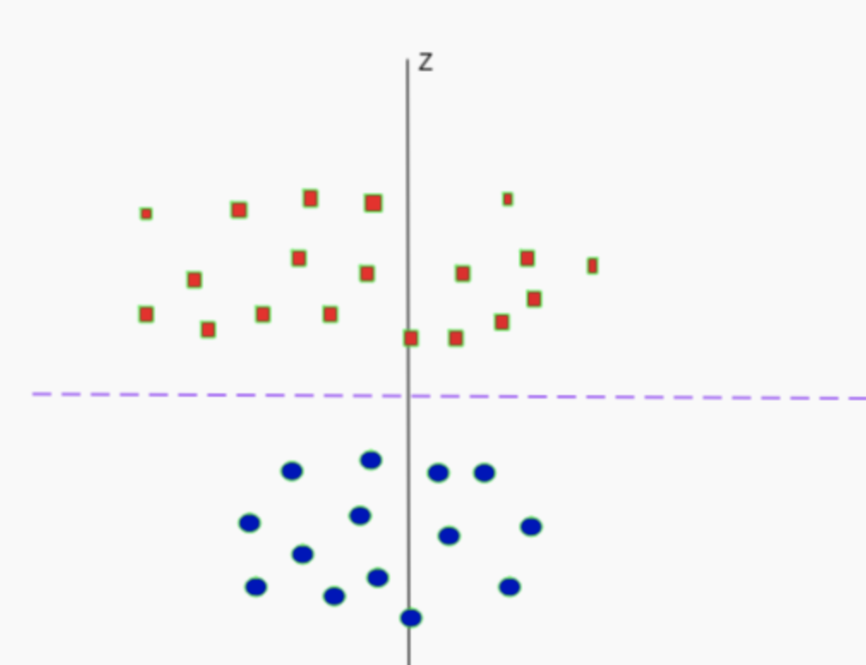
Mapping to higher dimension

Slide 6
Hyperplane
In geometry, a hyperplane is a subspace whose dimension is one less than that of its ambient space.
For example, if a space is 3-dimensional then its hyperplanes are the 2-dimensional planes, while if the space is 2-dimensional, its hyperplanes are the 1-dimensional lines

Slide 7
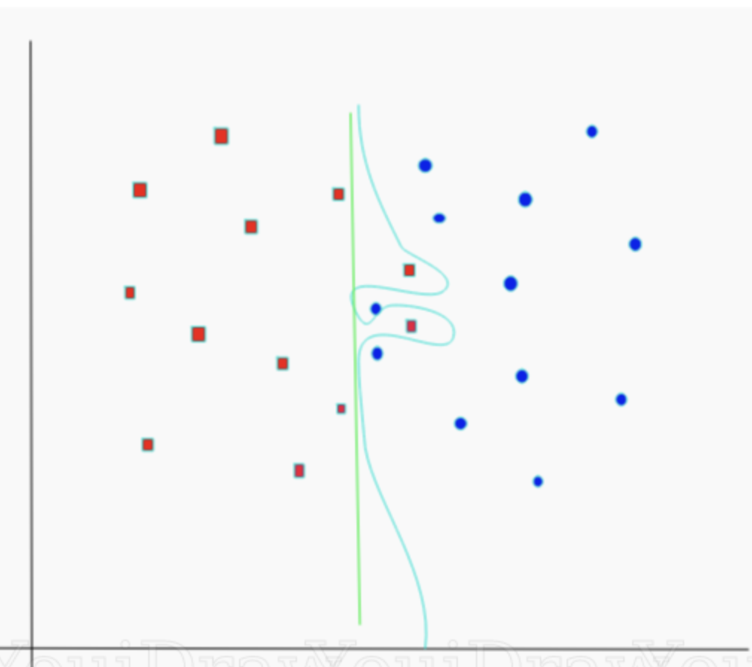
Parameter Tuning
C:
It controls the trade
off between smooth decision boundary and classifying training points correctly. A large value of c means you will get more training points correctly.

Slide 8
Parameter Tuning
Gamma:
It defines how far the influence of a single training example reaches. If it has a low value it means that every point has a far reach and conversely high value of gamma means that every point has close reach.
If gamma has a very high value, then the decision boundary is just going to be dependent upon the points that are very close to the line which effectively results in ignoring some of the points that are very far from the decision boundary.

Slide 9
Linear Regression Review
Parameter Estimation
Learning a linear regression model means estimating the values of the coefficients used in the representation with the data that we have available.
Simple Statistics (when 1 variable)
Ordinary Least Square (More than 1 variable)
Gradient Descent (More than 1 variable)
https://machinelearningmastery.com/linear-regression-for-machine-learning/

Slide 10
Ordinary Least Square
The Ordinary Least Squares procedure seeks to minimize the sum of the squared residuals.
This means that given a regression line through the data we calculate the distance from each data point to the regression line, square it, and sum all of the squared errors together.
This is the quantity that ordinary least squares seeks to minimize.

Slide 11
Gradient Descent
Even when we cannot solve the models analytically, we can still train models effectively by iteratively reducing the error by updating the parameters in the direction that incrementally lowers the loss function:
Derivative of the true loss (i.e., average of the losses computed over all examples in the training data).

Slide 12
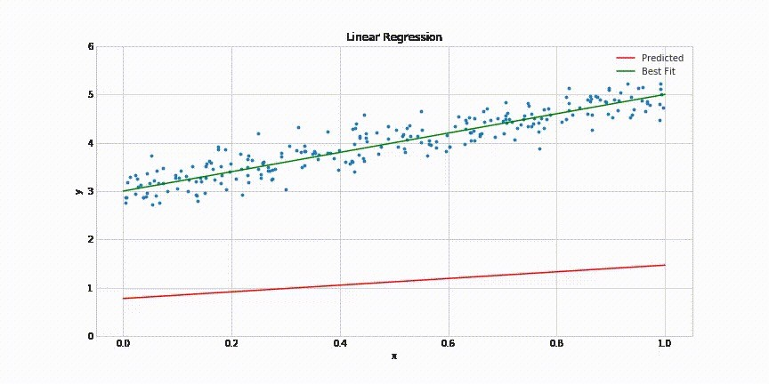
= 𝑚𝑥 + 𝑏
Case Study: 𝑓(x)

Slide 13
Gradient Descent (cont.)
Steps of the algorithm:
initialize the values of the model parameters, typically at random
iteratively update the parameters in the direction of the negative gradient.
Notation:
𝛳: model parameters (^{𝐰},𝑏)
C(𝛳): 𝐿 (^{𝐰},𝑏)

Slide 14
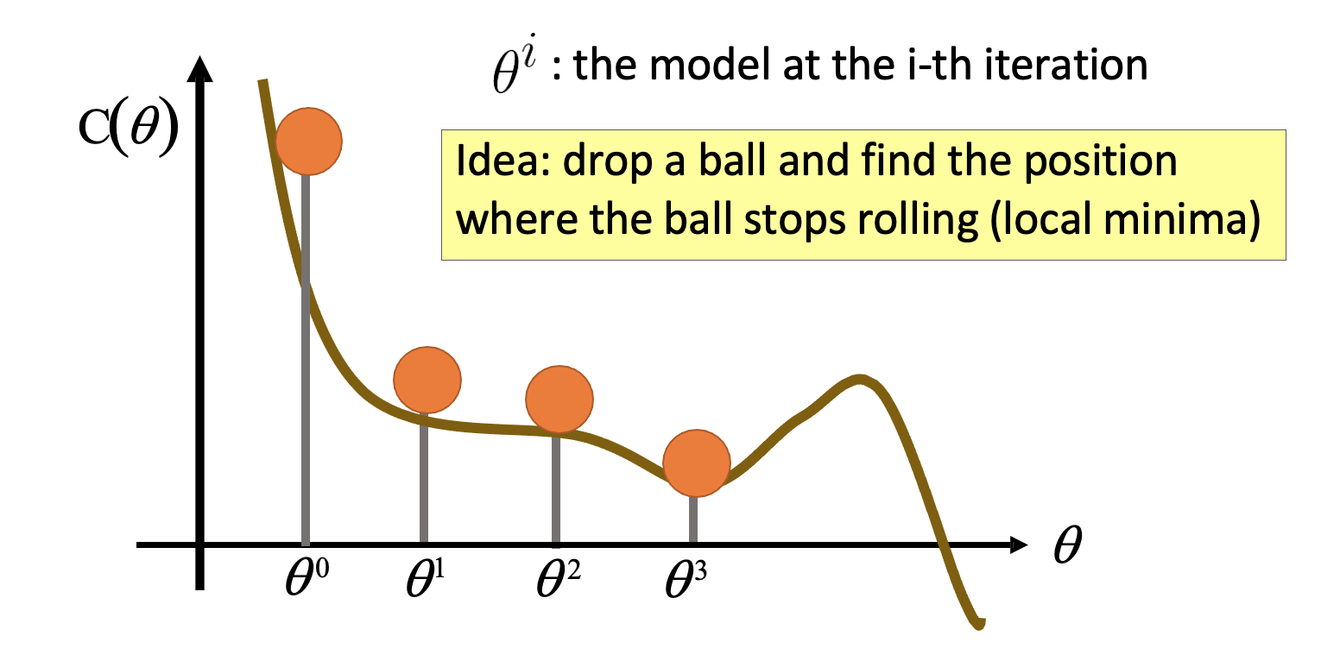
Gradient Descent (cont.)
Assume that θ has only one variable

Slide 15
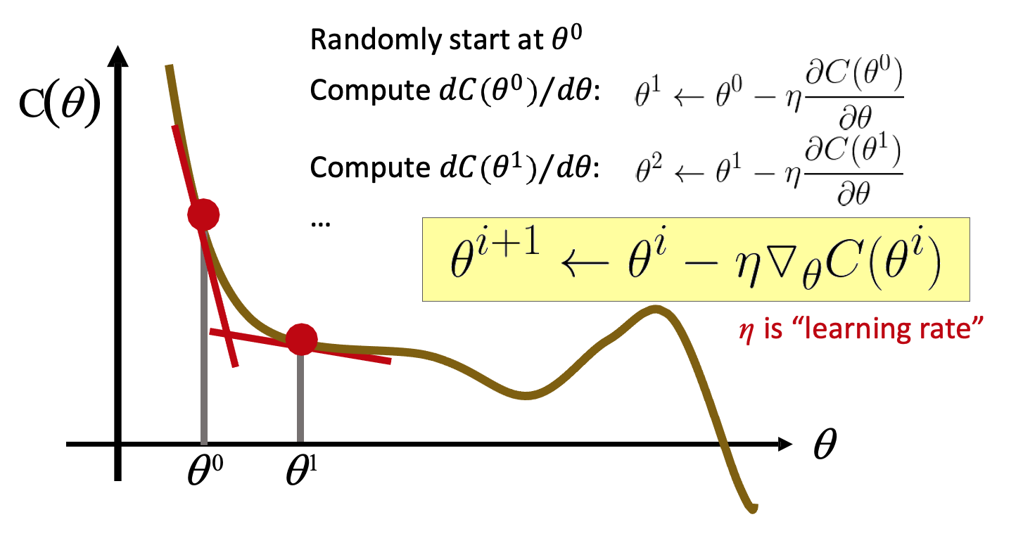
Gradient Descent (cont.)
Assume that θ has only one variable

Slide 16
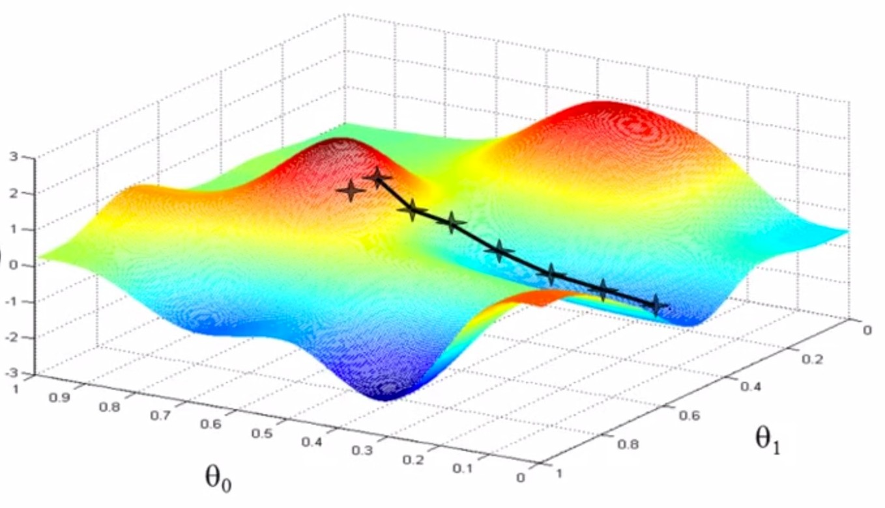



Gradient Descent (cont.)
Assume that θ has two variables {θ₁, θ₂}

Slide 17
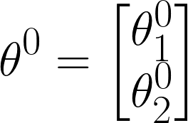
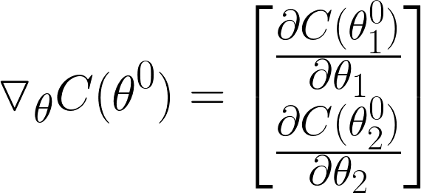
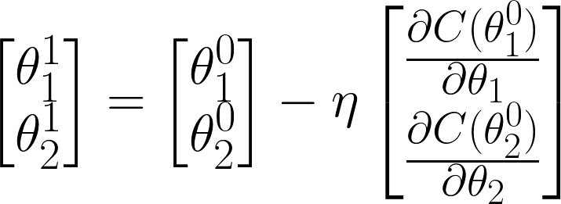

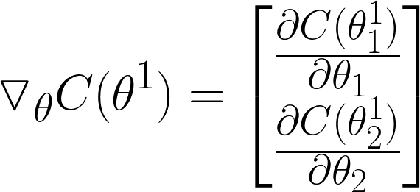
Gradient Descent (cont.)
Assume that θ has two variables {θ₁, θ₂}
Randomly start at 𝜃⁰:
Compute the gradients of 𝐶 𝜃 at 𝜃⁰:
Update parameters:
Compute the gradients of 𝐶 𝜃 at 𝜃¹:

Slide 18

Gradient Descent (cont.)
𝜃₂
𝛻𝐶 𝜃⁰
_{𝜃}0 𝛻𝐶 𝜃¹
Algorithm
Initialization: start at 𝜃⁰
while(𝜃^{(𝑖+1)} ≠ 𝜃^{𝑖})
{
compute gradient at 𝜃
update parameters
_{𝜃}1
𝛻𝐶 𝜃²
𝑖
Gradient Movement
_{𝜃}2
_{𝜃}3
𝛻𝐶 𝜃³
}
𝜃₁

Slide 19
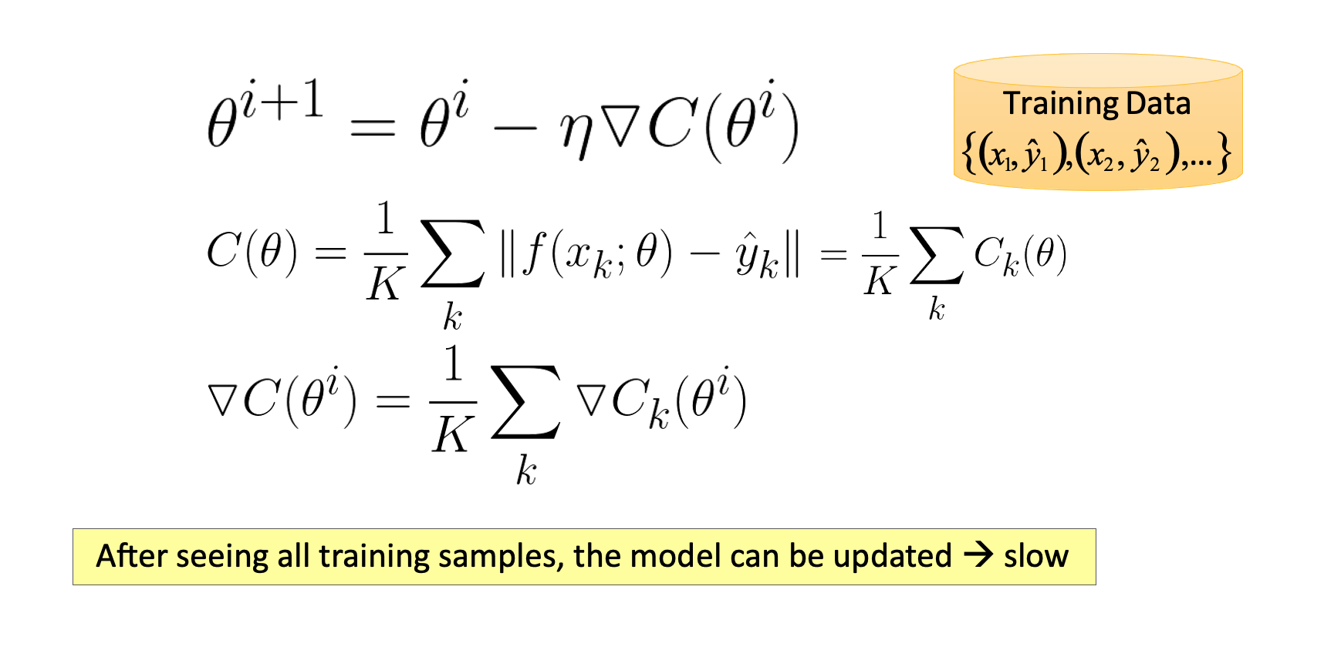
An Issue with Gradient Descent

Slide 20
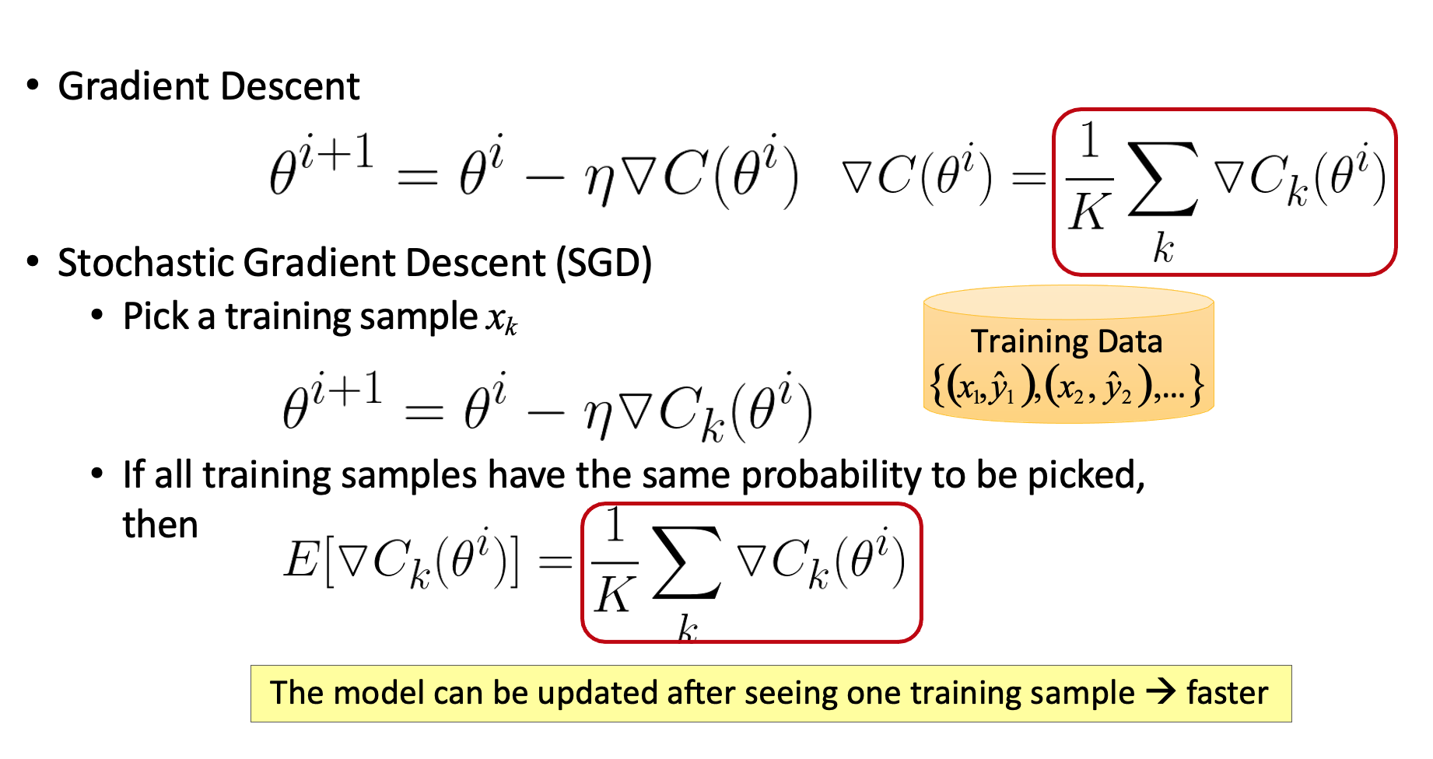
Stochastic Gradient Descent (SGD)

Slide 21
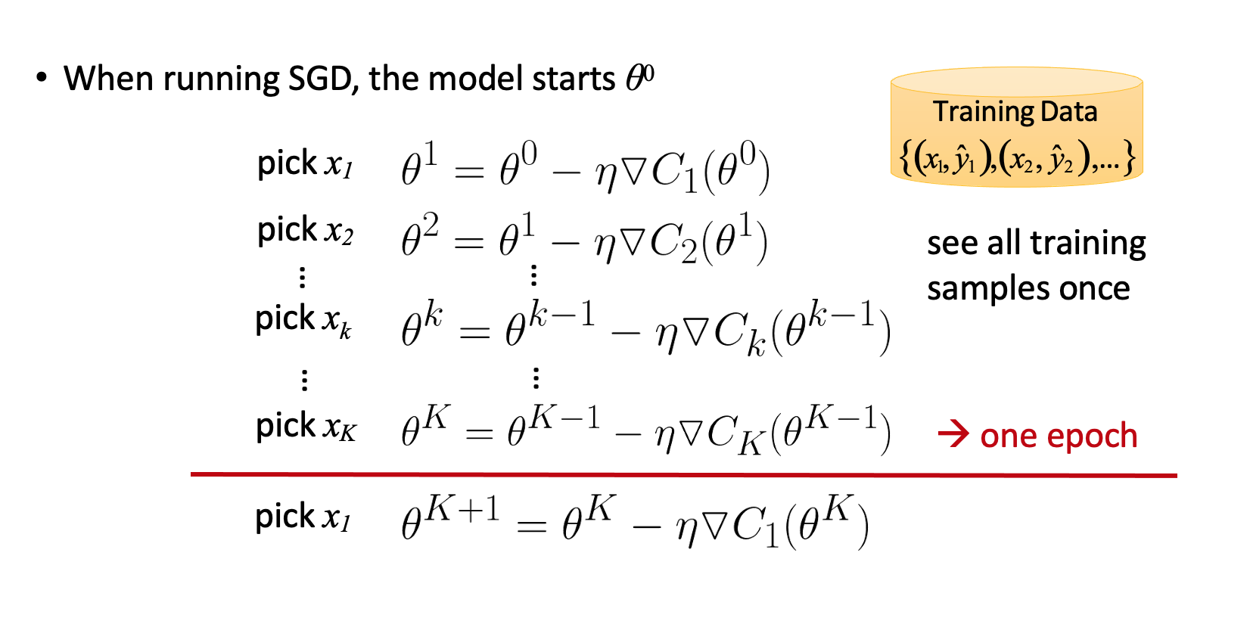
Epoch (Definition)

Slide 22
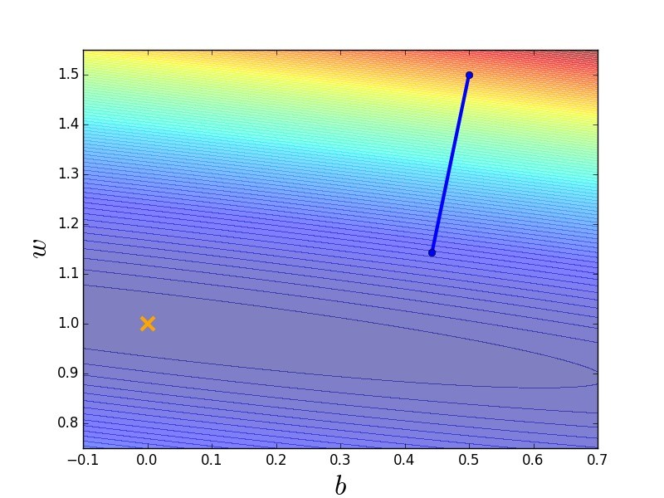
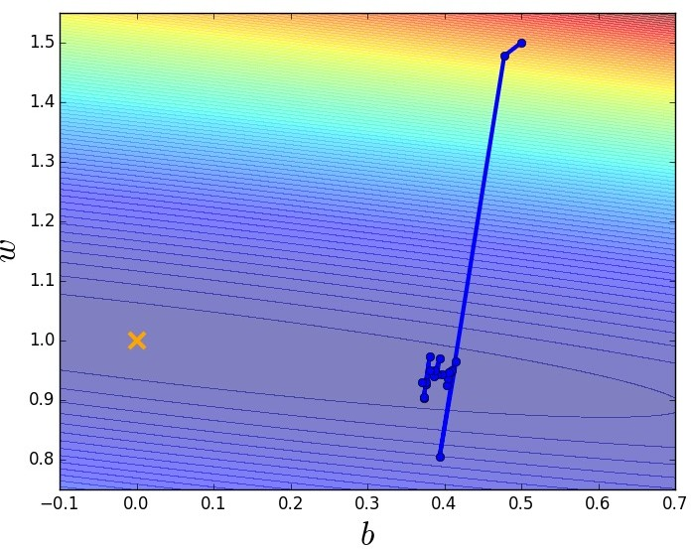
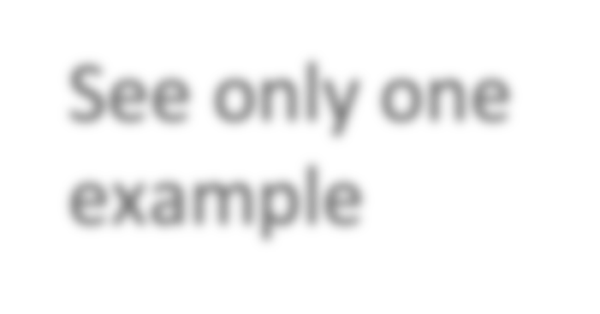


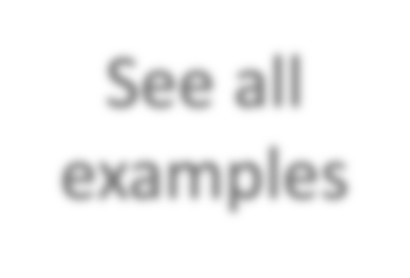



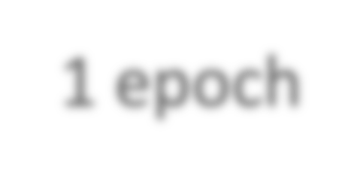


Gradient Descent v.s. SGD
Gradient Descent
Update after seeing all the examples
Stochastic Gradient Descent
If there are 20 examples, update 20 times in one epoch.
See all examples
See only one example
1 epoch
SGD approaches the target faster than gradient descent

Slide 23
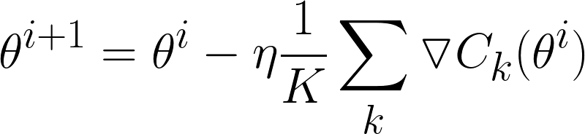

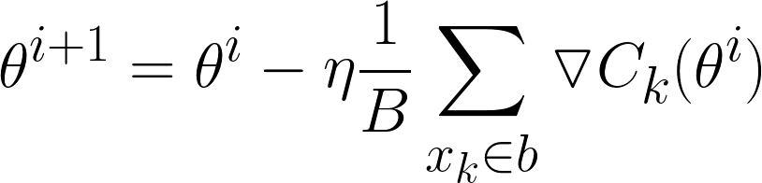
Mini-Batch SGD
Batch Gradient Descent
Use all K samples in each iteration
Stochastic Gradient Descent (SGD)
Pick a training sample x_{k}
Use 1 samples in each iteration
Mini-Batch SGD
Pick a set of B training samples as a batch b
B is “batch size”
Use all B samples in each iteration

Slide 24
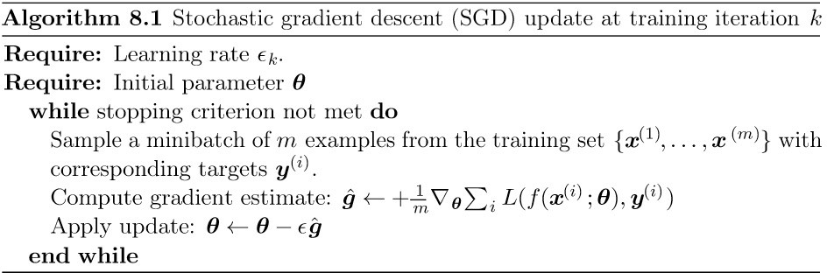
Mini-Batch SGD

Slide 25




















SGD vs. Mini-Batch
Training speed: mini-batch > SGD > Gradient Descent
Stochastic Gradient Descent (SGD)
_{𝑧}1
_{𝑊}1
𝑥
_{𝑧}1
=
=
_{𝑊}1
𝑥 ……
Mini-Batch SGD
matrix
_{𝑧}¹ _{𝑧}1
_{𝑊}1
𝑥
𝑥
=
Modern computers run matrix-matrix multiplication faster than matrix-vector multiplication

Slide 26
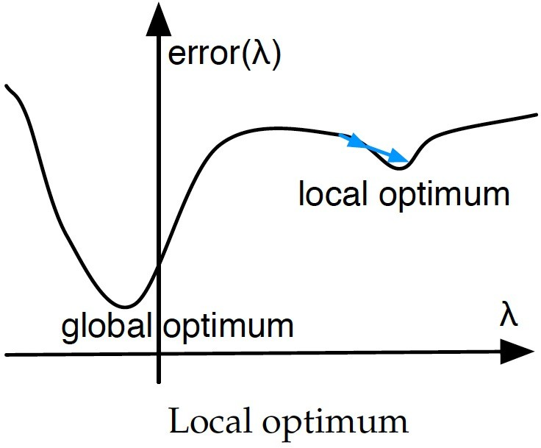
Practical Tips: Initialization
Diﬀerent initialization parameters may result in diﬀerent trained models
C(θ )
θ

Slide 27
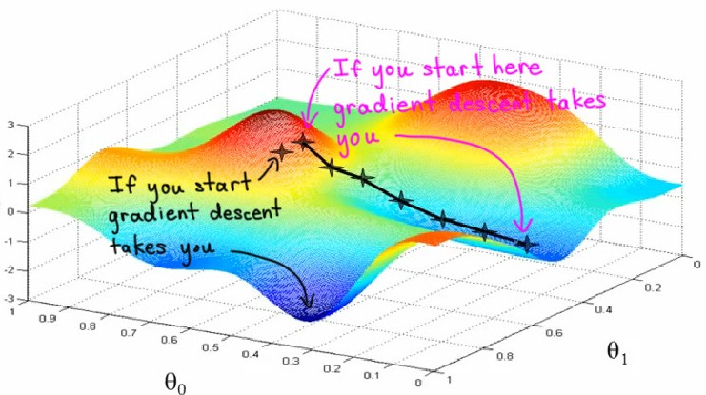
Practical Tips: Initialization
Different initialization parameters may result in different trained models
Do not initialize the parameters equally →
set them randomly

Slide 28
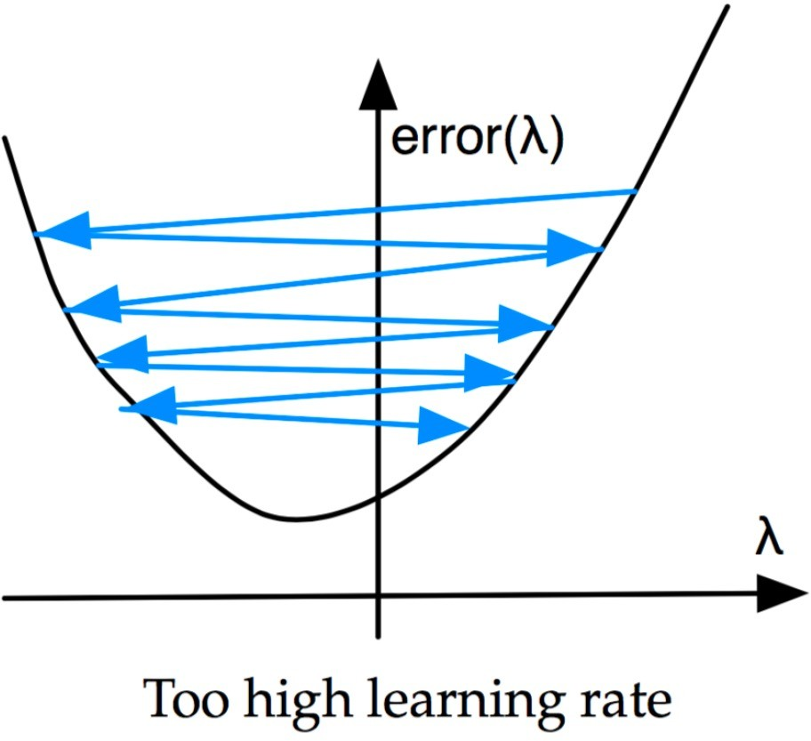
Practical Tips: Learning Rate
C(θ )
θ
Learning rate should be set carefully

Slide 29
Tips for Mini-Batch Training
Shuffle training samples before every epoch
the network might memorize the order you feed the examples
Use a fixed batch size for every epoch
enable fast implementation of matrix multiplication for calculations
Adapt the learning rate to the batch size
larger batch
smaller learning rate

Slide 30






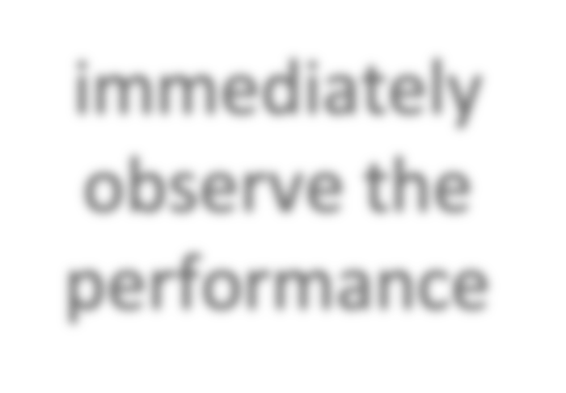
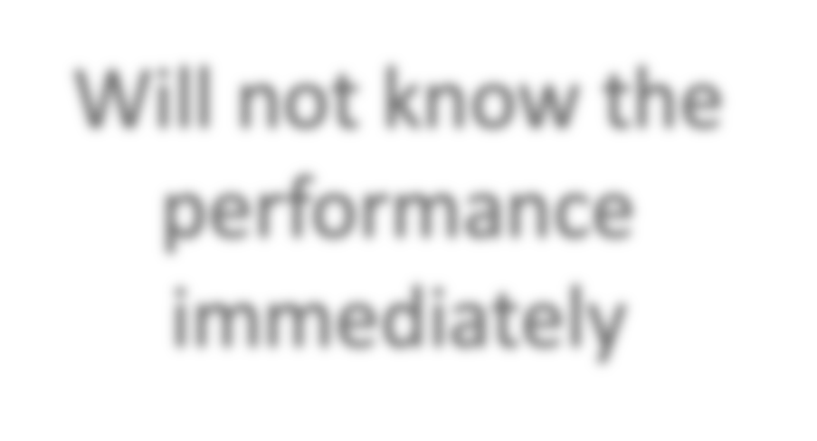




Learning Recipe
Testing Data
Training Data
x yˆ
Validation
Real Testing
x y
x y
immediately
Will not know the performance immediately
observe the
performance

Slide 31





Learning Recipe
Testing Data
Training Data
Validation
Real Testing
x y
x y
x yˆ
immediately
Will not know the performance immediately
observe the
performance

Slide 32
Learning Recipe
get good results on training set
modify training process
Possible reasons
no good function exists: bad hypothesis function set
→ reconstruct the model architecture
cannot ﬁnd a good function: local optima
→ change the training strategy
no

Slide 33
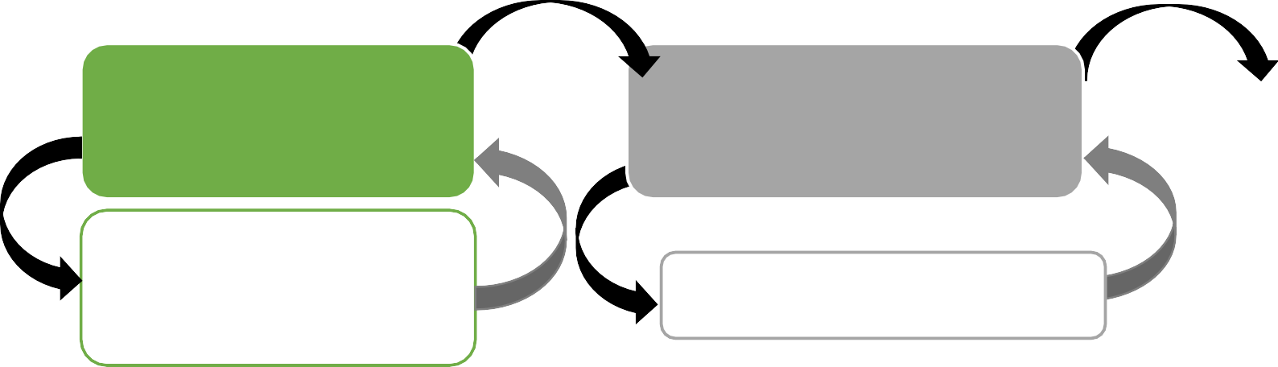
Learning Recipe
yes
yes
get good results on training set
modify training process
get good results on
done
no
^{no} dev/validation set
prevent overfitting
Better performance on training but worse performance on dev → overﬁtting

Slide 34
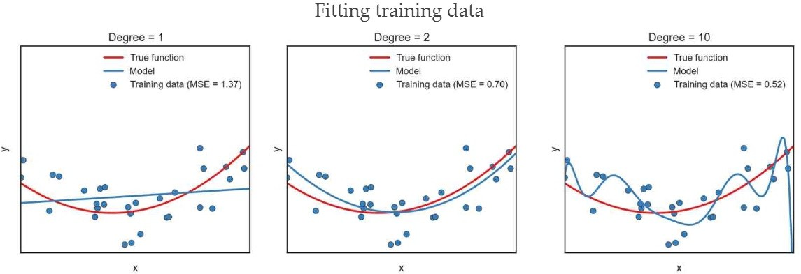
Overfitting
Possible solutions
more training samples
some tips: dropout, etc.

Slide 35
Regularization
There are extensions of the training of the linear model called regularization methods.
These seek to both minimize the sum of the squared error of the model on the training data (using ordinary least squares) but also to reduce the complexity of the model (like the number or absolute size of the sum of all coefficients in the model).

Slide 36
Regularization
Two popular examples of regularization procedures for linear regression are:
Lasso Regression: where Ordinary Least Squares is modified to also minimize the absolute sum of the coefficients (called L1 regularization).
Ridge Regression: where Ordinary Least Squares is modified to also minimize the squared absolute sum of the coefficients (called L2 regularization).
These methods are effective to use when there is collinearity in your input values and ordinary least squares would overfit the training data.

