Slide 1
NLP 220 Data Science and Machine Learning Fundamentals Lecture 7
Some Slides from Dilek Hakkani Tur, John Whitehead, Rachid Salmi, Jean-Claude Desenclos, Thomas Grein, Alain Moren, Pandu Nayak and Prabhakar Raghavan
Jalal Mahmud
jumahmud@ucsc.edu

Slide 2
Bias-Variance Trade Off
What is bias?
Bias is the difference between the average prediction of our model and the correct value which we are trying to predict.
Model with high bias pays very little attention to the training data and oversimplifies the model. It always leads to high error on training and test data.
https://towardsdatascience.com/understanding-the-bias-variance-tradeoff-165e6942b229

Slide 3
Bias-Variance Trade Off
What is variance?
Variance is the variability of model prediction for a given data point or a value which tells us spread of our data.
Model with high variance pays a lot of attention to training data and does not generalize on the data which it hasn’t seen before.
As a result, such models perform very well on training data but has high error rates on test data.

Slide 4
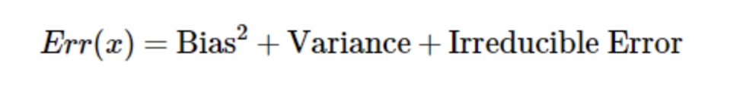
Bias-Variance Trade Off
Irreducible error is the error that can’t be reduced by creating good models. It is a measure of the amount of noise in our data.

Slide 5
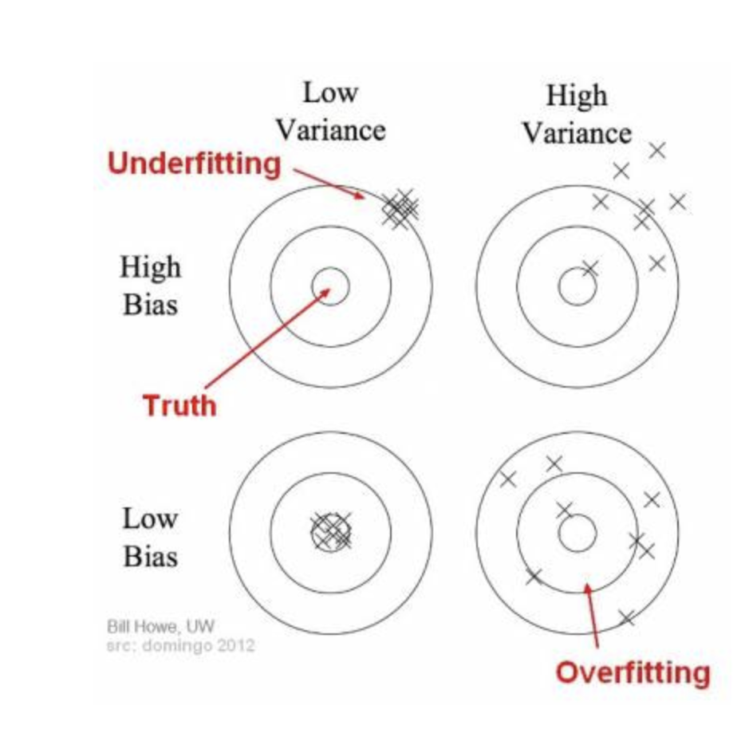
Bias-Variance Trade Off

Slide 6
Underfitting
underfitting happens when a model unable to capture the underlying pattern of the data.
These models usually have high bias and low variance. It happens when we have very less amount of data to build an accurate model or when we try to build a linear model with a nonlinear data.

Slide 7
Overfitting
In supervised learning, overfitting happens when our model captures the noise along with the underlying pattern in data.
It happens when we train our model a lot over noisy dataset. These models have low bias and high variance.
These models are very complex like Decision trees which are prone to overfitting.

Slide 8
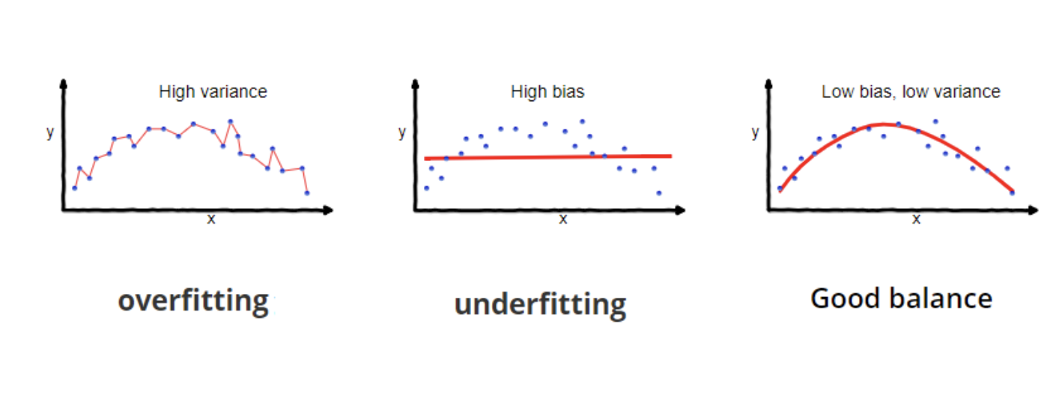
Overfitting/Underfitting

Slide 9
Bias-Variance Trade-Off
If our model is too simple and has very few parameters then it may have high bias and low variance.
On the other hand, if our model has large number of parameters then it’s going to have high variance and low bias.

Slide 10
Regularization Review

Slide 11
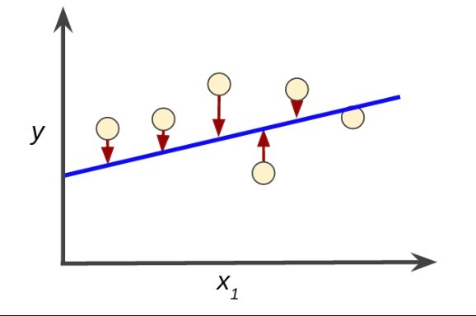
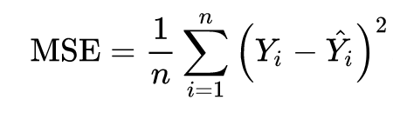
Mean Squared Error
𝑦_{𝑖} is the actual value, 𝑓 𝑥_{𝑖} is the prediction, and their difference is the error.
Commonly used function, (mean) squared error:

Slide 12
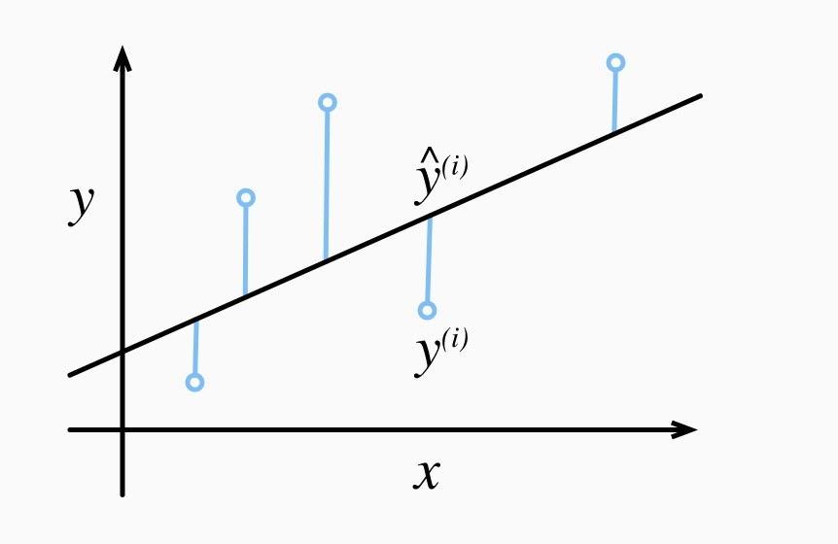
Loss Function
Measure of fitness, quantifies the distance between ^{𝐲} and ^{𝐲}̂.
Sum of squared errors:
𝑙^{(𝑖)}(^{𝐰},𝑏) = ¹ (𝑦̂ ^{(𝑖)}−𝑦^{(𝑖)})²
2
To measure quality over the entire training set,
we average over all K training examples
Residual = truth - predicted

Slide 13
Regularization
There are extensions of the training of the linear model called regularization methods.
These seek to both minimize the sum of the squared error of the model on the training data (using ordinary least squares) but also to reduce the complexity of the model (like the number or absolute size of the sum of all coefficients in the model).

Slide 14
Regularization
Two popular examples of regularization procedures for linear regression are:
Lasso Regression: where Ordinary Least Squares is modified to also minimize the absolute sum of the coefficients (called L1 regularization).
Ridge Regression: where Ordinary Least Squares is modified to also minimize the squared absolute sum of the coefficients (called L2 regularization).
These methods are effective to use when there is collinearity in your input values and ordinary least squares would overfit the training data.

Slide 15
Lasso (L1 Regularization)
Lasso regression is a regularization technique. It is used over regression methods for a more accurate prediction.
This model uses shrinkage. Shrinkage is where data values are shrunk towards a central point as the mean. The lasso procedure encourages simple, sparse models (i.e. models with fewer parameters).
Lasso Regression uses L1 regularization. It is used when we have more features because it automatically performs feature selection.

Slide 16
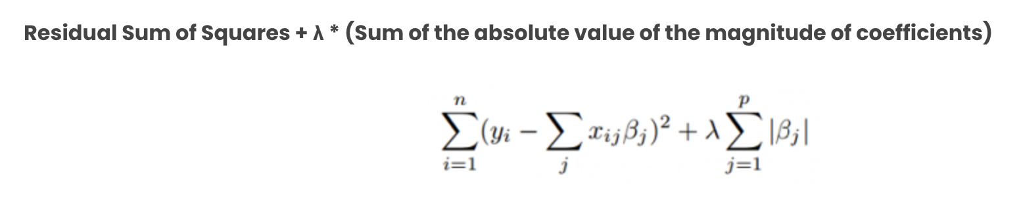
Lasso Regression
The difference between ridge and lasso regression is that it tends to
make coefficients to absolute zero as compared to Ridge which never sets the
value of coefficient to absolute zero.
https://www.mygreatlearning.com/blog/understanding-of-lasso-regression/

Slide 17
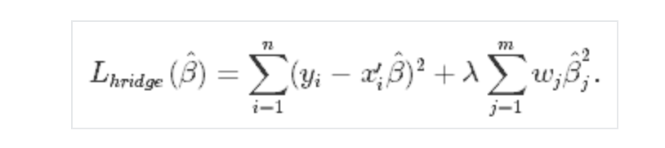
Ridge Regression
Similar to the lasso regression, ridge regression puts a similar constraint on the coefficients by introducing a penalty factor.
However, while lasso regression takes the magnitude of the coefficients, ridge regression takes the square. Ridge regression is also referred to as L2 Regularization.
Ridge regression decreases the complexity of a model but does not reduce the number of variables since it never leads to a coefficient been zero rather only minimizes it. Hence, this model is not good for feature reduction.
https://www.datacamp.com/tutorial/tutorial-lasso-ridge-regression
https://www.geeksforgeeks.org/lasso-vs-ridge-vs-elastic-net-ml/

Slide 18
Logistic Regression

Slide 19
Simple Linear Regression
Relation between 2 continuous variables (SBP and age)
Regression coefficient β₁
Measures association between y and x
Amount by which y changes on average when x changes by one unit
Least squares method
y
Slope
x

Slide 20
Multiple Linear Regression
Relation between a continuous variable and a set of i continuous variables
Partial regression coefficients β_{i}
Amount by which y changes on average when x_{i} changes by one unit and all the other x_{i}s remain constant
Measures association between x_{i} and y adjusted for all other x_{i}
Example
SBP versus age, weight, height, etc

Slide 21
Multiple Linear Regression
Predicted Predictor variables
Response variable Explanatory variables
Outcome variable Covariables
Dependent Independent variables

Slide 22
Why use logistic regression?
There are many important research topics for which the dependent variable is "limited."
For example: voting, morbidity or mortality, and participation data is not continuous or distributed normally.
Binary logistic regression is a type of regression analysis where the dependent variable is a dummy variable: coded 0 (did not vote) or 1(did vote)

Slide 23
The Logistic Regression Model
The "logit" model solves these problems: ln[p/(1-p)] = α + βX + e
p is the probability that the event Y occurs, p(Y=1)
p/(1-p) is the "odds ratio"
ln[p/(1-p)] is the log odds ratio, or "logit"

Slide 24
More:
The logistic distribution constrains the estimated probabilities to lie between 0 and 1.
The estimated probability is: p = 1/[1 + exp(-α - β X)]
if you let α + β X =0, then p = .50
as α + β X gets really big, p approaches 1
as α + β X gets really small, p approaches 0

Slide 25
Logistic regression
Table 1 Age and signs of coronary heart disease (CD)

Slide 26
How can we analyse these data?
Compare mean age of diseased and non-diseased
Non-diseased: 38.6 years
Diseased: 58.7 years (p<0.0001)
Linear regression?

Slide 27
Dot-plot: Data from Table 1

Slide 28
Logistic regression
Table 2 Prevalence (%) of signs of CD according to age group

Slide 29
Dot-plot: Data from Table 2
Diseased %
Age group

Slide 30
Logistic function
Probability of disease
x

Slide 31
Transformation
α = log odds of disease in unexposed
β = log odds ratio associated with being exposed
e ^{β} = odds ratio
{
logit of P(y|x)

Slide 32
Fitting equation to the data
Linear regression: Least squares
Logistic regression: Maximum likelihood
Likelihood function
Estimates parameters a and b
Practically easier to work with log-likelihood

Slide 33
Maximum likelihood
Iterative computing
Choice of an arbitrary value for the coefficients (usually 0)
Computing of log-likelihood
Variation of coefficients’ values
Reiteration until maximisation (plateau)
Results
Maximum Likelihood Estimates (MLE) for α and β
Estimates of P(y) for a given value of x

Slide 34
Maximum Likelihood Estimation (MLE)
MLE is a statistical method for estimating the coefficients of a model.
The likelihood function (L) measures the probability of observing the particular set of dependent variable values (p₁, p₂, ..., p_{n}) that occur in the sample: L = Prob (p₁* p₂* * * p_{n})
The higher the L, the higher the probability of observing the ps in the sample.

Slide 35
MLE involves finding the coefficients (α, β) that makes the log of the likelihood function (LL < 0) as large as possible
The maximum likelihood estimates solve the following condition: {Y - p(Y=1)}X_{i} = 0 summed over all observations, i = 1,…,n
Maximum Likelihood Estimation (MLE)

Slide 36
Multiple logistic regression
More than one independent variable
Dichotomous, ordinal, nominal, continuous …
Interpretation of b_{i}
Increase in log-odds for a one unit increase in x_{i} with all the other x_{i}s constant
Measures association between x_{i} and log-odds adjusted for all other x_{i}

Slide 37
Clustering

Slide 38
What is clustering?
Ch. 16
Clustering:
the process of grouping a set of objects into classes of similar objects
Documents within a cluster should be similar.
Documents from different clusters should be dissimilar.
The commonest form of unsupervised learning
Unsupervised learning = learning from raw data, as opposed to supervised data where a classification of examples is given
A common and important task that finds many applications in IR and other places

Slide 39
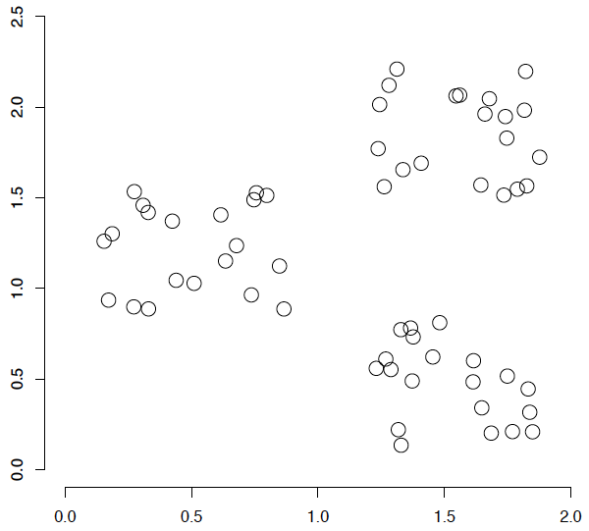
A data set with clear cluster structure
Ch. 16
How would you design an algorithm for finding the three clusters in this case?

Slide 40
Issues for clustering
Sec. 16.2
Representation for clustering
Document representation
Vector space? Normalization?
Need a notion of similarity/distance
How many clusters?
Fixed a priori?
Completely data driven?
Avoid “trivial” clusters - too large or small

Slide 41
Notion of similarity/distance
Ideal: semantic similarity.
Practical: term-statistical similarity
We will use cosine similarity.
Docs as vectors.
For many algorithms, easier to think in terms of a distance (rather than similarity) between docs.
We will mostly speak of Euclidean distance
But real implementations use cosine similarity

Slide 42
Clustering Algorithms
Flat algorithms
Usually start with a random (partial) partitioning
Refine it iteratively
K means clustering
Hierarchical algorithms
Bottom-up, agglomerative
(Top-down, divisive)

Slide 43
Partitioning Algorithms
Partitioning method: Construct a partition of n documents into a set of K clusters
Given: a set of documents and the number K
Find: a partition of K clusters that optimizes the chosen partitioning criterion
Globally optimal
Intractable for many objective functions
Ergo, exhaustively enumerate all partitions
Effective heuristic methods: K-means and K-medoids algorithms
See also Kleinberg NIPS 2002 – impossibility for natural clustering

Slide 44
K-Means
Sec. 16.4
Assumes documents are real-valued vectors.
Clusters based on centroids (aka the center of gravity or mean) of points in a cluster, c:
Reassignment of instances to clusters is based on distance to the current cluster centroids.
(Or one can equivalently phrase it in terms of similarities)

Slide 45
K-Means Algorithm
Sec. 16.4
Select K random docs {s₁, s₂,… s_{K}} as seeds.
Until clustering converges (or other stopping criterion):
For each doc d_{i}:
Assign d_{i} to the cluster c_{j} such that dist(x_{i}, s_{j}) is minimal.
(Next, update the seeds to the centroid of each cluster)
For each cluster c_{j}
s_{j} = μ(c_{j})

Slide 46
K Means Example (K=2)
Sec. 16.4
Pick seeds
Reassign clusters
Compute centroids
Reassign clusters
x
x
x
Compute centroids
x
x
x
Reassign clusters
Converged!

Slide 47
Termination conditions
Sec. 16.4
Several possibilities, e.g.,
A fixed number of iterations.
Doc partition unchanged.
Centroid positions don’t change.
Does this mean that the docs in a cluster are unchanged?

Slide 48
Convergence
Sec. 16.4
Why should the K-means algorithm ever reach a fixed point?
A state in which clusters don’t change.
K-means is a special case of a general procedure known as the Expectation Maximization (EM) algorithm.
EM is known to converge.
Number of iterations could be large.
But in practice usually isn’t

Slide 49
Convergence of K-Means
Sec. 16.4
Lower case!
Define goodness measure of cluster k as sum of squared distances from cluster centroid:
G_{k} = Σ_{i} (d_{i} – c_{k})² (sum over all d_{i} in cluster k)
G = Σ_{k} G_{k}
Reassignment monotonically decreases G since each vector is assigned to the closest centroid.

Slide 50
Hierarchical Clustering
Ch. 17
Build a tree-based hierarchical taxonomy (dendrogram) from a set of documents.
One approach: recursive application of a partitional clustering algorithm.
animal
vertebrate
invertebrate
fish reptile amphib. mammal worm insect crustacean

Slide 51
Dendrogram: Hierarchical Clustering
Clustering obtained by cutting the dendrogram at a desired level: each connected component forms a cluster.

Slide 52
Hierarchical Agglomerative Clustering (HAC)
Sec. 17.1
Starts with each doc in a separate cluster
then repeatedly joins the closest pair of clusters, until there is only one cluster.
The history of merging forms a binary tree or hierarchy.
Note: the resulting clusters are still “hard” and induce a partition

