Slide 1
NLP 220 Data Science and Machine Learning Fundamentals Lecture 8
Jalal Mahmud
jumahmud@ucsc.edu

Slide 2
Data Meant to Be Read by Machines
Common machine-readable formats include the following:
• Comma-Separated Values (CSV) [covered earlier]
• JavaScript Object Notation (JSON)
• Extensible Markup Language (XML)

Slide 3
JSON Data

Slide 4
JSON Data
JSON data is one of the most commonly used formats for data transfers.
It is preferred, because it is clean, easy to read, and easy to parse.
It is also one of the most popular data formats that websites use when transmitting data to the JavaScript on the page.
Example JSON file:
https://raw.githubusercontent.com/jackiekazil/data-wrangling/master/data/chp3/data-text.json

Slide 5
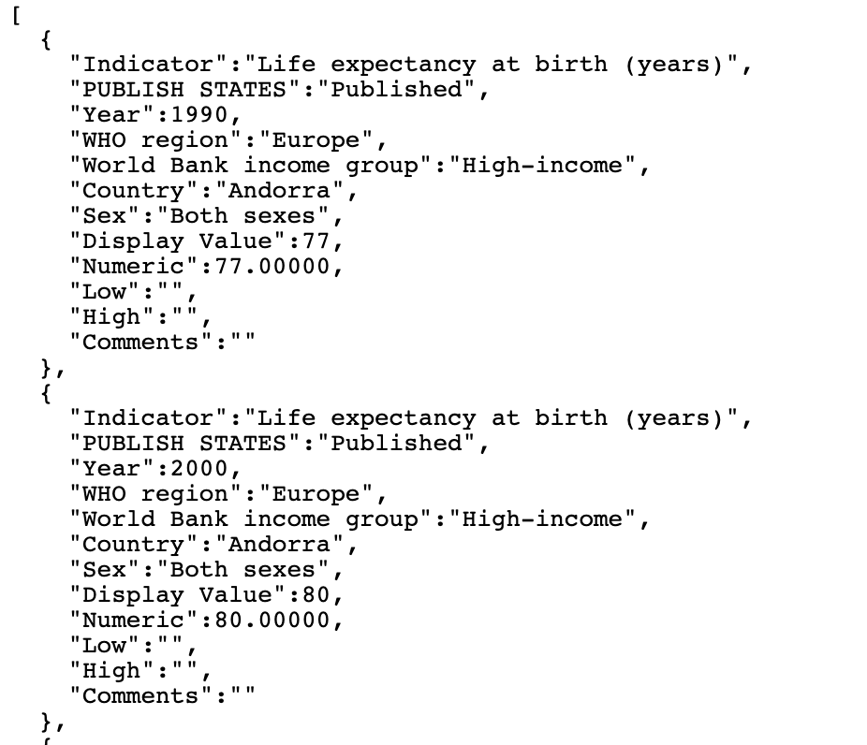
JSON Data
https://raw.githubusercontent.com/jackiekazil/data-wrangling/master/data/chp3/data-text.json

Slide 6
How to Import JSON Data
import json
json_data = open('data-text.json').read()
data = json.loads(json_data)
for item in data:
print item

Slide 7
How to Import JSON Data
import json
json_data = open('data-text.json').read()
data = json.loads(json_data)
for item in data:
print item
Imports the json Python library, which we will use to process the JSON. Uses the built-in Python function open to open the file.
The filename is data-text.json (and this is the first argument for our open function).
This line of codecalls the open file’s read method, which will read the file and store it in the json_data variable.Uses json.loads() to load JSON data into Python.
The data variable catches the output. Iterates over the data using a for loop and prints each item, which will be the output in this example.

Slide 8
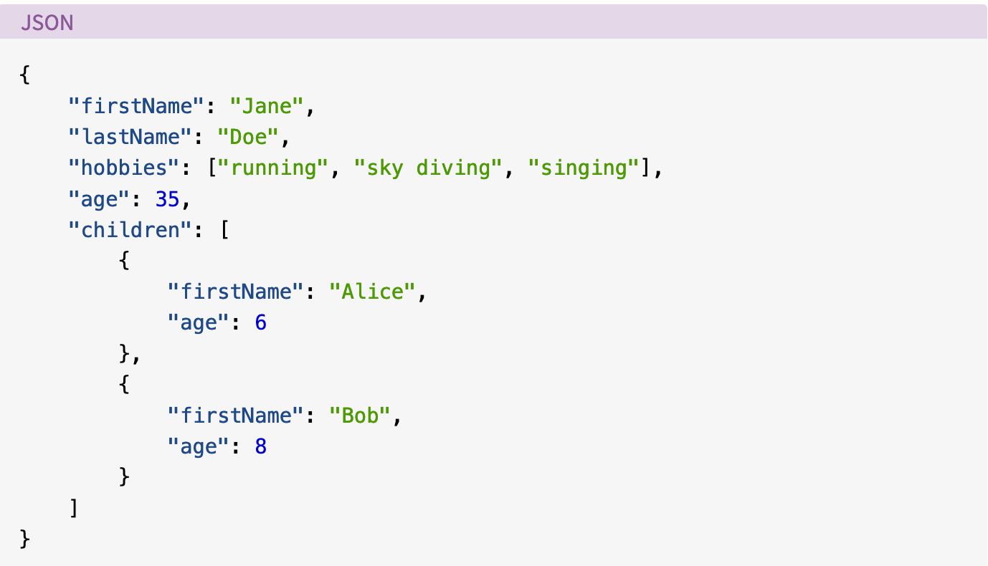
JSON Data – More Examples

Slide 9
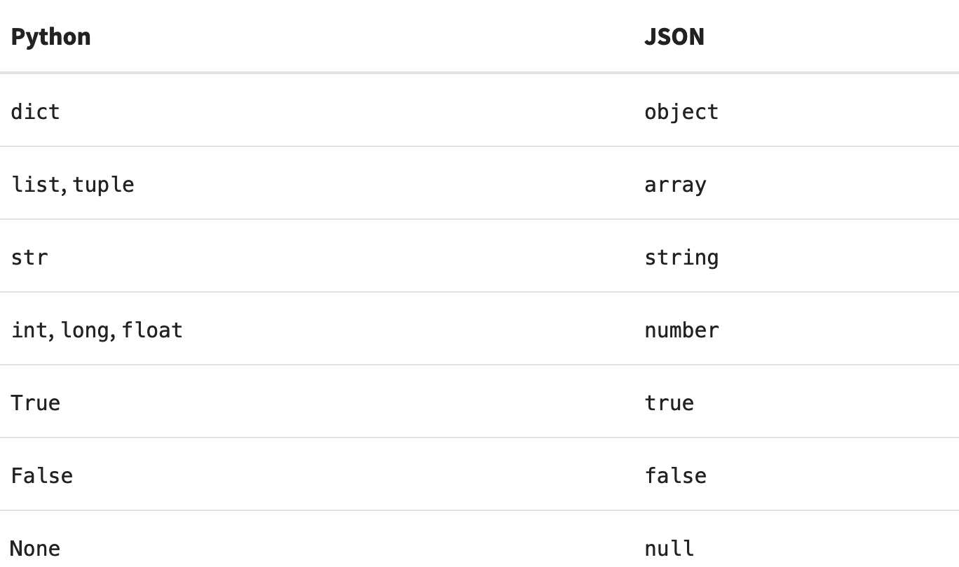
Serializing JSON

Slide 10
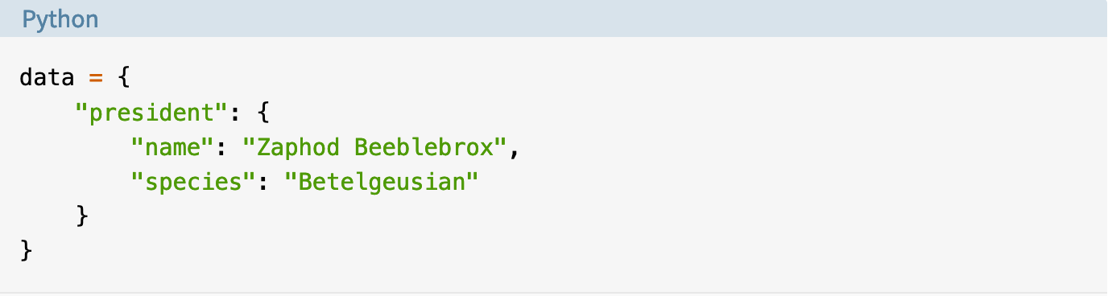
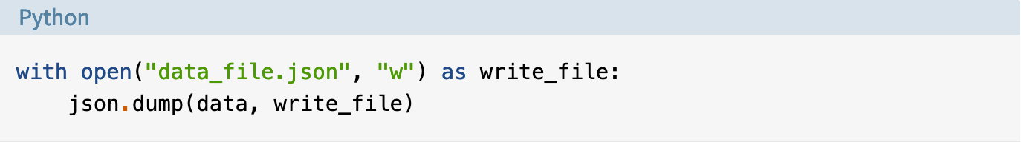
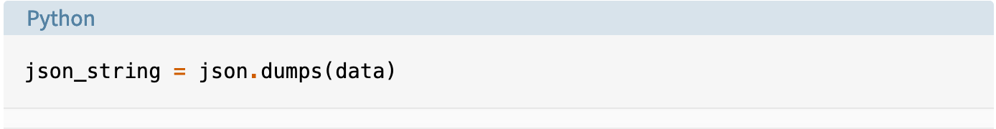
Serialization Example

Slide 11
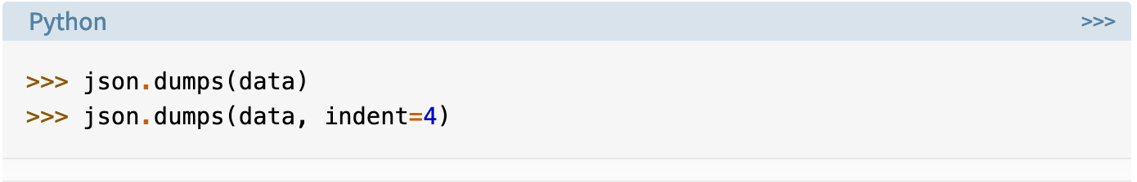
Some Useful Keyword Arguments
Changing Whitespaces
Another formatting option is the separators keyword argument.
By default, this is a 2-tuple of the separator strings (", ", ": "), but a common alternative for compact JSON is (",", ":").

Slide 12
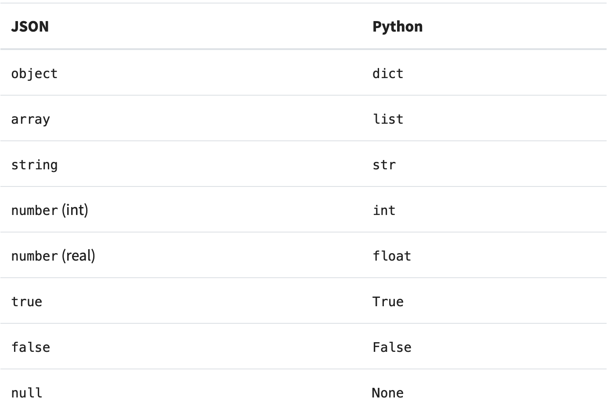
Deserializing JSON
Technically, this conversion isn’t a perfect inverse to the serialization table. That basically means that if you encode an object now and then decode it again later, you may not get exactly the same object back.
https://realpython.com/python-json/

Slide 13
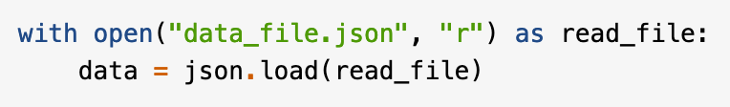
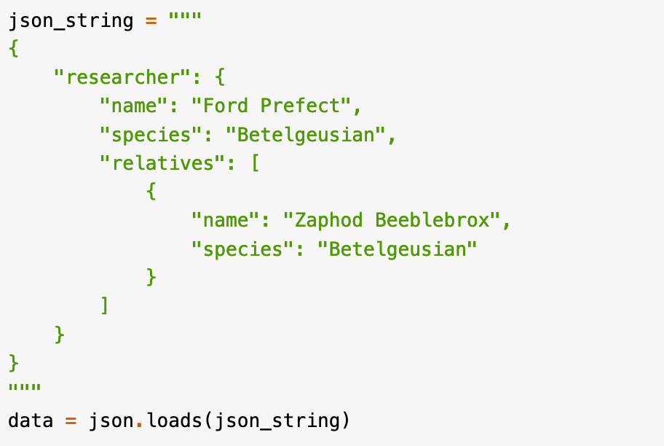
A Simple Deserialization Example
https://realpython.com/python-json/

Slide 14
XML Data

Slide 15
Background
XML developed by World Wide Consortium’s (W3C’s) XML Working Group (1996)
XML portable, widely supported, open technology for describing data
XML quickly becoming standard for data exchange between applications

Slide 16
XML Data
XML is often formatted to be both human and machine readable.
However, the CSV and JSON examples were a lot easier to preview and understand than the XML file for this dataset.
XML is a markup language, which means it has a document structure that contains formatted data. XML documents are essentially just specially formatted data files

Slide 17
XML Documents
XML documents end with .xml extension
XML marks up data using tags, which are names enclosed in angle brackets
<tag> elements </tag>
Elements: individual units of markup (i.e., everything included between a start tag and its corresponding end tag)
Nested elements form hierarchies
Root element contains all other document elements

Slide 18
<?xml version = "1.0"?>
<!-- Fig. : article.xml -->
<!-- Article structured with XML. -->
<article>
<title>Simple XML</title>
<date>December 21, 2001</date>
<author>
<firstName>John</firstName>
<lastName>Doe</lastName>
</author>
<summary>XML is pretty easy.</summary>
<content>we present a wide variety of examples
that use XML.
</content>
</article>
Optional XML declaration includes
version information parameter
XML comments delimited by
<!– and -->
Root element contains all other
document elements
End tag has format
</start tag name>

Slide 19
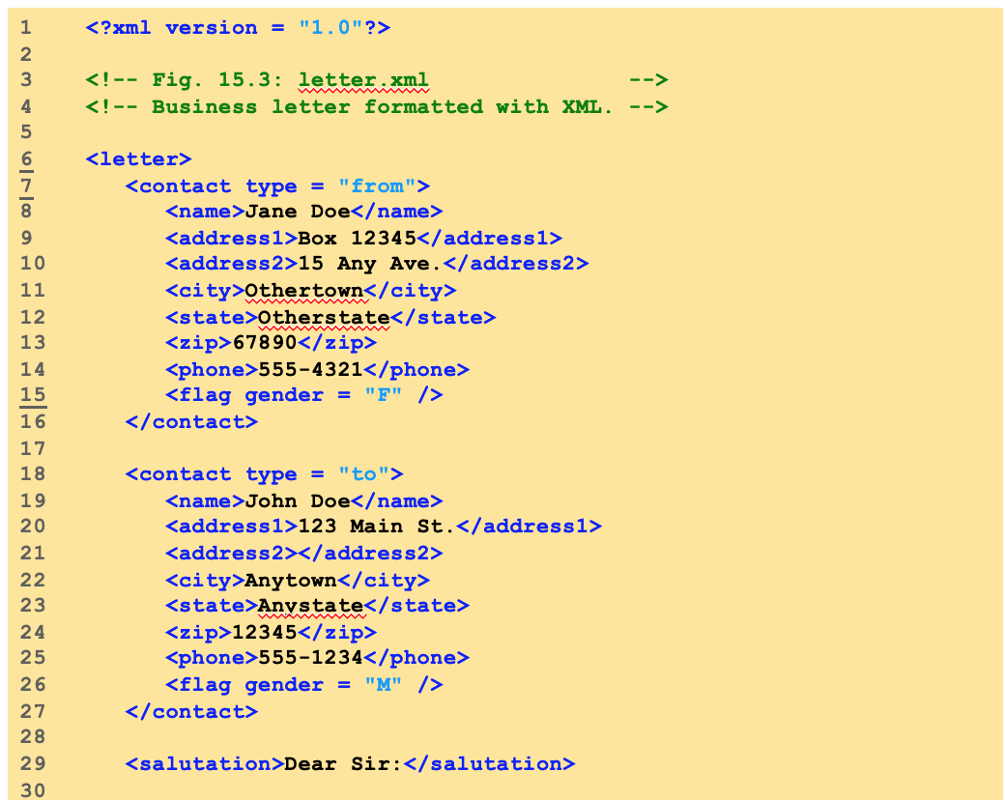
XML Data

Slide 20
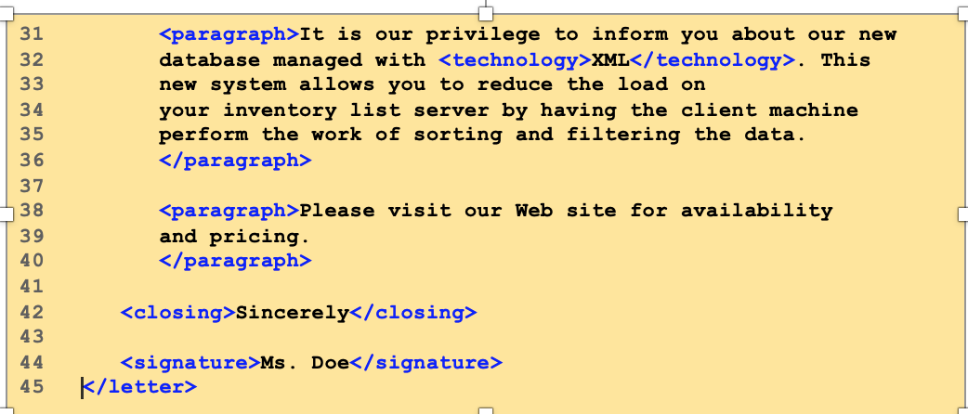
XML Data

Slide 21
XML Namespaces
Provided for unique identification of XML elements
Namespace prefixes identify namespace to which an element belongs

Slide 22
The DOM
Document Object Model
The DOM is a W3C standard.
Implemented in various languages.
The DOM is a tree-based API.
This implies a certain amount of overhead.
But also a lot of convenience and flexibility.

Slide 23
DOM Nodes
Elements, attributes, comments, etc. called "nodes".
Classes represent node types.
All node types subclass the "node" base class.

Slide 24
Node Objects
Example methods include:
getNodeType
getParentNode
getChildNodes
getAttributes
insertBefore
cloneNode

Slide 25
Element Objects
Elements are a representative subclass:
getTagName
getAttribute
setAttribute
getElementsByTagName

Slide 26
DOM node types
ATTRIBUTE
CDATA_SECTION
COMMENT
DOCUMENT
DOCUMENT_FRAGMENT
DOCUMENT_TYPE
ELEMENT
ENTITY
ENTITY_REFERENCE
NOTATION
PROCESSING_INSTRUCTION
TEXT

Slide 27
Navigation properties
parentNode - Parent of this node
firstChild - First child of this node
lastChild - Last child of this node
previousSibling - Node immediately preceding this node
nextSibling - Node immediately following this node
childNodes - List containing all the children of this node

Slide 28
Parsing XML using DOMParser
DOM parser retrieves data from XML document
Hierarchical tree structure called a DOM tree
Each component of an XML document represented as a tree node
Parent nodes contain child nodes
Sibling nodes have same parent
Single root (or document) node contains all other document nodes

Slide 29
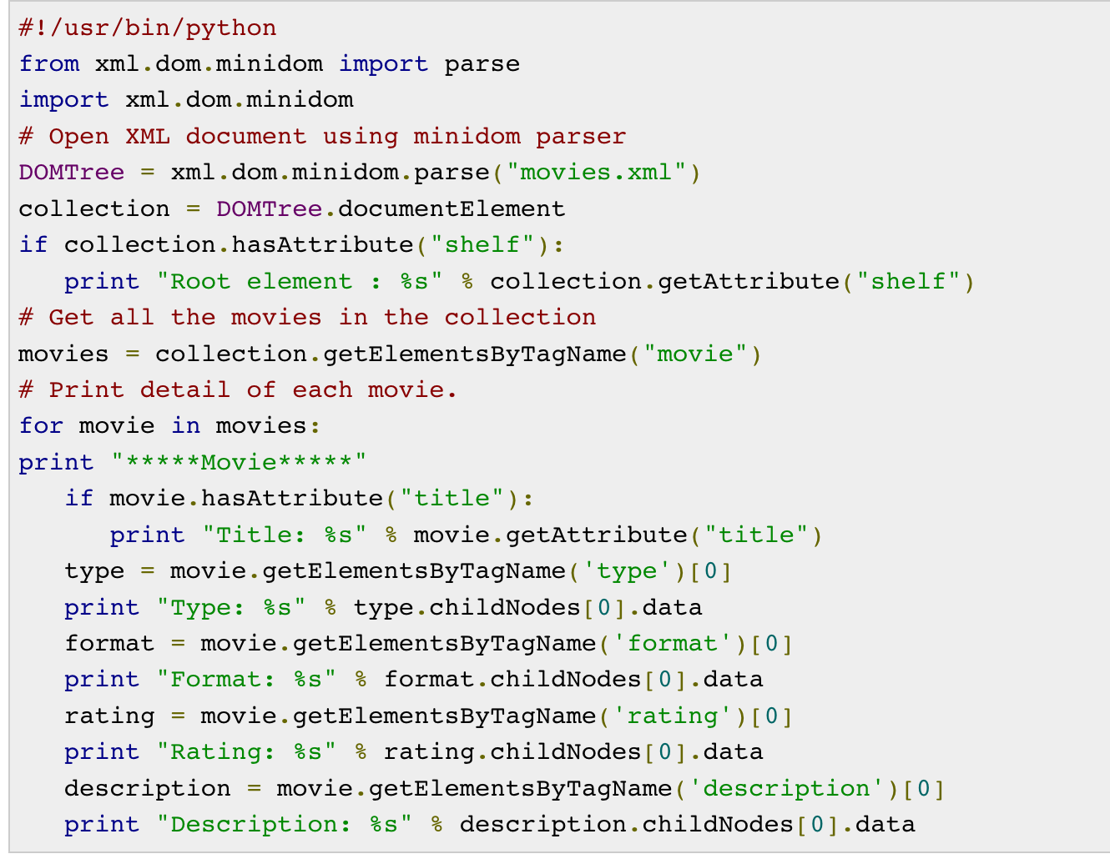
Parsing XML using DOMParser
https://www.tutorialspoint.com/parsing-xml-with-dom-apis-in-python

Slide 30
Example
<folder>
<title>XML bookmarks</title>
<bookmark href="http://www.python.org/sigs/xml-sig/" >
<title>SIG for XML Processing in Python</title>
</bookmark>
</folder>

Slide 31
Building a DOM
from xml.dom import minidom
dom = minidom.parse("test.xml")
rootel = dom.documentElement
print(rootel.nodeName)
topnodes = rootel.childNodes
for toplevel in topnodes :
print toplevel.nodeName

Slide 32
Searching a DOM
# print the last point element
# in the tree
print(h.document.documentElement.
getElementsByTagName('point')[-1])

Slide 33
Modifying a DOM
appendChild(newChild)
insertBefore(newChild, refChild)
replaceChild(newChild, oldChild)
removeChild(oldChild)

Slide 34
XML Parsing using ElementTree

Slide 35
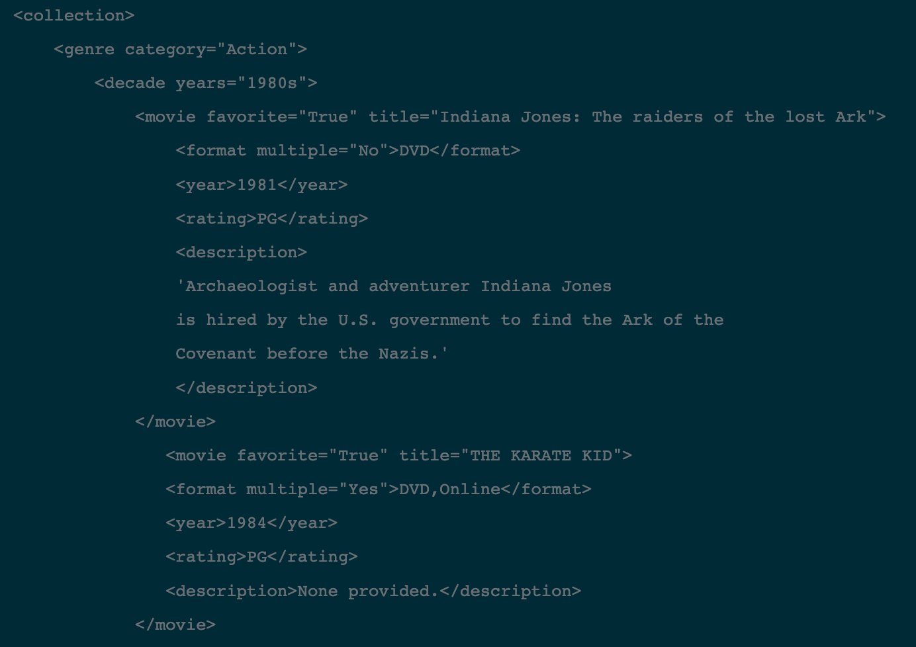
XML Parsing using ElementTree
https://www.datacamp.com/community/tutorials/python-xml-elementtree

Slide 36
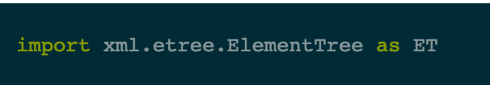
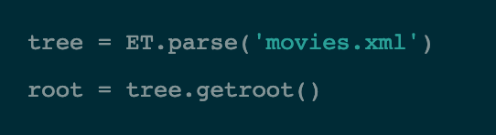
XML Parsing using ElementTree
Python has a built in library, ElementTree, that has functions to read and manipulate XMLs (and other similarly structured files).
https://www.datacamp.com/community/tutorials/python-xml-elementtree

Slide 37
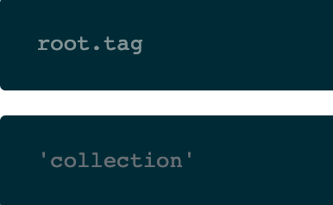
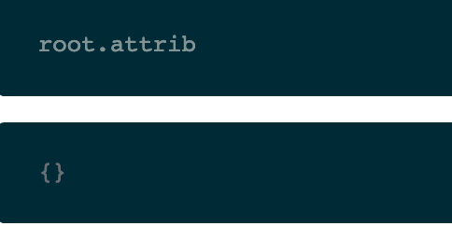
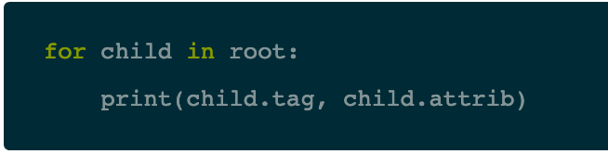
XML Parsing using ElementTree
https://www.datacamp.com/community/tutorials/python-xml-elementtree

Slide 38
XML Parsing using ElementTree
for elem in root.iter():
print(elem.tag)
collection
genre
decade
movie
format
year
rating
description
movie
format
year
rating
description
……

Slide 39
XML Parsing using ElementTree
There is a helpful way to see the whole document.
Any element has a .tostring() method. If you pass the root into the .tostring() method, you can return the whole document.
You can expand the use of the iter() function to help with finding particular elements of interest. root.iter() will list all subelements under the root that match the element specified.
Here, you will list all attributes of the movie element in the tree
for movie in root.iter('movie’): print(movie.attrib)

Slide 40
XML Parsing using ElementTree
Many times elements will not have attributes, they will only have text content. Using the attribute .text, you can print out this content.
for description in root.iter('description'):
print(description.text)

Slide 41
Xpath Expressions
XPath is a query language used to search through an XML quickly and easily.
XPath stands for XML Path Language and uses, as the name suggests, a "path like" syntax to identify and navigate nodes in an XML document.
ElementTree has a .findall() function that will traverse the immediate children of the referenced element. You can use XPath expressions to specify more useful searches.
for movie in root.findall("./genre/decade/movie/[year='1992']"):
print(movie.attrib)

Slide 42
Xpath Expressions
print out only the movies that are available in multiple formats
for movie in root.findall("./genre/decade/movie/format/[@multiple='Yes']"):
print(movie.attrib)

Slide 43
Let’s Look at Another Example

Slide 44
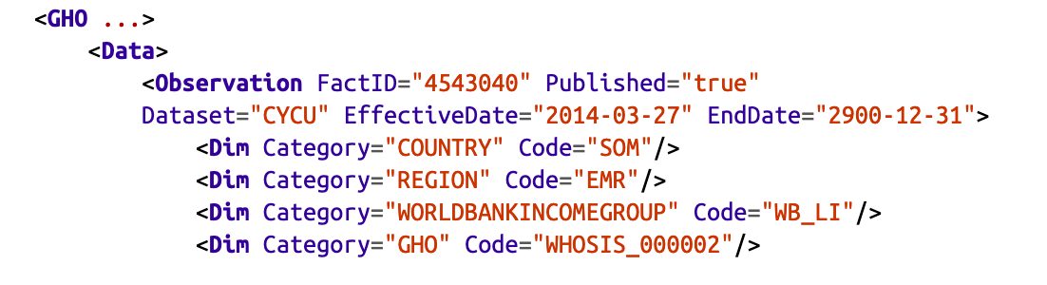
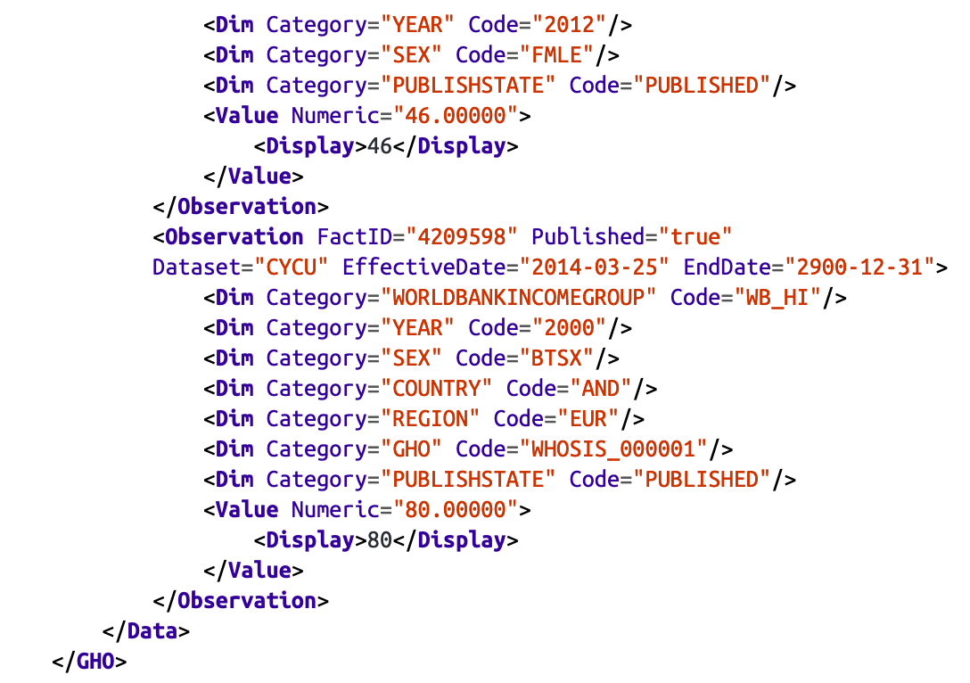
XML Data
In this example, <Observation />, <Dim />, and <Display /> are all examples of tags. Tags(or nodes) store data in a hierarchical and structured way:
https://raw.githubusercontent.com/jackiekazil/data-wrangling/master/data/chp3/data-text.xml

Slide 45
XML Data
Data values can be stored in two places in an XML file:
either in between two tags, as in <Display>46</Display>, where the value for the <Display> tag is 46;
or as an attribute of a tag, as in <Dim Category="COUNTRY" Code="SOM"/>, where the value ofthe Category attribute is "COUNTRY" and the value of the Code attribute is "SOM".
The XML tags and attributes hold data, similar to the JSON keys.

Slide 46
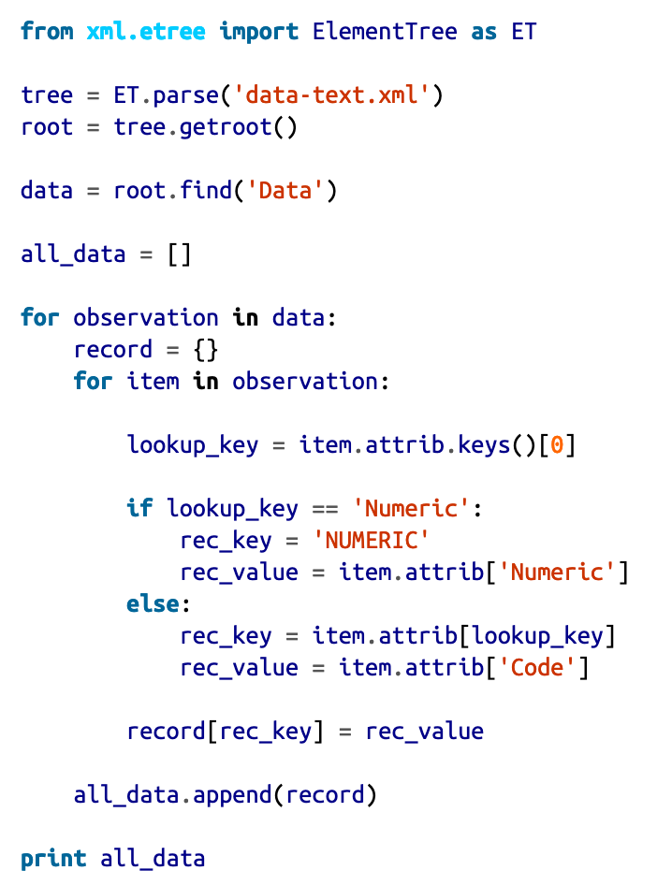
How to import XML Data

Slide 47
Some Explanations: Importing XML Data
First, let’s import ElementTree, part of the built-in library we are going to use to parse the XML:
from xml.etree import ElementTree as ET
Next, we call the parse method on the ET class, which will parse data from the file‐name we pass. Because we are parsing a file located in the same folder, the filename needs no file path:
tree = ET.parse('data-text.xml’)
We start at the root of the tree:
root = tree.getroot()

Slide 48
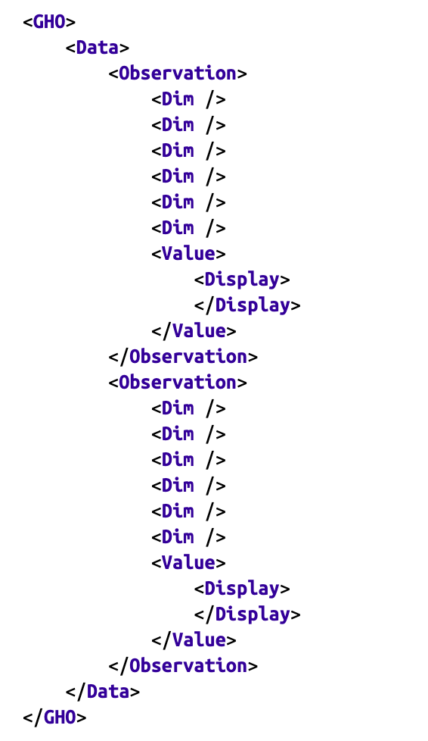
XML Data
Let’s review the core structure of the XML tree
we can see each “row” of data is held in an Observation tag.
The data for each of these rows is then held in the Dim, Value, and Display nodes within each Observation node.

Slide 49
XML Data
When searching for data stored in an XML tree, the Data element is likely a good place to start.
Now we have found the Data element, and we can focus
on that sub-element.
There are a couple of ways to get the Data element, but we will
use the find method.
The root element’s find method allows us to search for a sub element using the tag name.
data = root.find('Data’)
print(list(data))
When you rerun your file with the new lines of code, you will see an output of a list of Observation elements. These are our data points.
for observation in data:
for item in observation:
print(item)

Slide 50
XML Data
Let’s add our empty dictionary and an empty list to hold our data in.
all_data = []
for observation in data:
record = {}
for item in observation:
print(item.attrib)

Slide 51
XML Data
We need to figure out what our key and values are for each line and add them to our record’s dictionary.
For each attrib call, we get a dictionary with one or more value and key combinations returned, like this:
{'Category': 'YEAR', 'Code': '2012’}
The value of the Category key (here, YEAR) should be the key for our dictionary, and the value of Code (here, 2012) should be set as the value for that key.
With that knowledge, the preceding line would become:
'YEAR': '2012’
for item in observation:
lookup_key = item.attrib.keys()[0]
rec_key = item.attrib[lookup_key]
print(rec_key)

Slide 52
XML Data
If we rerun the code from your command line.
For each record, we get the following values:
PUBLISH
STATE
COUNTRY
WORLDBANK
INCOMEGROUP
YEAR
SEX
GHO
REGION
49.00000
These all look like great keys for our new dictionary, except for the last one.
for item in observation:
lookup_key = item.attrib.keys()[0]
rec_key = item.attrib[lookup_key]
print(rec_key)
if lookup_key == 'Numeric’:
rec_key = 'NUMERIC’
rec_value = item.attrib['Numeric']
else:
rec_key = item.attrib[lookup_key]
rec_value = item.attrib['Code']
record[rec_key] = rec_value

Slide 53
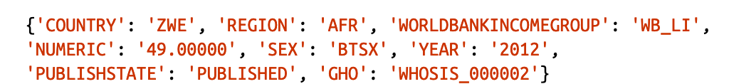
Putting it all together
Once we run this code, we will see a long list with a dictionary for each record

Slide 54
Reading Materials
https://www.w3.org/TR/xmlschema-1/
https://docs.python.org/3.5/library/xml.etree.elementtree.html
https://en.wikipedia.org/wiki/XML
https://docs.python.org/3.8/library/xml.dom.minidom.html

Slide 55
What is a corpus?
A corpus is a collection of machine-readable texts that have been produced in a natural communicative setting.
They have been sampled to be representative and balanced with respect to particular factors;
for example, by genre—newspaper articles, literary fiction, spoken speech, blogs and diaries, and legal documents.

Slide 56
What is a corpus?
The notion of a corpus being balanced is an idea that has been around since the 1980s, but it is still a rather fuzzy notion and difficult to define strictly.
Atkins and Ostler (1992) propose a formulation of attributes that can be used to define the types of text, and thereby contribute to creating a balanced corpus.
Two well-known corpora can be compared for their effort to balance the content of the texts.
The Penn TreeBank (Marcus et al. 1993) is a 4.5-million-word corpus that contains texts from four sources: the Wall Street Journal
The Brown Corpus, ATIS, and the Switchboard Corpus. By contrast, the BNC is a 100-million-word corpus that contains texts from a broad range of genres, domains, and media.

Slide 57
Types of corpus
Unannotated corpus
simple plain text or raw text
the linguistic information is implicit
e.g. no explicit representation of present as a noun
Annotated corpus
no longer just text
real repository of linguistic information
the relevant linguistic information is now explicit (e.g. present as a noun, adjective, or verb)

Slide 58
Timeline of Corpus Linguistics
1950s:
Descriptive linguists compile collections of spoken and written utterances of various languages from field research.
Literary researchers begin compiling system­atic collections of the complete works of different authors. Key Word in Context (KWIC) is invented as a means of indexing documents and creating concordances
1960s:
Kucera and Francis publish A Standard Corpus of Present-Day American English(the Brown Corpus), the first broadly available large corpus of language texts.
Work in Information Retrieval (IR) develops techniques for statistical similarity of document content.
The FRANTEXT database was created in the 1960s and is maintained by the INALF.

Slide 59
Timeline of Corpus Linguistics
1970s:
Stochastic models developed from speech corpora make Speech Recognition systems possible.
The vector space model is developed for document indexing. The London-Lund Corpus (LLC) is developed through the work of the Survey of English Usage

Slide 60
Timeline of Corpus Linguistics
1980s:
The Lancaster-Oslo-Bergen (LOB) Corpus, designed to match the Brown Corpus in terms of size and genres, is compiled.
The COBUILD (Collins Birmingham University International Language Database) dictionary is published, the first based on examining usage from a large English corpus, the Bank of English.
The Survey of English Usage Corpus inspires the creation of a comprehensive corpus-based gram­mar, Grammar of English.

Slide 61
Timeline of Corpus Linguistics
1980s:
The Child Language Data Exchange System (CHILDES) Corpus is released as a repository for first language acquisition data.
Researchers in Speech Recognition began to compile enough spoken language data to create language models (from tran­scriptions using n-grams and Hidden Markov Models [HMMS]) that worked well enough to recognize a limited vocabulary of words in a very narrow domain.

Slide 62
Timeline of Corpus Linguistics
1990s
Work in Machine Translation began to see the influence of larger and larger datasets, and with this, the rise of statistical language modeling for translation.
The Penn TreeBank is released. This is a corpus of tagged and parsed sentences of naturally occurring English (4.5 million words).
The British National Corpus (BNC) is compiled and released as the largest corpus of English to date (100 million words).
The Text Encoding Initiative (TEI) is established to develop and maintain a standard for the representation of texts in digital form
The Brown Corpus, ATIS, and the Switchboard Corpus. By contrast, the BNC is a 100-million-word corpus that contains texts from a broad range of genres, domains, and media.

Slide 63
Timeline of Corpus Linguistics
2000s
The American National Corpus (ANC) project releases a 22-million-word subcorpus, and the Corpus of Contem­porary American English (COCA) is released (400 million words)
Google releases its Google N-gram Corpus of 1 trillion word tokens from public web pages. The corpus holds up to five n-grams for each word token, along with their frequencies.
ClueWeb09 (http://lemurproject.org/clueweb09.php/), a dataset “created to support research on information retrieval and related human lan­guage technologies. It consists of about 1 billion web pages in ten languages that were collected in January and February 2009.
2010s
Entirely new forms of text corpora, such as Twitter, Face­book, and blogs, become available as a resource

Slide 64
Learner corpora
They are corpora compiled with texts written by non-native students in a given foreign language.
Study of such corpora allows language teachers to focus on the most frequent grammar mistakes that are typical of a particular language pair, and on any over- or under-used syntactic patterns or lexical items.
The major learner corpus project is the International Corpus of Learner English headed by Sylviane Granger (Université de Louvain-la-Neuve, Belgium).

Slide 65
Bilingual corpora
There are two kinds of bilingual corpora :
Translation corpora, which consist of translated texts that are generally aligned at sentence level (they may involve more than two languages).
Comparable corpora, in which both halves have a common subject matter but are not mutual translations.
The appellation "parallel corpus" is considered ambiguous, as it may be used to refer to either kind of corpus.

Slide 66
Using the Web as a corpus
The Web may be viewed as a very large corpus, which is constantly being updated, and cannot possibly be annotated.
If it is to be used as a sample for linguistic exploration, questions must be raised about what exactly it is representative of.
It is probably biased as regards several social categories (age, gender, social class) and is consequently not representative of general usage.
Furthermore, an undefined percentage of its contents (probably high in English) is posted by non-natives.

Slide 67
Ideal Corpus – Representative and Balanced
A corpus must be created by sampling the existing texts of a language.
Since any sampling procedure inherently contains the possibility of skew­ing the dataset, care should be taken to ensure that the corpus is representative of the “full range of variability in a population”.
The “population” being sampled will be determined by the goal and scope of your annotation task.

Slide 68
Ideal Corpus – Representative and Balanced (cont.)
The other important concept in corpus creation is that of balance.
Sinclair (2005) de­scribes a corpus as balanced this way: “the proportions of different kinds of text it con­tains should correspond with informed and intuitive judgments.”
This applies predom­inantly to corpora that are taking samples from different types of text: for example, a corpus that wants to represent “American English” would have to include all types of written and spoken texts, from newspaper articles to chat room discussions to television transcripts, book samples, and so on.
A corpus that has been predefined to require a smaller sample will be easier to balance, simply because there will be fewer directions in which the scope of the corpus can be expanded, but the utility of the corpus for general research purposes will be correspondingly decreased.

Slide 69
Balanced Corpora?
The notion of a corpus being balanced is an idea that has been around since the 1980s, but it is still a rather fuzzy notion and difficult to define strictly.
Atkins and Ostler (1992) propose a formulation of attributes that can be used to define the types of text, and thereby contribute to creating a balanced corpus.

Slide 70
Balanced Corpora?
Two well-known corpora can be compared for their effort to balance the content of the texts.
The Penn TreeBank (Marcus et al. 1993) is a 4.5-million-word corpus that contains texts from four sources: the Wall Street Journal, the Brown Corpus, ATIS, and the Switchboard Corpus.
By contrast, the BNC is a 100-million-word corpus that contains texts from a broad range of genres, domains, and media
The most diverse subcorpus within the Penn TreeBank is the Brown Corpus, which is a 1-million-word corpus consisting of 500 English text samples, each one approximately 2,000 words.

Slide 71
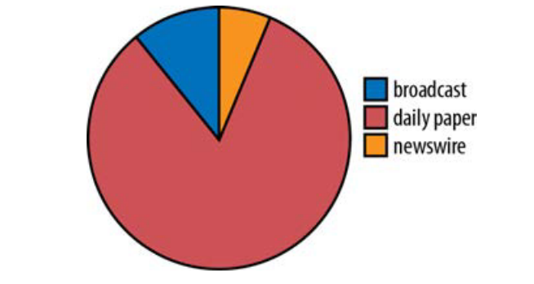
Distribution within a corpora
TimeBank is a selection of 183 news articles that have been annotated with time and event information.
However, not all the articles in TimeBank were produced the same way: some are broadcast transcripts, some are articles from a daily newspaper, and some were written for broadcast over the newswire

Slide 72
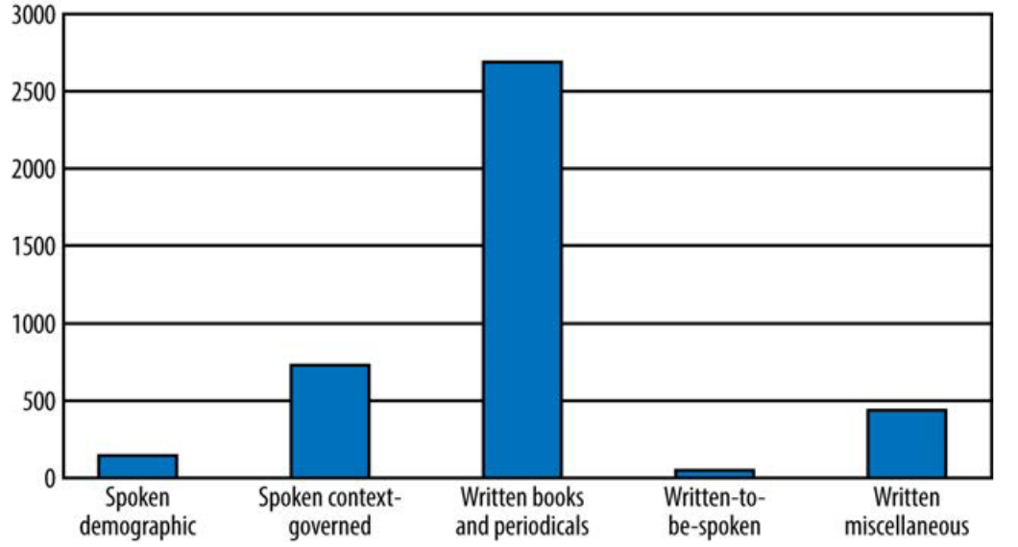
Distribution within a corpora
The British National Corpus (BNC) is another example of a corpus that draws from many sources—sources even more disparate than those in TimeBank.

Slide 73
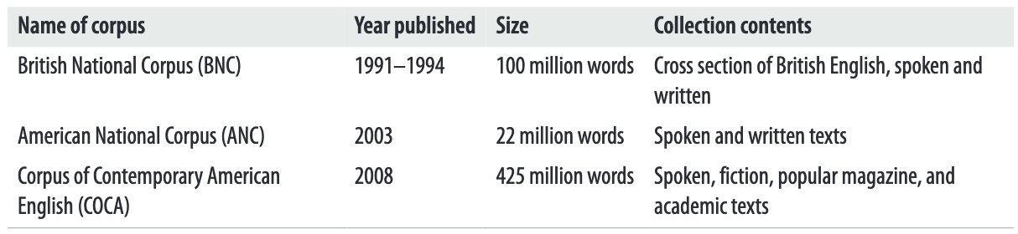
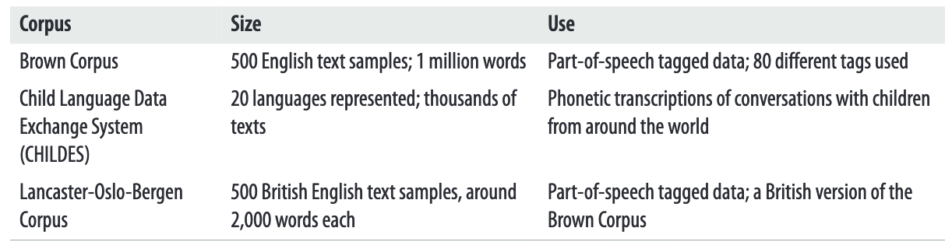
Sampling of important corpora

Slide 74
Usage of corpora
Many NLP Applications
Sentiment Analysis
Named Entity Tagging
Text categorization
Document classification
Individual word classification
POS tagging
…..
….

Slide 75
Corpus annotation
What is annotation?
“The process of adding […] interpretive, linguistic information to an electronic corpus of spoken and/or written language data” (Leech 1997)
Broadly, also refers to the results of the annotation process
In a strict sense, different from corpus mark-up
Markup provides objective, verifiable information
e.g. author, paragraph boundary
Annotation is concerned with interpretive linguistic information
e.g. part-of-speech

Slide 76
Terminology
Corpus Markup
processing/formatting information
metadata/text classifications
structural representation
Tagging
(usually) inline addition of category to word(s)
Parsing
higher-level, multiword units (constituents)
chunking/shallow vs. full syntactical parsing
needn’t just be syntactical analysis
XML
eXtensible Markup Language

Slide 77
Why annotate a corpus?
Makes information retrieval and extraction easier, faster
Annotated corpora are reusable resources
Automatic analysis of corpus
Annotated corpora are multifunctional - they can be annotated with a purpose and be reused with another
Corpus annotation records a linguistic analysis explicitly
Corpus annotation provides a standard reference resource, a stable base of linguistic analyses.
so that successive studies can be compared and contrasted on a common basis

Slide 78
How are corpora annotated?
Automatic annotation
Can be automated reliably for some types (POS, lemmatization)
Can annotate large amount of data quickly at low cost
Post-editing or human correction may be necessary to improve accuracy
Computer-assisted annotation
The semi-automatic annotation process (human-machine interface) may produce more reliable results than fully automated annotation, but it is also slower and more costly
Manual annotation
Occurs where no annotation tool is available or where the accuracy of available systems is not high enough to be useful
Expensive and time-consuming, typically only feasible for small corpora

Slide 79
Leech’s 7 maxims of annotation
It should be possible to remove the annotation from an annotated corpus in order to revert to the raw corpus.
It should be possible to extract the annotations by themselves from the text.
The annotation scheme should be based on guidelines which are available to the end user.
It should be made clear how and by whom the annotation was
carried out.

Slide 80
Leech’s 7 maxims of annotation
The end user should be made aware that the corpus annotation is not error-free or infallible, but simply a potentially useful tool.
Annotation schemes should be based as far as possible on widely agreed and theory-neutral principles.
No annotation scheme has the a priori right to be considered as a standard.
Standards emerge through practical consensus

Slide 81
Types of corpus annotation
Phonological level
Syllable boundaries (phonetic/phonemic annotation)
Prosodic or suprasegmental features (prosodic annotation, e.g. pitch, loudness, intonation)
Morphological level
Prefixes, suffixes, stems (morphological annotation)

Slide 82
Types of corpus annotation
Lexical level
Tokenization
Parts of speech (POS tagging)
Lemmas (lemmatization)
stop, stopped, stops, stopping → stop
Semantic fields (semantic annotation)
cricket: sport, insect

Slide 83
Tagging
The first editions of the TEI (Text Encoding Initiative) Guidelines used the Standard Generalized Markup Language (SGML)
The most recent edition can also be expressed in the Extensible Markup Language (XML)

Slide 84
Tagging Example
<pb n='474'/>
<div1 type="chapter" n='38'>
<p>Reader, I married him. A quiet wedding we had: he and I, the parson and clerk, were alone present. When we got back from church, I went into the kitchen of the manor-house, where Mary was cooking the dinner, and John cleaning the knives, and I said &mdash;</p>
<p><q>Mary, I have been married to Mr Rochester this morning.</q> The housekeeper and her husband were of that decent, phlegmatic order of people,[…]; but Mary, bending again over the roast, said only &mdash;
</p> <p><q>Have you, miss? Well, for sure!</q></p>

Slide 85
A TEI Document at the Textual Level
<front>
contains any prefatory matter (headers, title page, prefaces, dedications, etc.) found before the start of a text proper.
<group>
contains a number of unitary texts or groups of texts.
<body>
contains the whole body of a single unitary text, excluding any front or back matter.
<back>
contains any appendixes, etc., following the main part of a text.

Slide 86
POS Tagging: POSTagger
Corpus/NN annotation/NN is/VBZ
the/DT practice/NN of/IN
adding/VBG interpretative/JJ
linguistic/JJ information/NN
to/TO a/DT corpus/NN ./.

Slide 87
POS Tagging: Claws C5
Corpus_NN1 annotation_NN1 is_VBZ
the_AT0 practice_NN1 of_PRF
adding_VVG interpretative_AJ0
linguistic_AJ0 information_NN1
to_PRP a_AT0 corpus_NN1 ._.
NN1 singular noun AJ0 adjective
VBZ -s form of the verb "BE“ PRF the preposition OF
VVG -ing form of lexical verb AT0 article
https://en.wikipedia.org/wiki/CLAWS_(linguistics)

Slide 88
POS Tagging: Claws C7
Corpus_NN1 annotation_NN1 is_VBZ
the_AT practice_NN1 of_IO
adding_VVG interpretative_JJ
linguistic_JJ information_NN1
to_II a_AT1 corpus_NN1 ._.
http://www.comp.lancs.ac.uk/ucrel/claws/trial.html

Slide 89
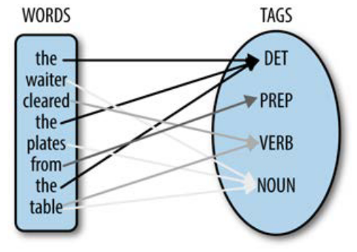
Types of corpus annotation
Syntactic level
Parsing / treebanking / bracketing
(S (NP Mary)
(VP visited
(NP a
(ADJP very nice)
boy)))
Stanford Parser
http://nlp.stanford.edu:8080/parser/

Slide 90
Parsing
(S
(NP Corpus annotation)
(VP is
(NP
(NP the practice)
(PP of
(S (VP adding
(NP interpretative linguistic information)
(PP to (NP a corpus))
))
)
)
)
.)

Slide 91
Semantic Annotation
Each word given code from thesaurus-style dictionary
Also called Word Sense Tagging
Examples
UCREL Semantic Analysis System
[http://www.comp.lancs.ac.uk/ucrel/usas/]
WordNet
[http://wordnet.princeton.edu/]

Slide 92
Semantic Annotation
The noun move has 5 senses
1. move -- (the act of deciding to do something; "he didn't make a move to help"; "his first move was to hire a lawyer")
2. move, relocation -- (the act of changing your residence or place of business; "they say that three moves equal one fire")
3. motion, movement, move, motility -- (a change of position that does not entail a change of location; "the reflex motion of his eyebrows revealed his surprise"; "movement is a sign of life"; "an impatient move of his hand"; "gastrointestinal motility")
4. motion, movement, move -- (the act of changing location from one place to another; "police controlled the motion of the crowd"; "the movement of people from the farms to the cities"; "his move put him directly in my path")
5. move -- ((game) a player's turn to take some action permitted by the rules of the game)

Slide 93
Semantic Annotation
The verb move has 16 senses (first 13 from tagged texts)
1. travel, go, move, locomote -- (change location; move, travel, or proceed; "How fast does your new car go?"; "We travelled from Rome to Naples by bus"; "The policemen went from door to door looking for the suspect"; "The soldiers moved towards the city in an attempt to take it before night fell")
2. move, displace -- (cause to move, both in a concrete and in an abstract sense; "Move those boxes into the corner, please"; "I'm moving my money to another bank"; "The director moved more responsibilities onto his new assistant")
3. move -- (move so as to change position, perform a nontranslational motion; "He moved his hand slightly to the right")
4. move -- (change residence, affiliation, or place of employment; "We moved from Idaho to Nebraska"; "The basketball player moved from one team to another")

Slide 94
Types of corpus annotation
Discourse level
Anaphoric relations (coreference annotation)
(6 the married couple 6) said that <REF=6 they were happy with <REF=6 their lot.
Speech acts (pragmatic annotation)
3 layers of coding
Segmentation (dividing dialogue in textual units, i.e. utterances)
Functional annotation (dialogue act annotation)
Utterance tags (applying utterance tags that characterize the role of the utterance as a dialogue act)
Stylistic features such as speech and thought in presentation (stylistic annotation)
The representation of people’s speech and thoughts, known as speech and thought presentation (S&TP)

Slide 95
Types of corpus annotation
Other types
Error tagging
Applying to learner corpus data
The CLEC error tagging scheme consists of 61 error types clustered in 11 categories
Problems-specific annotation
Not exhaustive – only the phenomenon directly relevant to a particular research question
Developed for its relevance to the specific research question, but not for its broad coverage and consensus-based theory-neutrality
E.g. Hunston (1993) studies how people talk about sameness and difference (“local grammar”)

Slide 96
Reading Materials
Chapter 1 from Natural Language Annotation for Machine Learning: A Guide to Corpus-Building for Applications, Pustejovsky, James
Reading: Chapter 2 from Natural Language Annotation for Machine Learning: A Guide to Corpus-Building for Applications, Pustejovsky, James https://www.oreilly.com/library/view/natural-language-annotation/9781449332693/

Slide 97
References
Hunston, S.
2002 Corpora in Applied Linguistics (Cambridge: Cambridge University Press)
McEnery, A
2003 ‘Corpus Linguistics’, in R. Mitov (ed.), The Oxford Handbook of Computational Linguistics (Oxford: Oxford University Press), pp. 448-463

