Slide 1
NLP 220 Data Science and Machine Learning Fundamentals Lecture 9
Jalal Mahmud
jumahmud@ucsc.edu

Slide 2
Corpus annotation
What is annotation?
“The process of adding […] interpretive, linguistic information to an electronic corpus of spoken and/or written language data” (Leech 1997)
Broadly, also refers to the results of the annotation process
In a strict sense, different from corpus mark-up
Markup provides objective, verifiable information
e.g. author, paragraph boundary
Annotation is concerned with interpretive linguistic information
e.g. part-of-speech

Slide 3
Terminology
Corpus Markup
processing/formatting information
metadata/text classifications
structural representation
Tagging
(usually) inline addition of category to word(s)
Parsing
higher-level, multiword units (constituents)
chunking/shallow vs. full syntactical parsing
needn’t just be syntactical analysis
XML
eXtensible Markup Language

Slide 4
Why annotate a corpus?
Makes information retrieval and extraction easier, faster
Annotated corpora are reusable resources
Automatic analysis of corpus
Annotated corpora are multifunctional - they can be annotated with a purpose and be reused with another
Corpus annotation records a linguistic analysis explicitly
Corpus annotation provides a standard reference resource, a stable base of linguistic analyses.
so that successive studies can be compared and contrasted on a common basis

Slide 5
How are corpora annotated?
Automatic annotation
Can be automated reliably for some types (POS, lemmatization)
Can annotate large amount of data quickly at low cost
Post-editing or human correction may be necessary to improve accuracy
Computer-assisted annotation
The semi-automatic annotation process (human-machine interface) may produce more reliable results than fully automated annotation, but it is also slower and more costly
Manual annotation
Occurs where no annotation tool is available or where the accuracy of available systems is not high enough to be useful
Expensive and time-consuming, typically only feasible for small corpora

Slide 6
Leech’s 7 maxims of annotation
It should be possible to remove the annotation from an annotated corpus in order to revert to the raw corpus.
It should be possible to extract the annotations by themselves from the text.
The annotation scheme should be based on guidelines which are available to the end user.
It should be made clear how and by whom the annotation was
carried out.

Slide 7
Leech’s 7 maxims of annotation
The end user should be made aware that the corpus annotation is not error-free or infallible, but simply a potentially useful tool.
Annotation schemes should be based as far as possible on widely agreed and theory-neutral principles.
No annotation scheme has the a priori right to be considered as a standard.
Standards emerge through practical consensus

Slide 8
Types of corpus annotation
Phonological level
Syllable boundaries (phonetic/phonemic annotation)
Prosodic or suprasegmental features (prosodic annotation, e.g. pitch, loudness, intonation)
Morphological level
Prefixes, suffixes, stems (morphological annotation)

Slide 9
Types of corpus annotation
Lexical level
Tokenization
Parts of speech (POS tagging)
Lemmas (lemmatization)
stop, stopped, stops, stopping → stop
Semantic fields (semantic annotation)
cricket: sport, insect

Slide 10
Tagging
The first editions of the TEI (Text Encoding Initiative) Guidelines used the Standard Generalized Markup Language (SGML)
The most recent edition can also be expressed in the Extensible Markup Language (XML)

Slide 11
Tagging Example
<pb n='474'/>
<div1 type="chapter" n='38'>
<p>Reader, I married him. A quiet wedding we had: he and I, the parson and clerk, were alone present. When we got back from church, I went into the kitchen of the manor-house, where Mary was cooking the dinner, and John cleaning the knives, and I said &mdash;</p>
<p><q>Mary, I have been married to Mr Rochester this morning.</q> The housekeeper and her husband were of that decent, phlegmatic order of people,[…]; but Mary, bending again over the roast, said only &mdash;
</p> <p><q>Have you, miss? Well, for sure!</q></p>

Slide 12
A TEI Document at the Textual Level
<front>
contains any prefatory matter (headers, title page, prefaces, dedications, etc.) found before the start of a text proper.
<group>
contains a number of unitary texts or groups of texts.
<body>
contains the whole body of a single unitary text, excluding any front or back matter.
<back>
contains any appendixes, etc., following the main part of a text.

Slide 13
POS Tagging: POSTagger
Corpus/NN annotation/NN is/VBZ
the/DT practice/NN of/IN
adding/VBG interpretative/JJ
linguistic/JJ information/NN
to/TO a/DT corpus/NN ./.

Slide 14
POS Tagging: Claws C5
Corpus_NN1 annotation_NN1 is_VBZ
the_AT0 practice_NN1 of_PRF
adding_VVG interpretative_AJ0
linguistic_AJ0 information_NN1
to_PRP a_AT0 corpus_NN1 ._.
NN1 singular noun AJ0 adjective
VBZ -s form of the verb "BE“ PRF the preposition OF
VVG -ing form of lexical verb AT0 article
https://en.wikipedia.org/wiki/CLAWS_(linguistics)

Slide 15
POS Tagging: Claws C7
Corpus_NN1 annotation_NN1 is_VBZ
the_AT practice_NN1 of_IO
adding_VVG interpretative_JJ
linguistic_JJ information_NN1
to_II a_AT1 corpus_NN1 ._.
http://www.comp.lancs.ac.uk/ucrel/claws/trial.html

Slide 16
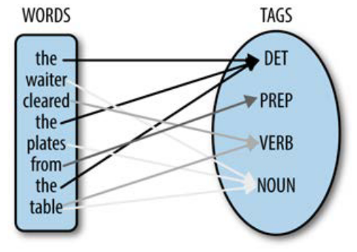
Types of corpus annotation
Syntactic level
Parsing / treebanking / bracketing
(S (NP Mary)
(VP visited
(NP a
(ADJP very nice)
boy)))
Stanford Parser
http://nlp.stanford.edu:8080/parser/

Slide 17
Parsing
(S
(NP Corpus annotation)
(VP is
(NP
(NP the practice)
(PP of
(S (VP adding
(NP interpretative linguistic information)
(PP to (NP a corpus))
))
)
)
)
.)

Slide 18
Semantic Annotation
Each word given code from thesaurus-style dictionary
Also called Word Sense Tagging
Examples
UCREL Semantic Analysis System
[http://www.comp.lancs.ac.uk/ucrel/usas/]
WordNet
[http://wordnet.princeton.edu/]

Slide 19
Semantic Annotation
The noun move has 5 senses
1. move -- (the act of deciding to do something; "he didn't make a move to help"; "his first move was to hire a lawyer")
2. move, relocation -- (the act of changing your residence or place of business; "they say that three moves equal one fire")
3. motion, movement, move, motility -- (a change of position that does not entail a change of location; "the reflex motion of his eyebrows revealed his surprise"; "movement is a sign of life"; "an impatient move of his hand"; "gastrointestinal motility")
4. motion, movement, move -- (the act of changing location from one place to another; "police controlled the motion of the crowd"; "the movement of people from the farms to the cities"; "his move put him directly in my path")
5. move -- ((game) a player's turn to take some action permitted by the rules of the game)

Slide 20
Semantic Annotation
The verb move has 16 senses (first 13 from tagged texts)
1. travel, go, move, locomote -- (change location; move, travel, or proceed; "How fast does your new car go?"; "We travelled from Rome to Naples by bus"; "The policemen went from door to door looking for the suspect"; "The soldiers moved towards the city in an attempt to take it before night fell")
2. move, displace -- (cause to move, both in a concrete and in an abstract sense; "Move those boxes into the corner, please"; "I'm moving my money to another bank"; "The director moved more responsibilities onto his new assistant")
3. move -- (move so as to change position, perform a nontranslational motion; "He moved his hand slightly to the right")
4. move -- (change residence, affiliation, or place of employment; "We moved from Idaho to Nebraska"; "The basketball player moved from one team to another")

Slide 21
Types of corpus annotation
Discourse level
Anaphoric relations (coreference annotation)
(6 the married couple 6) said that <REF=6 they were happy with <REF=6 their lot.
Speech acts (pragmatic annotation)
3 layers of coding
Segmentation (dividing dialogue in textual units, i.e. utterances)
Functional annotation (dialogue act annotation)
Utterance tags (applying utterance tags that characterize the role of the utterance as a dialogue act)
Stylistic features such as speech and thought in presentation (stylistic annotation)
The representation of people’s speech and thoughts, known as speech and thought presentation (S&TP)

Slide 22
Types of corpus annotation
Other types
Error tagging
Applying to learner corpus data
The CLEC error tagging scheme consists of 61 error types clustered in 11 categories
Problems-specific annotation
Not exhaustive – only the phenomenon directly relevant to a particular research question
Developed for its relevance to the specific research question, but not for its broad coverage and consensus-based theory-neutrality
E.g. Hunston (1993) studies how people talk about sameness and difference (“local grammar”)

Slide 23
Reading Materials
Chapter 1 from Natural Language Annotation for Machine Learning: A Guide to Corpus-Building for Applications, Pustejovsky, James
Reading: Chapter 2 from Natural Language Annotation for Machine Learning: A Guide to Corpus-Building for Applications, Pustejovsky, James https://www.oreilly.com/library/view/natural-language-annotation/9781449332693/

Slide 24
References
Hunston, S.
2002 Corpora in Applied Linguistics (Cambridge: Cambridge University Press)
McEnery, A
2003 ‘Corpus Linguistics’, in R. Mitov (ed.), The Oxford Handbook of Computational Linguistics (Oxford: Oxford University Press), pp. 448-463

Slide 25
NLTK Corpora
Brown Corpus
Carnegie Mellon Pronouncing Dictionary
CoNLL 2000 Chunking Corpus
Project Gutenberg Selections
NIST 1999 Information Extraction: Entity Recognition Corpus
US Presidential Inaugural Address Corpus
Indian Language POS-Tagged Corpus
Floresta Portuguese Treebank
Prepositional Phrase Attachment Corpus
SENSEVAL 2 Corpus
Sinica Treebank Corpus Sample
Universal Declaration of Human Rights Corpus
Stopwords Corpus
TIMIT Corpus Sample
Treebank Corpus Sample
…

Slide 26
Available CORPUS from NLTK

Slide 27
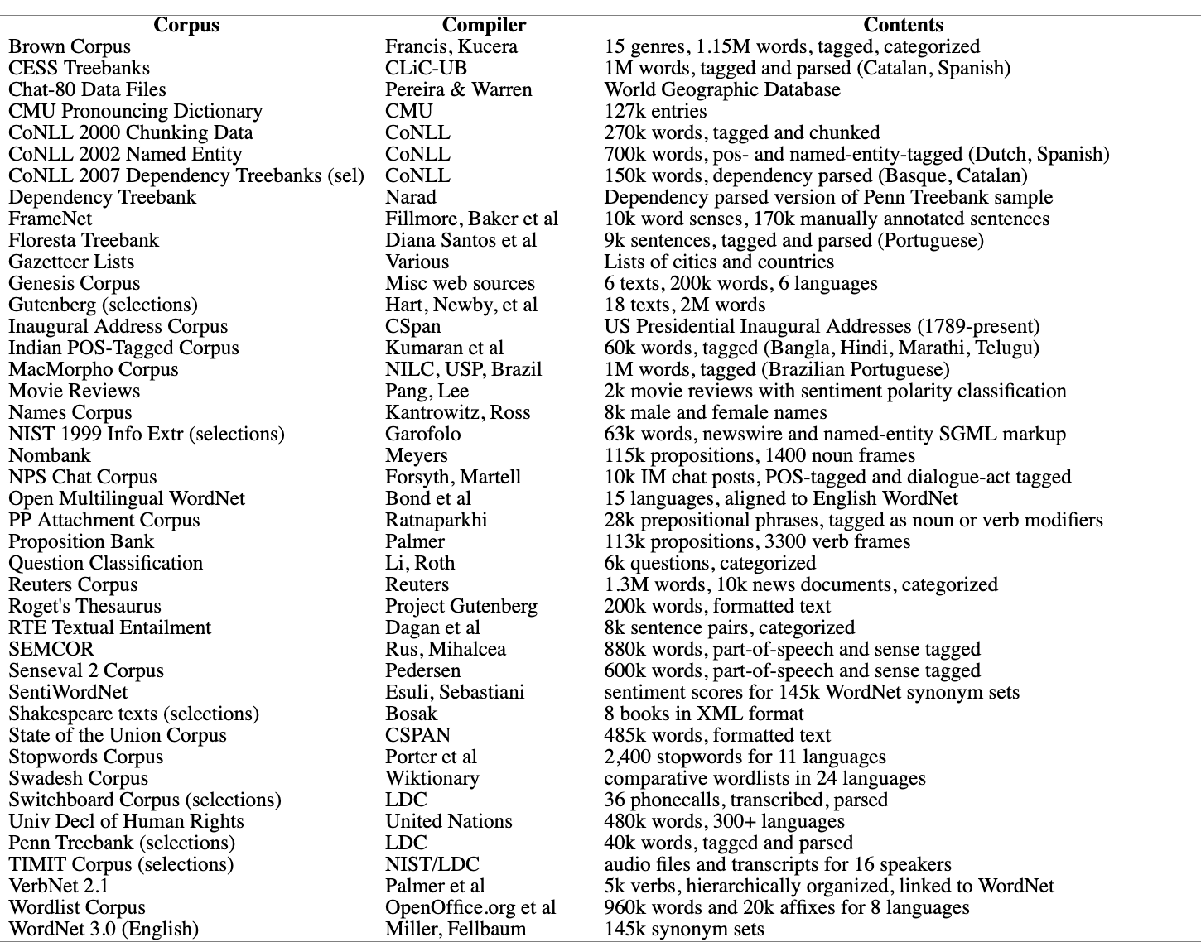
NLTK Corpus
Annotated Text Corpora from NLTK

Slide 28
NLTK Corpus Readers
nltk.corpus package defines a collection of corpus reader classes
>>> import nltk.corpus
>>> # The Brown corpus:
>>> print(str(nltk.corpus.brown).replace('\\\\','/’))
<CategorizedTaggedCorpusReader in '.../corpora/brown' (not loaded yet)>
>>> print(str(nltk.corpus.treebank).replace('\\\\','/’))
<BracketParseCorpusReader in '.../corpora/treebank/combined'...>
>>> print(str(nltk.corpus.names).replace('\\\\','/’))
<WordListCorpusReader in '.../corpora/names'...>
>>> print(str(nltk.corpus.inaugural).replace('\\\\','/’))
<PlaintextCorpusReader in '.../corpora/inaugural'...>

Slide 29
NLTK Corpus
Gutenberg Corpus
NLTK includes a small selection of texts from the Project Gutenberg electronic text archive, which contains some 25,000 free electronic books
>>> import nltk
>>. nltk.download('gutenberg')
>>> nltk.corpus.gutenberg.fileids()
['austen-emma.txt', 'austen-persuasion.txt', 'austen-sense.txt', 'bible-kjv.txt', 'blake-poems.txt', 'bryant-stories.txt', 'burgess-busterbrown.txt', 'carroll-alice.txt', 'chesterton-ball.txt', 'chesterton-brown.txt', 'chesterton-thursday.txt', 'edgeworth-parents.txt', 'melville-moby_dick.txt', 'milton-paradise.txt', 'shakespeare-caesar.txt', 'shakespeare-hamlet.txt', 'shakespeare-macbeth.txt', 'whitman-leaves.txt’]

Slide 30
NLTK Corpus
Gutenberg Corpus
Pick out the first of these texts — Emma by Jane Austen — and give it a short name, emma, then find out how many words it contains
>>> emma = nltk.corpus.gutenberg.words('austen-emma.txt’)
>>> len(emma)
192427
Other way
>>> from nltk.corpus import gutenberg
>>> gutenberg.fileids()
['austen-emma.txt', 'austen-persuasion.txt', 'austen-sense.txt', ...]
>>> emma = gutenberg.words('austen-emma.txt')

Slide 31
NLTK Corpus
Gutenberg Corpus
for fileid in gutenberg.fileids():
num_chars = len(gutenberg.raw(fileid))
num_words = len(gutenberg.words(fileid))
num_sents = len(gutenberg.sents(fileid))
num_vocab = len(set(w.lower() for w in gutenberg.words(fileid)))
print(round(num_chars/num_words), round(num_words/num_sents), round(num_words/num_vocab), fileid)

Slide 32
NLTK Corpus
Gutenberg Corpus
>>> macbeth_sentences = gutenberg.sents('shakespeare-macbeth.txt’)
>>> macbeth_sentences
[['[', 'The', 'Tragedie', 'of', 'Macbeth', 'by', 'William', 'Shakespeare', '1603', ']'], ['Actus', 'Primus', '.'], ...]
>>> macbeth_sentences[1116]
['Double', ',', 'double', ',', 'toile', 'and', 'trouble', ';', 'Fire', 'burne', ',', 'and', 'Cauldron', 'bubble’]
>>> longest_len = max(len(s) for s in macbeth_sentences)
>>> [s for s in macbeth_sentences if len(s) == longest_len]
[['Doubtfull', 'it', 'stood', ',', 'As', 'two', 'spent', 'Swimmers', ',', 'that', 'doe', 'cling', 'together', ',', 'And', 'choake', 'their', 'Art', ':', 'The', 'mercilesse', 'Macdonwald', ...]]

Slide 33
NLTK Corpus
Web and Chat Text
NLTK's small collection of web text includes:
- content from a Firefox discussion forum
- conversations overheard in New York
- the movie script of Pirates of the Carribean
- personal advertisements, and wine reviews
>>> from nltk.corpus import webtext
>>> for fileid in webtext.fileids():
... print(fileid, webtext.raw(fileid)[:65], '...’)
... firefox.txt Cookie Manager: "Don't allow sites that set removed cookies to se... grail.txt SCENE 1: [wind] [clop clop clop] KING ARTHUR: Whoa there! [clop... overheard.txt White guy: So, do you have any plans for this evening? Asian girl... pirates.txt PIRATES OF THE CARRIBEAN: DEAD MAN'S CHEST, by Ted Elliott & Terr... singles.txt 25 SEXY MALE, seeks attrac older single lady, for discreet encoun... wine.txt Lovely delicate, fragrant Rhone wine. Polished leather and strawb...

Slide 34
NLTK Corpus (cont.)
There is also a corpus of instant messaging chat sessions, originally collected by the Naval Postgraduate School for research on automatic detection of Internet predators.
The corpus contains over 10,000 posts, anonymized by replacing usernames with generic names of the form "UserNNN", and manually edited to remove any other identifying information.
The corpus is organized into 15 files, where each file contains several hundred posts collected on a given date, for an age-specific chatroom (teens, 20s, 30s, 40s, plus a generic chatroom).
Anonymized, POS-tagged and dialogue-act tagged.

Slide 35
NLTK Corpus
>> from nltk.corpus import nps_chat
>> nltk.download('nps_chat’)
>> print(nltk.corpus.nps_chat.words())
['now', 'im', 'left', 'with', 'this', 'gay', ...]
>>> print(nltk.corpus.nps_chat.tagged_words())
[('now', 'RB'), ('im', 'PRP'), ('left', 'VBD'), ...]

Slide 36
NLTK Corpus
>>> print(nltk.corpus.nps_chat.xml_posts())
[<Element 'Post' at 0...>, <Element 'Post' at 0...>, ...]
>>> posts = nltk.corpus.nps_chat.xml_posts()
>>> sorted(nltk.FreqDist(p.attrib['class'] for p in posts).keys())
['Accept', 'Bye', 'Clarify', 'Continuer', 'Emotion', 'Emphasis', 'Greet', 'Other', 'Reject', 'Statement', 'System', 'nAnswer', 'whQuestion', 'yAnswer', 'ynQuestion’]
>>> posts[4].text
‘ah well'

Slide 37
NLTK Corpus
In addition to the above methods for accessing tagged text, we can navigate the XML structure directly, as follows:
>>> tokens = posts[0].findall('terminals/t’)
>>> [t.attrib['pos'] + "/" + t.attrib['word'] for t in tokens]
['RB/now', 'PRP/im', 'VBD/left', 'IN/with', 'DT/this', 'JJ/gay', 'NN/name']

Slide 38
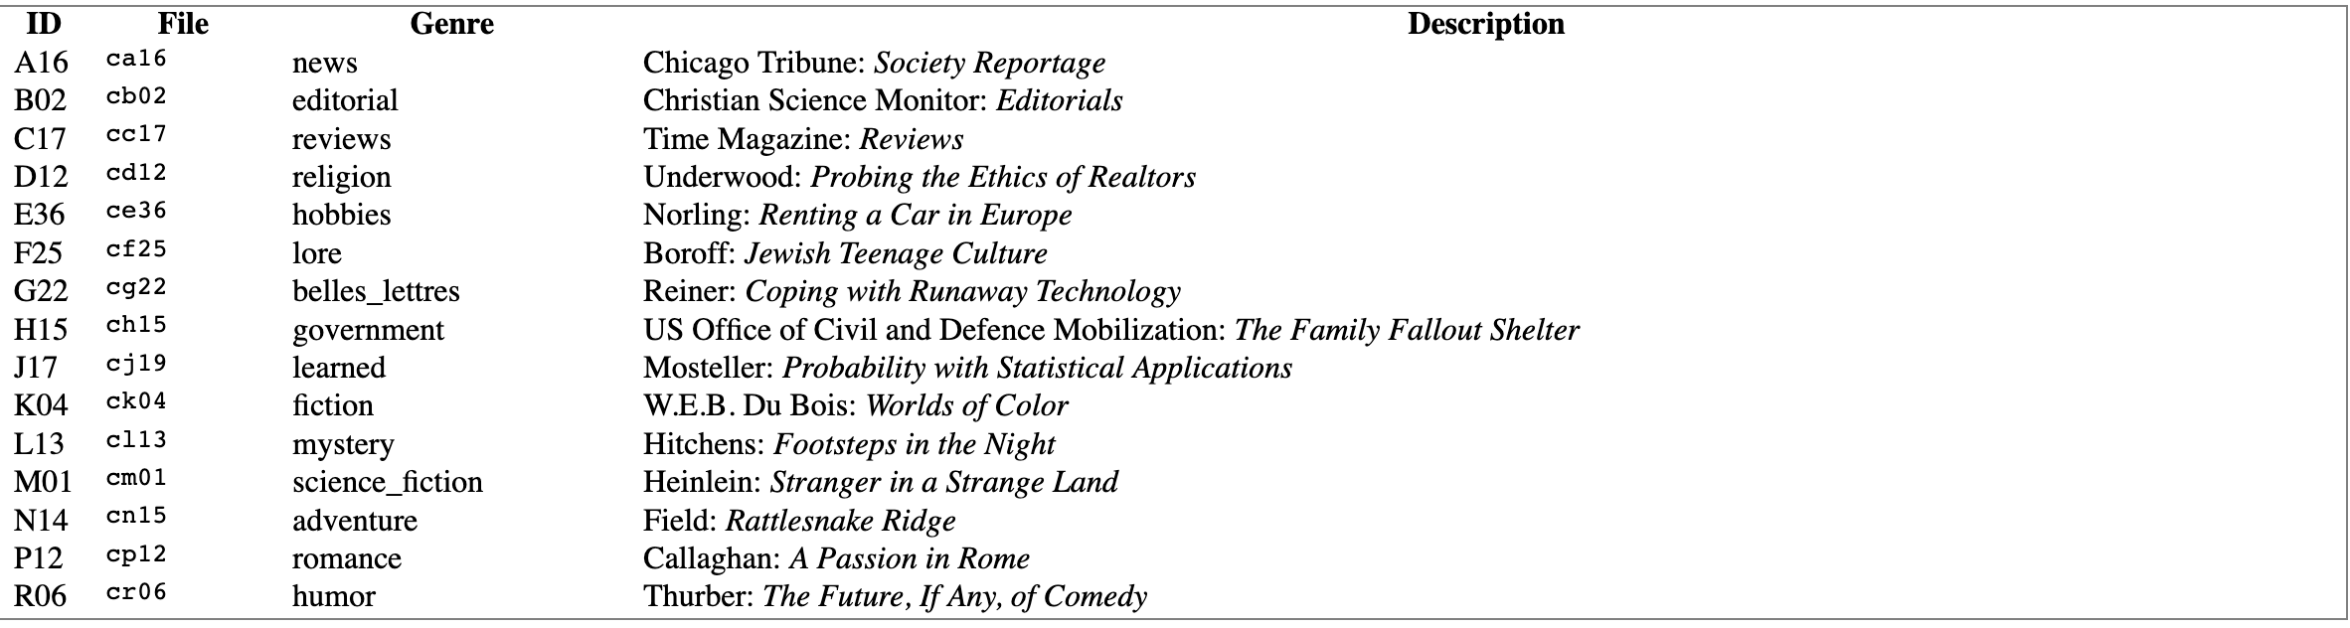
NLTK Corpus
Brown Corpus
The Brown Corpus was the first million-word electronic corpus of English, created in 1961 at Brown University. This corpus contains text from 500 sources, and the sources have been categorized by genre, such as news, editorial, and so on.

Slide 39
NLTK Corpus
Brown Corpus
>>> from nltk.corpus import brown
>>> brown.categories()
['adventure', 'belles_lettres', 'editorial', 'fiction', 'government', 'hobbies', 'humor', 'learned', 'lore', 'mystery', 'news', 'religion', 'reviews', 'romance', 'science_fiction’]
>>> brown.words(categories='news’)
['The', 'Fulton', 'County', 'Grand', 'Jury', 'said', ...]
>>> brown.words(fileids=['cg22’])
['Does', 'our', 'society', 'have', 'a', 'runaway', ',', ...] >>>
>>> brown.sents(categories=['news', 'editorial', 'reviews’])
[['The', 'Fulton', 'County'...], ['The', 'jury', 'further'...], ...]

Slide 40
NLTK Corpus
Brown Corpus
>>> from nltk.corpus import brown
>>> print(brown.tagged_words())
[('The', 'AT'), ('Fulton', 'NP-TL'), ...]
\
>>> print(brown.tagged_sents())
[[('The', 'AT'), ('Fulton', 'NP-TL')...], [('The', 'AT'), ('jury', 'NN'), ('further', 'RBR')...]...]
>>> print(brown.paras(categories='reviews’))
[[['It', 'is', 'not', 'news', 'that', 'Nathan', 'Milstein'...], ['Certainly', 'not', 'in', 'Orchestra', 'Hall', 'where'...]], [['There', 'was', 'about', 'that', 'song', 'something', ...], ['Not', 'the', 'noblest', 'performance', 'we', 'have', ...], ...], ...]
>>> print(brown.tagged_paras(categories='reviews’))
[[[('It', 'PPS'), ('is', 'BEZ'), ('not', '*'), ...], [('Certainly', 'RB'), ('not', '*'), ('in', 'IN'), ...]], [[('There', 'EX'), ('was', 'BEDZ'), ('about', 'IN'), ...], [('Not', '*'), ('the', 'AT'), ('noblest', 'JJT'), ...], ...], ...]

Slide 41
NLTK Corpus
Brown Corpus
>>> from nltk.corpus import brown
>>> news_text = brown.words(categories='news’)
>>> fdist = nltk.FreqDist(w.lower() for w in news_text)
>>> modals = ['can', 'could', 'may', 'might', 'must', 'will’]
>>> for m in modals: ... print(m + ':', fdist[m], end=' ‘)
... can: 94 could: 87 may: 93 might: 38 must: 53 will: 389

Slide 42
NLTK Corpus
Reuters Corpus
>>> from nltk.corpus import reuters
>>> reuters.fileids()
['test/14826', 'test/14828', 'test/14829', 'test/14832', ...]
>>> reuters.categories()
['acq', 'alum', 'barley', 'bop', 'carcass', 'castor-oil', 'cocoa', 'coconut', 'coconut-oil', 'coffee', 'copper', 'copra-cake', 'corn', 'cotton', 'cotton-oil', 'cpi', 'cpu', 'crude', 'dfl', 'dlr', ...]

Slide 43
NLTK Corpus
Reuters Corpus
>>> reuters.categories('training/9865’)
['barley', 'corn', 'grain', 'wheat’]
>>> reuters.categories(['training/9865', 'training/9880’])
['barley', 'corn', 'grain', 'money-fx', 'wheat’]
>>> reuters.fileids('barley’)
['test/15618', 'test/15649', 'test/15676', 'test/15728', 'test/15871', ...]
>>> reuters.fileids(['barley', 'corn’])
['test/14832', 'test/14858', 'test/15033', 'test/15043', 'test/15106', 'test/15287', 'test/15341', 'test/15618', 'test/15648', 'test/15649', ...]

Slide 44
NLTK Corpus
Reuters Corpus
We can specify the words or sentences we want in terms of files or categories. The first handful of words in each of these texts are the titles, which by convention are stored as upper case.
>>> reuters.words('training/9865')[:14]
['FRENCH', 'FREE', 'MARKET', 'CEREAL', 'EXPORT', 'BIDS', 'DETAILED', 'French', 'operators', 'have', 'requested', 'licences', 'to', 'export’]
>>> reuters.words(['training/9865', 'training/9880’])
['FRENCH', 'FREE', 'MARKET', 'CEREAL', 'EXPORT', ...]

Slide 45
NLTK Corpus
Reuters Corpus
>>> reuters.words(categories='barley’)
['FRENCH', 'FREE', 'MARKET', 'CEREAL', 'EXPORT', ...]
>>> reuters.words(categories=['barley', 'corn’])
['THAI', 'TRADE', 'DEFICIT', 'WIDENS', 'IN', 'FIRST', ...]

Slide 46
NLTK Corpus
Inaugural Address Corpus
>>> from nltk.corpus import inaugural
>>> inaugural.fileids()
['1789-Washington.txt', '1793-Washington.txt', '1797-Adams.txt', ...]
>>> [fileid[:4] for fileid in inaugural.fileids()]
['1789', '1793', '1797', '1801', '1805', '1809', '1813', '1817', '1821', ...]

Slide 47
NLTK Corpus
Inaugural Address Corpus
>>> from nltk.corpus import inaugural
>>> inaugural.raw('1789-Washington.txt')
'Fellow-Citizens of the Senate ...’
>>> inaugural.words('1789-Washington.txt’)
['Fellow', '-', 'Citizens', 'of', 'the', ...]
>>> inaugural.sents('1789-Washington.txt’)
[['Fellow', '-', 'Citizens'...], ['Among', 'the', 'vicissitudes'...]...]
>>> inaugural.paras('1789-Washington.txt’)
[[['Fellow', '-', 'Citizens'...]],
[['Among', 'the', 'vicissitudes'...],
['On', 'the', 'one', 'hand', ',', 'I'...]...]...]

Slide 48
NLTK Corpora in other languages
>>> nltk.corpus.cess_esp.words()
['El', 'grupo', 'estatal', 'Electricit\xe9_de_France', ...]
>>> nltk.corpus.floresta.words()
['Um', 'revivalismo', 'refrescante', 'O', '7_e_Meio', ...]
>>> nltk.corpus.indian.words('hindi.pos’)
['पूर्ण', 'प्रतिबंध', 'हटाओ', ':', 'इराक', 'संयुक्त', ...]

Slide 49
NLTK Corpora in other languages
>>> nltk.corpus.udhr.fileids()
['Abkhaz-Cyrillic+Abkh', 'Abkhaz-UTF8', 'Achehnese-Latin1', 'Achuar-Shiwiar-Latin1', 'Adja-UTF8', 'Afaan_Oromo_Oromiffa-Latin1', 'Afrikaans-Latin1', 'Aguaruna-Latin1', 'Akuapem_Twi-UTF8', 'Albanian_Shqip-Latin1', 'Amahuaca', 'Amahuaca-Latin1', ...]
>>> nltk.corpus.udhr.words('Javanese-Latin1')[11:]
['Saben', 'umat', 'manungsa', 'lair', 'kanthi', 'hak', ...]

Slide 50
Few other Plaintext Corpora
>>> nltk.corpus.abc.words()
['PM', 'denies', 'knowledge', 'of', 'AWB', ...]
>>> nltk.corpus.genesis.words()
[u'In', u'the', u'beginning', u'God', u'created', ...]
>>> nltk.corpus.state_union.words()
['PRESIDENT', 'HARRY', 'S', '.', 'TRUMAN', "'", ...]

Slide 51
Chunked Corpora
The CoNLL corpora also provide chunk structures, which are encoded as flat trees.
The CoNLL 2000 Corpus includes phrasal chunks; and the CoNLL 2002 Corpus includes named entity chunks.
>>> from nltk.corpus import conll2000, conll2002
>>> print(conll2000.sents())
[['Confidence', 'in', 'the', 'pound', 'is', 'widely', ...], ['Chancellor', 'of', 'the', 'Exchequer', ...], ...]

Slide 52
Chunked Corpora
>>> for tree in conll2000.chunked_sents()[:2]:
print(tree)
(S (NP Confidence/NN)
(PP in/IN)
(NP the/DT pound/NN)
(VP is/VBZ widely/RB expected/VBN to/TO take/VB)
(NP another/DT sharp/JJ dive/NN)
if/IN ...)
(S Chancellor/NNP (PP of/IN)
(NP the/DT Exchequer/NNP)
...)

Slide 53
Parsed Corpora
>>> from nltk.corpus import treebank
>>> print(treebank.fileids())
['wsj_0001.mrg', 'wsj_0002.mrg', 'wsj_0003.mrg', 'wsj_0004.mrg', ...]
>>> print(treebank.words('wsj_0003.mrg’))
['A', 'form', 'of', 'asbestos', 'once', 'used', ...]
>>> print(treebank.tagged_words('wsj_0003.mrg’))
[('A', 'DT'), ('form', 'NN'), ('of', 'IN'), ...]
>>> print(treebank.parsed_sents('wsj_0003.mrg')[0])
(S (S-TPC-1 (NP-SBJ (NP (NP (DT A) (NN form)) (PP (IN of) (NP (NN asbestos)))) (RRC ...)...)...) ... (VP (VBD reported) (SBAR (-NONE- 0) (S (-NONE- *T*-1)))) (. .))

Slide 54
Product Reviews
>>> from nltk.corpus import product_reviews_1
>>> camera_reviews = product_reviews_1.reviews('Canon_G3.txt’)
>>> review = camera_reviews[0]
>>> review.sents()[0]
['i', 'recently', 'purchased', 'the', 'canon', 'powershot', 'g3', 'and', 'am', 'extremely', 'satisfied', 'with', 'the', 'purchase', '.’]
>>> review.features()
[('canon powershot g3', '+3'), ('use', '+2'), ('picture', '+2'), ('picture quality', '+1'), ('picture quality', '+1'), ('camera', '+2'), ('use', '+2'), ('feature', '+1'), ('picture quality', '+3'), ('use', '+1'), ('option', '+1')]

Slide 55
Pros_Cons
>>> from nltk.corpus import pros_cons
>>> pros_cons.sents(categories='Cons’)
[['East', 'batteries', '!', 'On', '-', 'off', 'switch', 'too', 'easy', 'to', 'maneuver', '.'], ['Eats', '...', 'no', ',', 'GULPS', 'batteries'], ...]
>>> pros_cons.words('IntegratedPros.txt’)
['Easy', 'to', 'use', ',', 'economical', '!', ...]

Slide 56
Sentence Polarity
The Sentence Polarity dataset contains 5331 positive and 5331 negative processed sentences.
>>> from nltk.corpus import sentence_polarity
>>> sentence_polarity.sents()
[['simplistic', ',', 'silly', 'and', 'tedious', '.'], ["it's", 'so', 'laddish', 'and', 'juvenile', ',', 'only', 'teenage', 'boys', 'could', 'possibly', 'find', 'it', 'funny', '.'], ...]
>>> sentence_polarity.categories() ['neg', 'pos’]
>>> sentence_polarity.sents()[1]
["it's", 'so', 'laddish', 'and', 'juvenile', ',', 'only', 'teenage', 'boys', 'could', 'possibly', 'find', 'it', 'funny', '.']

Slide 57
Twitter Corpus
NLTK's twitter corpus currently contains a sample of 20k Tweets retrieved from the Twitter Streaming API.
>>> from nltk.corpus import twitter_samples
>>> twitter_samples.fileids()
['negative_tweets.json', 'positive_tweets.json', 'tweets.20150430-223406.json’]
>>> twitter_samples.strings('tweets.20150430-223406.json’)
['RT @KirkKus: Indirect cost of the UK being in the EU is estimated to be costing Britain \xa3170 billion per year! #BetterOffOut #UKIP', ...]
>>> twitter_samples.tokenized('tweets.20150430-223406.json’)
[['RT', '@KirkKus', ':', 'Indirect', 'cost', 'of', 'the', 'UK', 'being', 'in', ...], ['VIDEO', ':', 'Sturgeon', 'on', 'post-election', 'deals', 'http://t.co/BTJwrpbmOY'], ...]

Slide 58
Additional Language Resources

Slide 59
Language Resources
The Linguistic Data Consortium (LDC) - A collection of hundreds of corpora in both text and speech, from a variety of languages. https://www.ldc.upenn.edu/
The European Language Resources Association (ELRA) is another repository of both spoken and written corpora from many different languages.
As with the LDC, it is pos­sible to become a member of the ELRA in order to gain access to the entire database, or access to individual corpora can be sought. http://www.elra.info/en/
Another useful resource is the LRE (Linguistic Resources and Evaluation) Map, which provides a listing of all the resources used by researchers who submitted papers to the LRE Conference (LREC) for the past few years.

Slide 60
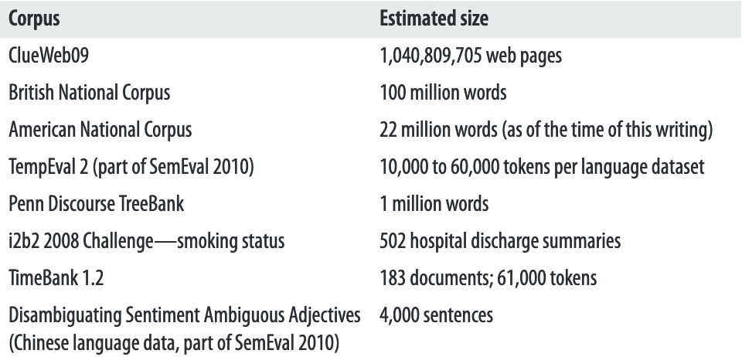
Language Resources

Slide 61
Few Other Datasets

Slide 62
ISEAR Dataset
https://www.kaggle.com/shrivastava/isears-dataset?select=isear.csv
ISEAR (International Survey on Emotion Antecedents and Reactions), dataset collected by Klaus R. Scherer and Harald Wallbott [9].
ISEAR dataset contains seven major emotions: joy, fear, anger, sadness, disgust, shame, and guilt.
Sample text:
each time that we met and √° especially when we had not met for a long time.
and for the first time we were speaking √° \the same language\"- meaning an inspiring discussion and √°|encounter.
I became very happy and the anxiety vanished. My family was at home.

Slide 63
ISEAR Dataset
Sample Text:
sadness,"When the neighbour of a friend of mine was stabbed to death by thieves in Kabwe. They stole his van."
disgust,"When we were young, a friend of mine tried to dissect a frog while we were playing near his home."
shame,"The time I shouted at most of my friends at a party. It was as if all my friends had done something wrong, or may be it was the influence of the beer."
guilt,"When I blamed my niece for misplacing my book, she denied having touched or seen it but I carried on insisting that it was her.”
joy,"After going through much shame, I became a Christian and something new happened in my heart. Joy that overflows was manifest in me”

Slide 64
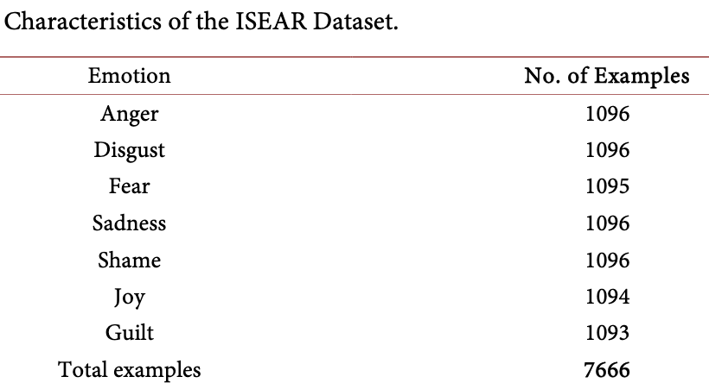
ISEAR Dataset

Slide 65
Sentiment TreeBank Dataset
https://nlp.stanford.edu/sentiment/treebank.html
https://www.kaggle.com/atulanandjha/stanford-sentiment-treebank-v2-sst2
9,645 sentences.
Sentiments are rated on a scale between 1 and 25, where 1 is the most negative and 25 is the most positive.

Slide 66
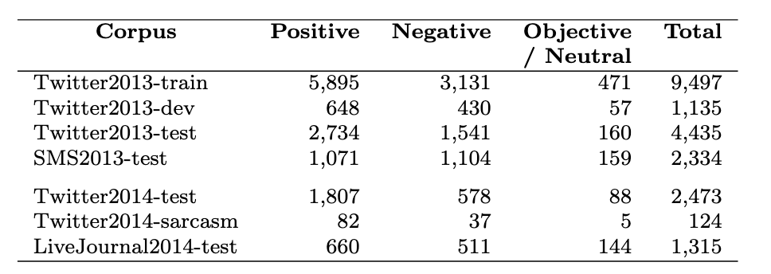
SEMEVAL Dataset
Creation of SemEval Sentiment Dataset
https://www.researchgate.net/publication/291390722_Developing_a_successful_SemEval_task_in_sentiment_analysis_of_Twitter_and_other_social_media_texts

Slide 67
SEMEVAL Dataset
Subtask A: Contextual Polarity Disambiguation:
Given a message containing a marked instance of a word or a phrase, determine whether that in-stance is positive, negative or neutral in that context.
The instance boundaries were provided: this was a classification task, not an entity recognition task.
Subtask B: Message Polarity Classification:
Given a message, decide if it is of positive, negative, or neutral sentiment.
For messages conveying both positive and negative sentiment, the stronger one is to be chosen

Slide 68
SEMEVAL Dataset
Data Creation
Gathered tweets that express sentiment about popular topics.
Extracted named entities using a Twitter-tuned NER system from millions of tweets.
Identified popular topics as those named entities that are frequently mentioned in association with a specific date.
They collected over a one-year period spanning from January 2012 to January 2013; for downloading, they used the public streaming Twitter API.

Slide 69
SEMEVAL Dataset
Data Creation
Given this set of automatically identified topics, they gathered tweets from the same time period which mentioned the named entities.
The collected tweet data were greatly skewed towards the neutral class.
In order to reduce the class imbalance, they removed messages that contained no sentiment-bearing words using SentiWordNet.
Datasets were annotated for sentiment on Mechanical Turk. Each sentence was annotated by five Mechanical Turk workers

Slide 70
SEMEVAL Dataset
Data Creation
They annotated the same Twitter messages for subtask A and subtask B.
However, the final training and testing datasets overlap only partially between the two subtasks since we had to discard messages with low inter-annotator agreement, and this differed between the subtasks.

Slide 71
SEMEVAL Dataset
Data Creation
After the annotation process, they split the annotated tweets into training, development and testing datasets; for testing, we further annotated three additional out-of-domain datasets:
– SMS messages: from the NUS SMS corpus; – LiveJournal: sentences from LiveJournal; – Sarcastic tweets: a small set of tweets containing the #sarcasm hashtag.

Slide 72
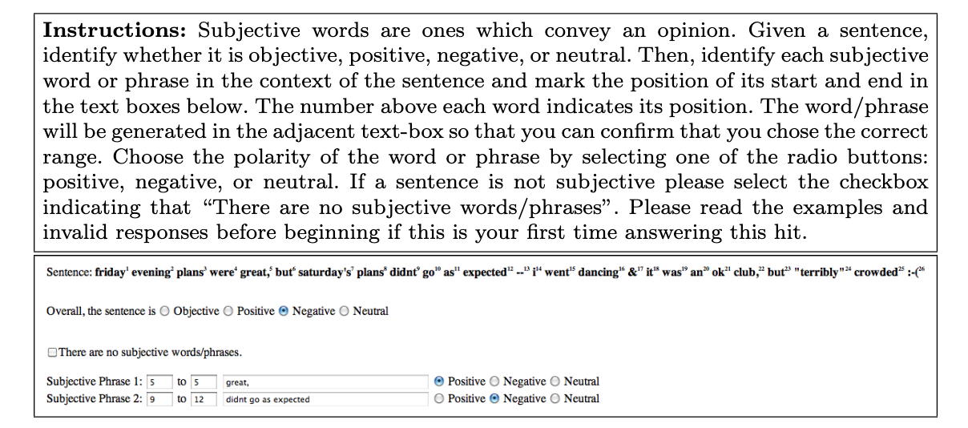
SEMEVAL Dataset
Data Creation
.

Slide 73
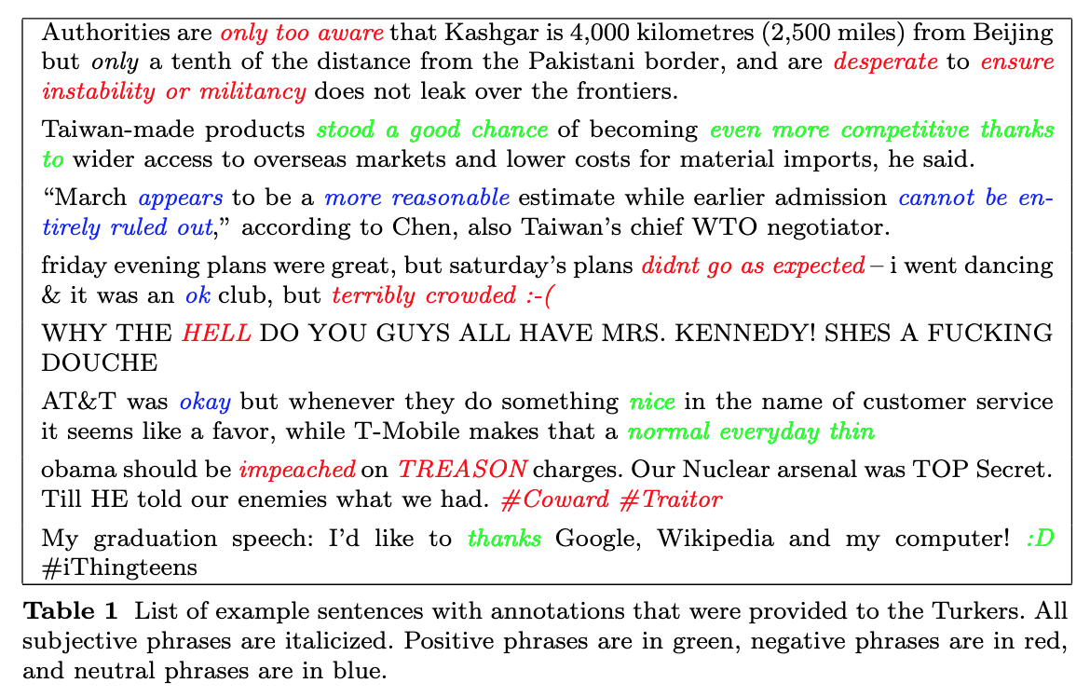
SEMEVAL Dataset
Data Creation
.

Slide 74
SEMEVAL Dataset
Data Creation.
The annotations for subtask A and subtask B were done concurrently.
Each Turker had to mark all the subjective words/phrases in the tweet message by indicating their start and end positions and to say whether each subjective word/phrase was positive, negative, or neutral (subtask A).
Turkers also had to indicate the overall polarity of the message (subtask B).

Slide 75
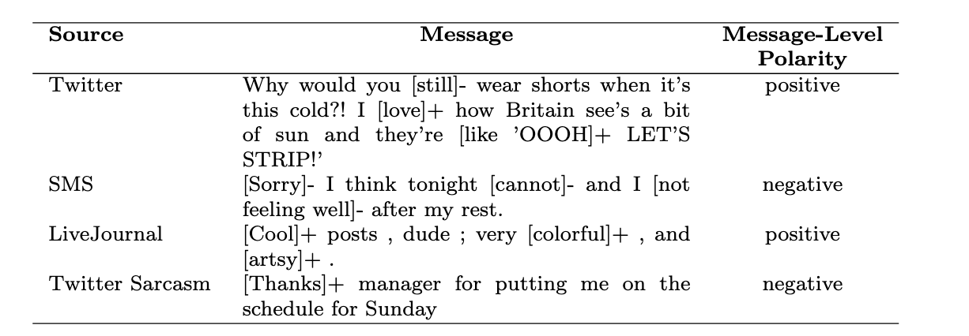
SEMEVAL Dataset
Example annotations for each source of messages. The target terms (i.e., subjective phrases) are marked in [. . .], and are followed by their polarity (subtask A); the message-level polarity is shown in the last column (subtask B).

Slide 76
CONLL-2003 Dataset
This dataset includes 1,393 English and 909 German news articles.
The English data was taken from the Reuters Corpus. This corpus consists of Reuters news stories between August 1996 and August 1997.
The text for the German data was taken from the ECI Multilingual Text Corpus (http://www.ldc.upenn.edu)

Slide 77
CONLL-2003 Dataset
Entities are annotated with LOC (location), ORG (organisation), PER (person) and MISC (miscellaneous).
Words tagged with O are outside of named entities and the I-XXX tag is used for words inside a named entity of type XXX.
Whenever two entities of type XXX are immediately next to each other, the first word of the second entity will be tagged B-XXX in order to show that it starts another entity

Slide 78
CONLL-2003 Dataset
This is an example sentence, where each line consists of [word] [POS tag] [chunk tag] [NER tag]
U.N. NNP I-NP I-ORG official NN I-NP O Ekeus NNP I-NP I-PER heads VBZ I-VP O for IN I-PP O Baghdad NNP I-NP I-LOC . . O O

Slide 79
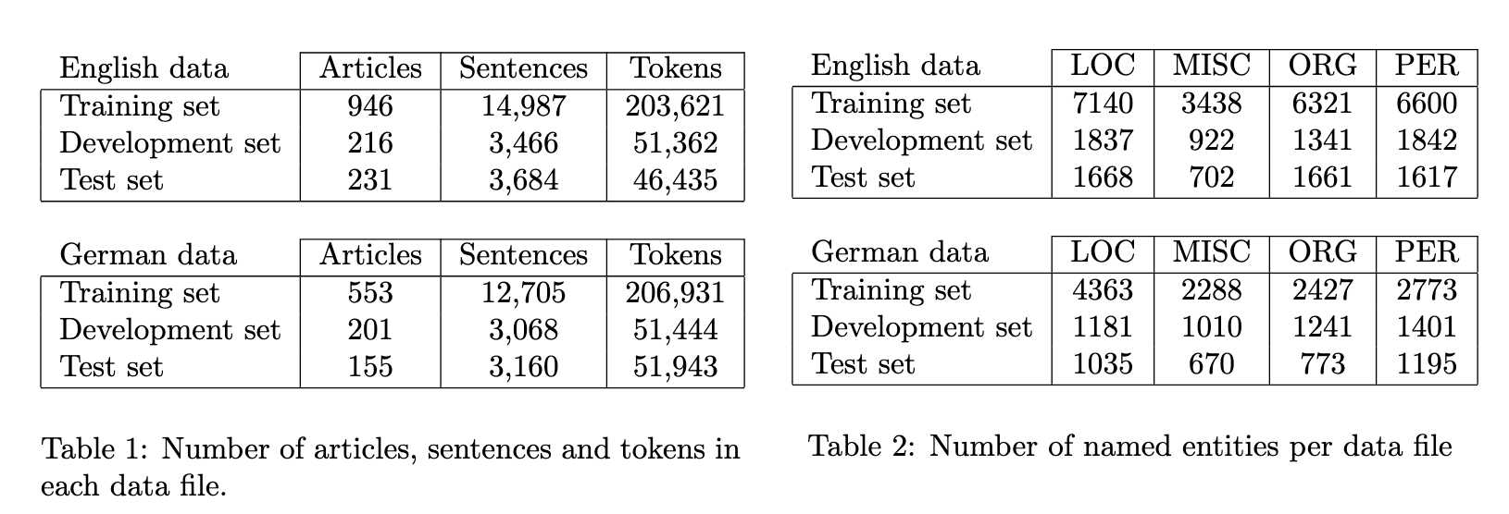
CONLL-2003 Dataset
CONLL-2003 paper:
https://www.aclweb.org/anthology/W03-0419.pdf

Slide 80
OntoNotes Dataset
https://catalog.ldc.upenn.edu/LDC2013T19
Data Source(s): | telephone conversations, newswire, newsgroups, broadcast news, broadcast conversation, weblogs
The goal of the project was to annotate a large corpus comprising various genres of text (news, conversational telephone speech, weblogs, usenet newsgroups, broadcast, talk shows) in three languages (English, Chinese, and Arabic) with structural information (syntax and predicate argument structure) and shallow semantics (word sense linked to an ontology and coreference).

Slide 81
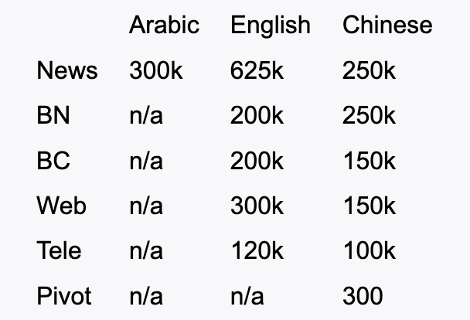
OntoNotes Dataset
newswire (News), broadcast news (BN), broadcast conversation (BC), telephone conversation (Tele) and web data (Web) in English and Chinese and newswire data in Arabic. Also contained is English pivot text (Old Testament and New Testament text).

Slide 82
Corpus Analytics

Slide 83
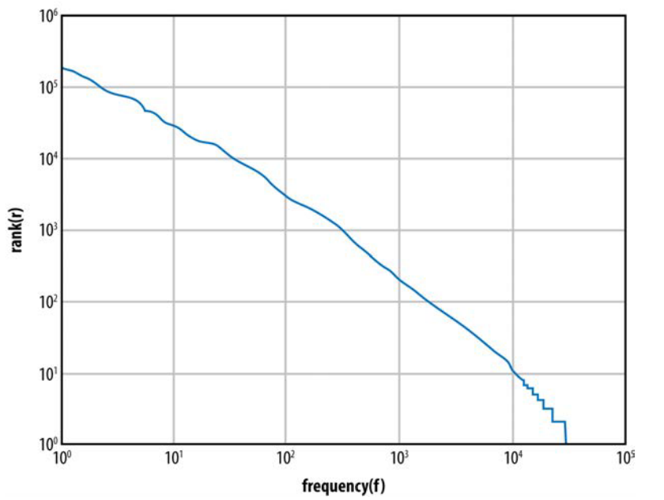
Corpus analytics
Frequency distribution in the NLTK Gutenburg corpus

Slide 84
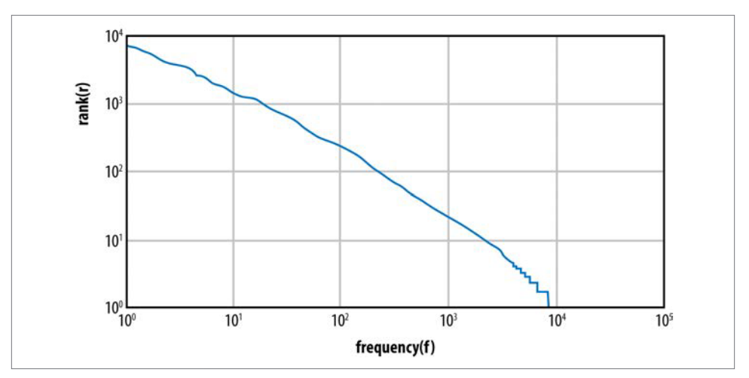
Corpus analytics
Frequency distribution in the IMDB corpus

Slide 85
Corpus analytics
>>> import nltk
>>> from nltk.corpus import PlaintextCorpusReader
>>> imdbcorpus = PlaintextCorpusReader('./training','.*’)
>>> from nltk import FreqDist
>>> fd1 = FreqDist(imdbcorpus.words())
>>> fd1.N()
#total number of sample outcomes. Same as len(imdbcorpus.words())
160035

Slide 86
Corpus analytics
>>> fd1.B()
#total number of sample values that have counts greater than zero
16715
>>> len(fd1.hapaxes())
#total number of all samples that occur once
7933
>>> frequentwords = fd1.keys()
#automatically sorts based on frequency
>>> frequentwords[:50]
[',', 'the', '.', 'and', 'to', 'a', 'of', 'is', 'in', "'", 'his', 's', 'he', 'that', 'with', '-', 'her', 'she', 'their', 'at', 'it', 'be', 'out', 'up', 'will', 'He', 'when', 'was', 'one', 'this', 'not', 'into', 'them', 'have']

Slide 87
Metrics to Remember
Two of the basic concepts you need for performing lexical statistics over a corpus
Corpus size (N) - The number of tokens in the corpus
Vocabulary size (V) - The number of types in the corpus

Slide 88
Metrics to Remember
For any tokenized corpus, you can map each token to a type; for example, how many times the appears (the number of tokens of the type the), and so on.
Once we have the word frequency distributions over a corpus, we can calculate two metrics:
- the rank/frequency profile and
- the frequency spectrum of the word frequencies.

Slide 89
Ranks and Frequency
Rank/Frequency Profile:
To get the rank/frequency profile, take the type from the frequency list and replace it with its rank, where the most frequent type is given rank 1, and so forth.
Frequency Specterm:
To build a frequency spectrum, you simply calculate the number of types that have a specific fre­quency.

Slide 90
Ranks and Frequency
In the Brown Corpus, about half of the vocabulary size is made up of words that occur only once.
The first thing one notices with these metrics is that the top few frequency ranks are taken up by function words (i.e., words such as the, a, and and; prepositions; etc.).
In the Brown Corpus, the 10 top-ranked words make up 23% of the total corpus size (Baroni 2009).

Slide 91
Ranks and Frequency
Another observation is that the bottom-ranked words display lots of ties in frequency.
For example, in the frequency table for the IMDb corpus, the number of hapax legomena (words appearing only once in the corpus) is over 8,000.
The mean or average frequency hides huge deviations.
In Brown, the average frequency of a type is 19 tokens, but the mean is increased because of a few very frequent types.

Slide 92
Frequency Distribution of IMDB Corpus
Frequency distribution in the IMDB corpus

Slide 93
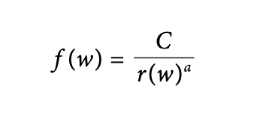
Zipf’s Law
The uneven distribution of word types shown in the preceding section was first pointed out over a variety of datasets by George Zipf in 1949.
He noticed that frequency of a word, f(w), appears as a nonlinearly decreasing function of the rank of the word, r(w), in a corpus, and formulated the following relationship between these two variables:

Slide 94
Zipf’s Law
C is a constant that is determined by the particulars of the corpus, but for now, let’s say that it’s the frequency of the most frequent word in the corpus.
Let’s assume that a is 1; then we can quickly see how frequency decreases with rank.
Notice that the law is a power law: frequency is a function of the negative power of rank, –a.
So the first word in the ranking occurs about twice as often as the second word in the ranking, and three times as often as the third word in the ranking, and so on.

