Slide 1
NLP 220 Data Science and Machine Learning Fundamentals
Lecture 1
Jalal Mahmud
Fall 2023
Slides from NLP 243 (2021) - Dilek Hakkani-Tur

Slide 2
Outline for Today
Introduction
Class logistics
What is natural language processing?
What is Machine Learning?

Slide 3
Expectations
Your knowledge of Python is already pretty solid.
You have basic knowledge of probability and linear algebra.
There will be multiple coding assignments

Slide 4
Important Information
Special Accommodations:
If you have special needs, we will accommodate you. The Disability Resource Center offers services that are confidential and free of charge.
http://drc.ucsc.edu/
https://intranet.soe.ucsc.edu/DisabilityResource
Students contact the DRC to determine their eligibility
Students then notify their instructor and provide their Accommodation Authorization form.
Please note that it is the student's responsibility to contact the instructor about their accommodations.
Students should submit their requests to faculty no later than 7 days before a regular exam and 14 days before a final exam.

Slide 5
Books and online resources
Foundations of Statistical NLP. Chris Manning, Hinrich Schuetze. https://nlp.stanford.edu/fsnlp/
Speech and Language Processing, Dan Jurafsky and James Martin. https://web.stanford.edu/~jurafsky/slp3/
Natural Language Annotation for Machine Learning: A Guide to Corpus-Building for Applications. James Pustejovsky and Amber Stubbs.
Kazil, Jacqueline, and Katharine Jarmul. Data wrangling with Python: tips and tools to make your life easier. O'Reilly Media, Inc., 2016.
Applied Text Analysis with Python: Enabling Language-Aware Data Products with Machine Learning, Bengfort, Benjamin

Slide 6
Outline for Today
Class logistics
What is natural language processing?
What is machine learning?
Python Basics
Reading from CSV File

Slide 7
What is Natural Language Processing (NLP)?
The field of natural language processing (NLP) develops theories and computational models of natural language data (the language that humans speak and write).

Slide 8
Why is NLP growing now?
So much NLP data: online forum discussions, posts on Facebook, LinkedIn and other social sites, books, journal and newspaper articles, phone calls, radio broadcasts, YouTube user generated videos or public lectures, web pages, weblogs, tweets, user reviews, email, and comment streams on newspaper or magazine articles.
So many NLP applications: Education, Economics, Digital Humanities, Biological, Environmental, Medical and Health Informatics, Conversational Interfaces, Search, Indexing, Business intelligence, Translation, Computational advertising.
So many interested parties: Research, companies and government funding agencies, as well as an area of inherent theoretical interest.

Slide 9
Why Machine Learning (ML) for NLP?
So much NLP data
ML (especially deep learning) approaches dominated the field over the past decade
Given the success of ML approaches, main NLP conferences such as ACL, NAACL, EMNLP, and others include mainly ML related papers.

Slide 10
What is Machine Learning?
Machine learning (ML) is the field of artificial intelligence that develops algorithms and statistical models that computers use to
perform a specific task without using explicit instructions (i.e., coding the specific steps for performing the task), relying on patterns and inference instead.

Slide 11
Example Task: Sentiment Detection for Product Reviews
Program for solving tasks:
Input:
“I love this product!”
program.py
“It claims too much.”
program.py
“It’s a little expensive.”
program.py
?
+
if input contains “love”, “like”, etc.
output = positive
-
if input contains “too much”, “bad”, etc. output = negative
Some tasks are complex, and we don’t know how to write a program to solve them Example: speech recognition.

Slide 12
Example Task: Sentiment Detection for Product Reviews
Learning ≈ Looking for a Function
Input:
“I love this product!”
f
+
“It claims too much.”
f
“It’s a little expensive.”
f
?
-
Given a large amount of data, the machine learns what the function f should be.

Slide 13
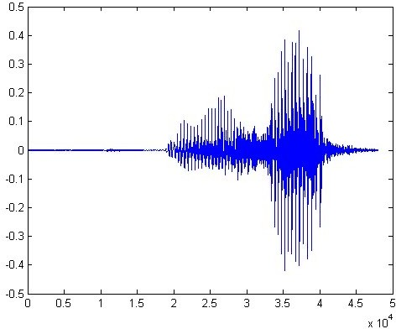



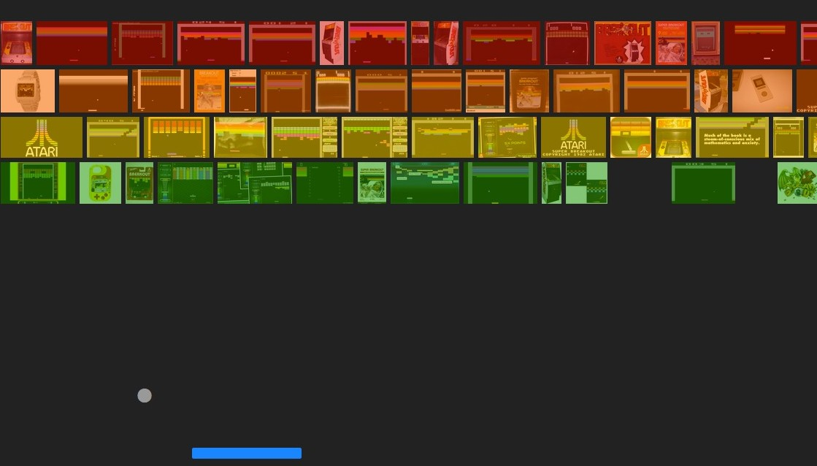
Other Example Tasks
Speech Recognition
f (
Handwriting Recognition
f (
Weather forecast
) = “the book”
) = “2”
f (
Playing video games
Thursday
) = “
Saturday”
f (
) = “move left”

Slide 14

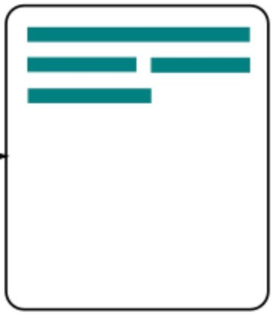
Other Examples: NLP Tasks
Machine Translation
f (
“Kitap masada.”
) = “The book is on the table.”
Question Answering
f (“Who wrote Leviathan?”) = “Paul Auster”
Summarization
f ( ) =

Slide 15
Kinds of Machine Learning
Supervised learning
Unsupervised learning
Reinforcement learning

Slide 16
Supervised Learning
Finding functions for predicting targets given inputs from pairs of
inputs and targets.
The targets, which we often call labels, are generally denoted by y.
The input data, also called the features or covariates, are typically denoted 𝐱.

Slide 17
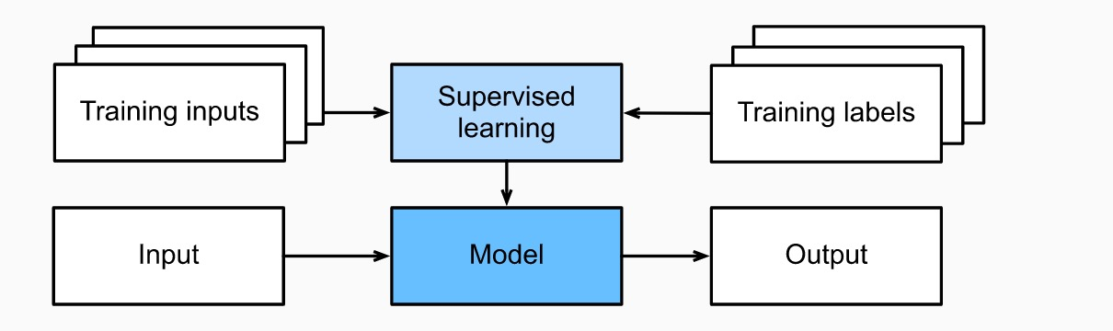
Supervised Learning
x : “It claims too much.”
function input
y:
- (negative)
function output
𝐱
y
Training:
Testing:

Slide 18
Supervised Learning
Each (input, target) pair is called a example or an instance.
Supervised learning learns the model/function from examples.
For example, machine translation models are trained from pairs of source and target language sentences.

Slide 19





Example: Model Parameters of A Single Neuron
w₁
w₂
w_{N}
z
+
y
1
1+ e^{− z}
ο (z) =
b
bias
1
w, b are the parameters of this neuron

Slide 20
Kinds of Machine Learning
Supervised learning
Unsupervised learning
Reinforcement learning

Slide 21
Unsupervised Learning
Finding previously unknown patterns in data set without pre-existing labels.
Clustering
Zero-Shot Learning
Few-Shot Learning
Semi-supervised Learning
Weakly-supervised Learning
Transfer Learning

Slide 22
Kinds of Machine Learning
Unsupervised learning
Supervised learning
Reinforcement learning

Slide 23
Reinforcement Learning
Learning action prediction policies through interactions with an environment over a series of timesteps.
At each timestep 𝑡, the learning agent receives some observation 𝑜_{𝑡} from the environment and must choose an action 𝑎_{𝑡} that is subsequently transmitted back to the environment via some mechanism.
Finally, the agent receives a reward 𝑟_{𝑡} from the environment.
The agent then receives a subsequent observation, and chooses a subsequent action, and so on.
A policy is a function that maps from observations to actions.

Slide 24
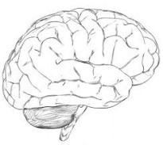
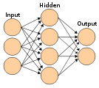
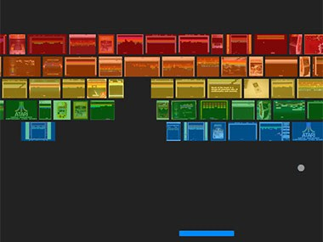

Agent and Environment
Agent
No labels, just a reward
Agent can exploit and explore
observation o_{t}
action a_{t}
→← MoveRight MoveLeft
reward r_{t}
Environment

Slide 25
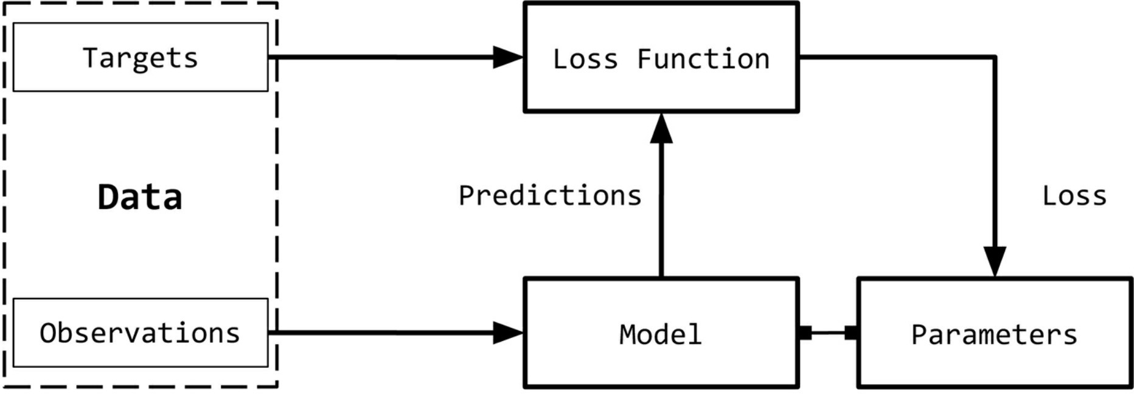
Terminology
Observations: inputs, x.
Targets: labels, y, corresponding to the observations (also called ground truth sometimes).
Model: Function that takes an observation and predicts the value of its target label.

Slide 26
More Terminology
Parameters: weights (for deep learning), w, that parameterize the model.
Predictions: Also called estimates, target values estimated by the model, 𝑦".
Loss Function: a function (denoted
L) that compares how far off a prediction is from its target. The lower the loss, the better is the model at predicting the target.

Slide 27
Supervised Learning - Regression
When the targets take arbitrary values in a range (instead of specific categories such as +/- for sentiment classification), we call it a regression problem.
Examples:
Estimating the price of a house given attributes such as location, square footage, number of rooms, etc.
Predicting how many miles can a dog run given attributes such as its breed, age, size, etc.

Slide 28
Supervised Learning - Classification
When the targets take a limited number of pre-defined categories, we call it a classification problem.
Binary classification: only two values
Positive/negative sentiment classification
Sentence segmentation from speech: each word boundary is classified into sentence boundary versus not a sentence boundary.
Sentence tokenization for text: each “.” is classified into two classes similarly.
Multi-class classification: more than two values
Digit recognition: each digit is classified into one of 10 values for 0,…,9.

Slide 29

Supervised Learning – Tagging
Some tasks are not simply binary or multi-class classification tasks, but we need to
Tagging images with multiple objects
Tagging tokens/words in natural language utterances
Locations in utterances:
I want to fly from Boston to Seattle via Chicago. => I want to fly from Boston to Seattle via Chicago.
Sequence Tagging

Slide 30
How to frame the learning problem?
The learning algorithm f is to map the input domain X into the output domain Y
f : X → Y
Input domain: word, word sequence, audio signal, click logs
Output domain: single label, sequence tags, tree structure, probability distribution
13

Slide 31

Output Domain – Classification
Sentiment Analysis
“I loved this product!”
“The screen is too small, design is awful”
Speech Phoneme Recognition
+
-
/h
/
Handwriting Recognition
2

Slide 32
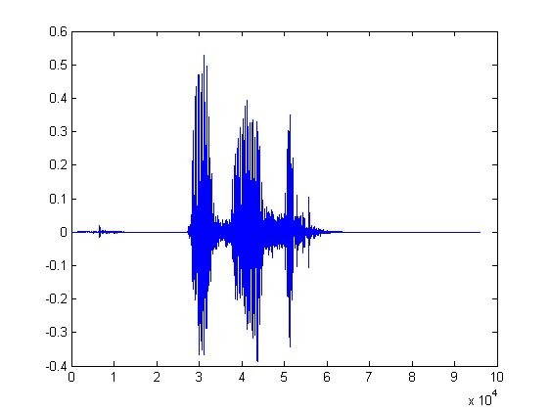
Output Domain – Sequence Prediction
POS Tagging
“I read the book”
Speech Recognition
I/PN read/VDB the/DT book/NN
“the book”
Machine Translation
“How are you doing today?”
“Bugün nasılsın?”
Learning tasks are decided by the output domains!

Slide 33
Input Domain –
How to aggregate information?
Input: word sequence, image pixels, audio signal, click logs
Properties: continuity, temporal, importance distribution
Example
CNN (convolutional neural network): local connections, shared weights, pooling
AlexNet, VGGNet, etc.
RNN (recurrent neural network): temporal information
Network architectures should also consider the input domain properties!

Slide 34
How to Frame the Learning Problem?
The learning algorithm f aims to map the input domain X into the output domain Y
f : X → Y
Input domain: word, word sequence, audio signal, click logs
Output domain: single label, sequence tags, tree structure, probability distribution
Network design should leverage input and output domain properties

Slide 35
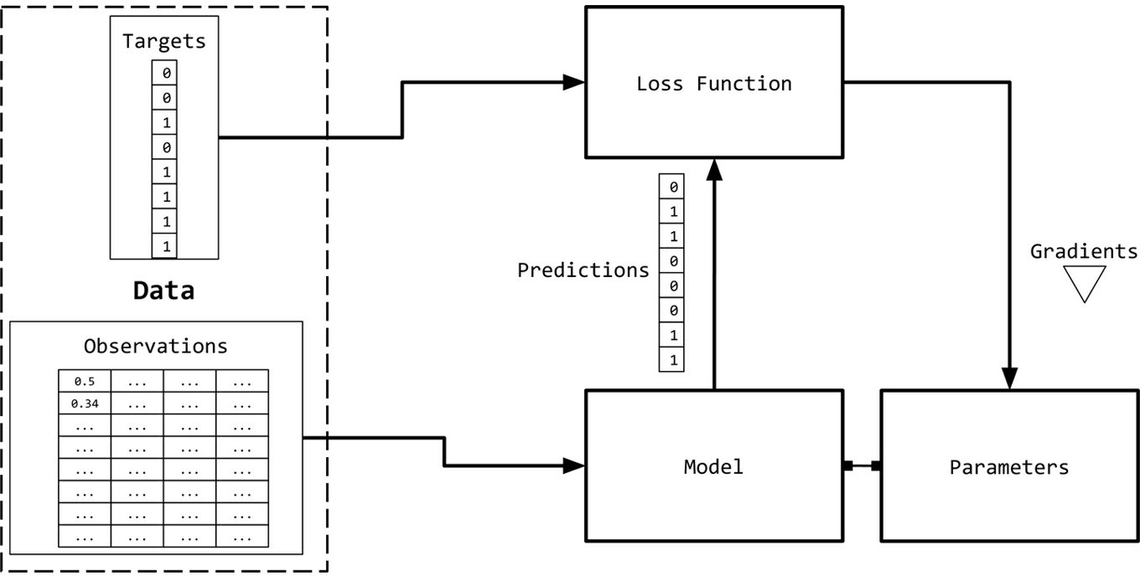
Observation and Target Encoding
Representations as numerical vectors.
Learned from data
Simple ways to represent:
One-hot encoding
Term frequency (TF) and bag-of-words
Term frequency – inverse document frequency (TF-IDF)

Slide 36
One-hot encoding
Vocabulary = { time, fruit, flies, like, a , an , arrow, banana}
”Time”: [1 0 0 0 0 0 0 0]
“flies”: [0 0 1 0 0 0 0 0]
“like”: [0 0 0 1 0 0 0 0]

Slide 37
The Bag of Words Representation
it I
the
6
5
4
to 3
and 3
seen 2
yet 1
would 1
whimsical 1
times 1
sweet 1
satirical 1
adventure 1
genre 1
fairy 1
humor 1
have 1
great 1
… …
I love this movie! It's sweet,
but with satirical humor. The dialogue is great and the adventure scenes are fun... It manages to be whimsical and romantic while laughing at the conventions of the fairy tale genre. I would recommend it to just about anyone. I've seen it several times, and I'm always happy to see it again whenever I have a friend who hasn't seen it yet!
fairy
it and
always love_{to} ^{it} whimsical it
I
seen
are
anyone
friend
happy
dialogue
adventure
recommend
satirical
_{who}sweet of _{movie}
it I
it ^{I} but ^{to} romantic
several
yet it
again
the
humor
the
seen
would
to scenes I
the manages
fun ^{the} times _{and}
I
and
about
whenever
have
while
conventions with

Slide 38
The Bag of Words Representation
Vocabulary = { time, fruit, flies, like, a , an , arrow, banana}
…
”Time flies like an arrow.”: [1 0 1 1 0 1 1 0]
“Fruit flies like a banana.”: [0 1 1 1 1 0 0 1]

Slide 39
Python and Natural Language Processing

Slide 40
Python and Natural Language Processing
Python is a great language for NLP:
Simple
Easy to debug:
Exceptions
Interpreted language
Easy to structure
Modules
Object oriented programming
Powerful string manipulation

Slide 41
Modules and Packages
Python modules “package program code and data for reuse.” (Lutz)
Similar to library in C, package in Java.
Python packages are hierarchical modules
Commands for accessing modules:
import
from…import

Slide 42
Modules and Packages: import
The import command loads a module:
>>> import re
To access the contents of a module, use dotted names:
>>> re.search(‘\w+’, str)
To list the contents of a module, use dir:
>>> dir(re)

Slide 43
Refresh skills in Python!

Slide 44
CSV Parsing
You don’t have to build your own CSV parser from scratch.
There are several perfectly acceptable libraries you can use.
The Python csv library will work for most cases.
If your work requires lots of data or numerical analysis, the pandas library has CSV parsing capabilities as well.

Slide 45
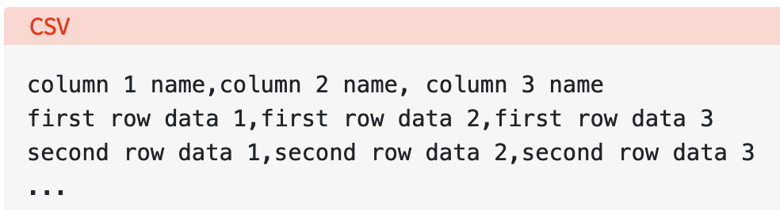
CSV Parsing
The separator character is called a delimiter, and the comma is not the only one used.
Other popular delimiters include the tab (\t), colon (:) and semi-colon (;) characters.
Properly parsing a CSV file requires us to know which delimiter is being used.
https://realpython.com/python-csv/

Slide 46
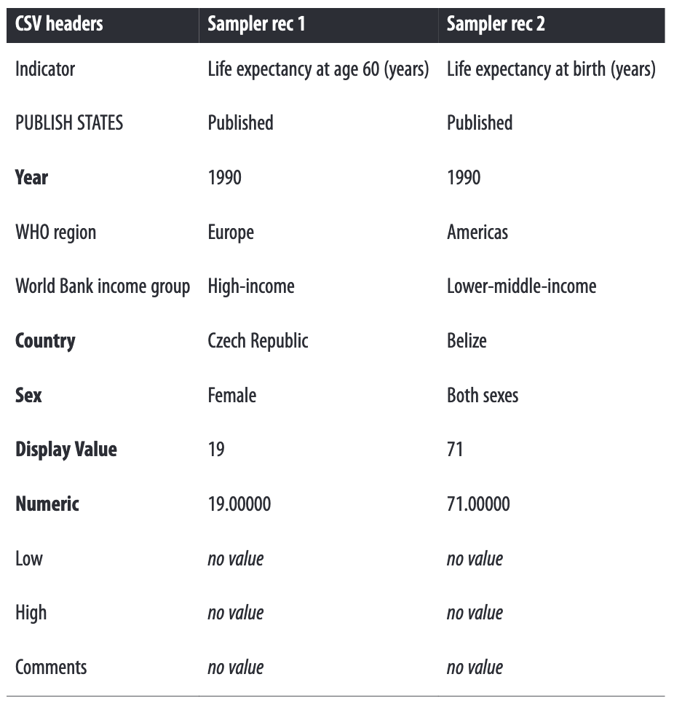
CSV Example

Slide 47
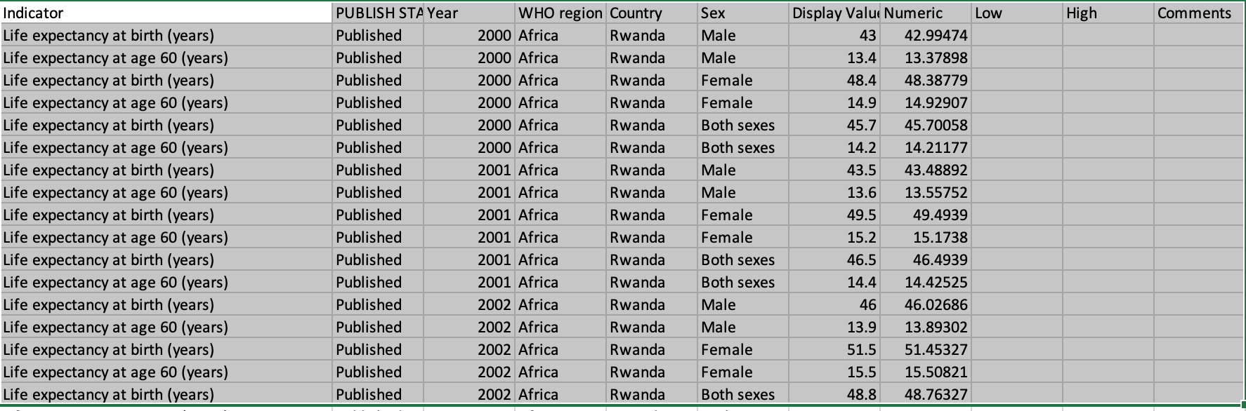
CSV Example
https://github.com/jackiekazil/data-wrangling/blob/master/data/chp3/data-text.csv

Slide 48
Python CSV Module
The csv module’s reader and writer objects read and write sequences.
Programmers can also read and write data in dictionary form using the DictReader and DictWriter classes.
https://docs.python.org/3/library/csv.html

Slide 49
How to Import CSV Data
import csv
csvfile = open('data-text.csv', 'rb’)
reader = csv.reader(csvfile)
for row in reader:
print(row)

Slide 50
Using Dictionary Reader
Instead of dealing with a list of individual String elements, you can read CSV data directly into a dictionary
import csv
csvfile = open('data-text.csv', 'rb’)
reader = csv.DictReader(csvfile)
for row in reader:
print row
{ 'Indicator': 'Healthy life expectancy (HALE) at birth (years)', 'Country': 'Zimbabwe', 'Comments': '', 'Display Value': '49', 'World Bank income group': 'Low-income', 'Numeric': '49.00000', 'Sex': 'Female', 'High': '', 'Low': '', 'Year': '2012’, 'WHO region': 'Africa', 'PUBLISH STATES': 'Published'}

Slide 51
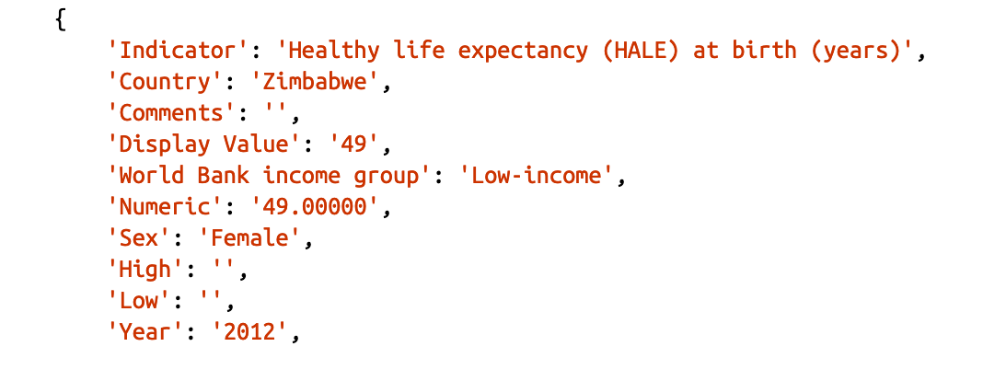
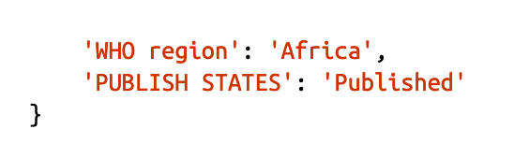
How to Import CSV Data: Using Dictionary Reader

Slide 52
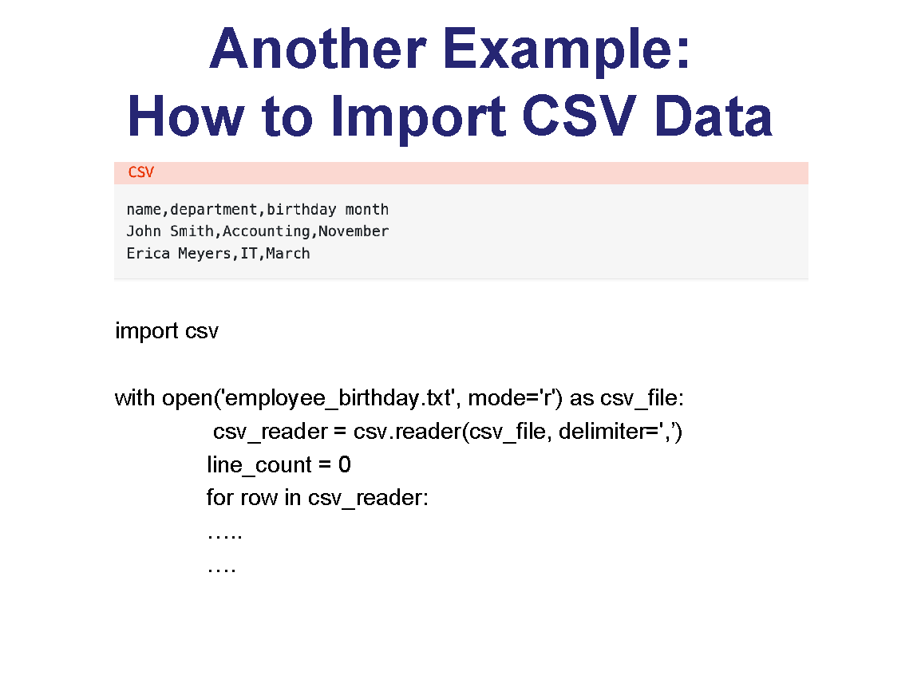
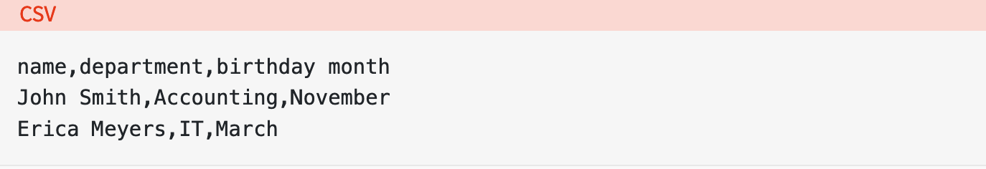
Another Example: How to Import CSV Data
import csv
with open('employee_birthday.txt', mode='r') as csv_file:
csv_reader = csv.reader(csv_file, delimiter=',’)
line_count = 0
for row in csv_reader:
…..
….
https://realpython.com/python-csv/

Slide 53
Using Dictionary Reader: How to Import CSV Data
import csv
with open('employee_birthday.txt', mode='r') as csv_file:
csv_reader = csv.DictReader(csv_file)
line_count = 0
for row in csv_reader:
…..
….

Slide 54
Optional Python CSV reader Parameters
The reader object can handle different styles of CSV files by specifying additional parameters, some of which are shown below:
delimiter specifies the character used to separate each field. The default is the comma (',').
quotechar specifies the character used to surround fields that contain the delimiter character. The default is a double quote (' " ').
escapechar specifies the character used to escape the delimiter character, in case quotes aren’t used. The default is no escape character.

Slide 55
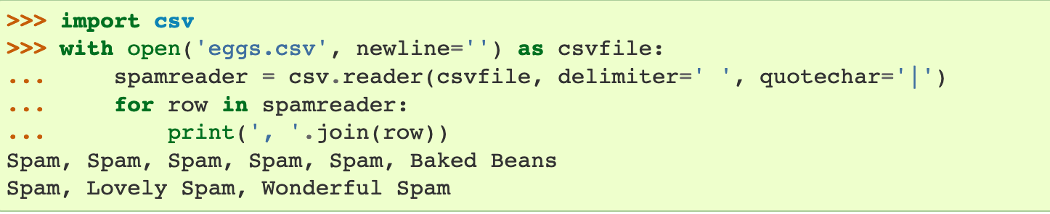
Optional Python CSV reader Parameters

Slide 56
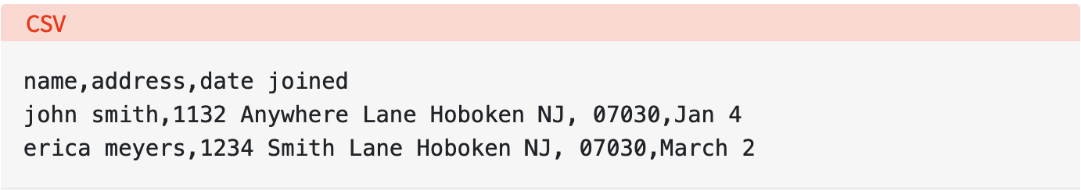
Optional Python CSV reader Parameters
This CSV file contains three fields: name, address, and date joined, which are delimited by commas.
The problem is that the data for the address field also contains a comma to signify the zip code.

Slide 57
How to handle this when data also contains the delimiter?
Use a different delimiter
The comma can safely be used in the data itself. You use the delimiter optional parameter to specify the new delimiter.
Wrap the data in quotes
The special nature of your chosen delimiter is ignored in quoted strings.
Therefore, you can specify the character used for quoting with the quotechar optional parameter.
As long as that character also doesn’t appear in the data, you’re fine.

Slide 58
How to handle this when data also contains the delimiter?
Escape the delimiter characters in the data
Escape characters work just as they do in format strings, nullifying the interpretation of the character being escaped (in this case, the delimiter).
If an escape character is used, it must be specified using the escapechar optional parameter.

Slide 59
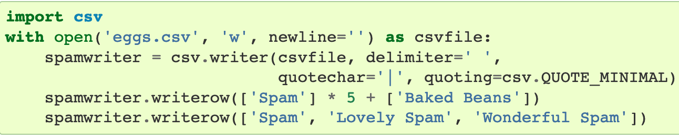
Writing to CSV File
csv.writer

Slide 60
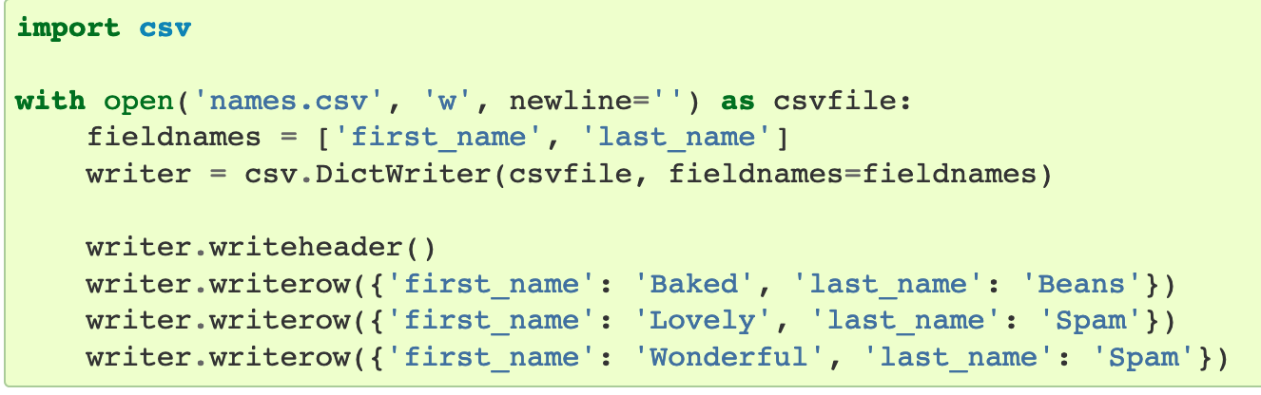
Writing to CSV File
csv.DictWriter

Slide 61
Using Python Pandas Library
Pandas is an open-source Python library that provides high performance data analysis tools and easy to use data structures.
Pandas is available for all Python installations
It is highly recommended if you have a lot of data to analyze.
install pandas
pip install pandas

Slide 62
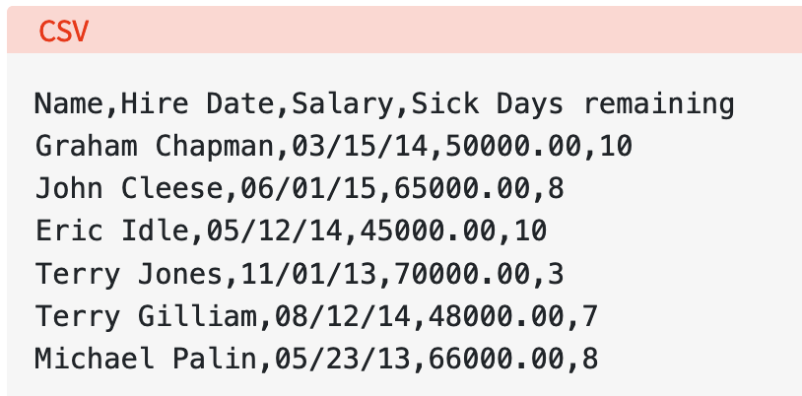
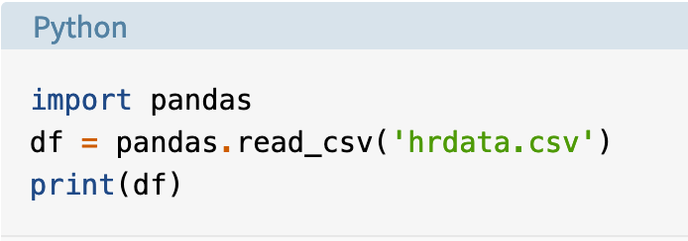
Reading a CSV File using Pandas

Slide 63
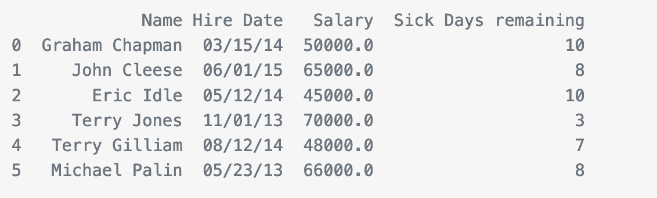
Reading a CSV File using Pandas
pandas.read_csv() opens, analyzes, and reads the CSV file provided, and stores the data in a DataFrame

Slide 64
Reading a CSV File using Pandas
Pandas recognized that the first line of the CSV contained column names, and used them automatically.
However, pandas is also using zero-based integer indices in the DataFrame. That’s because we didn’t tell it what our index should be.

Slide 65
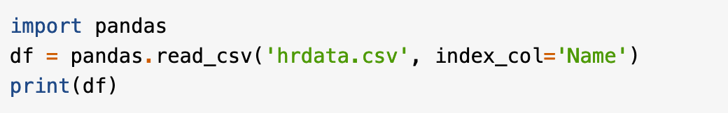
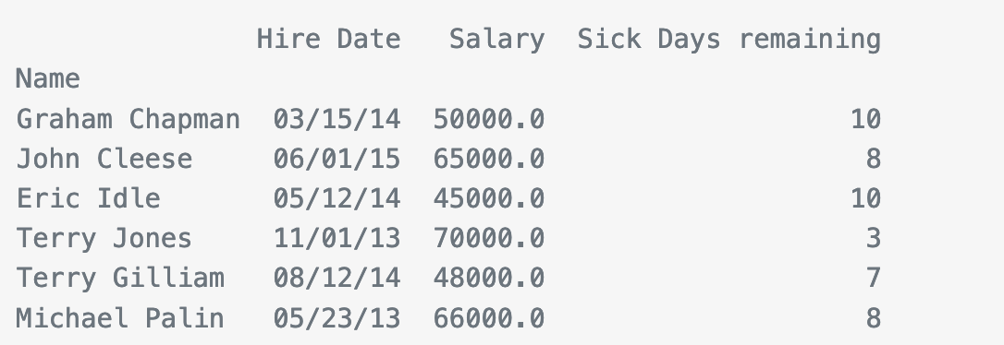
Reading a CSV File using Pandas
To use a different column as the DataFrame index, add the index_col optional parameter:

Slide 66
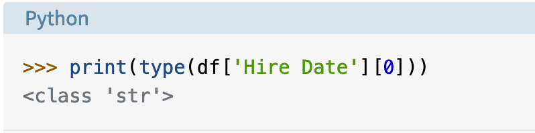
Reading a CSV File using Pandas
Pandas has properly converted the Salary and Sick Days remaining columns to numbers, but the Hire Date column is still a String.

Slide 67
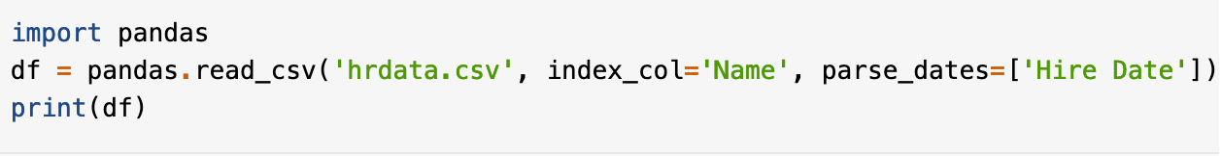
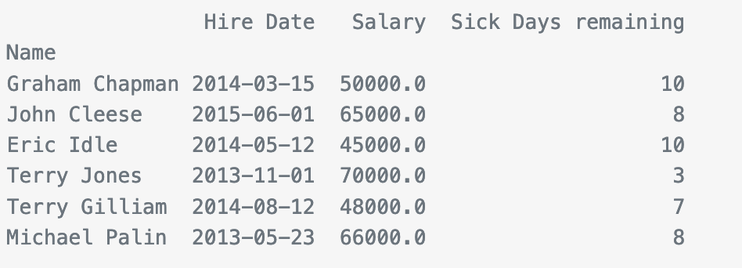
Reading a CSV File using Pandas
We can fix the data type of the Hire Date field.
We can force pandas to read data as a date with the parse_dates optional parameter, which is defined as a list of column names to treat as dates

Slide 68
Reading a CSV File using Pandas
If your CSV files doesn’t have column names in the first line, you can use the names optional parameter to provide a list of column names.
You can also use this if you want to override the column names provided in the first line.
In this case, you must also tell pandas.read_csv() to ignore existing column names using the header=0 optional parameter

Slide 69
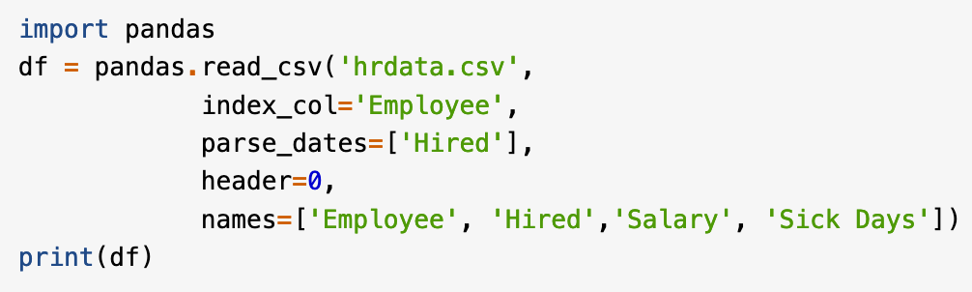
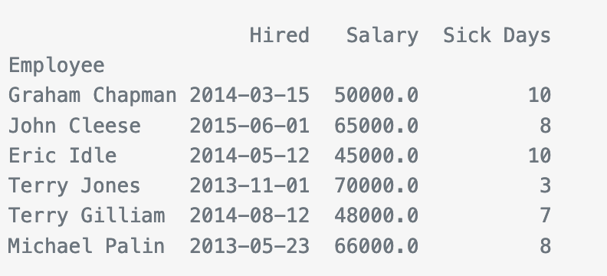
Reading a CSV File using Pandas

Slide 70
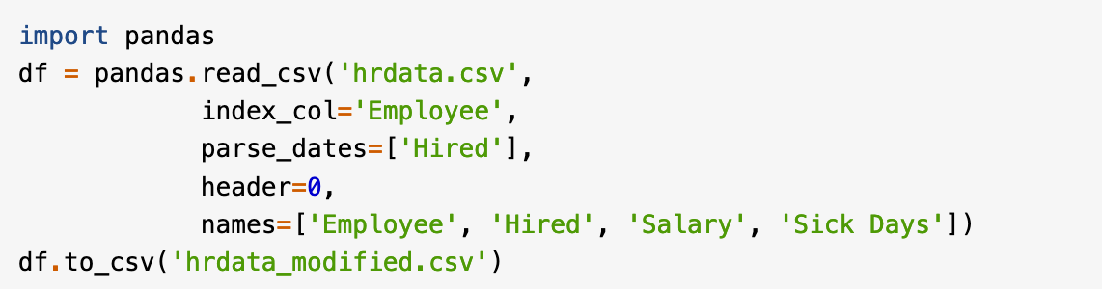
Writing a CSV File using Pandas

