Slide 1
NLP 220 Data Science and Machine Learning Fundamentals
Fall 2023
Lecture 3
Jalal Mahmud
Slides adapted from Dilek Hakkani Tur, Marilyn Walker and Dan Jurafsky

Slide 2
Outline for Today
Probability basics
ML basics
Training your own classifier: sklearn

Slide 3
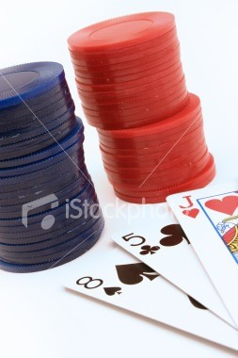
Definition of Probability
Probability theory encodes our knowledge or belief about the collective likelihood of the outcome of an event.
We use probability theory to try to predict which outcome will occur for a given event.
For language modeling, we want to calculate the probability of particular word sequences, in the most general case.
P(“orange”) or P(”The cat chased the dog.”)

Slide 4
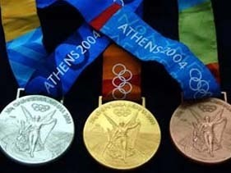
Sample Spaces
We think about the “sample space” as being set of all possible outcomes:
For tossing a coin, the possible outcomes are Heads or
Tails.
For competing in the Olympics, the set of outcomes for a given contest are {gold, silver, bronze, no_award}.
For computing part-of-speech, the set of outcomes are
{JJ, DT, NN, RB, … etc.}
We use probability theory to try to predict which outcome will occur for a given event.

Slide 5

The classic example: Flipping a coin
We flip a fair coin
What are the possible outcomes (sample space)?
Heads (H) or Tails (T)
Either is equally likely
What are the chances of getting H?
One out of two
P(H) = ½ = 0.5

Slide 6
Another Example
We roll a die. What are the chances of getting an even number?
There are six possible outcomes from rolling a die, each with a 1 out of 6 chance:
{1, 2, 3, 4, 5, 6}
There are 3 simple outcomes of interest making up the compound
event of interest:
even numbers: {2, 4, 6}
any of these qualifies as “success”
effectively, we can be successful 3 times out of 6
P(Even) = 3/6 = 0.5

Slide 7
Some Notation…
We view events and outcomes as sets
We use Ω (Omega) to denote the total set of outcomes, our event space

Slide 8
Venn diagram representation of die-throw example
Possible outcomes:
Ω = {1,2,3,4,5,6}
Outcomes of interest (denoted A): A = {2,4,6}
Ω
A
1
2
3 5
4 6

Slide 9
Probability: classical interpretation
Given n equally possible outcomes, and m events of interest, the probability that one of the m events occurs is m/n.
If we call our set of events of interest A, then:
| A |
Number of events of interest (A) over total number of events
P( A) =
| Ω |
Principle of insufficient reason (Laplace):
We should assume that events are equally likely, unless there is good reason to believe they are not.

Slide 10
Compound vs. simple events
If A is a compound event, then P(A) is the sum of the probabilities of the simple events making it up:
The sum of probabilities, for all
P( A) = ∑ P(a)
elements a of the set A
a∈A
Recall, that P(Even) = 3/6 = 0.5
In a throw of the Dice, the simple events are {1,2,3,4,5,6}, each with probability 1/6
P(Even) = P(2) + P(4) + P(6) = 1/6 * 3 = 0.5

Slide 11
More rules…
Since, for any compound event A:
P( A) = ∑ P(a)
a∈A
and the probability of all events, P(Ω) is:
P(Ω) = ∑ P(e) = 1
e∈Ω
(this is the likelihood of “anything happening”, which is always 100% certain)

Slide 12
More rules… (cont.)
If A is any event, the probability that A does not occur is the probability of the complement of A:
P( A) = 1− P( A)
i.e. the likelihood that anything which is not in A happens.
Impossible events are those which are not in Ω. They have probability of 0.
For any event A:
P( A) ∈[0,1]

Slide 13
Example: Throwing a dice
A = {4}
Probability that A does not occur
complement of A is B = {1, 2, 3, 5, 6}
P(B) = 5/6
P(A) = 1/6
P(B) = 1 – P(A)
Probability that the outcome of rolling a dice is 8
Impossible!
P ({8}) = 0

Slide 14
More complex outcomes…
Here’s an even more complicated example:
You flip a coin twice.
Possible outcomes (order irrelevant):
2 heads (HH)
Only one way to obtain this: both throws give H
Two different ways to obtain this:
1 head, 1 tail (HT)
2 tails (TT)
{throw1=H, throw2=T} OR {throw1=T, throw2=H}
Are they equally likely?
No!
Only one way to obtain this: both throws give T

Slide 15
Probability Trees
Tree diagram may be used to represent a probability space
Four equally likely outcomes:
outcome
HH
Flip 2
Flip 1
H
0.5
0.5
H
0.5
T
HT
0.5
0.5
0.5
H
TH
T
T
TT

Slide 16
So the answer to our problem
There are actually 4 equally likely outcomes when you flip a coin twice.
HH, HT, TH, TT
What’s the probability of getting 2 heads?
P(HH) = ¼ = 0.25
What’s the probability of getting head and tail?
P(HT OR TH) = 2/4 = 0.5

Slide 17
Teaser: violations of Laplace’s principle
You randomly pick out a word from a corpus containing 1000 words of English text.
Are the following equally likely?
word will contain the letter e
word will contain the letter h
What about?
word will be audacity
word will be the
E is the most frequent letter in English orthography
The is far more frequent than audacity
In both cases, prior knowledge or experience gives good reason for assuming unequal likelihood of outcomes.

Slide 18
Unequal likelihoods
When the Laplace’s Principle is violated, how do we estimate probability?
We often need to rely on prior experience
In general, for language events, P is unknown
We need to estimate P
By looking at evidence about what P must be based on a sample of data
Example:
In a big corpus, count the frequency of e and h
Take a big corpus, count the frequency of audacity vs. the
Use these estimates to predict the probability on a new 1000-word sample.
Language Modeling!

Slide 19
Example
Suppose that, in a corpus of 1 million words:
C(the) = 50,000
C(audacity) = 2
Based on frequency, we estimate probability of each outcome of interest:
frequency / total
P(the) = 50,000/1,000,000 = 0.05
P(audacity) = 2/1,000,000 = 0.000002

Slide 20
Interpretation of probability
The core assumption in statistical NLP, where we estimate probabilities based on frequency in corpora:
Given that a certain event of interest occurs m times in n identical situations, its probability is m/n
Stability of relative frequency:
we tend to find that if n is large enough, the relative frequency of an event m
is quite stable across samples

Slide 21
Corpus Based Statistical NLP
Based on counting in large corpora and developing different kinds of models
This approach only became possible with the Web
Google Translate: works because it’s seen tons of examples
Spelling Correction: also works because it’s seen tons of examples of words in context
Auto-complete
Word2Vec
Started out with simple word and POS based approaches, now NLP challenges are more to do with meaning (i.e., GLUE and SuperGLUE).

Slide 22
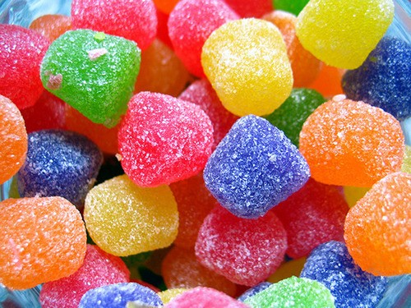
Prior knowledge
Sometimes, an estimation of the probability of an event is affected by what is known (which changes the sample space)
Example:
A box of 10 candies
5 red and sweet, 3 green and sour, 2 green and sweet
You close your eyes and randomly pick a candy, what is the probability that it is sweet?
7/10 = 0.7
After you pick the candy, you open your eyes and see it is green, now what is the probability that it is sweet?
2/5 = 0.4

Slide 23
Part-of-speech tagging example
One of the classic tasks in statistical NLP
Assign a label indicating the grammatical category to every word in a corpus of running text.
Statistical POS taggers are first trained on data that has been previously annotated. Yields a language model.
Language models vary based on the n-gram window (size of the sequence):
Unigrams: probability based on tokens (a lexicon)
e.g. input = the_DET tall_ADJ man_NN
model represents the probability that the word man is a noun (it could also be a verb)
Bigrams: probabilities across a span of 2 words
model represents the probability that a DET is followed by an adjective, adjective is
followed by a noun, etc.
Also: Trigrams, 4-grams, etc.

Slide 24
POS tagging
Suppose we’ve trained a tagger on the annotated data. It has:
a lexicon of unigrams:
P(the=DET), P(man=NN), etc
a bigram model
P(DET is followed by ADJ), etc
Assume we’ve trained it on a large input sample.
We now feed it a new phrase:
the audacious alien
Our tagger knows that the word the is a DET, but it’s never seen the other words.
It can:
Make a wild guess (not very useful!)
Alternative: estimate the probability that the is followed by an ADJ, and that an ADJ is followed by a NOUN

Slide 25
Prior knowledge revisited
Given that I know that the is DET, what’s the probability that the following word
audacious is ADJ?
This is very different from asking what’s the probability that audacious is ADJ out of context.
We have prior knowledge that DET has occurred. This can significantly change
the estimate of the probability that audacious is ADJ.
We therefore distinguish:
Prior probability: “Naïve” estimate based on long-run frequency
The unconditional probability that is assigned before any relevant evidence is taken into account.
Posterior probability: probability estimate based on prior knowledge after
some observation
The conditional probability that is assigned after the relevant evidence or background is taken into account.

Slide 26
Conditional Probability
In our example, we were estimating:
P(ADJ|DET) = probability of ADJ given DET
P(NN|ADJ) = probability of NN given ADJ
…
In general:
The conditional probability P(A|B) is the probability that A occurs, given that we know that B has occurred

Slide 27
Estimation of conditional probability
Intuition:
P(A|B) is a ratio of the chances that both A and B happen, divided by the chances of B happening alone
P( A | B) = ^{P( A ∩ B)}
P(B)
P(ADJ|DET) = P(DET+ADJ) / P(DET)

Slide 28
Estimating P(A AND B)
P( A ∩ B) = P( A)P(B | A)
Probability that both A and B occur
Probability of A happening overall
Probability of B happening given that A has happened
Multiplication rule

Slide 29
Multiplication rule: example
We have a standard deck of 52 cards
What’s the probability of pulling out two aces in a row?
Standard deck has 4 aces
Let A1 stand for “an ace on the first pick”, A2 for “an ace on the second pick”
We’re interested in P(A1 AND A2)

Slide 30
Example continued
P(A1 AND A2) = P(A1)P(A2|A1)
P(A1) = 4/52
(since there are 4 aces in a 52-card pack)
If we do pick an ace on the first pick, then we diminish the odds of picking a second ace (there are now 3 aces left in a 51-card pack).
P(A2|A1) = 3/51
Overall: P(A1 AND A2) = (4/52) (3/51) = .0045
in the event of A1, the chances of A2 are diminished
the multiplication rule takes this into account

Slide 31
Some observations
In this example, the two events are not independent of
each other
occurrence of one affects likelihood of the other
e.g. drawing an ace first diminishes the likelihood of drawing a
second ace
Sampling without replacement
If we put the ace back into the pack after we’ve drawn it, then we have sampling with replacement
In this case, the probability of one event doesn’t affect the probability of the other.

Slide 32

Independence
Multiple coin tosses
Card picks from two different decks (or sampling with replacement)

Slide 33
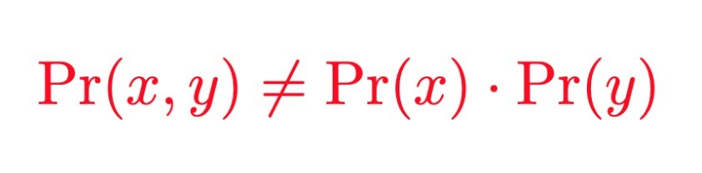
Dependence
Picking cards consecutively from a deck (i.e., sampling without replacement)
Message exchanges between two friends

Slide 34
Extending the multiplication rule
The logic of the “A AND B” rule is:
Both conditions, A and B have to be met
A is met a fraction of the time
B is met a fraction of the times that A is met
Can be extended indefinitely
E.g. chances of drawing 4 straight aces from a pack
P(A1 & A2 & A3 & A4)
=
P(A1) P(A2|A1) P(A3|A1 & A2) P(A4|A1 & A2 & A3)

Slide 35
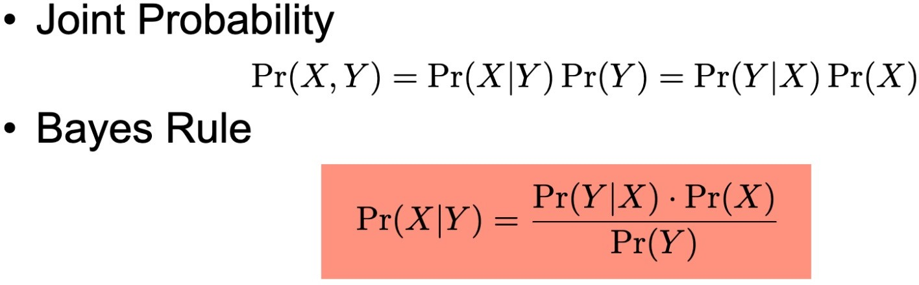
Bayes Rule

Slide 36
Classification
Classification: choosing the correct class label for a given input
each input is considered in isolation from all other inputs
set of labels is defined in advance

Slide 37
Learning to Classify Text – Intent Detection
User Intent Detection for a Virtual Personal Assistant.
APIs: Book_Table, Get_Directions, Show_Weather
User Utterance:
Can you book me a table tomorrow night for dinner?
Show me directions to work
I wanna reserve a table for our anniversary
Will it rain in SeaBle tomorrow?
Get me directions to Jack’s school
How is the weather in Atlanta this weekend?
I need to get a table at Sponge for the group lunch
API to be called: Book_Table Get_Directions Book_Table Show_Weather Get_Directions Show_Weather Book_Table

Slide 38


Learning to Classify Text – Sentiment Detection
Sentiment classiﬁcation of restaurant reviews (input): Positive / Negative (output)
Review:
An excellent restaurant. The food was wonderful, the service friendly and a8entive, and the atmosphere warm and homey.
Sentiment:
Positive 🙂
Skip this "downtown" experience...who wants to "go downtown" in Memphis at night? The food is simply not worth the hassle and trip if you live past the Perimeter
Negative ☹
Sometimes its worth trying a new place. We were so glad we did. Food was excellent.
Positive 🙂

Slide 39
Learning to Classify Text – Other Examples
Task | Input | Output
Spam detection | Emails | Spam/Ham
Topic Classification | e.g., news articles | Sports/Tech./Entrtn./etc.
Emotion Detection | e.g., user utterances | Happy/Neut./Angry/etc.
Dialogue Act Tagging | e.g., sentences in conv. | Statement/Feedback/etc.

Slide 40
Example of feature-based description of text
Classifying the review sentiment and categories
The staff of the restaurant is nice and the eggplant is not bad. Apart from that, very uninspired food, lack of atmosphere and too expensive. I am a staunch vegetarian and was sorely disappointed with the veggie options on the menu.
Sentiment polarity (+/-)
Category: Food/Movie/Electronics/etc.

Slide 41

Example of feature-based description of text
Classifying user utterances to a conversational agent into user intentions
Can you book me a table tomorrow night for dinner?
Show me directions to work
I wanna reserve a table for our anniversary
Will it rain in Seattle tomorrow?
Get me directions to Jack’s school
How is the weather in Atlanta this weekend?
I need to get a table at Sponge for the group lunch
Book _Table
Show_Weather
Get_Directions

Slide 42
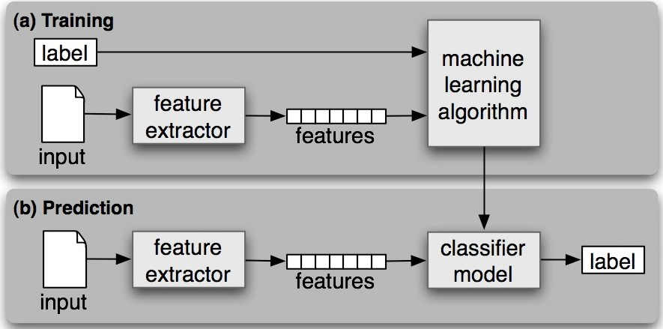
Supervised Classification
Built based on training corpora of input-output pairs.
Training: Feature extractor: input → a feature set
Features, designed to capture the basic information about each input).
Prediction: same feature extractor, unseen inputs → feature sets

Slide 43
In Practice: Where do we get the data and labels from?
Mine from the web
E.g., review sentiment classification
Inputs: scrape actual customer reviews
Outputs: use customer ratings
Crowdsourcing: workers perform data collection and annotation
E.g., intent classification
Inputs: write down utterances intended for an assistant
Outputs: pick one of the categories

Slide 44
In Practice: Human Annotation
Prepare annotation guidelines
Definition of the schema of all classes (i.e., positive/neutral/negative for sentiment)
Instructions on how to label samples, and also examples for each class
Get annotations from multiple annotators based on the guidelines
Compute inter-annotator agreement from multiple annotators
Ensure consistent annotations
Percentage agreement, Cohen’s Kappa, etc.
Usually repeat these steps multiple times:
refine guidelines, collect more annotations, compute agreement, check confusions, and repeat

Slide 45
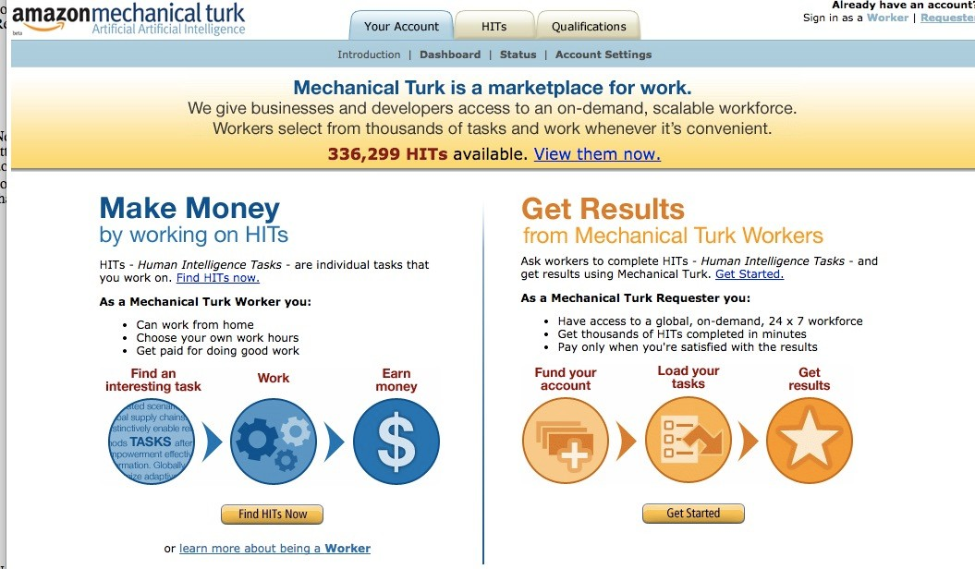
Mechanical Turk
There are templates and a good interface
Pretty straightforward to learn how to set these up

Slide 46
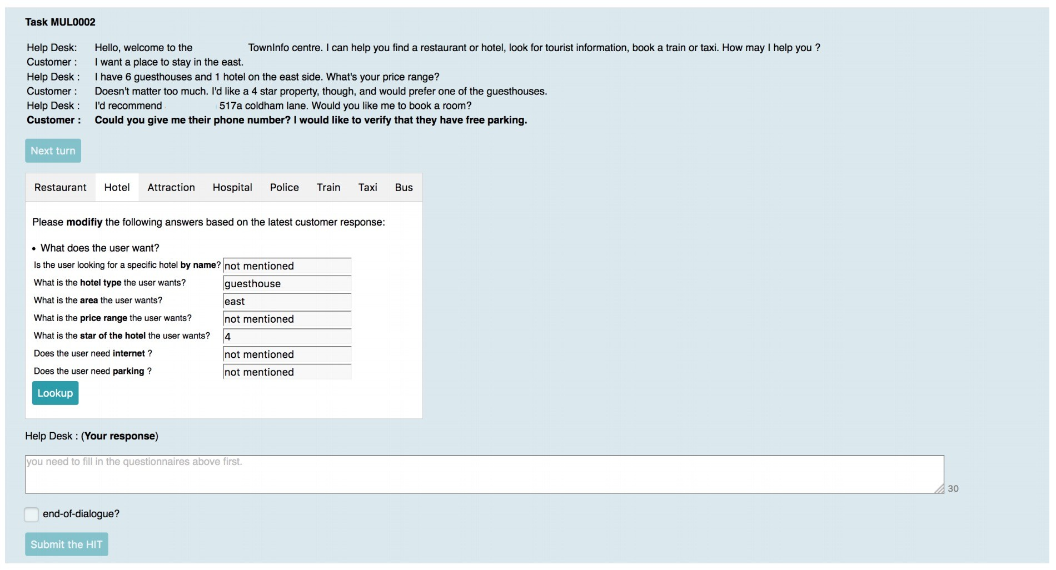
Example from CU MultiWOZ data collection

Slide 47
In Practice: How do we get the features?
Features are the independent variables, what we use to try to predict the labels (the dependent variables)
Kitchen sink approach (at ﬁrst)
Words, Stemmed words
POS tags, unigram, and bigram counts
Sentiment dictionaries, gazetteers (location, movie, restaurant names, etc.)
Regex, or phrasal patterns that combine features:
“very ADJ” “not ADJ” for sentiment, “directions to LOC” for intent, etc.

Slide 48
Feature Engineering
Developing relevant features
Deciding how to encode them
Can be informed by theoretical work in linguistics
Can be learned from the data (kitchen sink)
Often possible to get decent performance by using a fairly simple and obvious set of features
But sometimes can get significant gains by using carefully constructed features based on a thorough understanding of the task and data

Slide 49


POS/NEG classification of reviews
All the words
An excellent restaurant. The food was wonderful, the service friendly and attentive, and the atmosphere warm and homey.
(an, excellent, restaurant, the, food,…)
But my steak had a funny taste to it. I cut a piece and ate it thinking that they must use a very strange seasoning, I tried 2 more bites and just didn’t like it… I could smell that the steak was spoiled… Well needless to say i did not eat it, and i sat and waited for my daughter to ﬁnish her meal. When she was done we went to the front counter and waited again for our waitress to ﬁnally come and tally up our bill (I was feeling kind of invisible). We talked about the steak and I asked her to have the cook taste it, and when he did you could see on his face that there was something wrong.
(but, my, steak, have, a, funny, taste, to, it, I, cut, piece, and,…)

Slide 50

POS/NEG classification of reviews
An excellent restaurant. The food was wonderful, the service friendly and attentive, and the atmosphere warm and homey.
Or just the sentiment words
(excellent, wonderful, friendly, attentive, warm, homey,…)
Or task speciﬁc features, i.e., complex word combinations:
(strange_seasoning, not_like, needless_to_say, not_eat, wait_again, ﬁnally_come, …)
Lexical resources N-grams
Length of document
…
But my steak had a funny taste to it. I cut a piece and ate it thinking that they must use a very strange seasoning, I tried 2 more bites and just didn’t like it… I could smell that the steak was spoiled… Well needless to say i did not eat it, and i sat and waited for my daughter to finish her meal. When she was done we went to the front counter and waited again for our waitress to finally come and tally up our bill (I was feeling kind of invisible). We talked about the steak and I asked her to have the cook taste it, and when he did you could see on his face that there was something wrong.

Slide 51
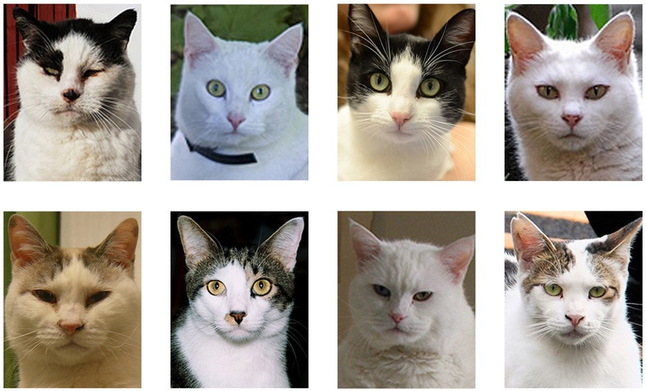

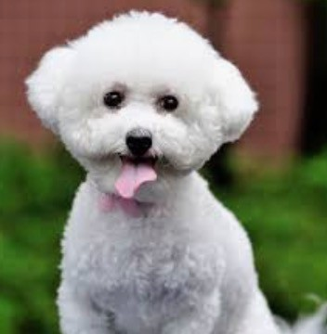

Overfitting: How do we avoid?
Model is trained by maximizing its performance on some set of training data. However, it is evaluated not by its performance on the training data but by its performance on unseen data.
Overfitting occurs when a model begins to "memorize" training data rather than "learning" to generalize from trend
Overfitting: poor predictive performance, exaggerate minor fluctuations in the data
For example, never seen an orange cat in training

Slide 52
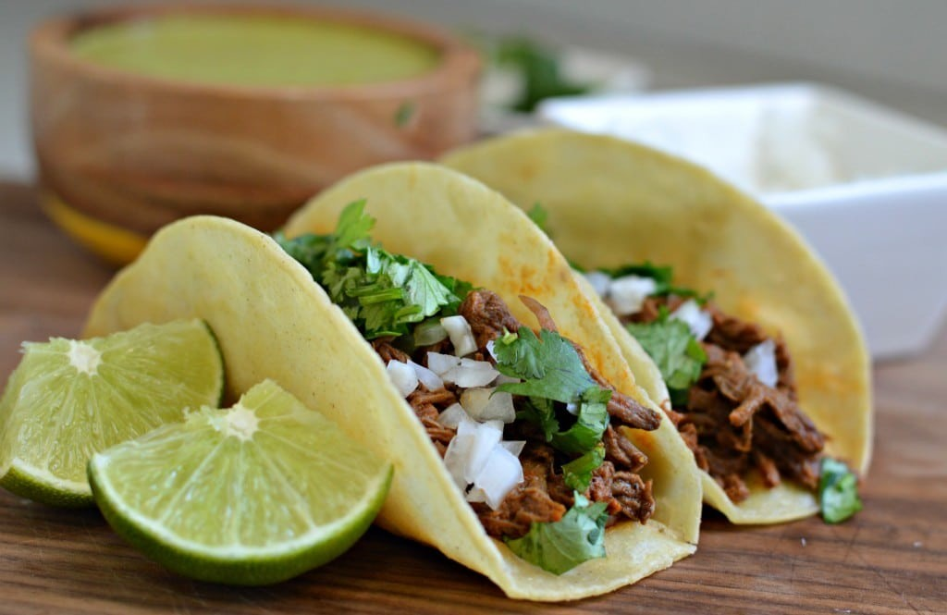
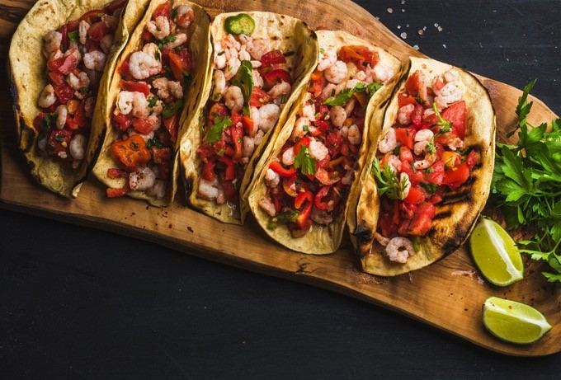
Overfitting: How do we avoid?
Imagine a prolific restaurant reviewer who loves tacos and has never had a bad taco
Reviews about great tacos dominate the training
Restaurant rating = 5
More general features can help

Slide 53
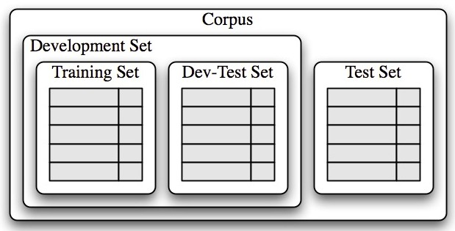



Avoiding Overfitting: Training, Dev and Test Sets
Split corpus into three parts (training, dev, test), usually randomly (80%, 10%, 10%)
Creating the model:
Training set: used to train the model
Dev set (also called validation set): used to perform error analysis and refine features (to avoid overfitting)
Test set: final evaluation of the system (can’t be used for training or tuning model parameters)
Dev

Slide 54





Developing the model: Error analysis and
feature refinement
examine individual error cases where the model predicted the wrong label
try to determine
what additional pieces of information would allow it to make the right decision
which existing pieces of information are tricking it into making the wrong decision
Then adjust the feature set/ model accordingly
Train a model using the training set
Run the model on dev set
Reﬁne features by error analysis

Slide 55

Developing the model: Error analysis and feature refinement
Train a model using the training set
Error analysis can be repeated: check for error patterns in newly improved classifier
Use a different dev/training split, to ensure that the classifier does not reflect idiosyncrasies in the dev set (overfitting to dev)
We use dev set to help us develop the model, so it does not give us a completely accurate picture of how well the model will perform on new data
Keep held-out test set separate, and unused, until our model development is complete
Run the model on dev set
Refine features by error analysis

Slide 56
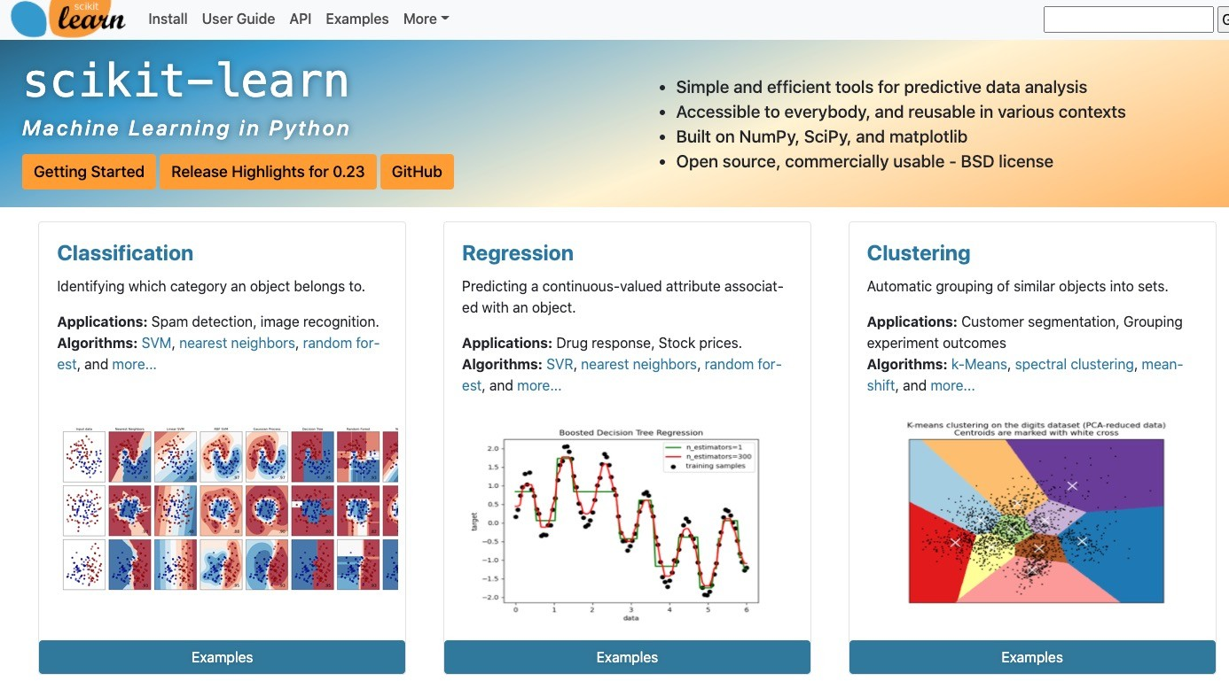
Training Your Own Classifier: sklearn

Slide 57
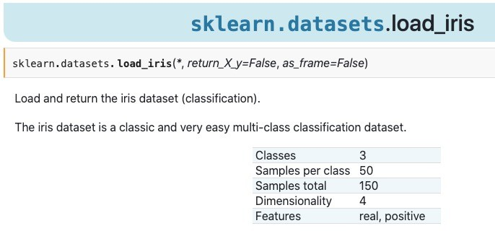
Training Your Own Classifier: sklearn
Sklearn also comes with datasets!

Slide 58
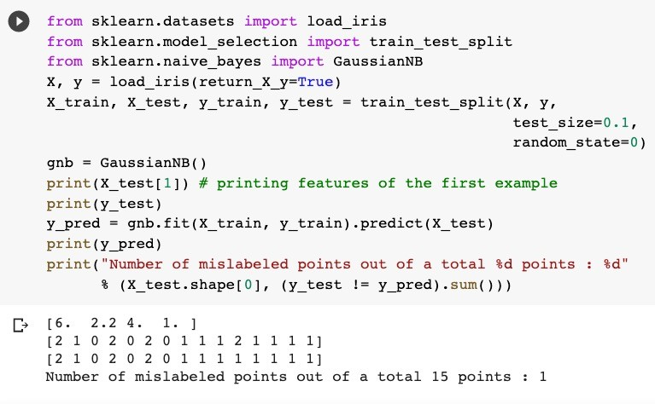
Training Your Own Classifier: sklearn
Splitting into train & test
train
inference

