Slide 1
NLP 220 Data Science and Machine Learning Fundamentals
Fall 2023 Lecture 4 Jalal Mahmud
Including slides adapted from Marilyn Walker, Dan Jurafsky, Mu Li and Alex Smola

Slide 2
Outline for Today
Naïve Bayes Classification
Decision Trees
Support Vector Machines
Optional Readings:
http://web.mit.edu/zoya/www/SVM.pdf
https://www.di.ens.fr/~mallat/papiers/svmtutorial.pdf

Slide 3
Naïve Bayes Intuition
Simple (“naïve”) classification method based on Bayes rule
Relies on very simple representation of document: Bag of words
it 6
I 5
the 4
to 3
and 3
seen 2
yet 1
would 1
whimsical 1
times 1
sweet 1
satirical 1
adventure 1
genre 1
fairy 1
humor 1
have 1
great 1
… …
I love this movie! It's sweet, but with satirical humor. The dialogue is great and the adventure scenes are fun... It manages to be whimsical and romantic while laughing at the conventions of the fairy tale genre. I would recommend it to just about anyone. I've seen it several times, and I'm always happy to see it again whenever I have a friend who hasn't seen it yet!
fairy
it and
always love_{to} ^{it} whimsical it
I
seen
are
anyone
friend
happy
dialogue
adventure
recommend
satirical
_{who}sweet of _{movie}
it I
it ^{I} but ^{to} romantic
several
yet it
again
the
humor
the
seen
would
to scenes I
the manages
fun ^{the} times _{and}
I
and
about
whenever
have
while
conventions with

Slide 4


Naïve Bayes Intuition (cont.)
The bag of words representation
seen | 2
sweet | 1
whimsical | 1
recommend | 1
happy | 1
... | ...
f(
)=c

Slide 5
Bayes’ Rule Applied to Documents and Classes
For a document d and a class c
_{P(c | d) =} P(d | c)P(c)
P(d)

Slide 6





Naïve Bayes Classifier (I)
c_{MAP} = argmax P(c | d)
MAP is “maximum a posteriori” = most likely class
c∈C
P(d | c)P(c)
= argmax
c∈C
Bayes Rule
P(d)
= argmax P(d | c)P(c)
c∈C
Dropping the denominator

Slide 7


Naïve Bayes Classiﬁer (II)
c_{MAP} = argmax P(d | c)P(c)
c∈C
= argmax P(x₁, x₂,…, x_{n} | c)P(c)
c∈C
Document d represented as features x1..xn

Slide 8

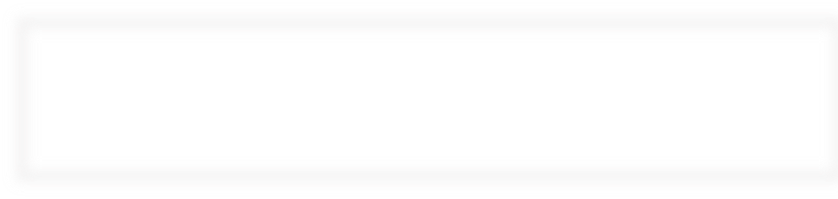


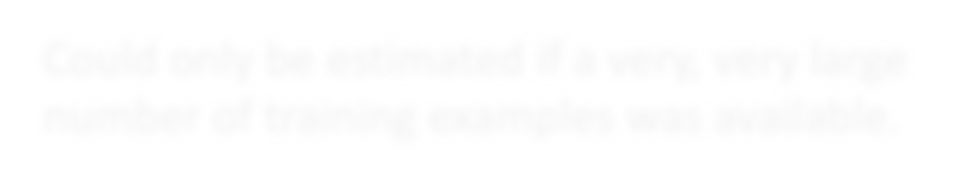
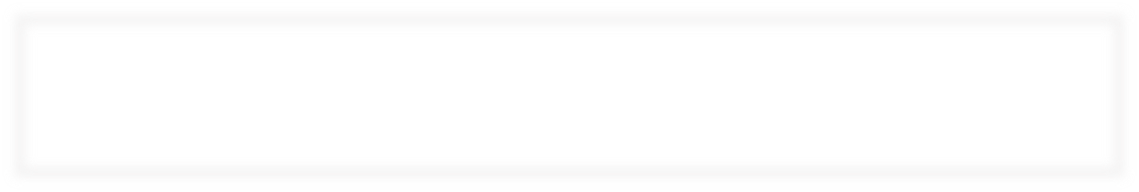
Naïve Bayes Classifier (III)
c_{MAP} = argmax P(x₁, x₂,…, x_{n} | c)P(c)
c∈C
How often does this class occur?
We can just count the relative frequencies in a corpus
O(|X|^{n}•|C|) parameters
Could only be estimated if a very, very large number of training examples was available.

Slide 9
Multinomial Naïve Bayes Independence Assumptions
P(x₁, x₂,…, x_{n} | c)
P(x₁,x₂,…,x_{n} | c) = P(x₁ | c) • P(x₂ | x₁,c)• … • P(x_{n} | x₁, x₂, …,x_{n-1},c)
Bag of Words assumption: Position doesn’t matter
Conditional Independence: Assume the feature probabilities
P(x_{i}|c_{j}) are independent given the class c.
P(x₁,…, x_{n} | c) = P(x₁ | c)• P(x₂ | c)• P(x₃ | c)•... • P(x_{n} | c)

Slide 10
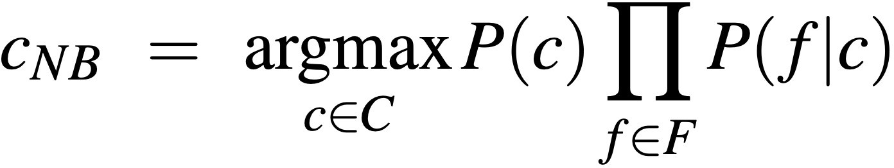
Multinomial Naïve Bayes Classifier
c_{MAP} = argmax P(x₁, x₂,…, x_{n} | c)P(c)
c∈C

Slide 11
Applying Multinomial Naive Bayes Classiﬁers to Text Classiﬁcation
positions ¬ all word positions in test document
∏
c_{NB} = argmax P(c_{j} )
P(x_{i} | c_{j} )
c_{j}∈C
i∈ positions

Slide 12
Learning the Multinomial Naïve Bayes Model
First attempt: maximum likelihood estimates
simply use the frequencies in the data
Counting!
doccount(C = c )
ˆ
j
P(c ) =
j
N
doc
count(w_{i}, c_{j} )
P^{ˆ}(w_{i} | c_{j} ) =
∑ count(w, c )
j
w∈V

Slide 13
Parameter estimation
count(w_{i}, c_{j} )
fraction of times word w_{i} appears among all words in documents of topic c_{j}
P^{ˆ}(w_{i} | c_{j} ) =
∑ count(w, c )
j
w∈V
Create mega-document for topic j by concatenating all docs in this topic
Use frequency of w in mega-document

Slide 14
Problem with Maximum Likelihood
What if we have seen no training documents with the word fantastic
and classiﬁed in the topic positive (thumbs-up)?
Zero probabilities cannot be conditioned away, no matter the other evidence!
count("fantastic", positive)
P^{ˆ}("fantastic" positive) =
∑ count(w, positive)
w∈V
= 0
c_{MAP} = argmax_{c} P^{ˆ}(c)∏ P^{ˆ}(x_{i} | c)
i

Slide 15
Laplace (add-1) smoothing for Naïve Bayes
No more zero probabilities!
count(w_{i}, c)
count(w_{i}, c) +1
P^{ˆ}(w | c) =
∑ (count(w, c))
w∈V
P^{ˆ}(w | c) =
∑ (count(w, c) +1)
w∈V
i
i
count(w_{i}, c) +1
=
# &
% ∑ count(w, c)₍ + V
∃w∈V
′

Slide 16
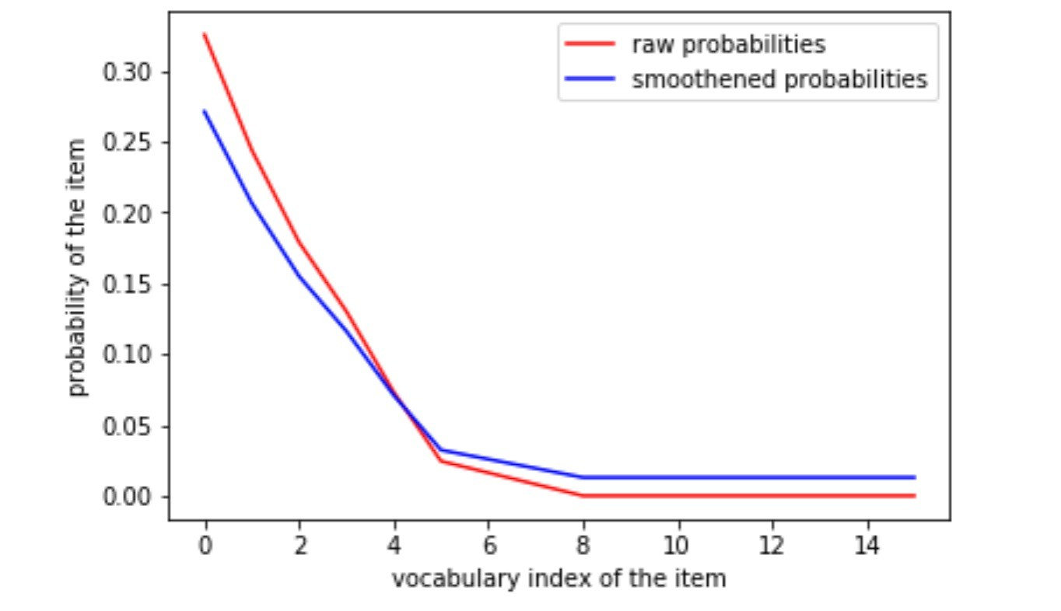
Laplace (add-1) smoothing for Naïve Bayes (Depiction)
Non-zero probabilities after smoothing.
* Items (samples) are sorted in order of decreasing probability
Zero probabilities

Slide 17
Multinomial Naïve Bayes: Learning
From the training corpus, extract Vocabulary
Calculate P(c_{j}) terms
For each c_{j} in C do
docs_{j} ¬ all docs with class =c_{j}
| docs_{j} |
P(c ) ←
j
| total # documents|
Calculate P(w_{k} | c_{j}) terms
Text_{j} ¬ single doc containing all docs_{j}
For each word w_{k} in Vocabulary
n_{k} ¬ # of occurrences of w_{k} in Text_{j}
n_{k} + α
P(w_{k} | c_{j} ) ←
Add ⍺
n + α | Vocabulary |

Slide 18
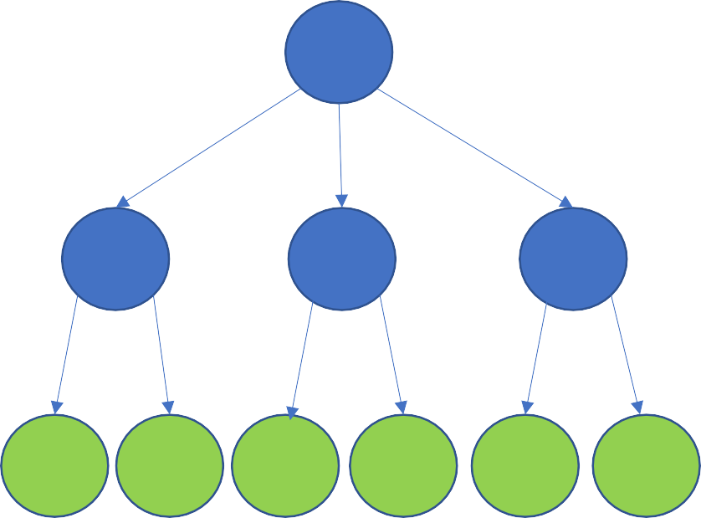
Decision Trees
Decision tree is a classifier in the form of a tree structure, where each node is either:
Decision node - specifies some test to be carried out on a single attribute-value, with one branch and sub-tree for each possible outcome of the test
Leaf node - indicates the value of the target attribute (class) of examples
A decision tree can be used to classify an example by starting at the root of the tree and moving through it until a leaf node, which provides the classification of the instance.

Slide 19
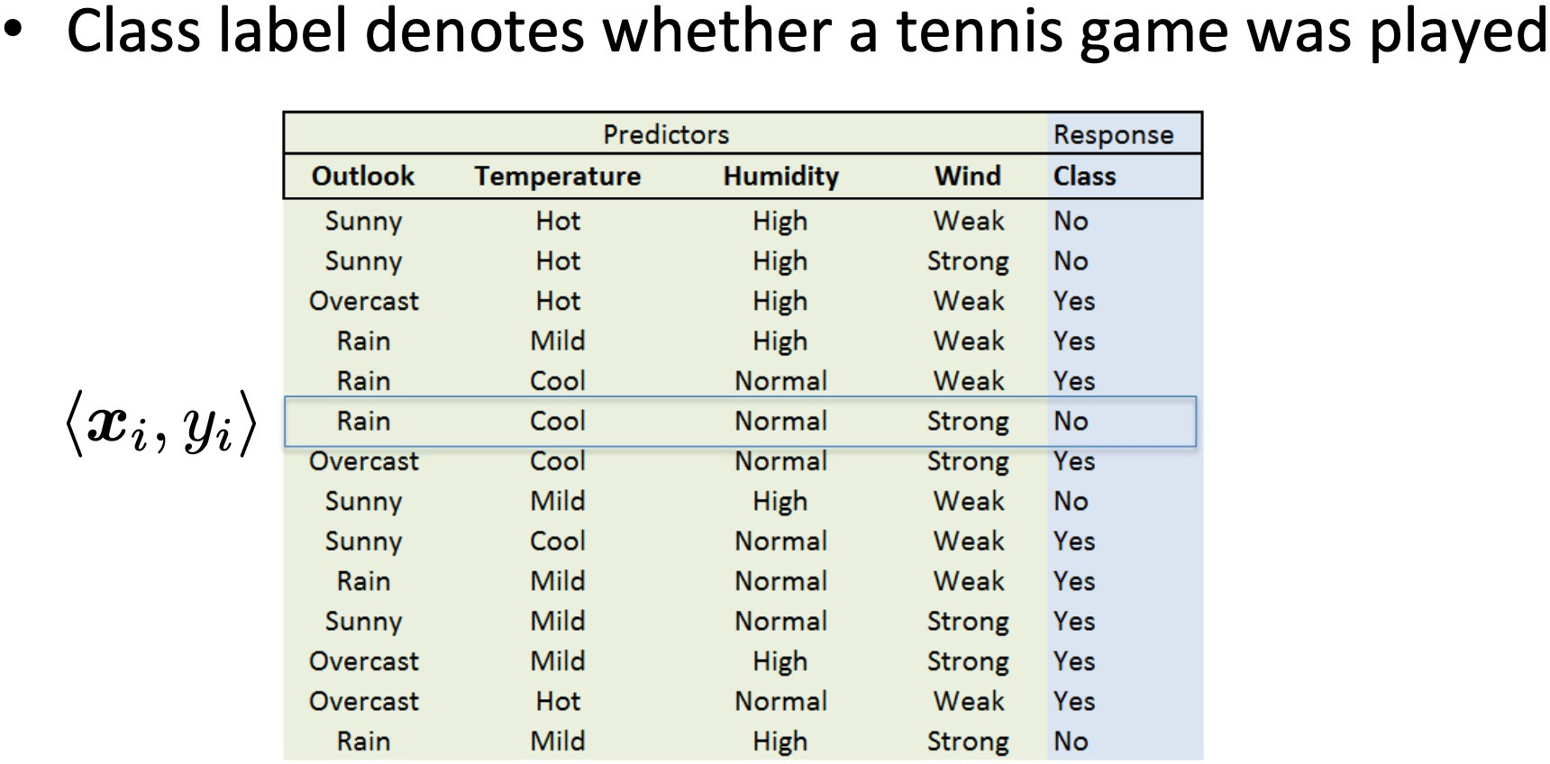
Decision Trees
Example from Eric Eaton, UPENN

Slide 20
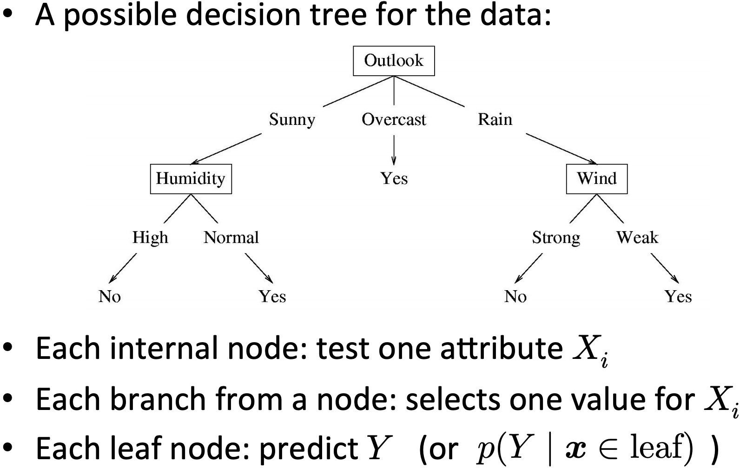
Decision Trees (Examples)
Example from Eric Eaton, UPENN

Slide 21
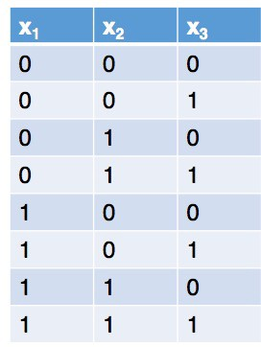
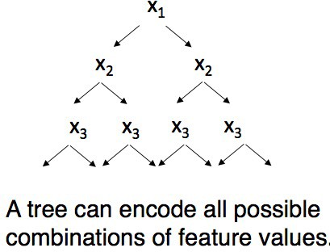
Decision Trees
Do you think decision tree learners explore all possible trees?

Slide 22
Decision Trees
Algorithm decides at each step what to split on next
Usually greedy

Slide 23















What are these classifiers doing?
An intuitive picture of the problem
f₂
Two features: f₁ and f₂ Two classes: + and - Depiction of all examples in the training set.
f₁

Slide 24
What classifier to use?
There may be a simple separator (e.g., a straight line in 2D or a hyperplane in general) or there may not
There may be “noise” of various kinds
There may be “overlap”
Some classifiers explicitly represent separators (e.g., straight lines), while for other classifiers the separation is done implicitly
Some classifiers just make a decision as to which class an object is in; others estimate class probabilities

Slide 25
Many different classification methods
Probabilistic models:
Naïve Bayes
Decision Models:
Decision Trees
Linear Models:
Support Vector Machine (SVM)
Linear regression
K-nearest neighbors
And many many more

Slide 26

















Linear versus non-linear algorithms
Linearly separable data: if all the data points can be correctly classified by a linear (hyperplanar) decision boundary
f₂
Two features: f₁ and f₂ Two classes: + and - Depiction of all examples in the training set.
f₁
Linear decision boundary

Slide 27




















Non-linearly separable data
f₂
Two features: f₁ and f₂ Two classes: + and - Depiction of all examples in the training set.
f₁
Set of linear classifiers

Slide 28
Non-linearly separable data
f₂
Two features: f₁ and f₂ Two classes: + and - Depiction of all examples in the training set.
f₁
Non-linear classifiers

Slide 29
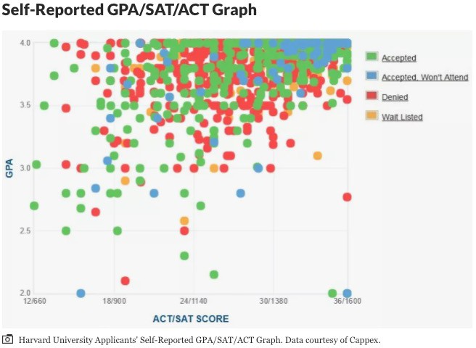
Example: College Admission
Plot from Thoughtco.com

Slide 30
Linear versus Non-linear algorithms
Linear or Non linear separable data?
We can find out empirically
Linear algorithms (algorithms that find a linear decision boundary)
When we think the data is linearly separable
Advantages
Simpler, less parameters
Disadvantages
High dimensional data (like for NLP) is usually not linearly separable
Example: Linear Regression, SVM
Note: we can use linear algorithms also for non linear problems

Slide 31
Linear versus Non-linear algorithms
Non-linear algorithms
When the data is non linearly separable
Advantages
More accurate
Disadvantages
More complicated, more parameters
Example: Decision Trees

Slide 32
Decision Trees
f₂
Two features: f₁ and f₂ Two classes: + and - Depiction of all examples in the training set.
f₁

Slide 33
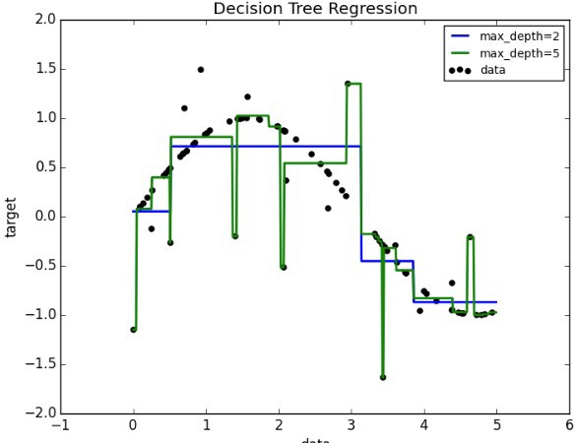
Decision tree can fit a nonlinear function

Slide 34
Building Decision Trees - Decision Stump
Decision tree with a single node
Decides how to classify examples with a single feature.
f <1200?
Which feature should be used?
Simplest solution:
Build a decision stump for each feature
Select according to accuracy on data
1
yes
no

Slide 35
Building Decision Trees
The central focus of the decision tree growing algorithm is selecting which attribute to test at each node in the tree. The goal is to select the attribute that is most useful for classifying examples.
Top-down, greedy search through the space of possible decision trees.
That is, it picks the best attribute and never looks back to reconsider earlier choices.

Slide 36
Building Decision Trees
Splitting criterion
Finding the features and the values to split on
for example, why test first “past tense” and not “negative emotion”?
Split that gives us the maximum information gain (or the
maximum reduction of uncertainty)
Stopping criterion
When all the elements at one node have the same class, no need to split further
In practice, one first builds a large tree and then one prunes it back (to avoid overfitting)

Slide 37
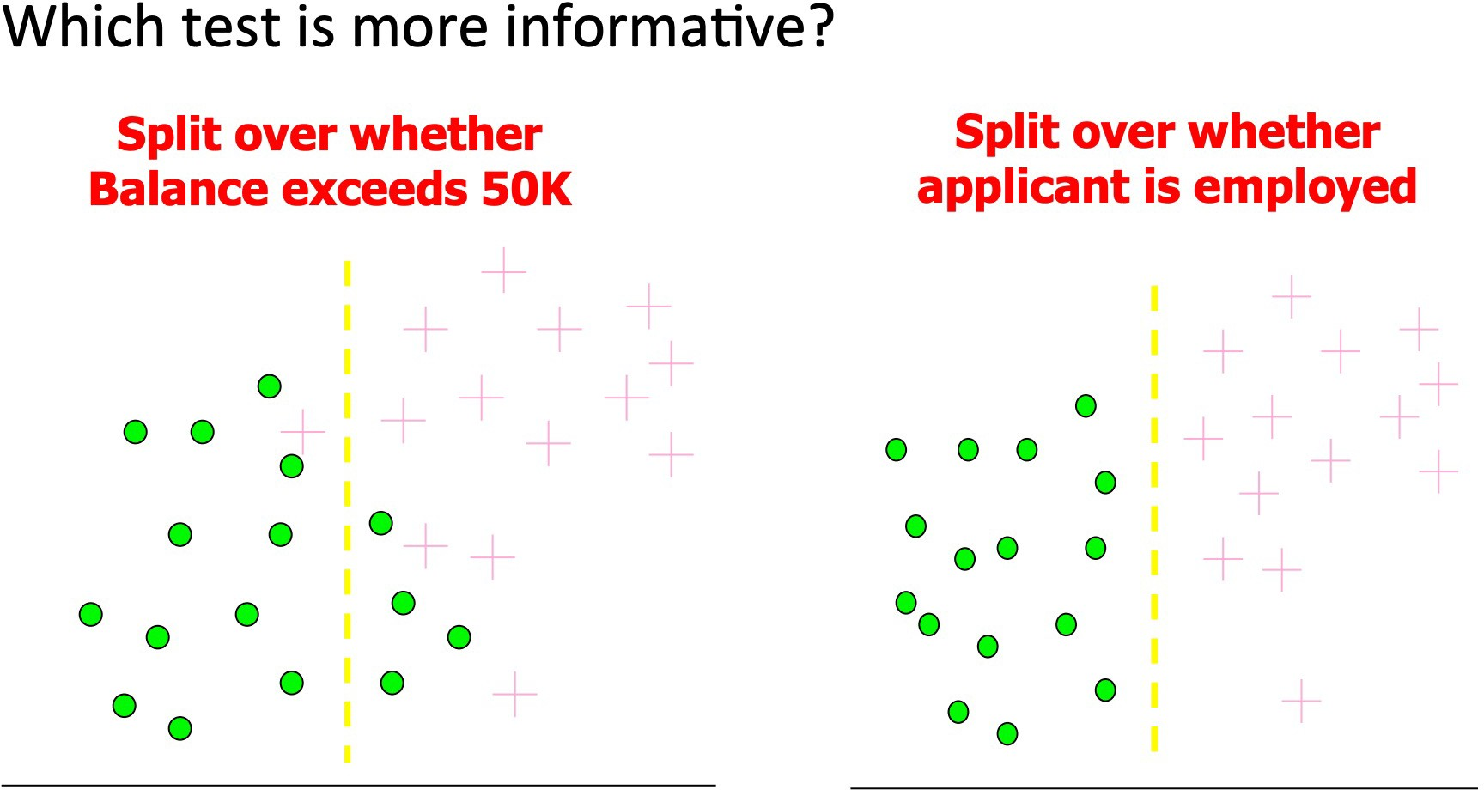
Information Gain
Imagine you need to determine who a bank can safely give credit to?
Based on slide by Pedro Domingos, UW.

Slide 38
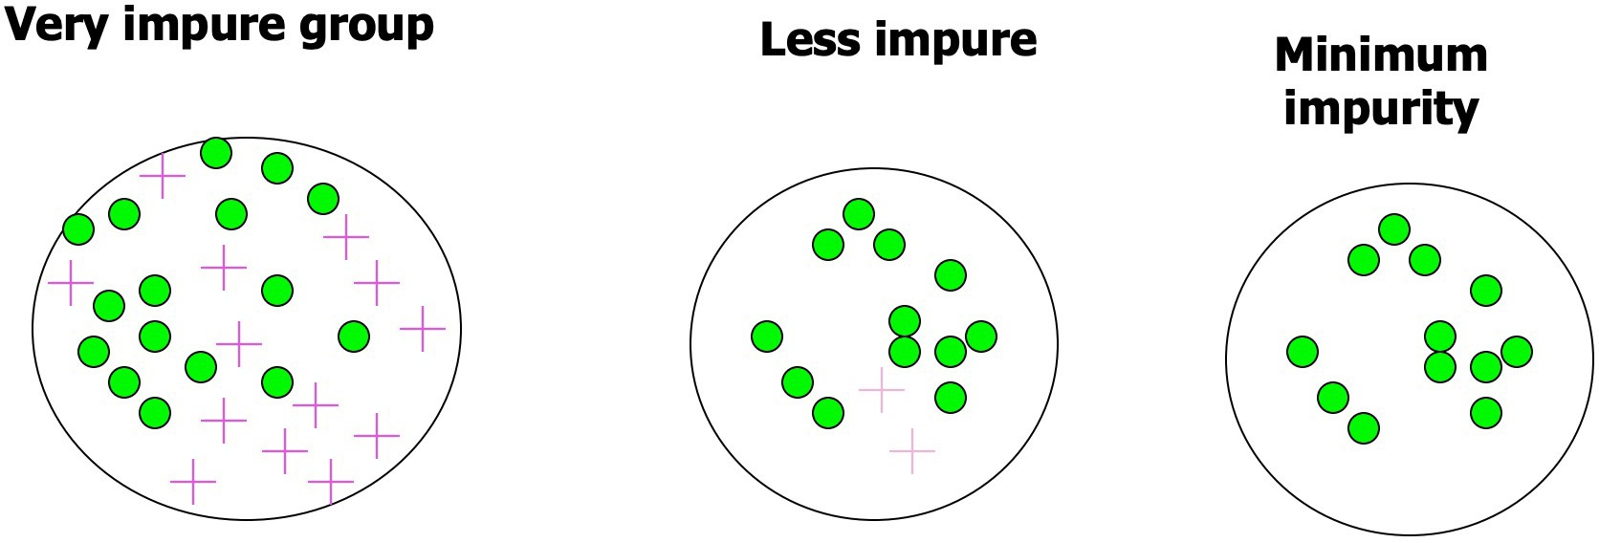
Impurity
Based on slide by Pedro Domingos, UW.

Slide 39
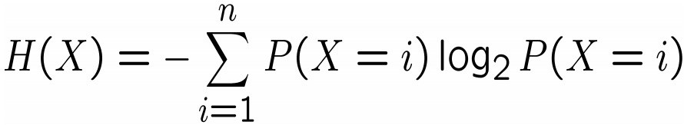
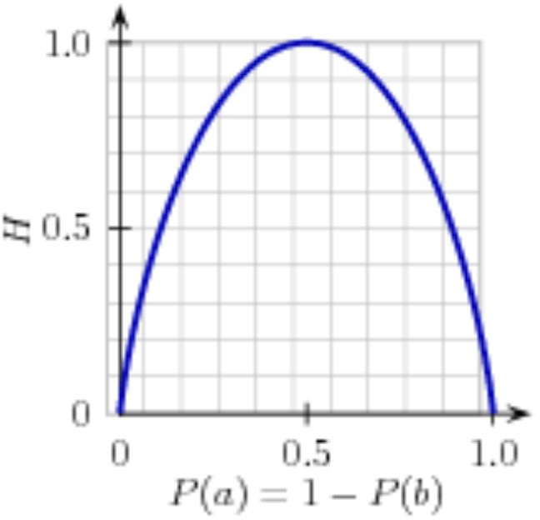
Entropy: A way to measure impurity
Entropy H(X) of a random variable X:
Binary Classification example, classes are a and b:
For a set of examples, P(a) is the proportion of examples of type a.

Slide 40
Entropy: A way to measure impurity
Entropy H(X) of a random variable X:
Binary Classification example, classes are a and b:
If P(a=0) => P(b) = 1
H(X) = -(0* log₂ 0 + 1 * log₂ 1) = 0
Same for P(a=1)! If P(a) = 0.5
H(X) = -(½ * log₂ ½ + ½ * log₂ ½ )
= 1 (½ * -1 + ½ * -1) = 1

Slide 41
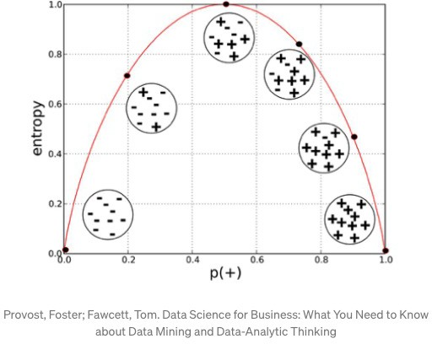
Entropy: A way to measure impurity
Entropy H(X) of a random variable X:

Slide 42
From entropy to information gain
How much more organized the labels become once we apply the decision stump?
We calculate the entropy for each of the decision stump's leaves, and take the average of those leaf entropy values (weighted by the number of samples in each leaf)
The information gain is then equal to the original entropy minus this new, reduced entropy.

Slide 43
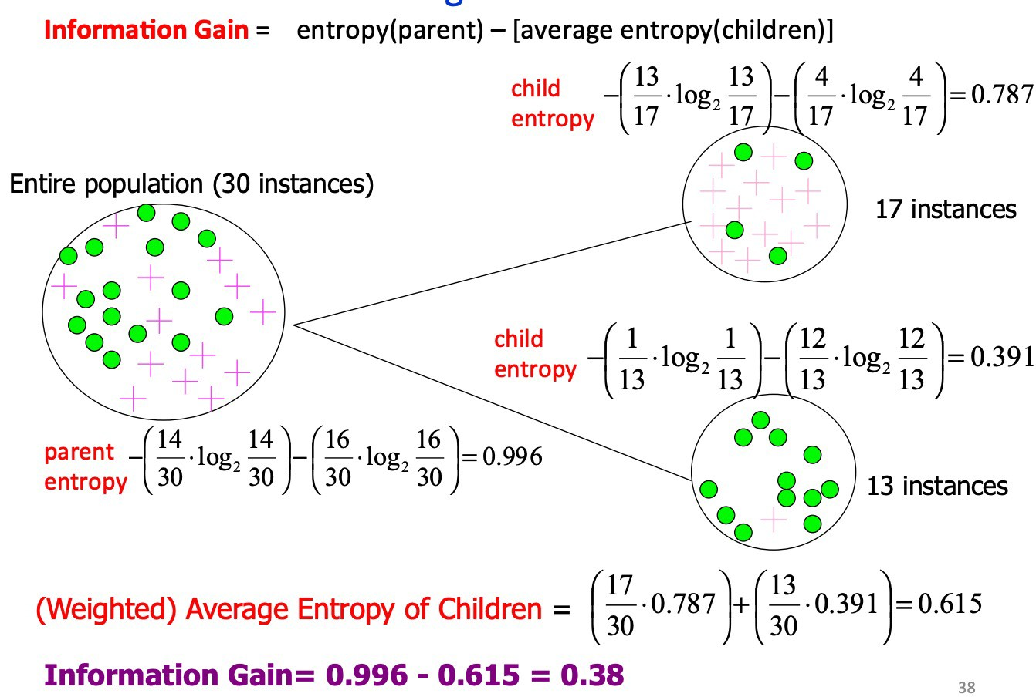
Calculating Information Gain
Based on slide by Pedro Domingos, UW.

Slide 44
Calculating Information Gain
Based on slide by Pedro Domingos, UW.

Slide 45
Impurity and Entropy
High Entropy
Medium Entropy
Low Entropy

Slide 46
Decision Trees: Strengths
Decision trees are able to generate understandable rules.
Decision trees perform classification without requiring much computation.
Decision trees are able to handle both continuous and categorical variables.
Decision trees provide a clear indication of which features are most important for prediction or classification.

Slide 47
Decision Trees: Weaknesses
Decision trees are prone to errors in classification problems with many classes and relatively small number of training examples.
Since each branch in the decision tree splits the training data, the amount of training data available to train nodes lower in the tree can become quite small.
Decision tree can be computationally expensive to train.
Need to compare all possible splits

Slide 48
Decision Trees: Weaknesses
Most decision-tree algorithms only examine a single field at a time. This leads to rectangular classification boxes that may not correspond well with the actual distribution of records in the decision space.
The fact that decision trees require that features be checked in a specific order limits their ability to exploit features that are relatively independent of one another.
Naive Bayes overcomes this limitation by allowing all features to act "in parallel."

Slide 49
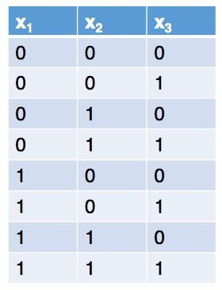
Decision trees can easily overfit
Two common techniques to avoid overfitting:
Restrict the maximum depth of the tree
Restrict the minimum number of instances that must be remaining before splitting further
If you stop creating a deeper tree before all instances at that node belong to the same class, use the majority class within that group as the final class for the leaf node.

Slide 50
Shallow Decision Tree
Shallow decision trees - trees that are too shallow might lead to overly simple models that can’t fit the data.
A model that is underfit will have high training and high testing error. Hence, bad performance on training and test sets indicates underfitting which means the set of hypotheses are not complex enough (decision trees that are shallow ) to include the true but unknown prediction function.
The shallower the tree the less variance we have in our predictions

Slide 51
Can we average the output of multiple decision trees?
Averaging out the predictions of multiple classifiers will drastically reduce the variance.
Averaging is not specific to decision trees; it can work with many different learning algorithms. But it works particularly well with decision trees.
Why averaging?
If two trees pick different features for the very first split at the top of the tree, then it’s quite common for the trees to be completely different.
So decision trees tend to have high variance. To fix this, we can reduce the variance of decision trees by taking an average answer of a bunch of decision trees.

Slide 52
Pruning a Decision Tree
The reason for pruning is that the trees prepared by the base algorithm can be prone to overfitting as they become incredibly large and complex.
Pruning is a technique in machine learning and search algorithms that reduces the size of decision trees by removing sections of the tree that provide little power to classify instances.
Pruning reduces the complexity of the final classifier, and hence improves predictive accuracy by the reduction of overfitting.

Slide 53
High Variance
A model has high variance if it is very sensitive to (small) changes in the training data.
Decision trees are generally unstable considering that a small change in the data set can result in a very different set of splits. This results in high variance.
This is mainly due to the hierarchical nature of decision trees, since a change in split points in the initial stages will affect all the subsequent splits.

Slide 54
Support Vector Machines

Slide 55
Support Vector Machines
Data: <x_{i},y_{i}>, i=1,..,|D|
x_{i} Ε R^{d}
y_{i} Ε {-1,+1}
f(x)
=-1
=+1
All hyperplanes in R^{d} are parameterized by a vector (w) and a constant b (bias). Hence, they can be expressed as w•x+b=0 (remember the equation for a hyperplane from algebra!)
Our aim is to find such a hyperplane f(x)=sign(w•x+b), that can correctly classify our data.

Slide 56


Support Vector Machines (SVM)
Another family of linear algorithms
Intuition (Vapnik, 1965)
If the classes are linearly separable:
Separate the data
Place hyper-plane “far” from the data:
large margin
Statistical results guarantee good generalization
BAD
From Gert Lanckriet, Statistical Learning Theory Tutorial

Slide 57
SVM: Large margin classifier
Another family of linear algorithms
Intuition (Vapnik, 1965)
If the classes are linearly separable:
Separate the data
Place hyper-plane “far” from the data:
large margin
Statistical results guarantee good generalization
GOOD
➔ Maximal Margin Classifier
From Gert Lanckriet, Statistical Learning Theory Tutorial

Slide 58
SVM: Large margin classifier
If not linearly separable
Allow some errors
Still, try to place hyperplane “far”
from each class
From Gert Lanckriet, Statistical Learning Theory Tutorial

Slide 59
SVM: Large Margin Classifiers
Advantages
Theoretically better (better error bounds)
Limitations
Computationally more expensive, large quadratic programming

Slide 60
So, what if it’s a non-linear problem?
f₂
Two features: f₁ and f₂ Two classes: + and - Depiction of all examples in the training set.
f₁
Set of linear classifiers

Slide 61
So, what if it’s a non-linear problem?
f₂
Two features: f₁ and f₂ Two classes: + and - Depiction of all examples in the training set.
f₁
Non-linear classifiers

Slide 62






So, what if it’s a non-linear problem?
=-1
=+1
What if the decision function is not a linear?
Slide from Pierre Dönnes.

Slide 63
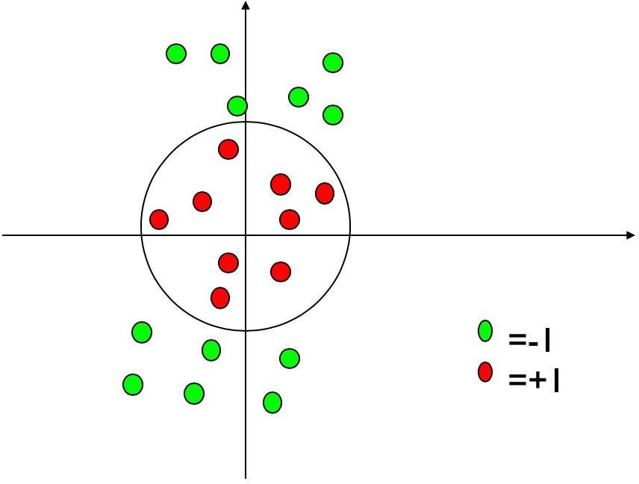
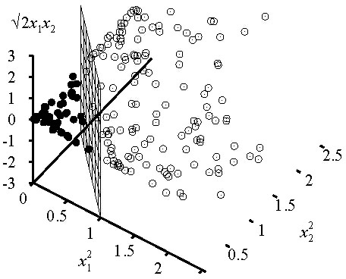
Kernel Trick
General idea: The original feature space can always be mapped to some higher-dimensional feature space where the training set is separable.
Φ: x → φ(x)
Slide from Pierre Dönnes.

Slide 64
So, what if it’s a non-linear problem?
Kernel methods: A family of non-linear algorithms
Transform the non linear problem in a linear one (in a different feature space)
Use linear algorithms to solve the linear problem in the new space
There are SVM learners in Scikit-Learn that have a kernel that does this kind of transform
http://scikit-learn.org/stable/modules/svm.html - svm-kernels
classifier = SklearnClassifier(svm.SVC()).train(train_sets)
class sklearn.svm.SVC(C=1.0, kernel=’rbf’, degree=3, gamma=’auto’, coef0=0.0, shrinking=True, probability=False, tol=0.001, cache_size=200, class_weight=None, verbose=False, max_iter=-1, decision_function_shape=’ovr’, random_state=None)
From Gert Lanckriet, Statistical Learning Theory Tutorial

Slide 65
Evaluation – F1-measure
Harmonic mean of recall and precision
For example, for the example utterance:
What movies has Tom Cruise has been in recently
If the classifier returns: movie.starring.actor, movie.genre, and movie.directed_by
TARGET SET
RETURNED SET
True Positives = {movie.starring.actor}
False Positives = {movie.directed_by,
movie_genre}
False Negatives = {movie.initial_release_date}
Movie. starring
.actor
Movie. Directed_by
Movie. Initial_release_date
Movie.genre

Slide 66
Evaluation – F1-measure (cont.)
In NLP we are always dealing with these kinds of errors.
Reducing the error rate for an application often involves two antagonistic efforts:
Increasing precision (minimizing false positives)
Increasing recall (minimizing false negatives)
Precision = TP / TP + FP
Recall = TP / TP + FN
F1 = (2 X Precision X Recall) / (Precision + Recall)

Slide 67
Evaluation – F1-measure (cont.)
Recall = ½ = 0.50 Precision = 1/3 = 0.33 F1 = 0.40
TARGET SET
RETURNED SET
True Positives = {movie.starring.actor}
False Positives = {movie.directed_by,
movie_genre}
False Negatives = {movie.initial_release_date}
Movie. starring
.actor
Movie. Directed_by
Movie. Initial_release_date
Movie.genre

