Slide 1

EA-MT
Entity-Aware Machine Translation in English to Chinese
Team4 Jou-Yi Lee 2024/12/2

Slide 2
Contents
6 – EA-MT
Evaluation Flowchart
1 – Introduction
2 – IWSLT En-Zh Dataset
7 – METEOR
3 – EA-MT Flowchart
8 – HIT-CIR (Tongyici Cilin 同義詞詞林)
WordSimilarity Dataset
4 – NER - SpaCy
9 – OpenHowNet
5 – mBART
10 – Evaluation Results

Slide 3
PART.01
Introduction
EA-MT : Entity-Aware Machine Translation English to Chinese

Slide 4
Introduction Section
Challenges in NER
Study Focus
Objective
Contextual Ambiguity :
Apple (Fruit? Or Company?)
Multi-word Entities:
literal translations often produce awkward outputs.
Department of Justice 司法部
Cross-lingual Consistency :
Entities can have multiple valid translations
IWSLT 2017 NER Translation Task
SpaCy for NER
mBART
Integrates these entities into a machine translation model
Enhance Translation Accuracy
Named Entity Translation Model
Maintain context and semantic accuracy when doing cross-lingual machine translation jobs.

Slide 5
点击输入您的标题
输入标题
输入替换内容58pic.com输入替换内容58pic.com
输入标题
输入替换内容58pic.com输入替换内容58pic.com
输入标题
输入替换内容58pic.com输入替换内容58pic.com
输入标题
输入替换内容58pic.com输入替换内容58pic.com

Slide 6
点击输入您的标题
输入标题
输入标题
输入替换内容58pic.com输入替换内容58pic.com输入替换内容58pic.com输入替换内容58pic.com
输入替换内容58pic.com输入替换内容58pic.com输入替换内容58pic.com输入替换内容58pic.com
输入标题
输入标题
输入替换内容58pic.com输入替换内容58pic.com输入替换内容58pic.com输入替换内容58pic.com
输入替换内容58pic.com输入替换内容58pic.com输入替换内容58pic.com输入替换内容58pic.com

Slide 7
点击输入您的标题
小标题
输入替换内容58pic.com输入替换内容58pic.com
小标题
小标题
输入替换内容58pic.com输入替换内容58pic.com
输入替换内容58pic.com输入替换内容58pic.com
小标题
小标题
输入替换内容58pic.com输入替换内容58pic.com
输入替换内容58pic.com输入替换内容58pic.com

Slide 8
PART.02
IWSLT En-Zh Dataset

Slide 9
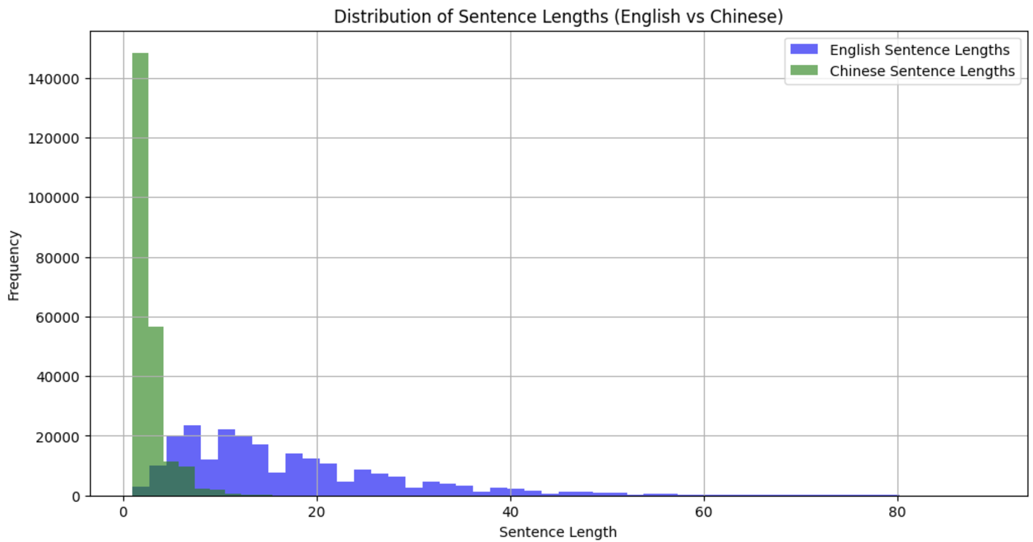
IWSLT
IWSLT 2017 En-Zh
IWSLT is Real-World conversation dataset.
English sentences are longer than Chinese sentences.
The Chinese language is character-based.

Slide 10
Linguistic Structural Differences
Character-Based vs. Word-Based
Word Order and Syntax
Chinese uses characters as the smallest semantic units.
English follows a strict Subject-Verb-Object (SVO)
Chinese allows flexible structures.
Example:
[The dog is on the mat.]
(6 English words)
[狗在墊子上]
(5 Chinese characters)
Example:
[I like this book]
Standard Chinese
[我喜歡這本書]
Emphasis:
[這本書，我喜歡]
These will cause inaccuracies in translaation

Slide 11


Word Cloud Analysis
Common function words
(e.g., "the," "and," "to ,"of")
High-frequency tokens
(“的,”“是,”“我,“)
Conform to Zipf's Law

Slide 12
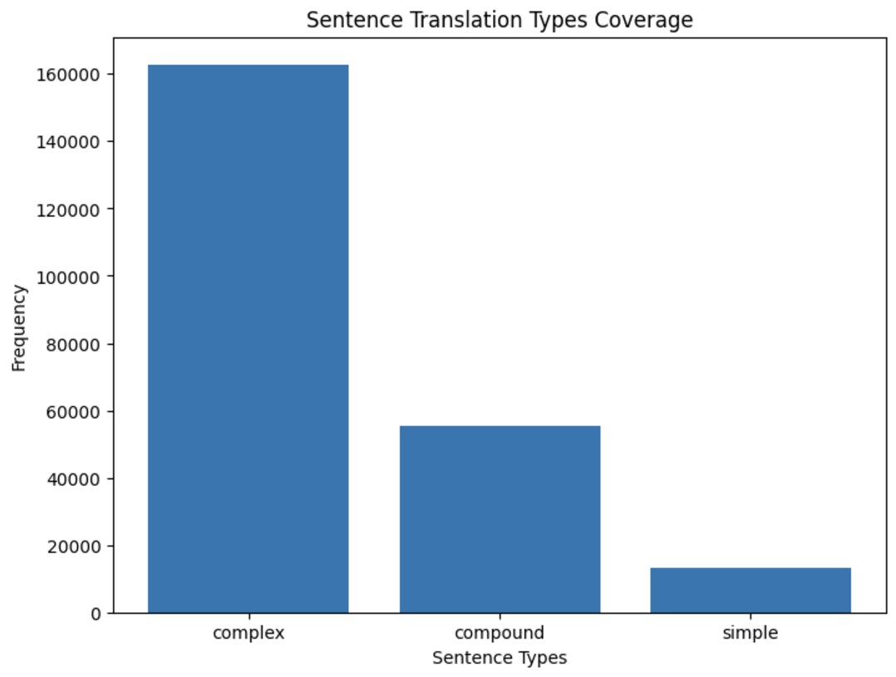
Sentence Type Analysis
Complex Sentences:
Have “because,” “although”
Compound Sentences:
Have "and" or "but
Implications for Machine Translation
Character-Based vs. Word-Based
Word Order and Syntax
Zipf's Law
Different Sentences Type

Slide 13
PART.03
EA-MT Flowchart
Entity-Aware Machine Translation Flowchart

Slide 14
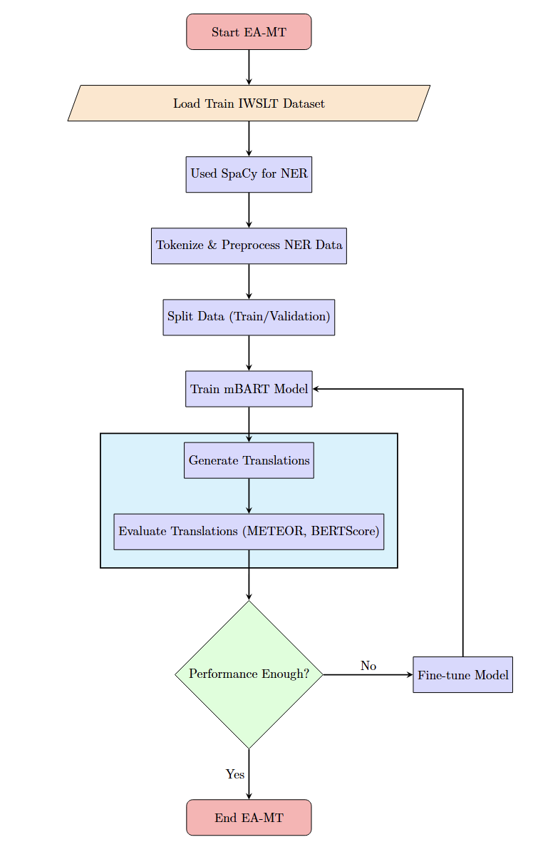
EA-MT Flowchart

Slide 15
PART.04
NER - SpaCy
Named Entity Recognition using

Slide 16
PART.05
EA-MT Flowchart
Entity-Aware Machine Translation Flowchart

Slide 17
PART.06
EA-MT Flowchart
Entity-Aware Machine Translation Flowchart

Slide 18
PART.07
EA-MT Flowchart
Entity-Aware Machine Translation Flowchart

Slide 19
PART.08
EA-MT Flowchart
Entity-Aware Machine Translation Flowchart

Slide 20
PART.09
EA-MT Flowchart
Entity-Aware Machine Translation Flowchart

Slide 21
PART.10
EA-MT Flowchart
Entity-Aware Machine Translation Flowchart

Slide 22
点击输入您的标题
输入替换内容58pic.com输入替换内容58pic.com
小标题
小标题
输入替换内容58pic.com输入替换内容58pic.com输入替换内容58pic.com输入替换内容58pic.com输入替换内容58pic.com输入替换内容58pic.com输入替换内容58pic.com输入替换内容58pic.com输入替换内容58pic.com输入替换内容58pic.com输入替换内容58pic.com输入替换内容58pic.com

Slide 23
点击输入您的标题
小标题
4
输入替换内容58pic.com输入替换内容58pic.com
小标题
5
输入替换内容58pic.com输入替换内容58pic.com
小标题
1
6
小标题
输入替换内容58pic.com输入替换内容58pic.com
输入替换内容58pic.com输入替换内容58pic.com
小标题
2
输入替换内容58pic.com输入替换内容58pic.com
小标题
3
输入替换内容58pic.com输入替换内容58pic.com

Slide 24
点击输入您的标题
请小标题
输入替换内容58pic.com输入替换内容58pic.com
小标题
输入替换内容58pic.com输入替换内容58pic.com
小标题
输入替换内容58pic.com输入替换内容58pic.com
小标题
输入替换内容58pic.com输入替换内容58pic.com

Slide 25
点击输入您的标题
小标题
小标题
输入替换内容58pic.com输入替换内容58pic.com
输入替换内容58pic.com输入替换内容58pic.com
小标题
输入替换内容58pic.com输入替换内容58pic.com
输入替换内容58pic.com输入替换内容58pic.com
小标题
小标题

Slide 26
PART.04
点击输入标题
I love you more than I've ever loved any woman. And I've waited longer for you than I've waited for any woman.

Slide 27
点击输入您的标题
输入替换内容58pic.com输入替换内容58pic.com
输入替换内容58pic.com输入替换内容58pic.com
输入替换内容58pic.com输入替换内容58pic.com输入替换内容58pic.com输入替换内容58pic.com
输入替换内容58pic.com输入替换内容58pic.com
输入替换内容58pic.com输入替换内容58pic.com

Slide 28
点击输入您的标题
小标题
小标题
输入替换内容58pic.com输入替换内容58pic.com
输入替换内容58pic.com输入替换内容58pic.com
小标题
小标题
输入替换内容58pic.com输入替换内容58pic.com
输入替换内容58pic.com输入替换内容58pic.com

Slide 29
点击输入您的标题
输入替换内容58pic.com输入替换内容58pic.com
小标题设
小标题
输入替换内容58pic.com输入替换内容58pic.com
输入替换内容58pic.com输入替换内容58pic.com
小标题
小标题
输入替换内容58pic.com输入替换内容58pic.com
输入替换内容58pic.com输入替换内容58pic.com

Slide 30
点击输入您的标题
小标题
小标题
输入替换内容58pic.com输入替换内容58pic.com
输入替换内容58pic.com输入替换内容58pic.com
小标题
小标题
输入替换内容58pic.com输入替换内容58pic.com
输入替换内容58pic.com输入替换内容58pic.com
小标题
小标题
输入替换内容58pic.com输入替换内容58pic.com
输入替换内容58pic.com输入替换内容58pic.com
55
70
85
40
60
80
Please replace text, click add relevant headline, modify the text content, also can copy your content to this directly.Please replace text, click add relevant headline, modify the text content, also can copy your content to this directly.。

Slide 31
WRITE A TITLE IN THIS SECTION
非常感谢您的观看
By faith I mean a vision of good one cherishes and the enthusiasm that pushes one to seek its fulfillment regardless of obstacles. By faith I By faith I mean a vision of good one cherishes and the enthusiasm
汇报人： 千图网 汇报时间：XX年XX月

Slide 32
版权声明
感谢您支持原创设计事业，支持设计版权产品！
感谢您下载千图网原创PPT模板，为了您和千图网以及原创作者的利益，请勿复制、传播、销售，否则将承担法律责任！
千图网将对作品进行维权，按照传播下载次数的十倍进行索取赔偿金！
1、千图网网站出售的PPT模版是免版税类（RF：Royalty-free）正版受《中华人民共和国著作法》和《世界版权公约》的保护，作品的所有权、版权和著作权归千图网所有，您下载的是PPT模版素材使用权。
2、不得将千图网的PPT模版、PPT素材，本身用于再出售，或者出租、出借、转让、分销、发布或者作为礼物供他人使用，不得转授权、出卖、转让本协议或本协议中的权利。
3、禁止把作品纳入商标或服务标记。
4、禁止用户用下载格式在网上传播作品。或者作品可以让第三方单独付费或共享免费下载、或通过转移电话服务系统传播。

