Slide 1
Using clustering method to find the most convenient place for a fiend to live in Toronto
Zuyu Yang
2021.03.09

Slide 2
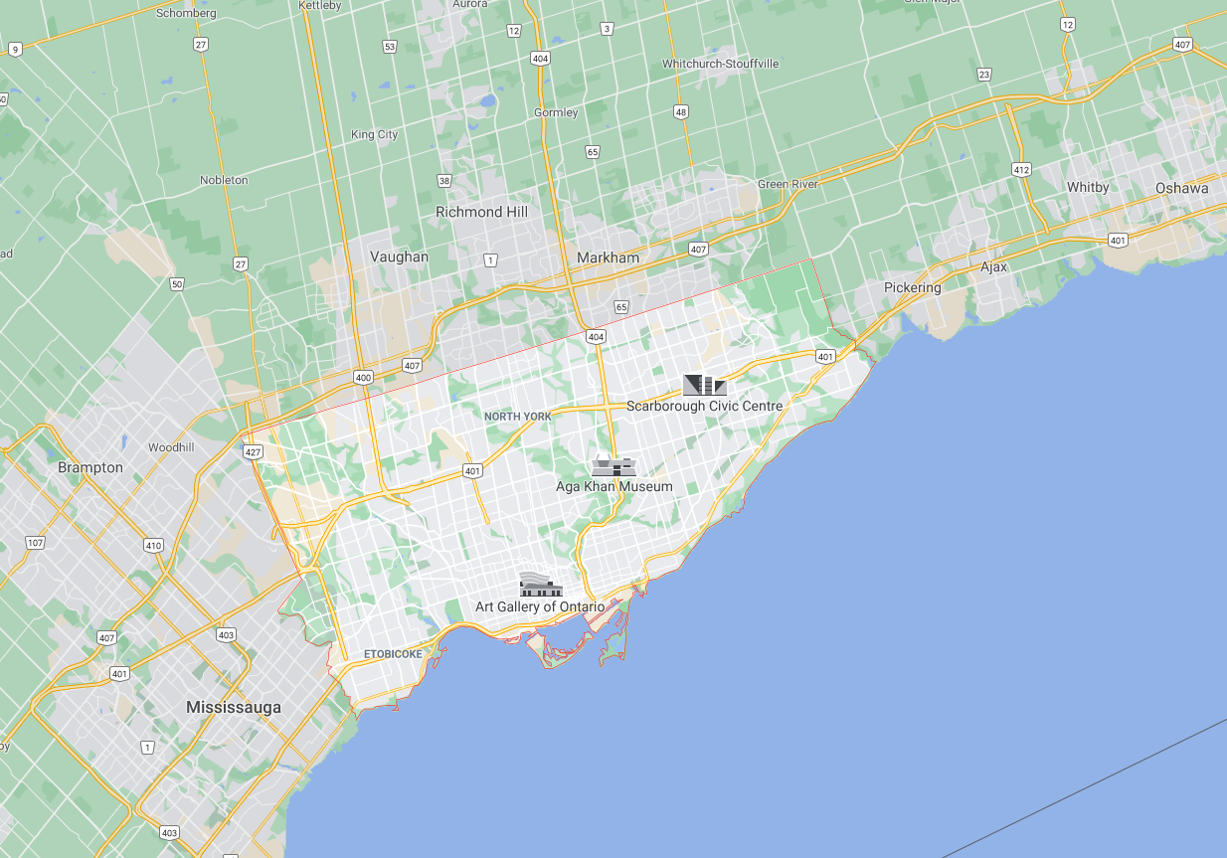
Background
One of my friends named Lin who will relocate from BeiJing to Toronto.
She is asking my suggestion where is the most convenient for her to live. Lin likes doing exercise and enjoys going out for dinner.
So the regions that she prefers to live needs to be close to gyms, parks, as well as restaurant.

Slide 3
Question
Which region in Toronto is most close to gyms, parks, as well as restaurant.

Slide 4
Methods
library BeautifulSoup to scrape the list of neighbourhoods of Toronto Wikipedia.
Each neighbourhood's coordinates were retrieved using Geocoder.
Retrieve the list of venues for each neighbourhood from FoursquareAPI.
K-means algorithm to perform the clustering analysis after dataset combined and cleaned.
The neighbourhoods were displayed with different colors on a map using Folium.
Look detail of each cluster and find the regions that match Lin's requirement for setting her new home.

Slide 5
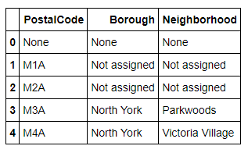
Results
Scrape the list of neighbourhoods
The Wikipedia page contains a table of postal codes followed in Toronto, along with the boroughs and neighborhoods in Toronto city. I used the library BeautifulSoup to scrape the list of neighbourhoods of Toronto Wikipedia

Slide 6
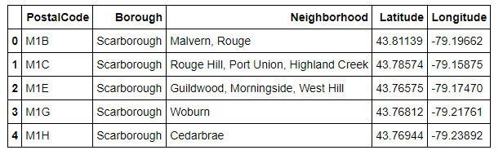
Results
Combine the latitude and the longitude coordinates of each neighbourhood
Each neighbourhood's coordinates were retrieved using Geocoder. Merge the coordinates dataframe with the original neighbourhoods dataframe. With the head() function, the data in the form of table now looks like this:

Slide 7
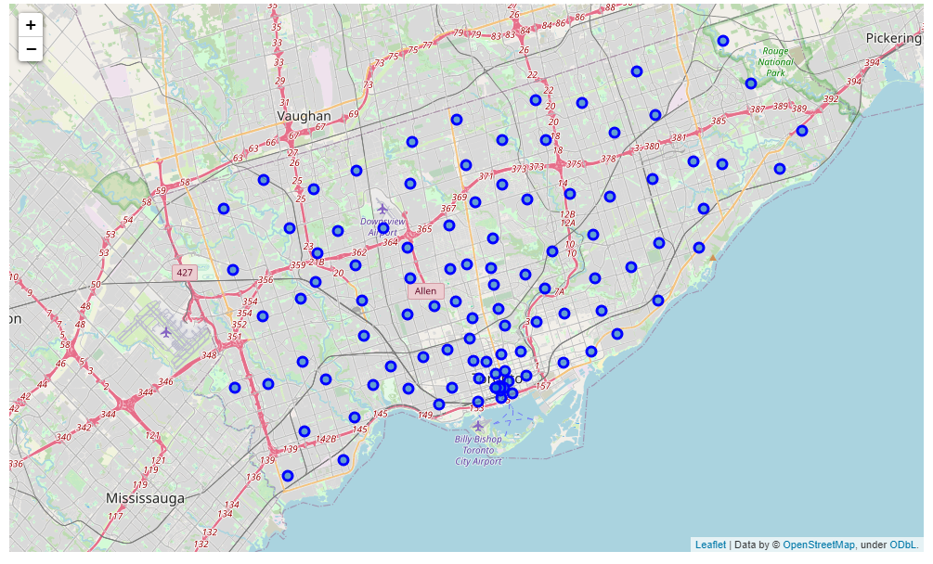
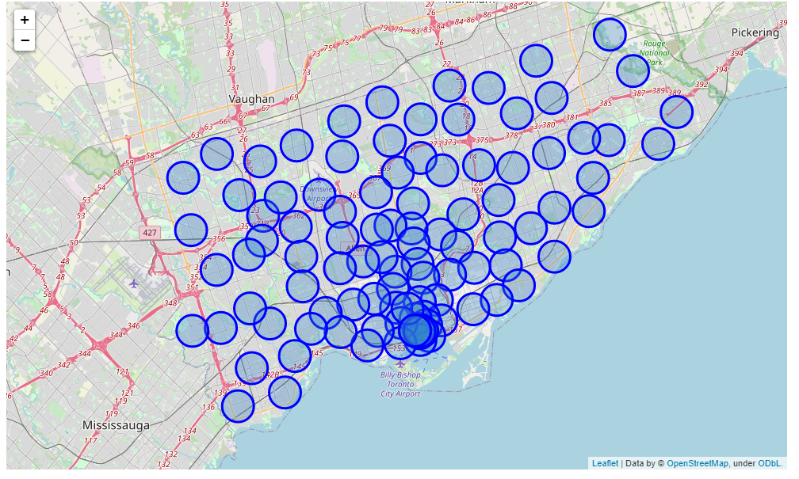
Results
Draw the city of Toronto with the neighbourhoods from the dataframe: create map of Toronto using latitude and longitude values and add markers to map:

Slide 8
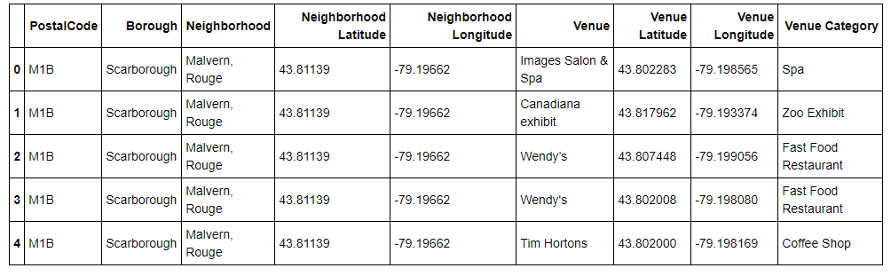
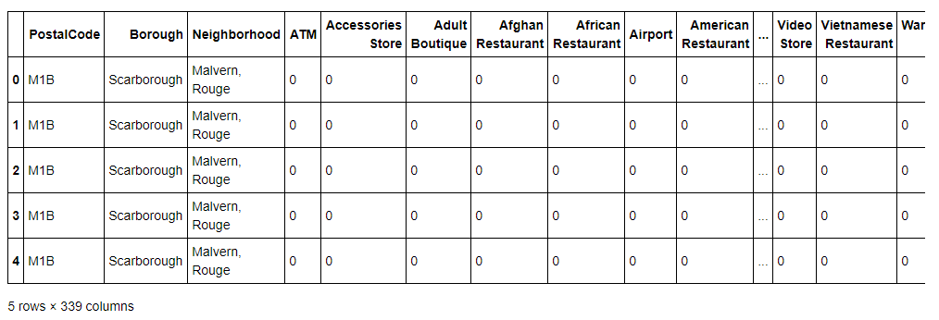
Results
Get the venues in Toronto, using FoursquareAPI: Retrieve the list of venues for each neighbourhood from FoursquareAPI, the follow table shows its first 5 lines:
Analyse each neighborhood : As we are going to perform a K-means clustering on the dataframe each type of venue will be one hot encoded.

Slide 9
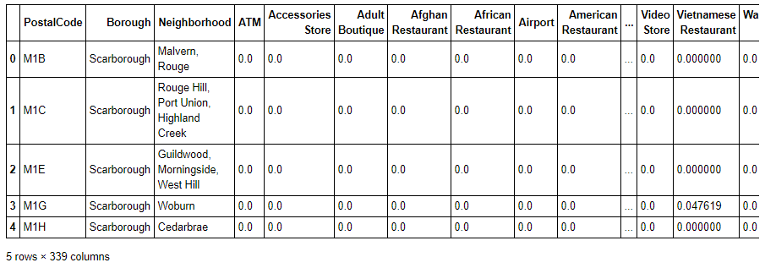
Results
Group rows by postal code, borough and neighbourhood, using means

Slide 10
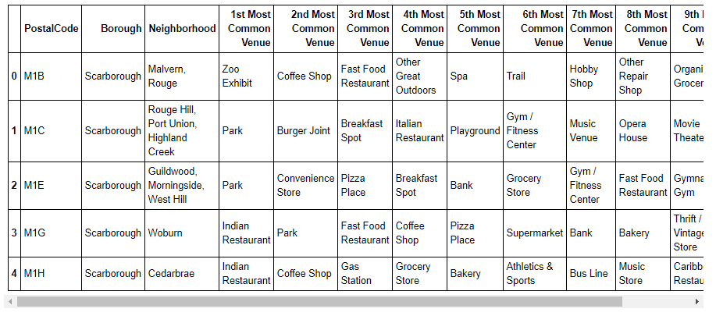
Results
Create the new dataframe and display the top 10 venues for each neighborhood.

Slide 11
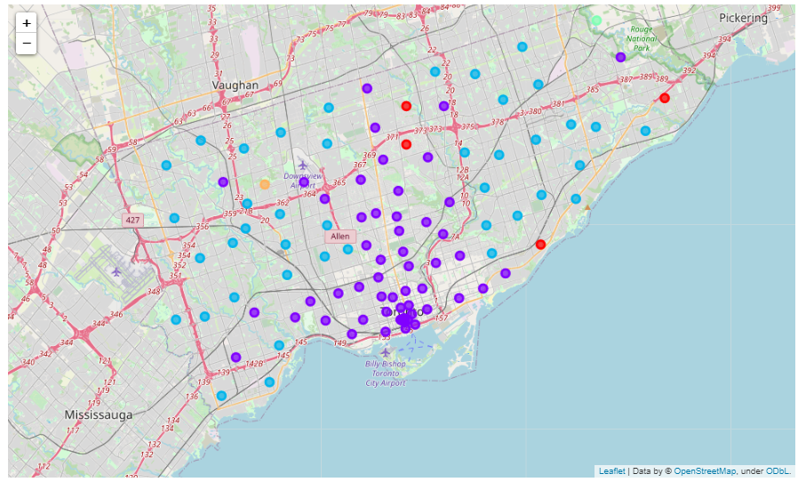
Results
Cluster neighbourhoods: set number of clusters as 5, and run k-means clustering. visualise the clusters using folium.
Cluster 0
Cluster 1
Cluster 2
Cluster 3
Cluster 4

Slide 12
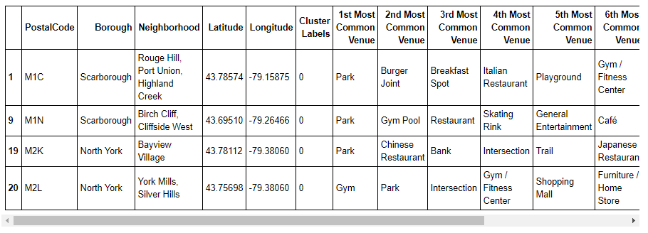
results
Cluster 0 (red) focuses on Parks, Gyms, and places to practice sports and/or chillout outside. This cluster is the places that you want to go if you want to do exercise and outdoor activities.

Slide 13
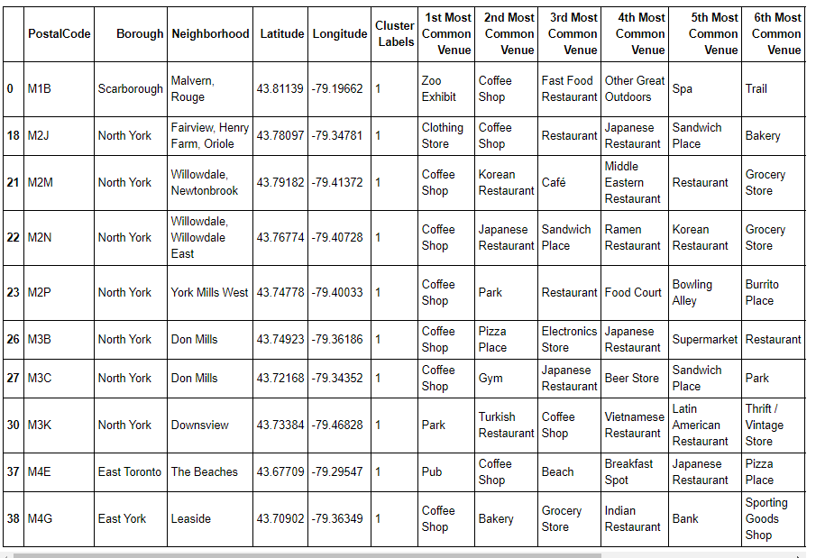
results
Cluster 1 (purple) focuses on the diversity of coffee shops, Restaurant, and bars. Its 1st common Venue is Zoo Exhibit, We can see that the downtown of Toronto is highly categorised in this cluster.

Slide 14
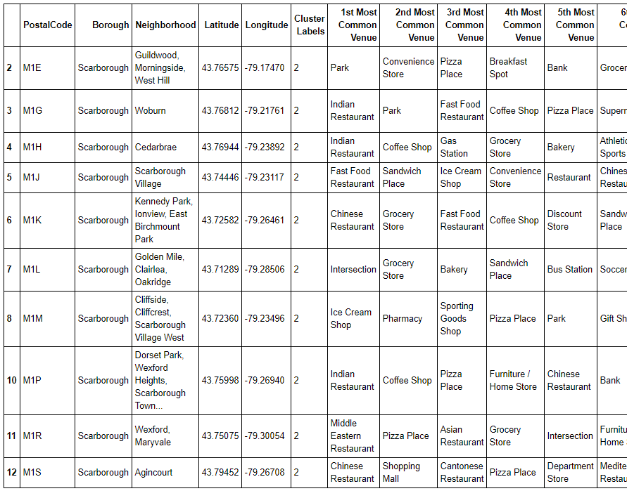
results
Cluster 2 (blue) focuses on the diversity of Restaurant, Grocery storesm, Convenience store. This cluster is predominant outside of the downtown.

Slide 15
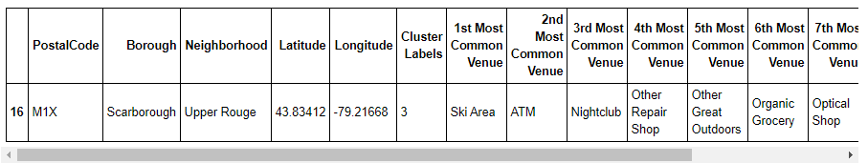
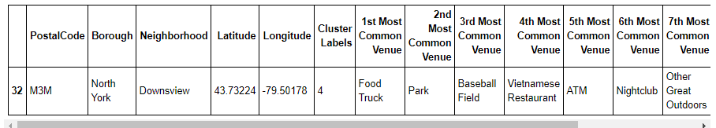
Result
Cluster 3 (green) is an outlier, its 1st commont venue is Ski Area.
Cluster 4 (orange) focuses on Food Truck, Park and Baseball field and restaurants

Slide 16
Summary
Since Lin prefers to live close to gyms, parks, as well as restaurant, the North York region of near both cluster 0 and cluster 1 could be a good choice for her.
Cluster 0
Cluster 1
Cluster 2
Cluster 3
Cluster 4

