Slide 1
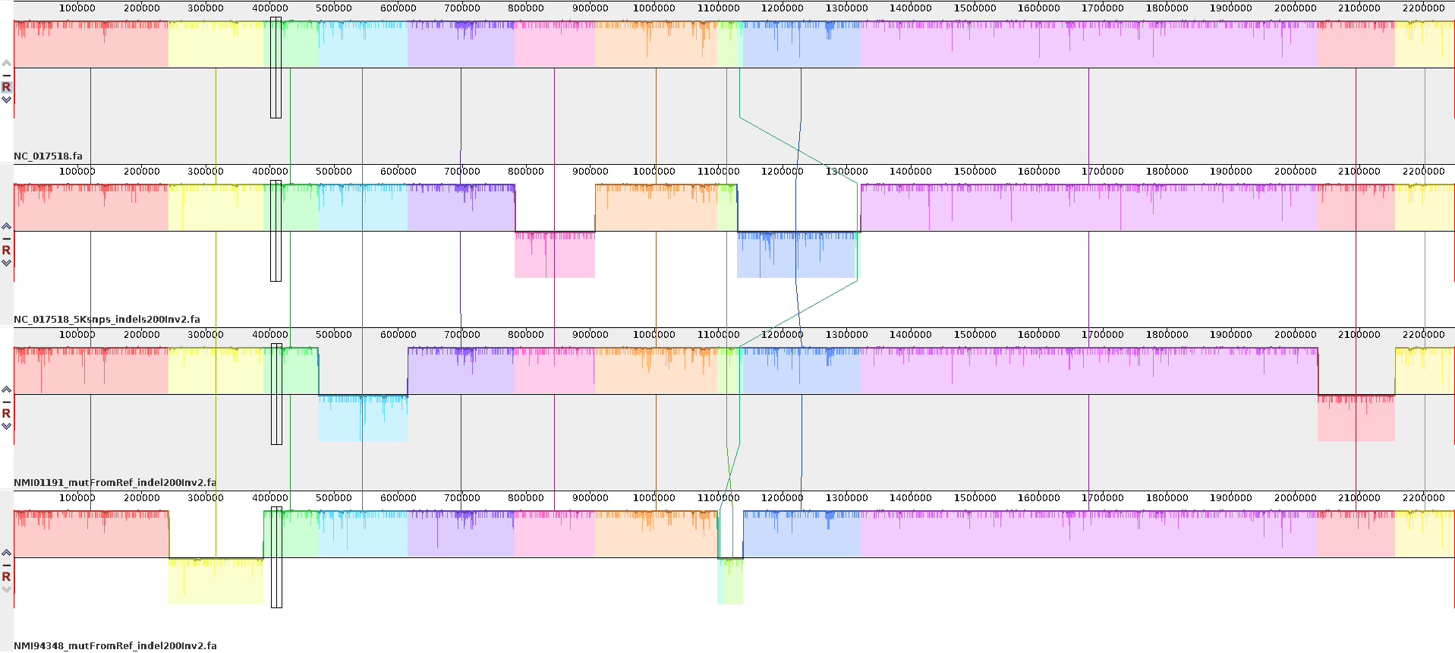

Simulate Neisseria meningitidis genomes to test pangenome graph construction
Three genomes were simulated by simuG from a single ST42 reference genome
4Sim genomes
ST42
ST42Sim: 5K SNPs+Indel200+Inv2
ST41Sim:2892SNPs+Indel200+Inv2
ST154Sim:4183SNPs+Indel200+Inv2
4Sim genome alignment showing big rearrangements
ST42
ST42Sim
ST41Sim
ST154Sim
Genomes used to test PGGB: 4Sim and 24 Neisseria meningitidis genomes
Notes:
Need simplify

Slide 2
Use 0.5.3 docker image to construct pangenome graph
dataset | Pggb version | paremeter | Issue with last path in graph
24NM.fa | pggb0.5.3 docker image | 10k,95 | Yes
24NM_LPD.fa | pggb0.5.3 docker image | 10k,95 | no
4Sim.fa | pggb0.5.3 docker image | 1k,96 | Yes
4Sim_LPD.fa | pggb0.5.3 docker image | 1k,96 | no
4Sim_reorder.fa | pggb0.5.3 docker image | 1k,96 | Yes
4Sim_reorder_LPD.fa | pggb0.5.3 docker image | 1k,96 | Yes
*note, LPD means there is a duplication for the last path (genome) in the input .fa file Reorder means I put the first genome(4Sim) as the last in the reorder one (4Sim_reorder)
The distance of the last path from graph to others is very small. The cluster relationship based on the distance showed that the last path is far away from other, which seems not true, such as 24NM, 4Sim, 4Sim_reoder.
When reorder the input, e.g. 4Sim_reoder. fa, the last path has changed, also have problem of the distance for the new last genome.
When duplicate the last genome, the issue is gone for 24NM_LPD, 4Sim_LPD, but not for 4Sim_reorder_LPD

