Slide 1

Overview of the pangenome graph pipeline using pggb and vg
Sequences/Assemblies/Contigs
FASTA
smoothxg
gfaestus
View and Annotation
wfmash
Smoothed Pangenome Graph
GFA
Deconstruct
VCF Variants
Index GFA
All Versus All Alignments
PAF
Phylogenetic analysis
vg
vg
seqwish
odgi
Extract distance
vg
Map Reads
GAM
Seqwish Induced Graph
GFA
1D VIZ
PNG
2D VIZ
PNG
Region VIZ
PNG
Genotyping
Known Variants
Call Novel Variants
Pangenome graph construction by pggb
Manipulate pangenome graphs by odgi
Vg toolkit for mapping and variant calling

Slide 2
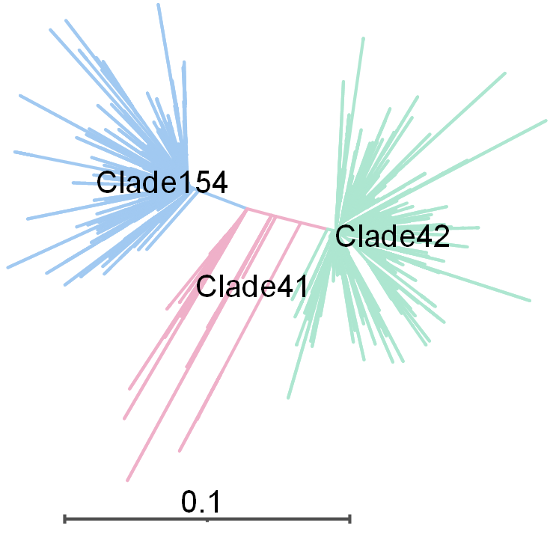
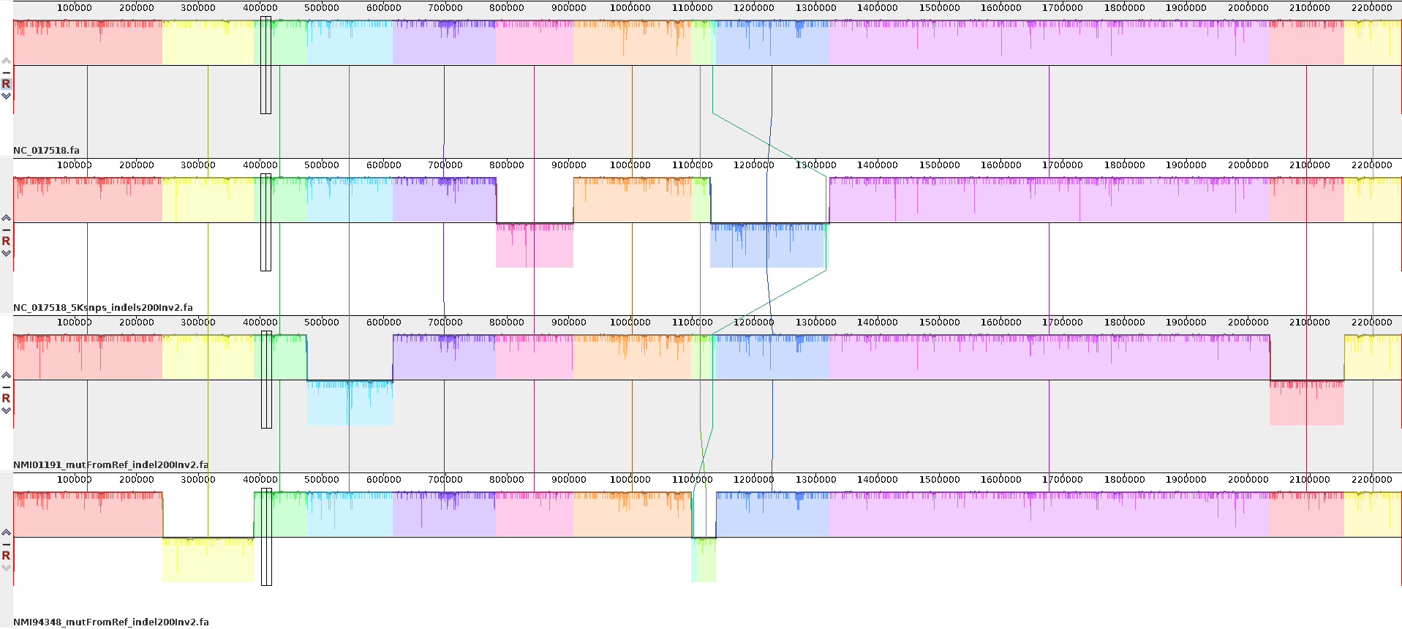
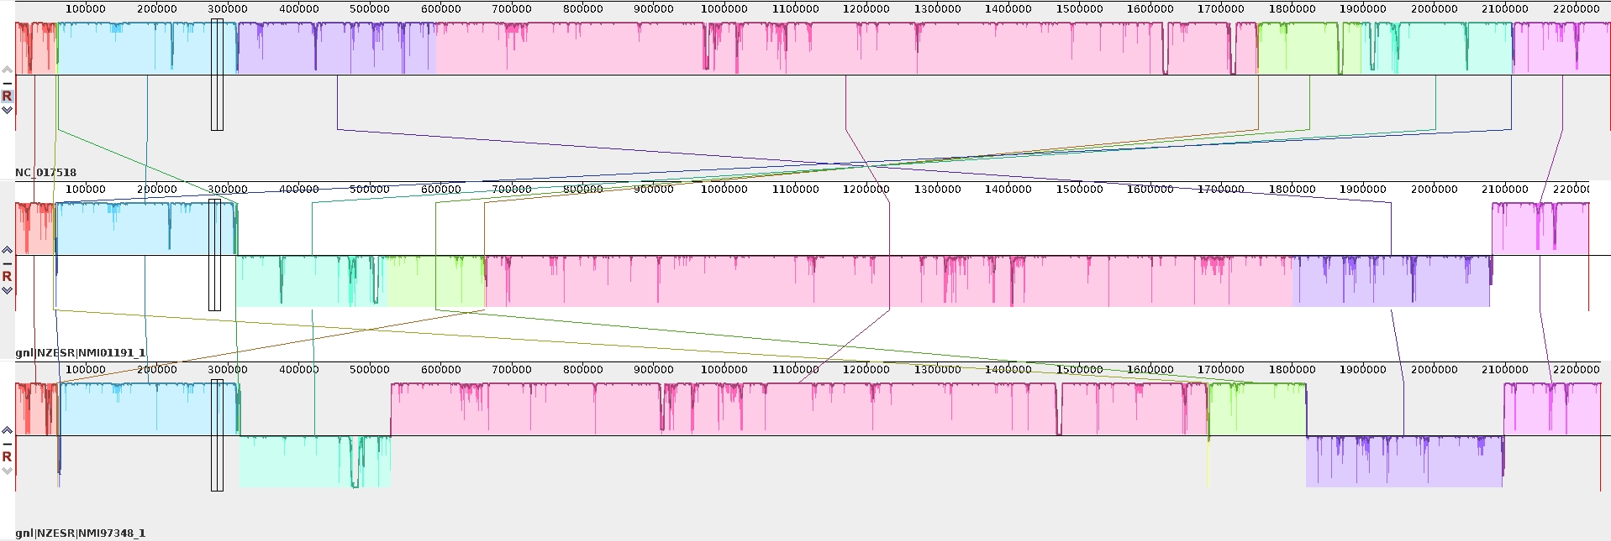

Simulate Neisseria meningitidis genomes to test pangenome graph construction
Three genomes were simulated by simuG from a single ST42 reference genome
Phylogeny of NZmenB epidemic isolates
4Sim genomes
ST42
ST42Sim: 5K SNPs+Indel200+Inv2
ST41Sim:2892SNPs+Indel200+Inv2
ST154Sim:4183SNPs+Indel200+Inv2
4Sim genome alignment showing big rearrangements
ST42
ST42Sim
ST41Sim
ST154Sim
3STs genome alignment showing big rearrangements
ST42
ST41
ST154
Genomes used to test PGGB: 4Sim, 3ST, 131 Neisseria meningitidis genomes
Notes:
Need simplify

Slide 3
 | Pangenome graph by PGGB and compuational resourse used record
 | 4Sim genomes 1k96
 | Sample Name | Length | Nodes | Edges | Paths | Components | A | C | T | G | N
0.4 | seqwish | 2280395 | 22208 | 29813 | 4 | 1 | 551650 | 578604 | 557459 | 592682 | 0 | 10.85s user 2.44s system 367% cpu 3.62s total 466844Kb max memory
 | smooth | 2260578 | 30209 | 40497 | 4 | 1 | 546815 | 569565 | 553365 | 590833 | 0 | 589.41s user 146.43s system 3099% cpu 23.73s total 1539752Kb max memory
0.5 | seqwish | 2280344 | 22216 | 29823 | 4 | 1 | 551639 | 578590 | 557450 | 592665 | 0 | 10.42s user 1.50s system 325% cpu 3.66s total 466256Kb max memory
 | smooth | 2260556 | 30212 | 40507 | 4 | 1 | 548624 | 574535 | 551539 | 585858 | 0 | 375.94s user 73.77s system 1298% cpu 34.63s total 557932Kb max memory
0.5.3 | seqwish | 2280344 | 22216 | 29823 | 4 | 1 | 551639 | 578590 | 557450 | 592665 | 0 | 13.77s user 0.88s system 492% cpu 2.97s total 462816Kb max memory
 | smooth | 2260957 | 30032 | 40273 | 4 | 1 | 551419 | 580042 | 548919 | 580577 | 0 | 277.24s user 375.67s system 1155% cpu 56.51s total 559348Kb max memory
 | 3ST Neisseria 2k95
 | Sample Name | Length | Nodes | Edges | Paths | Components | A | C | T | G | N
0.4 | seqwish | 2346163 | 8963 | 12011 | 3 | 1 | 570240 | 594074 | 573974 | 607875 | 0 | 6.45s user 0.86s system 304% cpu 2.40s total 369428Kb max memor
 | smooth | 2310859 | 22394 | 30059 | 3 | 1 | 558170 | 579553 | 569639 | 603497 | 0 | 407.92s user 141.36s system 1159% cpu 47.35s total 583488Kb max memory
0.5 | seqwish | 2331248 | 10016 | 13424 | 3 | 1 | 566556 | 590192 | 570481 | 604019 | 0 | 4.65s user 0.65s system 247% cpu 2.14s total 367184Kb max memory
 | smooth | 2301264 | 24455 | 32843 | 3 | 1 | 555876 | 577092 | 567234 | 601062 | 0 | 283.40s user 91.00s system 1261% cpu 29.66s total 570508Kb max memory
0.5.3 | seqwish | 2331248 | 10016 | 13424 | 3 | 1 | 566556 | 590192 | 570481 | 604019 | 0 | 11.25s user 0.54s system 491% cpu 2.39s total 361516Kb max memory
 | smooth | 2304073 | 23323 | 31325 | 3 | 1 | 556752 | 583682 | 567679 | 595960 | 0 | 209.43s user 528.10s system 1206% cpu 61.14s total 577696Kb max memory
 | 131Neisseria meningitidis 10k95
 | Sample Name | Length | Nodes | Edges | Paths | Components | A | C | T | G | N
0.4 | seqwish | 5310036 | 392555 | 544354 | 131 | 1 | 1359720 | 1300452 | 1362962 | 1286090 | 801 | 2063.56s user 116.54s system 979% cpu 222.63s total 19059084Kb max memory
 | smooth | 4871882 | 644054 | 912371 | 131 | 1 | 1279910 | 1209172 | 1240798 | 1141192 | 810 | 151784.96s user 16636.90s system 1245% cpu 13521.63s total 17548472Kb max memory
0.5 | seqwish | 4678052 | 388385 | 529965 | 131 | 1 | 1199846 | 1143023 | 1201017 | 1133354 | 801 | 22962.4s user 678.76s system 3841% cpu 615.43s total 40150772Kb max memory
 | smooth | 4430201 | 654601 | 961559 | 131 | 1 | 1138618 | 1057899 | 1154875 | 1078099 | 710 | 258473.72s user 31204.28s system 982% cpu 29475.73s total 19736356Kb max memory
0.5.3 | seqwish | 4678052 | 388385 | 529965 | 131 | 1 | 1199846 | 1143023 | 1201017 | 1133354 | 801 | 21293.24s user 471.08s system 3679% cpu 591.43s total 40160532Kb max memory
 | smooth | 4354104 | 624509 | 878713 | 131 | 1 | 1120930 | 1034970 | 1130845 | 1066547 | 812 | 190044.54s user 286003.11s system 1217% cpu 39094.32s total 24682416Kb max memory

Slide 4
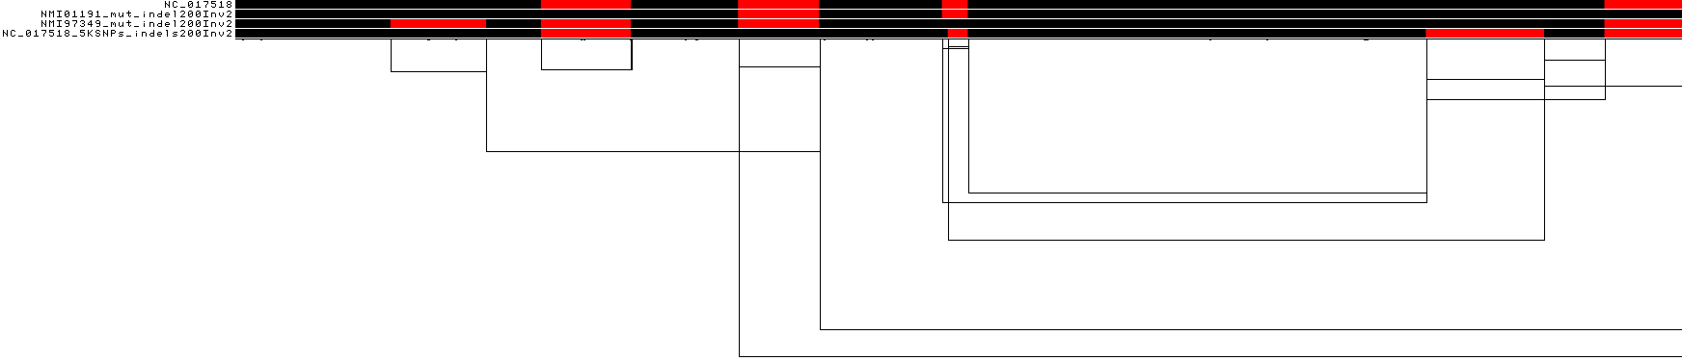
Pangenome graph of the 4Sim genomes by pggb0.5.3
Pggb generated consistent graph for the 4Sim genomes using different settings
All big inversions were correctly identified in the graph as different genotypes
ST42
ST42Sim
ST41Sim
ST154Sim
Notes:
1k96

Slide 5
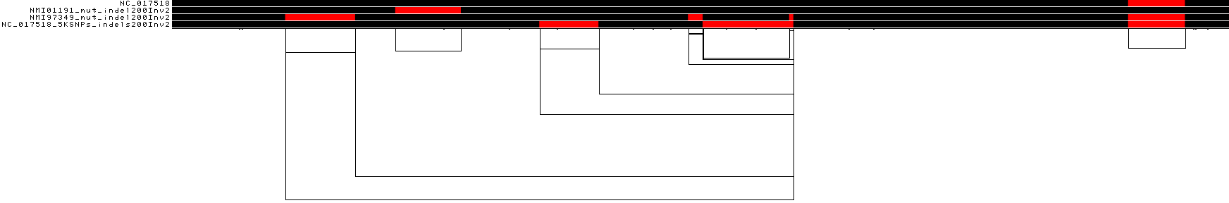
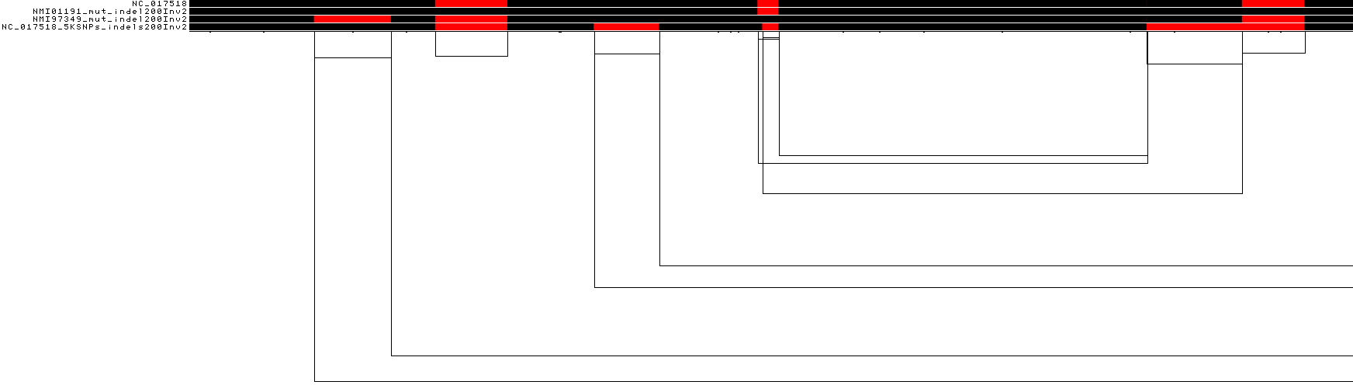
Pangenome graph of the 4Sim genomes by pggb0.4, 0.5, 0.5.3
ST42
ST41Sim
pggb0.4
ST154Sim
ST42Sim
pggb0.5
pggb0.5.3
From the version of 0.4, Pggb works almost the same the simulated 4 genomes
 | Length | Nodes | Edges | Paths | (M)SNPs | Indels (<50 bp) | SVs (>=50 pb)
0.4 | 2260578 | 30209 | 40497 | 4 | 9580 | 638 | 6
0.5 | 2260556 | 30212 | 40507 | 4 | 9579 | 643 | 5
0.5.3 | 2260957 | 30032 | 40273 | 4 | 9510 | 646 | 12

Slide 6
High sensitivity and specificity of graph capturing variants
Variations captured by 4Sim graph Vs. the ground truth
 | Sample | ground truth | Graph captured | FN | FP
small variants (SNPs+indels) | ST42Sim | 5200 | 5196 | 4
 | ST41Sim | 3092 | 3089 | 3
 | ST154Sim | 4383 | 4381 | 2 | 7
inversions | ST42Sim | 2 | 2
 | ST41Sim | 2 | 2
 | ST154Sim | 2 | 2
PGGB 0.4
Sensitivity =TP/TP+FN, >99.9%
Specificity =TN/FP+TN, >99.99%
Variations captured by 4Sim graph Vs. the ground truth
 | Sample | ground truth | Graph captured | FN | FP | FP?GT1/0, note
small variants (SNPs+indels) | ST42Sim | 5200 | 5197 | 3 | 1 | 8
 | ST41Sim | 3092 | 3089 | 2 |  | Two sites of truth are together, it is one in the graph
 | ST154Sim | 4383 | 4382 | 1 | 1
inversions | ST42Sim | 2 | 2
 | ST41Sim | 2 | 2
 | ST154Sim | 2 | 2
PGGB 0.5.3
Notes:
Pangenome graph construction by PGGB works very well
All different types variants from the simulated genomes are correctly presented in the graph

Slide 7
Examples of variation in the graph Vs. ground truth
NC_017518 | 132117 | AT | A | 1 | 0 | 0 | 0 | decon0 | same
NC_017518 | 132118 | TT | T | 1 | 0 | 0 | 0 | true0 | same
NC_017518 | 206804 | CG | C | 1 | 0 | 0 | 0 | decon0 | same
NC_017518 | 206806 | GG | G | 1 | 0 | 0 | 0 | true0 | same
NC_017518 | 208945 | C | CA | 1 | 0 | 0 | 0 | decon0 | same
NC_017518 | 208946 | A | AA | 1 | 0 | 0 | 0 | true0 | same
NC_017518 | 265375 | C | CT | 1 | 0 | 0 | 0 | true0 | same
NC_017518 | 265376 | T | TT | 1 | 0 | 0 | 0 | decon0 | same
NC_017518 | 367611 | GA | G | 1 | 0 | 0 | 0 | true0 | same
NC_017518 | 367612 | AA | A | 1 | 0 | 0 | 0 | decon0 | same
NC_017518 | 370191 | TT | T | 1 | 0 | 0 | 0 | true0 | same
NC_017518 | 370192 | TT | T | 1 | 0 | 0 | 0 | decon0 | same

Slide 8
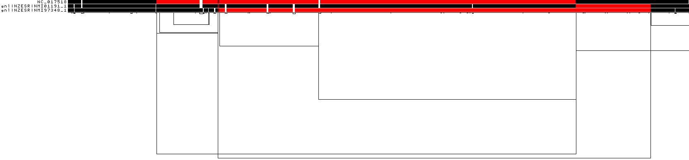
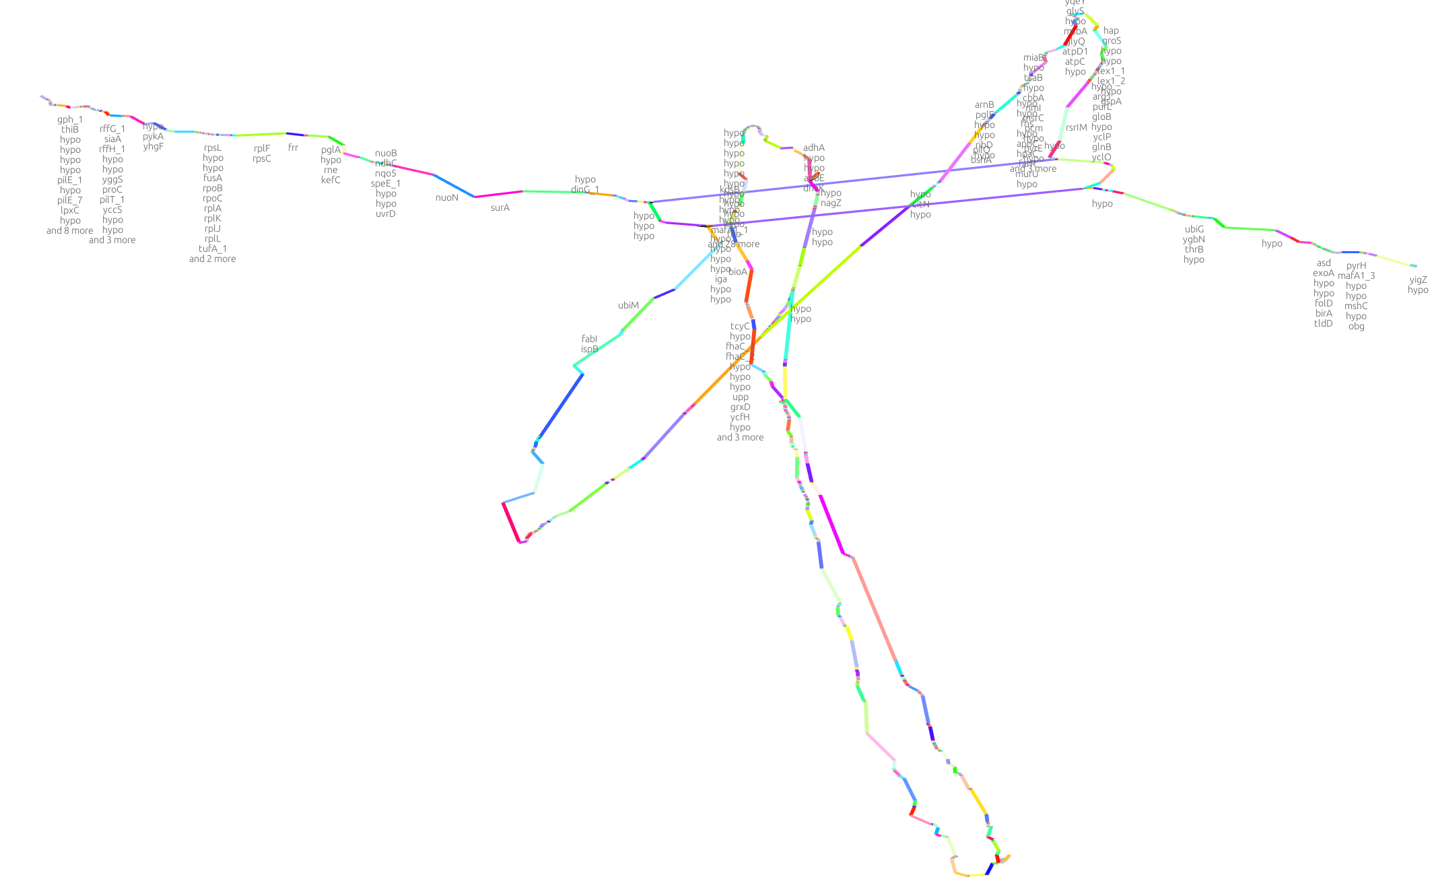

How about real data? 3STs N. meningitidis by PGGB 0.5.3
genome size of ST42: 2.249M
Length | Nodes | Edges | Paths | (M)SNPs | Indels (<50 bp) | SVs (>=50 pb)
2304073 | 23323 | 31325 | 3 | 7070 | 518 | 90

Slide 9
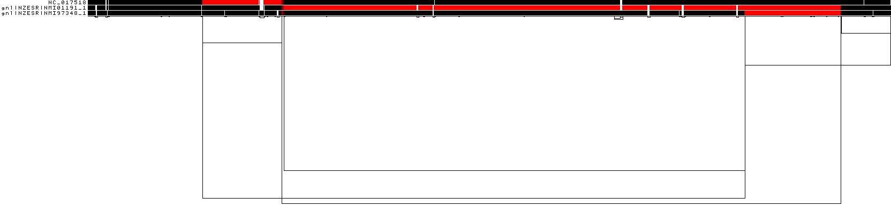
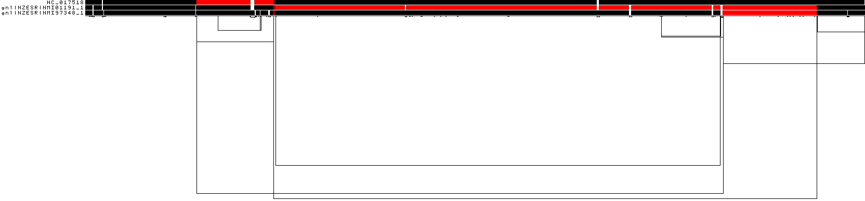
Pangenome graph of the 3ST Neisseria meningitidis genomes by pggb0.4, 0.5, 0.5.3
pggb0.4
pggb0.5
pggb0.5.3
 | Length | Nodes | Edges | Paths | (M)SNPs | Indels (<50 bp) | SVs (>=50 pb)
0.4 | 2310859 | 22394 | 30059 | 3 | 6815 | 488 | 67
0.5 | 2301264 | 24455 | 32843 | 3 | 7454 | 568 | 73
0.5.3 | 2304073 | 23323 | 31325 | 3 | 7070 | 518 | 90

Slide 10
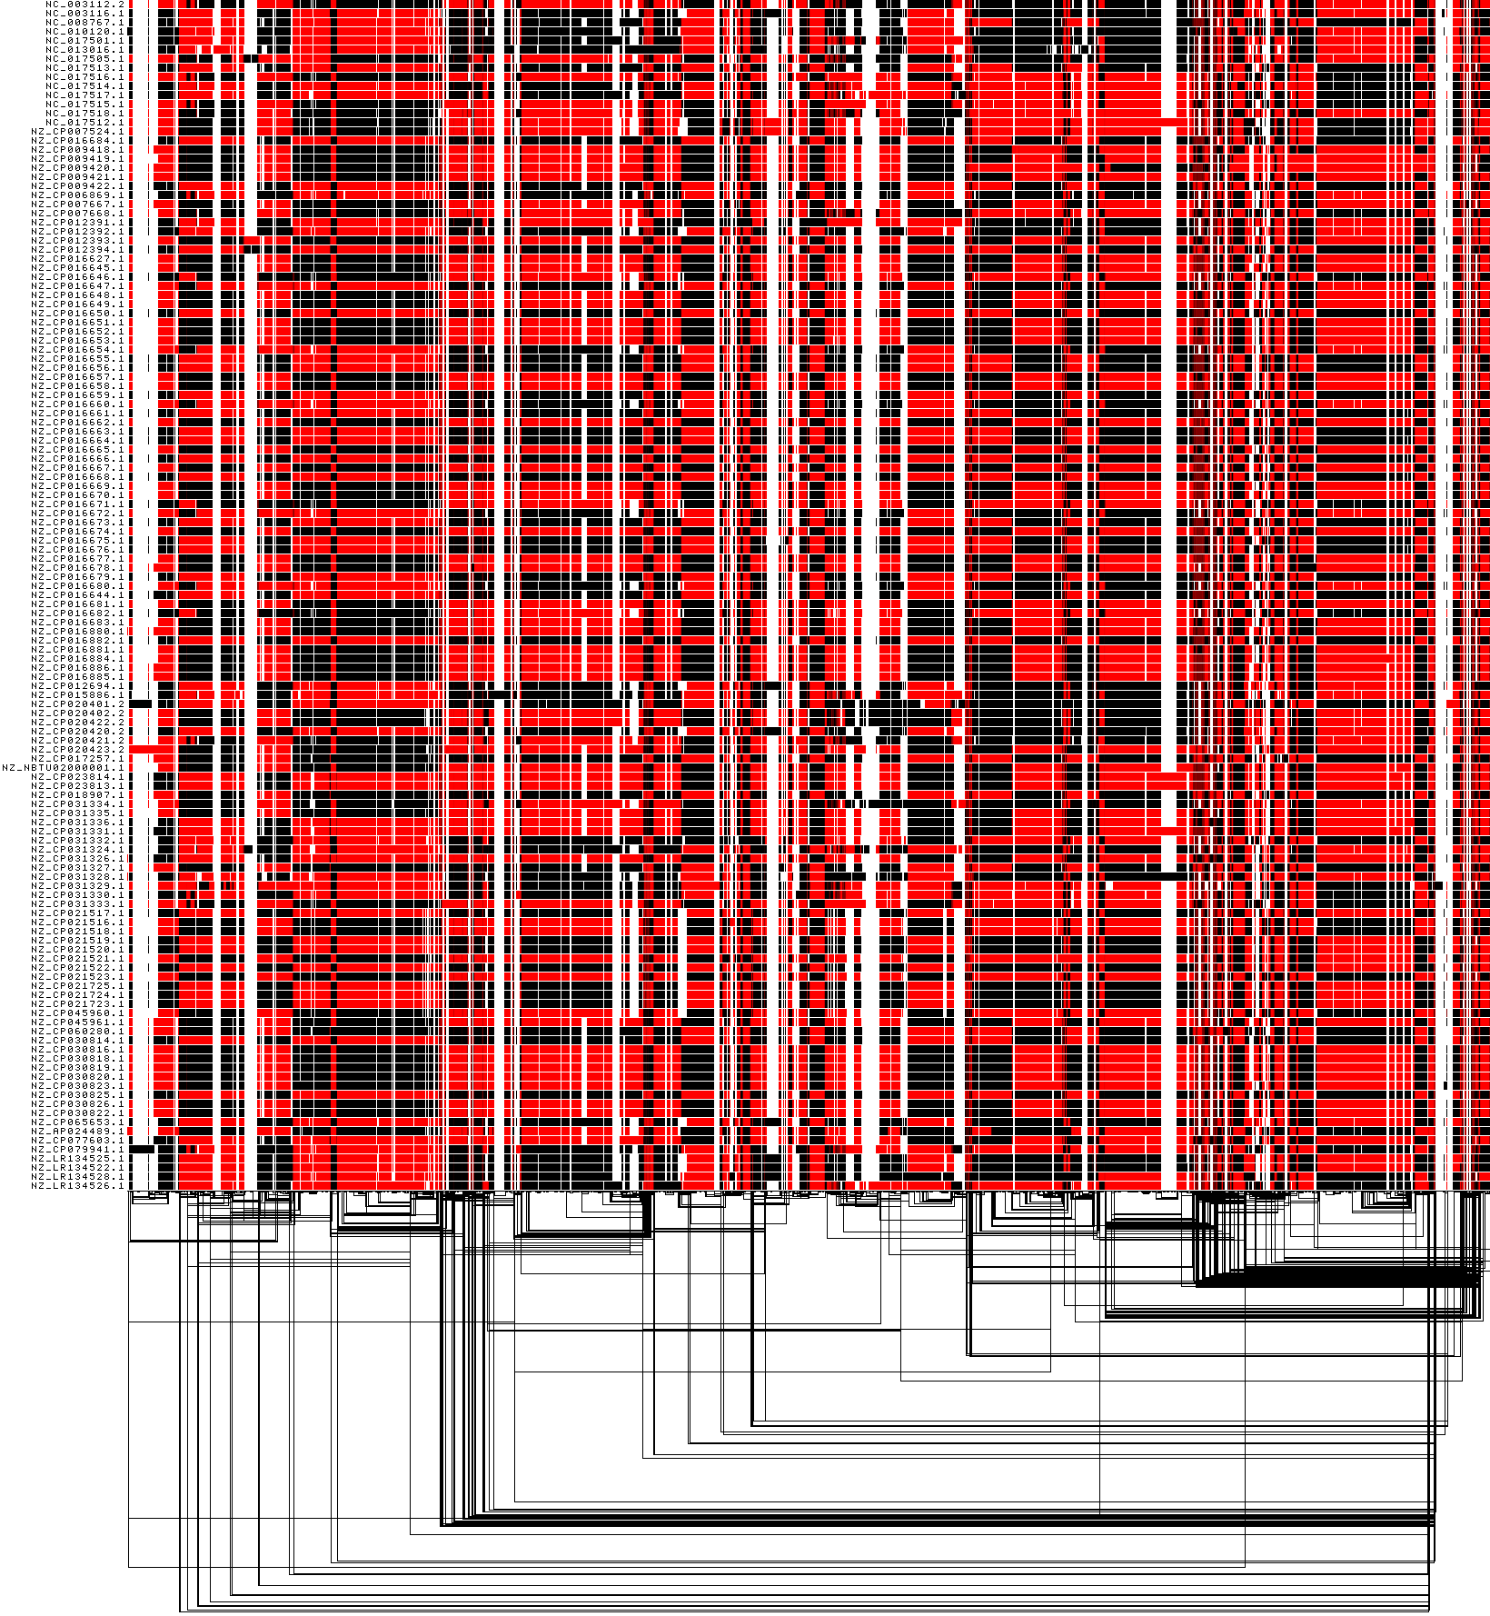
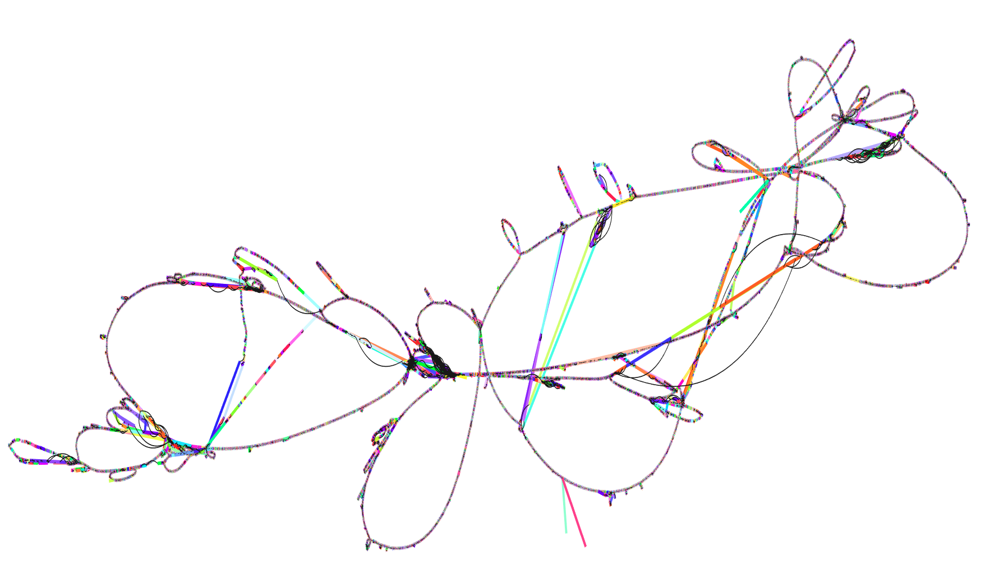
Pangenome graph of 131 N. meningitidis genomes by pggb0.5
Length | Nodes | Edges | Paths | (M)SNPs | Indels(<50) | SVs(>=50 pb)
4430201 | 654601 | 961559 | 131 | 135368 | 26126 | 1259

Slide 11
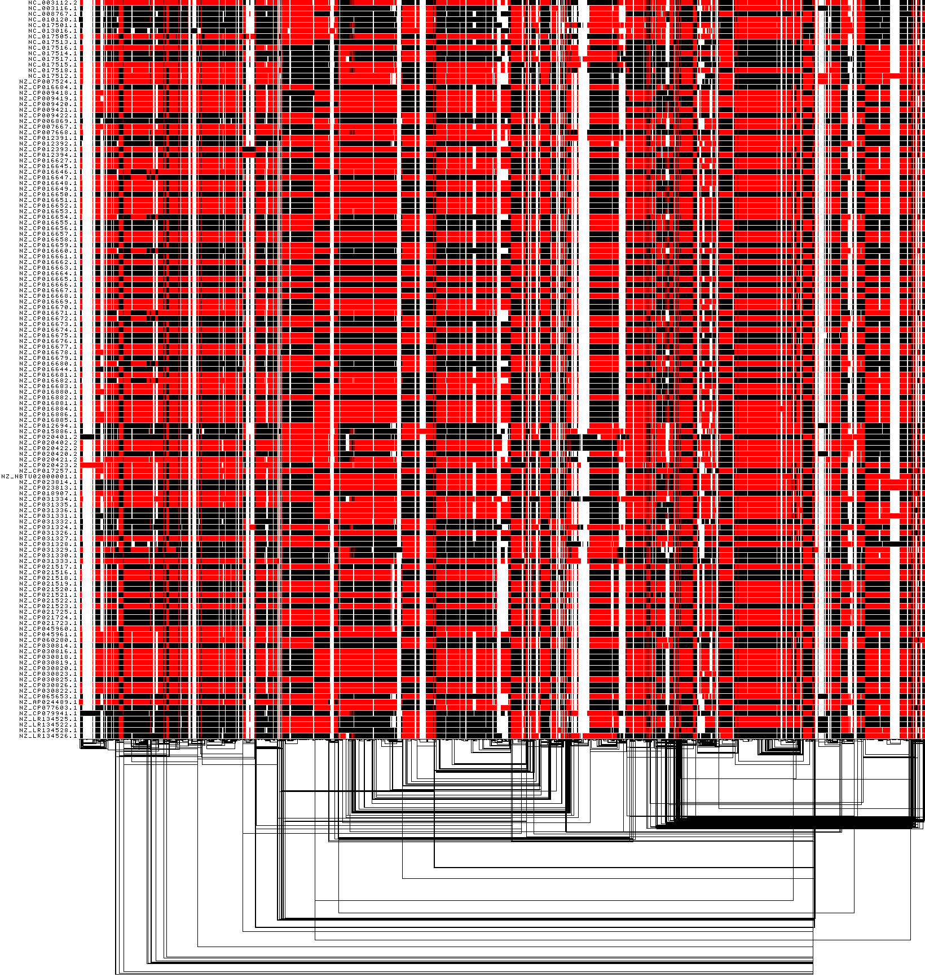
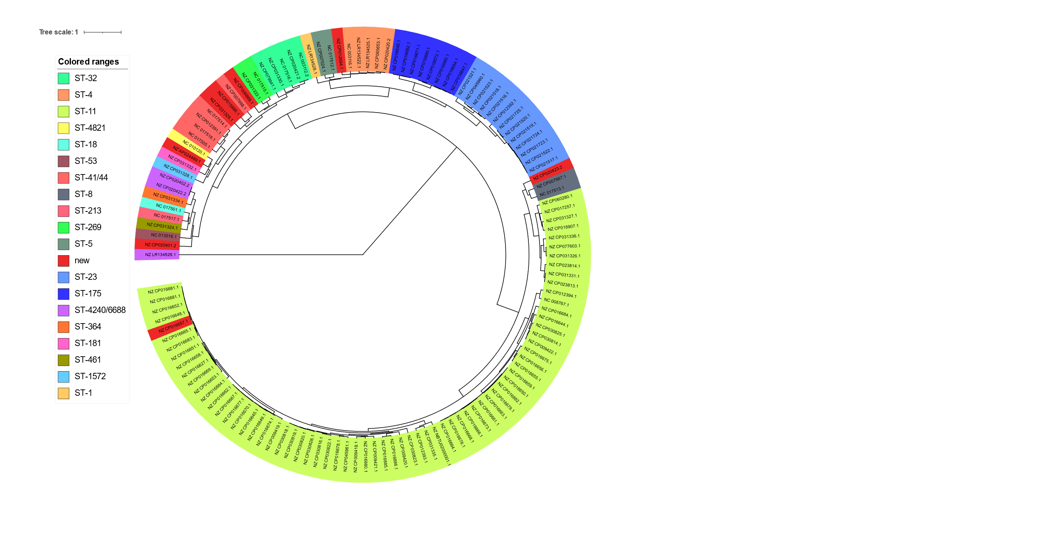
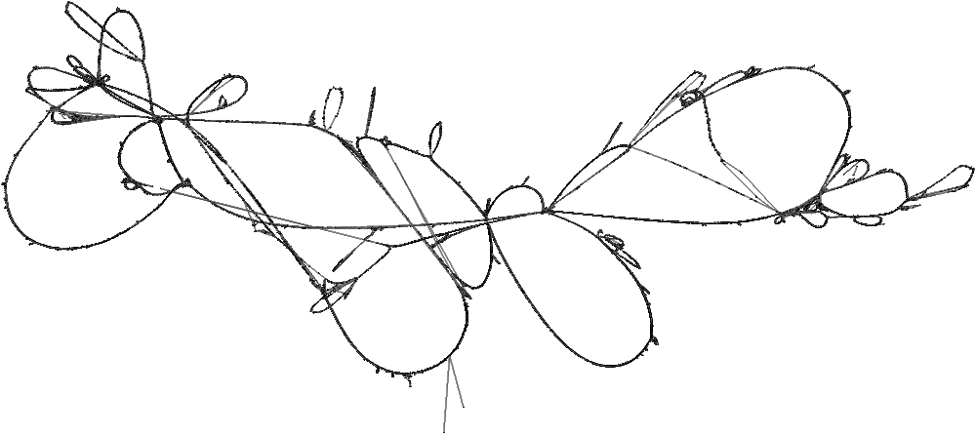
Pangenome graph of 131 N. meningitidis genomes by PGGB 0.5.3
Length | Nodes | Edges | Paths | (M)SNPs | Indels(<50) | SVs(>=50 pb)
4354104 | 624509 | 878713 | 131 | 133933 | 25352 | 1461

Slide 12
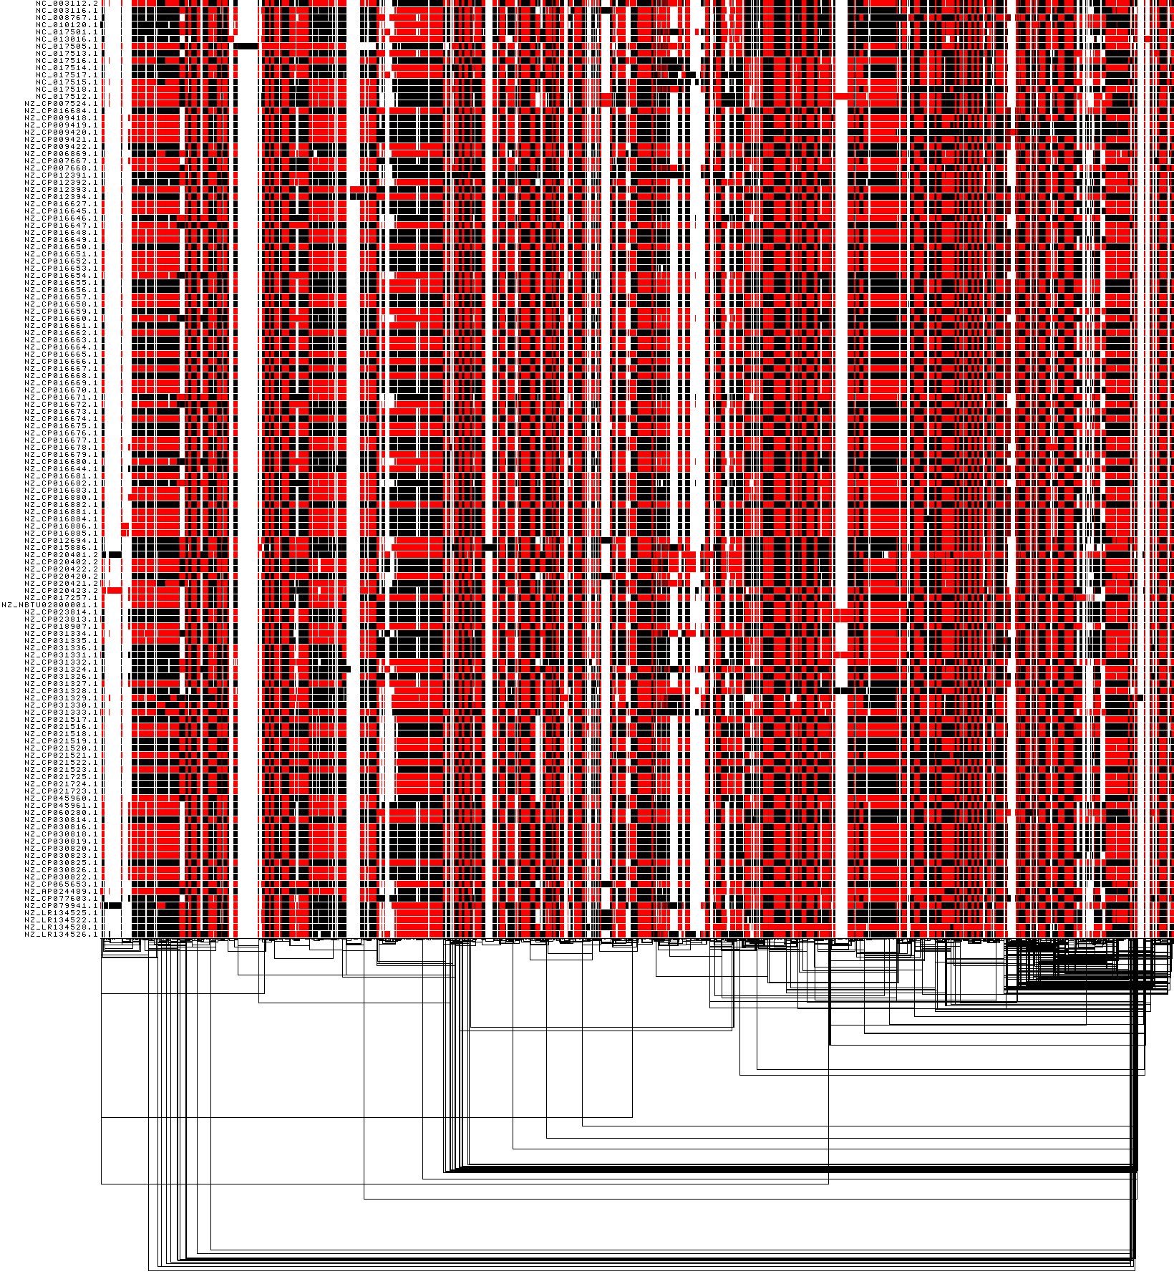
Pangenome graph of the 131 Neisseria meningitidis genomes by pggb0.4, 0.5, 0.5.3
pggb0.4
pggb0.5
pggb0.5.3
When I used odgi paths to get the paired distances of the paths in the graph, the distance of last pathNZ_LR134526.1 to others by pggb0.4 and pggb 0.5.3 look so different from pggb0.5. The cluster relationship based on the distance showed that NZ_LR134526.1 is far away from other, which seems not true. Why ?

Slide 13
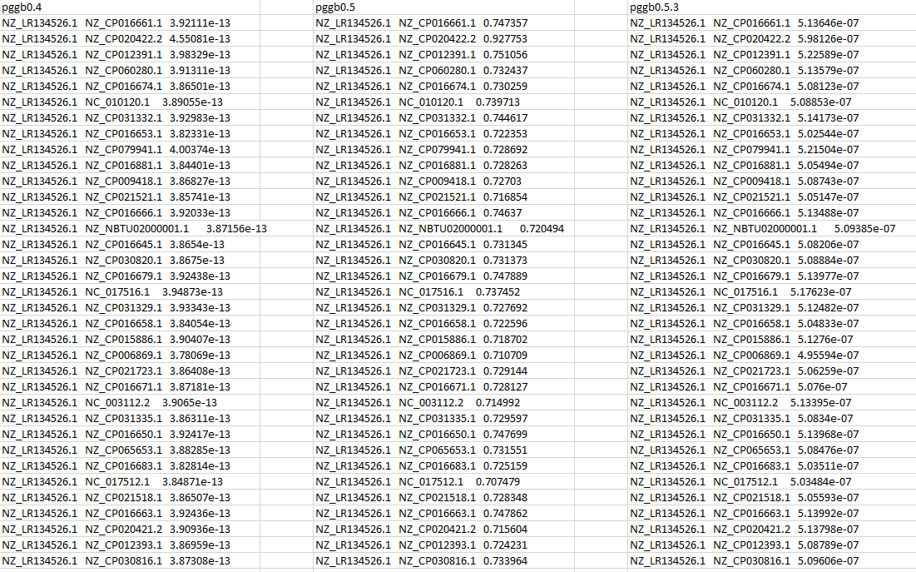
When I used odgi paths to get the paired distances of the paths in the graph, the distance of last pathNZ_LR134526.1 to others by pggb0.4 and pggb 0.5.3 look so different from pggb0.5. The cluster relationship based on the distance showed that NZ_LR134526.1 is far away from other, which seems not true. Why ?

Slide 14
Summary
For the 4Sim genome, different pggb work ok, all get consistent results of the variants in the graph compare to the ground truth.
some variants looks a little different, once de-complexed, compared with the ground truth. Congruent results
For the 131 Neisseria genomes
The distance of last pathNZ_LR134526.1 to others by pggb0.4 and pggb 0.5.3 look so different from pggb0.5. The cluster relationship based on the distance showed that NZ_LR134526.1 is far away from other, which seems not true. Why ?

