Slide 1
Pangenome graph for 5NM dataset construction by PGGB
Zoe Yang
15 July 2023

Slide 2
5NM genomes
genomes | ASM IDs | GCF IDs | SEROGROUP | Sequence type | Clonal Complex
NC_017518.1 Neisseria meningitidis NZ-05/33 | ASM19152v1 | GCF_000191525.1 | B | 42 | ST-41/44
NC_003112.2 Neisseria meningitidis MC58 | ASM880v1 | GCF_000008805.1 | - | 74 | ST-32
NZ_CP007668.1 Neisseria meningitidis M0579 | ASM102983v1 | GCF_001029835.1 | B | - | ST-41/44
NZ_CP016880.1 Neisseria meningitidis strain M07165 | ASM170367v1 | GCF_001703675.1 | W | 11 | ST-11
NZ_CP020423.2 Neisseria meningitidis strain FDAARGOS_212 | ASM207367v2 | GCF_002073675.2

Slide 3
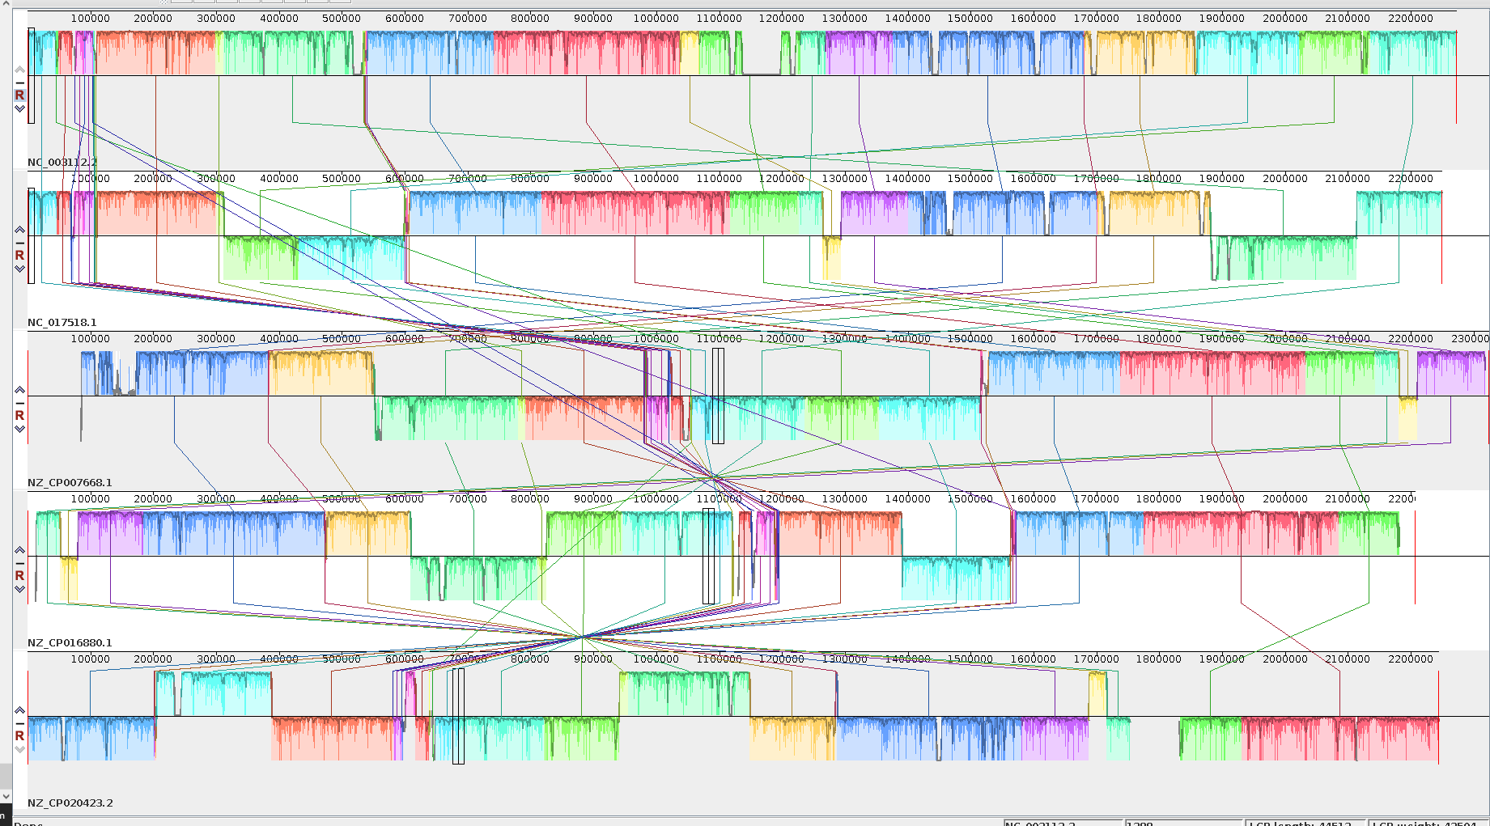
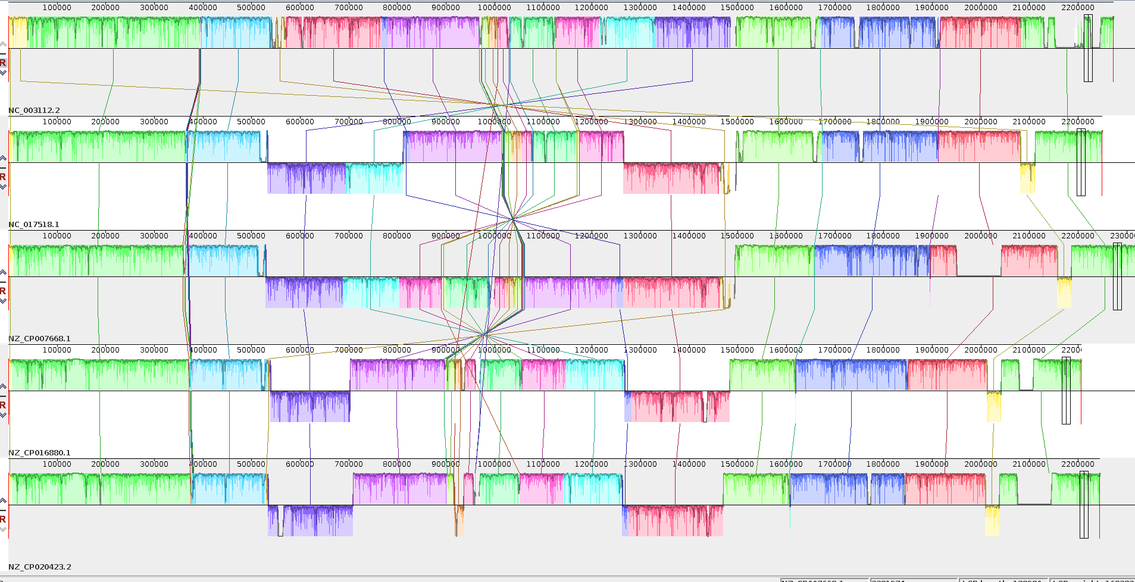
5NM
5NM_re2, with start point being fixed

Slide 4
Same settings for same dataset generated different results
pggb -i 5NM_re2.fa -s 20000 -p 94 -n 4 -t 24 -S -m -o 5NMre2_20K94_1 -V 'NC_017518.1:#'
Sample Name | Length | Nodes | Edges | Paths | Components | A | C | T | G | N
seqwish | 3363122 | 122382 | 167967 | 5 | 1 | 833849 | 855877 | 836043 | 837253 | 100
smooth | 3031369 | 244925 | 330212 | 5 | 1 | 755469 | 765901 | 760245 | 749654 | 100
pggb -i 5NM_re2.fa -s 20000 -p 94 -n 4 -t 24 -S -m -o 5NMre2_20K94_2 -V 'NC_017518.1:#'
Sample Name | Length | Nodes | Edges | Paths | Components | A | C | T | G | N
seqwish | 3363122 | 122382 | 167967 | 5 | 1 | 833849 | 855877 | 836043 | 837253 | 100
smooth | 3031061 | 244792 | 330079 | 5 | 1 | 755570 | 764218 | 760100 | 751073 | 100
It seems that the Smoothxg processes for both repeats were slightly different. Why this might be?
Smoothxg, POA, at a scale of around 1kb?

