Slide 1
Group : DIA6 Name : Han
Analysis of customer reviews

Slide 2
Table of contents
1 | Data Exploration and Cleaning
2 | Summary and Topic Modeling
3 | Word Embeddings
4 | Supervised Learning and Sentiment Analysis
5 | Results Interpretation
6 | Streamlit Application

Slide 3
Purpose and context
Context :
French insurance customer reviews collected from 35 companies across multiple products (auto, santé, habitation)
Objectives:
Predict star ratings and detect sentiment from review text
Identify key themes impacting customer satisfaction
Build an interactive application for real-time analysis
Techniques used :
Data cleaning, topic modeling (LDA), word embeddings (Word2Vec, GloVe)
Supervised learning: TF-IDF, CNN, BERT-based zero-shot classification
Streamlit interactive application

Slide 4
1
Dataset Overview
Source: 35 Excel files merged into one dataset
Total: 34,435 reviews → 24,104 after removing missing ratings
11 columns: note (1-5 stars), avis (French), assureur (insurer), produit, avis_en (English translation), avis_cor, avis_summary
Star distribution: 1★ 7,271 | 2★ 3,716 | 3★ 3,382 | 4★ 4,885 | 5★ 4,850
Most reviewed insurer: AXA (629 reviews)
Reviews span multiple insurance types: auto, santé, habitation

Slide 5
2
Data Cleaning and Exploration
Frequent words and n-gram analysis
Spelling correction (pyspellchecker)
Summary and translation (BART)
Topic modeling (LDA)

Slide 6
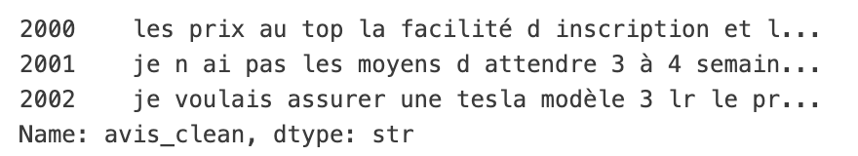
Data cleansing
Text preprocessing: lowercase, remove punctuation, remove extra whitespace
Stopword removal: French stopwords (NLTK) + domain-specific (l, j, d, qu, c...)
Spelling correction: pyspellchecker (French), distance=1, applied to all 24,104 reviews
Output columns:
avis_clean → cleaned French text
avis_corrected → spelling-corrected text
avis_en → English translation (provided)
avis_summary → generated summary (BART)

Slide 7
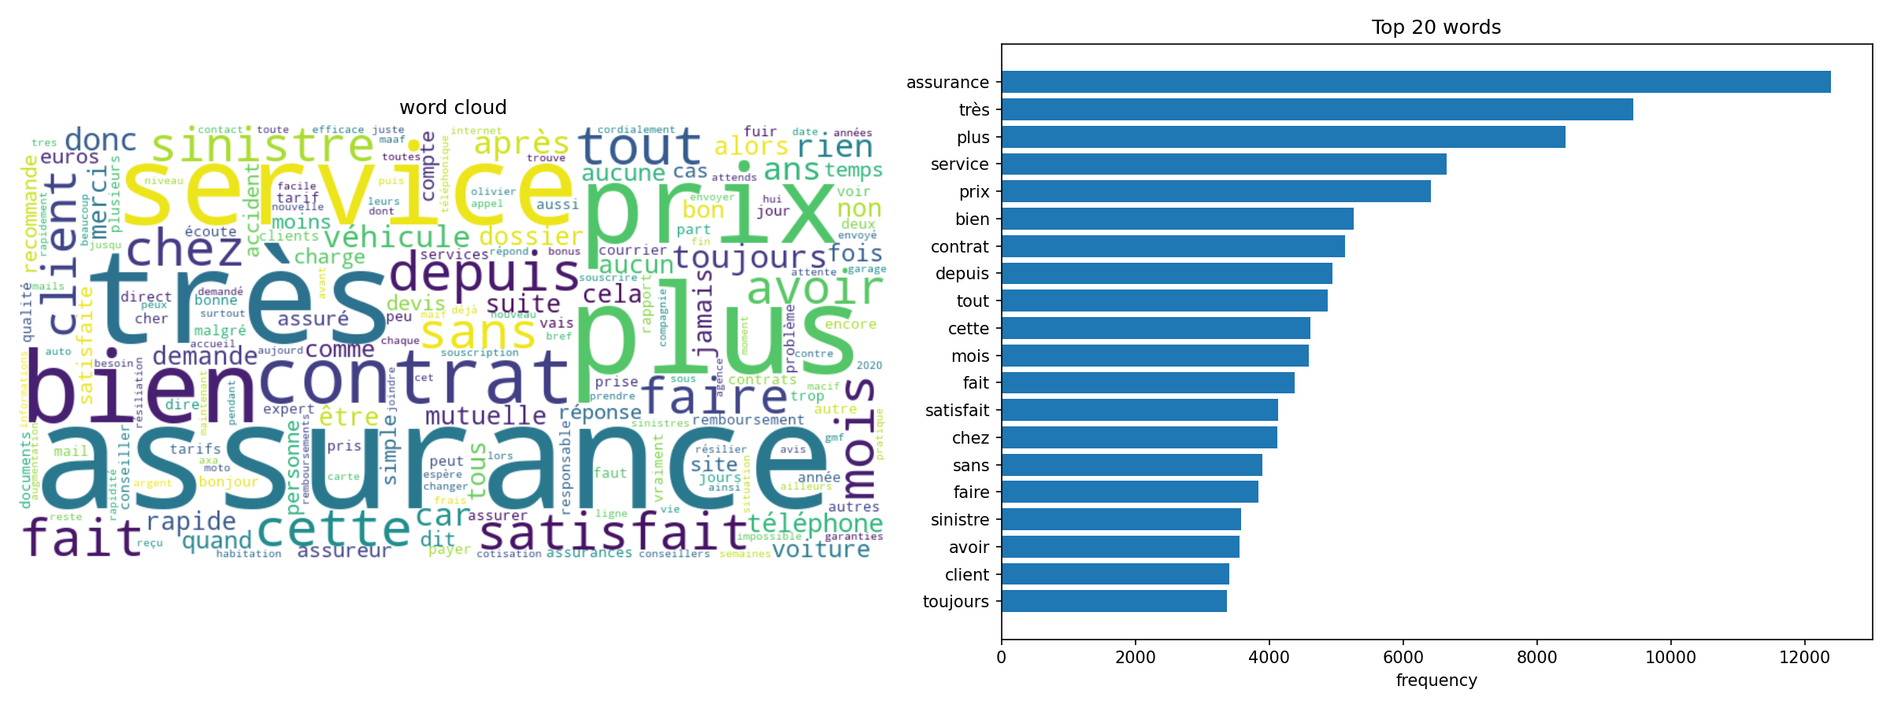
Frequent Words and N-gram Analysis
After stopword removal, top words: assurance (12,390), prix (8,426), service (6,649), contrat (5,134), sinistre (3,579)
Top Bigrams: service client (1,552) | direct assurance (1,360) | prise charge (1,018)
Top Trigrams: rapport qualité prix (383) | sinistre non responsable (149) | depuis plusieurs années (129)
Key insight: pricing and customer service are the most discussed topics

Slide 8
Summary Generation and Translation
English translation already provided in avis_en column
Summarization model: facebook/bart-large-cnn (HuggingFace)
Applied to all 24,104 English reviews, accelerated with Apple MPS GPU
Reviews shorter than 30 words kept as-is
Result stored in avis_summary column
orign: hello
I am quite received to see that despite a drastic reduction in the use of specific vehicles in France in 2020 and 2021 (Covid pandemic), the price of insurance premiums has not dropped. It is indisputable that the French have bcp less rolled and that the number of claims has decreased sharply.
Summary: Despite a drastic reduction in the use of specific vehicles in France in 2020 and 2021, the price of insurance premiums has not dropped. It is indisputable that the French have bcp less rolled and that the number of claims has decreased sharply

Slide 9
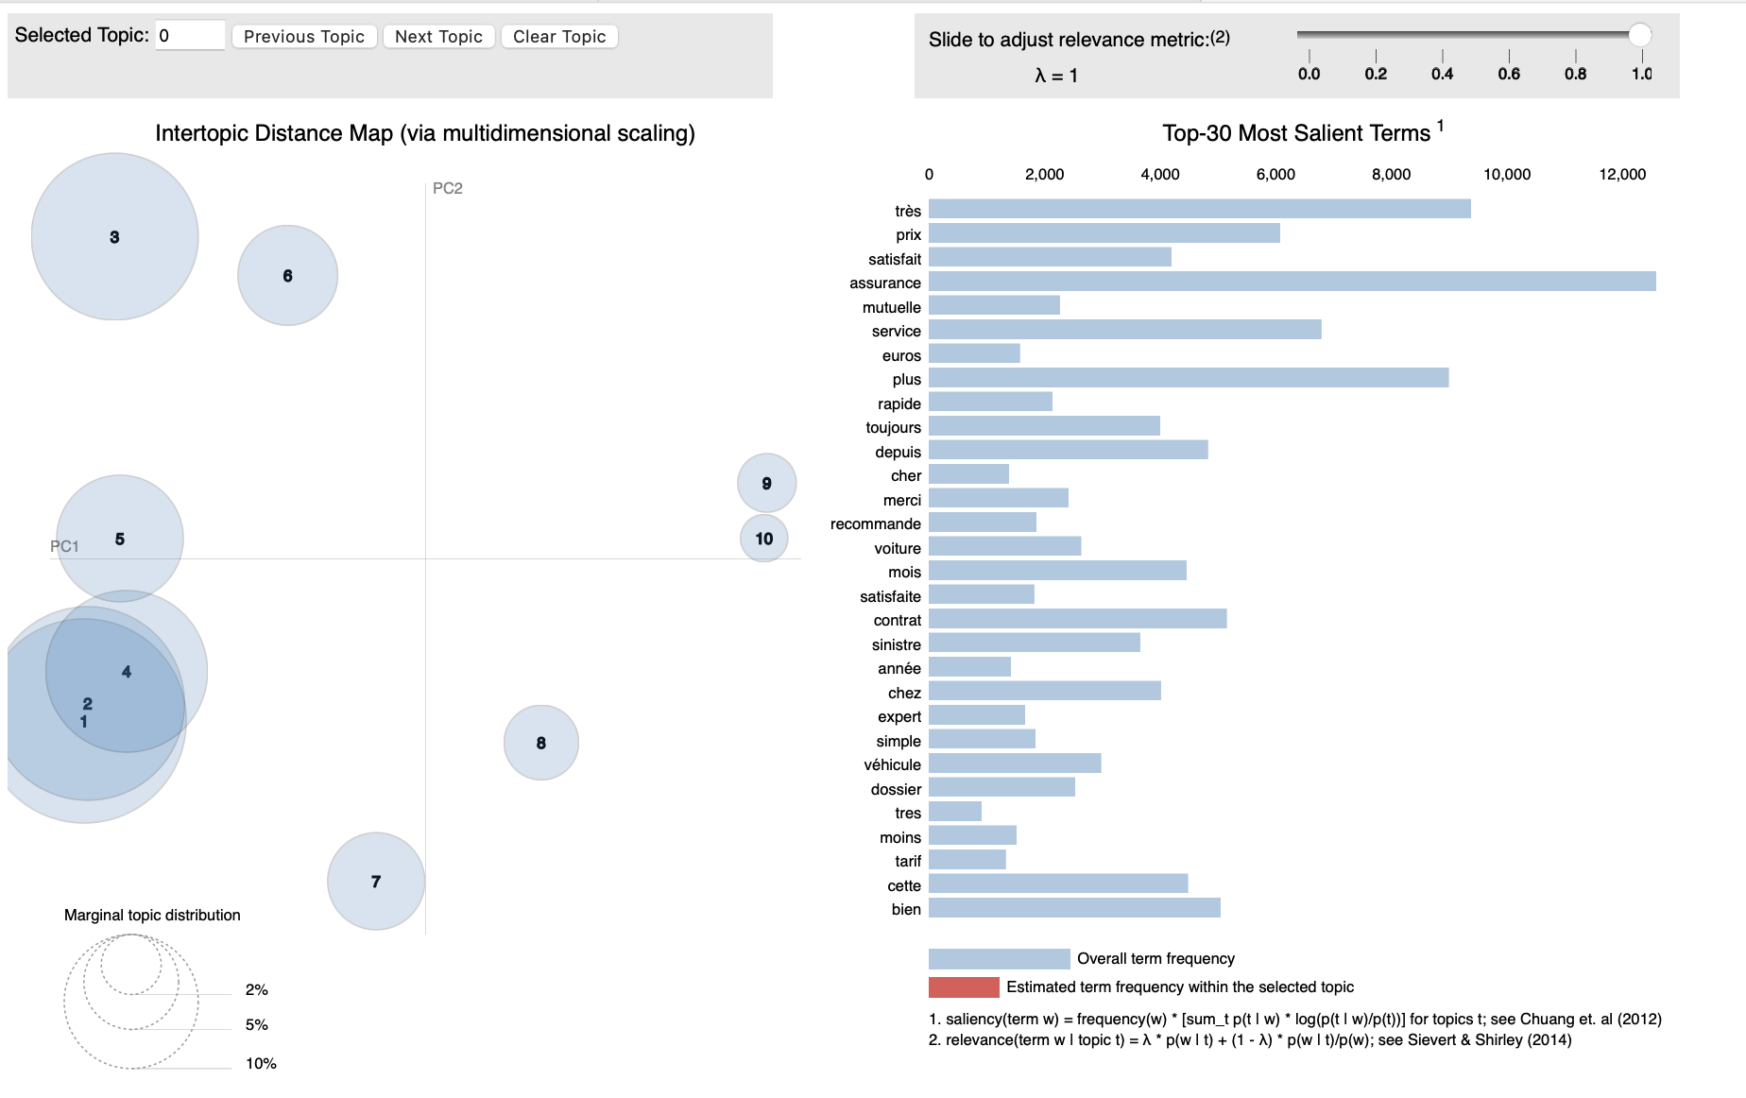
Topic Modeling with LDA
Model: Latent Dirichlet Allocation, 10 topics, library: Gensim
Trained on French cleaned reviews (24,104 documents, vocab 31,308 words)
Key topics identified:

Slide 10
3
Word Embeddings
Word2Vec training on corpus
GloVe pre-trained embeddings
Visualization: Matplotlib and TensorBoard
Cosine and Euclidean distance
Semantic search

Slide 11
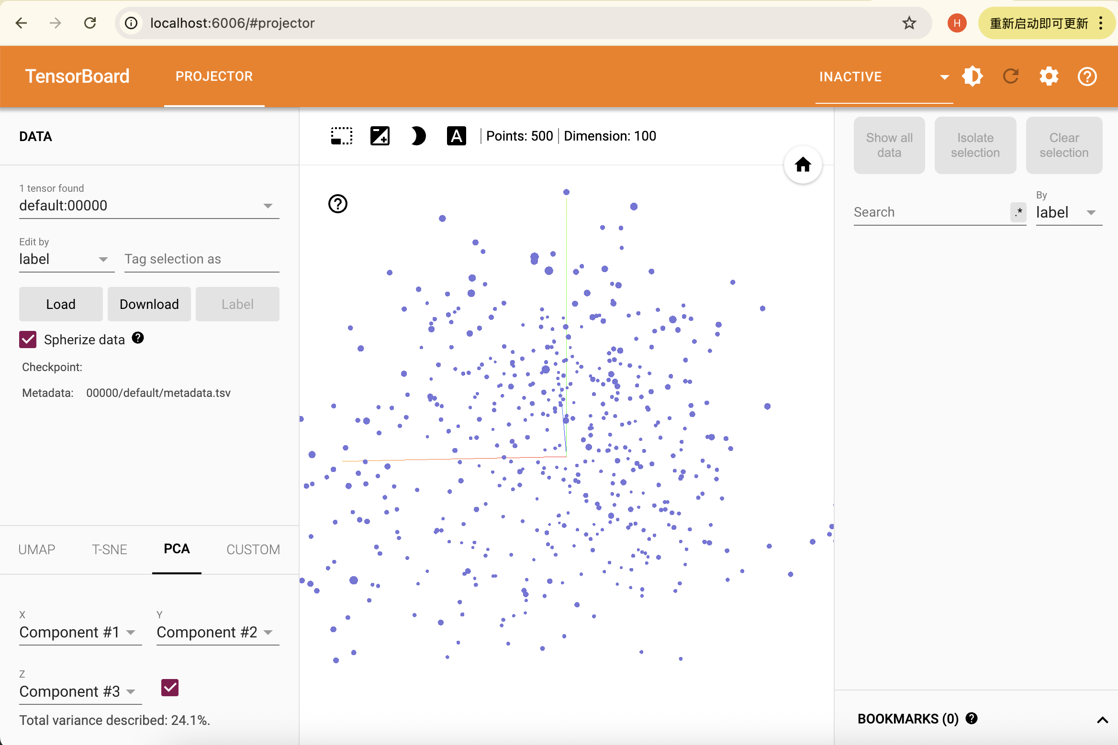
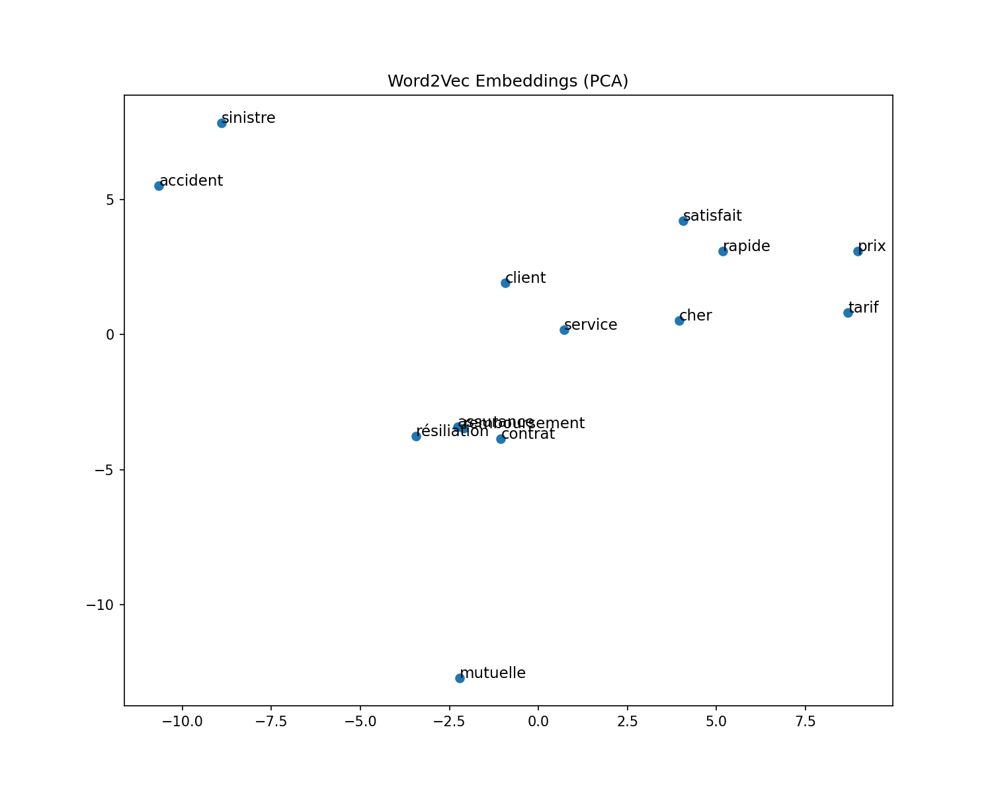
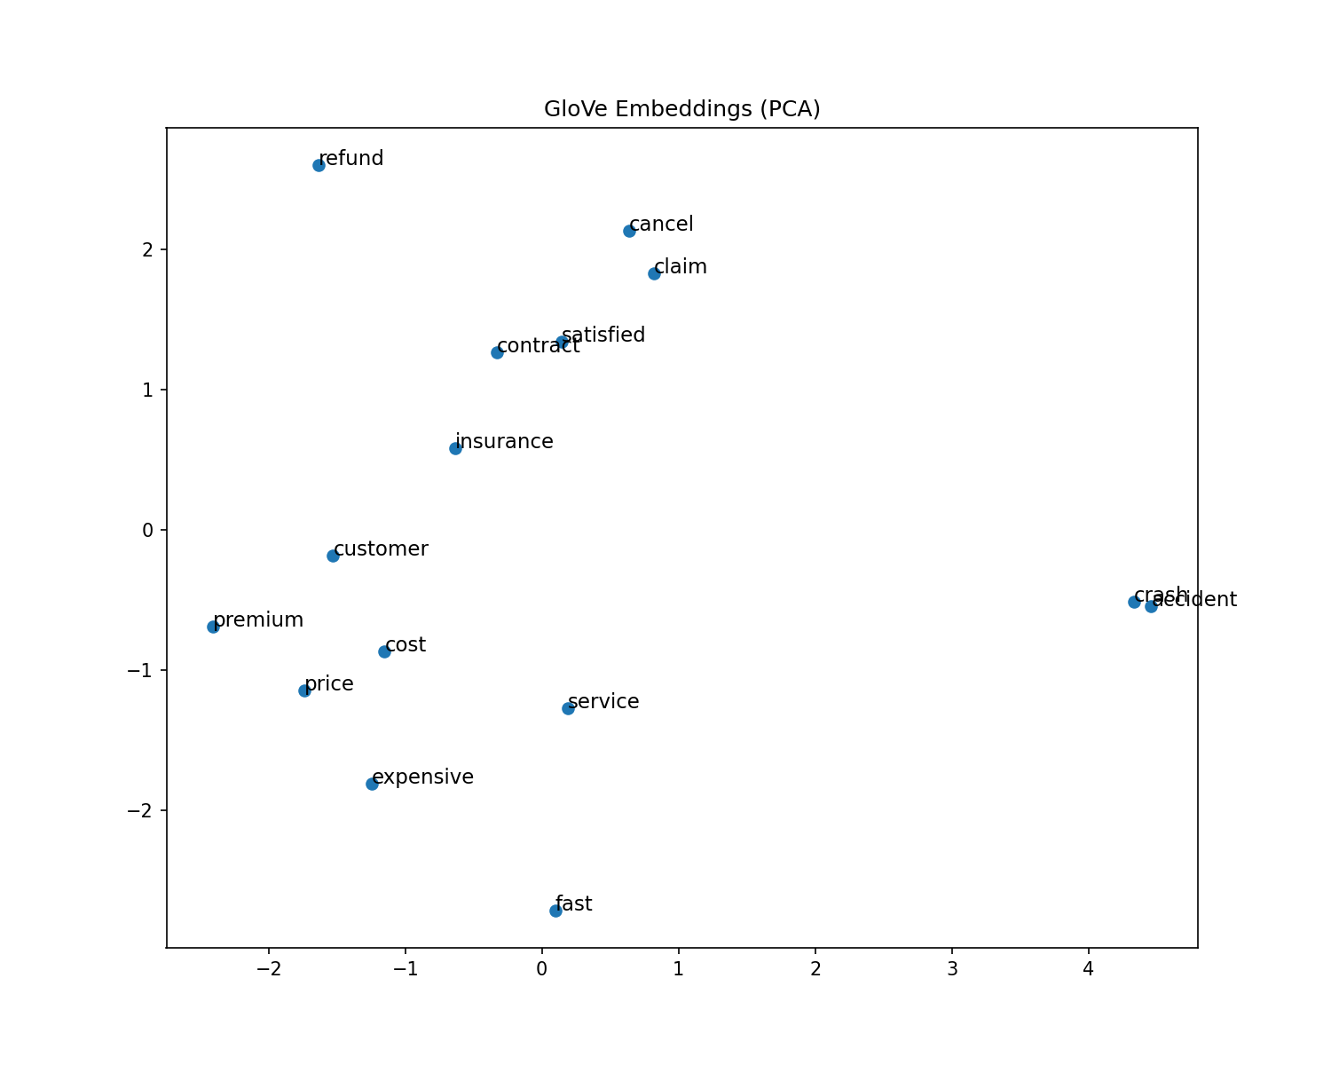
Word2Vec and GloVe
Word2Vec (trained on corpus):
vector_size=100, window=5, min_count=2, epochs=10
Vocabulary: 16,096 words
prix↔tarif: cosine 0.87 | sinistre↔accident: cosine 0.75
Euclidean: prix↔tarif = 6.97 | sinistre↔accident = 10.4
GloVe
insurance↔insurer: 0.81 | accident↔crash: 0.87
Visualization:
PCA 2D (Matplotlib) + TensorBoard Projector (500 words, 3D)
Semantic search:
input query → find top-5 most similar reviews by cosine similaritytest impact on the score. This would be a classic machine learning approach.

Slide 12
4
Supervised learning
Star rating prediction (5-class)
Sentiment analysis (3-class)
TF-IDF, Embedding, CNN, LLM
Model comparison

Slide 13
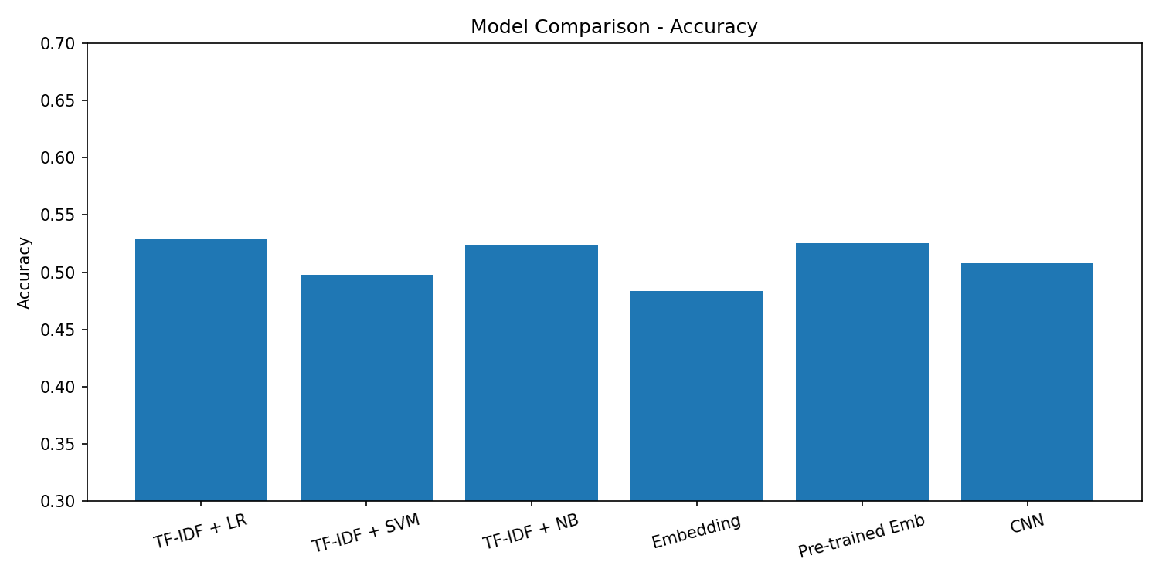
Supervised Learning - Star Rating Prediction
Task: predict 1-5 stars from French review text
Train/test split: 80/20 → 19,283 train / 4,821 test
6 models trained and compared:
Also tested: zero-shot LLM (facebook/bart-large-mnli)
Best model: TF-IDF + LR — fast, interpretable, competitive

Slide 14
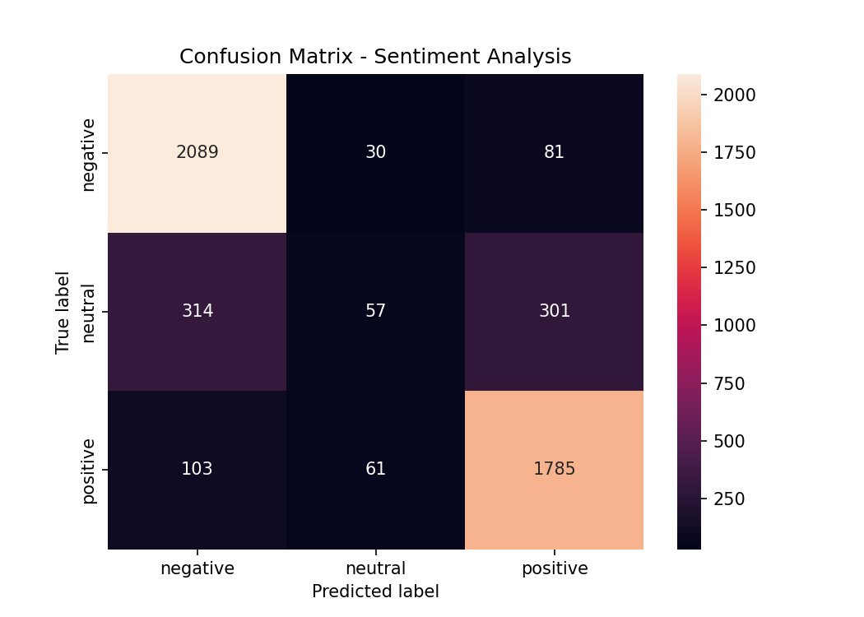
Sentiment Analysis
Sentiment analysis is a special case of supervised learning
Labels derived from star ratings:
1-2★ → negative (10,987 reviews)
3★ → neutral (3,382 reviews)
4-5★ → positive (9,735 reviews)
Model: TF-IDF + Logistic Regression
Accuracy: 81.5% (vs 52.9% for 5-class)
Negative: precision 0.83, recall 0.95
Positive: precision 0.82, recall 0.92
Neutral: precision 0.39, recall 0.08
(hardest — mixed opinions)

Slide 15
5
Results Interpretation
Error analysis
Theme analysis by insurer
CNN overfitting analysis
Key business insights

Slide 16
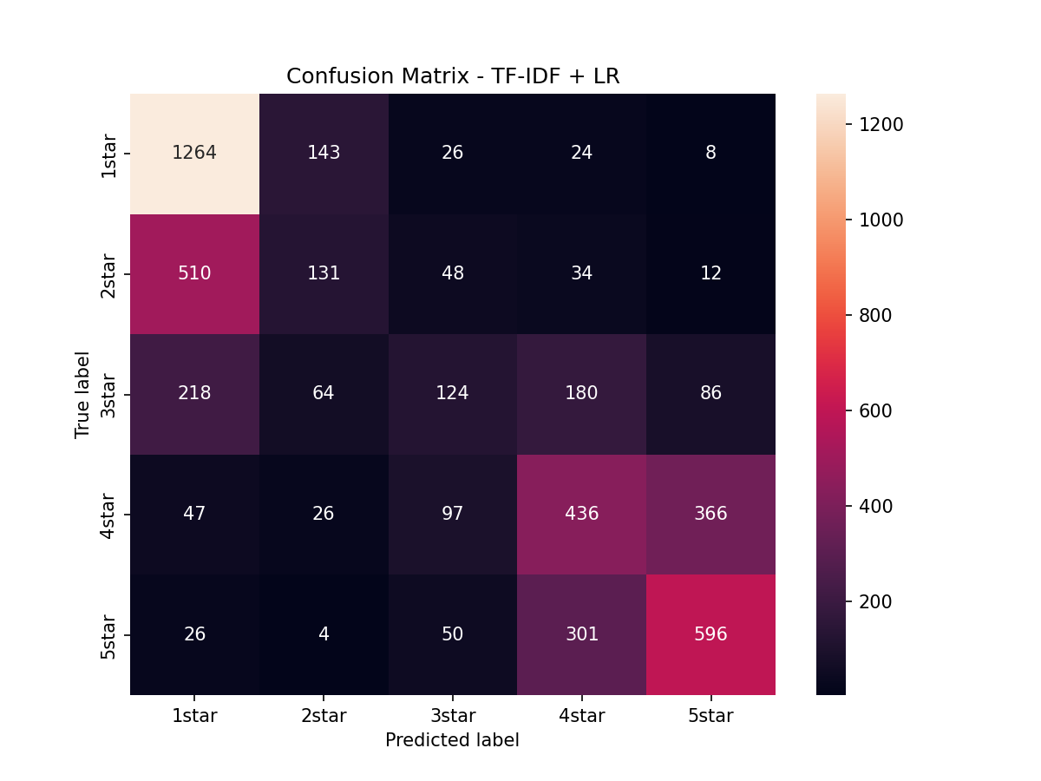
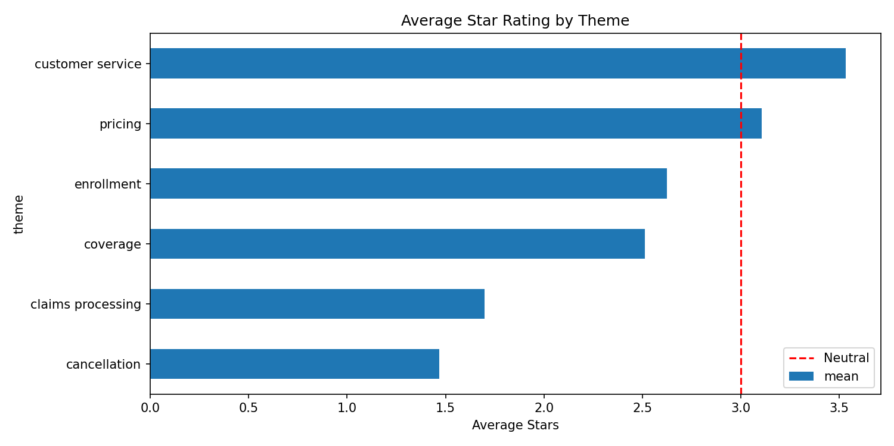
Results Interpretation
Error analysis (5-class):
Total errors: 2,270 / 4,821 (47.1% error rate)
Most confused: 2★→1★ (510 cases), 4★→5★ (366 cases)
3★ most ambiguous — confused with all classes
CNN overfitting:
Train accuracy: 92% vs Validation accuracy: 48%
Model memorizes training data, fails to generalize

Slide 17
6
Streamlit applications
Prediction and sentiment analysis
Summary by insurer
Explanation of predictions
Information retrieval and search
RAG and Q&A

Slide 18
Streamlit Application - 6 Interactive Pages
Prediction: input French review → predict stars (1-5) + sentiment (positive/neutral/negative)
Summary: select insurer → avg rating + 5 recent summaries + rating distribution chart
Explanation: prediction + top 10 most influential words with TF-IDF scores
Information Retrieval: keyword search + star filter → top 10 matching reviews
RAG: question → retrieve relevant reviews by keyword → display context
QA: select insurer → % positive/negative + sample reviews + key statistics

Slide 19
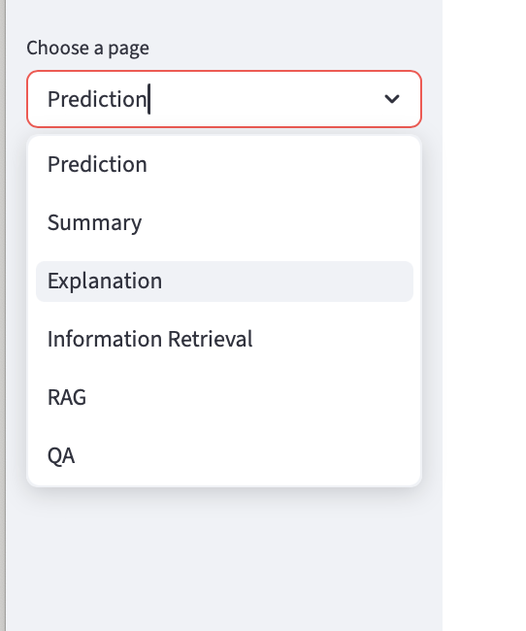
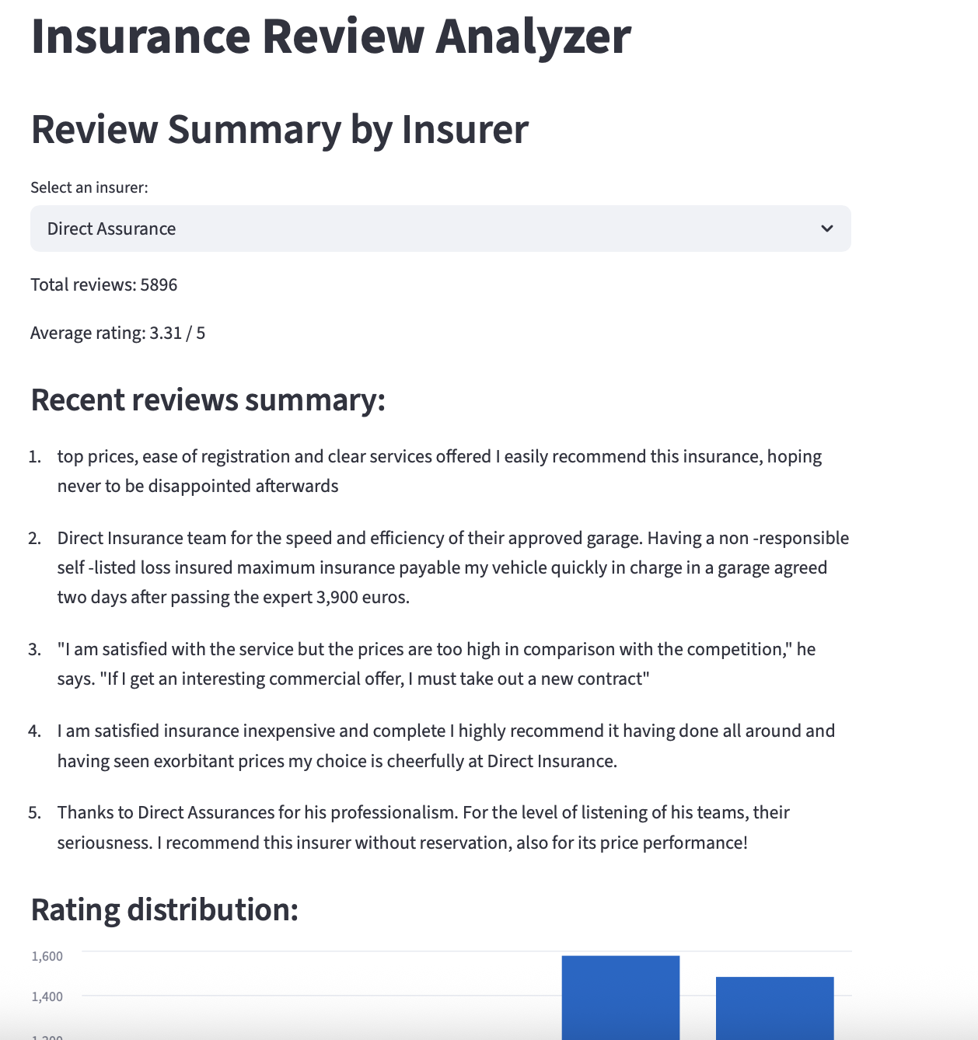
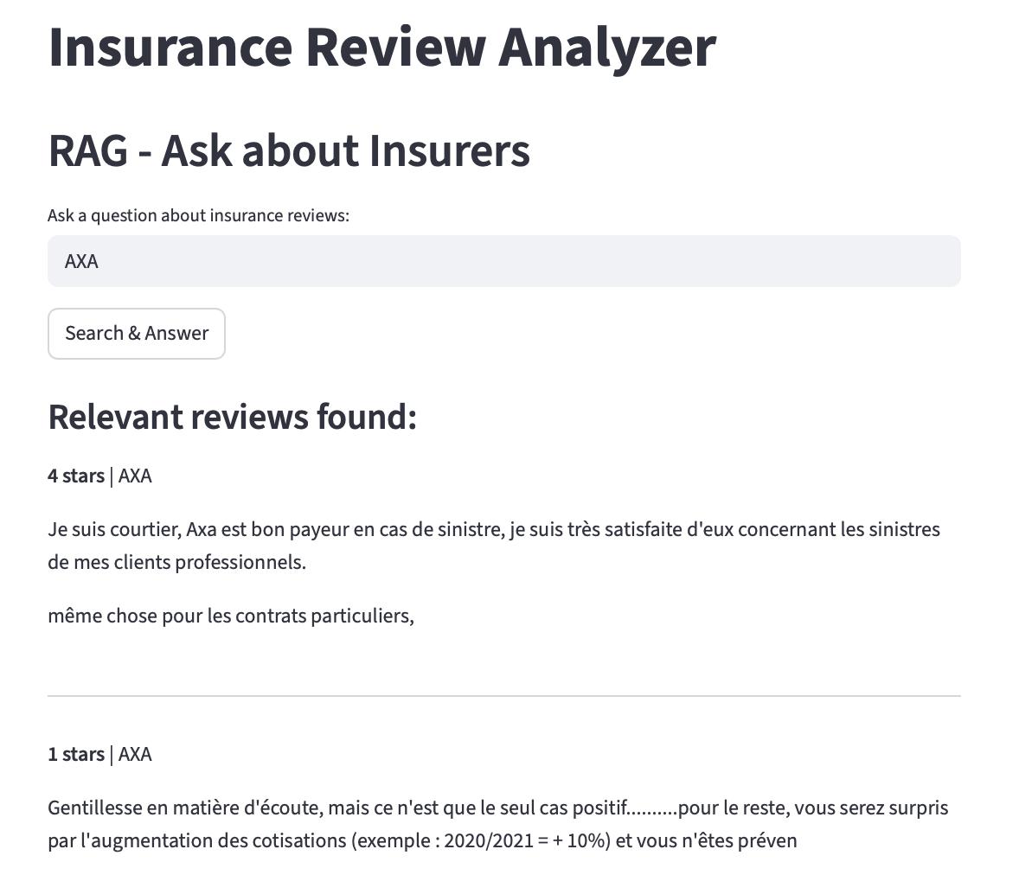
Streamlit Application - 6 Interactive Pages

Slide 20
Group : DIA6 Name : Han
Thank you

