Slide 1
GPA1-B
Zoé Hibbert
September 1, 2025

Slide 2
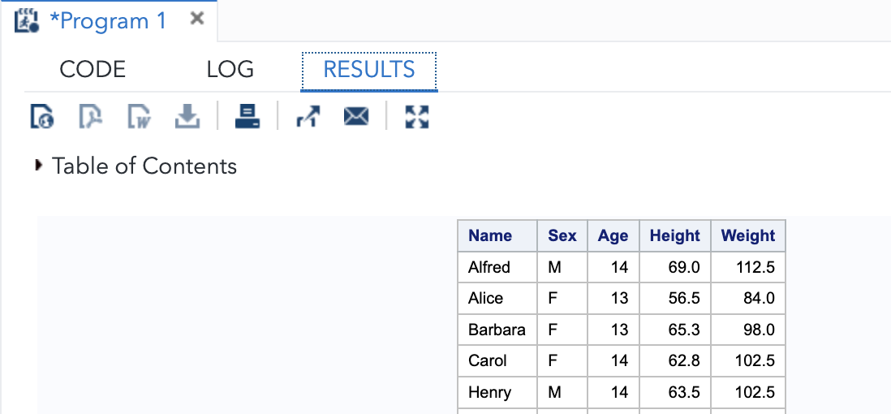

Slide 3
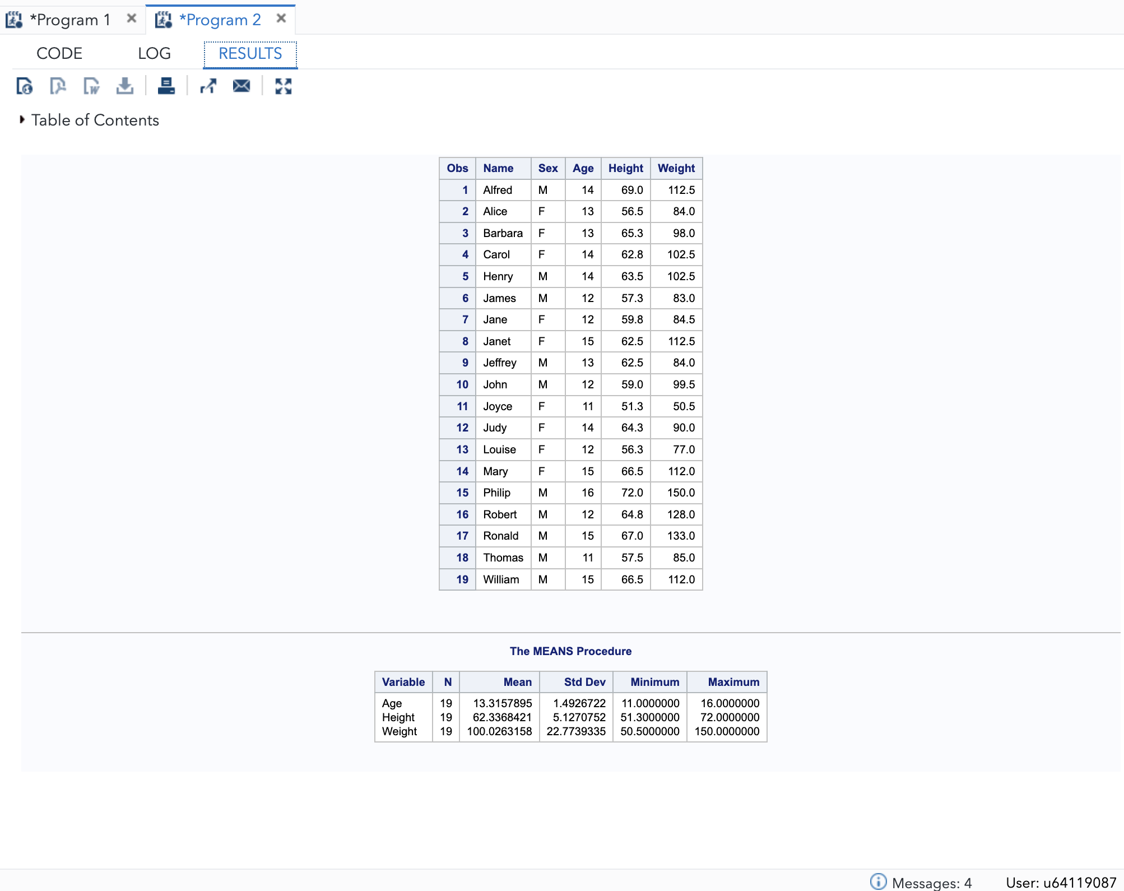

Slide 4
