Slide 1
Initiator | Initiator’s Goal | Participants | Use Case Name
Tenant | Unlock with mobile phone and enter home | Lock, Household Devices, Database, Mobile phone | Unlock (UC-1)
Landlord | Retire an existing user account and disable access of mobile phone | Database, Mobile Phone | Retire User (UC-4)

Slide 2
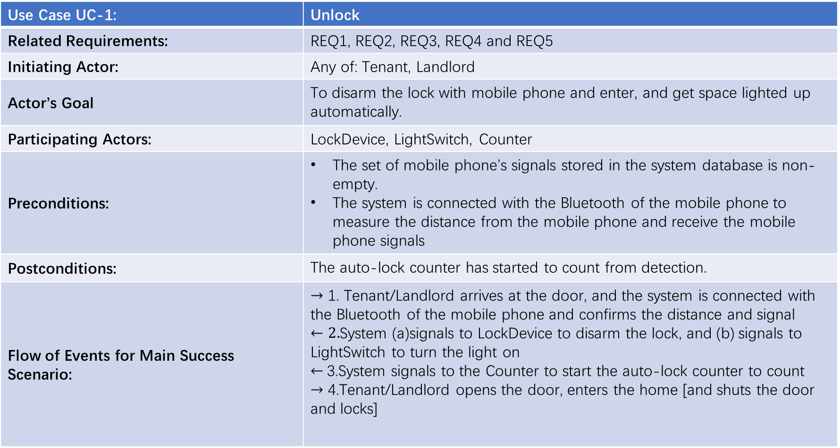
Use Case UC-1: | Unlock
Related Requirements: | REQ1, REQ2, REQ3, REQ4 and REQ5
Initiating Actor: | Any of: Tenant, Landlord
Actor’s Goal | To disarm the lock with mobile phone and enter, and get space lighted up automatically.
Participating Actors: | LockDevice, LightSwitch, Counter
Preconditions: | The set of mobile phone’s signals stored in the system database is non-empty. The system is connected with the Bluetooth of the mobile phone to measure the distance from the mobile phone and receive the mobile phone signals
Postconditions: | The auto-lock counter has started to count from detection.
Flow of Events for Main Success Scenario: | $→$ 1. Tenant/Landlord arrives at the door, and the system is connected with the Bluetooth of the mobile phone and confirms the distance and signal $←2.$System (a)signals to LockDevice to disarm the lock, and (b) signals to LightSwitch to turn the light on $←$3.System signals to the Counter to start the auto-lock counter to count $→$ 4.Tenant/Landlord opens the door, enters the home [and shuts the door and locks]

Slide 3
Use Case UC-4 | Retire User
Related Requirements: | REQ7
Initiating Actor: | Any of: Tenant, Landlord
Actor’s Goal: | To retire an existing user account and disable the access of mobile phone
Participating Actors: | LockDevice, Database, Mobile Phone
Preconditions: | The set of mobile phone’s signals stored in the system database is non-empty.
Postconditions: | The system can’t recognize the mobile phone’s signal
Flow of Events of Main Success Scenario: | The system delete the signal of mobile phone

Slide 4
Test-case Identifier: | TC-1
Use case Tested: | UC-1, main success scenario
Pass/fail Criteria: | The test passes if the user’s mobile phone is within the limited distance and its signal is stored in the database, with less than a maximum allowed number of unsuccessful attempts
Input Data: | Mobile phone’s signal
Test Procedure: | Expected Result:
Step 1. Long distance and correct signal | System beeps to indicate failure; records unsuccessful attempt in the database; prompts the user to try again
Step 2. Short distance and wrong signal | System beeps to indicate failure; records unsuccessful attempt in the database; prompts the user to try again
Step 3. Long distance and wrong signal | System beeps to indicate failure; records unsuccessful attempt in the database; prompts the user to try again
Step 4. Short distance and correct signal | System flashes a green light to indicate success; records successful access in the database; disarms the lock device

Slide 5
Test-case Identifier: | TC-4
Use Case Tested: | UC-4
Pass/fail Criteria: | The test pass if the user’s mobile phone can’t be recognized by the auto-lock over the maximum allowed number of unsuccessful attempts
Input Data: | Mobile phone’s signal
Test Procedure: | Expected Result:
Step 1. Mobile phone whose signal should have been remove by the system | Within the maximum allowed number of unsuccessful attempts, system records successful access in the database; disarms the lock device
Step 2. Mobile phone whose signal should be remove by the system | Over the maximum allowed number of unsuccessful attempts, system can’t recognized the signal of mobile phone

