Slide 1
Analyzing Data As A Data Scientist & The Body Fat Dataset
STAT628 Module 2 Group 4
Yike Wang Jonquil Liao Runze You

Slide 2
The main goal of this project is to get a statistical model from a clinical data-set, generate an accurate body fat calcula- tor, and provide the predicted body fat density for users.
the procedures in our project:
Data Cleaning Model Finding
Statistical Analysis and Interpretation Model Diagnostics
Model Evaluating

Slide 3
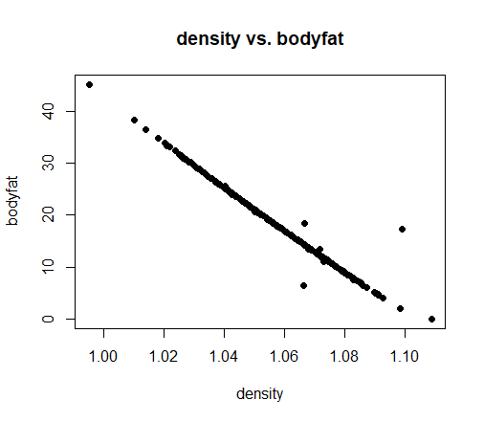
Data Cleaning
First of all, the data set has 252 observations with 14 vari- ables. Since body fat density has already been collected with has obvious linear relation with Body Fat from given materials, we use this to have a original impression with the data set.
Figure BodyFat v.s. BodyDensity

Slide 4
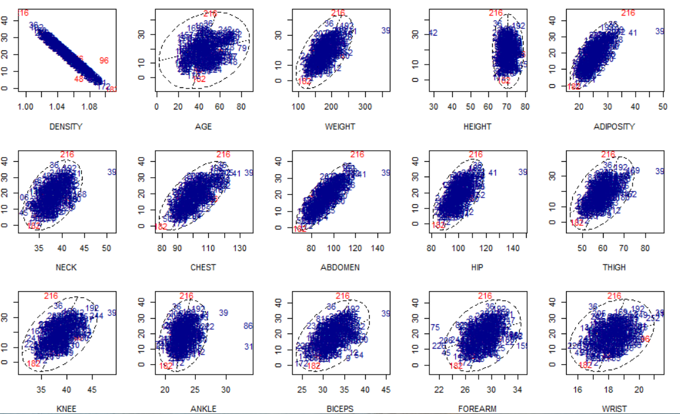
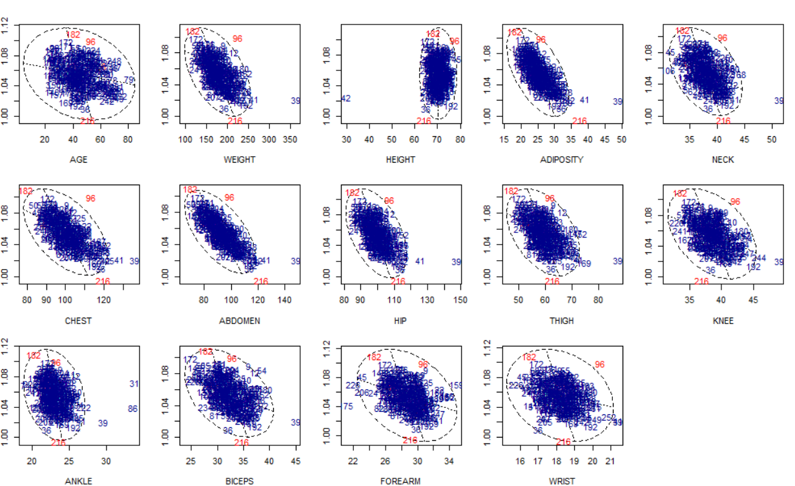
Data Cleaning
5 possible outliers by IQR method:No.48, No.76, No.96, No.182, No.216.
Taking a closer look at these points, 182 and 216 are two extreme records with body fat of 1.9% and 45.1%.
potential outliers with each variable

Slide 5
Data Cleaning
Therefore, from plots of body fat with each variables, we think the outliers should be No.39, No.41, No.182, No.216. Besides, since No.42 with extreme value of height, we use other index to replace its value of height.

Slide 6
Model Finding
We tried different model selection methods, such as all possible subsets, stepwise, Lasso method, and finally, we chose the model using step-wise selection.
Procedure in Doing Step-wise Selection
get full model, which contains all possible terms and inter- action.
1
from full model, at each step, add or cut some terms to make reduced model have better BIC index.
2
stop when cutting or adding terms can not generate a bet- ter BIC.
3

Slide 7
Model Finding
Candidate Models and Prediction Accuracy
Criteria | Model | _{R}2 | RMSE | MAE
Ad R² | Body∼ Age + Hei + Neck + Chest + Abd + Bic + F or + W rist | 0.75 | 3.71 | 3.12
^{C}p | Body∼ Age + Hei + Neck + Chest + Abd + Bic + W rist | 0.74 | 3.74 | 3.13
BIC | Body∼ Height + Abd + W rist | 0.73 | 3.83 | 3.19
step bic(main) | Body∼ Age + Adi + Chest + Abd + W rist | 0.73 | 3.83 | 3.18
step bic | Body∼ Age + Adi + Che + Abd + W ri + Age : W ri + Adi : Che | 0.76 | 3.53 | 2.84
Lasso | Body∼ Age + Hei + Neck + Abd + W rist | 0.73 | 3.83 | 3.20

Slide 8
Model Finding
Therefore, our model is
Bodyfat = − 2.728 − 1.143 Age + 2.864 Adiposity
+ 0.347 Chest + 0.685 Abdomen − 5.288 Wrist
+ 0.067 Age:Wrist − 0.022 Adiposity:Chest
For each term of variable with fixed other variables, the increase of Body Fat in percentile will be the sum of its coefficient and interaction with it.

Slide 9
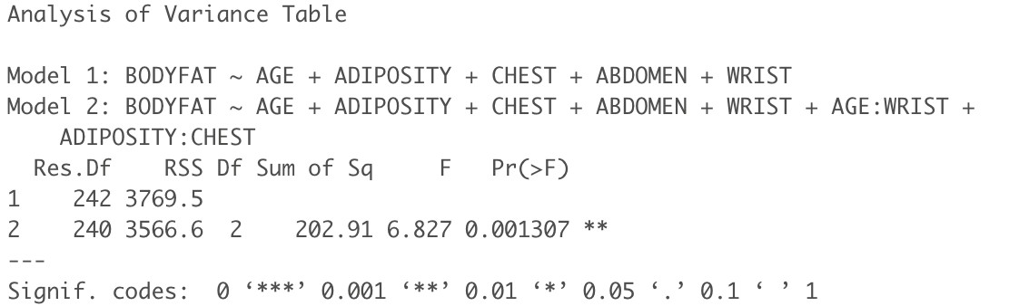
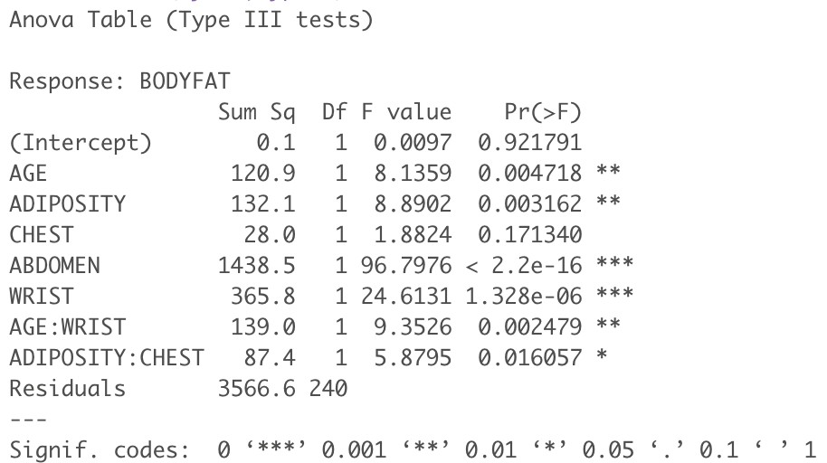
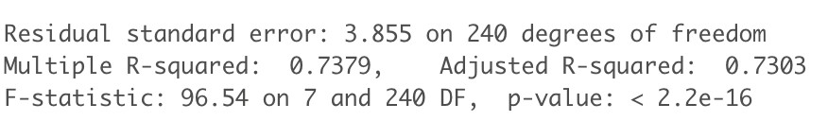
Statistical Analysis and Explanation
Analyse the interaction and get summary of the final model.
(a) ANOVA table of two models
(b) Anova of final model
(c) Summary of the final model

Slide 10
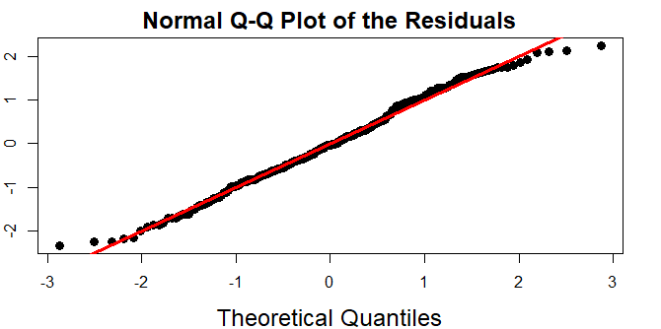
Diagnostics
QQ-plot to check normality
Normality looks reasonable because the points in QQ plot hug the red line very closely. But, there may be possibly skinny tail or right skew issue.

Slide 11
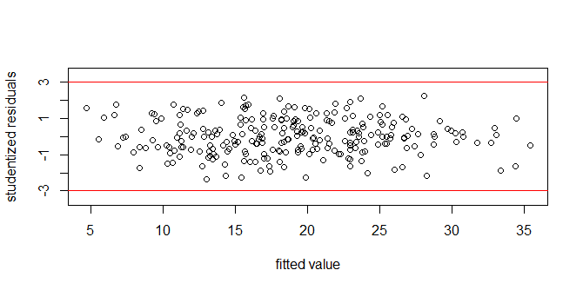
Diagnostics
Studentized Residual Plot to check linearity and homoskedas- ticity
Linearity seems reasonable because there are no obvious non- linear trends in the residual plot; the points look randomly scat- tered around the X axis.
Homoskedasticity is plausible since all points seem dis- tribute randomly between two red lines from rule of thumb.

Slide 12
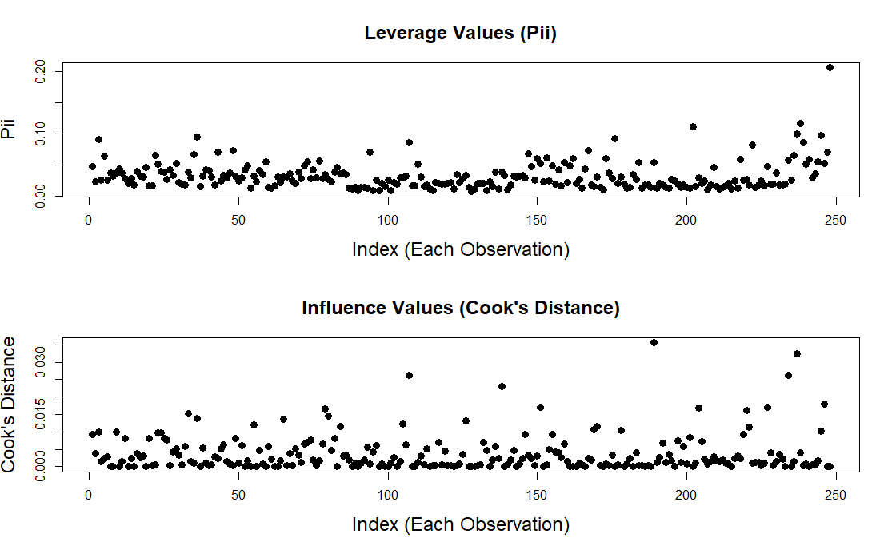
Diagnostics
Leverage and Influential Points

Slide 13
Diagnostics
There may be a leverage point (around the 250th-ish ob- servation).
However, there does not seem to be any influential points by comparing both the Cook’s distance and the leverage values.

Slide 14
Evaluating
Strength:
Stability to abnormal data inputs. Stability to abnormal data inputs. Accuracy of body fat prediction. Simple and interpretable.
Weakness:
Small sample size and limited data resources. Some multi-collinearity.

