Slide 1


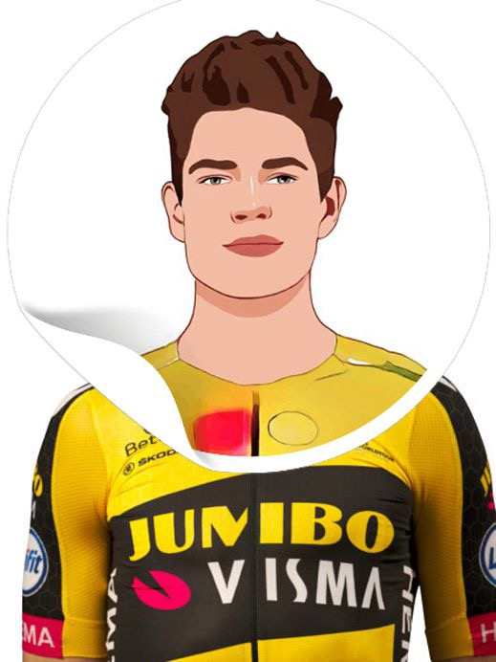
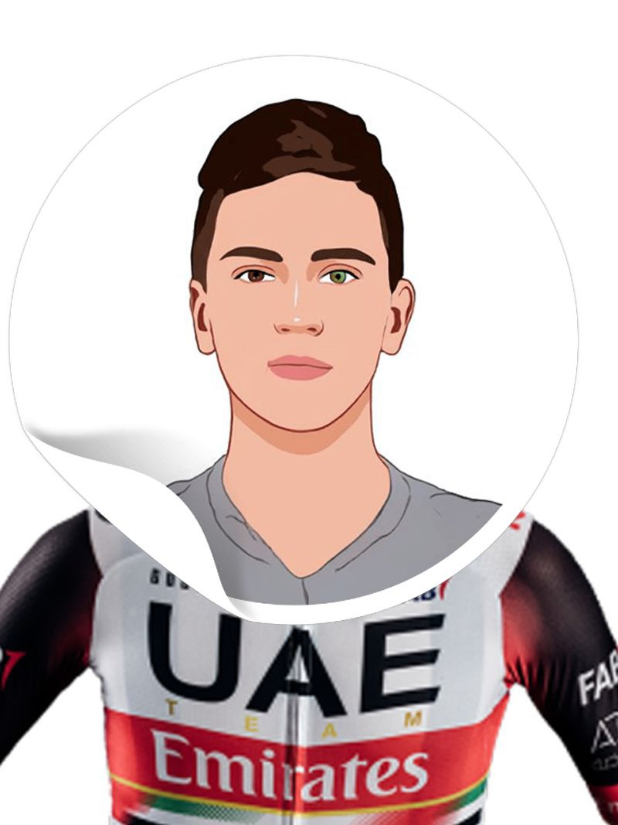



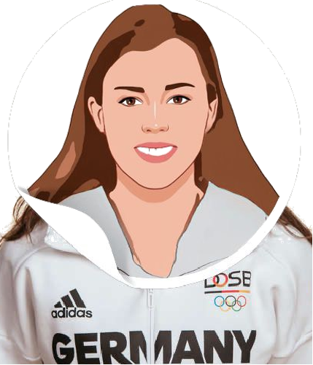
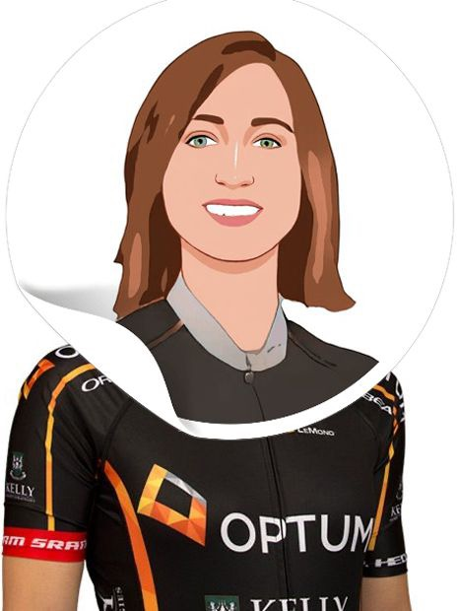
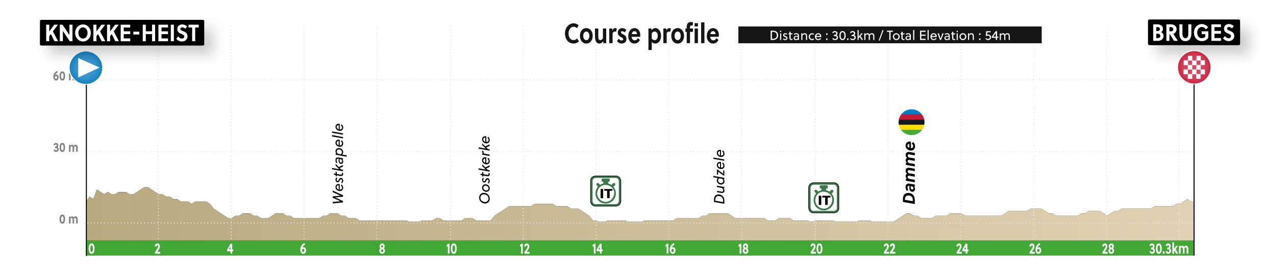
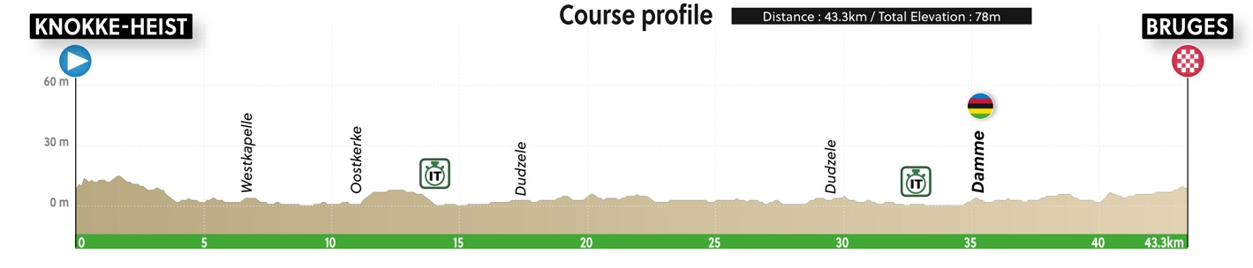
Filippo GANNA
Wout van AERT
Our MTT rider
Tadej POGACAR
47:47
47:53
49:35
49:40
RANK #1
RANK #2
RANK #10
Ellen van DIJK
Lisa KLEIN
Our FTT rider
Leah KIRCHMANN
36:05
37:57
38:27
38:39
RANK #1
RANK #7
RANK #11

Slide 2
Ellen van DIJK
Lisa KLEIN
Our FTT rider
Leah KIRCHMANN
36:05
37:57
38:27
38:39
RANK #1
RANK #7
RANK #11

Slide 3
