Slide 1
Pomodoro Timer
Zoey Zhang

Slide 2
Pomodoro Timer
This is a simple GUI timer that lets users set their own work and break times.
class PomodoroTimer:
def __init__( )
def run_timer( )
def start( )
def pause( )
def reset(self):

Slide 3
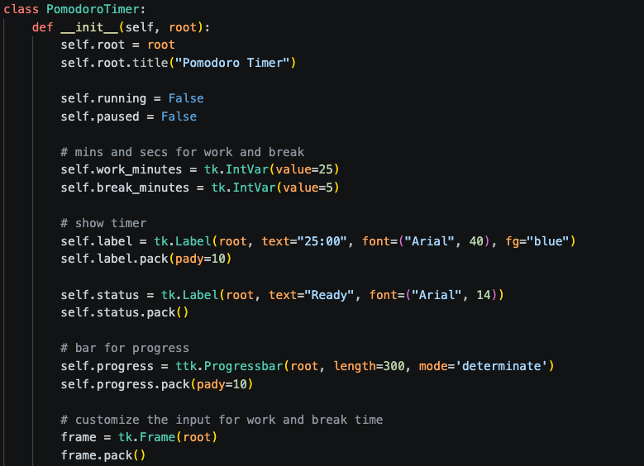
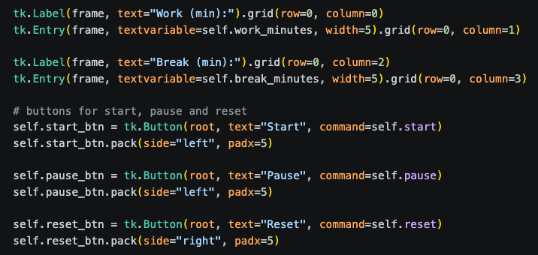

Code:
UI layout + state initialization：
logic layer
Display components
Interaction
User customization

Slide 4
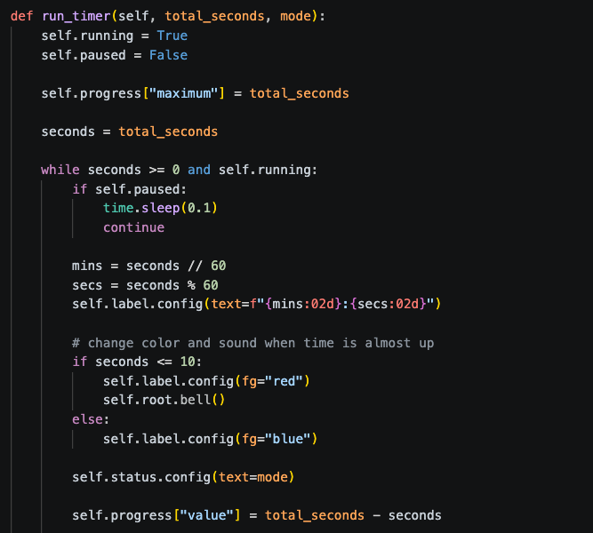
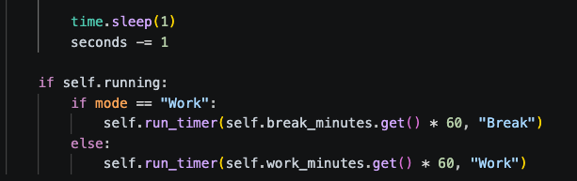
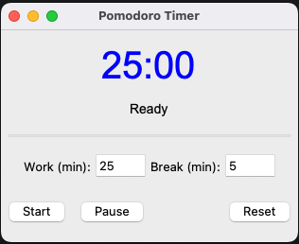
Code:

Slide 5
Demo

