Slide 1
Project 2
Ames Housing Sale Price Prediction
Zoey Cheng

Slide 2
Agenda
Problem Statement
Intro to dataset
Modeling process
Executive Summary of Model
Possible Inferences
Recommendations
References

Slide 3
Problem statement
Which are the features that affects the Sale Price of the house the most.
Determine the features that are compulsory when collecting data.
How to use these data to produce a model that makes good prediction of the Sale Price.

Slide 4
Intro to Dataset
There are 2,930 observations and 81 variables in our dataset, two of which (Order ID and Parcel ID (PID)) will not be included in our modeling process.
2051 observations in train dataset
879 observations in test dataset
80 variables will be included in our features dataset, and will be modeled against our target variable - Sale Price.
Variable types:
19 Continuous (e.g. Gr Liv Area, Total Bsmt SF etc.)
14 Discrete (e.g. Year Built, Garage Yr Blt etc.)
23 Nominal (e.g. House style, Neighborhood etc.)
23 Ordinal (e.g. Overall Qual, Land Slope etc.)

Slide 5
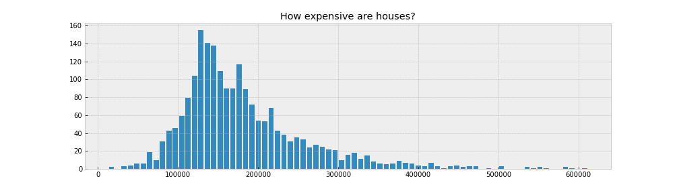
Intro to Dataset
Min: $12,789
Max: $611,657
Mean: $181,470
Median: $162,500

Slide 6
Data Cleaning
Data Imputation (Filling null and zero values)
Filter out categorical columns with low variance threshold
EDA on filtered features using scatter plots to drop outliers
Use correlation with sales price to merge certain columns together and also to eliminate more features
Encoding Categorical (Ordinal & Nominal) Features
Label encoding
One-hot encoding
Applying RFE (Recursive Feature Elimination) on the remaining features

Slide 7
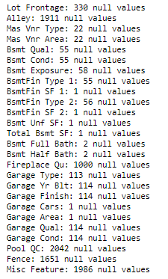
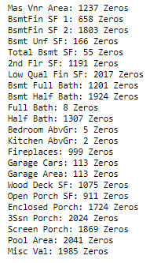
Filling out null/ zero values
Dealt with each null/ zero values accordingly.
Removed null/zero values above 60% of the number of rows as they are highly skewed to one side, which might affect how our model learn when we input these features.

Slide 8
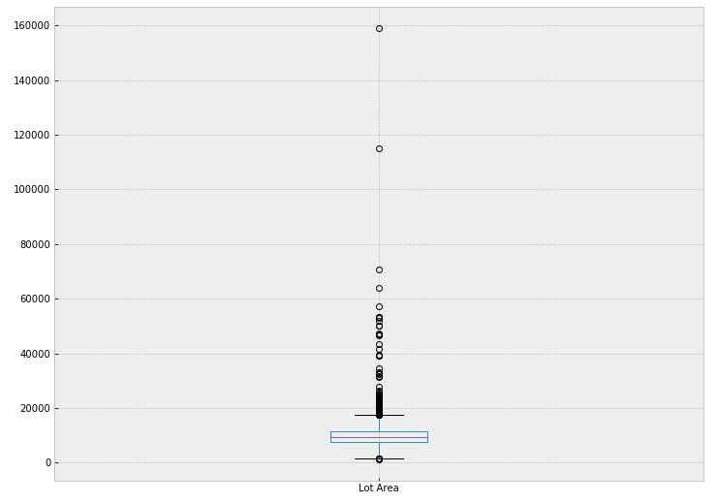
Dropping outliers
The boxplot is one of the example of an outlier in our feature
9 outliers were removed in total

Slide 9
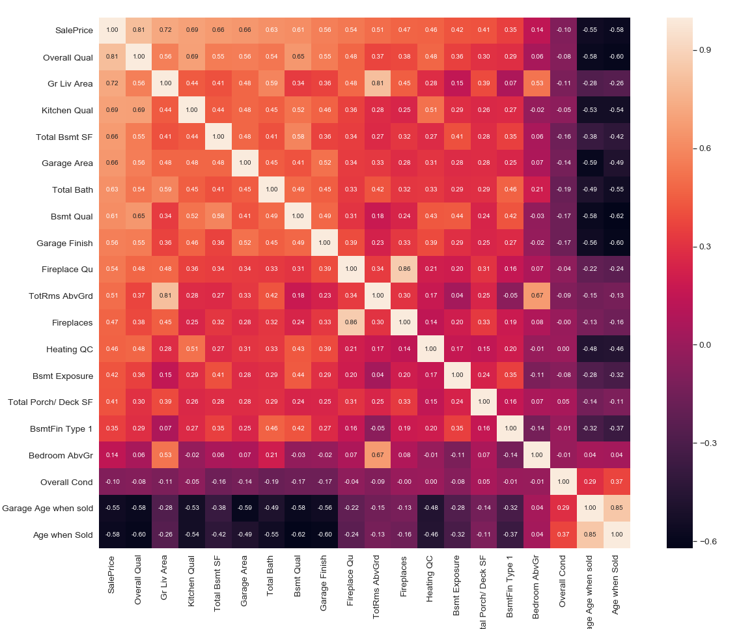
Correlation of data
We will set a threshold of 0.8 for collinear relationship between features:
TotRms AbvGrd (remove) vs Gr Liv Area
Garage Age when sold (remove) vs Age when Sold
Age when Sold = Year Built – Year sold
Fireplace (remove) vs Fireplace Qu

Slide 10
Data Modelling Process
Perform Train Test Split
Standard Scaling
Cross Validation for Linear, Lasso, Ridge and Elastic Net Regression
Model Selection
Fit test data into model

Slide 11
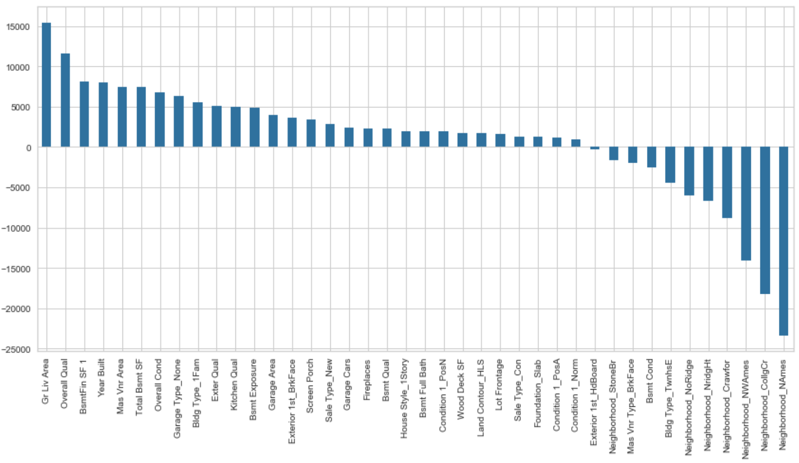
Top 40 Ridge Coefficients

Slide 12
Possible Inferences
The feature with the greatest impact on the Sale Price is Overall Quality.
In general, a larger area for house (Gr Liv Area) generates a higher Sale Price.
The model seem to suggest that by improving the Overall Quality, Overall Condition and Kitchen Quality will have a positive effect on the Sale Price.
Age when sold (Year Built – Year Sold) shows that there’s a negative impact on the price, which means the older the house the higher the impact will be on the Sale Price.

Slide 13
Recommendations
Suggested 14 features that should be made mandatory when collecting data:
Gr Liv Area
Overall Qual
Garage Area
Total Bsmt SF
Year Built
Building type
Mas Vnr Area
Overall Cond
Neighborhood
Exter Qual
Kitchen Qual
Sale Type
Bsmt Exposure
Bsmt Qual

Slide 14
References
http://jse.amstat.org/v19n3/decock/DataDocumentation.txt
https://www.kaggle.com/c/dsi-us-6-project-2-regression-challenge
https://www.cityofames.org/government/departments-divisions-a-h/city-assessor
https://beacon.schneidercorp.com/Application.aspx?AppID=165&LayerID=2145&PageTypeID=4&PageID=1108&Q=1957777753&KeyValue=0526301100

