Slide 1
Parking System Orchestrator
Unified LangGraph Workflow
Zofia Chodorowska

Slide 2
System Overview
Integrated Components via LangGraph:
Chatbot (RAG Agent): Interacts with users to fetch info and collect reservations.
Orchestrator Graph: Master graph seamlessly routing Chatbot output to Admin.
Admin Agent: Human-in-the-Loop interrupt node confirming pending actions.
MCP Logger Engine: Triggers automatically upon admin approval to log to file.

Slide 3
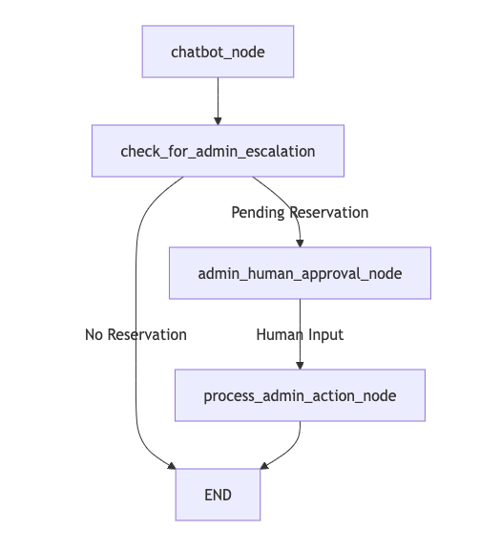
Architecture Diagram

Slide 4
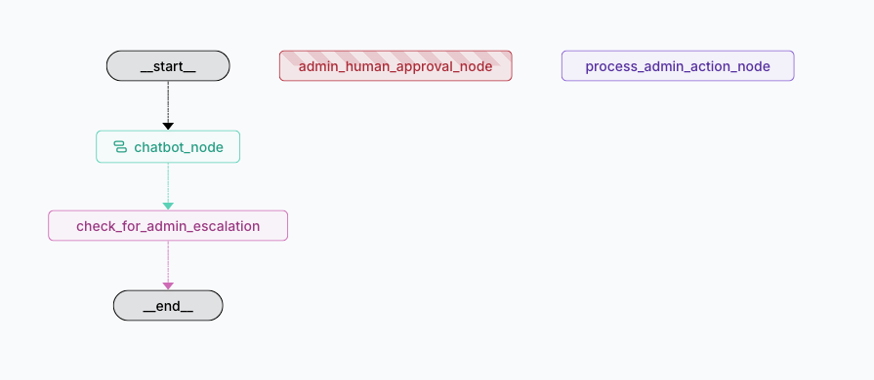
LangGraph Studio graph

Slide 5
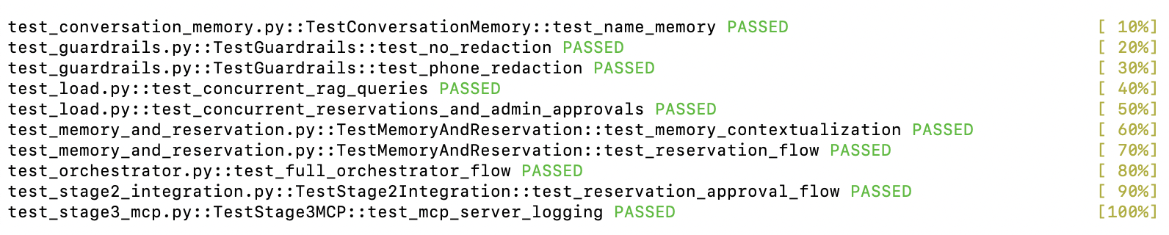
Test passed

