Slide 1
英文语法
1. 词法
－各类词的形态和变化
2. 句法
－句子的种类
－句子成分
－遣词造句的规律

Slide 2


五大基本句型初体验
I swear.
I love you
Your are my destiny/beautiful.
I will give you all my money.
I will make you happy forever.

Slide 3
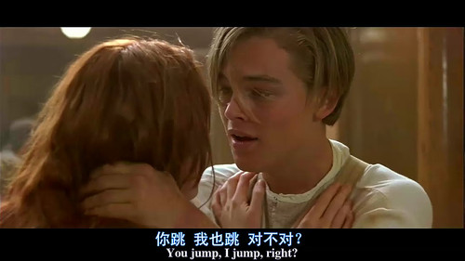
简单句的五大句型
1. 主+谓
－You jump; I jump.

Slide 4
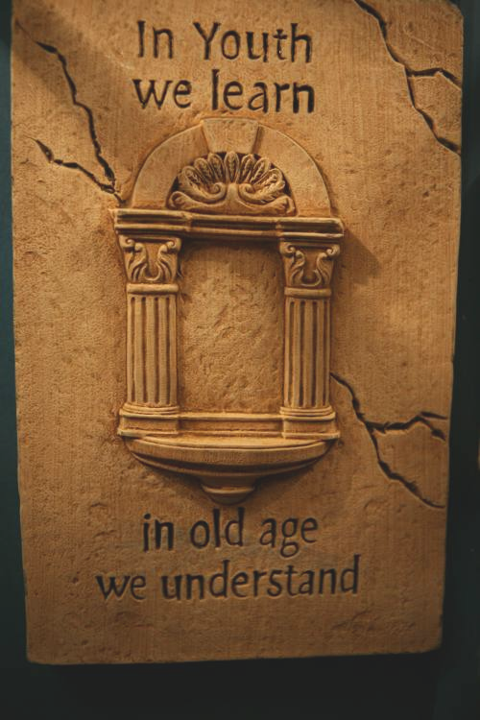
简单句的五大句型
1. 主+谓
In youth, we learn.
In old age, we understand.
少时历沧海，暮年品百川。

Slide 5
简单句的五大句型
1. 主+谓
1). The sun rose.
2). Who cares?
3). What he said does not matter.
4). They talked for half an hour.
5). The pen writes smoothly

Slide 6

简单句的五大句型
2. 主+谓+宾
I see you.
眼相见，心相连。

Slide 7

简单句的五大句型
2. 主+谓+宾
I love you.

Slide 8
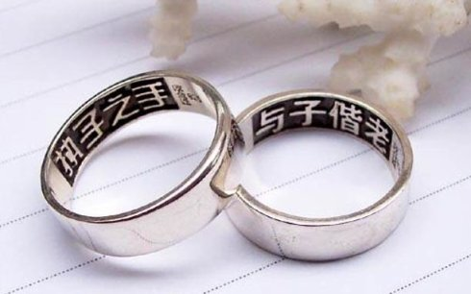
简单句的五大句型
I love three things, the sun, the moon and you. The sun for the day, the moon for the night, and you ,forever.

Slide 9
简单句的五大句型
予独爱世间三物。
昼之日，
夜之月，
汝之永恒。
I love three things, the sun, the moon and you. The sun for the day, the moon for the night, and you ,forever.

Slide 10
简单句的五大句型
I love three things, the sun, the moon and you. The sun for the day, the moon for the night, and you ,forever.
浮世万千，挚爱有三：
喷薄朝阳，皓婉皎月，
不及汝尔，沧海桑田。

Slide 11
简单句的五大句型
2. 主+谓+宾
1). 在业余时间，我喜欢听流行音乐。
In my spare time, I enjoying listening to pop music.
2). 他拒绝(refuse)帮助他们。
He refused to help him.
3). 他承认(admit)他错了。
He admitted that he was wrong.

Slide 12
简单句的五大句型
主+谓+直宾+间宾
He bought you a gift.
Love gives us a fairy tale.
检验原则：两个宾语可以调换位置。
(需增加相应介词to / for. )

Slide 13
简单句的五大句型
主+谓+直宾+间宾
1). She ordered herself a new dress.
2). He brought you a dictionary.
3). I showed him my pictures.
4). I told him that the bus was late.
5). He showed me how to run the machine.

Slide 14
简单句的五大句型
主+谓+直宾+间宾
常见的双宾语动词：
buy, give, leave, lend, offer, pay, show, teach, tell, bring, make, pass, sell, send, sing, write

Slide 15
简单句的五大句型
主+谓+宾+宾
他们给他提供了一份工作。
They offered him a job.
2）王老师去年教我们英语。
Mr Wang taught us English last year.

Slide 16
简单句的五大句型
4. 主+谓+ 宾+宾补
- I found the book easy.
-Love makes man grow up or sink down.
或成长，或沉沦，皆因有爱。

Slide 17
简单句的五大句型
4. 主+谓+ 宾+宾补
1). The war made him a soldier.
2). New methods make the job easy.
3). I often find him at work.
4). The teacher ask the students to close the windows.
5). I saw a cat running across the road.

Slide 18
简单句的五大句型
区分双宾语和复合宾语
I will make Alex my friend.
I will make Alex a cake.

Slide 19

简单句的五大句型
5. 主+系+表
- You are my sunshine.
系动词：linking verb（连接主语和后面的成分）
五感，四变，三保持，两终止，一个be
feel, smell, sound, taste，look/seem/appear
grow, turn, get, go, (run, become, fall)
keep, remain, stay
be (is/am/are, was/were)
终止系动词：prove，turn out

Slide 20
简单句的五大句型
5. 主+系+表
1). This is an English dictionary.
2). The dinner smells good.
3). He felt happy.
4). Everything looks different.
5). The weather became warmer.
6). His face turned red.

Slide 21
简单句的五大句型
You are my sunshine, my only sunshine
You make me happy when skies are grey
You''ll never know dear, how much I love you
So please don't take my sunshine away
The other night dear, as I lay sleeping
I dreamed I held you in my arm
But When I awoke dear, I was mistaken
And I hung my head and cried

Slide 22
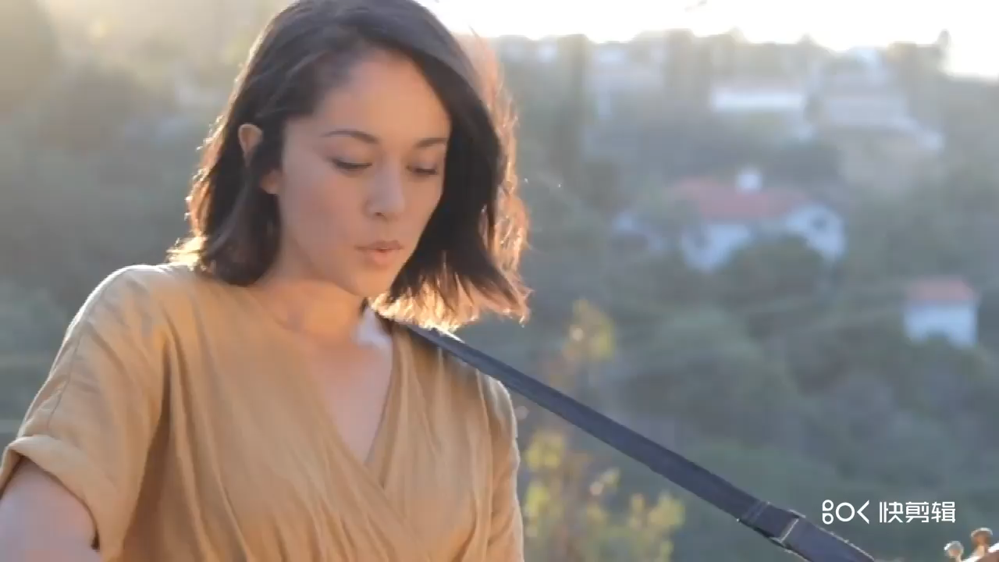

Slide 23
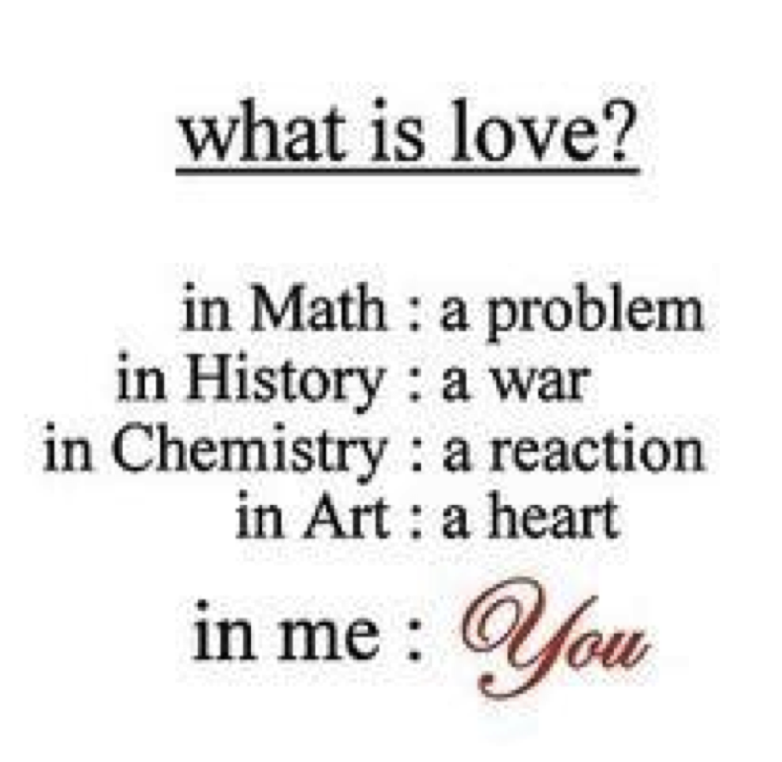
简单句的五大句型
5. 主+系+表
- 问世间情为何物？
- 解不开的数学难题，
战无休的历史争斗，
停不了的化学反应，
永不灭的艺术真心。
然而所有这一切，都不及我心中，
独一无二的，你。

Slide 24
简单句
1. 抓主干：主谓宾
2. 修饰成分：定状补

Slide 25
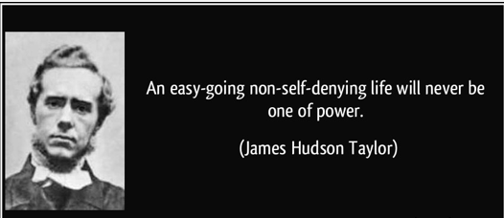
简单句
修饰成分：定语，状语，补语
一个人如果随遇而安、不检讨自己，
他永远无法主宰自己的人生。

Slide 26
简单句变复杂句
修饰成分：定语，状语，补语
Tools and technology have been ignored .
Over the years, tools and technology themselves as a source of fundamental innovation have largely been ignored.

Slide 27
英文思维黄金法则
谓语单一
－一个简单句只能有一个谓语。
－如果要表达多个动作概念，有三种方式：
a. 连词
b. 非谓语动词
C. 从句

